Slide 1
Recycling Nuclear Waste: Potentials and Global Perspectives
Mikael Nilsson
Department of Chemical Engineering and Materials Science
University of California, Irvine
TeraWatts, TeraGrams, TeraLiters
UC Santa Barbara, Monday Feb 2, 2015

Slide 2
Current Nuclear Fuel Cycle
The current US approach is a once-through fuel cycle
  There is currently ~70,000 MT of used fuel in the US which should be disposed in a geologic repository.
The composition of the used fuel is ~96% uranium, ~1% TRU (mostly Pu) and ~3% fission products.
The used nuclear fuel must be managed, monitored, and isolated.

Slide 4
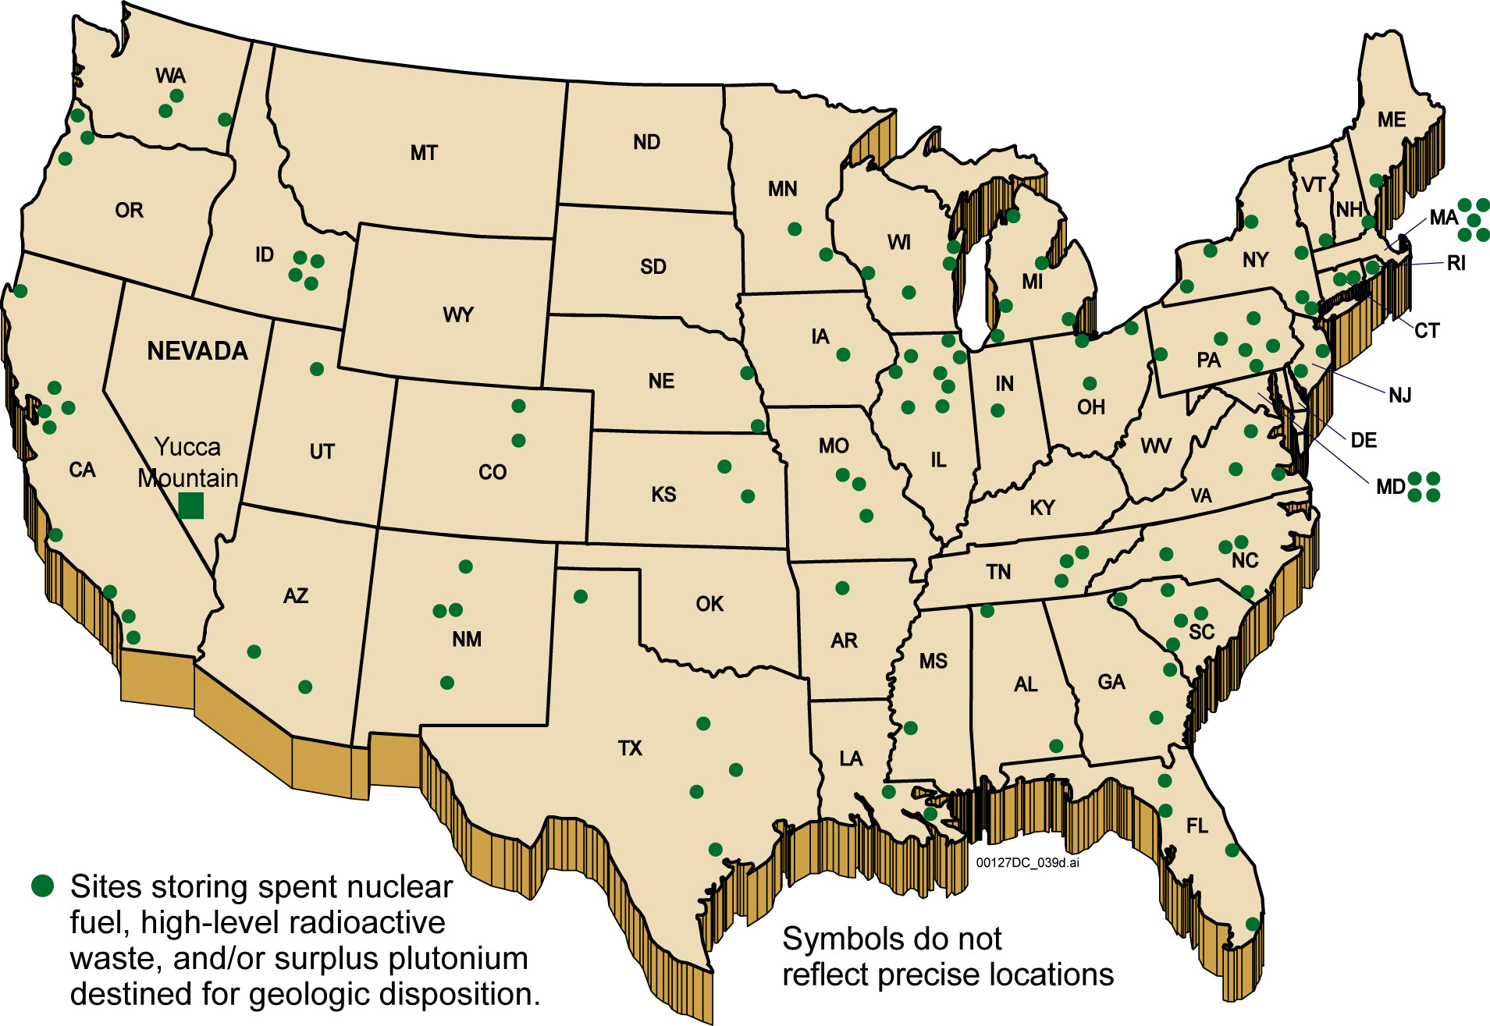
What are the consequences?
Are there better options?
http://www.ocrwm.doe.gov/info_library/newsroom/photos

Slide 5
Identifying alternative options
Nuclear Fuel Cycle Evaluation and Screening Final Report, US-DOE
In 2011, US-DOE initiated a study for Nuclear Fuel Cycle Evaluation and Screening.
    Different suggestions for nuclear fuel cycles suggestions were collected.
  Over 4000 different options for fuel cycles were found and compounded into 40 different groups.
    EG01-EG40 where EG01 is reference, current, nuclear fuel cycle.)
9 different evaluation criteria were developed
  6 related to benefits (resources, safety, waste etc), 3 related to challenges (financial, development, etc)
https://inlportal.inl.gov/portal/server.pt/community/nuclear_science_and_technology/337/online_nuclear_fuel_cycle_options_catalog

Slide 6
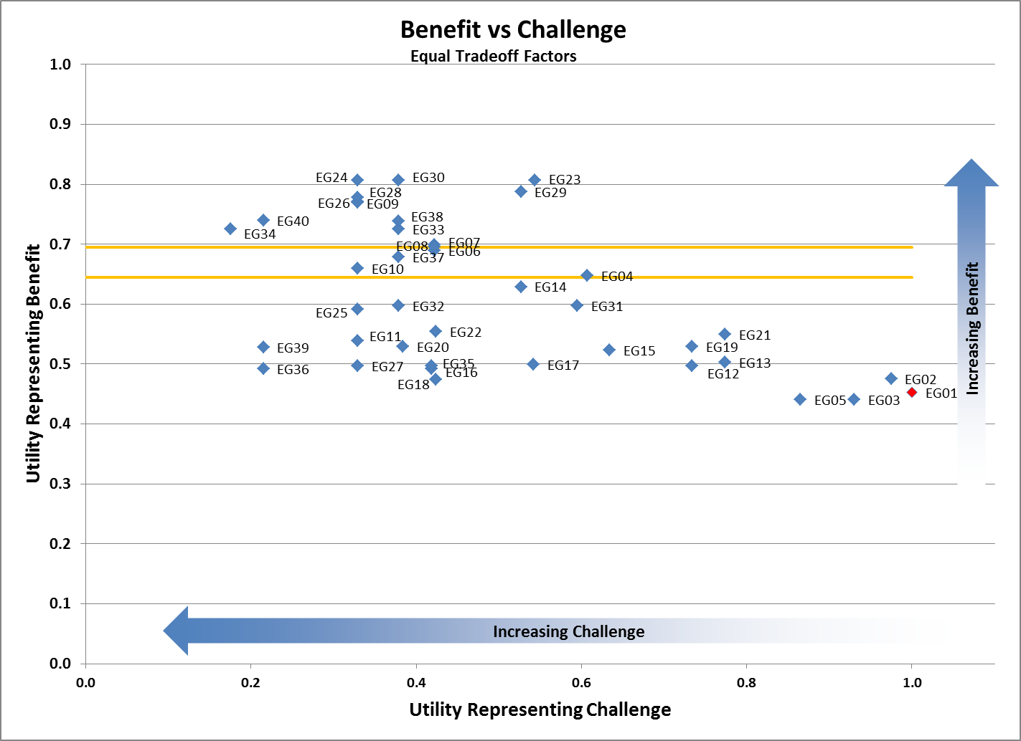
Study Summarized

Slide 7
Conclusions
The fuel cycles providing the highest benefit are :
  Continuous recycle of U/Pu with new natural-U (Nat. U) fuel in fast critical reactors
  Continuous recycle of U/TRU with new Nat. U fuel in fast critical reactors
  Continuous recycle of U/TRU with Nat. U fuel in both fast and thermal critical reactors
  Continuous recycle of U/Pu with new Nat. U fuel in both fast & thermal critical reactors
Costs for development of these fuel cycles would range from $2B-$10B (for U/Pu) and $10B-$25B (for U/TRU) for development to engineering scale followed by $10B-$25B (for U/Pu) and $25B-$50B (for U/TRU) for development to commercial facility. Implementation of the industrial fleet is comparable to maintaining current reactor fleet.

Slide 8
Levelized Cost at Equilibrium

Slide 9
With already existing technology we can:
Reuse up to 97% of the material
Reduce the volume of waste considerably
Reduce the need for mining and enrichment
Increase the utilization of uranium by a factor of ~100.
We still face the challenge of handling a long lived waste product.

Slide 10
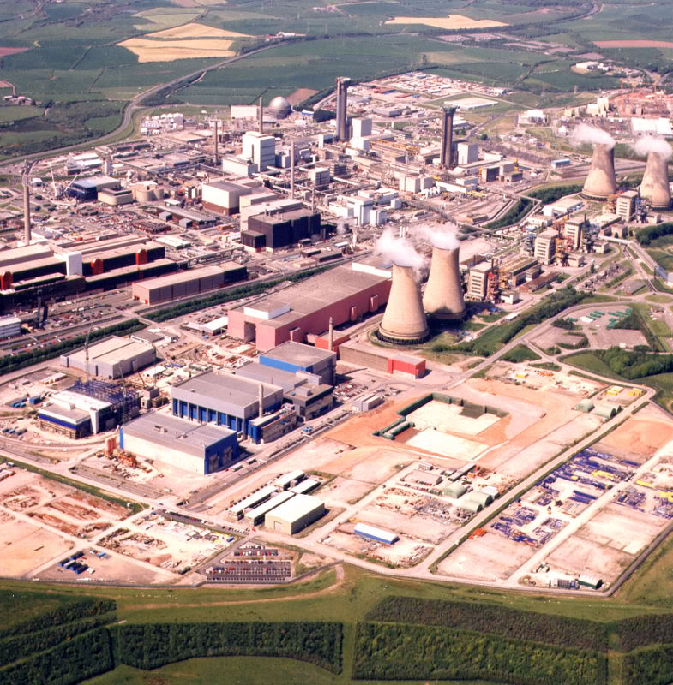
Sellafield, UK
6 square km
10,000 employees
50+ years of reprocessing
50,000 tons of used fuel have been recycled to date

Slide 12
International collaboration may be required
Countries that have nuclear power reactors might not have the option to invest in recycling facilities.
Countries that have already existing capabilities can receive the used fuel from other countries, remove the reusable material and prepare the waste form.
Requires transportation of used nuclear fuel across the world.

Slide 13
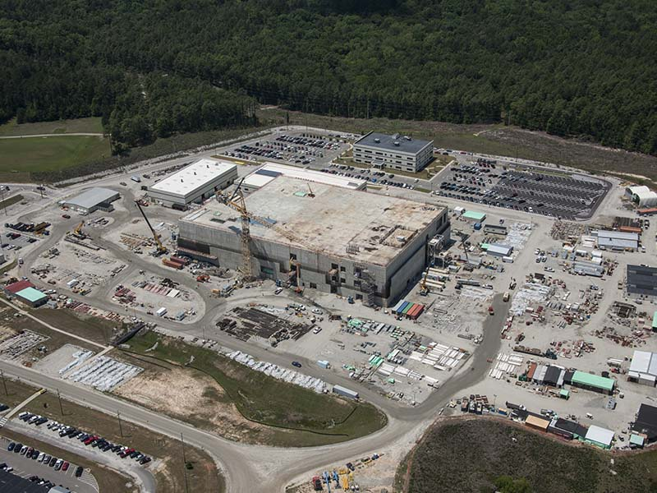
MOX plant construction
(Aqueous-polishing)
http://www.moxproject.com/construction/

Slide 14
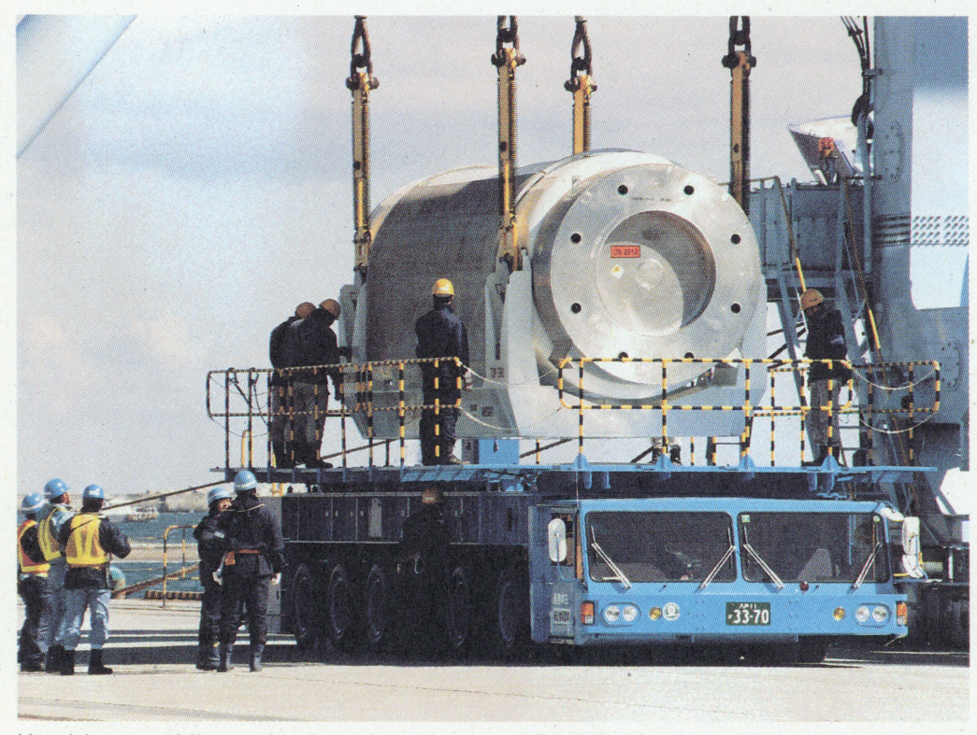
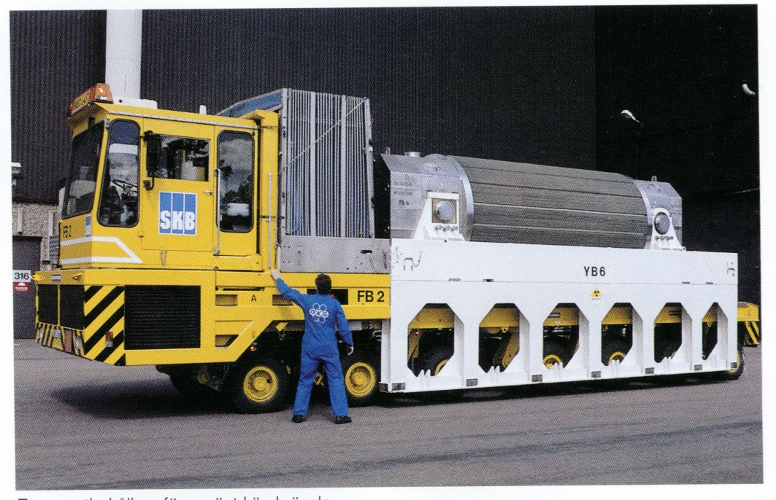
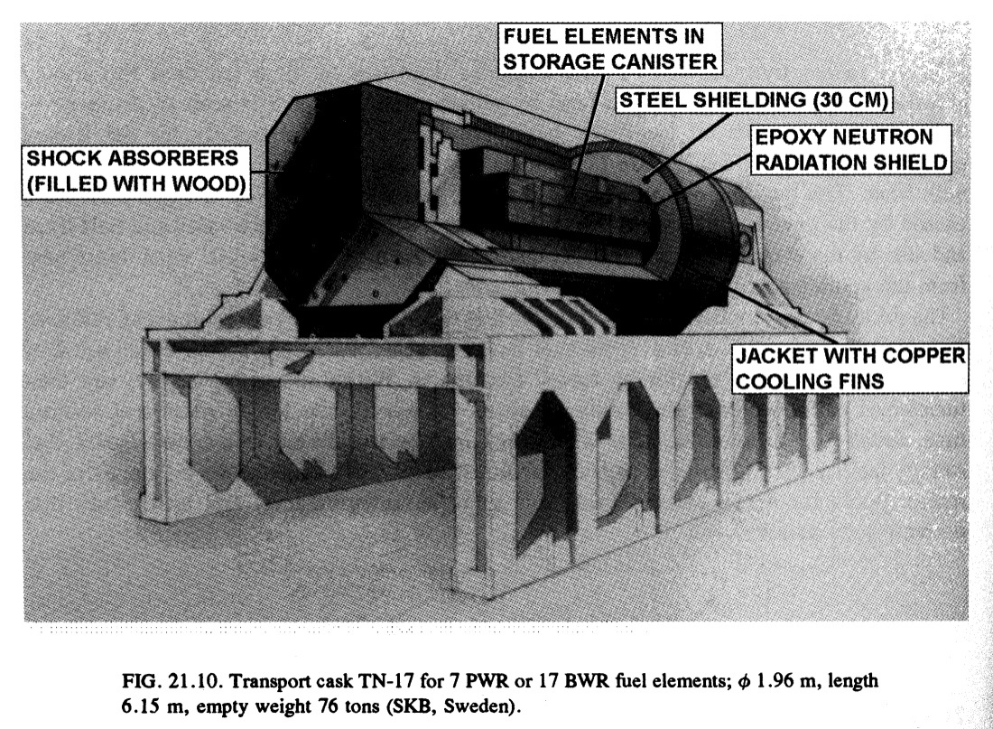
Can we transport waste safely?

Slide 15
To Dream the Impossible Dream
What could we do to avoid:
  Storing radioactive material for an eternity?
  Using less than 1% of the useful resources?
Used Nuclear fuel contains potentially valuable material, Rh, rare earths, Pd.
  Can we recover and reuse some of these elements?

Slide 18
Grand Challenges
Advanced separation processes.
Advanced materials
Nonproliferation and perceived safety.
Political decisions, or lack thereof.
Long term investments and security.

Slide 19
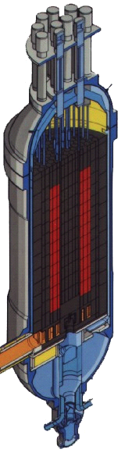
H₂ can be manufactured cleanly by using nuclear energy for water-splitting
Electricity
Low Temp.
Electrolysis
Nuclear
Reactor
High Temp.
Electrolysis
H₂
Heat
Thermo-
chemical
Courtesy of Ken Schultz

Slide 20
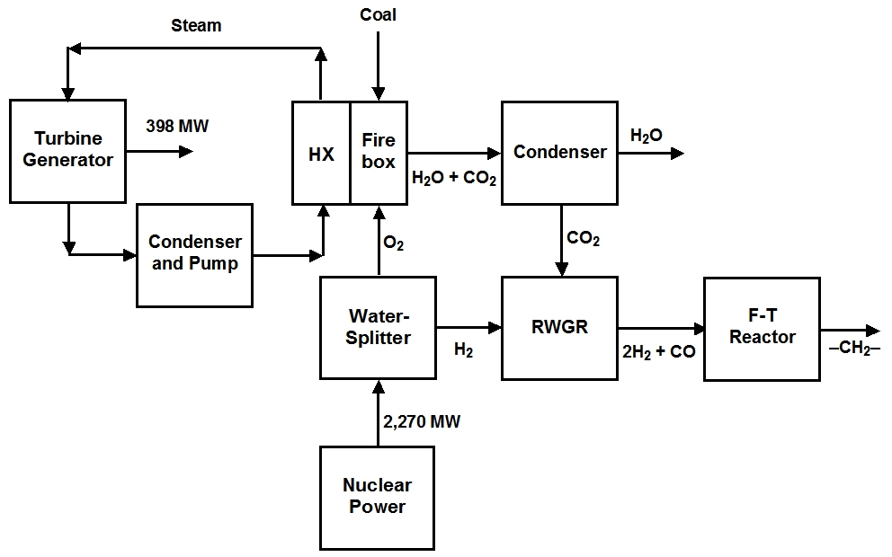
Scheme for Nuclear assisted CO₂ capture from Coal combustion

Slide 21
The CO₂ credit is a key parameter
Coal gasification synfuel cost estimated from Rentech study (http://www.rentechinc.com/process-technical-publications.htm)
A modest CO₂ credit allows synfuel via nuclear H₂ production to compete with coal synfuel

Slide 22
Burning synfuel made from captured CO₂ results in ZERO CO₂ net release
Annual production of CO₂ from manufacturing and
combustion of synfuel from various sources
Century Gothic 24 bold
Century Gothic 24 bold
Century Gothic 24 bold
CO₂ produced
during fuel
manufacturing
CO₂ released
upon fuel
combustion
Net CO₂
released

Slide 23
Thank You

