Slide 1
Innovating New Grid Technologies:
Providing Electricity on Demand
John P. Lemmon
DOE ARPA-E Program Director

Slide 2
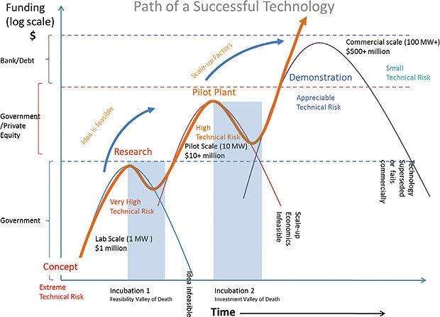
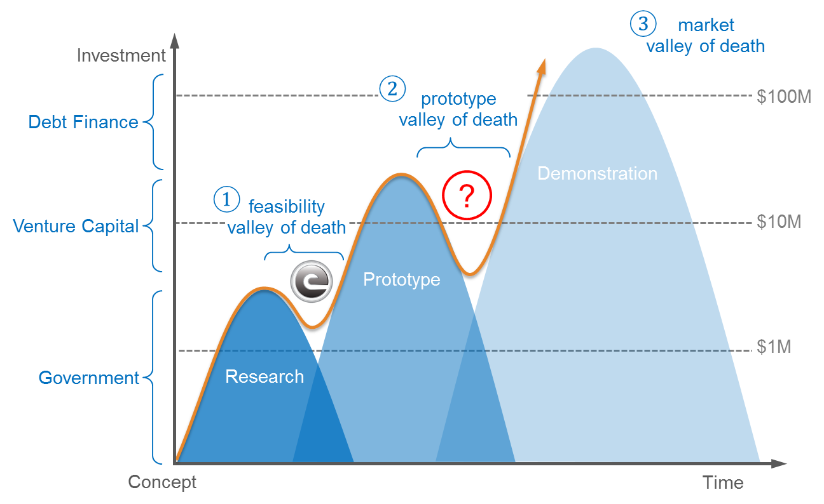
Energy Technology “Valleys of Death”

Slide 3


You Have a Choice to Make
Electricity generation with renewables will never compete economically with hydrocarbons and the grid will continue to be vertically integrated.
Renewable and/or distributed generation coupled storage will become economically competitive with hydrocarbons and lead to flat integration of transmission and distribution .

Slide 4
U.S. Primary Energy Consumption
Nat. Gas
Oil
Coal
Biomass
Source: EIA

Slide 5
U.S. Electricity Net Generation
Nuclear
Nat. Gas
Oil
Hydro
Coal
Source: EIA

Slide 6
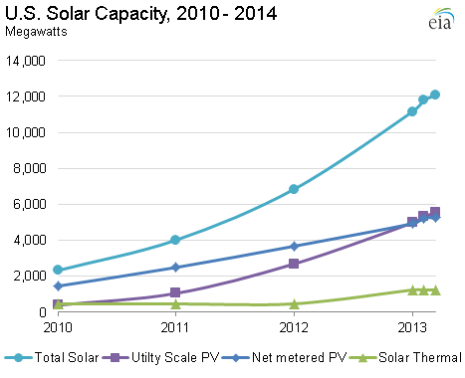
U.S. Installed Solar Capacity

Slide 7
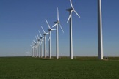
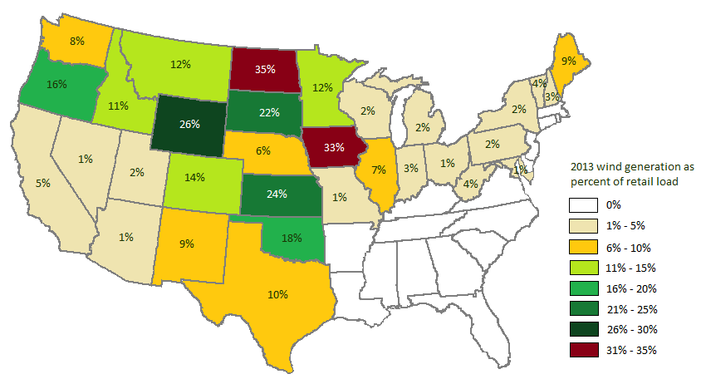
U.S. Wind Power
Total U.S. wind capacity reached 60 GW in 2012 (expected energy production of roughly a quarter of installed nuclear power)
Expansion of wind surpassed gas in capacity, not in expected energy production
30% Denmark (1st)
4.4% U.S. (12th)
LBNL
2012 Wind Technologies
Market Report

Slide 8
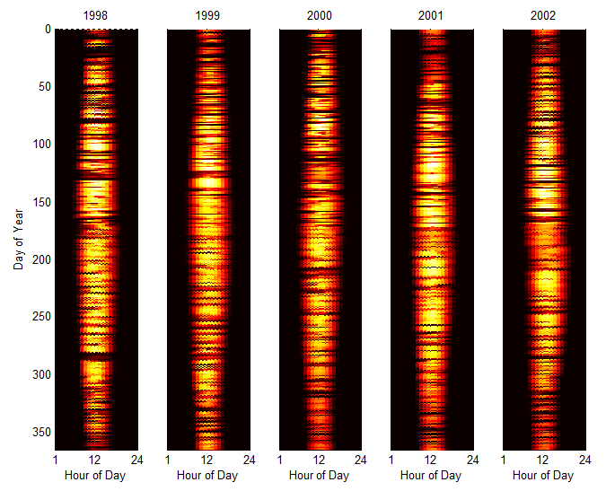
Increasing Intermittent Generation
Impacts predictability and inertia on the grid, resulting in decreased resiliency.
Source: National Solar Radiation Database

Slide 9
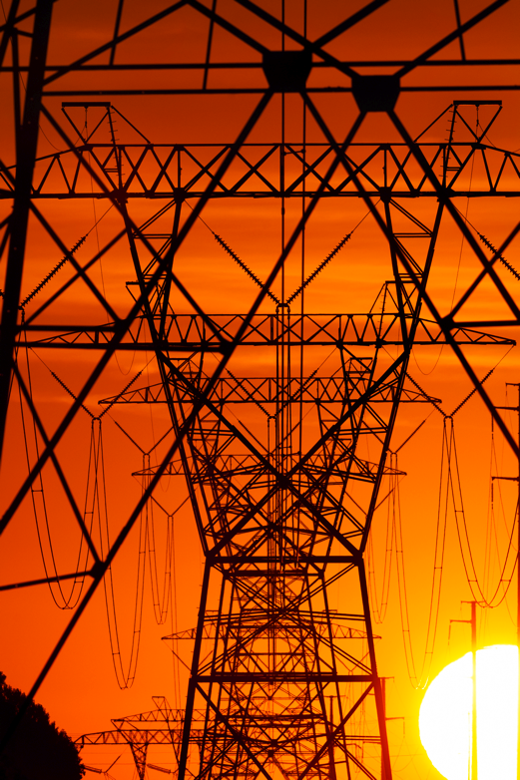
Emerging Power System Challenges
  Increasing wind and solar generation
  Decentralization of generation
  Aging infrastructure
  Changing demand profiles
  Increasing natural gas generation
All of these challenges require greater power system flexibility.
What role can energy storage have to meet these challenges.

Slide 10
Evolution of Grid Requirements
GRID
Modernization
Affordable
Safe
Accessible
Reliable
Clean
Secure
Resilient
Flexible
Federal Power Act
1930s
Increasing Dynamics
and Uncertainty
2020s
Hurricanes
Katrina, Sandy
Polar Vortex
2010s
Blackouts
1960s
9/11
Stuxnet
2000s
Oil Embargo, Environmental concerns
1970s
Source: DOE Grid Tech Team

Slide 11
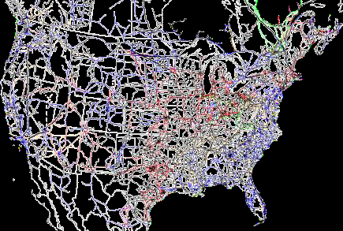
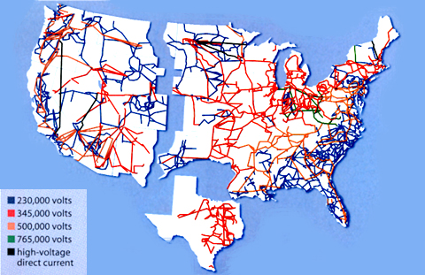
U.S. Electric Grid - Big with Several Players
157,000 miles of high-voltage
electric transmission lines.
Over 15,000 generating units.
143 million customers
Total Electricity Revenues in 2009 - $353B
Over 3100 electric utilities in the U.S.
  213 stockholder owned – provide 73% of electric power.
  2000 public utilities, state and local government - provide 15% electric power.
  930 electric cooperatives- provide about 12% electric power.
  2100 nonutility power producers, including both independent power companies and customer-owned distributed facilities.

Slide 12
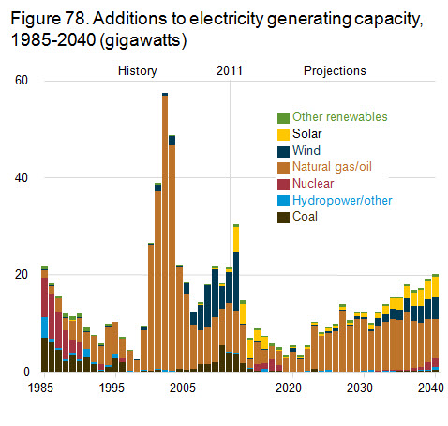
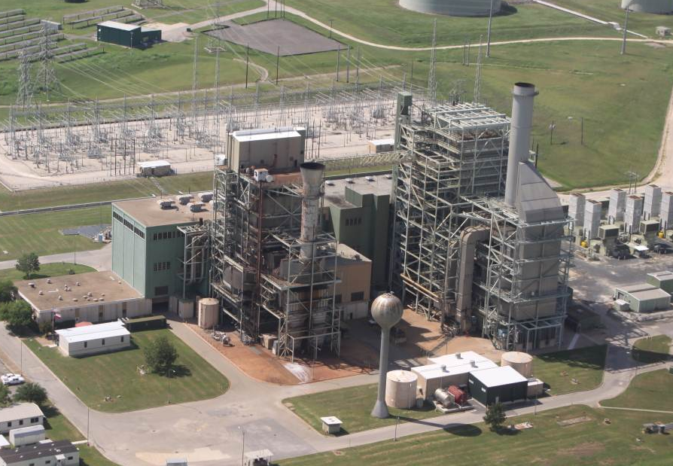
Stationary Power Today
Strengths
~55% efficiency (HHV) for NGCC CO₂ point source for future CCS High capacity factor Mature technology
Weaknesses
T&D Losses Grid vulnerability to natural disasters and terrorist attacks Difficulty in integrating intermittent renewable technologies Future efficiency gains incremental
Future generation dominated by NGCC and increasing renewables:
emissions improvement over coal but weaknesses need to be addressed

Slide 13
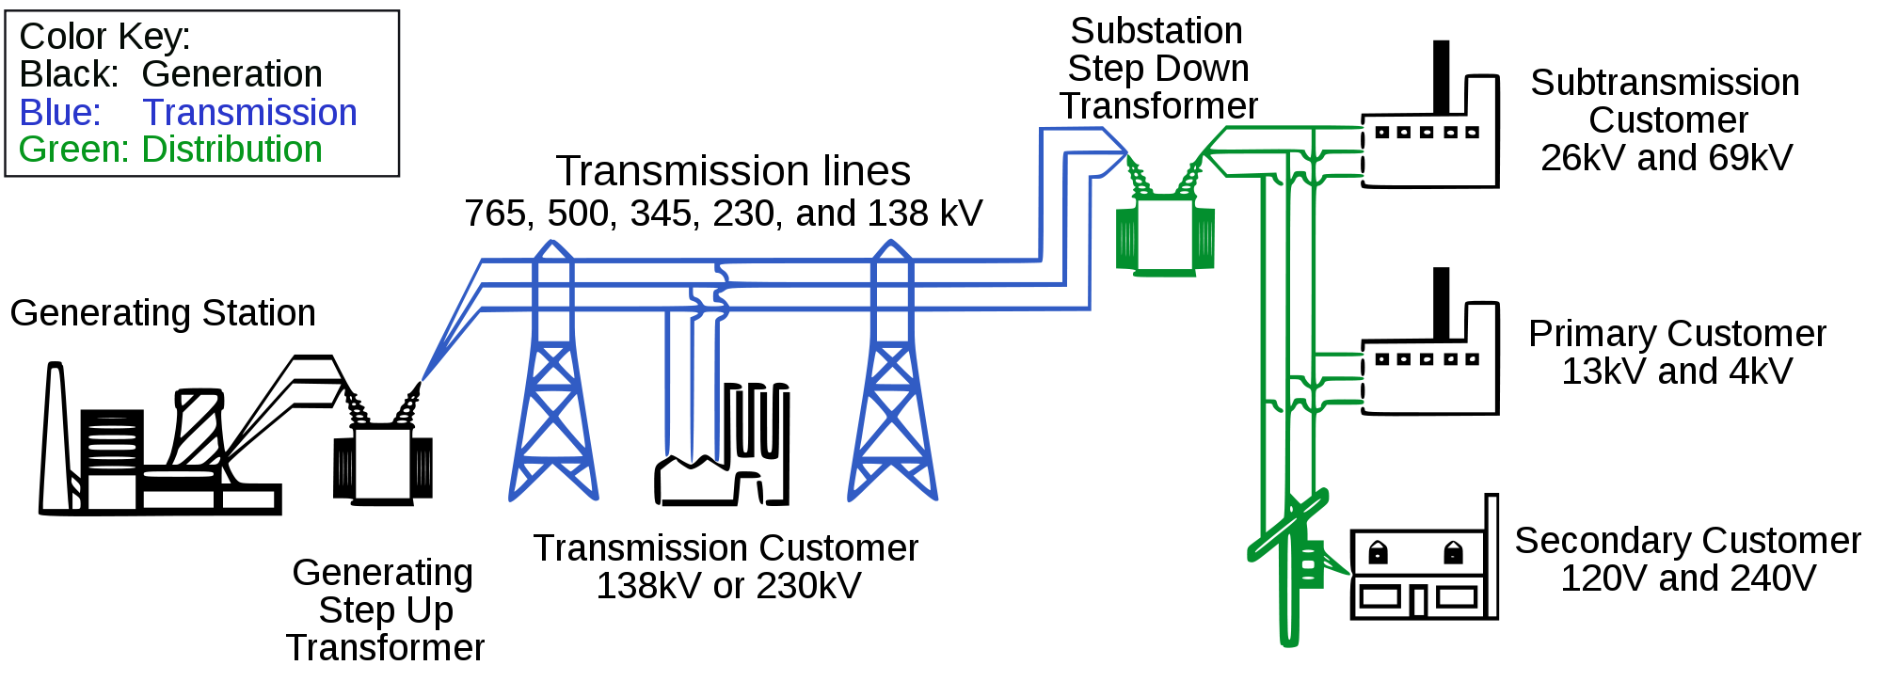
Energy Loss in Today’s Grid
Typical losses on Transmission level:
2.5% - 5%
Typical losses on Substation level: 1.0% - 2.5%
Typical losses on Distribution level: 6.0% - 8.0%
Note: The losses above are at peak load, based from a study of AEP’sT&D system. The ranges above do not directly correlate to the previous page due to differences in source data
The majority of the losses are in the distribution level
Source: Nourai, et al; “Load Leveling Reduces T&D Line Losses”, IEEE Transactions on Power Delivery, 2008

Slide 14


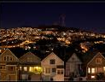
Impact of Efficiency Losses in T&D
Impact of Capturing Losses
200 million tons of CO₂ = output of 56 coal plants
Reducing 200 million tons of CO₂ emissions =
removing 38.5 million cars from the road
375,000 GWh¹ =
enough to power 8.9 million of homes for a year
These losses equate to a significant amount of CO₂
(1) EIA 2009 data of GWh generated (less direct use) and GWh consumed

Slide 15
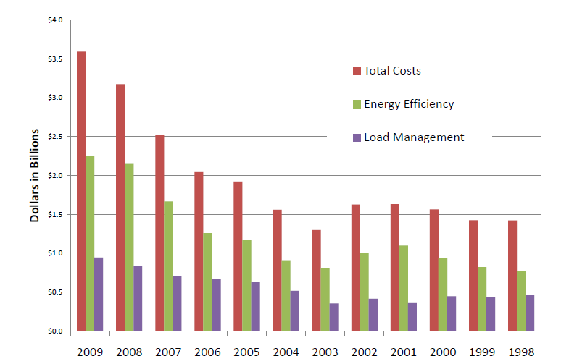

Grid Designed for Peak Power
Generation Load Duration Curve
MW
Total Load Responsibility
Planning Reserve Requirements
Forecasted Peak
0
100%
% of Time (Year)
(Or Hours in a Year)
Peaking Generation
Load Responsibility (MW)
Intermediate Generation
$3.5 Billion Spent in 2009 Demand-Side Management
Baseload Generation
0
Hours in Year
8,760
Generation assets can be deployed based on need, transmission investments must be sized for peak demand.
14
14

Slide 16
Generation-Demand Balance
Power generation matches demand at all times
Frequency stability directly affected by generation-demand balance
60 Hz
slope = system inertial
0 s
5-10 s
20-30 s
5-10 min
30 min
3 hrs
Frequency Ctrl
Automated Generation Control (AGC)
Contingency Reserves
Regulation Reserves
Ramping Reserves
Grid Ancillary Services

Slide 17
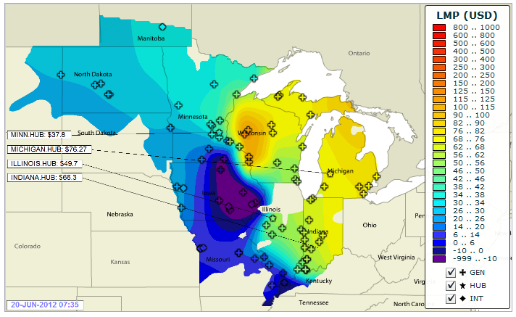
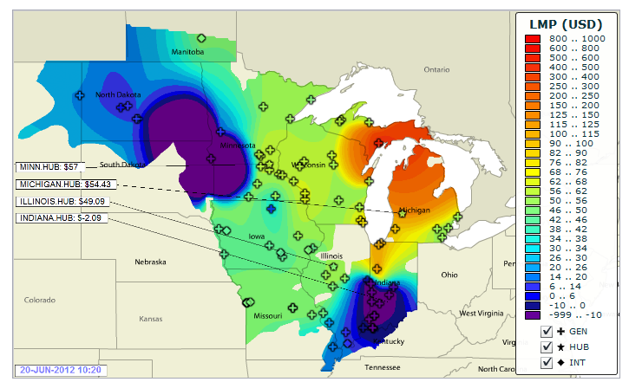
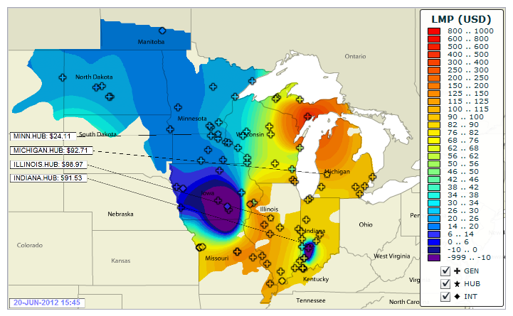
Optimal Transmission Network: When?
Midwest ISO real time LMPs for June 20th, 2012
07:30
10:20
15:45

Slide 18
Grid Ancillary Services
Ancillary Services Categories Contingency reserves Regulating reserves Ramping reserves | Reserve Control Resources Generators Inertial Response (sec) Spinning Reserves (sec-min) Non-spinning Reserves (min-hrs)
Early ES Market
Potential ES Market
Today’s Grid
Control
Spinning Reserves
Curtailment
Droop Control
Load Shedding
Economic Dispatch
Non-Spinning Res, DR
Unit Commitment
Bulk DR
Regulating Reserves (Spinning)
Wind Variability Response
Ancillary Service
Contingency Reserves
Ramping Reserves (Non-Spinning)
Frequency
Control
Automatic Generation Control (AGC)
Solar Time Shifting
Peak Load Reduction
2-4
sec
30
sec
10
min
30
min
1
hr
2-3
hr
Time-Scale

Slide 19
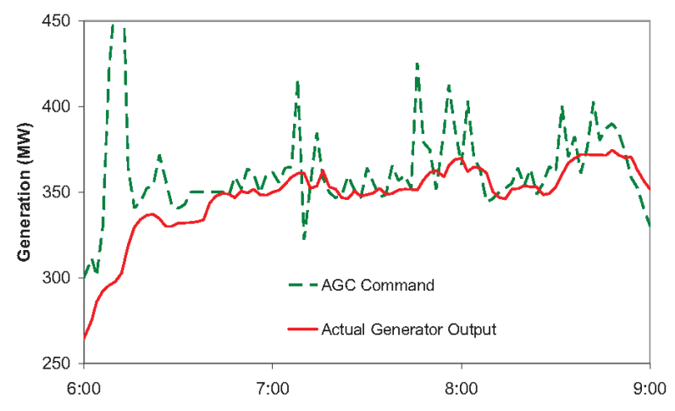
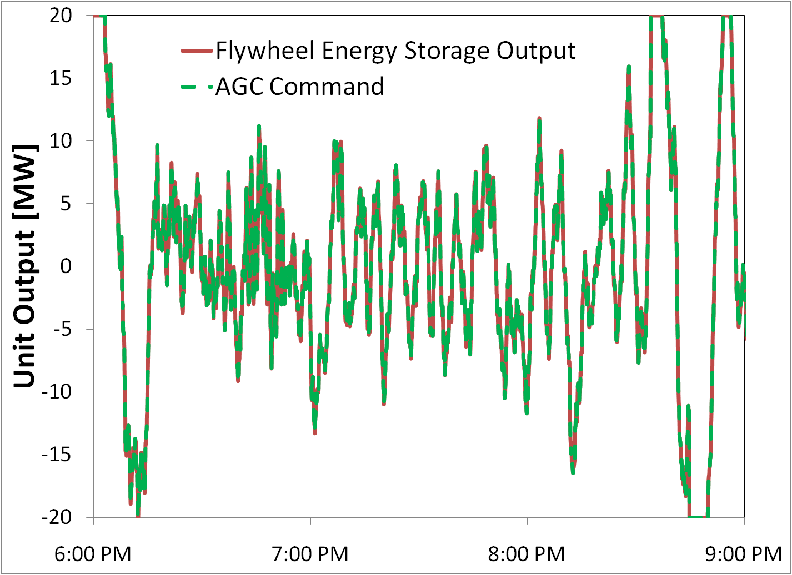

Battery Performance in Regulation
A fossil plant following a regulation command signal.
(left)
Energy Storage Output
Regulation Signal
Energy Storage accurately following a regulation command signal. (right)
The high value of regulation services decreases the cost constraints for grid storage that can meet performance requirements.
Courtesy Scott Baker, PJM

Slide 20
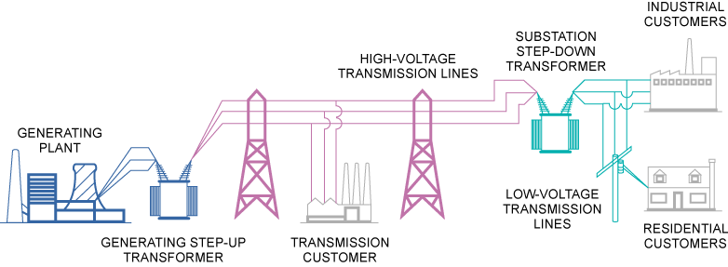
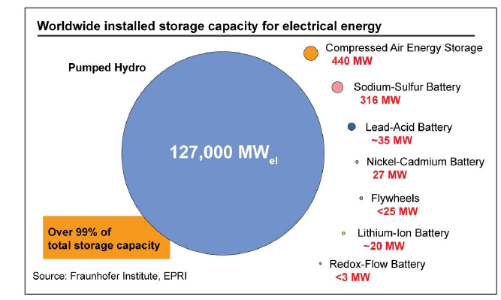
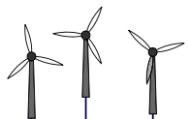

Grid Storage Today
Bulk Generation
Dispatch, Set-points & Inertia
Industrial Load
Bulk DR (hour-day)
WIND
Bulk Renewables
Curtailment
Majority of storage is pumped hydro, hydroelectric can also be used to balance renewables.
SOLAR

Slide 21
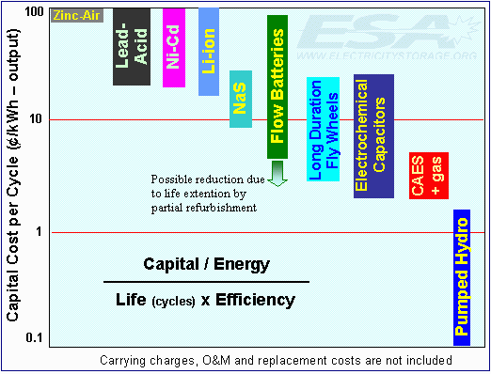
Performance and Cost Metrics
  - Cost
  Cycle life
  Reliability
  Flexibility
  Safety
  $0.025 per kWh_{e} = $100 per kWh
  5000 cycles • 80% RTE
For most applications a 10x step change is needed.
Chemical Reviews 111 (5), 3577-3613

Slide 22
Increasing DG and DS (near term)
Central/Bulk
Distributed Utility
End-User
Micro grids
Commercial & Industrial
Highest accumulated value at
Edge of Grid
Residential
Level of Benefits
Regulation
Reliability, deferral, peak shaving, etc.
Distributed Generation Markets – Impact of Future Fuel Cell Applications, DNV KEMA report prepared for ARPA-E (2013). Cost-Effectiveness of Distributed Generation Technologies, Iton, submitted to PG&E, 2011

Slide 23
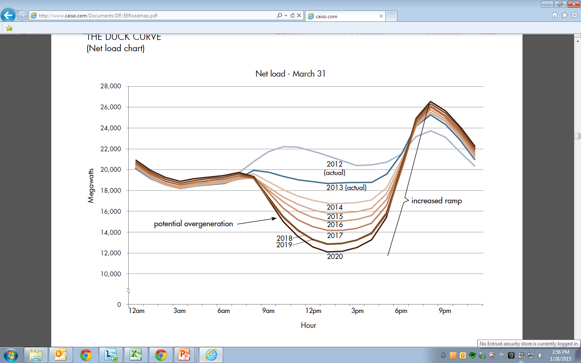
Predicted Ramping Requirements (CAISO)
Net load (load minus renewables) for March 31
2013 (actual)
Increased ramping
2016
Potential over generation
2020
Adapted from
http://www.caiso.com/Documents/DR-EERoadmap.pdf

Slide 24
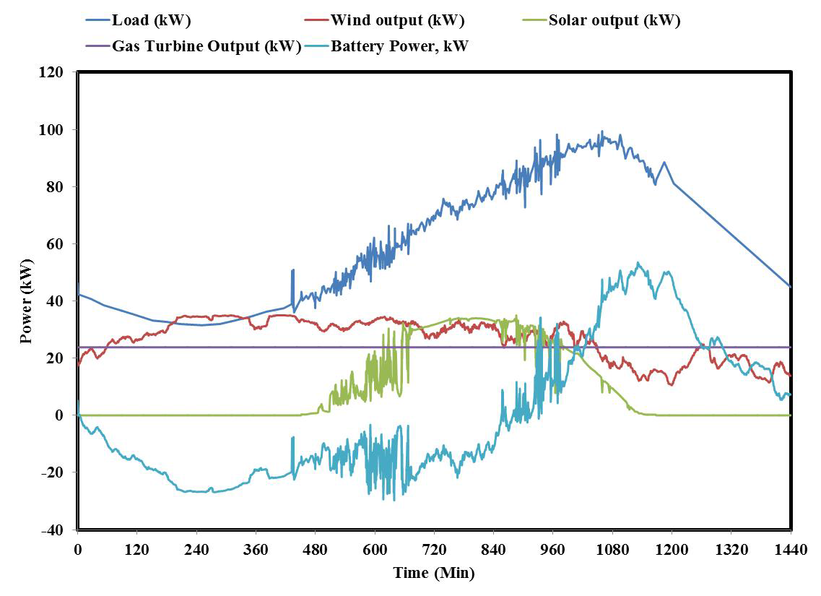
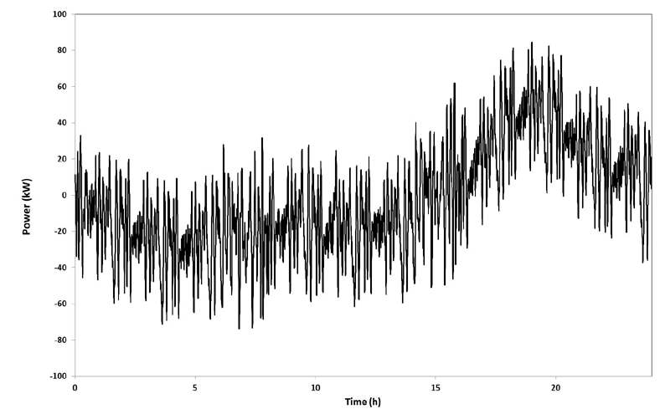
Predicted Ramping Requirements (CAISO)
Load and generation mix for micro-grid
Micro grid ES duty cycle
$
$
Consolidated duty cycle with solar and wind smoothing with regulation.
Stacking multiple grid application with different values increases the value of grid storage.
Microgrids Sub Group of the ESS Protocol Working Group June 2014

Slide 25
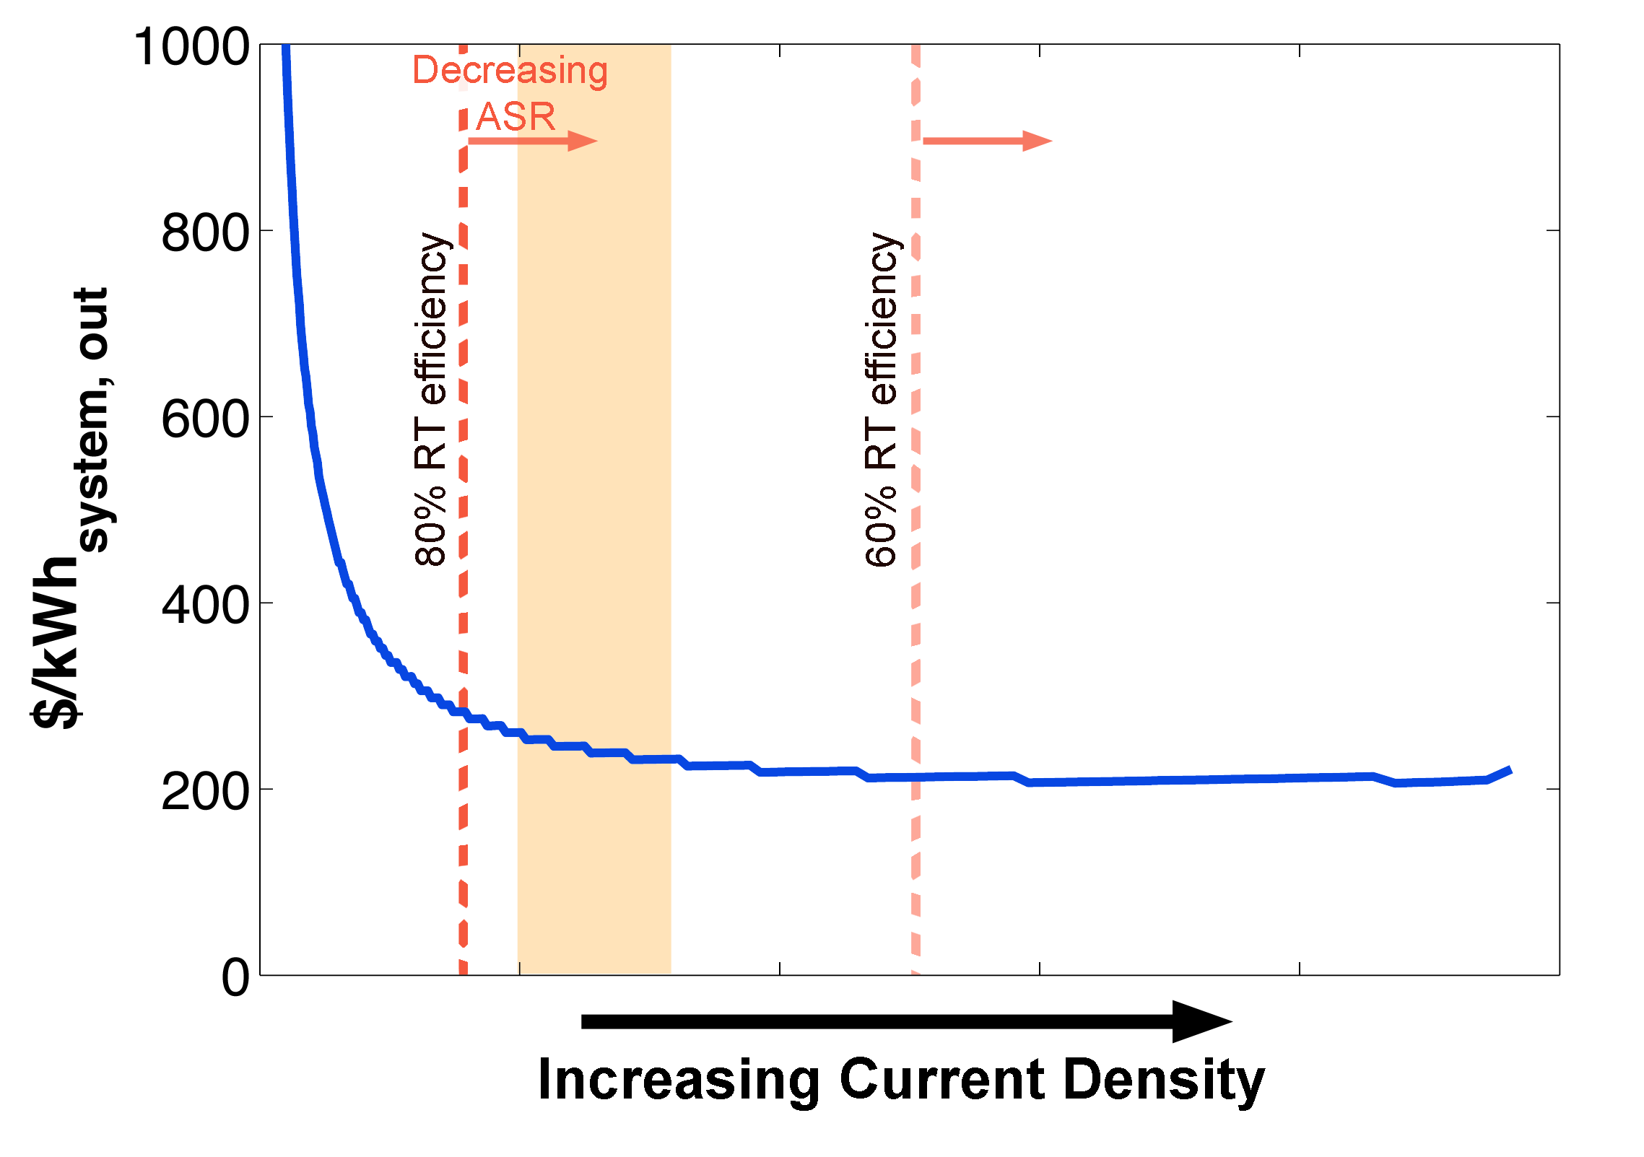
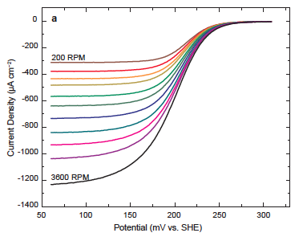
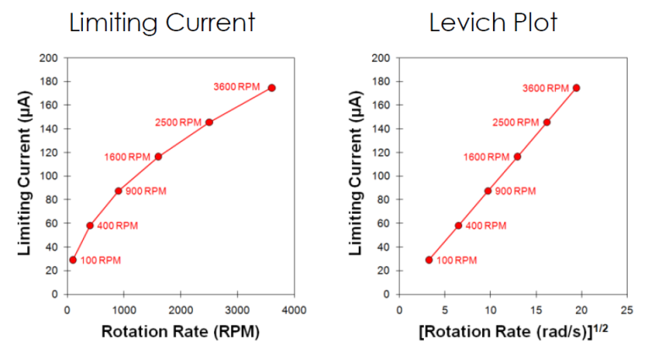

System Drives Cell Metrics
Flow battery performance based cost model.
Electrode Kinetics
Defines operation parameters and critical electrochemical properties.

Slide 26
Characteristics Scales of the Electrochemical Cell
mm
nm
μm
mm – cm - m
Electrode
Concentration boundary layer
Bulk Electrolyte
V
Φ_{m}
Φ_{s}
C_{e}
mass transport-Conc BL:
Potential distribution:
∇²Φ =0
Φ
charge transfer:
C_{b}
η_{a}
η_{c}
η_{ohm}
Double layer

Slide 27

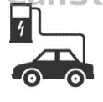
Additional DG and DS (future grid)
Bulk Generation
Dispatch, Set-points & Inertia
Industrial Load
Bulk DR (hour-day)
WIND
Net Load
Bulk Renewables
Curtailment
Active control of Load & Distributed Generation
SOLAR
Stacking multiple grid applications across TD network with seamless integration.

Slide 28
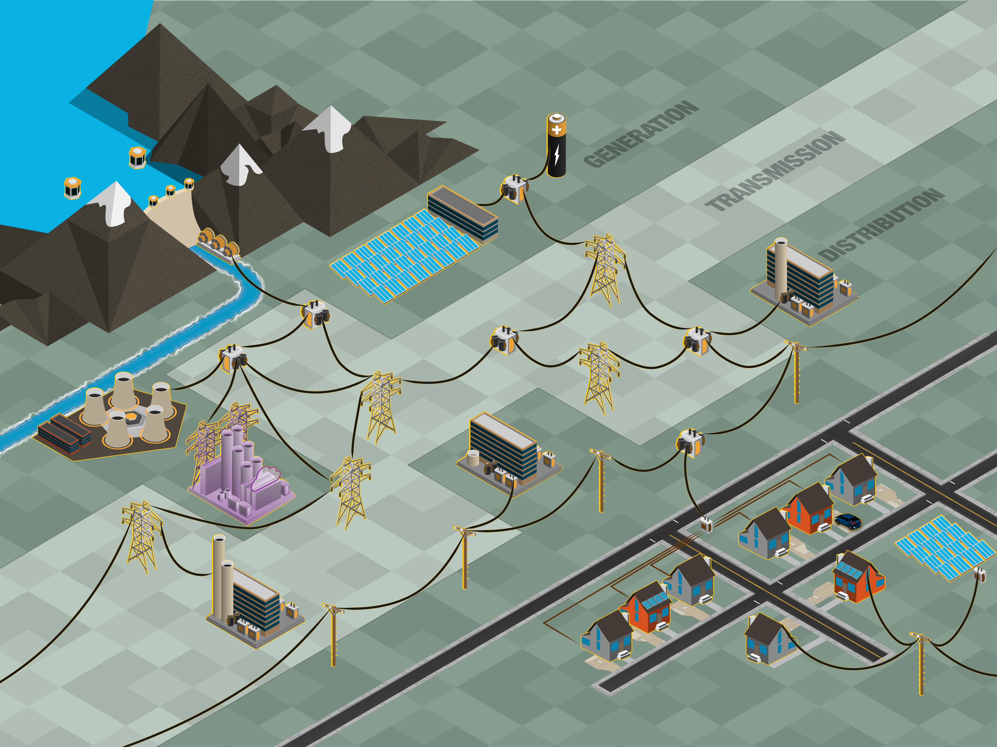
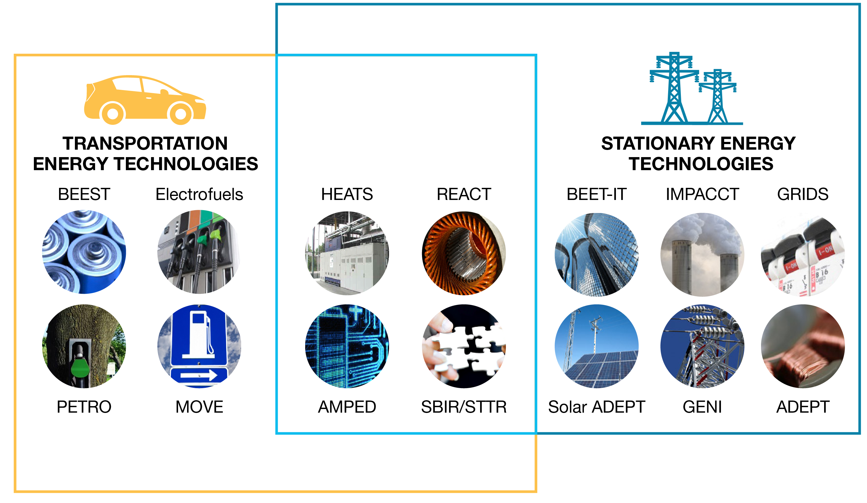




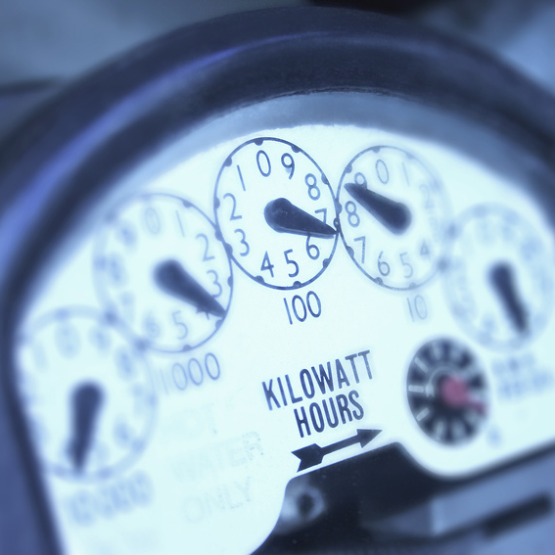
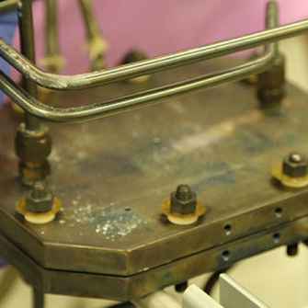
ARPA-E & Electric Power
HEATS
GRIDS
AMPED
FOCUS
Solar ADEPT
GENI
REACT
ADEPT
BEETIT
SWITCHES
ARID
MOSAIC
GEN-SET
METALS
REBELS

Slide 29
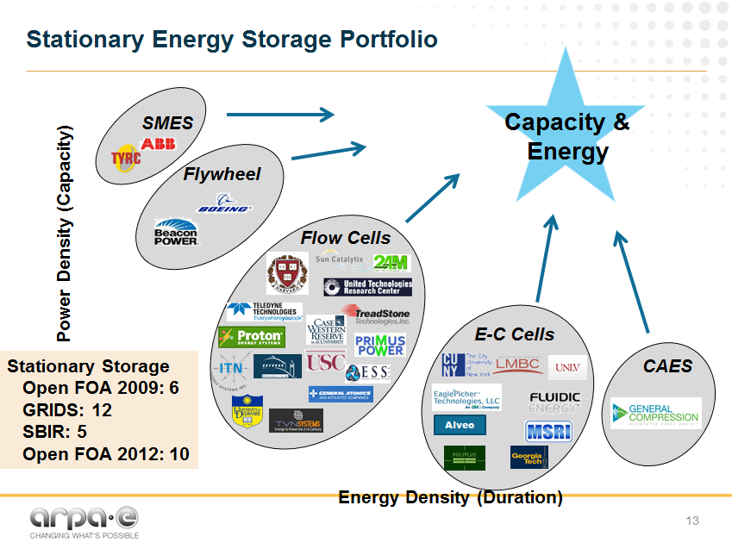

Slide 30













Reliable Electricity Based on ELectrochemical Systems (REBELS)
Intermediate temperature operation enables load-following fuel cells for distributed generation applications and grid support
FUEL CELL
FUEL CELL + BATTERY MODE
FUEL CELL + FUEL PRODUCTION
Nearer-term to market
Longer-term to market
Duration of stored energy

Slide 31

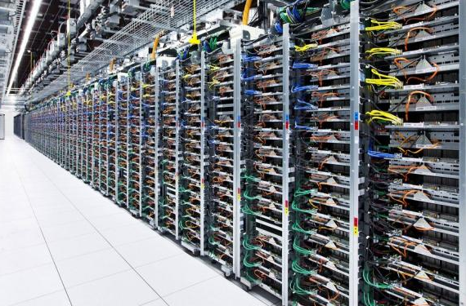
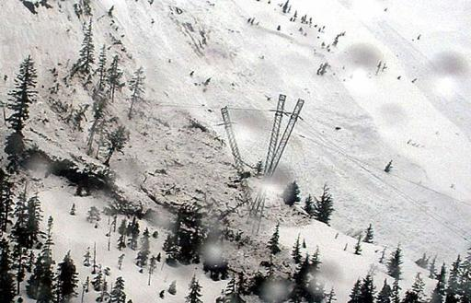

Path to Market
DoD
$8,000+ /kW
Telecom / Data Centers
$3,000-5,000 / kW
Reliable and flexible
generation / storage needs
Alaska & Hawaii
$1,500-$2,000 / kW
Residential DG
$1,000-1,500 / kW
Establish manufacturing, supply chains via early markets
Willingness to pay premium

Slide 32


www.arpa-e.energy.gov

