Slide 1
Another "Climate Change" in the
Chemical Industry toward
Green and Sustainable Societies
Mitsubishi Chemical Group
Science and Technology Research Center, Inc.
Tohru Setoyama & Fumihiko Shimizu*

Slide 2
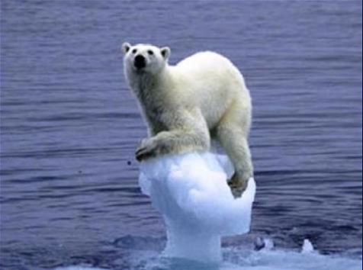
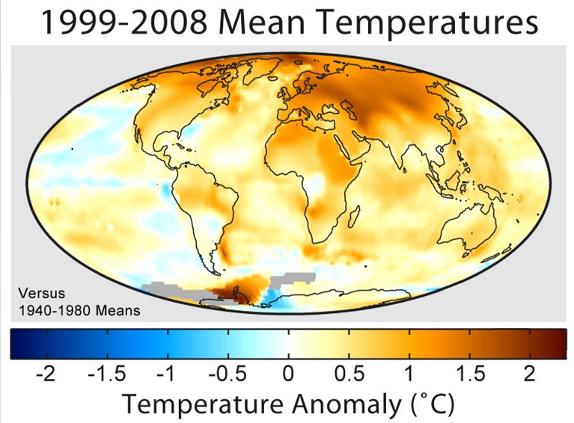
Chemical Industry is responsible for taking action!

Slide 3
"The economy without ethics
is sin, while the ethics without
economy is a moonshine."
However, at the same time, it is obvious that the economy is meaningless unless the human society is sustainable...
Sontoku Ninomiya (1787-1856)

Slide 4
What economical actions should we take?

Slide 5
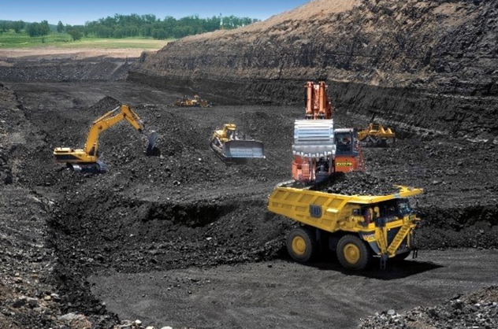
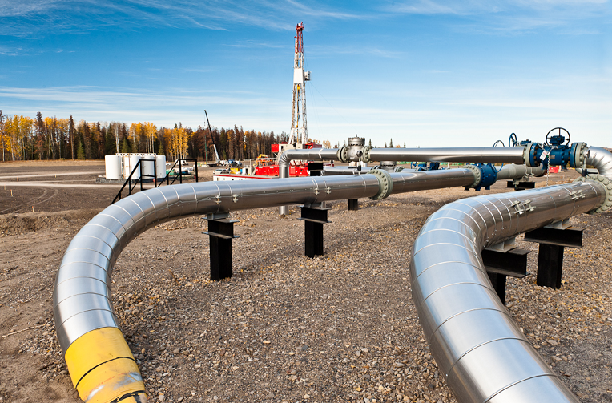
Shale Gas in the U.S. and Coal Chemistry in China
Another "Climate Change" in Chemical Industry

Slide 6
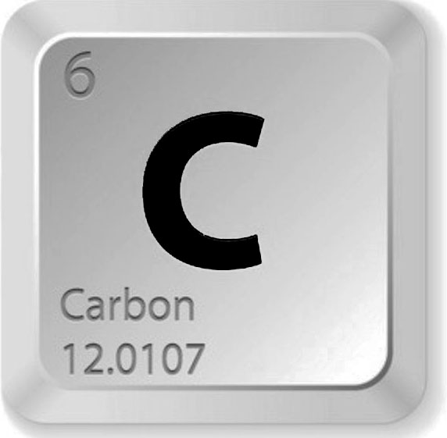
What carbon sources should we use?

Slide 7
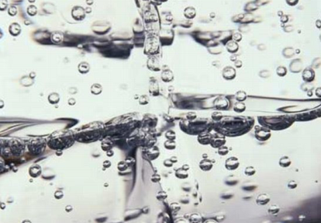
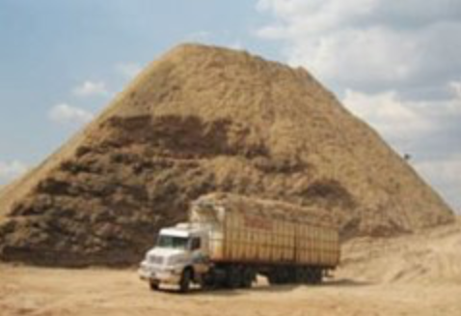
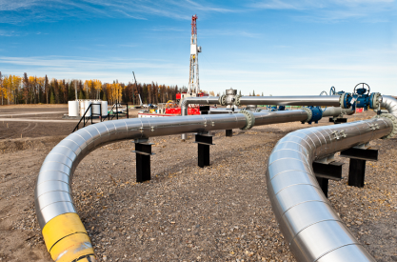
Sustainable
Society
Artificial
Photo
Synthesis
Inedible
Biomasses
Lower
Alkanes
Naphtha
Our Idea

Slide 8
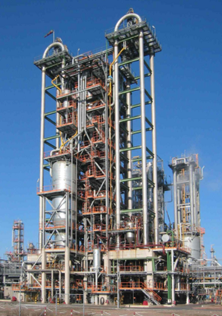
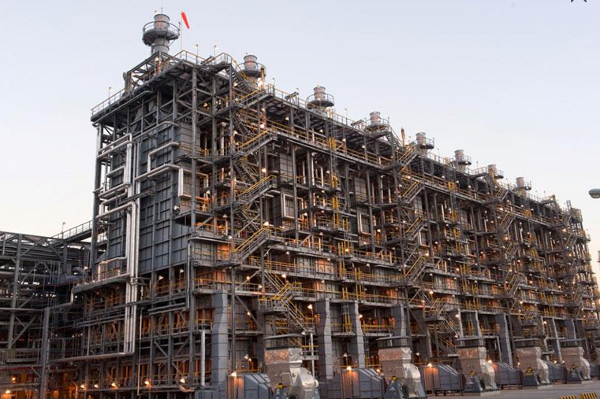
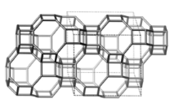
Why lower alkanes?
Because higher H/C results in lower CO₂ emissions.
propylene
n-butene
Shale Gas
(ethane)
ethylene
Ethane Cracker
ETP Technology
ETP(B) Technology

Slide 9
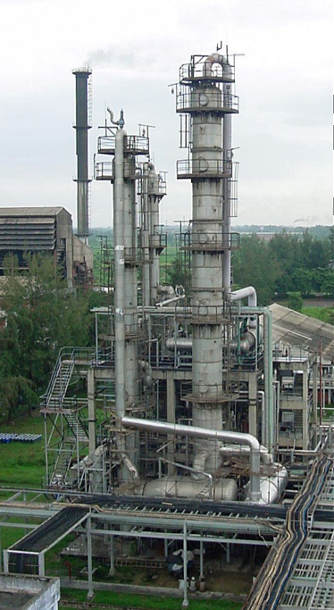
Inedible Biomasses ... carbon neutral
bagasse
Furan
C4-Chemistry
Why furan from bagasse?
A1: Bagasse is an inedible, established biomass.
A2: This process will be competitive enough.

Slide 10
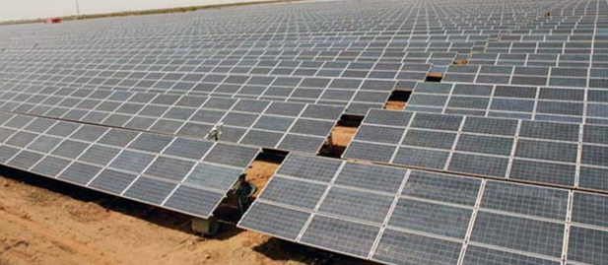
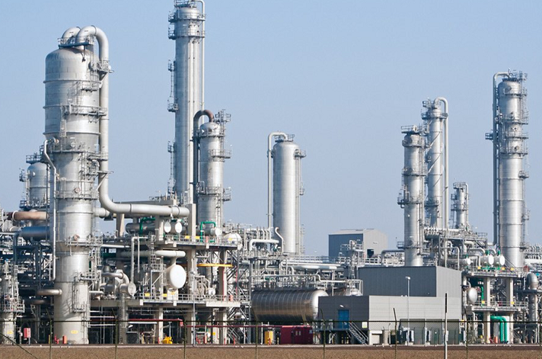
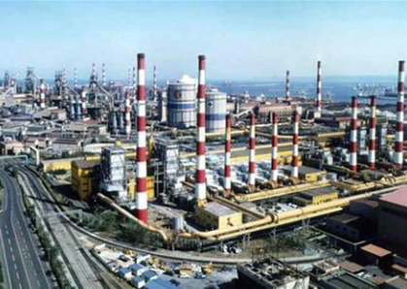
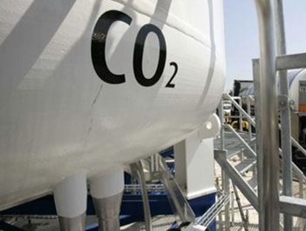
Artificial Photosynthesis: a final goal?
H₂
water splitting
CO₂
Syngas
Methanol
Lower Olefins
Fuels
etc.
CO₂ capturing

