Slide 1
Sustainability – A Key Competitive Advantage in Petrochemicals
Venki Chandrashekar
Cori Demmelmaier

Slide 2
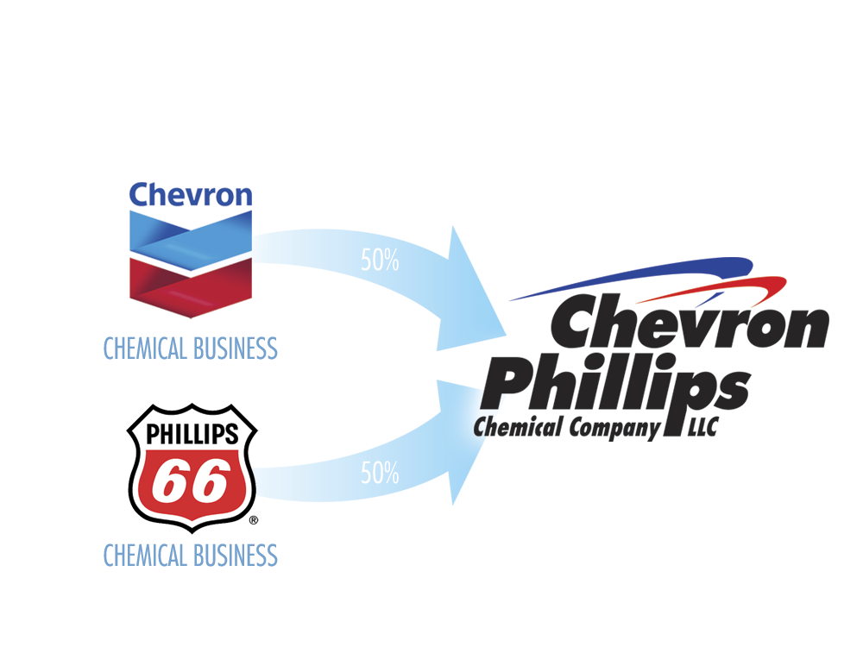
Who We Are
Manufacturer of petrochemicals that are essential to manufacturing over 70,000 consumer and industrial products
Currently $10.5 billion in assets and more than $13.7 billion in annual revenues
Trusted supplier to customers in 140 countries
A highly educated and diverse workforce of approximately 5,000 employees working on five continents across the globe

Slide 3
Who We Serve
Employees
Communities
Environment
Customers
Shareholders
We recognize that to reach our goal of sustainable growth and meet the increasing global demand for petrochemicals, we must do so in a manner that protects the planet’s land, water and air resources.
- Chevron Phillips Chemical Company LLC, 2013 Sustainability Report
Notes:
Company goal – make optimum use of the energy resources we consume

Slide 4
Sustainability
Keep our employees and communities safe
Provide solutions to everyday needs
Develop products that better society
Give back to communities
Society
Sustained Business
Resources
Environment
Environmental initiatives for air quality, green house gas emissions
Continuous improvement on safety and environmental metrics
Build plants for long term: 30 + years
Provide cost effective solutions for consumers with new products
Energy and water conservation and integration in chemical plants
Higher efficiency conversion of raw materials into products

Slide 5
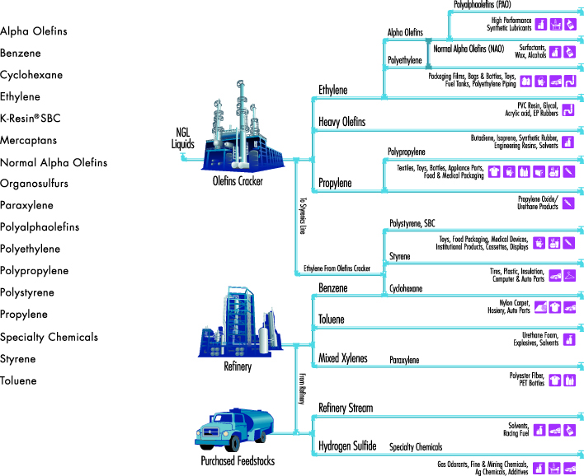
Our Products

Slide 6
Ethylene Alternatives
Ethane Feed
Natural Gas Feed
Coal
Bio
Pyrolysis Routes
Oxidative Coupling of Methane (OCM) Routes
Steam/Methane Reforming (SMR) Routes
Fermentation Routes
Ethane Dehydrogenation
Syngas Generation
Ethane Cracking
Gas
Gas to Liquids (GTL)
Methanol Production
Ethanol Production
Separations
CO₂
H₂O
Acetylene Removal
Liquid Products
Methanol to Olefins (MTO)
Ethanol to Olefins (ETO)
H₂
Ethane Recycle
Ethane Separation
Separations
Purification
O₂, CO₂, etc.
Ethylene Product
Notes:
Pyrolysis → acetylene commercially practiced. Acetylene → ethylene is not practiced currently

Slide 7
Ethylene Alternatives
Ren et al., Energy 33 (2008) 817-833
Ren et al., Resources, Conservation, and Recycling 53 (2009) 513-528

Slide 8
Energy Optimization Sustainable Source Reduction
Furnace efficiency improvement through burner retrofits and optimization
Furnace safety system upgrades
Improvement of steam turbine efficiency
Addition of steam generation
Execution of heat integration projects
Process technology integrations (e.g. coupling exothermic/endothermic reactions)
Efficient operation of utility systems
Implementation of process monitoring and optimization programs

Slide 9
Environmental
Emissions reductions
Ethane cracking utilizes tail gas (high methane / hydrogen) – very low CO₂ emissions
Advanced separations technologies to reduce emissions and fully utilize resources needed to meet decreasing NOx/VOC regulations
Opportunities to address long term water challenges
Reduce fresh water demand (clean up/ recycle technologies)
Higher efficiency cooling tower
Hybrid fan/cooling tower
Salt water cooling
Desalination

Slide 10
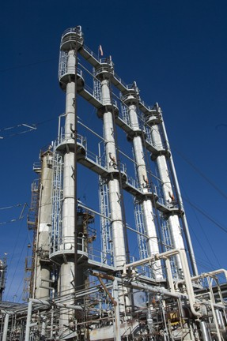
Building Plants of the Future
Environmental, Utilities, and Energy
Balance water/energy efficiency by adjusting designs to fit community you are in
Perform energy reviews early in capital projects and include energy consumption in technology selection
Technology Selection and Design
Use life cycle analysis in decision making process – including final product disposition
Build plants to last a long time (materials of construction, technology, feedstock, etc.)
Site Selection, Synergy & Integration
Integrate product streams and utilities to increase efficiencies
Transportation
Optimize movement of materials, reducing emissions and pollutants
Labor
Less human interaction with utilization of robotics and advanced controls, process simplification
Community/Quality of Life
Partner with communities to attract and retain qualified personnel
Companies will need to remain sensitive to social pressures

Slide 11
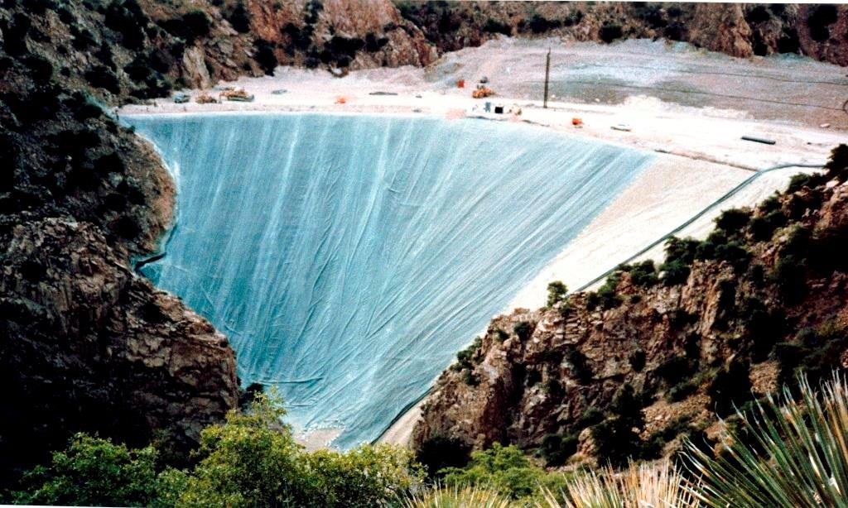
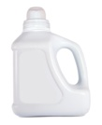
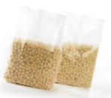
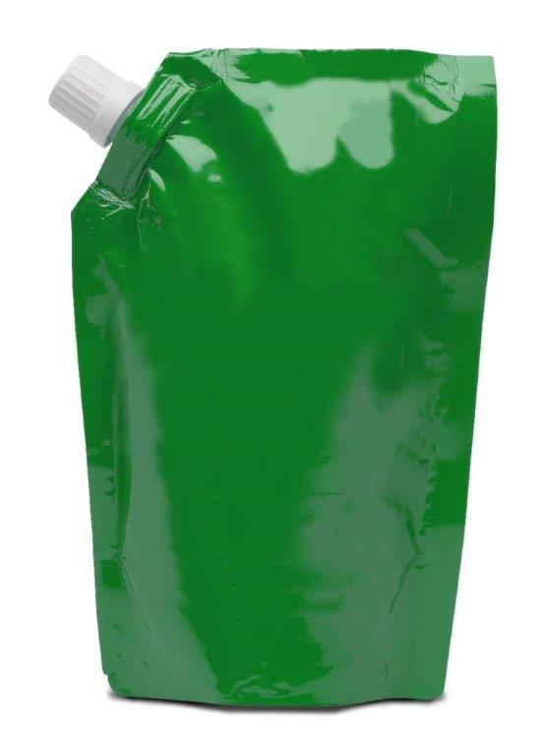
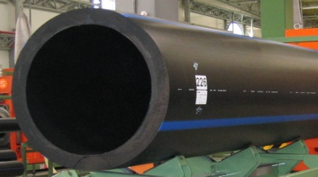
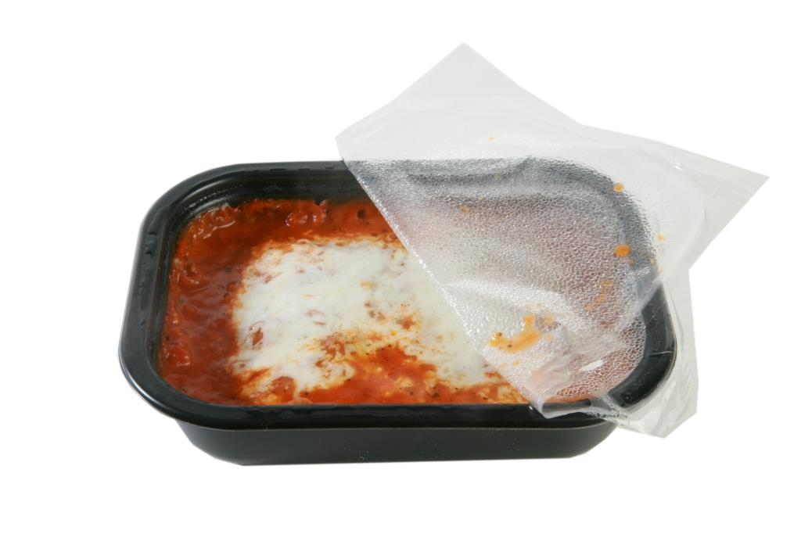
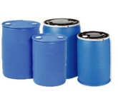
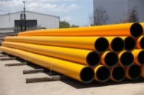
Products of the future
Safe products
Products with improved properties
Long lifetime
Recyclable to recover raw materials
Reduced weight
Improved strength
Composatability or biodegradation where needed
Responsible product management throughout the product lifecycle
Products that better the quality of life for consumers

