Slide 1
energy.umich.edu
Beyond Carbon Neutral:
Integrative Ideas about CO₂ Uptake and the Fate of Carbon
Mark A. Barteau
Director, University of Michigan Energy Institute (UMEI)
DTE Energy Professor of Advanced Energy Research
Department of Chemical Engineering
Department of Chemistry
barteau@umich.edu
With thanks to John DeCicco, Research Professor, UMEI

Slide 2
Is cognitive dissonance rising along with GHG emissions?

Slide 3
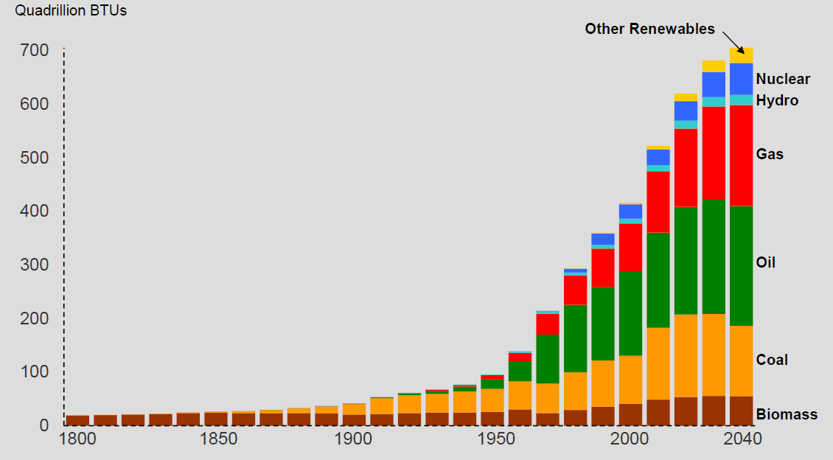
Historical and Projected World Energy Use by Fuel
Source: Exxon-Mobil Energy Outlook, 2013

Slide 4
Ⅰ Strategic Demand for Developing Coal-based Clean Energy
In the next 40 years, coal consumption aggregate will reach 160-200 billion tons, 3-4 times of the past 60 years, 5-6 times of the annual consumption volume of the past 60 years
hundred million tons
60
50
40
30
160-200 billion tons
160~200 billion tons
20
10
~50 billion tons
~50 billion tons
0
1950
1960
1970
1980
1990
2000
2010
2020
2030
2040
2050
China’s coal consumption status and trend（1950-2050）

Slide 5
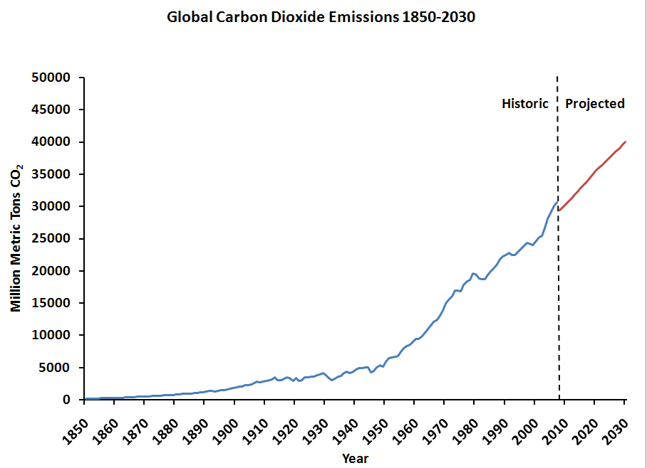
IEA (2012)
US EIA (2009)
450 ppm scenario
Center for Climate and Energy Solutions http://www.c2es.org/facts-figures/international-emissions/historical

Slide 6
“It’s pretty hard to see how in 2050 we can be burning much of anything in the state of California to meet our carbon goals.”
Mary Nichols, Chairperson, California Air Resources Board

Slide 7
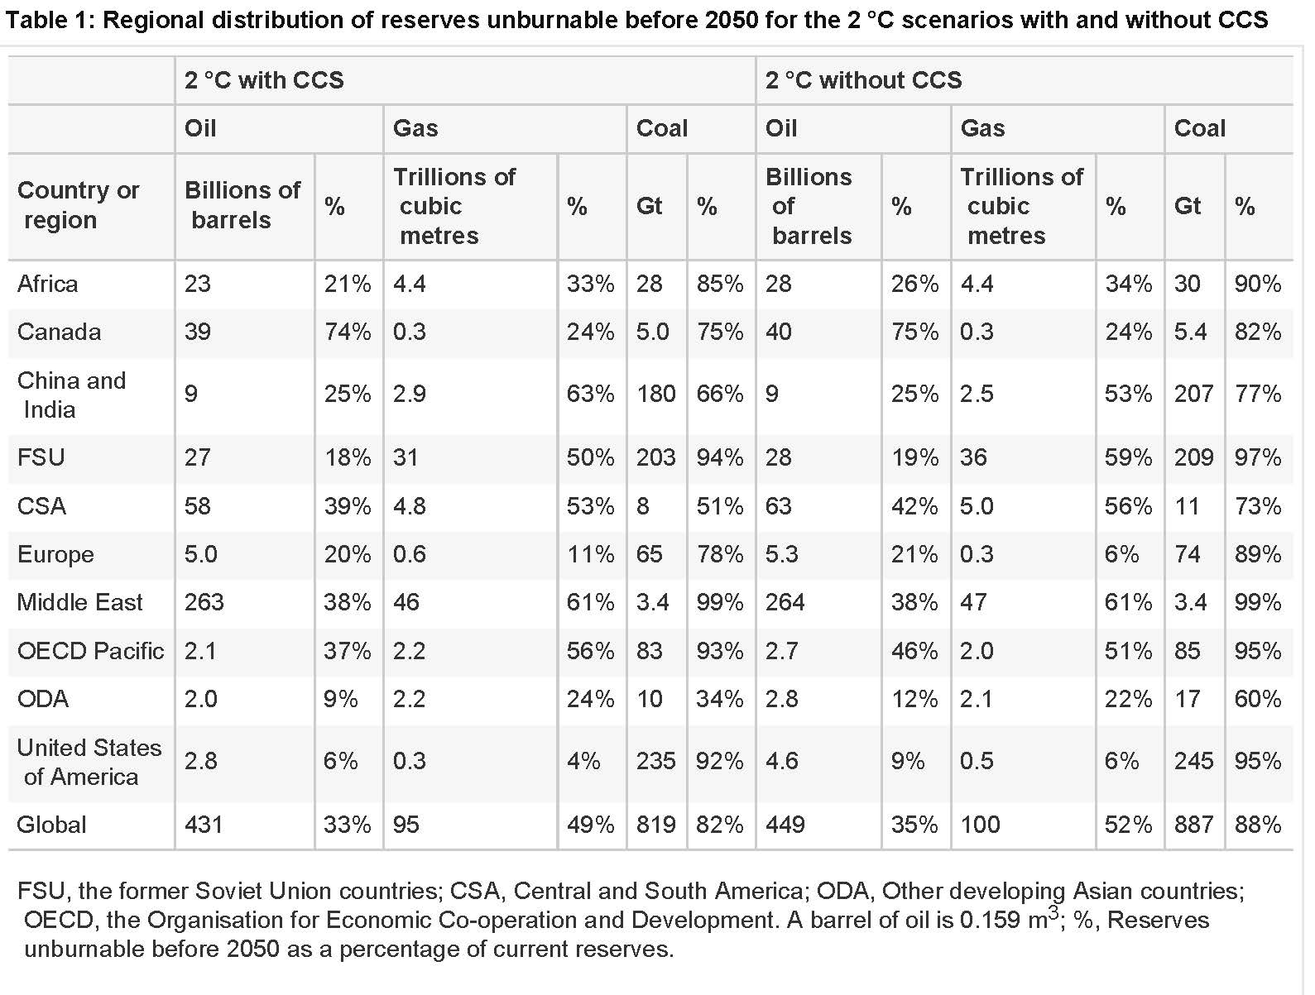
C. McGlade and P. Ekins, Nature 517 (2015) 187

Slide 8
“Three-quarters of the global population uses just 10 percent of the world’s energy, 1 billion people lack access to electricity, and 3 billion cook their food over dung, wood, and charcoal, leading to millions of early deaths. These people are energy starved—and they need a feast, not a diet. People in Angola, Bangladesh, and Cameroon, for example, use about 250 kilowatt-hours of electricity per year, while people in the U.S. use 12,246.”
Lisa Margonelli, The Carbon Diet Fallacy
http://www.slate.com/articles/technology/future_tense/2015/01/what_the_carbon_diet_metaphor_gets_wrong_about_climate_change.2.html

Slide 9

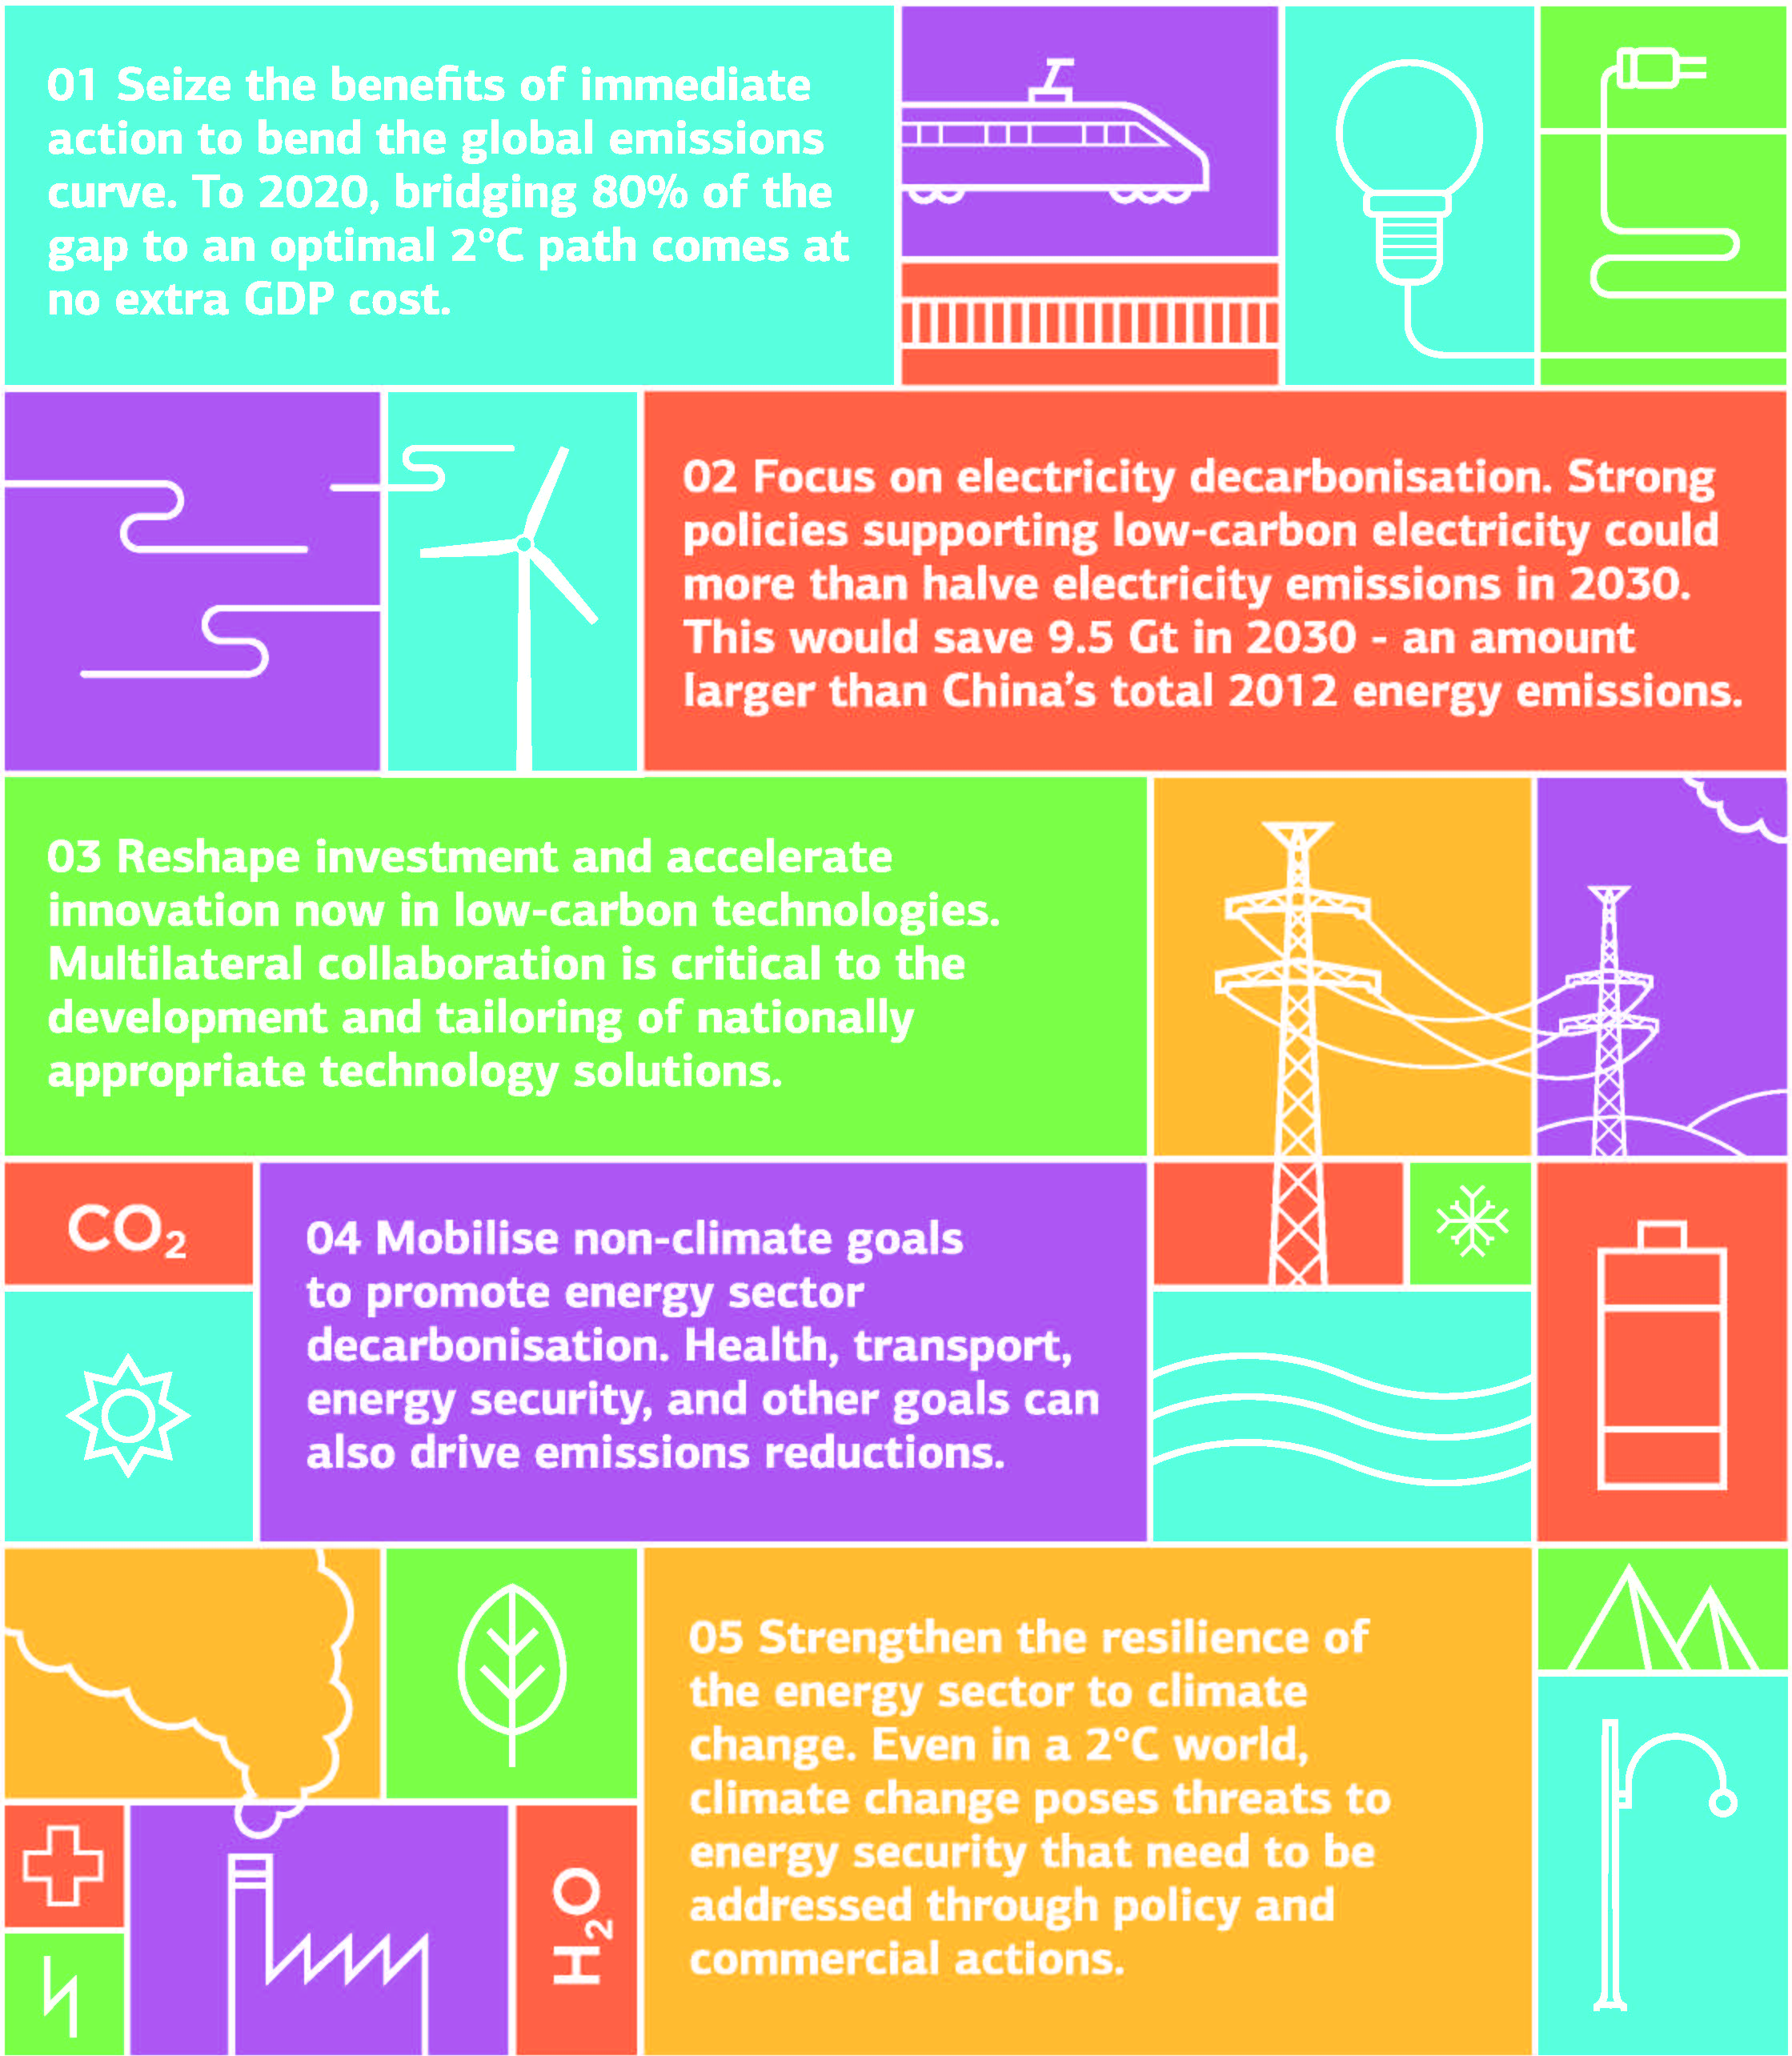
Decarbonization of energy supply/use
Stationary use
  Natural gas substitution for coal
  Increase carbon-free energy supplies/utilization
Transportation
  “cross-over” of low/zero carbon resources (e.g. vehicle electrification)
  “carbon neutral” biofuels

Slide 10
The Carbon Emissions Challenge
The carbon emissions challenge is fundamentally different in nature and scale from virtually every other emissions challenge that the world has ever faced.
  Consequences of greenhouse gas emissions are global and are unconnected to sources, unlike other forms of pollution
  Local and regional climate impacts are related to global cumulative inventories of GHGs, not to local or regional emissions.
The carbon emissions challenge is distinct in that it is due to an imbalance in the global stocks and flows of an essential substance rather than environmental pollution by a non-essential waste product.
  It is scientifically incomplete, economically inefficient and unnecessarily polarizing to emphasize solutions premised on treating carbon as a pollutant to be eliminated rather than the molecular foundation of highly efficient energy carriers on which both life and world economies depend.

Slide 11
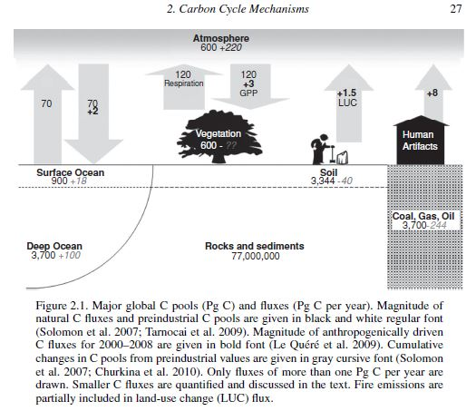
G. Churkina in Land Use and the Carbon Cycle - Advances in Integrated Science, Management, and Policy, D. G. Brown, D. T. Robinson, N. H. F. French, B. C. Reed (eds), Cambridge Univ. Press (2013)

Slide 12
What is the Objective Function?
Reducing atmospheric carbon levels
(Reducing our debt, not just eliminating or reducing the growth rate of our deficit)
Need to operate processes that are carbon-negative
Supply energy needed for these from carbon-free sources
Is “hoovering up” carbon a viable strategy/business?

Slide 13
Interrupting the Bioenergy Triangle?
CO₂
Fuel
Biomass

Slide 14
Interrupting the Bioenergy Triangle?
CO₂
Fuel
Biomass
Sources uncoupled from sinks
Removal of C from the global cycle
Uncoupling of C removal strategies from energy source/use/location
A CO₂ molecule in the atmosphere doesn’t know whether it came from burning a fossil fuel or biomass, or whether it was emitted from the US, China or anyplace else
If you have successfully removed CO₂ from the atmosphere in the form of plants via photosynthesis, why reconvert these to CO₂ and emit, just because this appears to close a “carbon neutral” cycle by some accounting?

Slide 15
Carboneum Interruptum
Strategies for carbon removal
Carbon Dioxide Removal (CDR):
Biological capture and biological storage (afforestation, soil-carbon build-up)
Biological capture plus geological storage (CCS of biofuel emissions)
Non-biological capture and geological storage (Direct air capture (DAC) with chemicals + geological storage)
Non-biological capture and biological storage (use concentrated CO₂ from DAC to stimulate growth of long-lived plants)
from M. Tavoni and R. Socolow, Climatic Change 118 (2013) 1.

Slide 16
Carboneum Interruptum
Strategies for carbon removal
Conversion of CO₂ to useful products
CO₂ → fuels (e.g. “solar fuels”)
  Chemical cycle analogous to “carbon neutral” biofuels processes if energy source is carbon-free
  Allows us to continue to enjoy advantages of liquid fuels, especially for transportation, but doesn’t remove carbon from the global cycle
CO₂ → durable materials/durable products
  Not conceptually different from sustainable forestry where wood harvested is used for “permanent” material
  Market capacity?

Slide 17
Can we remove carbon from the global carbon cycle other than by sequestration of CO₂ ?
CDR approaches table – from J. Meadowcroft, Climatic Change 118 (2013) 137.
CDR approach | Potential difficulties | Potential co-benefits | Other relevant characteristics
Afforestation, reforestation | Quantifying removals; ensuring security of storage; land use impacts and conflicts | Livelihoods, water management, air quality, biodiversity | Low cost; already proven; low risk; ongoing REDD negotiations; immediately practical
BECCS (geological sequestration) | Dependent on bio-energy economy; dependent on safe and socially acceptable geological storage; land use impacts and conflicts | Linked to bio-energy pathways | High cost; far from market; link to conventional CCS development
Biochar | Quantifying removals; verifying permanence; land use impacts and conflicts | Agricultural productivity; bio-energy production | Very little research to date on this approach; many unknowns
Biomass burial (terrestrial) | Quantifying removals; verifying permanence | None identified | Very little research to date on this approach; many unknowns
Air capture (geological sequestration) | Dependent on safe and socially acceptable geological storage | None identified | High cost; far from market Smaller land use foot-print that terrestrial biological approaches
Enhanced weathering Land deposition | Quantifying removals; mining and processing large volumes of material; | None identified
Enhanced weathering Ocean deposition | Quantifying removals; mining and processing large volumes of material; interference with open ecosystems | Reducing ocean acidification | Risk of unanticipated impacts
Ocean fertilization | Quantifying removals; ensuring security of storage; interference with open ecosystems | None clearly established | Risk of unanticipated impacts
Convert CO₂ to concentrated, stable forms (biomass, char, carbonate minerals) and store
COROLLARY: Don’t use low value forms of fossil resources or byproducts as fuel – leave coal in the ground; put petcoke in the ground.

Slide 18
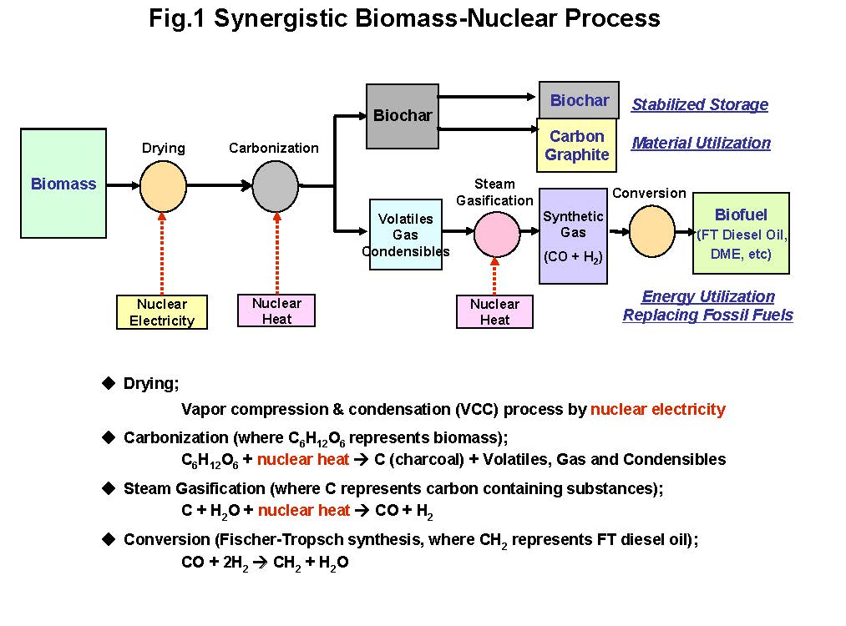
“Nuclear carbonization and gasification of biomass for effective removal of atmospheric CO₂”
M. Hori, Progress in Nuclear Energy 53 (2011) 1022.
M. Hori, Oxford Conference on Negative Emissions Technologies (2013)
2.70 Gton C/yr
6 Gton C/yr
1.74 Gton oil
equivalent/yr
2.16 Gton C/yr
~40% of carbon removal efficiency of decarbonizing electricity by replacing coal with nuclear power
Output of ~900 power plants @ 1000 MWe

Slide 19
Carboneum Interruptum
Biomass becomes a vehicle for carbon capture/removal, rather than a source of fuel. This may change optimal biomass forms/sources/locations.
Carbon-free energy production for carbon-negative processes would be sited based on biomass distribution, rather than population/energy demand distribution.
This represents creation of carbon offsets on a grand scale
Analogous opportunities for decarbonization of other fuels? - e.g. methane to carbon plus hydrogen, instead of gasification

Slide 20
Summary
Because the consequences of carbon emission are completely separate from the source or location of emissions, there is an opportunity to develop mitigation strategies that are not coupled to the source (in addition to those that are connected to sources of particular types.)
Exploration of near- and long-term strategies and development of technologies for removing carbon at significant scales from the global carbon cycle is urgently needed.
Meeting the challenge of reducing the global footprint of past and future GHG emissions requires much more than new technologies for removing carbon from the global cycle. Strongly intertwined are issues and instruments of policy and economics (e.g., carbon pricing or regulation) as well as international diplomacy (developed vs. developing nations’ responsibilities for reducing GHG levels and impacts.)
Decoupling carbon emissions from carbon capture, both spatially and temporally, can introduce a degree of freedom into policy considerations that has largely not been explored.

