Slide 1


Climate Change - risk and opportunity for the insurance industry
Mark Way Head Sustainability Americas Hub
UCSB workshop, February 1st, 2016

Slide 2
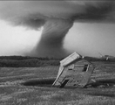
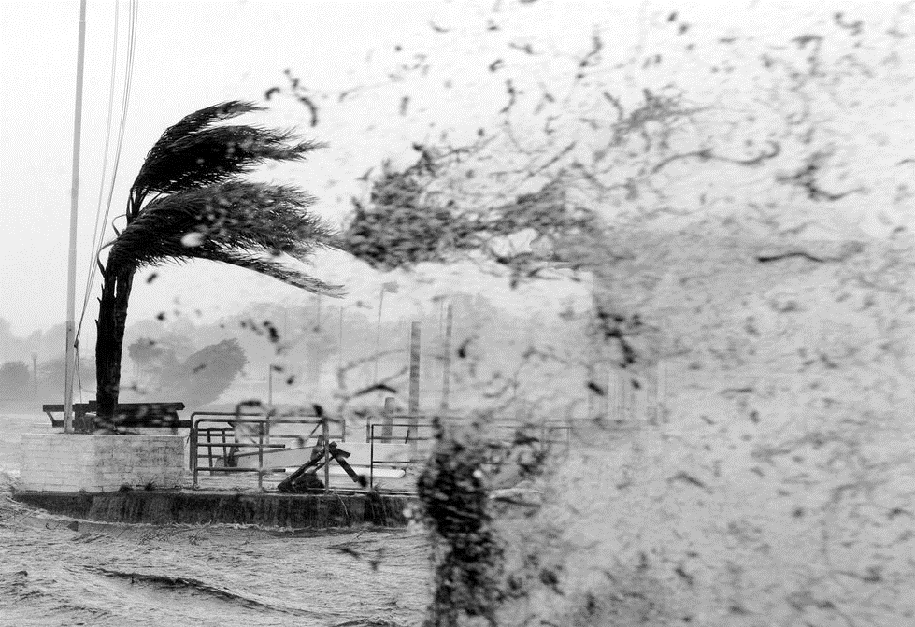


Agenda
UCSB Workshop
Growing losses due to severe weather
The role of insurance
Swiss Re’s approach
The Economics of Climate Adaptation

Slide 3

Swiss Re Group at a glance
Swiss Re is a leading and highly diversified global reinsurer, founded in
Zurich (Switzerland) in 1863
The Group offers traditional reinsurance products and related services for property and casualty, as well as for life and health businesses
The Group also offers commercial insurance through Corporate Solutions and manages closed books of life business via Admin Re®
The financial strength¹ of Swiss Reinsurance Company Ltd is currently rated:
Standard & Poor’s: AA- (stable); Moody’s Aa3 (stable); A.M. Best: A+ (stable)
Swiss Re was named as the insurance sector leader in the 2015 Dow Jones Sustainability Indices
Armonk, New York
Key statistics (USD billions) FY 2011 FY 2012 FY2013 FY2014
Total revenues 28.0 33.6 36.9 37.3
Net income 2.6 4.2 4.4 3.5
Shareholders’ equity 29.6 34.0 33.0 35.9
¹ As at 31 August 2015
Notes:
3

Slide 4
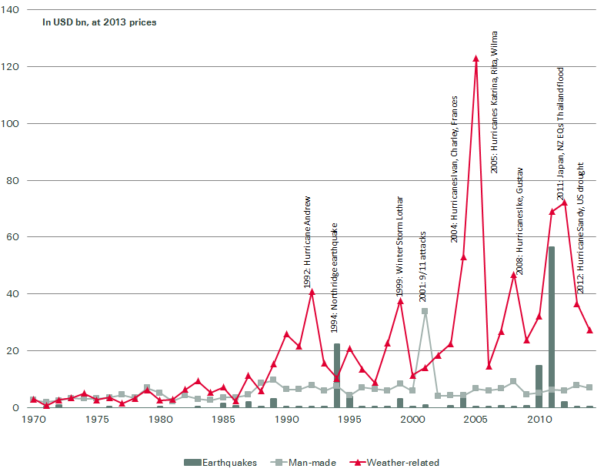
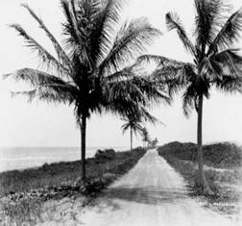
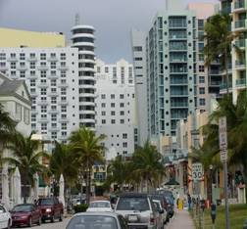
Global Insured Catastrophe Losses
Weather related natural catastrophes are main driver of losses
In USD at 2014 prices
Ocean Drive, FL, 1926
Ocean Drive, FL, 2000
Ocean Drive, FL, 2000
Source: sigma 2/2015
Notes:
2013 ranks:
No.10 in terms of insured losses from both nat cat and man-made
No. 7 in terms of insured losses from man-made only
No. 9 in terms of insured losses from Nat Cat only
No. 8 in terms of insured losses from weather-related only
No. 31 in terms of insured losses from earthquakes only
Relative to GDP and direct non-life premiums written (DPW), the 2013 nat cat losses were 0.05% of GDP and 2.2% of DWP, below the respective 10-y averages of 0.09% and 3.7%.

Slide 5
The growing burden of uninsured losses
Natural catastrophe losses 1970 – 2014 (in 2014 USD)
Source: Swiss Re Economic Research & Consulting and Cat Perils.

Slide 6
Insurance Industry uniquely positioned to help tackle climate change
Insurance can help contain severe weather impacts
  Protecting economies against the financial costs of climate-related disasters (adaptation)
Insurance can help to reduce global warming
  Unlocking critical investments in renewable energy and the low-carbon economy (mitigation)
New role as institutional investor?
  Financer of the transition to the low carbon and resilient economy?
The insurance industry has a central role to play because no other industry can identify, assess, quantify, price and transfer risk to the degree insurers can. These skills are essential if we are to successfully manage climate risk.

Slide 7

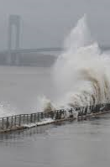
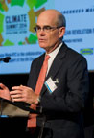
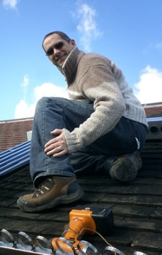
Linked to Business:
Swiss Re's 4 Pillar climate change strategy
Risk intelligence – assess the risk
Business solutions – seize opportunities
Advance (our) knowledge about climate change risk
Quantify climate change risk → Economics of Climate Adaptation (ECA)
Integrate climate change risk into underwriting and risk management
Collaborate with leading institutions
→ New Climate Economy (NCE)
Develop appropriate solutions for adapting to and mitigating climate risk
Traditional catastrophe insurance, weather risk solutions, renewable energy solutions
We promote risk transfer as a way of becoming more resilient
Risk dialogue – advocacy
Our footprint - lead by example
Raise awareness, actively disseminate knowledge to all stakeholders and advocate a long-term, marked-based policy framework, through
Publications, platforms (e.g. World Economic Forum), Centre for Global Dialogue, speaking engagements
Top Topic Managing climate and natural disaster risk
Greenhouse neutral since October 2003,
Reduced emissions per employee by around 50% by 2013
CO_{You2} Programme since 2006,
re-launched Jan 2014 (to 2020)
Notes:
Swiss Re was one of the first organizations to realize the potential impact of climate change. For more than two decades, we have been an acknowledged thought leader on the topic and have developed some path-breaking initiatives. With two of our Top Topics – “Advancing sustainable energy solutions” (→ climate mitigation) and “Managing climate and natural disaster risk” (→ climate adaptation) – focusing on different aspects of climate change, we continue to take this challenge very seriously.
Mirroring this, we have a specific strategy for tackling climate change that rests on four pillars:
Business solutions: Developing products and services to mitigate and adapt to climate risk
Risk intelligence: Advancing our knowledge and understanding of climate change risks, quantifying and integrating them into our risk management and underwriting frameworks where relevant → Economics of Climate Adaptation (ECA)
Risk dialogue: Raising awareness about climate change risks through dialogue with clients, employees and the public, and advocacy of a worldwide policy framework for climate change
Our footprint: Tackling our own carbon footprint and ensuring transparent, annual emissions reporting

Slide 8
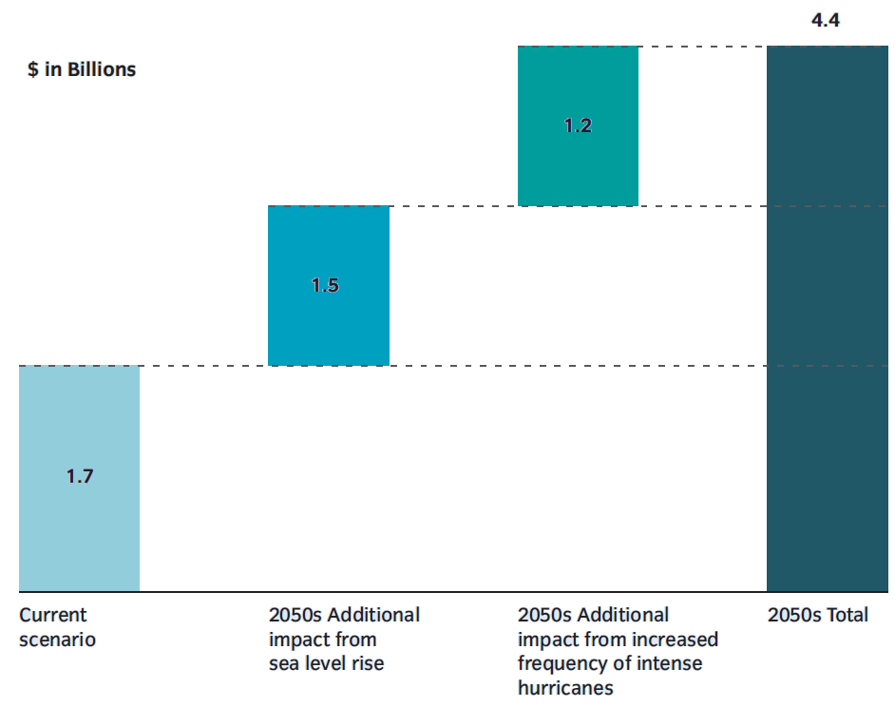
Business Solutions: Swiss Re's Collaboration With NYC
Sea level rise & altered hurricane frequencies significantly increase losses
Expected annual losses
from storm surge and wind
(billion USD)
+ 70%
+ 168%
+ 88%
Source: www.nyc.gov: A Stronger More Resilient New York
8

Slide 9
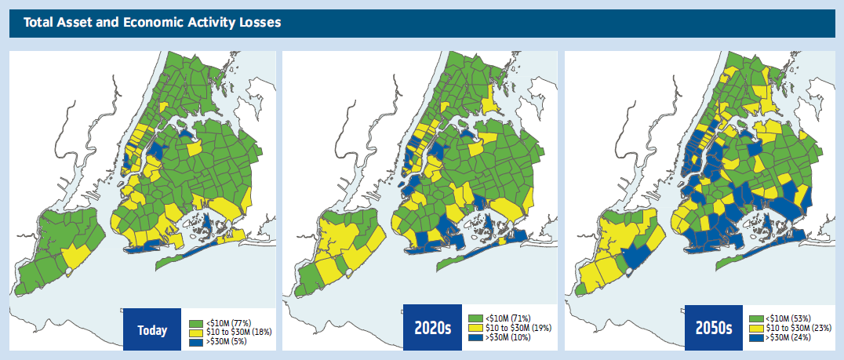
Swiss Re's Collaboration With New York City
Annual Expected Loss by Zip Code
Source: A Stronger, More Resilient New York
Under 2050's scenario: 400% increase in ZIP codes which have an annual expected loss of USD 30 million

Slide 10
Locally specific adaptation cost / benefit curve
Example Florida
Notes:
The cost curve shows that Florida could offset close to half of its annual expected loss under the climate change scenarios through measures that have net economic benefits. Nonetheless, the cost curve also demonstrates a significant proportion of the loss – some 40 percent of it – is unlikely averted.

Slide 11
Business Solutions: Climate Change Risk Management
Risk is best dealt with via a portfolio of adaptation measures
High
List of potential measures to reduce hurricane damage
1
Sand bags
Opening/ masonry
Temporary floodwall
Levee and floodwall
Targeted hardening (utilities)
Home elevation
Local levees
Road elevation
Roof (various)
Beach nourishment
Vegetation management
Financial risk transfer
Undergrounding (utilities)
Substation backup
2
12
3
9
4
4
5
2
6
13
7
Severity of hazard
6
5
8
14
9
7
10
10
11
11
3
12
1
13
8
14
Low
<=Once every 50 years
Once every 10-25 years
Once every 10 or fewer years
Frequency of hazard
Example Florida
Source: Team analysis

Slide 12
Thank You!

Slide 14
Legal notice
©2016 Swiss Re. All rights reserved. You are not permitted to create any modifications
or derivative works of this presentation or to use it for commercial or other public purposes
without the prior written permission of Swiss Re.
The information and opinions contained in the presentation are provided as at the date of
the presentation and are subject to change without notice. Although the information used
was taken from reliable sources, Swiss Re does not accept any responsibility for the accuracy
or comprehensiveness of the details given. All liability for the accuracy and completeness
thereof or for any damage or loss resulting from the use of the information contained in this
presentation is expressly excluded. Under no circumstances shall Swiss Re or its Group
companies be liable for any financial or consequential loss relating to this presentation.

