Slide 1
Possibilities and Challenges for Next Generation Nuclear Reactors
Mikael Nilsson
Chemical Engineering and Material Science
University of California Irvine
TeraWatts, TeraGrams, TeraLiters 2016
Workshop on Challenges and Opportunities for Future Sustainable Production of Chemicals and Fuels.
February 1, 2016, Santa Barbara

Slide 2
Nuclear Energy
60+ years of commercial power production.
~11% of world electricity supply.
40% of clean energy
Capable of base-load power 24/7.
High grid stability and high capacity
No CO₂ emission during operation of the plant.

Slide 3
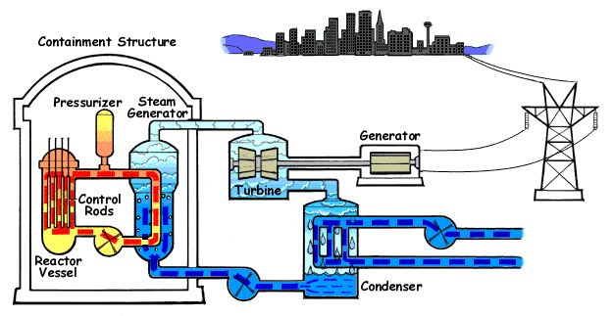
Principle of Nuclear Power

Slide 4
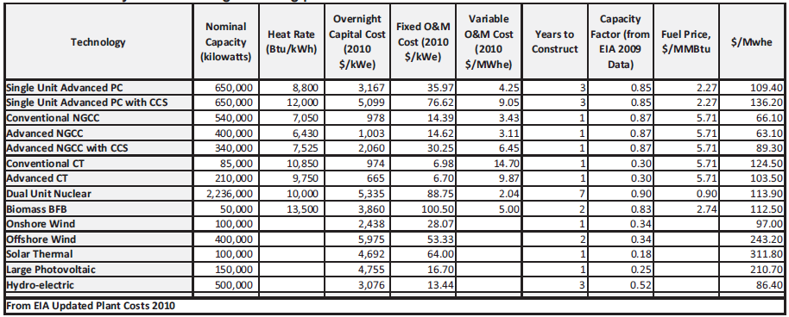
Cost Estimates
How does nuclear compare with other power sources.

Slide 5
Cost Estimates
Technology | Overnight capital cost ($/kWe) | Electricity cost ($/Mwh) | Capital cost recovery (cent/kWh) | Electricity cost ($/Mwh)
Adv. Pulverized Coal | 3,167 | 109.4 | 2.8 | 56
Natural Gas Combine Cycle | 1,003 | 63.1 | 1.0 | 48
On-shore wind farm | 2,438 | 97.0 | 17.4 | 184
Solar (Photovoltaic) | 4,755 | 210.70 | 22.5 | 235
Biomass | 3,860 | 112.50 | 4.0 | 97
Advanced Nuclear | 5,335 | 113.90 | 2.0 | 30
Source | US EIA (2010) |  | R. Hargraves (2012)

Slide 6
Challenges For Current Nuclear Power Industry
High cost
Long time to deployment
Public Perception unfavorable
Conservative industry
Innovations
Regulations

Slide 7
History of Nuclear Reactors

Slide 8
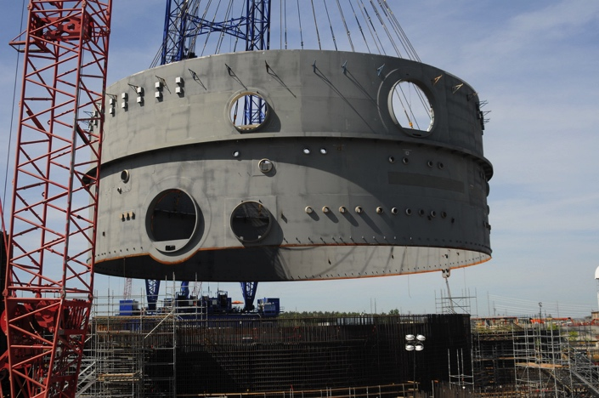
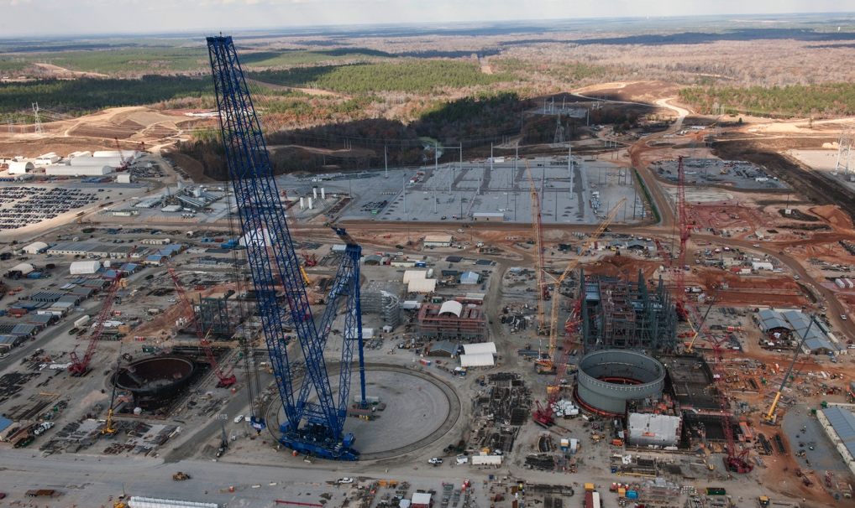
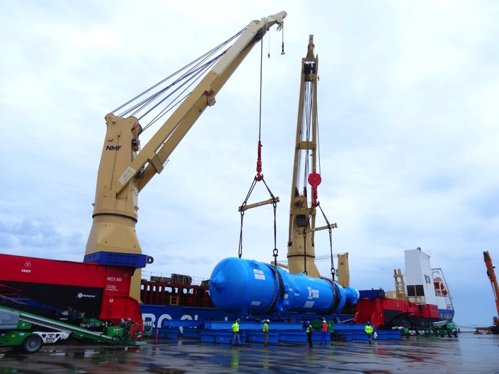
Vogtle, AP-1000

Slide 9
Small Modular Reactors
Among the Gen3+ and Gen4 reactors are smaller reactors that can be constructed in conventional factories and transported in modules.
Several companies have proposed designs of a variety of different reactors.
Smaller reactors may allow for using nuclear for both base load and peak power.
Modular concept may open up for mass production to push costs down.

Slide 10
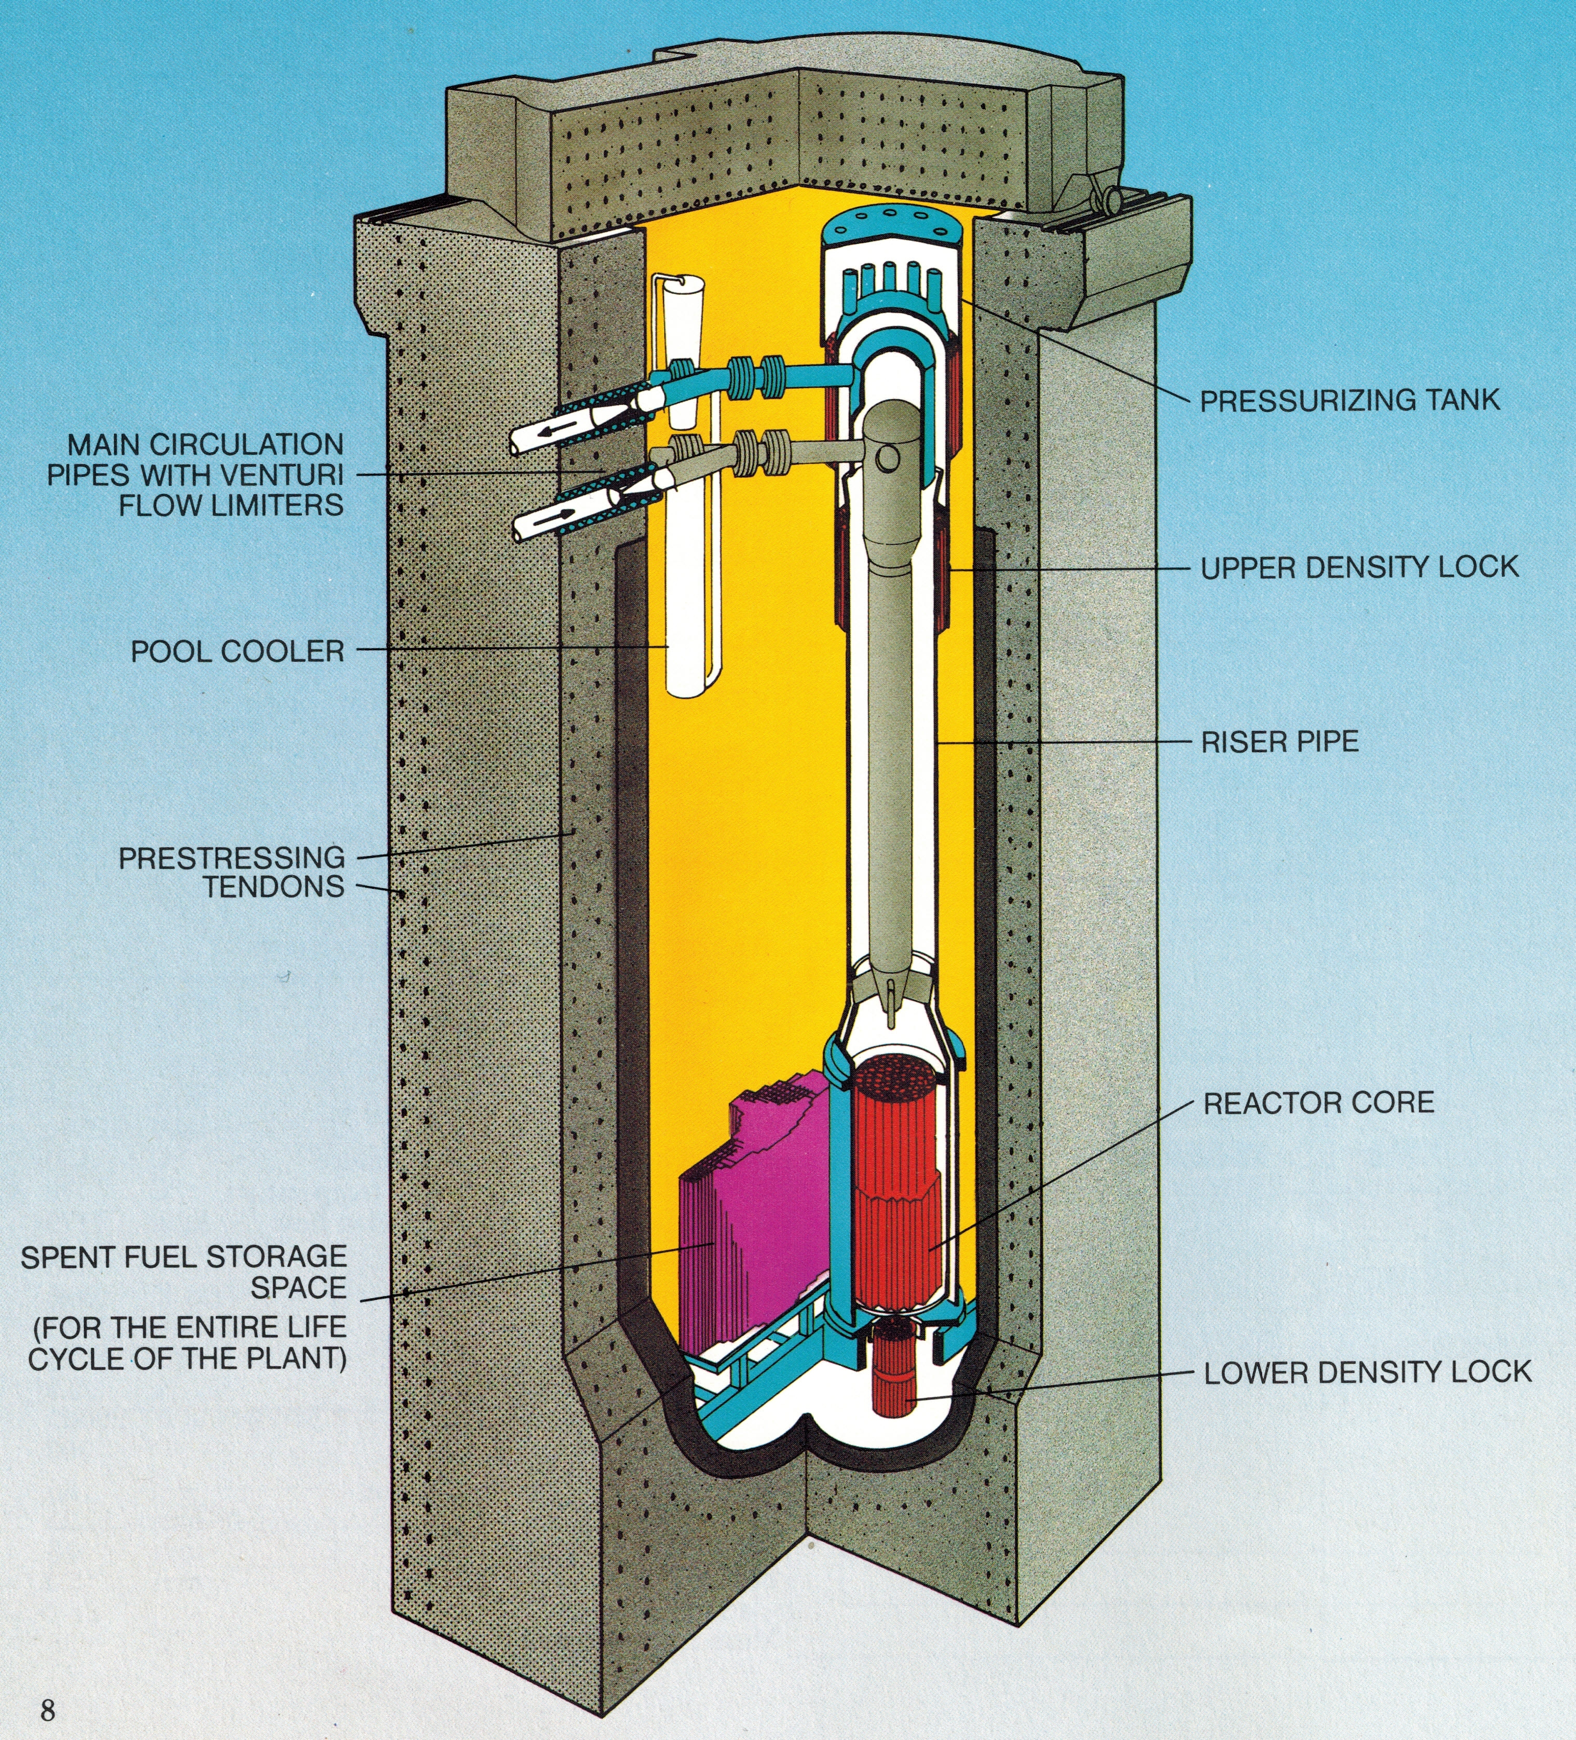
Secure H (Asea-Atom 70s-80s)

Slide 11
Cogeneration
Using a nuclear reactor to produce only electricity, or only heat may not be the most economical alternative.
With abundant heat and power we can produce other chemicals.
With the radiation and neutrons we can produce high value chemicals.
Cogeneration may make it easier to follow demand for electricity.

Slide 12
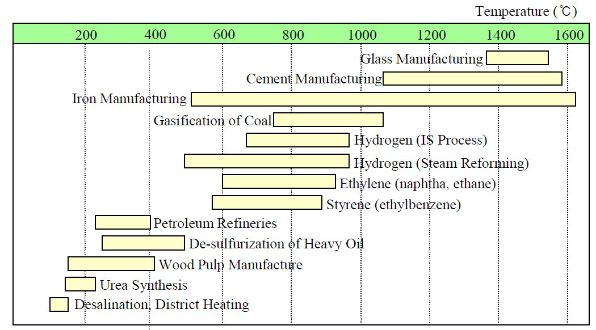
Cogeneration

Slide 13
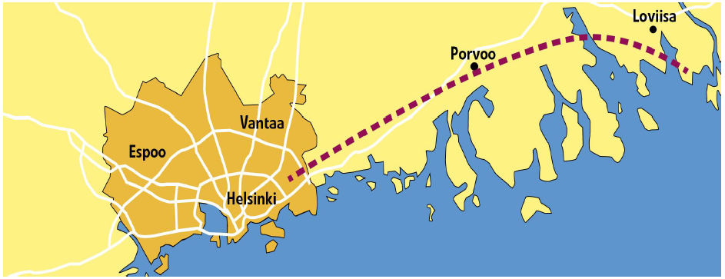
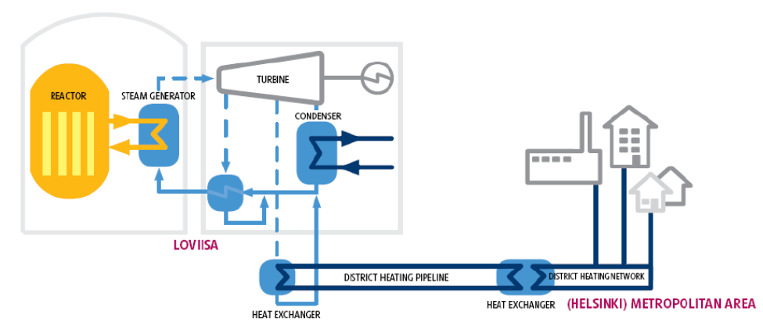
District Heating

Slide 14
Basis of the Loviisa 3 CHP option
Replacement of heat generated with fossil fuels
Thermal energy consumption (district heat) 11 - 12 TWh per year.
Large reduction of carbon dioxide emissions
Up to 4 million tons annually (6 % of the entire CO2 emissions in Finland).
Higher plant efficiency
Reduction of heat discharge to the Gulf of Finland.

Slide 15
Desalination
Using waste heat (220MW_{th} at 70 °C) with MED desalination could produce 15,000 to 30,000 m³ of desalinated water/day.
Cogeneration of 90% electricity + 10% water could produce 130,000 m³/day and increase revenue by 7% or more.
What are we willing to pay for water?

Slide 16
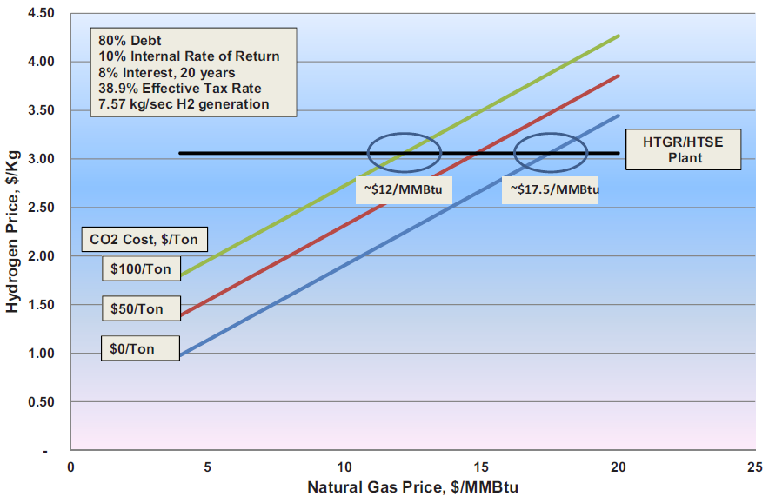
Hydrogen Production

Slide 17
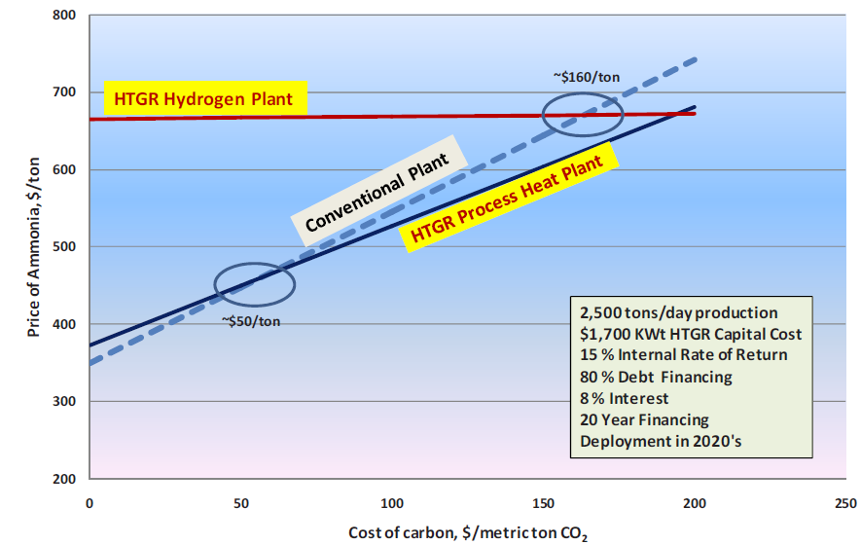
Ammonia Production

Slide 18
Public Perception
Nuclear power has a bad name in the eyes of the general public.
Organizations and activists often vilify the industry.
Regulators and proponents of the LNT theory also hurt the industry and nuclear science field in general.
Often, people living close to nuclear industry are quite happy.

Slide 19
Nuclear Energy Institute (NEI) Surveys
Biennial surveys of plant neighbors: within 10-mile radius of all U.S. nuclear power plant sites, 18 per site, sample over 1,000.
Spring and Fall surveys of general public:1,000 nationally representative U.S. adults.
All phone interviews, landline and cell, by Bisconti Research, Inc. with Quest Global Research.
6th Biennial National Survey of U.S. Nuclear Power Plant Neighbors 2015

Slide 20
Plant Neighbors More Favorable to Nuclear Energy than the General Public
Overall, do you strongly favor, somewhat favor, somewhat oppose, or strongly oppose the use of nuclear energy as one of the ways to provide electricity in the United States? (%)
83
68
Strongly favor
Somewhat favor
Somewhat oppose
Strongly oppose
16
30
6th Biennial National Survey of U.S. Nuclear Power Plant Neighbors 2015

Slide 21
Few Feel Very Well Informed About Nuclear Energy
Do you feel very well informed, somewhat well informed, not too well informed, or not well informed at all about nuclear energy used to produce electricity? (%)
Bisconti Research, Inc. with Quest Global Research, national public opinion, February-March 2015

Slide 22
The More People Feel Informed about Nuclear Energy, the More They Favor
Bisconti Research, Inc. with Quest Global Research, national public opinion, February-March 2015

Slide 23
Top Low-Carbon Energy Source
Of these low-carbon energy sources, which one provides the most electricity in the United States today?
70% unaware that nuclear energy is top source by far
70
Bisconti Research, Inc. with Quest Global Research, national public opinion, September 2015

Slide 24
Impact of Knowing the Facts
Actually, in 2014 nuclear energy produced 63% of low-carbon electricity in the United States. Hydro produced 20%, wind produced 14%, and solar produced one and a half a percent. Given the Environmental Protection Agency’s new plan to reduce carbon emissions from electricity generation and the fact that nuclear energy is the largest clean air electricity source, do you think nuclear energy should be…
Bisconti Research, Inc. with Quest Global Research, national public opinion, September 2015

Slide 25
Impact of Knowing the Facts
Actually, in 2014 nuclear energy produced 63% of low-carbon electricity in the United States. Hydro produced 20%, wind produced 14%, and solar produced one and a half a percent. Given the Environmental Protection Agency’s new plan to reduce carbon emissions from electricity generation and the fact that nuclear energy is the largest clean air electricity source, do you think nuclear energy should be…
84
Includes 62% of those initially opposed to nuclear energy and 43% of those initially strongly opposed to nuclear energy.
14
Bisconti Research, Inc. with Quest Global Research, national public opinion, September 2015

Slide 26
Summary
Nuclear Power has untapped potential for solving many of the challenges ahead related to power supply and, to some degree, supply of chemicals and water.
New designs and technology improve safety and efficiency.
Small reactors may provide a faster route to deploying nuclear power.
Cogeneration of high value products can improve the economics of nuclear power.
The public perception can be changed but require campaigns to educate and inform the general public.

Slide 27
Thank you

Slide 28
Sources
U.S. Energy Information Administration, 2010, Updated Capital Cost Estimates for Electricity Generating Plants
R. Hargraves, 2012, Thorium: Energy Cheaper than Coal
INL/EXT-10-19037, High Temperature Gas-Cooled Reactor Projected Markets and Preliminary Economics
NEA-OECD, Non-Electricity Products of Nuclear Energy
Bisconti Research, NEI, New View of Nuclear Energy
Fortum, Nuclear Industry in Finland
Joint NEA/IAEA Expert Workshop on the Technical and Economic Assessment of Non-Electric Applications of Nuclear Energy (NUCOGEN), Paris, France, 4-5 April, 2013
https://www.oecd-nea.org/ndd/workshops/nucogen/presentations/

