Slide 1
Unconventional Routes to Conventional Chemicals
Thomas F. Jaramillo
Dept. of Chemical Engineering
SUNCAT Center for Interfacial Science & Catalysis
Stanford University
February 1, 2016
TeraWatts, TeraGrams, TeraLiters 2016
Workshop on Challenges and Opportunities for Future Sustainable Production of Chemicals and Fuels
Santa Barbara, CA

Slide 2
Some thoughts on global energy
Major action will be needed to keep global temperature increases to 2 °C or less (COP21 Agreement).
  Long-term:
    Need 80-100 % of energy from renewable / CO₂-free sources.
  Short-term:
    Need to use conventional energy more intelligently.
    Improved energy efficiency
    Natural gas and/or nuclear
Technological innovation is the ultimate key to making this happen. Policy and finance are absolutely crucial.
Q: Which technologies? A: ‘All of the above’.
  Each plays its role.
  Some technologies are on the right track, but more need to be developed to get onto the right track.
  If the right mix of ~ 12-15 technologies can contribute 1-10 % each to global energy, we can replace fossil fuels entirely.
Efficient, sustainable chemical transformations are essential.
Well-designed and executed systems integration will be just as important as the energy technologies themselves.

Slide 3
Key Points from
ExxonMobil’s Outlook for 2040
(updated January 2016)

Slide 4
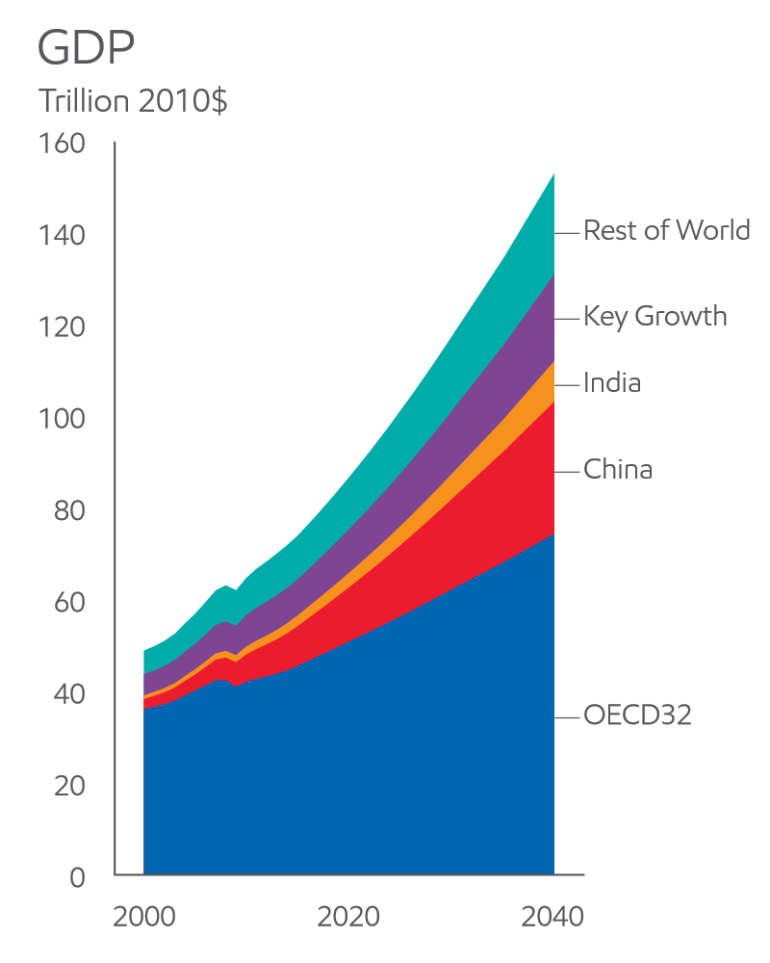
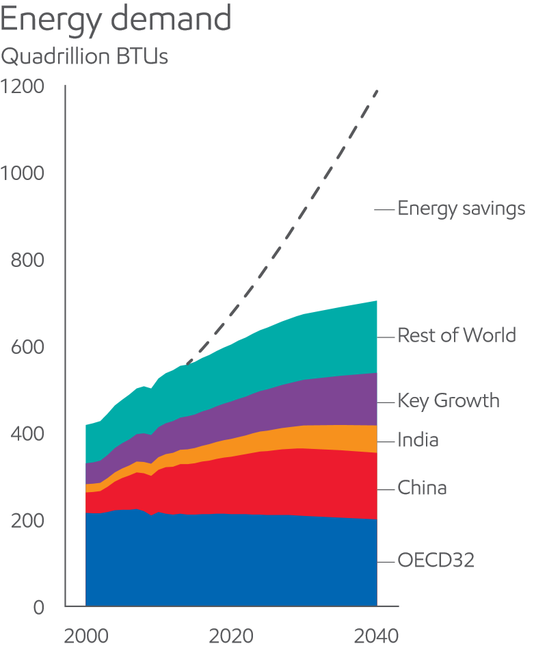
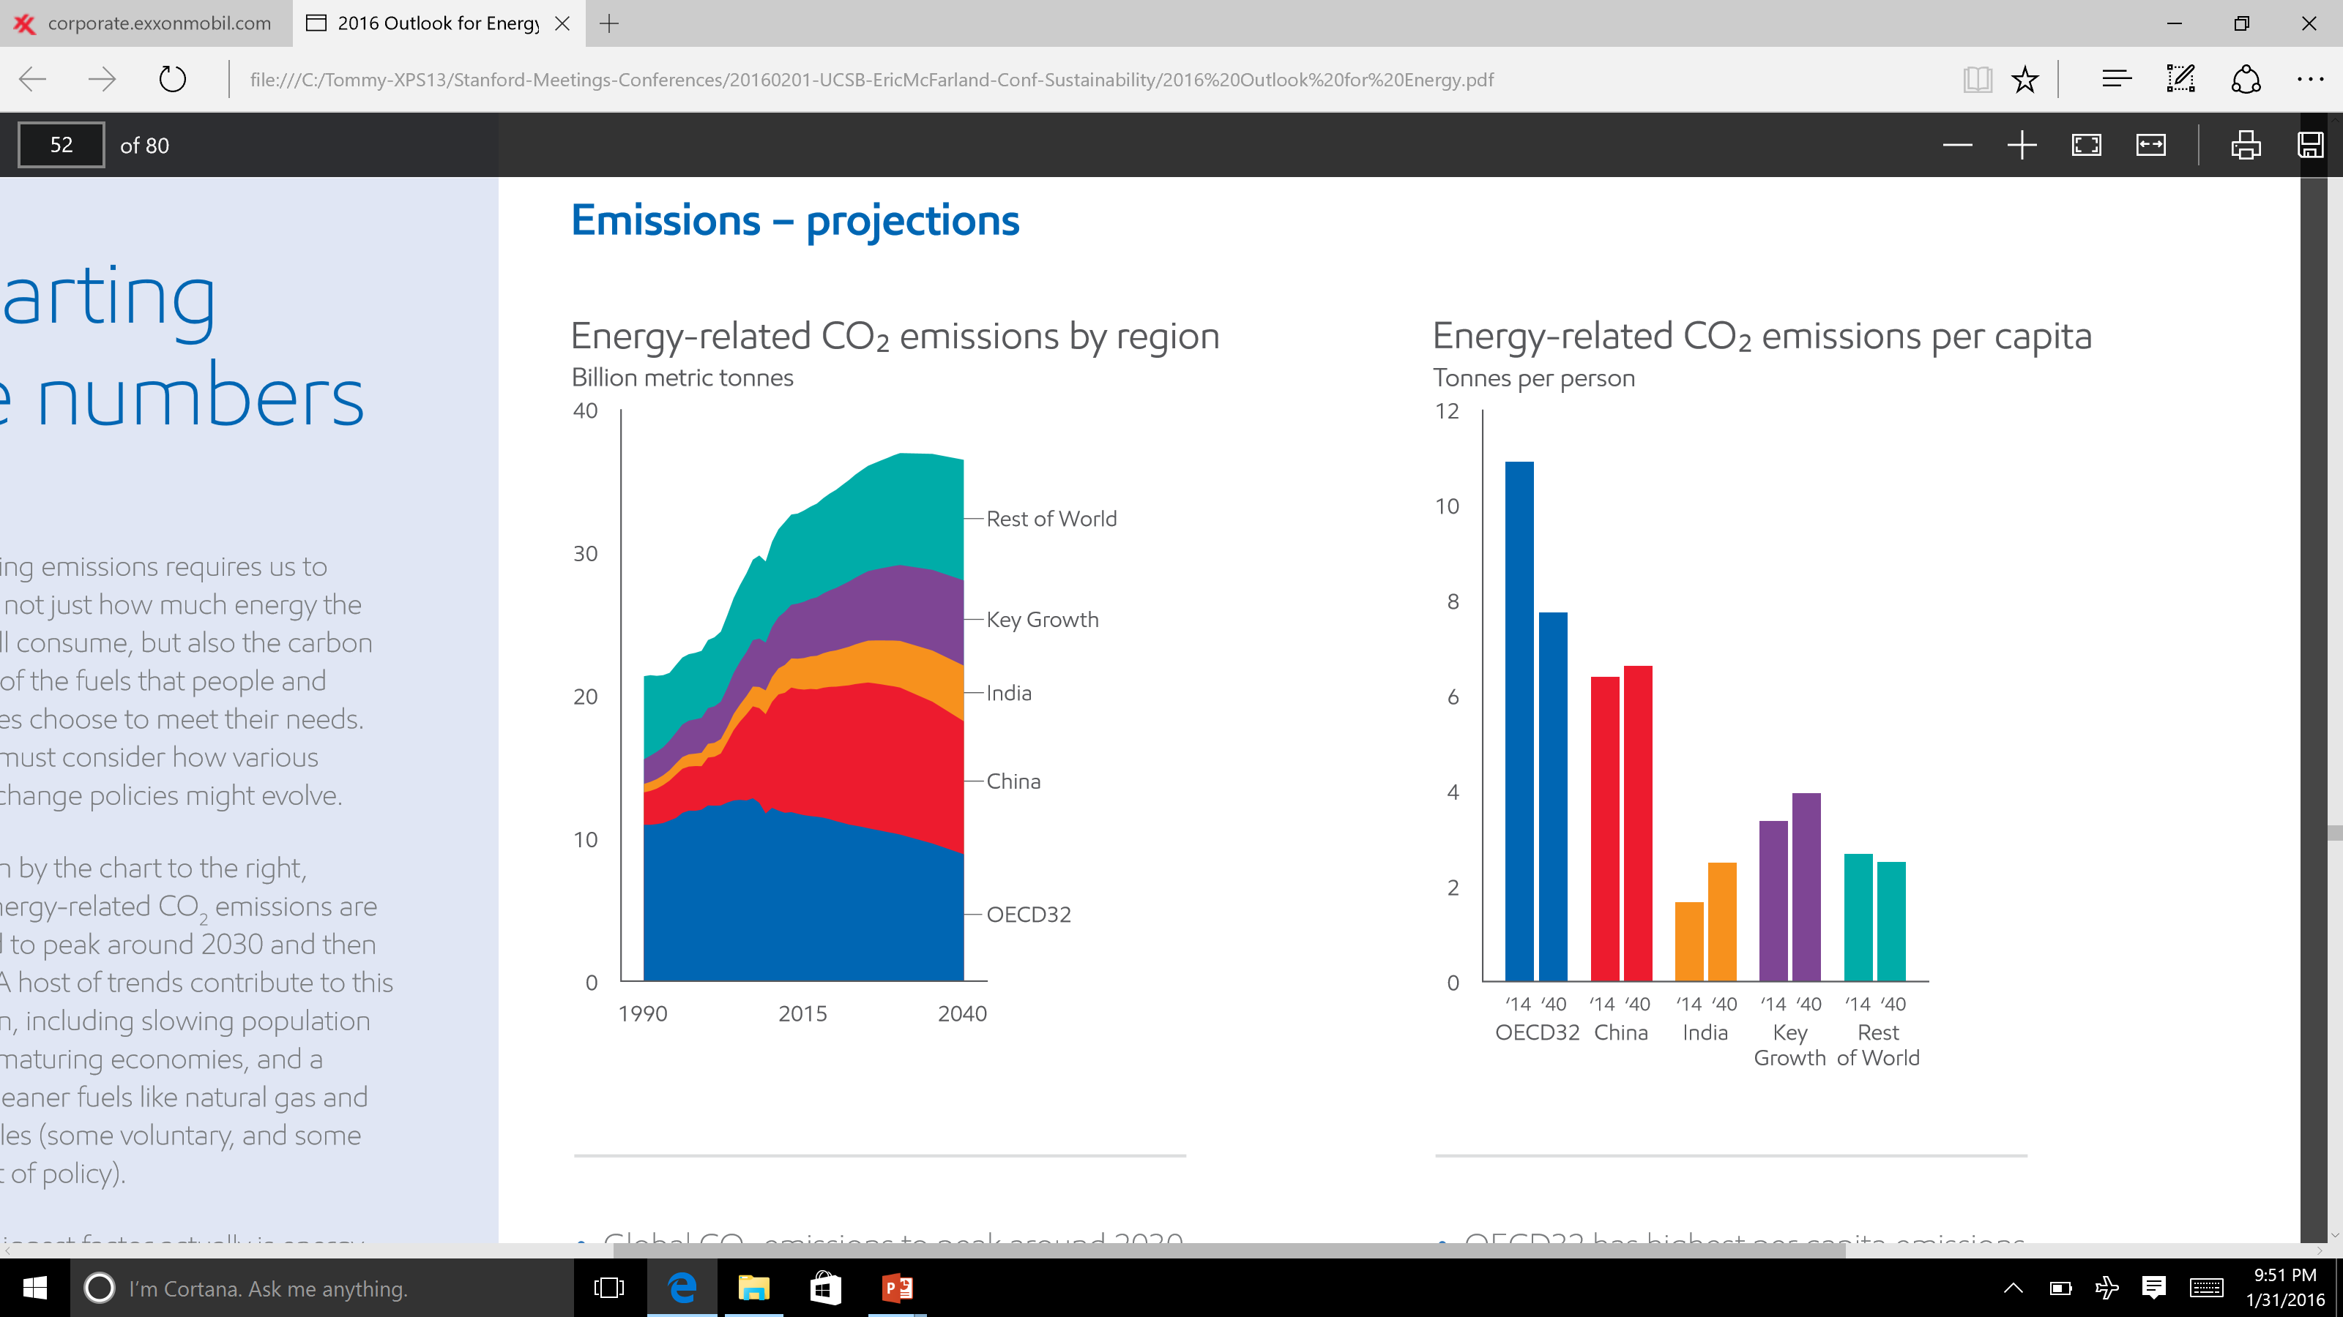
Global Projections: GDP, energy, CO₂ emissions
Global GDP doubles between 2014-2040
Global energy demand increases by 25% between 2014-2040
Global CO₂ emissions to peak around 2030, then decline
23 TW
“The Outlook for Energy: A View to 2040” by ExxonMobil (2016).

Slide 5
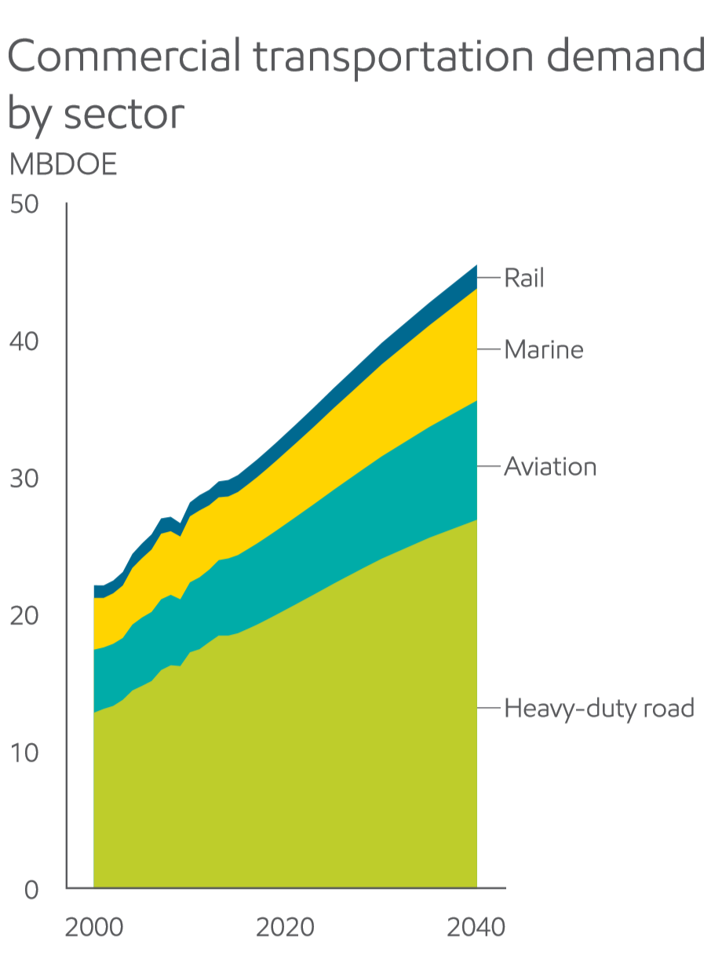
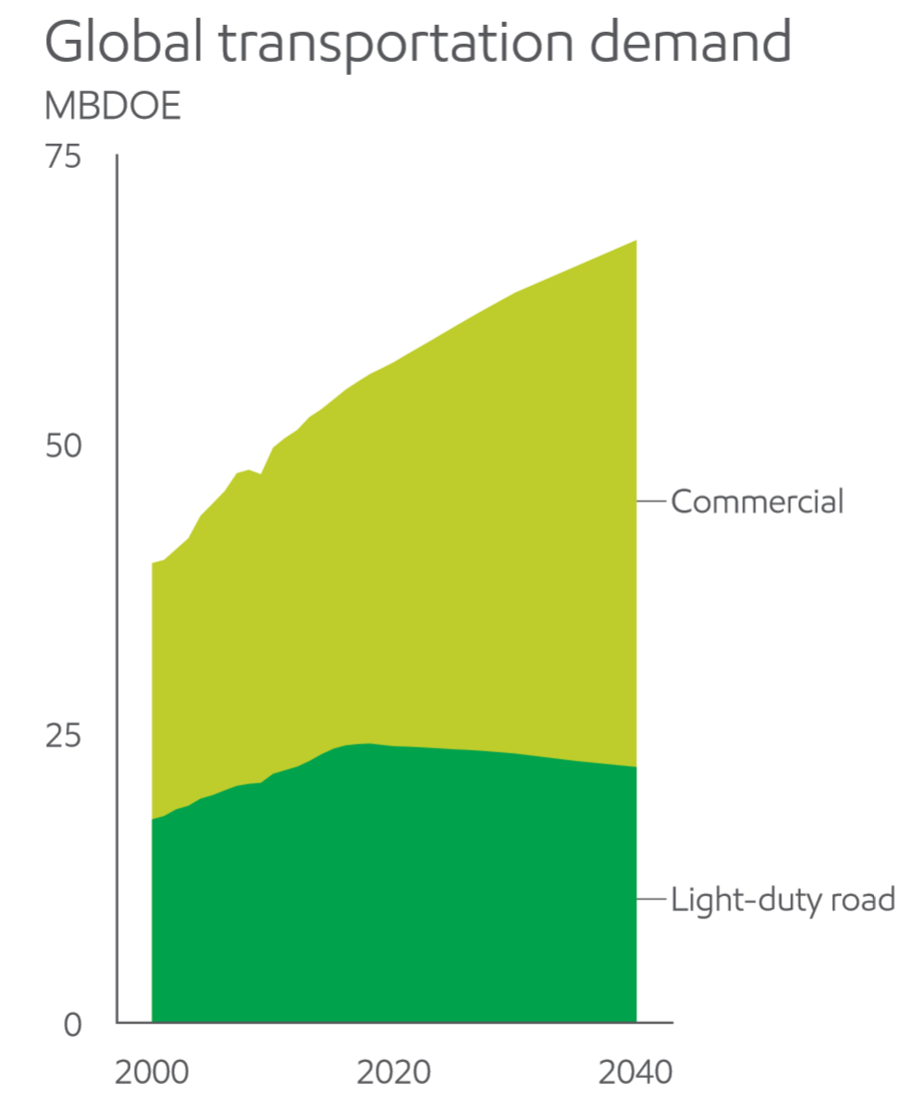
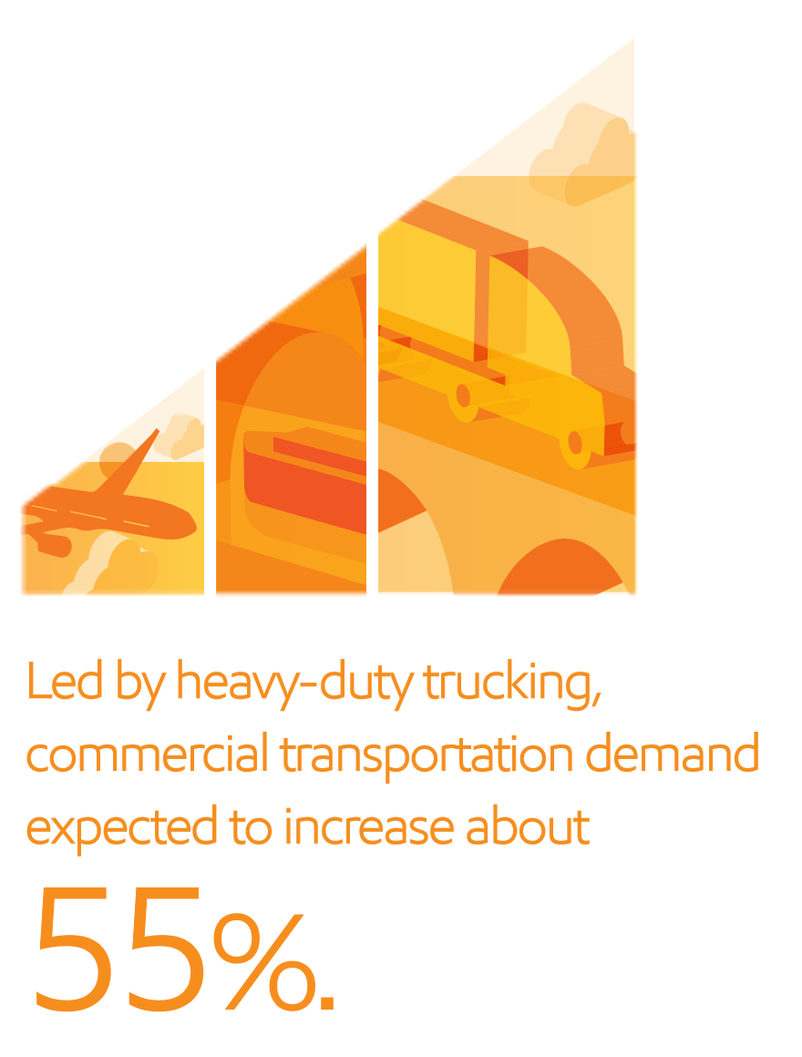
The future of transportation
Global energy demand for transportation to rise by about 30 percent 2014-2040
Trade, economic growth spur close to 55 % increase in commercial transport needs
3.5 TW
For the bulk of transportation in 2040, chemical fuels will be needed.
“The Outlook for Energy: A View to 2040” by ExxonMobil (2016).

Slide 6
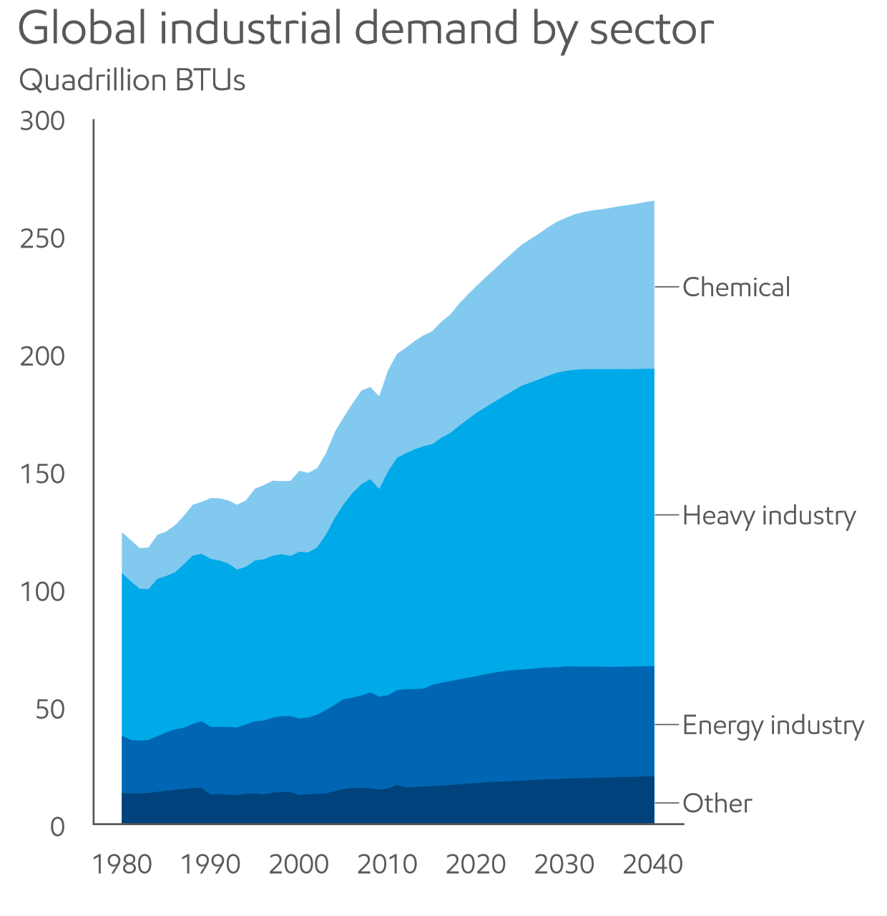
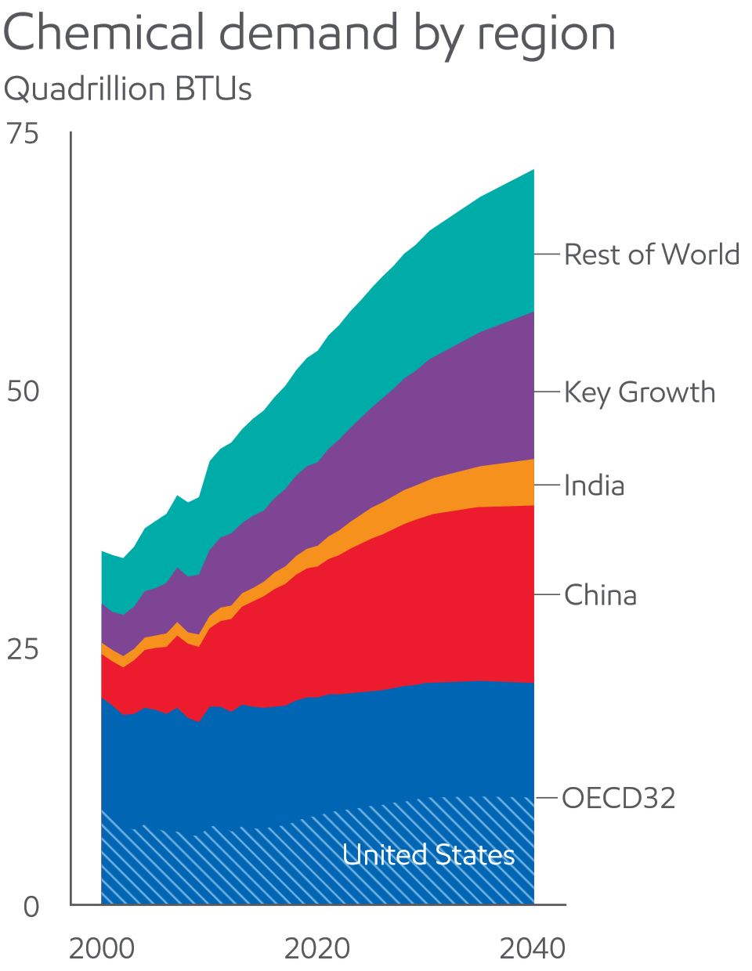
The future of the chemical industry
Industrial activity expands to serve non-OECD growth
Chemicals is one of the fastest-growing energy-demand sectors
2.5 TW
The chemical industry will demand ~ 2.5 TW, more efficient, sustainable processes are needed.
“The Outlook for Energy: A View to 2040” by ExxonMobil (2016).

Slide 7
A look at the U.S. Chemical Industry

Slide 8
U.S. Chemical Sector
  Over 70,000 chemicals are produced in the USA.
  The business of chemistry supports 25% of the U.S. GDP.
  It is the largest U.S. exporting sector, contributing 12% of all exports.
  The U.S. chemical sector accounts for 15% of the world’s chemical production.
  The value of chemical goods produced in the United States in 2010 totaled $701 billion and weighed 1.2 billion tons.

Slide 9
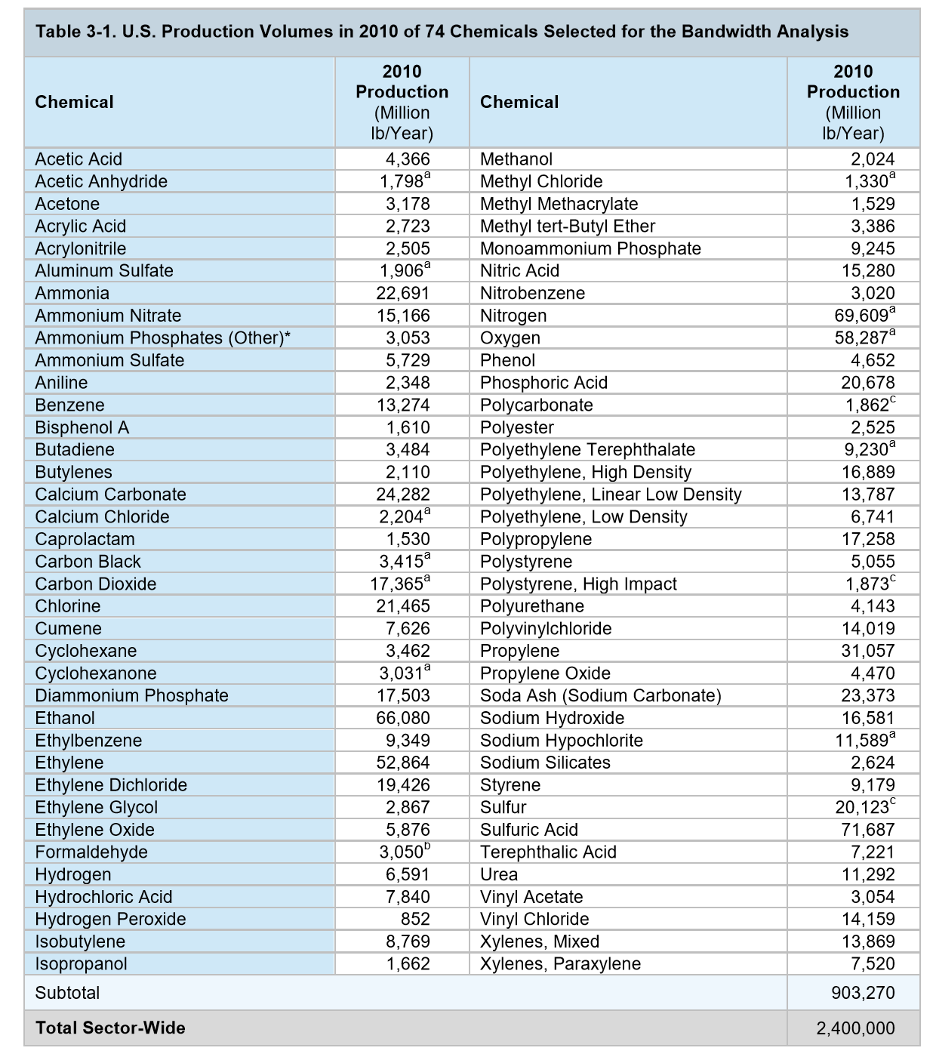
Examples of US Chemical Production
Bandwidth Study on Energy Use and Potential Energy Saving Opportunities in U.S. Chemical Manufacturing, U.S. DOE EERE (June 2015).

Slide 10
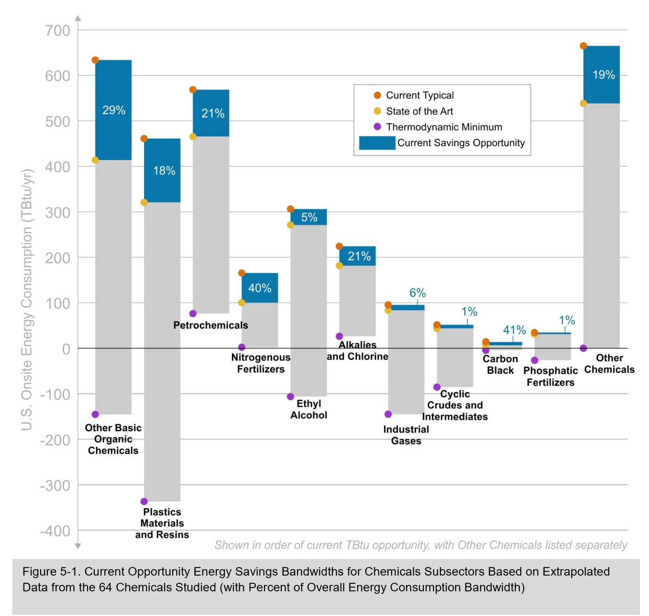
Overall chemical production is exothermic
For these chemicals:
3.2 quads was input
Thermodynamically, it could have been:
0.8 quads output
New processes are needed!
Bandwidth Study on Energy Use and Potential Energy Saving Opportunities in U.S. Chemical Manufacturing, U.S. DOE EERE (June 2015).

Slide 11
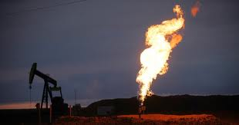
The need for a new chemistry
Current technology is extremely wasteful
Subsector | Quantity produced ton product per year | Product Value US $ per kg | E-factor (kg waste/kg product)
Oil Refining | 10⁶ – 10⁸ | <5 | < 0.1
Bulk Chemicals | 10⁴ – 10⁶ | 1-10 | < 1 to 5
Fine Chemicals | 10² – 10⁴ | 10 – 10³ | 5 to > 50
Pharmaceuticals | 10 -10³ | 10² - 10⁶ | 25 to100
Sheldon, Chemtech, March 1994, p38

Slide 12
A vision for the future:
A more integrated approach

Slide 13
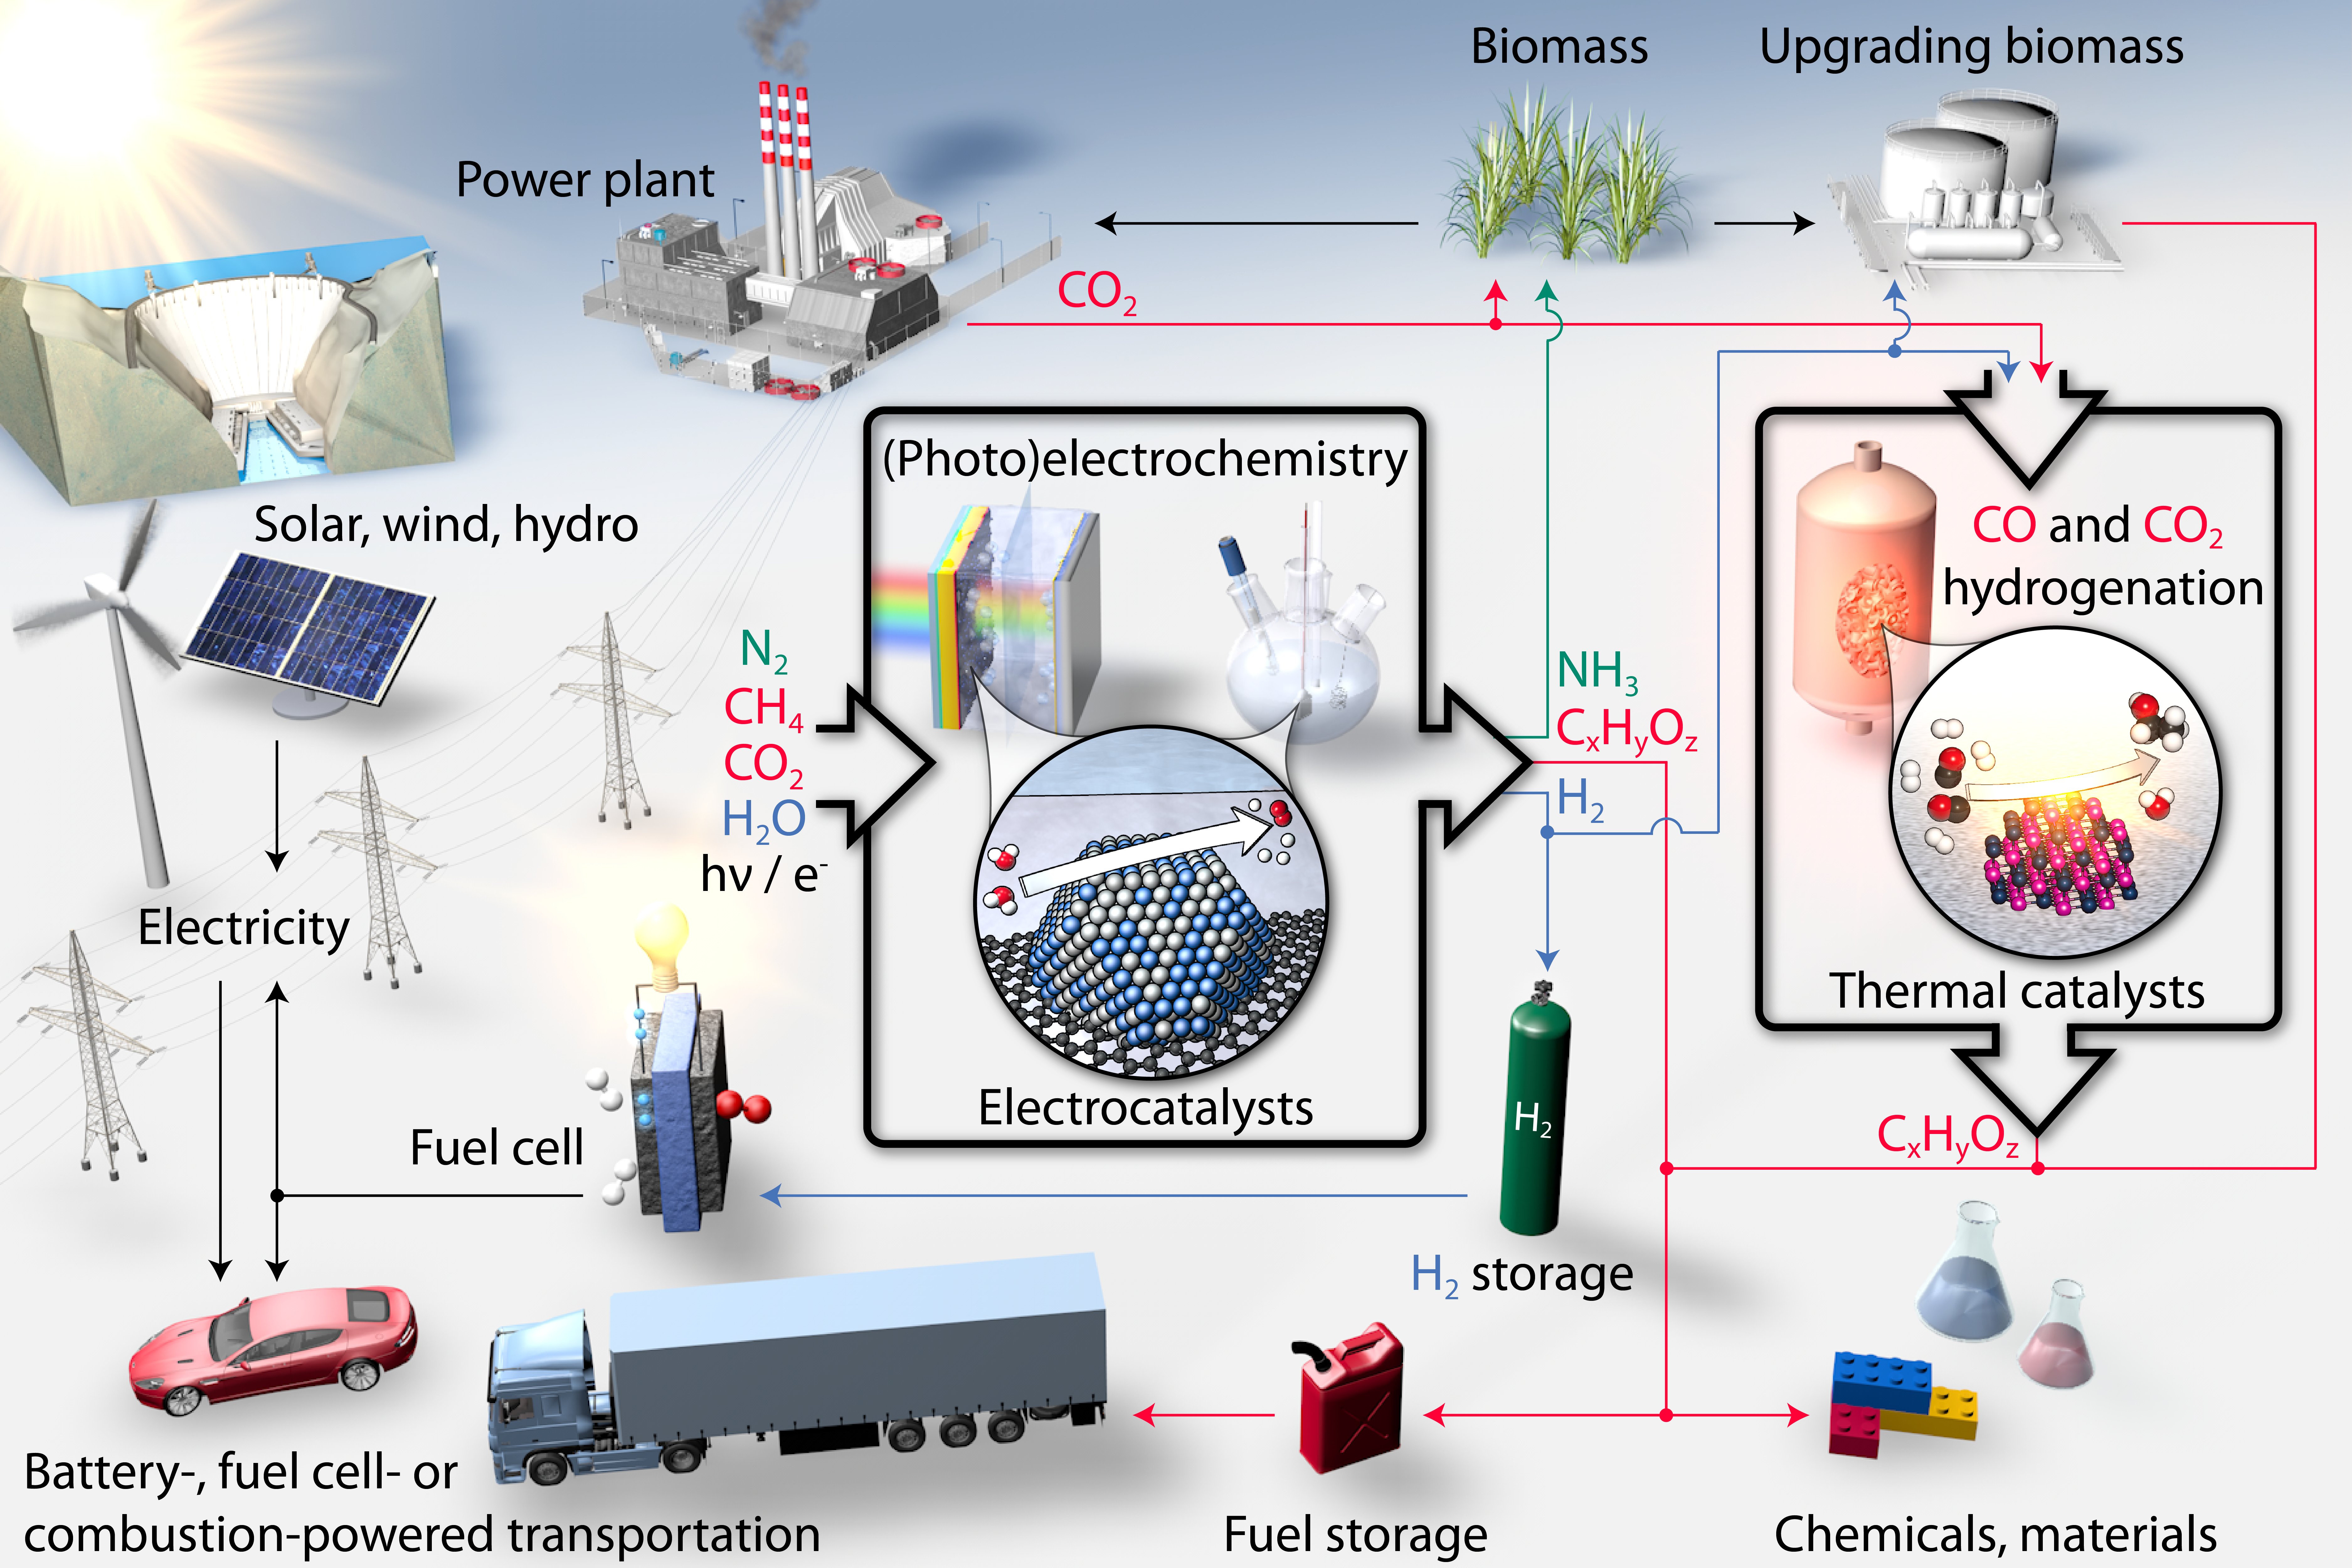

Slide 14
An example:
An unconventional approach to
fertilizer production

Slide 15

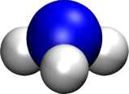
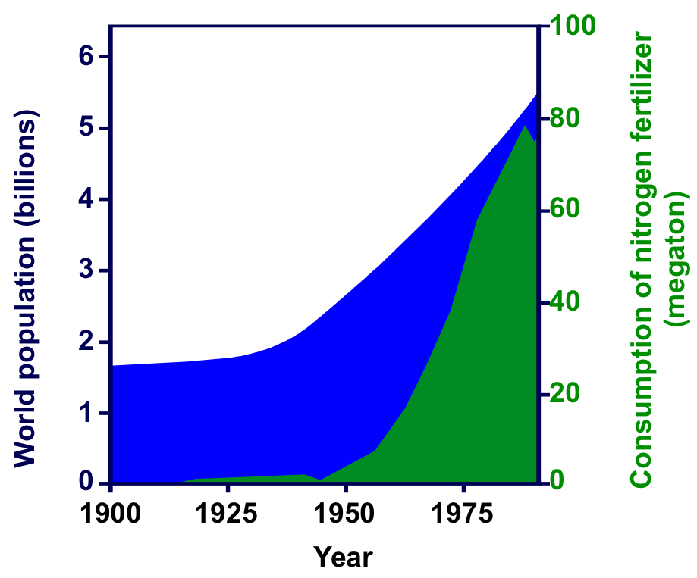

Ammonia Synthesis
“Most important discovery in 20th century”
Smil, Nature 400, 415 (1999)
Industrial production
Haber-Bosch process
N₂
+
3H₂
2NH₃
1-2% of all energy use in world
3-5% of global natural gas supply
SUNCAT Center for Interface Science and Catalysis
Stanford University and SLAC National Accelerator Laboratory

Slide 16
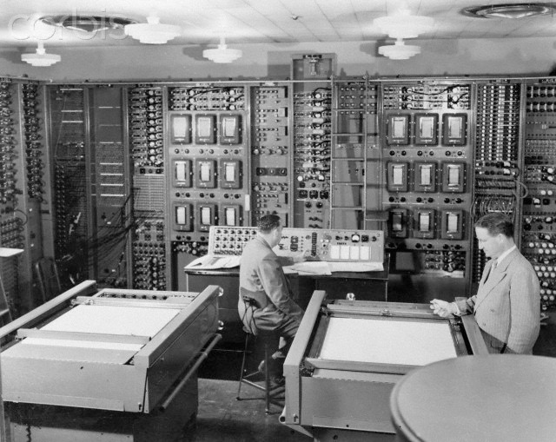


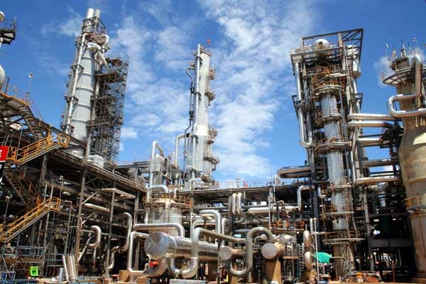
The need for a new chemistry
Decentralized production
→
→ ?
SUNCAT Center for Interface Science and Catalysis
Stanford University and SLAC National Accelerator Laboratory

Slide 17
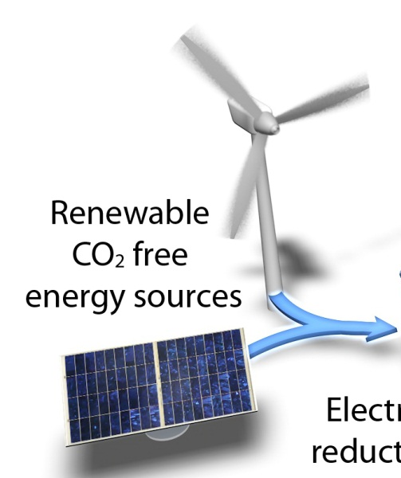
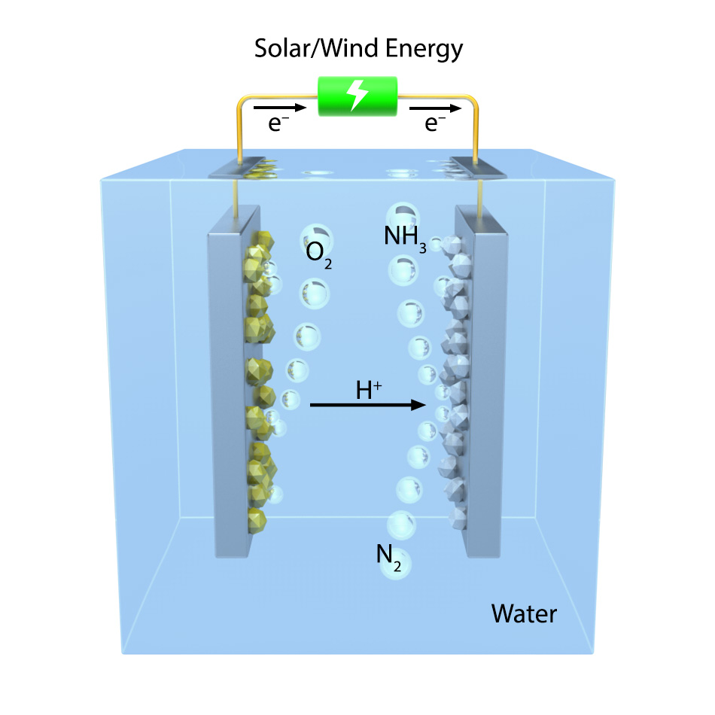
Sustainable Nitrogen Reduction
Biomimetic ammonia synthesis for fertilizers
SUNCAT Center for Interface Science and Catalysis
Stanford University and SLAC National Accelerator Laboratory

Slide 18

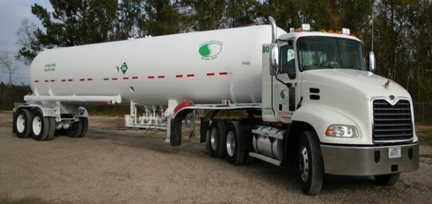
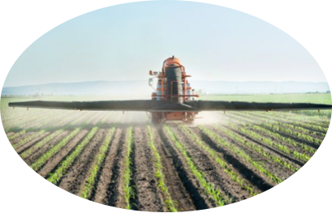

Today’s Technology
5 nm
>50%
<50%
Haber Bosch Process
N₂+3H₂ → 2NH₃
100-150 bar
700-800K
H₂ from natural gas reforming

Slide 19
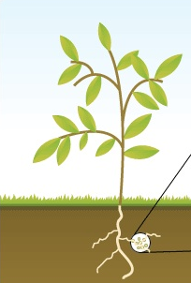
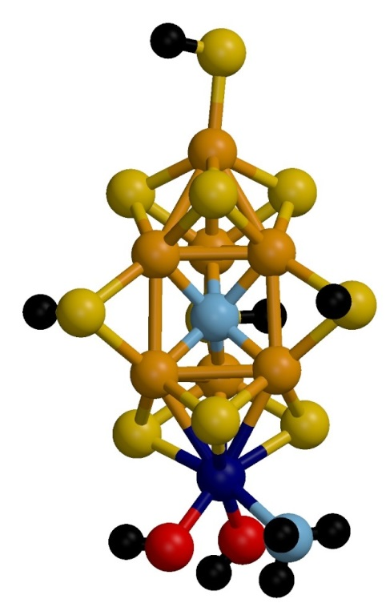
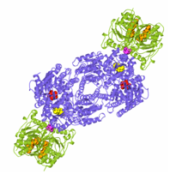
Nature’s Ammonia Plant: Nitrogenase
N₂+6(H⁺+e⁻) → 2NH₃

Slide 20
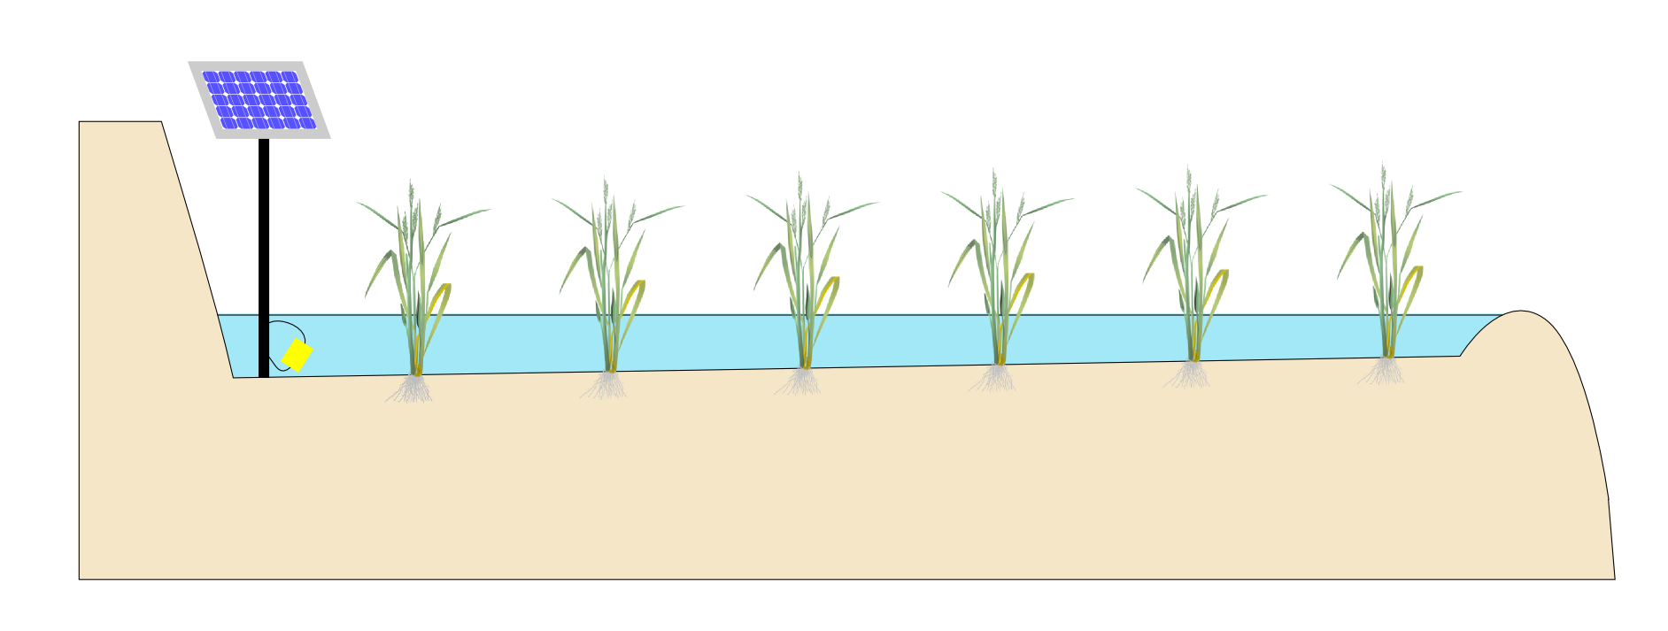

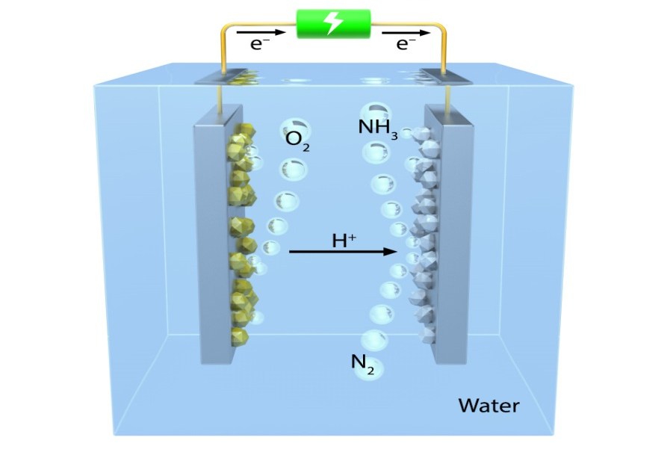

(Photo-)electrochemical Ammonia
Just-in-time fertilizer:
Only when the sun is shining
Only when water is present
SUNCAT Center for Interface Science and Catalysis
Stanford University and SLAC National Accelerator Laboratory

