Slide 1

The Global Chemistry
Enterprise is Completely Unsustainable – What are you going to do about it?
TeraWatts, TeraGrams, TeraLiters 2016
Workshop on Challenges and Opportunities
for Future Sustainable Production of Chemicals and Fuels
ACS Green Chemistry Institute
1 Feb 2016

Slide 2

ACS Membership
ACS welcomes members from across the globe.
Join the ACS community today and enjoy the benefits of membership.
  Access to SciFinder, ACS Publications, C&EN, & more
  Discounts on ACS National Meeting Registrations
  Career, cont. education, & professional development resources
  Global professional networking opportunities
Become a member of the ACS!

Slide 3

ACS Green Chemistry Institute®
Engaging you to reimagine chemistry and engineering for a sustainable future.
We believe sustainable and green chemistry innovation holds the key to solving most environmental and human health issues facing our world today.
Advancing Science
Advocating for Education
Accelerating Industry

Slide 4
Why Reimagine Chemistry?
The global chemistry enterprise as currently operated is completely unsustainable:
  Feedstocks
  Chemicals
  Chemistries
  Processes
  Products
Chemists and chemical engineers are uniquely equipped to do something about making the world more sustainable

Slide 5
Asking the Right Questions is Imperative
Avoid “the perfect uselessness of knowing the answer to the wrong question”
    The Left Hand of Darkness
            Ursula K. LeGuin
            1969

Slide 6
What is the question we’re trying to answer?
What is chemistry for?
  it’s own sake?
  for my own gratification?
What is green chemistry and why does trying to define it lead to so much contention?
What is green chemistry for?
Why is green chemistry so important?

Slide 7
Sustainability Risks are Real
THE BIG DRIVERS
How do you view the world?
  Plenty of resources vs. finite and diminishing resources?
  Room for lots more people vs. too many people?
  The environment will take care of itself vs. the environment is stressed?
  Life as I know it will continue on just as it always has vs. disruptive change?

Slide 8
Does it Matter Where Chemicals Come From and How they are Made?
How many of you have had an industrial chemistry course?
How many of you have attempted to do a life cycle assessment?
What does the term “chemical supply chain” mean to you?
Do you care where things come from and what social, economic and environmental impacts are associated with the chemicals you work with?

Slide 9
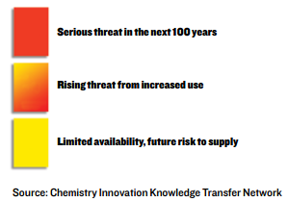
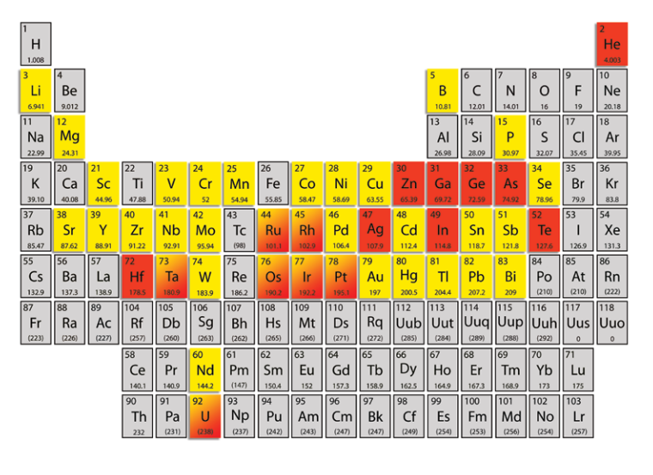
Supply of Critical Elements is not Sustainable
50% of all Zn is used to galvanize steel for corrosion resistance; 5-50 years of Zn are left at current rate of consumption
Rh is one of the rarest elements in the Earth’s crust accounting for 0.0002 parts per million; only 5-50 years of Rh are left.
Global production of Sn = 140 tonnes; if current consumption continues, 5-50 years of Sn are left

Slide 10
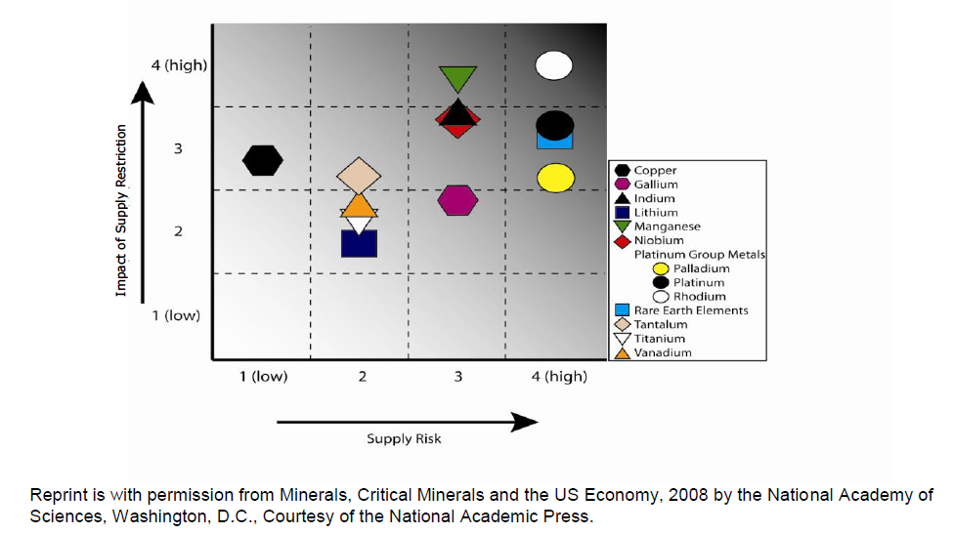
We are Criticality Dependent on Some Elements

Slide 11
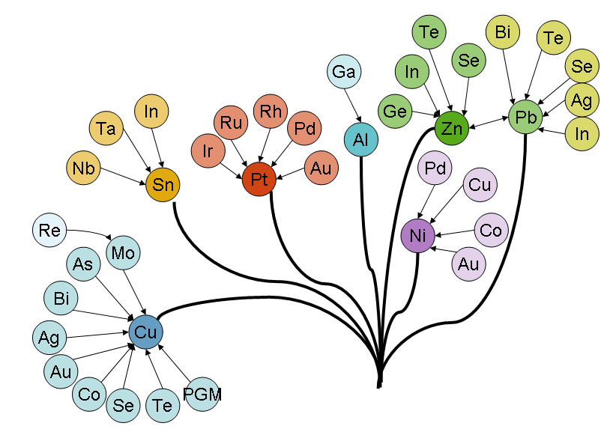
Metal families – most precious and specialty metals are coupled to major metals production
PGM
 supply of many “technology metals” is price-inelastic:
Increased demand can only be met by primary production if demand for major metal rises accordingly
Short term demand surges lead to price peaks (see Ir, Ru, In)
Effective recycling important for supply security

Slide 12
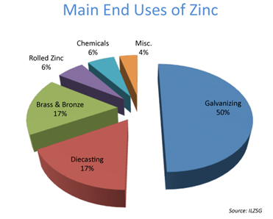
Zinc
Dwindling Supply of a Useful Metal
23rd most abundant element in the Earth’s crust
Makes up an average of 65 grams for every ton of the Earth’s crust
Commercially exploitable reserves exceed 100 million tons
Chemically used in a variety of chemistries and as a catalyst in the form of zinc oxide
One of the most common uses (50%) of zinc is in galvanizing steel for corrosion resistance
Estimated 5-50 years Zinc left if consumption continues at current rate

Slide 13
Tin Has Many Important Uses
Uses:
Coatings for metals as component in corrosion inhibition, protective oxide layer that prevents further oxidation
Historically used in formulations of marine anti-foulants
Used in a number of catalyst systems
Component in solder for electronics
Abundance
Global production of tin is more than 140 tonnes per year
  Reserves are approximately 4 million tonnes.
  An estimated 130 tonnes of tin concentrates are produced each year.
If current consumption continues, 5-50 years of Tin are left

Slide 14
Tin has Negative Social and Environmental Impacts
One third of all tin mined in the world comes from the Indonesian island of Bangka
Mining in Bangka has become dangerous
  Low income workers and cheap tools→ safety measures have been ignored
  Lethal cave-ins have risen as tin ore pits become deeper
Most of the human health and environmental impacts come through exposure to organo-tin compounds.
  Very significant toxicity to multiple environmental organisms

Slide 15
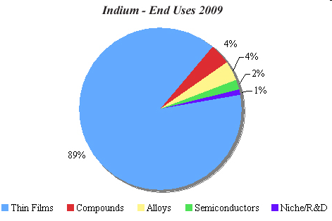


Example by-product element: indium (demand)
Uses of indium
Thin films: transparent and conductive coatings of indium tin oxide (ITO) for
- liquid crystal displays (50% of In use!)
- flat panel displays
- touch screens
- photovoltaic cells
smart windows
…
Source: Ch. Hagelueken
(Umicore)
→ Demand is rising sharply
→ Recycling challenge: Very small quantities per unit, but many units

Slide 16
Rhodium is Not Abundant
Found mainly in South Africa (60%) and Russia. Also found in the state of Montana, U.S.A.
The annual world production of rhodium is around 16 tonnes a year with an estimated reserve of 3 tonnes
It is one of the rarest elements in the Earth’s crust as it accounts for only 0.0002 parts per million
If this element is used at the rate it is consumed now, only 5-50 years of rhodium are left
82.7% of Rhodium used as a catalytic converter for cars and used extensively in many catalytic reactions
Finish for jewelry, mirrors, and search lights as it is highly reflective; manufacture of nitric acid; hydrogenation of organic compounds; alloying agent for hardening and improving the corrosion resistance of platinum and palladium

Slide 17
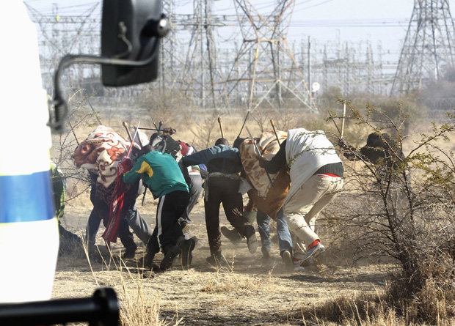

The Socio-Economic Cost Of Mining Pt Group Metals Is High
“South African platinum miners must return to work Monday, despite 34 strikers killed by police”
Associated Press and Reuters | Aug 19, 2012 11:51 AM ET
“The world's second-largest platinum miner, Johannesburg-listed Impala Platinum Holdings Ltd., fired more than 17,000 striking workers in February, sending the price to a year-to-date high over $1,600 an ounce. The 12-month high is around $1,900 an ounce.”
By 24/7 Wall St.
Posted 8:33AM 08/17/12

Slide 18
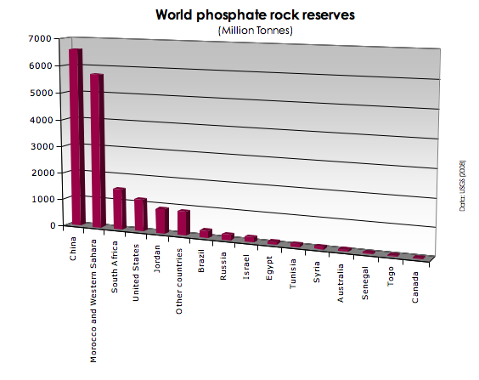
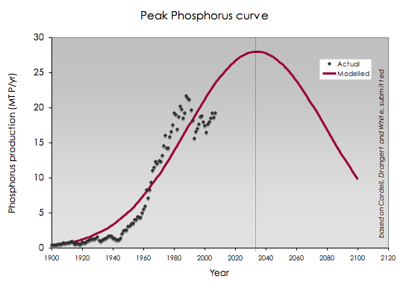
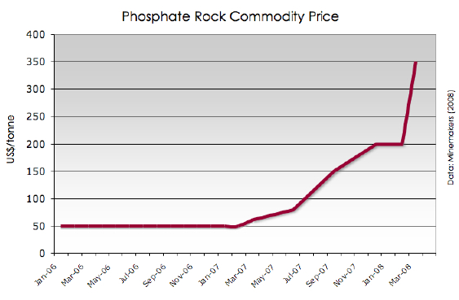
Cheap Phosphorus Won’t be Available Forever
Endangered Species: Should Cheap Phosphorus Be First On an Elemental 'Red List?'
ScienceDaily (Oct. 13, 2011) — Should the periodic table bear a warning label in the 21st century or be revised with a lesson about elemental supply and demand?
http://www.sciencedaily.com/releases/2011/10/111014104948.htm
James Elser,
Elena Bennett.
Phosphorus cycle:
A broken
biogeochemical
cycle.
Nature, 2011;
478 (7367): 29
DOI:10.1038/478029a
http://phosphorusfutures.net/

Slide 19
A Few Challenges Facing the Batch Chemical Industries

Slide 20
There are Large Challenges
Some traditional sticking points:
  Infrastructure
    Double Death Valley
    In ground capital
    Economics / financial analysis
    Current business climate
  Societal / Organizational
    Bigger SD / CSR issues dominate senior executive agendas
    Educational system
    Resistance to change and risk aversion
    Maintaining status quo

Slide 21
Current Batch Chemical Process Development is Complicated
Large portfolios
Significant route modifications or complete substitution
Incremental optimisation of chemical processes
Focus on yield, quality, CoG and number of steps

Slide 22
Top 10 Chemistries Used 2004 - 2005

Slide 23
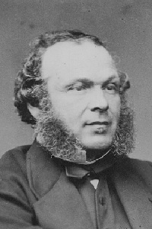
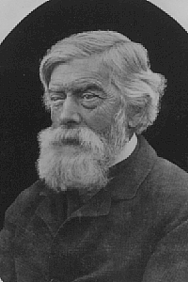
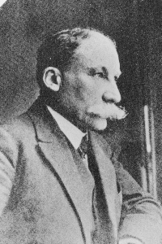
Chemists Use Ancient Chemistries
A random selection of 100 chemistries in a review of named reactions:
54% before World War 1
74% before World War 2
91% before 1975
9% during the 1980’s
Wurtz, Charles Adolphe
Born: Wolfisheim, 1817
Died: Paris, 1884
Williamson, Alexander William
Born: London, 1824
Died: Hindhead, 1904
Grignard, François Auguste
Born: Cherbourg, 1871
Died: Lyon, 1935

Slide 24
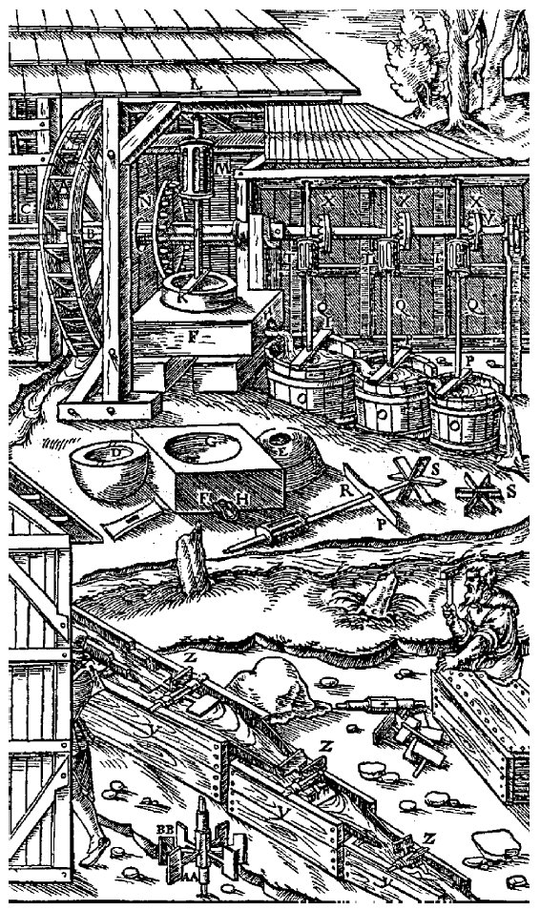
Chemical Technology Hasn’t
Changed Much
Batch reactor
Distillations
Crystallisation
Bronze age
e.g., Dutch gin was imported before the English industry for distilled spirits took over in the 18th century
Salt crystallisation during bronze age
“The difficulty lies, not in the new ideas, but in escaping the old ones, which ramify, for those brought up as most of us have been, into every corner of our minds.”
- John Maynard Keynes

Slide 25
NSF Sustainable Chemistry Workshop Conclusions – Jan, 2012
Systems-level thinking is required
More fundamental research should be use inspired
Green is not synonymous with sustainable
Efficiency is necessary but not sufficient due to the rebound effect (Jevon’s paradox)
Sustainability research and education is multi-disciplinary and collaborative

Slide 26
Sustainable Chemistry Challenges
Exploit greater chemical diversity especially what is available from biorenewables
Greater understanding and uptake of synthetic biology as a synthesis tool
New reactions that are focused on biologically-derived molecules.
Low energy, direct conversion of CO₂ to methanol or >C₁ molecules
Sustainable source of hydrogen
Closing the materials loop – waste as raw material

Slide 27
Conclusions
The chemistry and chemical engineering communities are the best suited to make a difference in sustainability
Sustainable and Green chemistry is more than just hazard and pollution reduction
Innovation is key to making chemistry greener and more sustainable
Early design that incorporates sustainable and green chemistry and engineering principles is imperative to achieve the most cost effective gains
There’s a lot going on in this space!
Readily available tools are available for giving design guidance but chemists generally don’t know how to use them

Slide 28
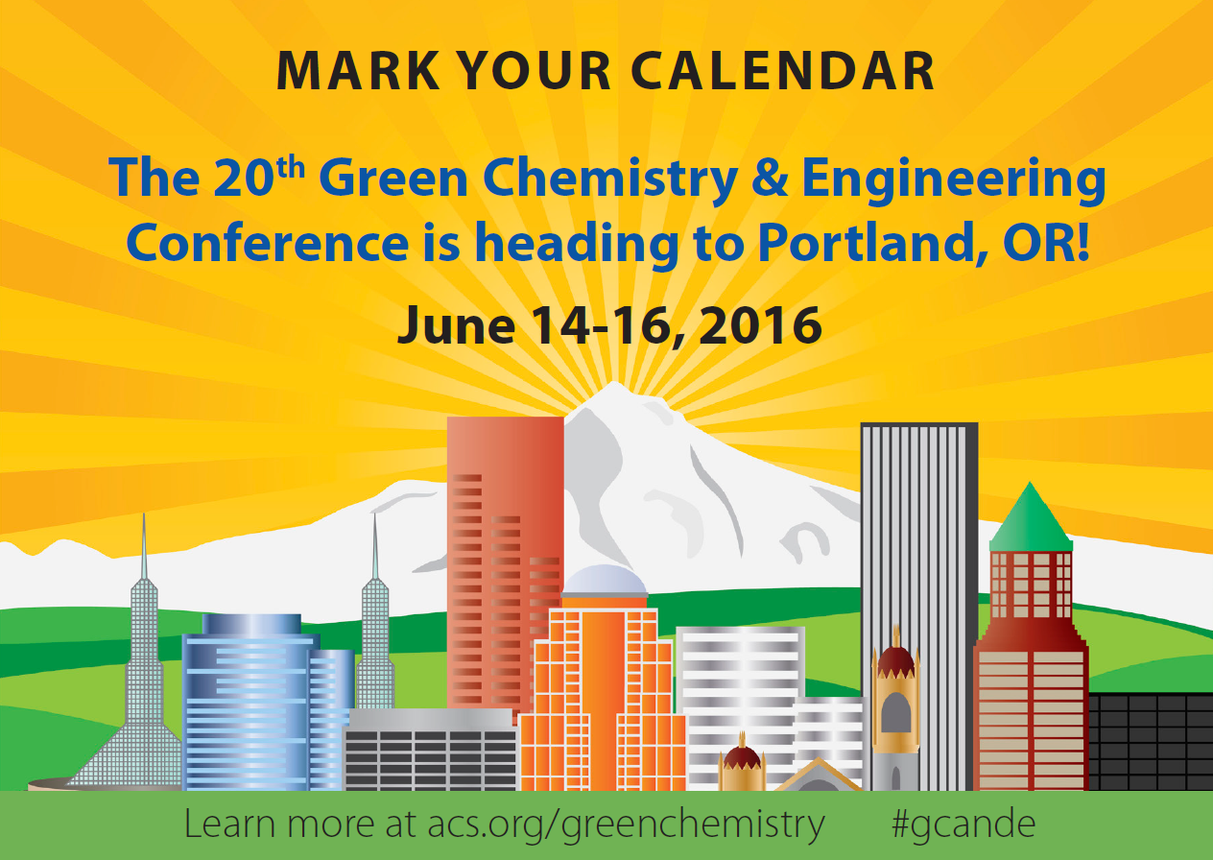

Slide 29
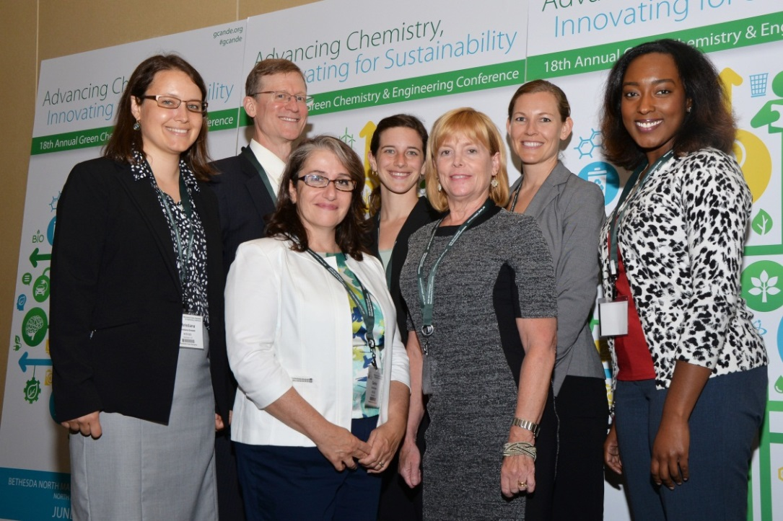
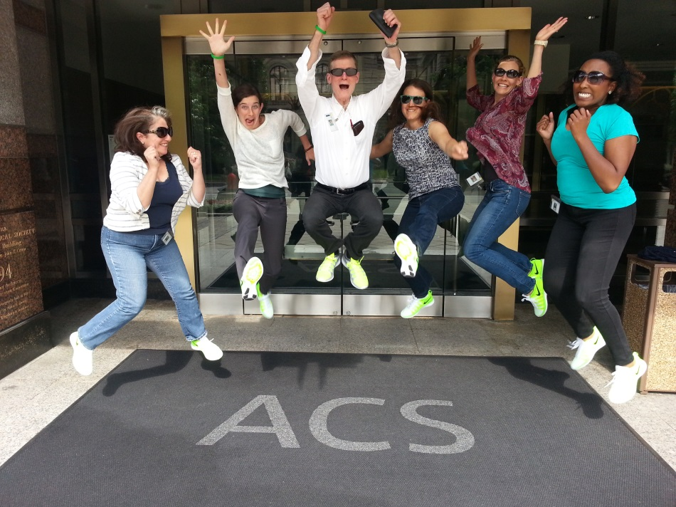
Questions?
David J. C. Constable
d_constable@acs.org
What’s Your Green Chemistry? TM
We want to hear your story. Contact gci@acs.org

Slide 30
Thinking about Molecular Design Drivers, Rules, Possibilities

Slide 31
Thinking About Design
“Design is a signal of intention”
“Cradle to Cradle”
William McDonough
2002

Slide 32
Sustainability Needs to be Designed into Products and Processes
If we want to make the biggest impacts to products, services and costs, we have to start from the ground up.
If we want to build sustainability into the design of products and services we have to think differently about the what and how of R&D.
Increasing demands and decreasing budgets are likely to mean greater reliance on easily accessible company-wide tools that provide early assessments and highlight sustainability issues.
Implementing more sustainable practices requires patience and persistence.

Slide 33
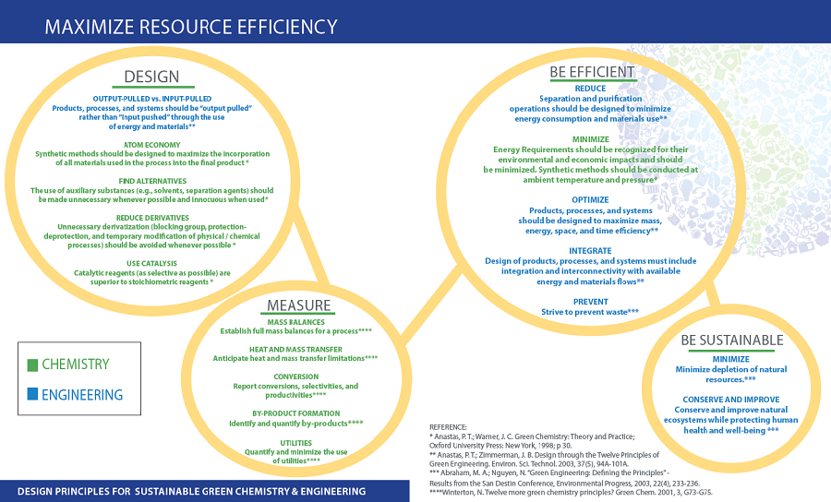
American Chemical Society

Slide 34
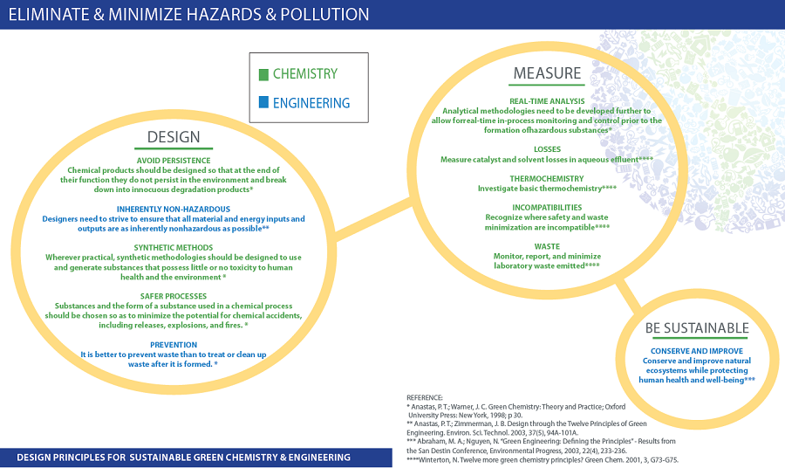

Slide 35
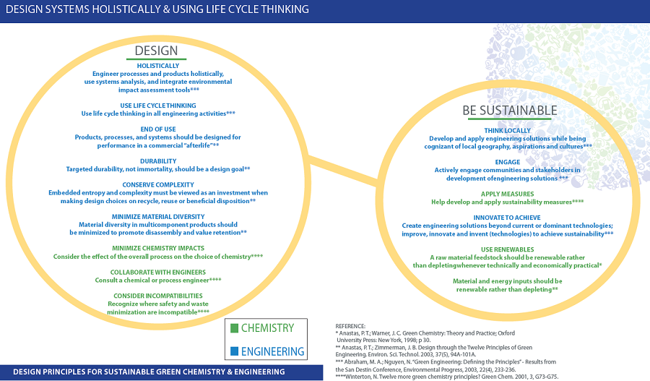

Slide 36
Two Major Focal Points of Most Green Chemistry Efforts
Elimination of the use of toxics (hazardous substances in general)
  Examples of how governments use policy to drive this: Green Chemistry initiative in California, EU REACH legislation, TSCA reauthorization, TRI, etc.
Elimination/reduction of waste
  Examples of how governments use policy to drive this: EU Producer Responsibility, RCRA, etc.
  Voluntary initiatives: Energy Star, Green Energy Leaders, etc.

Slide 37


There is a Debate over Hazard and Risk in Green Chemistry
The Industrial view:
The Government and NGO view:

Slide 38
We Want Functional and Safer Molecules
Performance equal to or better than existing materials
Non-VOCs, not HAP’s, and not TRI listed chemicals
Not Ozone Depleting Agents
Not containing toxic elements such as heavy metals
Not classified as carcinogens, mutagens or reproductive toxins (CMR)
Not persistent, bioaccumulative, toxic (PBTs) or Persistent Organic Pollutants (POP)
Cost effective

Slide 39

Finding the Right Balance is Challenging
Commercial
Focus on
Speed to
Market
Sustainable process
design early when
costs are lower
Attrition

Slide 40
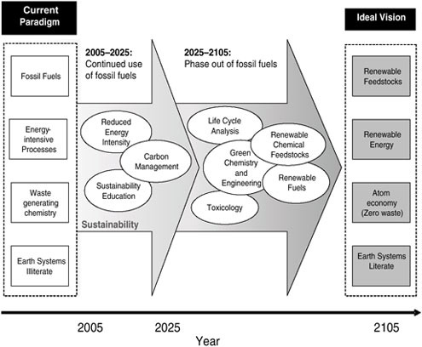
Getting to More Sustainable Chemistry
Source: Sustainability in the Chemical Industry: Grand Challenges and Research Needs - A Workshop Report (2005)

Slide 41
Reasons Chemist’s Use the Chemical Building Blocks they Use
Because they:
  Ensure thermodynamically and kinetically favorable reactions
  Result in the highest yields
  React in predictable ways
  Are “easily” obtained (lowest cost)
  Generally don’t require sophisticated reactors or technology in the laboratory
But….

Slide 42
These Chemical Building Blocks have a few Sustainability Risks
Feedstocks
Process efficiencies
Missing Data
High-hazard materials
High risk process chemistries
Inappropriate engineering or process controls
  Human and Environmental Exposures
Legislation/regulations

