Slide 1
The Systems (R)evolution
in Energy Metrics
Hanna Breetz
Arizona State University
School of Sustainability
2/1/16

Slide 2
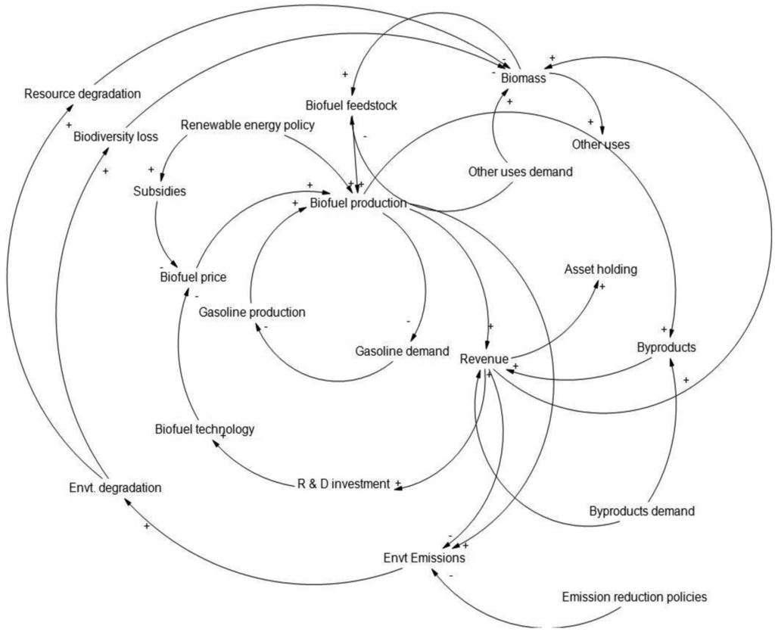
Paradigm Shifts
Lifecycle
(“Cradle-to-grave”)
End-of-pipe
Systems
Design
Raw Materials
Manufacturing
Distribution
Use
End-of-life

Slide 3
Complex, Adaptive Systems
Multi-functional, multi-actor systems
Many interacting elements and agents, responding/adapting to local information
Macro patterns emerge from micro behavior
May operate far from equilibrium due to path dependencies, feedbacks, non-linearities,
→ Key themes of emergence, adaptation, interdependence, feedbacks, co-evolution

Slide 4
Energy represents an integrated
Social-Ecological-Technical System (SETS)
‘Energy systems’ aren’t just technical – but technical systems embedded in natural systems governed by social systems
Interactions among: technology, infrastructure, environment, institutions, markets, and human decision-making
(Michael Schoon)
Notes:
So if we really want to understand how the bioenergy system evolves – and how to shape it – we have to look at interactions among the technology, infrastructure, the environment, institutions, markets, policy, patterns of human decision-making

Slide 5
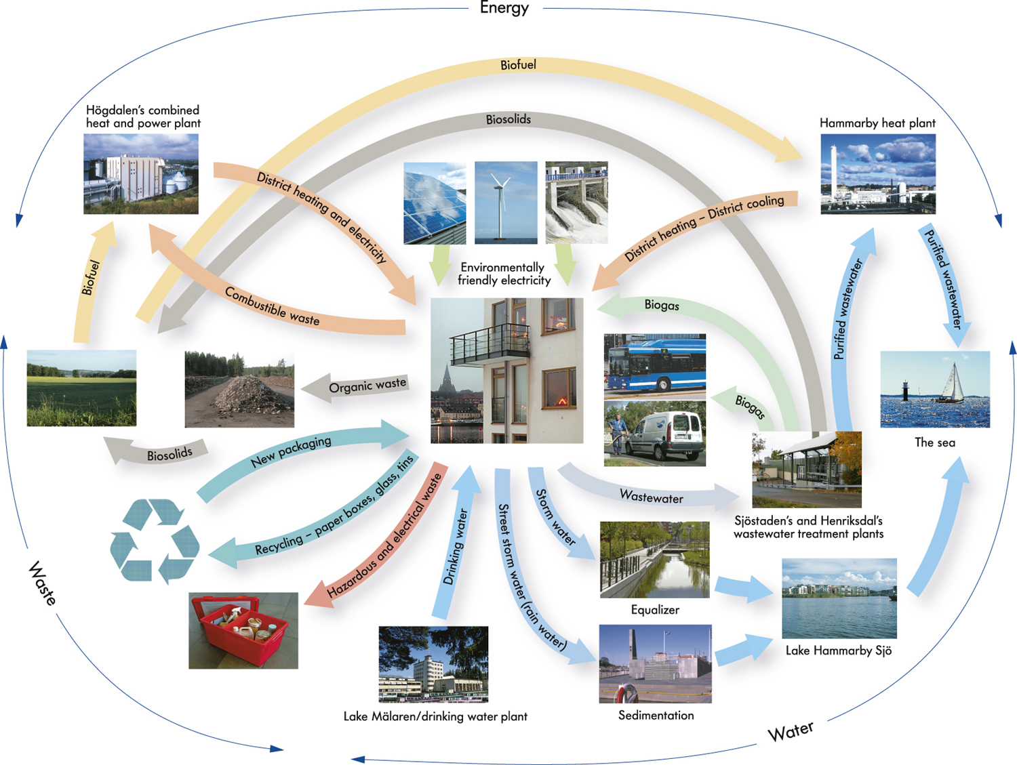
http://www.enpc.fr/sites/default/files/files/Rutherford%20Hammarby%20Sjöstad%20121213.pdf

Slide 6
Different causal stories,
different assignments of responsibility
“Problem definition is a process of image making, where the images have to do fundamentally with attributing cause, blame, and responsibility. …. Political conflict over causal stories are, therefore, more than empirical claims about sequences of events. They are fights about the possibility of control and the assignment of responsibility.”
- Stone (1989)

Slide 7
Metric: End-of-pipe pollution
Era: c. 1960s – 1970s
Causal story: smokestacks, tailpipes, waste streams, toxics spewing pollution (“silent spring”)
Policies: command-and control environmental regulations addressing each media/pollutant
Epistemology: empirical data
Politics: identifying “villains,” making the “polluter pay,” highly confrontational and legalistic

Slide 8
Metric: lifecycle emissions
Design
Raw Materials
Era: academic discourse 1970s, policy discourse 1990s-2000s
Causal theme: multi-criteria impacts throughout supply chain, extends boundaries of attribution
Policies: more market-oriented mechanisms, focused on big actors within the supply chain
Epistemology: Life Cycle Analysis
Politics: CSR, consumer pressure, roundtables and certifications, mix of confrontation and engagement
Manufacturing
Distribution
Use
End-of-life

Slide 9
Metric: systems outcomes
Era: systems dynamics c. 1970s, academic policy discourse c 1990s, policy discourse c. 2000-2010s
Causal story: multi-actor, multi-functional complex systems, where goal is sustainability & resilience
Epistemology: systems dynamics modeling, scenario analysis, uncertainty analysis
Policies: integrated and adaptive management, feedback controls, closing loops, targeting ‘hotspots’
Politics: it’s complicated!

Slide 10
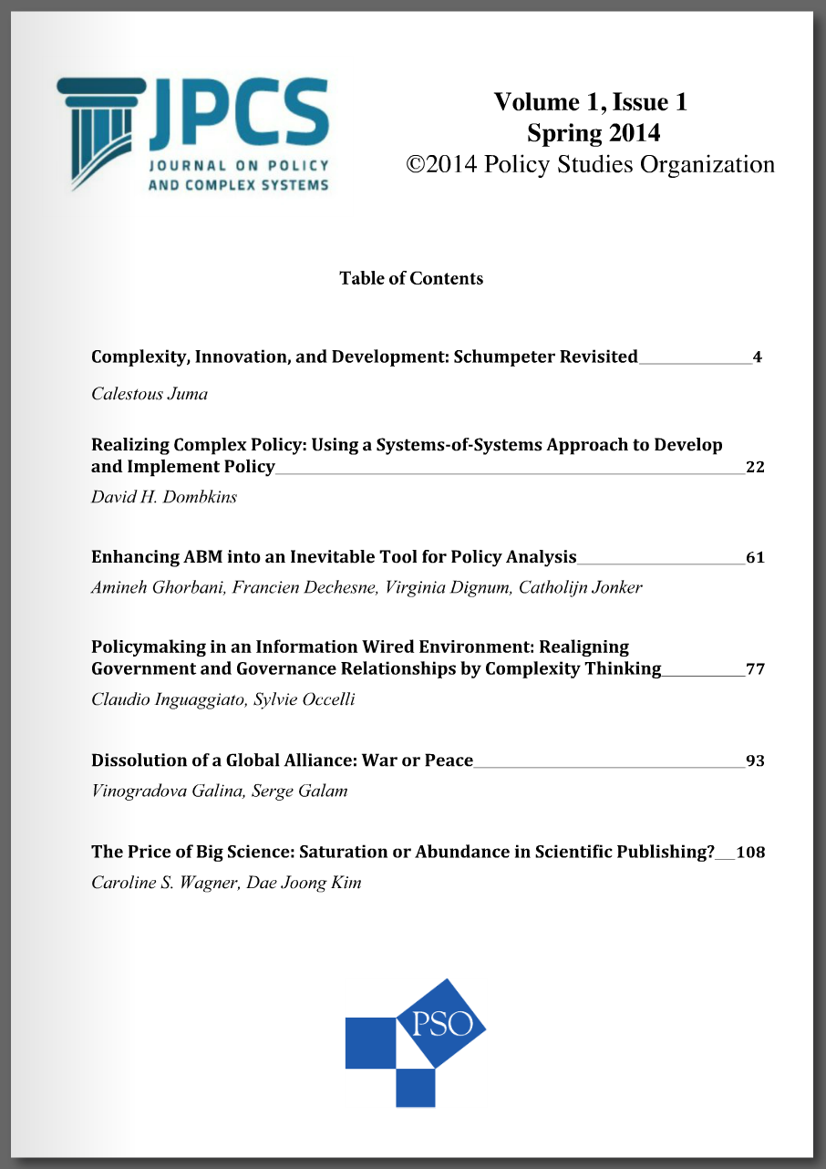
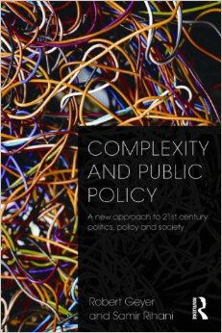
Growing discussion of complex systems policy, but it’s a new and emerging field
“complexity theory” means a “radical rethink” of public policy
- Editor of Journal on Policy and Complex Systems.

Slide 11
Policy for complex systems means:
adaptive management
Decentralized/multi-level/poly-centric regimes
Attention to points of leverage in systems
Emphasis on adaptation and learning
Acknowledgement of uncertainty in dynamic systems with emergent properties

Slide 12
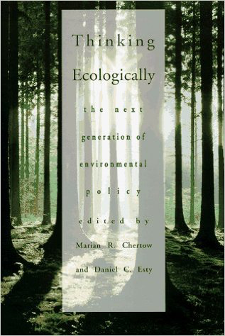
“Thinking Ecologically argues for a next generation of policies that are not confrontational but cooperative, less fragmented and more comprehensive, not inflexible but ... tailored to fit varying circumstances. We see a need for a “systems” approach to policy built on rigorous analysis, an interdisciplinary focus, and an appreciation that context matters.”
Chertow and Esty
1997

Slide 13
Political Economic Challenges for
Systems-Based Policy
Organizational and bureaucratic politics
Policy lock-in and path dependency
Lack of certainty → lack of interest group buy-in
Complicated informational demands
Attention, mobilization, agenda-setting
“In the past, when environmental insults were obvious and the targets of controls were big smokestack industries, making companies pay for their despoliation had a moral logic that offered wide appeal. Today, however, when...the harms we face reflect the cumulative impact of millions of individuals and small enterprises, the enemy is “us” and the moral certainty of a crusade is harder to sustain.” (Chertow & Esty 1997)

Slide 14
Ok, so a radical “revolution” of energy policy regimes is far off.
How about a gentler “evolution” that just injects systems thinking into existing policy?
→ Can we do “systems lite”?

Slide 15
Early experimentation: accounting for market-mediated spillovers in bioenergy policy
Biofuel Policy “Shock”
LCA Model
Direct Biofuel Lifecycle GHG Emissions
Direct Emissions
+
Indirect Emissions
Econometric/ Agricultural Model
Emission Factor Database
Time Accounting
Annual ILUC Emissions
LUC
Net GHG Emissions
Total Lifecycle Carbon Intensity
Broch et al 2013, Env. Sci. & Policy
Notes:
The key point that I want to make is that this represents a paradigm shift. ILUC is not just another parameter that we’re adding to LCA. It means different system boundaries, different causal mechanisms, different models, and different underlying datasets. It greatly expands the range of uncertainty, because the economic models …

Slide 16
ILUC effects reflect many parameters,
many of which aren’t well modeled or quantified
Agricultural systems
yield responses to price, co-product accounting, land use convertibility, yields on newly converted land, use of idle cropland
Energy systems
cost and efficiency of ethanol production, substitution of fossil fuels and biofuels, infrastructural constraints, technological change over time
Trade patterns
how domestic prices are transmitted to global markets
Government policy
sustainability criteria, energy policies, trade policies, food policies
Time
reference year, time horizon, discounting
Scale
geographic resolution, size of biofuel shock
ILUC model inputs
Khanna and Crago (2012), Wicke et al. (2010), Plevin et al. (2010), Delucchi (2011), Dumortier et al. (2011), Broch et al. (2013), Plevin, Delucchi, and Creutzig (2014)
Notes:
Have to make assumptions about a wide variety of parameters – agricultural systems, energy systems, patterns of global trade, government policy, and issues of time and scale – many of which are themselves quite uncertain or values-based. I saw this not to dismiss ILUC modeling, but to remind us of what it is and what it is not. It’s great for exploring complex systems insights. But not so great for producing single number estimates.

Slide 17
“estimates of global LUC are highly uncertain, unobservable, unverifiable, and dependent on assumed policy, economic context, and inputs.”
--- 5th IPCC Assessment
Working Group III, Mitigation of Climate Change
“Obtaining tightly bounded estimates of these impacts is likely beyond the reach of current models and data”
-- Hertel and Tyner (2013
Notes:
Or as the IPCC 5th assessment concluded: estimates are highly uncertain, unobservable, since you can’t by definition observe indirect causation, and unverifiable.

Slide 18
Is ‘regulation’ of indirect emissions a solution? Or bad precedent of ‘systems lite’?
Mis-uses models for numbers rather than insights
Politicizes the science (Campbell’s Law: when an indicator is used for policy, it becomes less useful)
Scientizes the politics
Doesn’t actually solve the problem (Zilberman: “a second rate solution to a first rate problem”)

Slide 19
“Complexity does not have a specific final ‘answer’ to a particular policy, economic, or social issue.”
“Adopting a complexity framework enables us to interpret what goes on … in a new way that recognizes the limits of knowledge and prediction and the consequent need to adjust policymaking and actions accordingly.”
Geyer and Rihani (2010)
Complexity and Public Policy

Slide 20
Paradigm Shifts
Lifecycle
(“Cradle-to-grave”)
End-of-pipe
Systems
Design
Raw Materials
Manufacturing
Distribution
Use
End-of-life

Slide 21
“Naively employing … the tools of complexity in an unquestioning, unsophisticated way, without concern for their limitations, is little better than denying complexity.”
- Richardson (2007)

