Slide 1
The art and science
of effective (poster) communication
Hayden Evans
Department of Chemistry and Biochemistry
Summer 2017
Adapted from Leo. L, Peter C., Daniel S.

Slide 2
Science is not just the results, but the communication of results
Communication is a big part of science,
both oral presentation and and writing.
Posters are a great way to engage in person.
Chance to network
You can get real feed back, and establish collaborations.
Its fun. There also usually food.

Slide 3
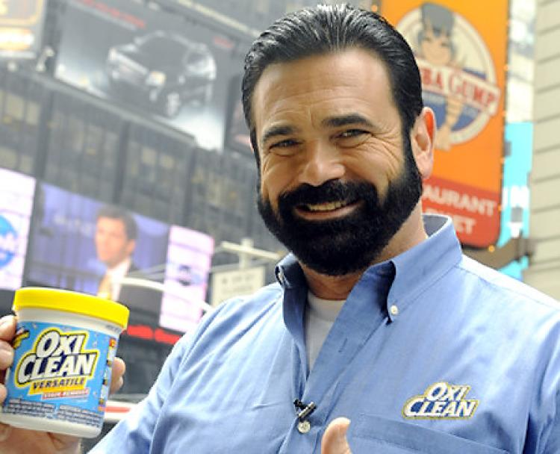
Engaging is key!
Smile, introduce yourself, eye contact.
Hook the audience with the
minimum amount of background information.
Practice!
The late Billy Mays
king of the pitch
Laypersons

Slide 4
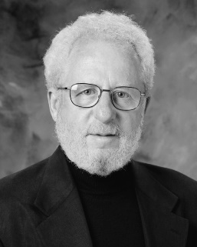
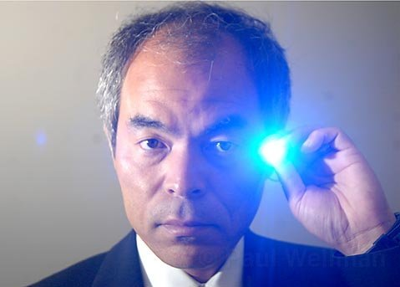
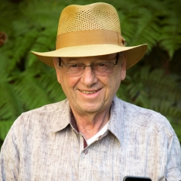
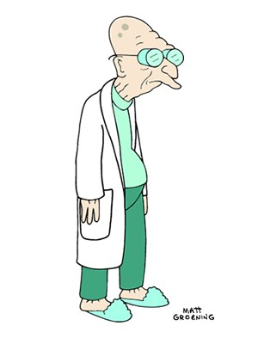
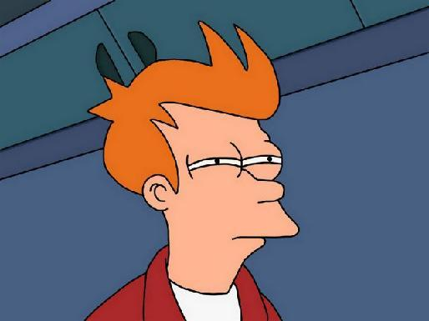
Knowing your audience: this changes rapidly at a poster session
Professors
Scientist that are not well versed in your area of work
Laypersons

Slide 5
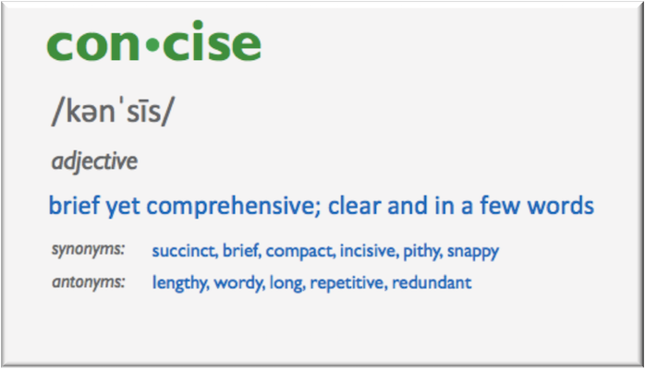
The main event: you should be able to explain all parts of your
poster in about two sentences.
The problem
The significance
The approach
The experiments
The results
The conclusion and future work
Laypersons

Slide 6
Handling questions is hard,
but try your best and be honest about what you know
Be clear and concise, not rambling
If you are unsure what they are asking, ask them to clarify
It is okay to admit you do not know something!
People who think they know everything suck
Laypersons

Slide 7
To gracefully exit a conversation,
thank the person you’re talking to for talking with you.
“Would you like me to go over anything more?”
Do not use:
“Do you understand?”
“Do you get everything?”
Laypersons

Slide 8
Try and avoid these common verbal pitfalls.
READING FROM YOUR POSTER VERBATIM
The two minute backtrack
Skipping from place to place
Forgetting to give credit where credits due
Laypersons

Slide 9
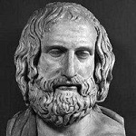
Final thoughts:
Prepare, be brief, and be yourself!
Practice short (2 mins) to long (5 – 10 mins) presentations of your poster. This prepares you for all types of visitors
Anticipate possible questions. This could become evident after the first couple of visitors
Be brief.
Be confident and enthusiastic about your work!
Anaxemenes
Supposed first practitioner of extemporaneous speech
Laypersons

