Slide 1
Superconductivity

Slide 2
This presentation:
Metallic conductors , Ohm’s law, and the effect of temperature
Semiconductors and departures from Ohm’s law
The need for low temperatures and liquid He
Superconductivity in Hg
The superconducting elements
The Meissner effect and superconducting levitation
Type I and type II superconductors
Superconducting magnets and MRI
The rudiments of Bardeen-Cooper-Schrieffer theory
High T_{C}

Slide 3
Metallic conductors and Ohm’s Law
Georg Simon Ohm (1789–1854); law stated in 1827: V = IR
The potential difference V across a metallic conductor is proportional to the current I, and the constant of proportionality is the resistance R
V
I
R
amp
+V
–V
I
The resistivity ρ incorporates sample geometry, and is an intrinsic property of all materials: ρ = AR/d
Units are Ohm-meter: Ω m
d
A

Slide 4
Semiconductors and departures from Ohm’s law
Semiconductors have an energy gap that prevents electrons from carrying current until a certain energy barrier is overcome. This barrier can be overcome at high temperatures, or at high voltages:
ρ
I
region where V is not proportional to I
}
1/R
behavior of a typical semiconductor
V
T
100 K
300 K

Slide 5
Temperature effects on metallic conductivity
Vibrations in solids (also called phonons) scatter electrons, giving rise to the resistivity, and the scattering processes increase with the temperature:
ρ
behavior of a typical metal
T
100 K
300 K

Slide 6
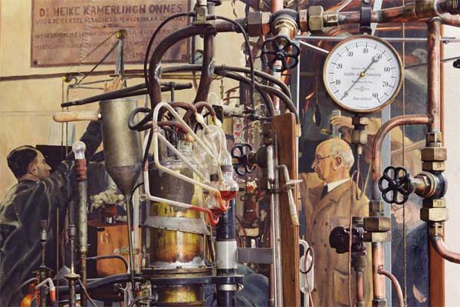
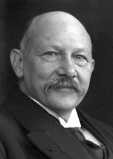
Very low temperatures 1
He (4.2 K) first achieved by Heike Kamerlingh Onnes at the University of Leiden in the Netherlands, 1908
Leiden Institute of Physics
nobel.se
H. Kamerlingh Onnes, Investigations into the properties of substances at low temperatures, which have led, amongst other things, to the preparation of liquid helium, Nobel Lecture, December 11, 1913.

Slide 7
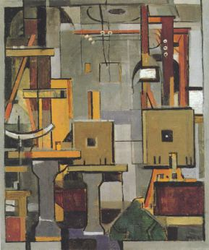
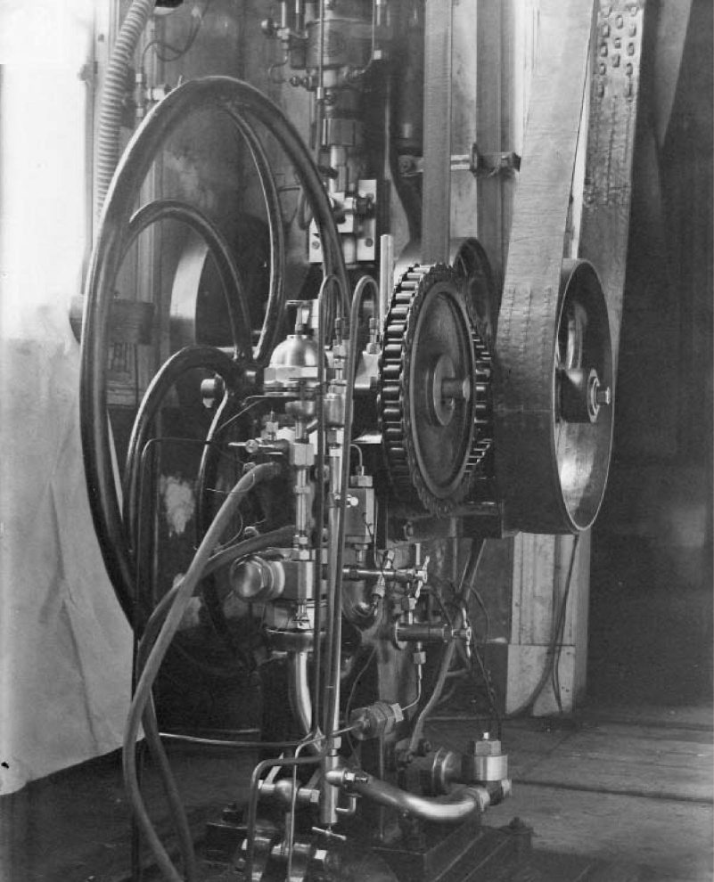
Very low temperatures 2
More pictures of the equipment: An abstract view (left) and the Cailletet compressor (right)
Leiden Institute of Physics
Leiden Institute of Physics
D. Van Delft, Little cup of helium, big science, Physics Today March 2008, page 26.

Slide 8
Metals at very low temperatures
Some ideas:
Augustus Mathiessen recognized that the resistivity of metal decreases as the temperature is decreased.
[Matthiessen and Vogt, Philos. Trans. R. Soc. London153 (1863) 369-383]
Lord Kelvin: Electrons would be cooled down till they came to complete halt, ie. metals would become completely insulating at the absolute zero.

Slide 9
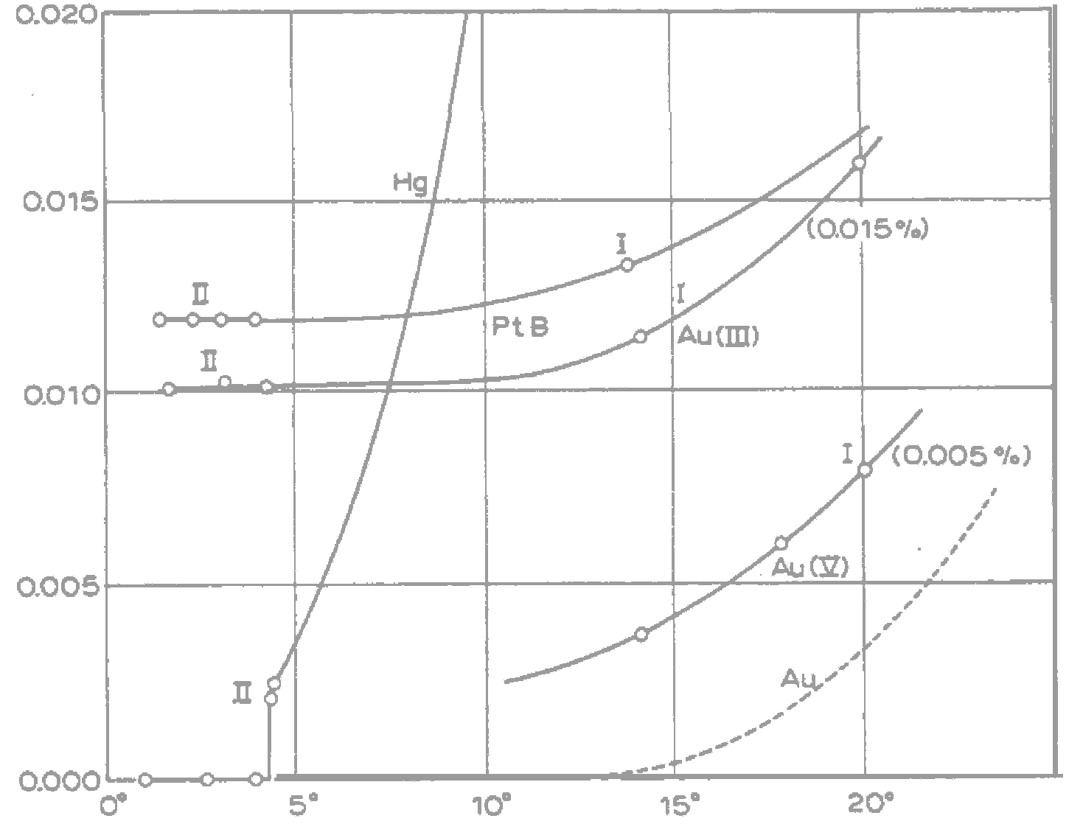
The discovery of superconductivity in Hg (1911)
R (Ω)
The behavior of Hg below T_{C} = 4.2 K; zero resistance, was a complete surprise.
T_{C}, the critical temperature
T (K)
H. Kamerlingh Onnes, Nobel Lecture, December 11, 1913.

Slide 10
What was happening ? A new quantum ground state
“… something unexpected occurred. The disappearance did not take place gradually but abruptly. From 1/500 the resistance at 4.2º K drops to a millionth part. At the lowest temperature, 1.5º K, it could be established that the resistance had become less than a thousand-millionth part of that at normal temperature.”
Rather than immersing myself in a possible explanation based on the quantum theory, I should like to consider …
H. Kamerlingh Onnes, Nobel Lecture, December 11, 1913.

Slide 11
The superconducting elements 1
Bulk samples at ambient pressure:
1
2
3
4
5
6
7
8
9
10
11
12
13
14
15
16
17
18
H
He
Li
Be
B
C
N
O
F
Ne
Na
Mg
Al
Si
P
S
Cl
Ar
K
Ca
Sc
Ti
V
Cr
Mn
Fe
Co
Ni
Cu
Zn
Ga
Ge
As
Se
Br
Kr
Rb
Sr
Y
Zr
Nb
Mo
Tc
Ru
Rh
Pd
Ag
Cd
In
Sn
Sb
Te
I
Xe
Cs
Ba
La
Hf
Ta
W
Re
Os
Ir
Pt
Au
Hg
Tl
Pb
Bi
Po
At
Rn
Fr
Ra
Ac
La
Ce
Pr
Nd
Pm
Sm
Er
Gd
Tb
Dy
Ho
Eu
Tm
Yb
Lu
Ac
Th
Pa
U
Np
Pu
Am
Cm
Bk
Cf
Es
Fm
Md
No
Lr
CRC Handbook of Physics and Chemistry [http://www.hbcpnetbase.com/]

Slide 12
The superconducting elements 2
The magnetic (and not superconducting) elements:
1
2
3
4
5
6
7
8
9
10
11
12
13
14
15
16
17
18
H
He
Li
Be
B
C
N
O
F
Ne
Na
Mg
Al
Si
P
S
Cl
Ar
Fe
ferromagnet
K
Ca
Sc
Ti
V
Cr
Mn
Fe
Co
Ni
Cu
Zn
Ga
Ge
As
Se
Br
Kr
Rb
Sr
Y
Zr
Nb
Mo
Tc
Ru
Rh
Pd
Ag
Cd
In
Sn
Sb
Te
I
Xe
Mn
antiferro
Cs
Ba
La
Hf
Ta
W
Re
Os
Ir
Pt
Au
Hg
Tl
Pb
Bi
Po
At
Rn
Tm
mixed
Fr
Ra
Ac
La
Ce
Pr
Nd
Pm
Sm
Er
Gd
Tb
Dy
Ho
Eu
Tm
Yb
Lu
Ac
Th
Pa
U
Np
Pu
Am
Cm
Bk
Cf
Es
Fm
Md
No
Lr
CRC Handbook of Physics and Chemistry [http://www.hbcpnetbase.com/]

Slide 13
The Meissner effect (Walther Meissner 1933):
ρ
S
S
N
N
T_{C}
T (K)
Below T_{C} superconductors strongly exclude magnetic fields; superconductors are perfect diamagnets

Slide 14
The Meissner effect (Walther Meissner 1933):
The magnetization M is the number of magnetic dipoles per unit volume of the material; M becomes negative below T_{C}
M
T_{C}
+ve
T (K)
–ve

Slide 15
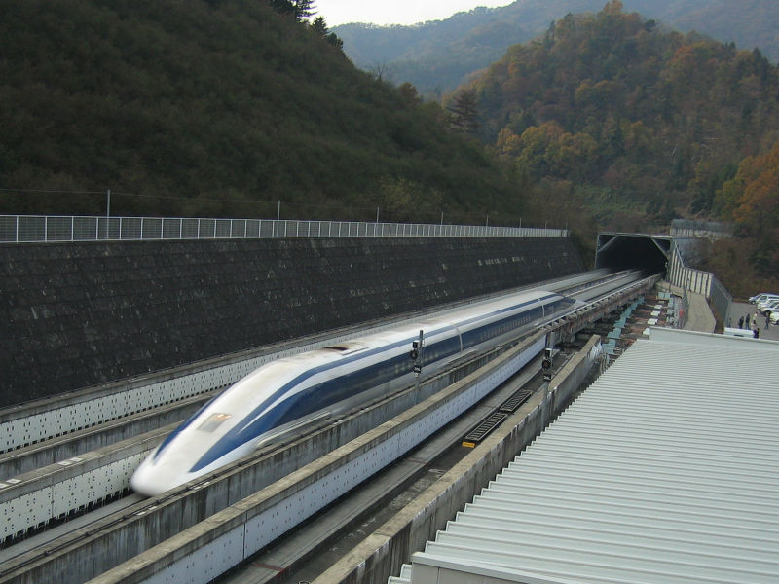
Superconducting levitation
On a larger scale, the worlds fastest train, a Japan Rail prototype uses superconducting magnets: http://en.wikipedia.org/wiki/JR-Maglev

Slide 16
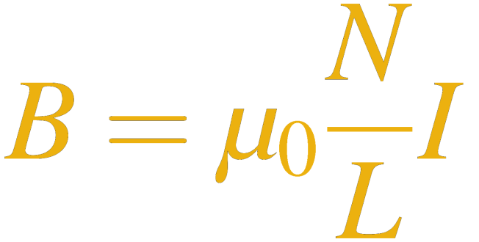
Superconducting magnets
A solenoid is a current-carrying coil. According to the Ampère’s law applied to a long coil, the magnetic field it develops is given by:
The magnetic field intensity increases with the number of turns N per a given length L of the wire, and the current I.
For a normal (resistive) coil, high current and many turns means solenoids can melt (and they do) before high magnetic fields are reached.
The solution: Use a superconducting solenoid.

Slide 17
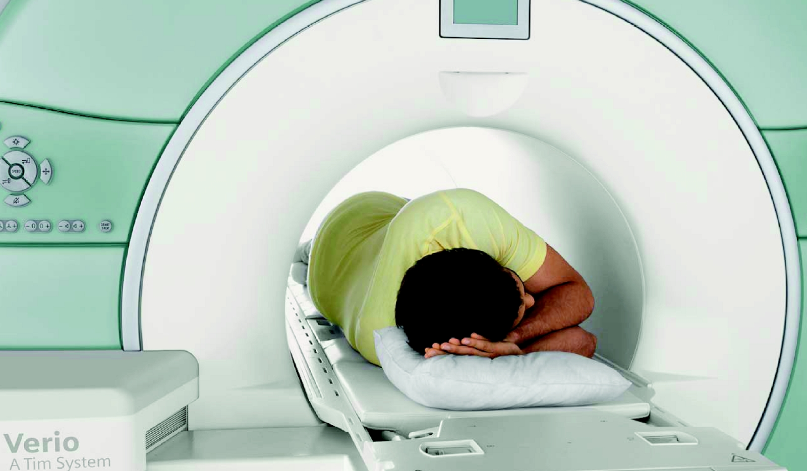
Superconducting magnets
This whole body Magnetic Resonance Imaging (MRI) system [from Siemens in Germany] uses a superconducting 3 T magnet

Slide 18
Bardeen-Cooper-Schrieffer theory
Leon Cooper (1954): At low-enough temperatures, electrons pair up to form (what are now called) Cooper pairs. These travel through crystals carrying pairs of charges (2e–) without resistance.
John Bardeen, Leon Cooper and Robert Schrieffer (1957): The attractive pairing occurs because of crystal vibrations: As an electron travels through the crystal, it perturbs atoms near its path …
… the perturbation makes it more attractive for another electron to follow closely. This is the virtual “attraction” or “glue”.
+
+
+
+
+
+
+
+
+
+
+
+
+
+
+
+
+
+
+
+
+
+
+
+
+
+
+
+
+
+
+
+
+
+
+
+
+
+
+
+
+
+
+
+
+
+
+
+
+
+
+
+
+
+
+
+
+
+
+
+

Slide 19
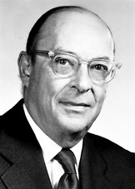
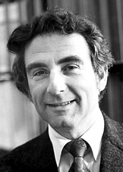
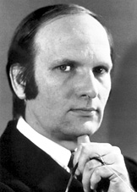
Bardeen-Cooper-Schrieffer theory: Tests
If it is about vibrations of the crystal, then perturbing the crystal should influence superconductivity. This is indeed verified by:
Isotope effects: Replacing atoms by heavier or lighter isotopes changes the T_{C} in a predictable manner.
Changing the nature of the vibrations by applying pressure on the crystal changes T_{C} in a predictable manner.
For their development of the theory, Bardeen, Cooper and Schrieffer were awarded the 1972 Nobel Prize in physics.
[Pictures from nobel.se]

Slide 20
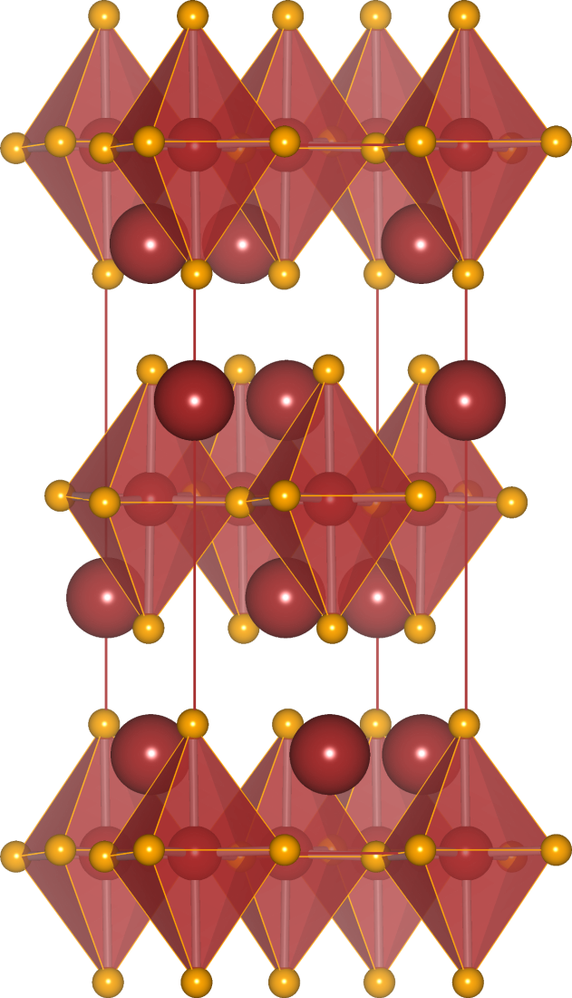
High T_{C}
Until 1986, all superconductors possessed T_{C}’s below 23 K. Then in 1985, Bednorz and Müller (Zurich, Switzerland) reported superconductivity above 30 K in the system La_{2–x}Ba_{x}CuO₄:
A single unit cell of La_{2–x}Ba_{x}CuO₄. Corner-connected slabs of CuO₆ octahedra are separated by double layers of La atoms.

Slide 21
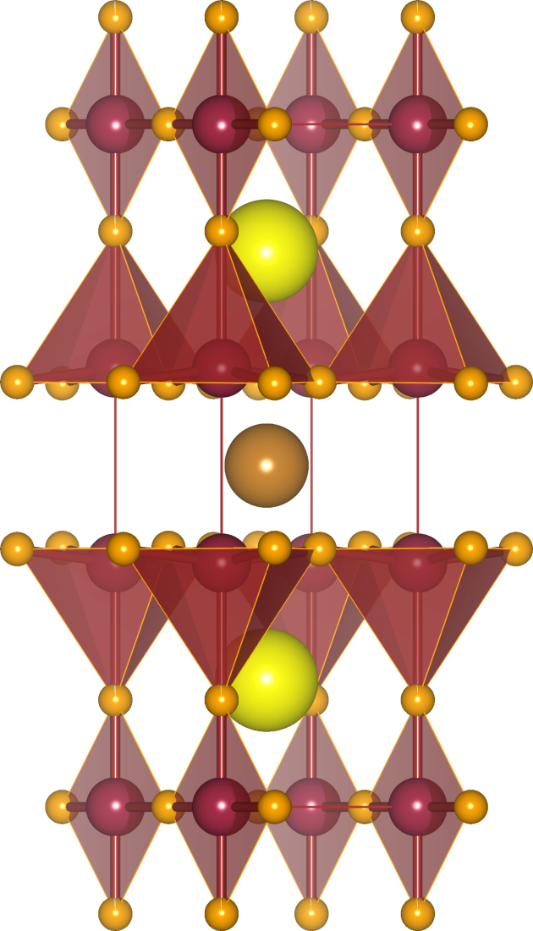
High T_{C}
In 1987, Paul Chu (University of Houston) and coworkers discovered the Y-Ba-Cu-O systems of oxides which are superconducting above 77 K, the boiling point of liquid N₂.
A single unit cell of YBa₂Cu₃O_{7–δ}. Corner connected slabs of Cu(2)O₅ square pyramids are separated by layers of Y and Ba atoms, from chains of Cu(1)O₄.
It is this compound, with a T_{C} of 92 K that simplifies demonstrations of superconductivity.
These copper oxides are collectively referred to as high-T_{C} compounds.

Slide 22
New excitement: The superconducting elements 3
The application of pressure changes the situation drastically
1
2
3
4
5
6
7
8
9
10
11
12
13
14
15
16
17
18
High pressures (above ≈10 GPa) generated with a diamond anvil cell:
H
He
Li
Be
B
C
N
O
F
Ne
Na
Mg
Al
Si
P
S
Cl
Ar
K
Ca
Sc
Ti
V
Cr
Mn
Fe
Co
Ni
Cu
Zn
Ga
Ge
As
Se
Br
Kr
Rb
Sr
Y
Zr
Nb
Mo
Tc
Ru
Rh
Pd
Ag
Cd
In
Sn
Sb
Te
I
Xe
Cs
Ba
La
Hf
Ta
W
Re
Os
Ir
Pt
Au
Hg
Tl
Pb
Bi
Po
At
Rn
Fr
Ra
Ac
La
Ce
Pr
Nd
Pm
Sm
Er
Gd
Tb
Dy
Ho
Eu
Tm
Yb
Lu
Ac
Th
Pa
U
Np
Pu
Am
Cm
Bk
Cf
Es
Fm
Md
No
Lr
Buzea, Robbie, Supercond. Sci. Technol. 18 (2005) R1–R8.

Slide 23
Summary
Metallic conductors , Ohm’s law, and the effect of temperature
Semiconductors and departures from Ohm’s law
The need for low temperatures and liquid He
Superconductivity in Hg
The superconducting elements
The Meissner effect and superconducting levitation
Type I and type II superconductors
Superconducting magnets and MRI
The rudiments of Bardeen-Cooper-Schrieffer theory
Newer systems: Higher T_{C}’s, more processible ?

