Slide 1
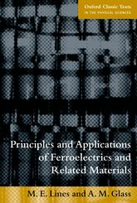
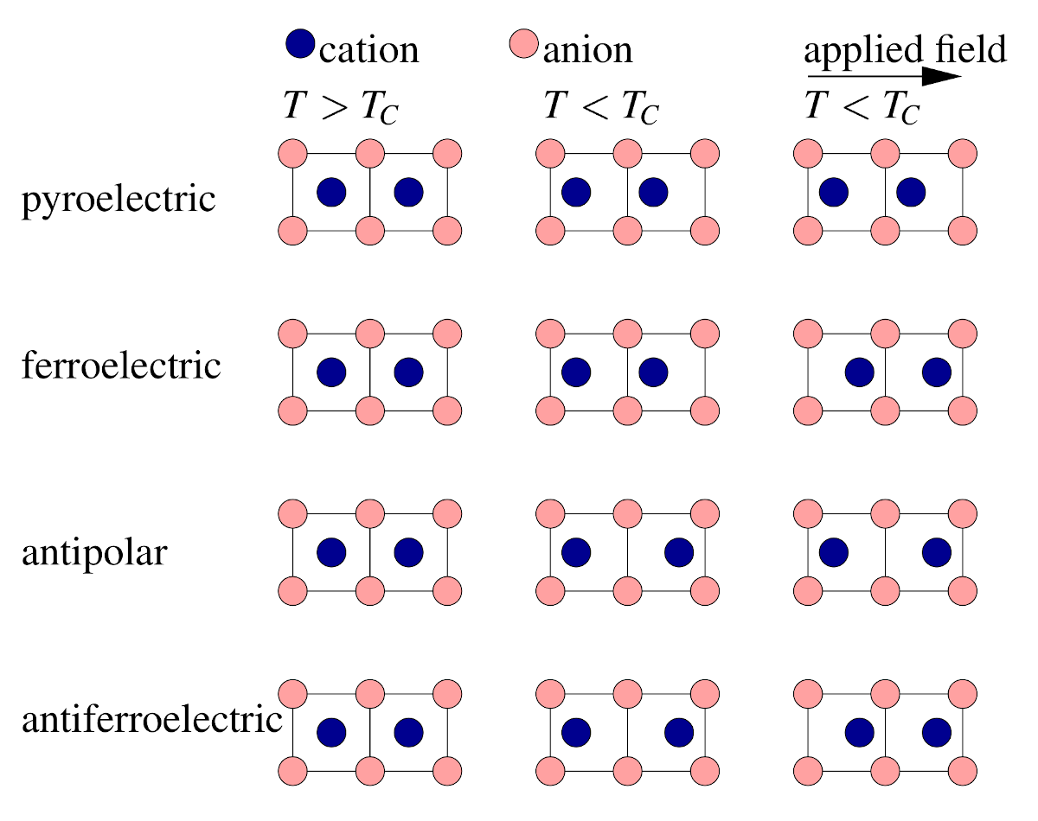
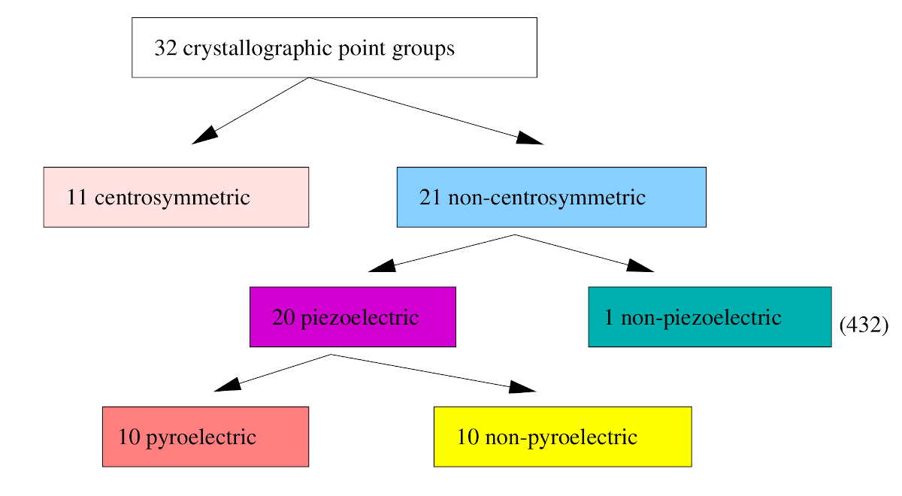
Polar Materials and Ferroelectrics
Principles and Applications of Ferroelectrics and Related M. E. Lines, A. M. Glass. OUP Oxford, 2001
All of these materials display thermal phase transitions to a compound with a polar point group

Slide 2
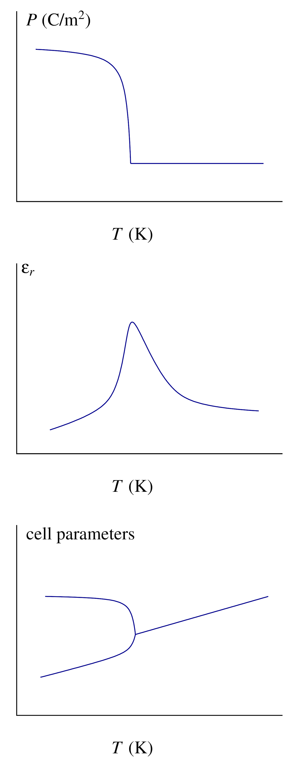
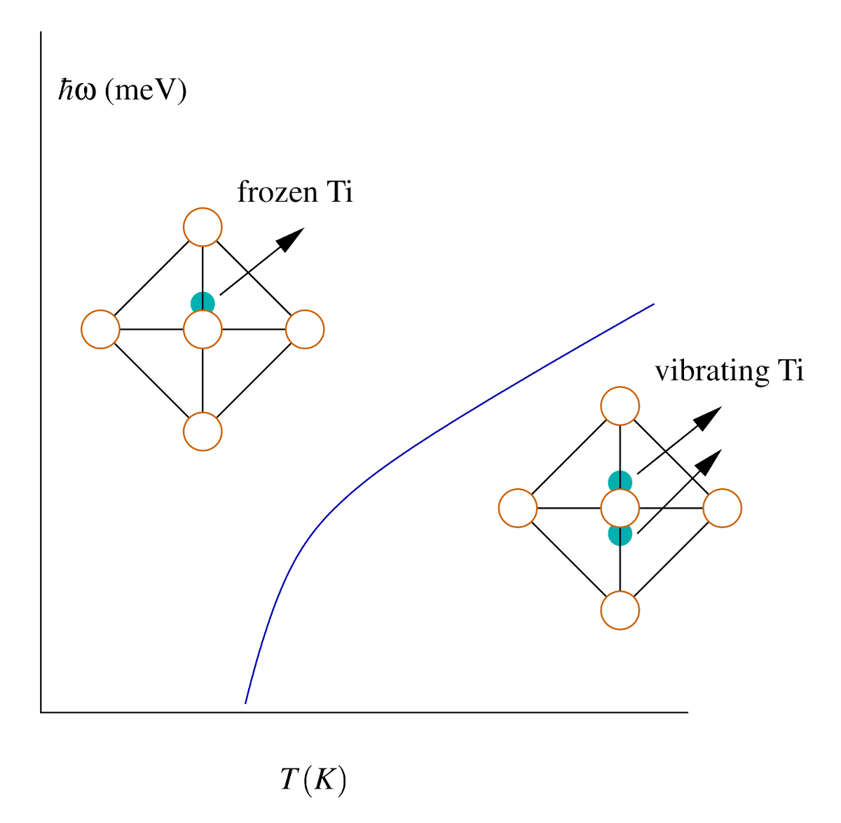
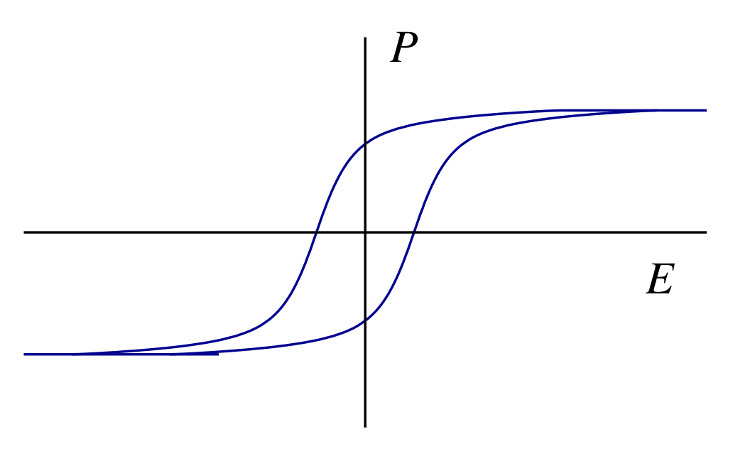
Polar Materials and Ferroelectrics
Thermal evolution of a ferroelectric
Ferroelectric soft mode: A vibration that goes to 0 frequency at the transition (upon cooling to the polar phase)

Slide 3
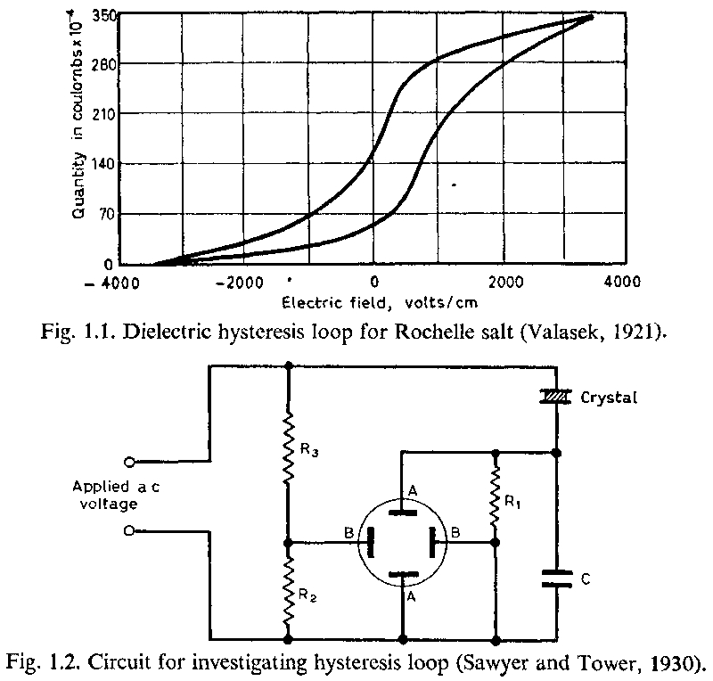
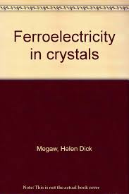
Polar Materials and Ferroelectrics
The original discovery by Valacek in Rochelle salt, in 1921. The Sawyer-Tower circuit for measurements is shown below.
Rochelle salt: Potassium sodium tartrate tetrahydrate, (KNaC₄H₄O₆·4H₂O)
David Brewster in 1824 demonstrated piezoelectric effects thereon, which led to him naming the effect pyroelectricity.
From H. W. Megaw, Ferroelectricity in Crystals, Methuen, London, 1957

Slide 4
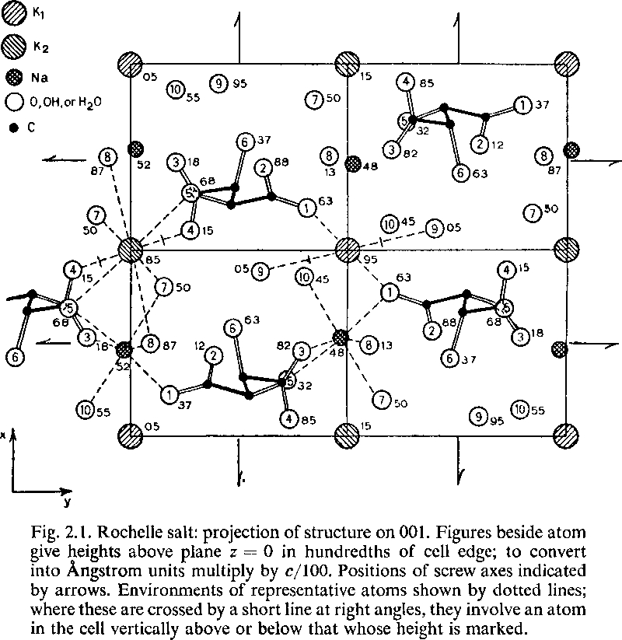
Polar Materials and Ferroelectrics
Hydrogen-bonded ferroelectricity in Rochelle’s salt.
From H. W. Megaw, Ferroelectricity in Crystals, Methuen, London, 1957

Slide 5
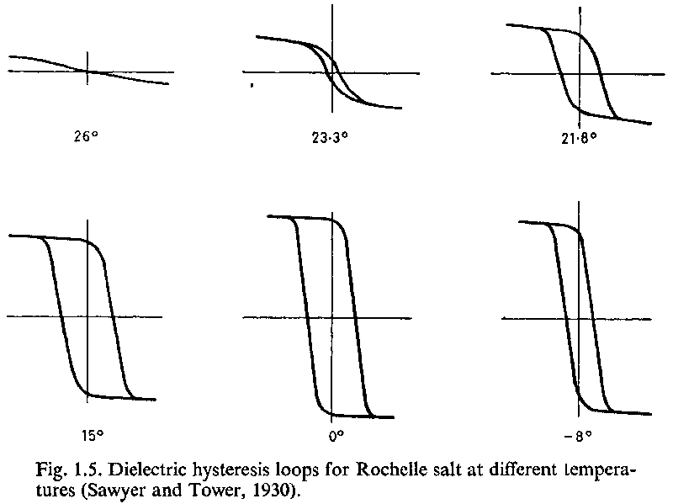
Polar Materials and Ferroelectrics
From H. W. Megaw, Ferroelectricity in Crystals, Methuen, London, 1957

Slide 6
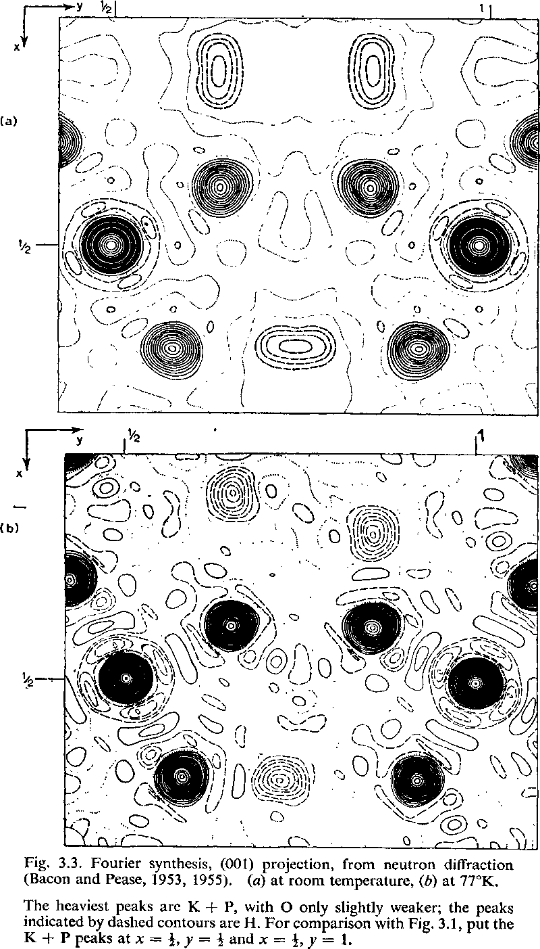
Polar Materials and Ferroelectrics
Hydrogen-bonded ferroelectricity in potassium dihydrogen phosphate (KDP); early neutron diffraction work.
From H. W. Megaw, Ferroelectricity in Crystals, Methuen, London, 1957

Slide 7
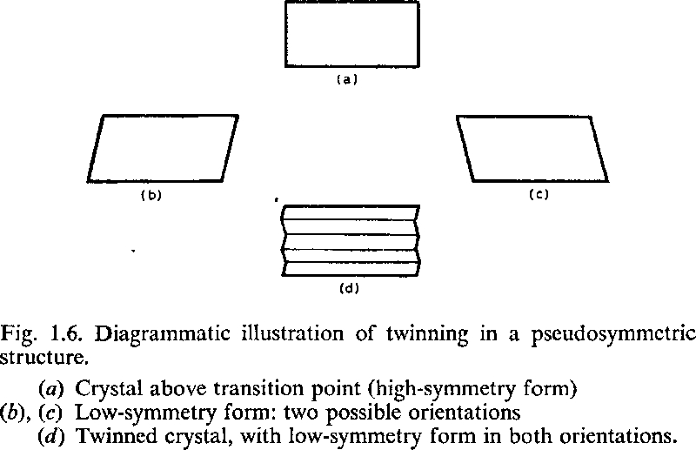
Polar Materials and Ferroelectrics
From H. W. Megaw, Ferroelectricity in Crystals, Methuen, London, 1957

Slide 8
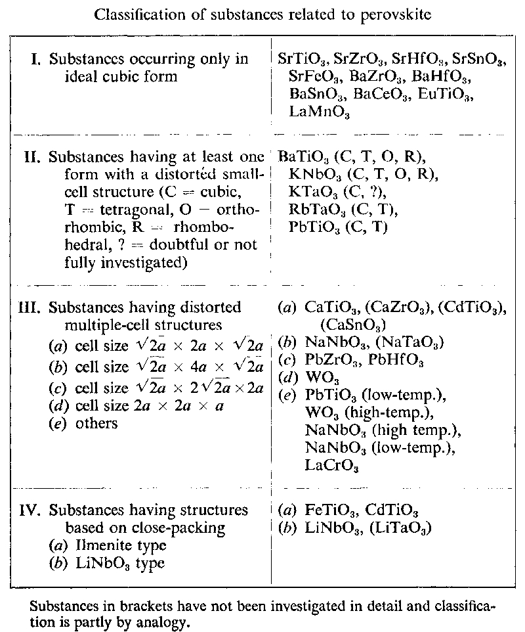
Polar Materials and Ferroelectrics
From H. W. Megaw, Ferroelectricity in Crystals, Methuen, London, 1957

Slide 9
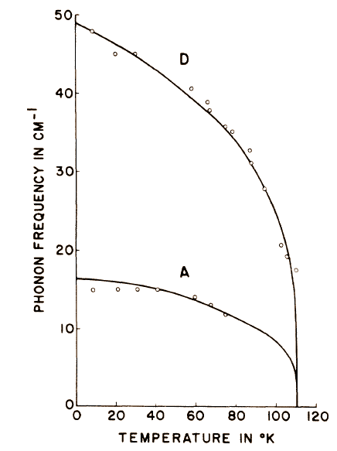
Polar Materials and Ferroelectrics: SrTiO₃ (on the cusp of becoming ferroelectric)
Antiferrodistortive transition in SrTiO₃ in R-point of the Brillouin zone
A_{1g}
Splitting of the structural soft mode (Raman active below T_{a})
E_{g}
T_{a}

Slide 10
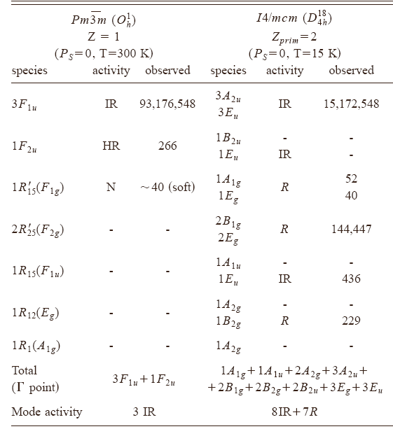
Polar Materials and Ferroelectrics: SrTiO₃
Ferroelectric SM
Structural SM (doublet)
Mode frequencies on STO ceramics
(Petzelt et al., PRB 64, 184111 (2001))

Slide 11
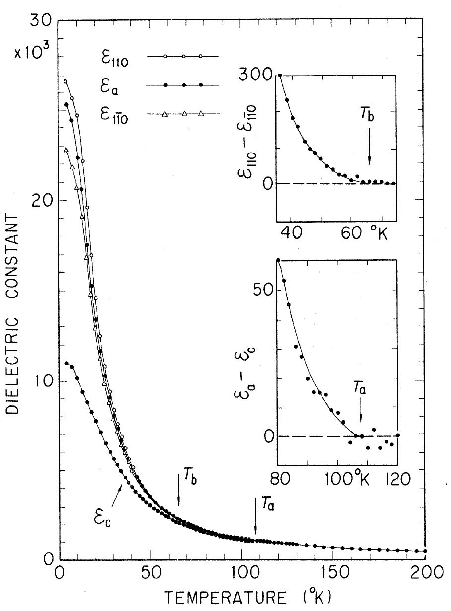
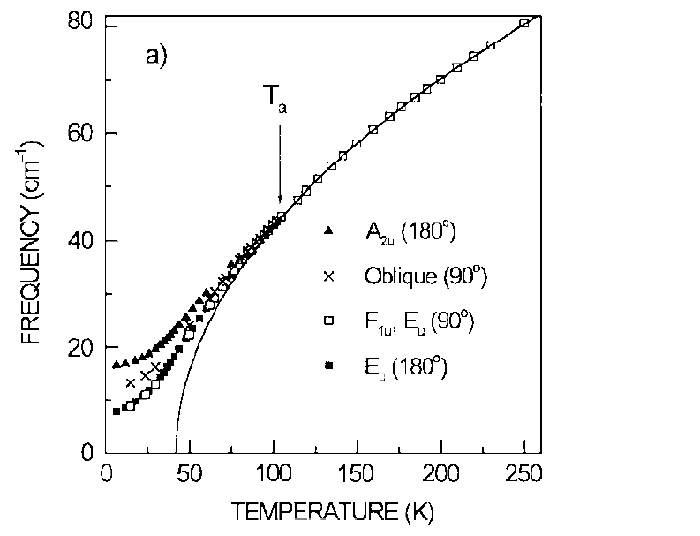
Polar Materials and Ferroelectrics: SrTiO₃

Slide 12
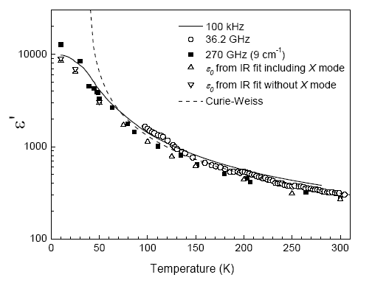
Polar Materials and Ferroelectrics: SrTiO₃

Slide 13
Polar Materials and Ferroelectrics: SrTiO₃

Slide 14
Polar Materials and Ferroelectrics: SrTiO₃

Slide 15
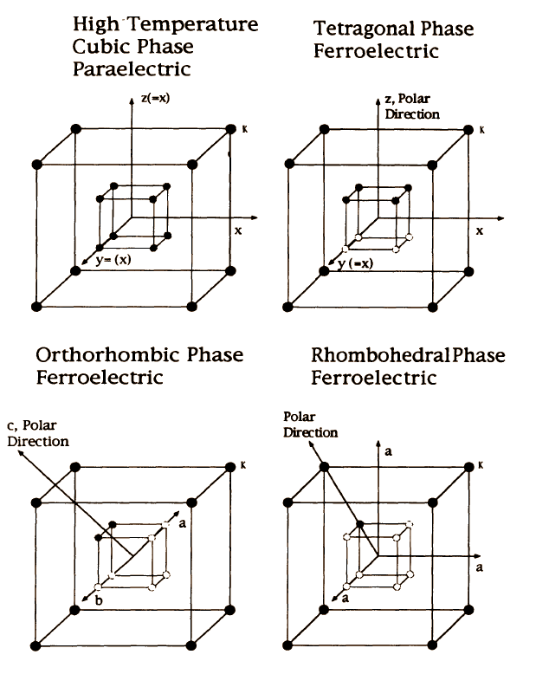
Polar Materials and Ferroelectrics
Order-disorder model for BaTiO₃ phase transitions
Ordered Ba
Dynamically disordered Ti

Slide 16
Polar Materials and Ferroelectrics

Slide 17
Polar Materials and Ferroelectrics

Slide 18
Polar Materials and Ferroelectrics: Bulk and nanoscale BaTiO₃
Page, Proffen, Niederberger, Seshadri, Probing local dipoles and ligand structure in BaTiO3 nanoparticles, Chem. Mater. 22 (2010) 4386–4391.

Slide 19
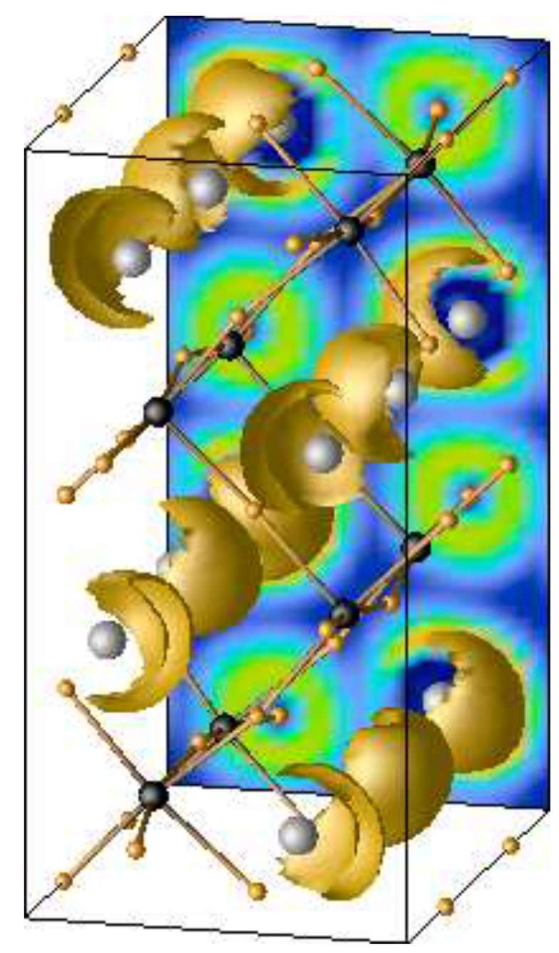
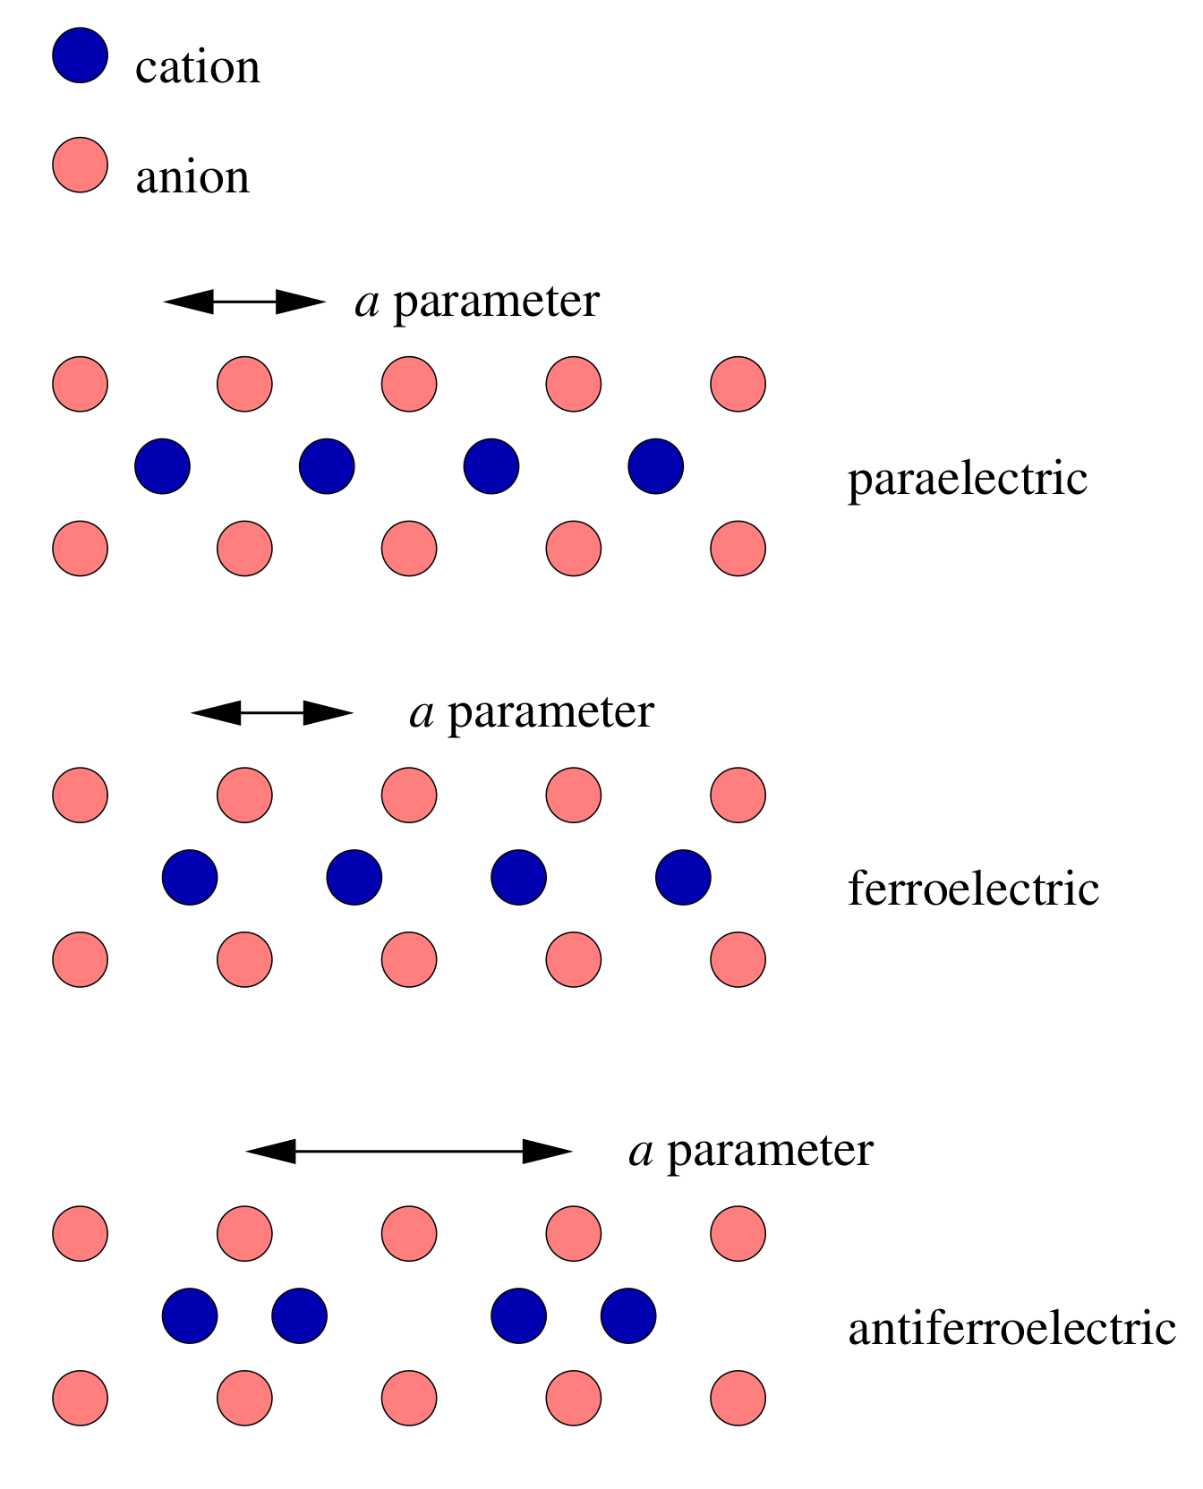
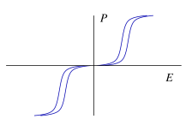
Polar Materials and Ferroelectrics
Antiferroelectrics: The example of PbZrO₃

