Slide 1
Oxide crystal structures: The basics
Ram Seshadri
Materials Department and Department of Chemistry & Biochemistry
Materials Research Laboratory, University of California, Santa Barbara CA 93106 USA
seshadri@mrl.ucsb.edu
Materials 286G, Spring 2020

Slide 2
en.wikipedia.org:
“Helen Dick Megaw (1 June 1907 – 26 February 2002) was an Irish crystallographer who was a pioneer in X-ray crystallography. She made measurements of the cell dimensions of ice and established the Perovskite crystal structure.”

Slide 3
This lecture
Brief description of oxide crystal structures
Ionic radii and Pauling’s rules
Electrostatic valence
Bond valence, and bond valence sums
Connectivity and bandwidth
First rule: the radius ratio rule
Second rule: the electrostatic valence rule
Third rule: sharing of polyhedron corners, edges and faces
Fourth rule: crystals containing different cations
Fifth rule: the rule of parsimony

Slide 4
Ionic radii and Pauling’s first rule (the radius ratio rule)
In brief: The cation-anion distance is the sum of cation and anion radii, and the number of anions around a cation (the coordination number) is a function of the radius ratio. Exemplified by AO₂ compounds below. MRR below is the mimimum radius ratio.
Pauling, The Nature of the Chemical Bond, 3rd Edn., Cornell University Press, Ithaca 1960

Slide 5
Crystal structures of simple oxides [containing a single cation site]

Slide 6

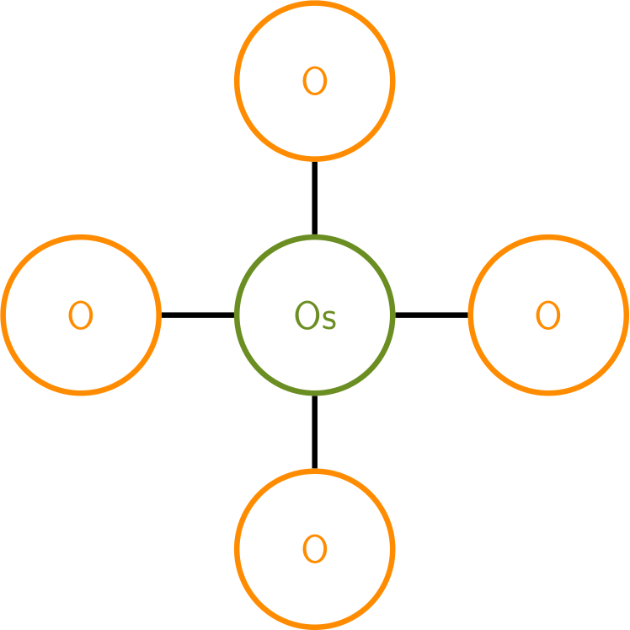
Crystal structures of simple oxides [containing a single cation site]
N.B.: CoO is simple, Co₃O₄ is not. ZnCo₂O₄ is certainly not !
Co₃O₄ and ZnCo₂O₄ are complex oxides.
Graphs of connectivity in crystals: Atoms are nodes and edges (the lines that connect nodes) indicate short (near-neighbor) distances.
CO₂: The molecular structure is O=C=O. The graph is:
Each C connected to 2 O, each O connected to a 1 C
OsO₄: The structure comprises isolated tetrahedra (molecular). The graph is below:
Each Os connected to 4 O and each O to 1 Os

Slide 7
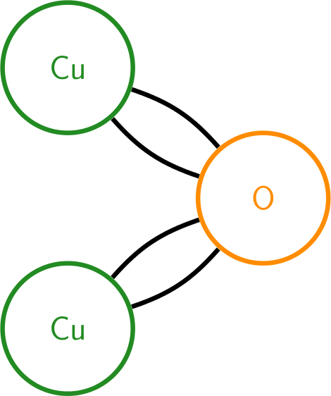
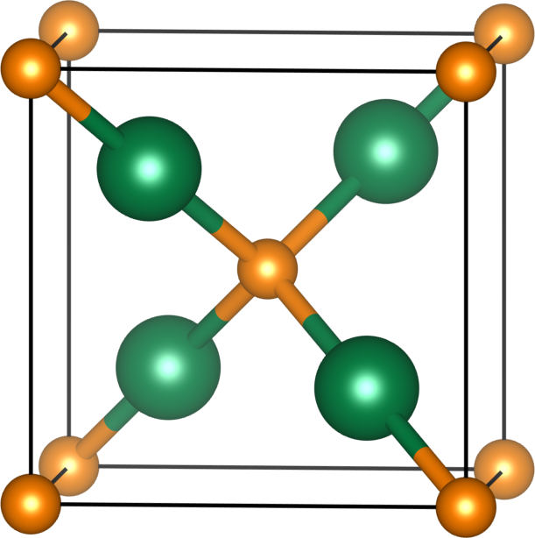
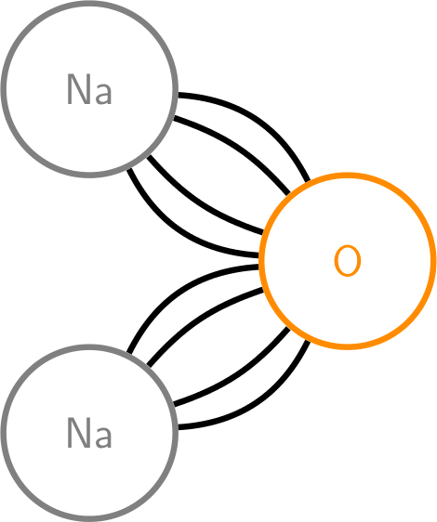
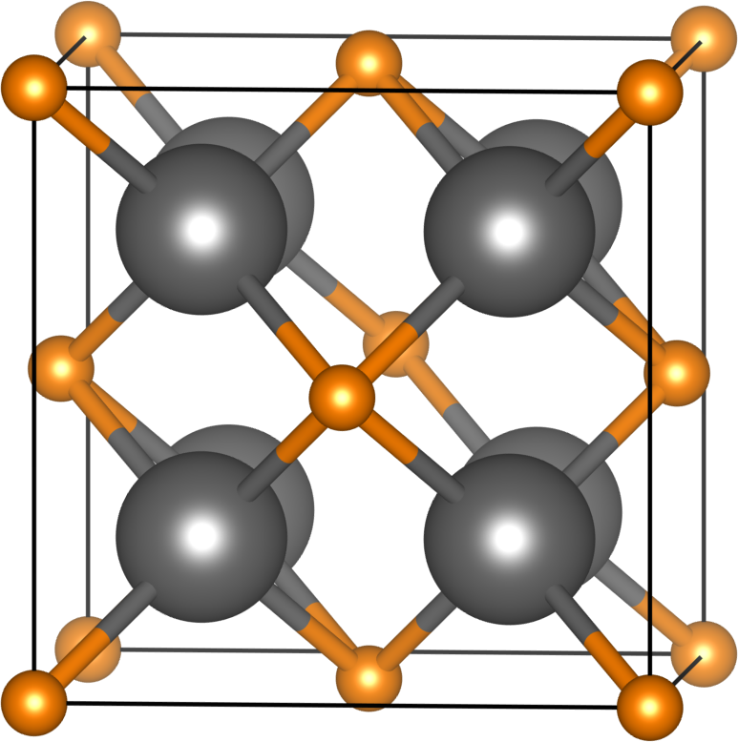
Crystal structures of simple oxides of monovalent ions: A₂O
Cu₂O
Linear coordination is unusual. Found usually in Cu⁺ and Ag⁺.
Na₂O (anti-fluorite)
4-coordination for Na⁺ and 8-coordination for O^{2–} are unusual.

Slide 8
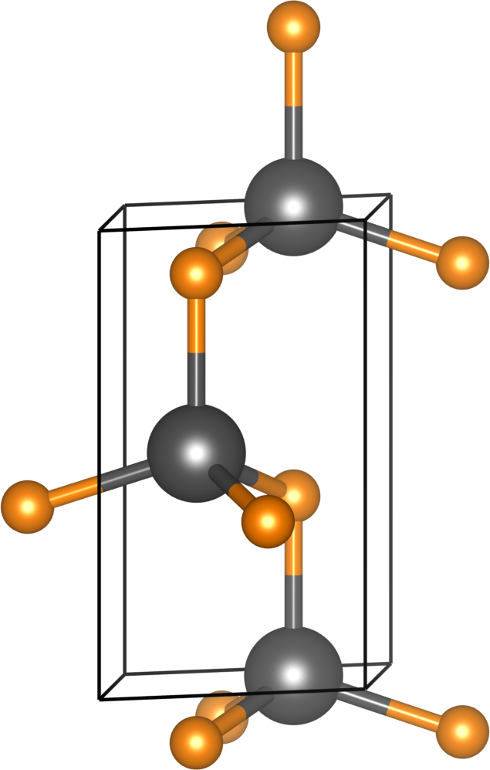
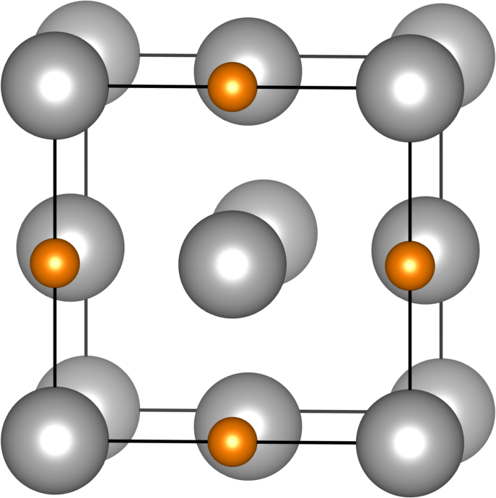
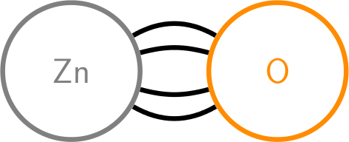
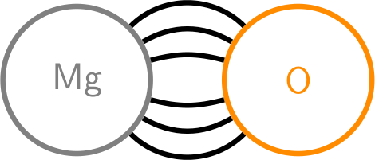
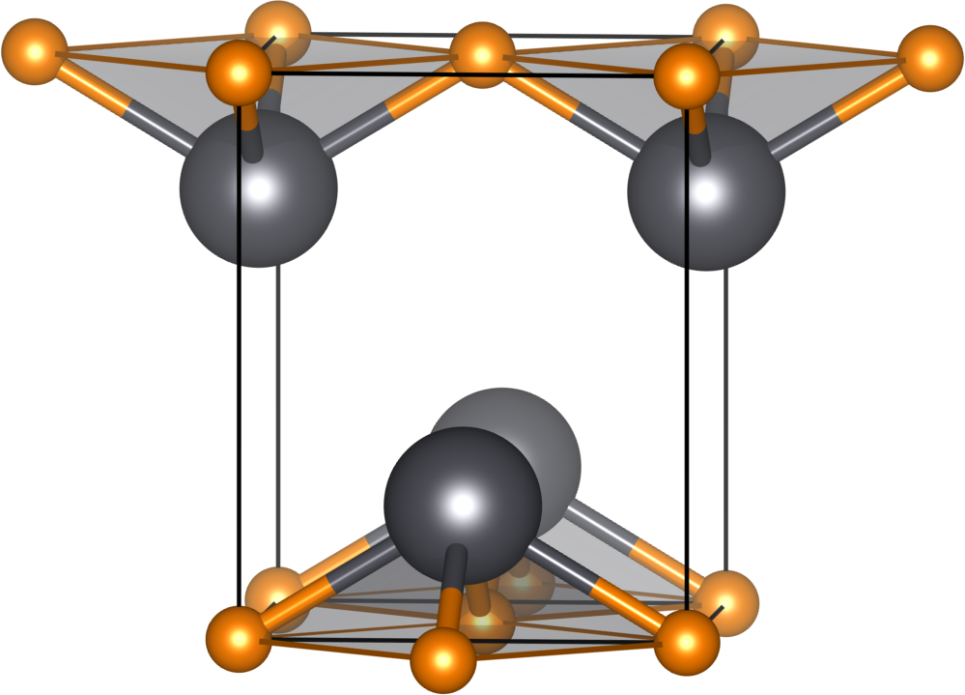
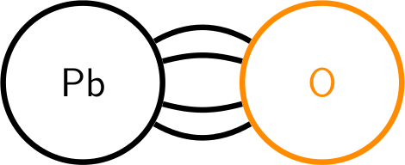
Crystal structures of simple oxides of divalent ions: AO
ZnO (wurtzite), sp³
MgO (rock-salt)
Ubiquitous for AO oxides including transition metals (distorted for CuO and NbO).
Insulators, metals (TiO), magnetic, …
PbO (litharge), lone pairs
Pb²⁺ is [Xe]4f¹⁴5d¹⁰6s²6p⁰

Slide 9
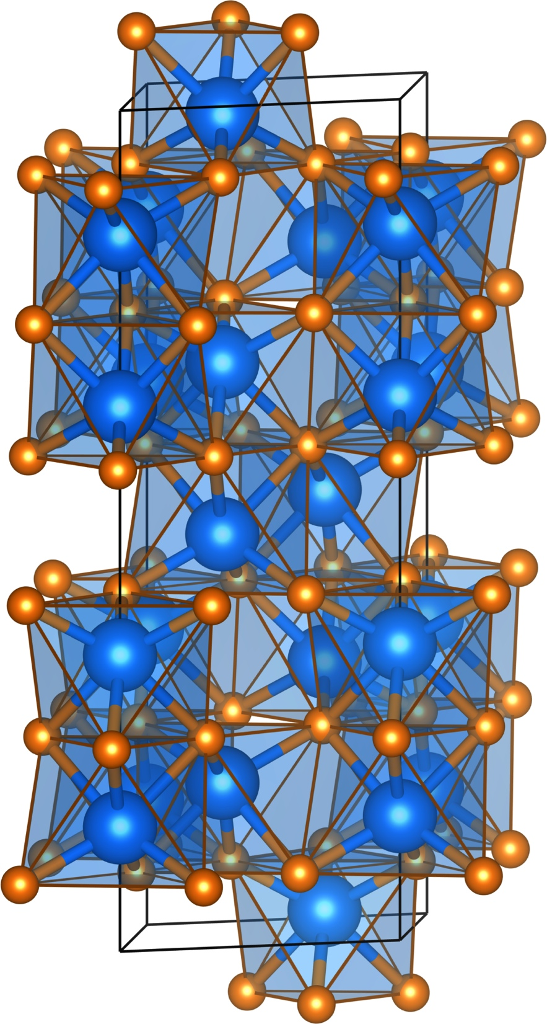
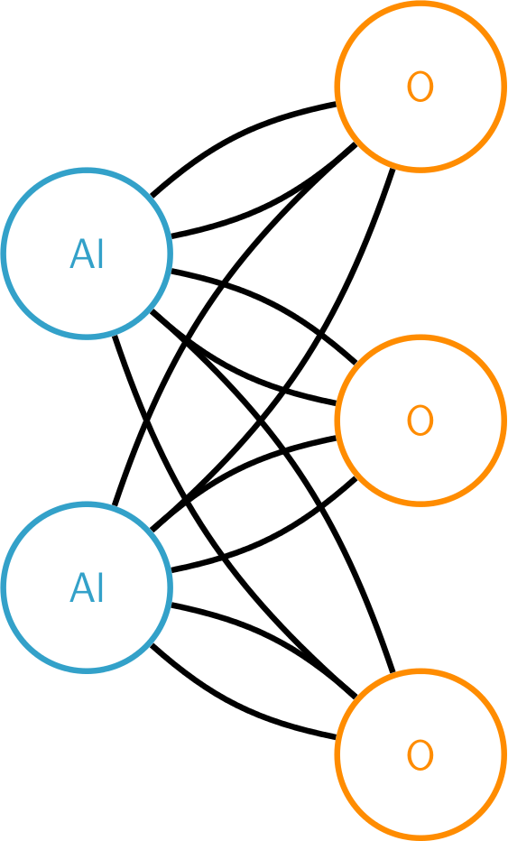
Crystal structures of simple oxides. Al₂O₃ as an example of a sesquioxide
α-Al₂O₃ (corundum)
Also the structure of Cr₂O₃ and Fe₂O₃.
Ga₂O₃ does funny things.
In₂O₃ is different (bixbyite).

Slide 10
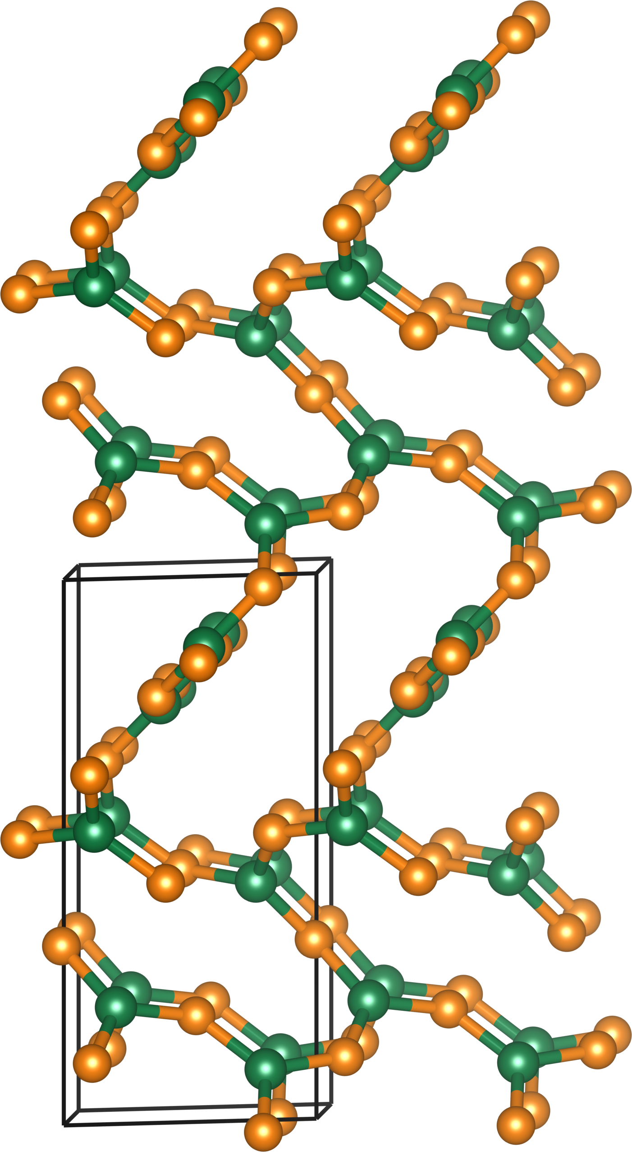
B₂O₃ (chiral, P3₁2₁)
B₂O₃ (hugely important for glass industry).
NB: This structure is not in scale with the others.

Slide 11
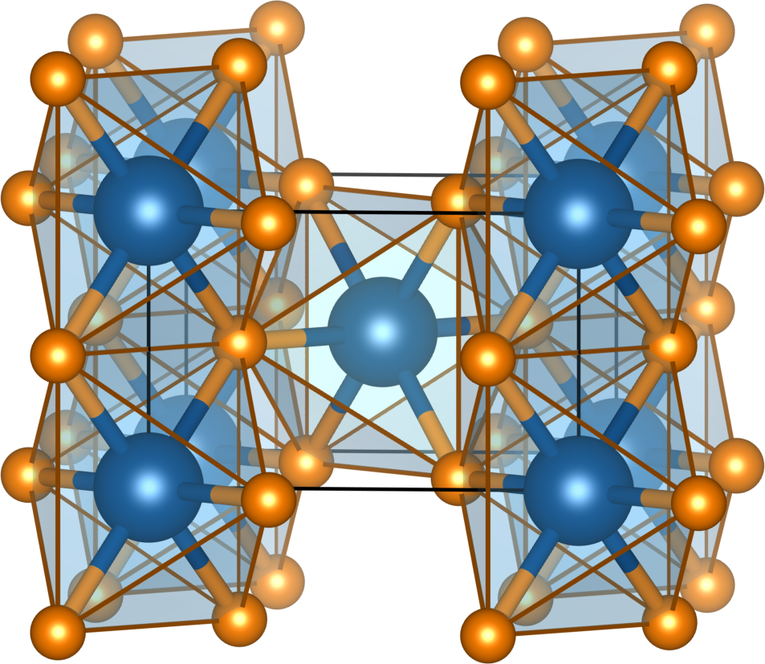
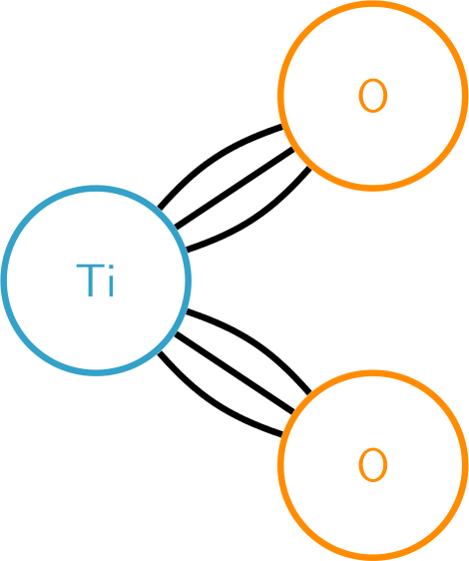
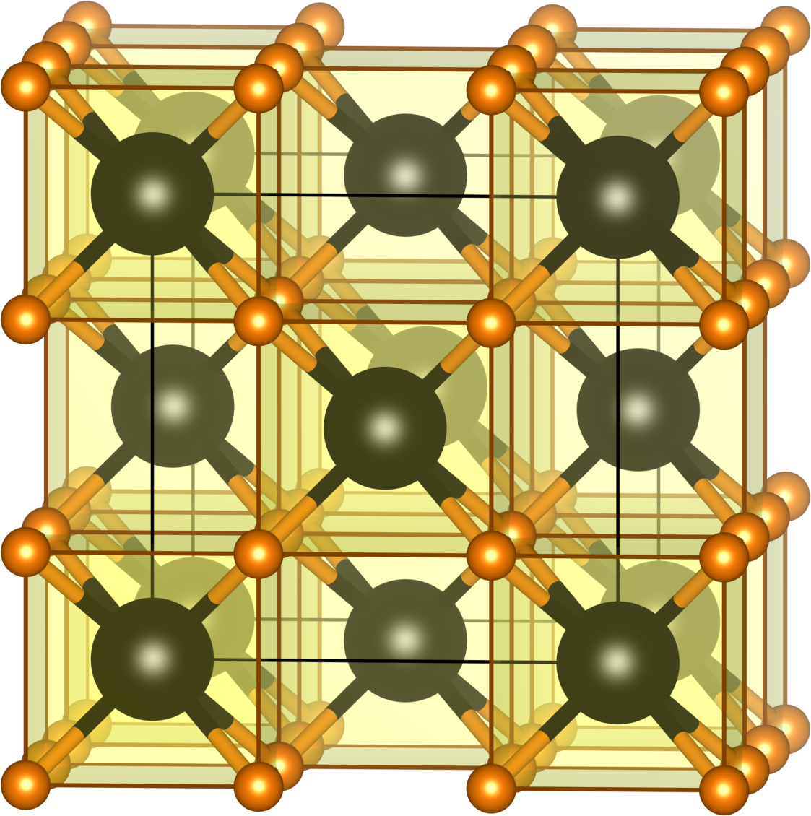
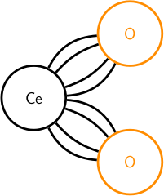
Crystal structures of simple oxides of tetravalent ions: AO₂
TiO₂ (rutile)
TiO₂ also crystallizes as anatase and brookite.
SiO₂ takes on this structure, and can be quenched to it, (stishovite) under pressure.
Also the structure of ThO₂, and of ZrO₂ and HfO₂ at elevated temperatures.
Ordered variants abound.
The radius ratio rule at play:
CO₂ Linear
SiO₂ Tetrahedral
TiO₂ Octahedral
HfO₂ 7-coordinate
CeO₂ Cubic
CeO₂ (fluorite)

Slide 12
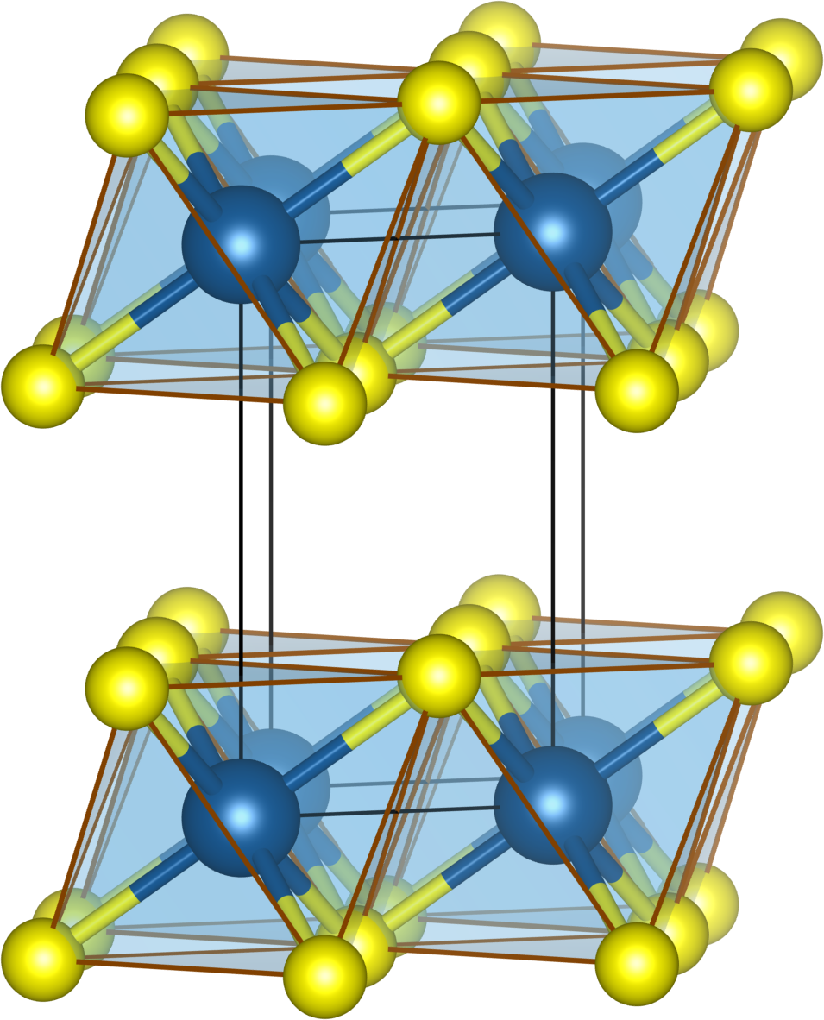
Oxides versus sulfides: TiS₂
1T–TiS₂
van der Waals gap (unlikely in oxides or fluorides, but occurs frequently in hydroxides)
This is the CdI₂ structure.

Slide 13
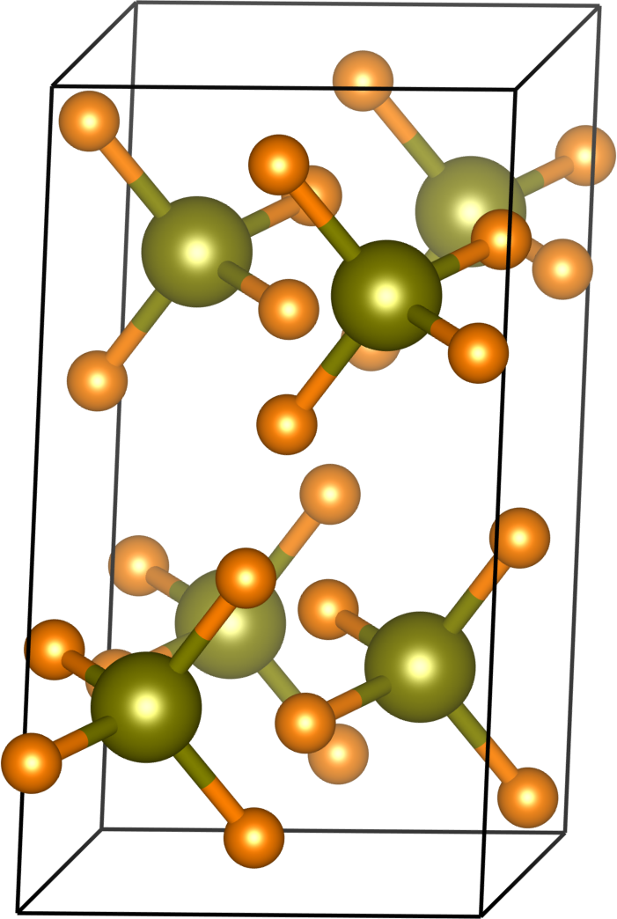
Crystal structures of an oxide with an octavalent ion: OsO₄
OsO₄

Slide 14
Pauling’s second rule: The electrostatic valence rule
In brief: Charges going out from cations should balance anions and vice-versa
+1/2
+3/6
electrostatic bond strength or valence
s = charge on cation/coordination number
+8/4
Why is OsO₄ a molecule? Radius ratio + electrostatic valence
Pauling, The Nature of the Chemical Bond, 3rd Edn., Cornell University Press, Ithaca 1960

Slide 15
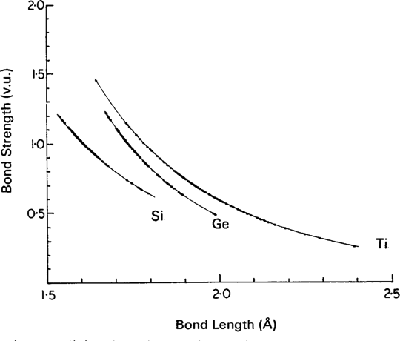
Electrostatic valence and bond valence
Pauling, and later Brown and Shannon, noted that the Pauling bond strength (the electrostatic valence) correlates very well with distance for many oxides: Short bonds (distances) correspond to strong bonds and vice-versa
Brown, Shannon, Empirical bond-strength-bond-length curves for oxides, Acta Cryst. A 29 (1973) 266–281

Slide 16

Electrostatic valence and bond valence
The modern bond valence relationship:
Where s is the strength of the bond, R is the cation to anion distance, and R₀ and B (≈ 0.37 Å) are parametrized for the specific ion pair.
When all s are calculated: valence of the ion
s = +2/6
For Mn²⁺–O^{2–}, R₀ = 1.790 Å, B = 0.37 Å.
This means R = 2.20 Å.
experiment: 2.22 Å
Brown, Shannon, Empirical bond-strength-bond-length curves for oxides, Acta Cryst. A 29 (1973) 266–281.

Slide 17
Electrostatic valence and bond valence: Parameters for Mn
Mn 2 O -2 1.790 0.37 a
Mn 2 O -2 1.765 0.37 j
Mn 2 S -2 2.22 0.37 e
Mn 2 F -1 1.698 0.37 a
Mn 2 Cl -1 2.133 0.37 a
Mn 2 Br -1 2.34 0.37 e
Mn 2 I -2 2.52 0.37 e
Mn 2 N -3 1.849 0.37 j
Mn 2 N -3 1.65 0.35 e
Mn 3 O -2 1.760 0.37 a
Mn 3 O -2 1.732 0.37 j
Mn 3 F -1 1.66 0.37 b
Mn 3 Cl -1 2.14 0.37 b
Mn 3 N -3 1.837 0.37 j
Mn 4 O -2 1.753 0.37 a
Mn 4 O -2 1.750 0.37 j
Mn 4 F -1 1.71 0.37 b
Mn 4 F -1 1.63 0.37 e
Mn 4 Cl -1 2.13 0.37 b
Mn 4 N -3 1.822 0.37 j
Mn 6 O -2 1.79 0.37 e
Mn 7 O -2 1.827 0.37 e
Mn 7 O -2 1.79 0.37 b
Mn 7 F -1 1.72 0.37 b
Mn 7 Cl -1 2.17 0.37 b
bvsparm.cif

Slide 18
Crystal structures of some complex oxides [containing two or more cation sites]

Slide 19
The major ternary structural families (Muller and Roy, page 3, redrawn and modified)
CaCO₃
Perovskite
ABX₃
Hexagonal ABX₃ (eg. BaNiO₃ in the CsCrBr₃ structure)
Pyroxenes and related structures (eg. diopside CaMgSi₂O₆)
Corundum and related structures (eg. ilmenite FeTiO₃)
Zircon (ZrSiO₄)
Scheelite (CaWO₄)
ABX₄
Barite (BaSO₄)
Ordered SiO₂ derivatives
Ordered rutile derivatives
not listed by Muller and Roy
Ternary structural families
K₂NiF₄ (m = 1 Ruddlesden-Popper)
β–K₂SO₄
A₂BX₄
Olivine (Mg₂SiO₄ and for eg. LiFePO₄)
Spinel (MgAl₂O₄)
CaFe₂O₄
Phenacite (Be₂SiO₄)
Will discuss compounds in highlighted boxes: Characterized by dense connectivity.
ABX₂ (eg. LiCoO₂ and CuFeO₂)
A₂B₂X₇ (eg. pyrochlore Y₂Ti₂O₇)
others
A₂BX₅
A₂BX₆
A₃BX₅

Slide 20
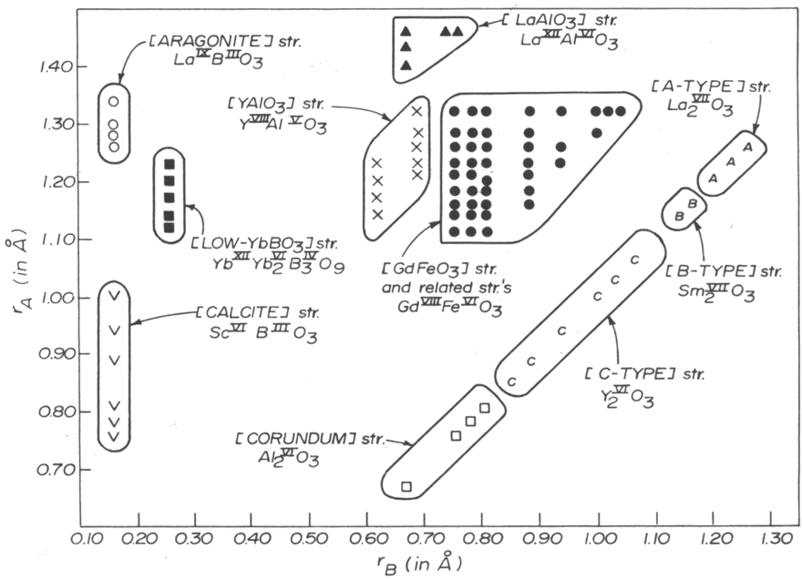
The ABO₃ structure-sorting field (from Muller and Roy)
The superscripted roman numerals indicate coordination number.

Slide 21
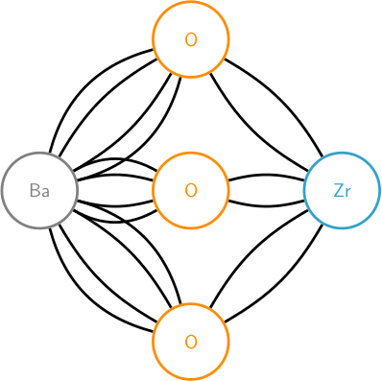
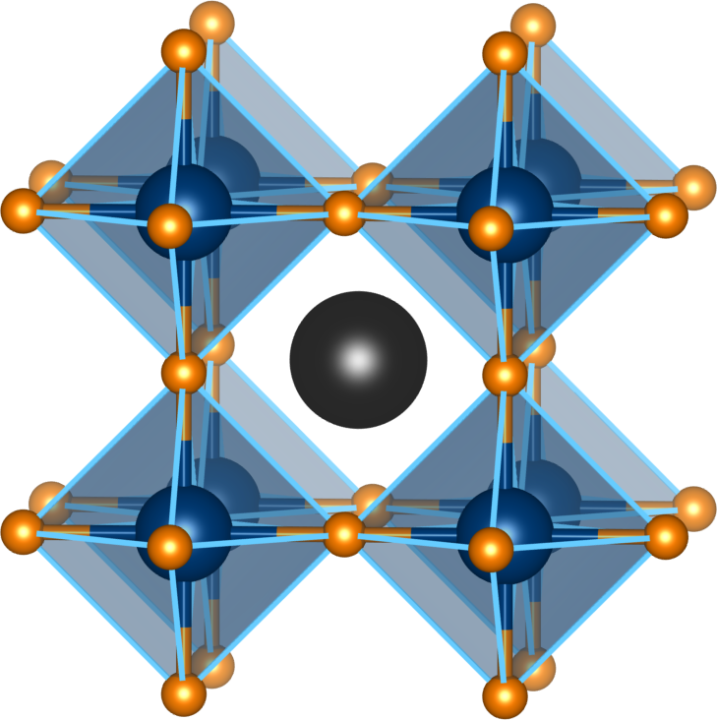
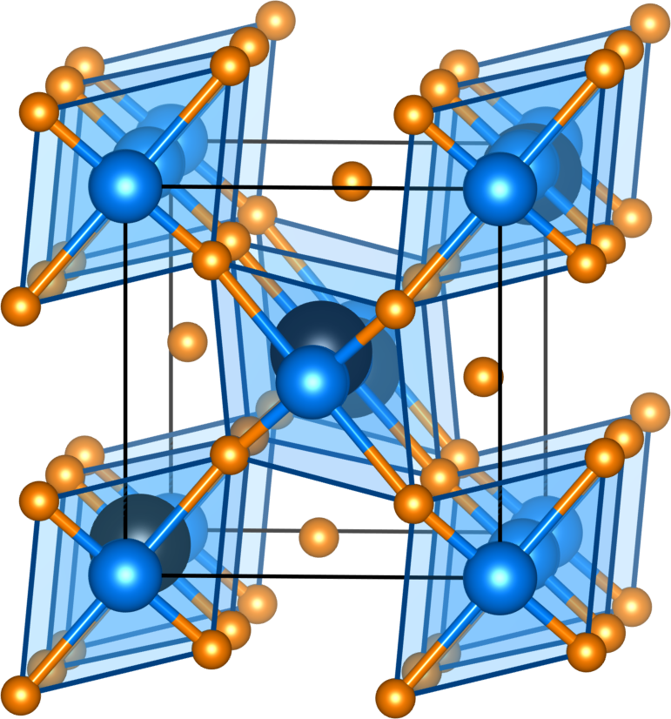
Perovskite
BaZrO₃
+2/12
+4/6
LaMnO₃ Pnma
(Jahn-Teller distorted)
Note that the space group Pnma (#62) can be written in a variety of ways.
This is the most common perovskite space group.
In the next so many structures, BO₆-polyhedra are depicted.

Slide 22
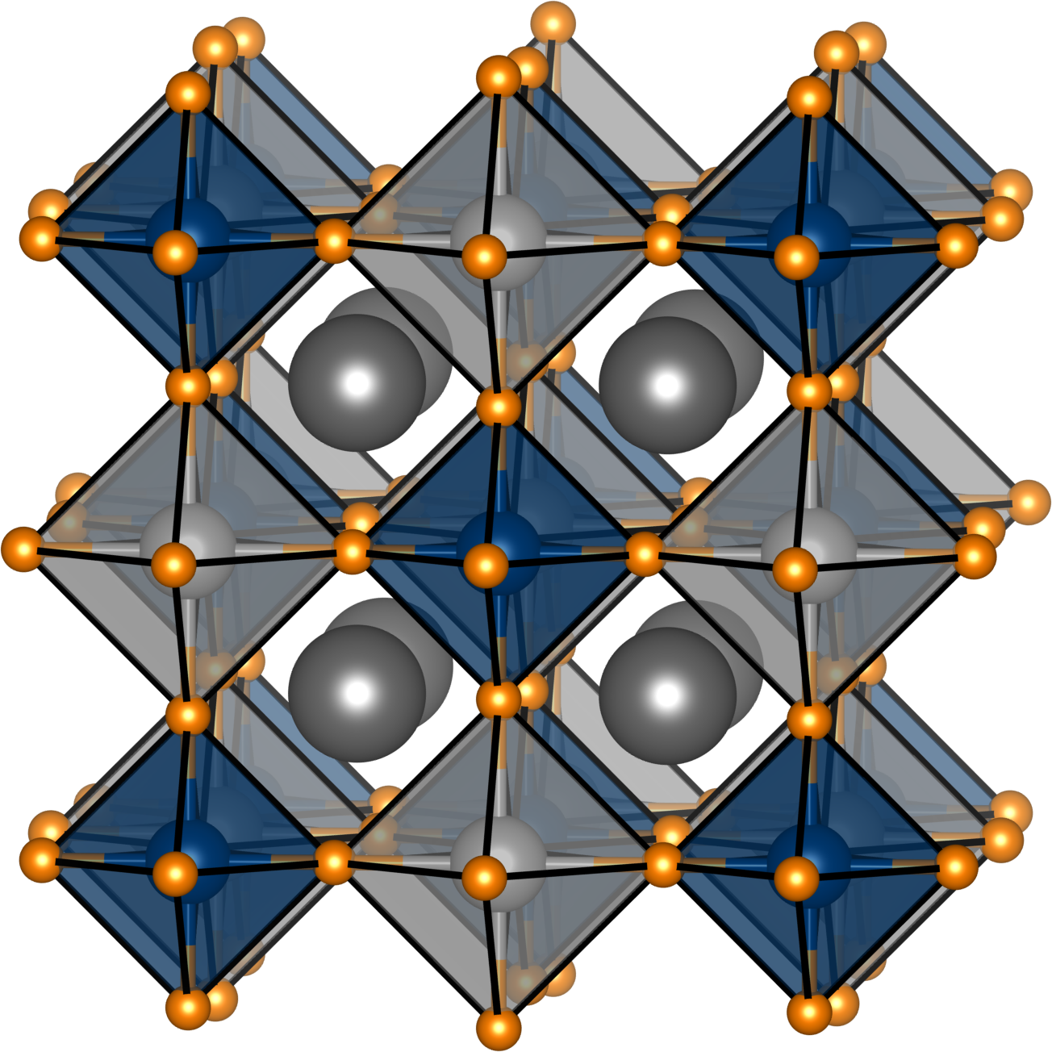
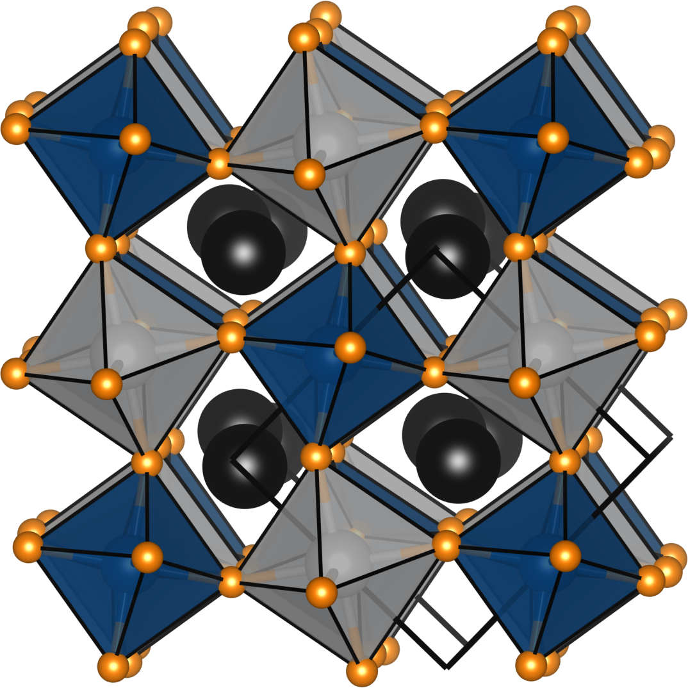
Ordered double perovskites (elpasolites), obtained through charge forking
2BaZr⁴⁺O₃ = Ba₂(Mg²⁺ + W⁶⁺)O₆
Ba₂MgWO₆
Ca₂MgWO₆
Rock-salt like ordering of dissimilar octahedra. Space group same as rock-salt: Fm–3m
Smaller A-ions associated with tilting as in simple perovskites.

Slide 23
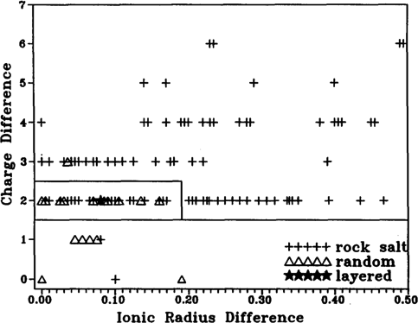
The double perovskite field: Charge and radius
Anderson, Greenwood, Poeppelmeier, Prog. Solid State Chem. 22 (1993) 197–233.

Slide 24
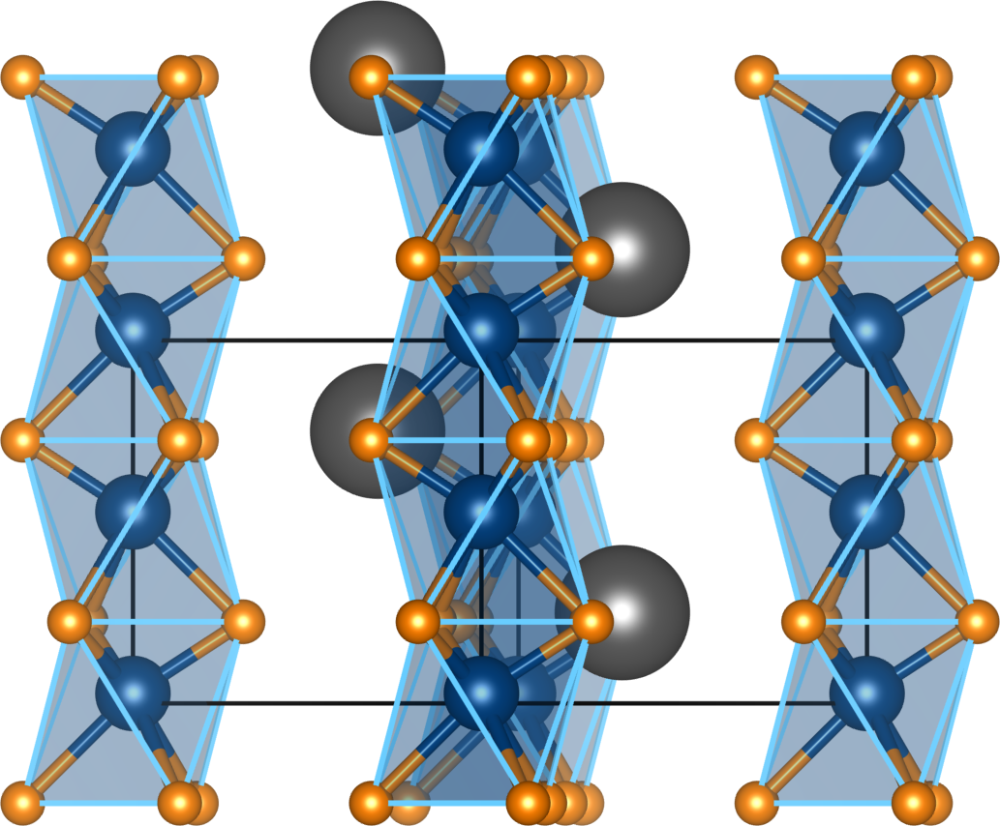
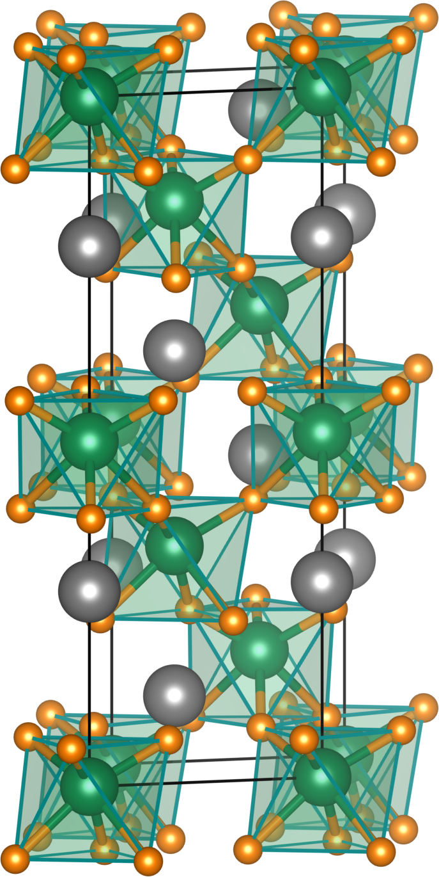
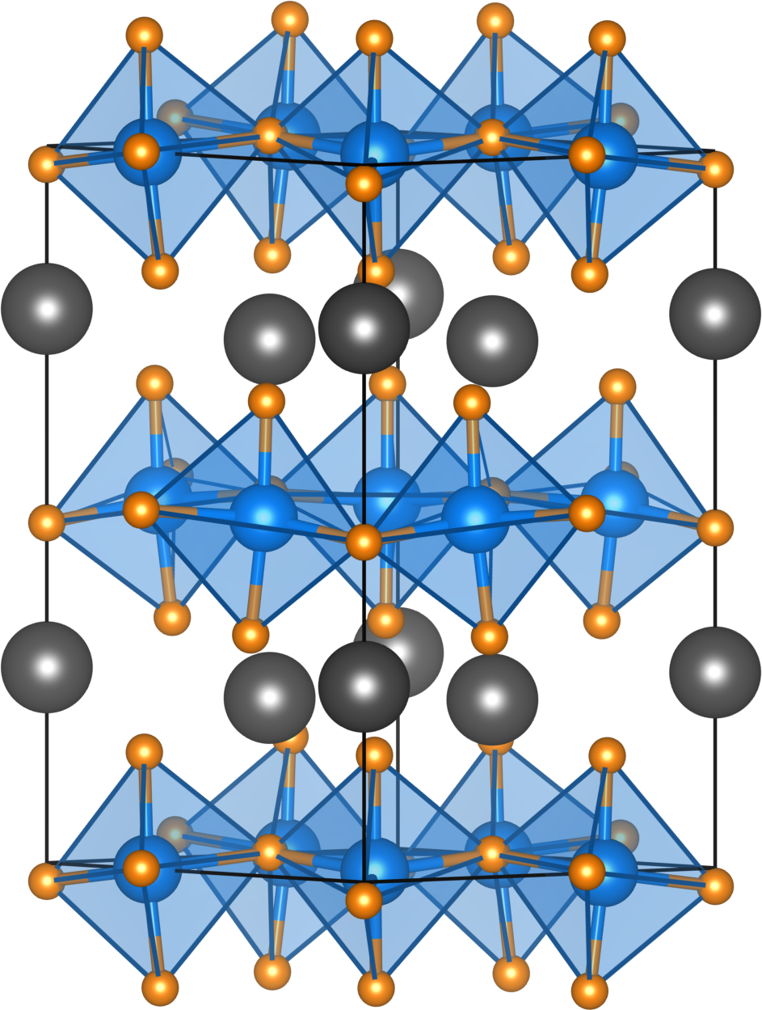
Hexagonal ABO₃ structures
BaNiO₃
LiNbO₃ (ferroelectric R3c)
Ferroelectric YMnO₃ (“YAlO₃”)
Unusual 5-fold coordination (trigonal bibyramid) of MnO₅

Slide 25
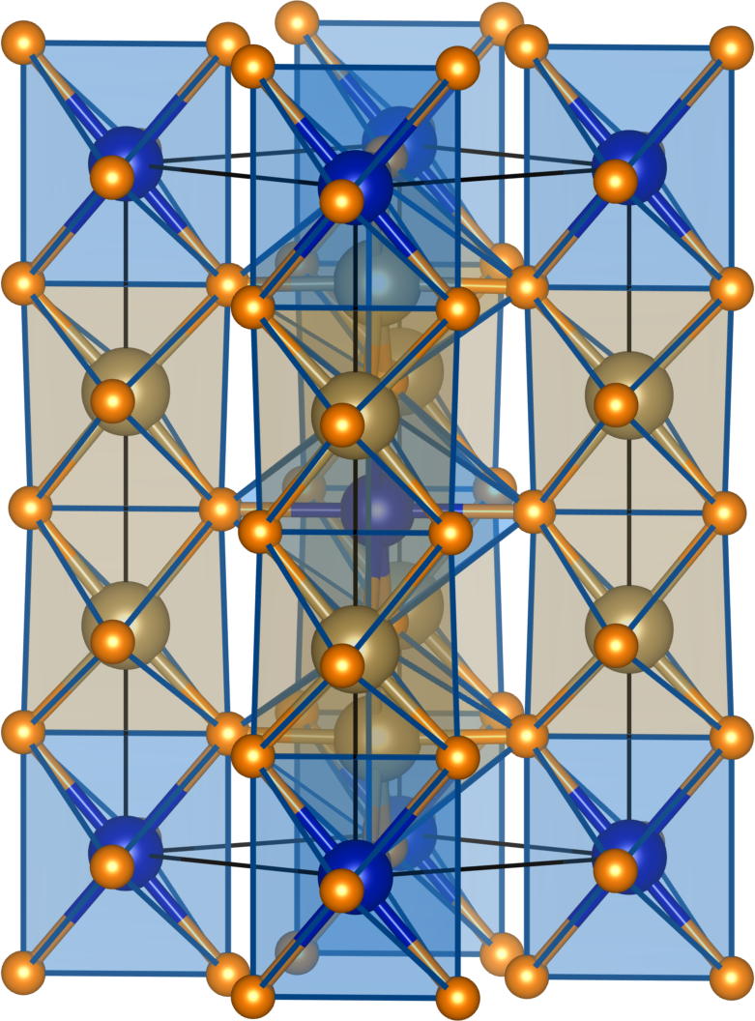
Ordered rutiles (the trirutile), obtained through charge forking
CoTa₂O₆: 3×TiO₂ = Ti₃O₆; 3×Ti⁴⁺ = Co²⁺ + 2×Ta⁵⁺

Slide 26
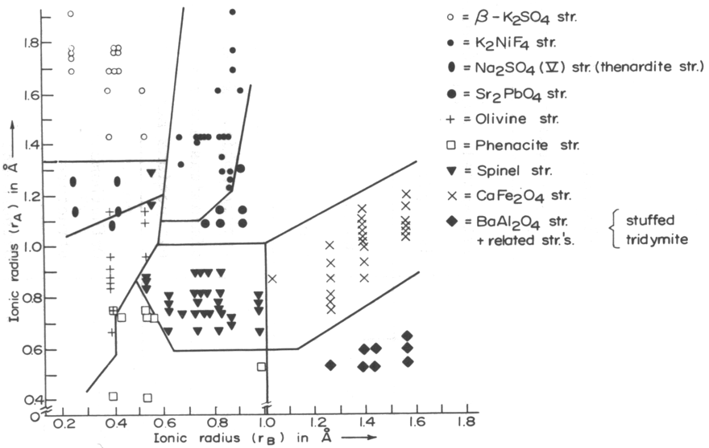
The A₂BO₄ structure-sorting field (from Muller and Roy)
The superscripted roman numerals indicate coordination number.

Slide 27
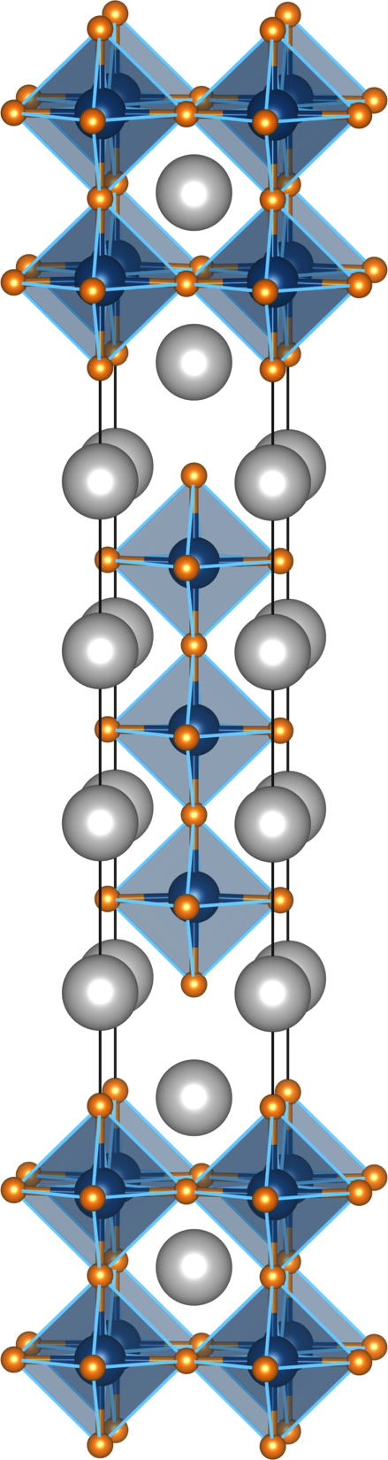
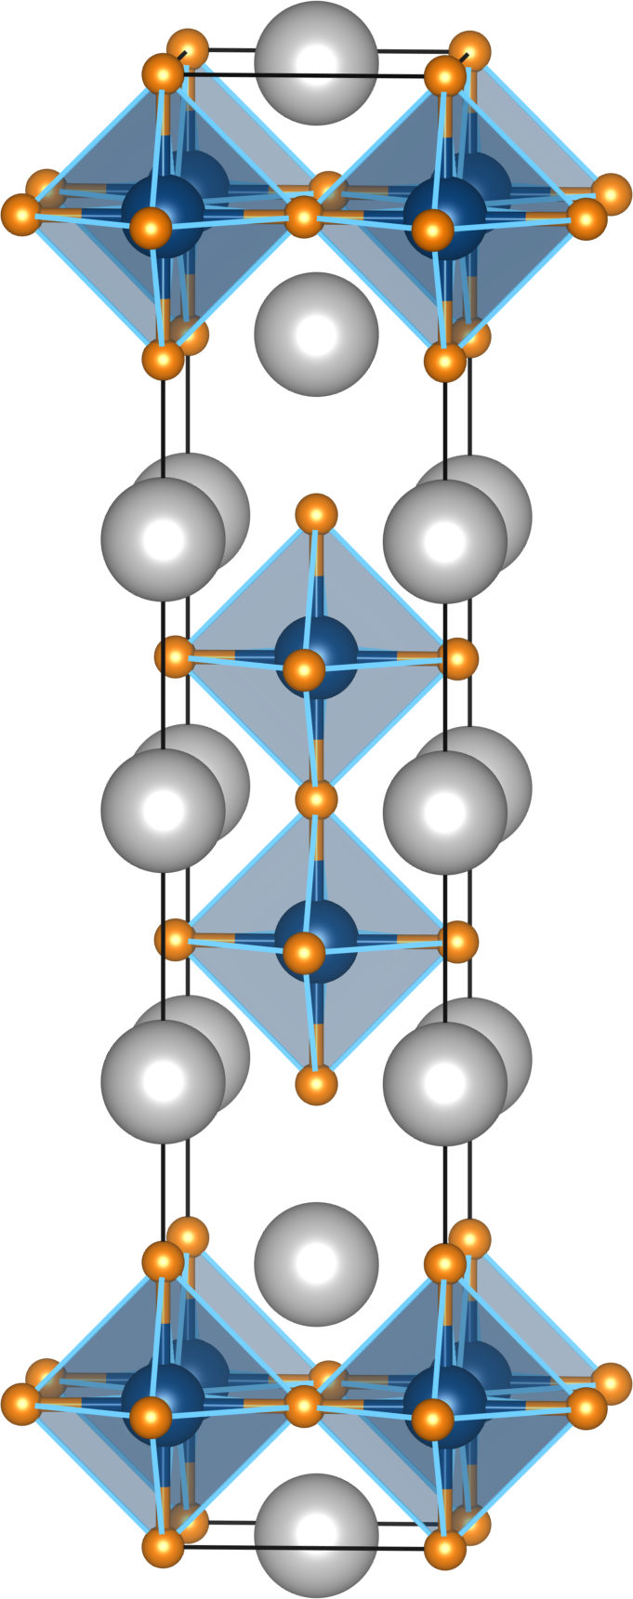
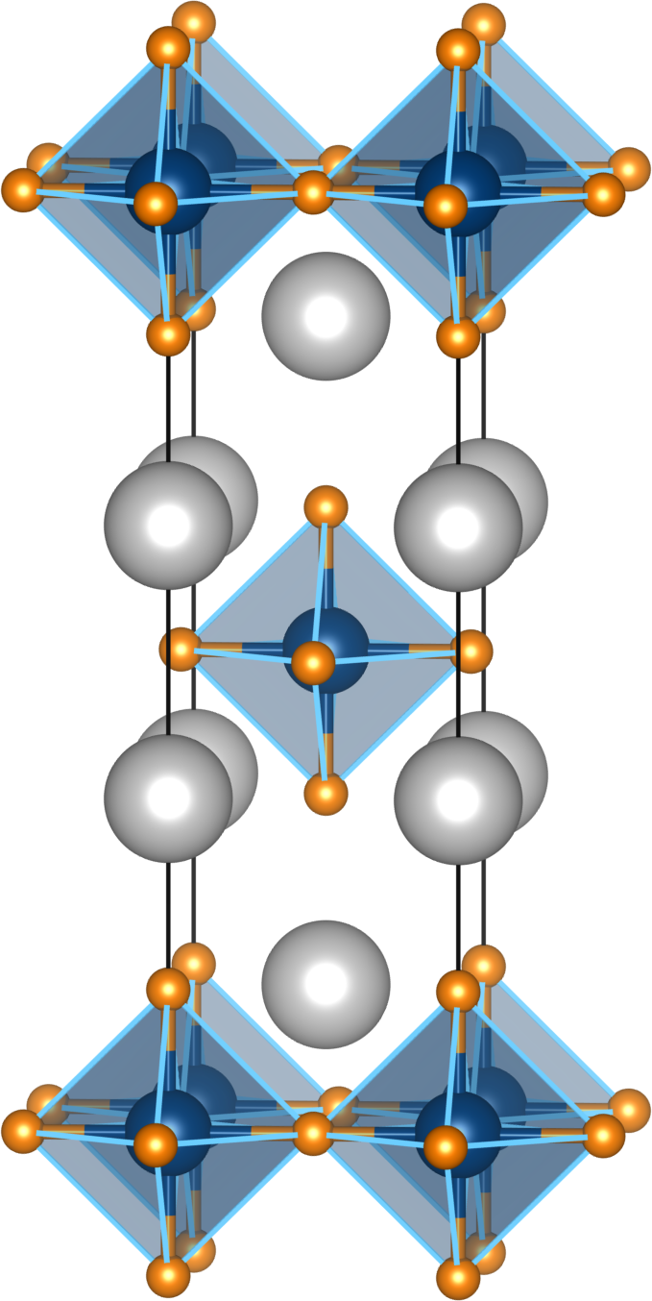
K₂NiF₄ and Ruddlesden-Popper (m = 1, 2, 3)
General formula [SrO][SrTiO₃]_{m}
Sr₄Ti₃O₁₀
Sr₃Ti₂O₇
Sr₂TiO₄
m = 3

Slide 28
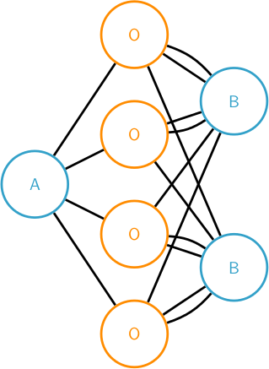
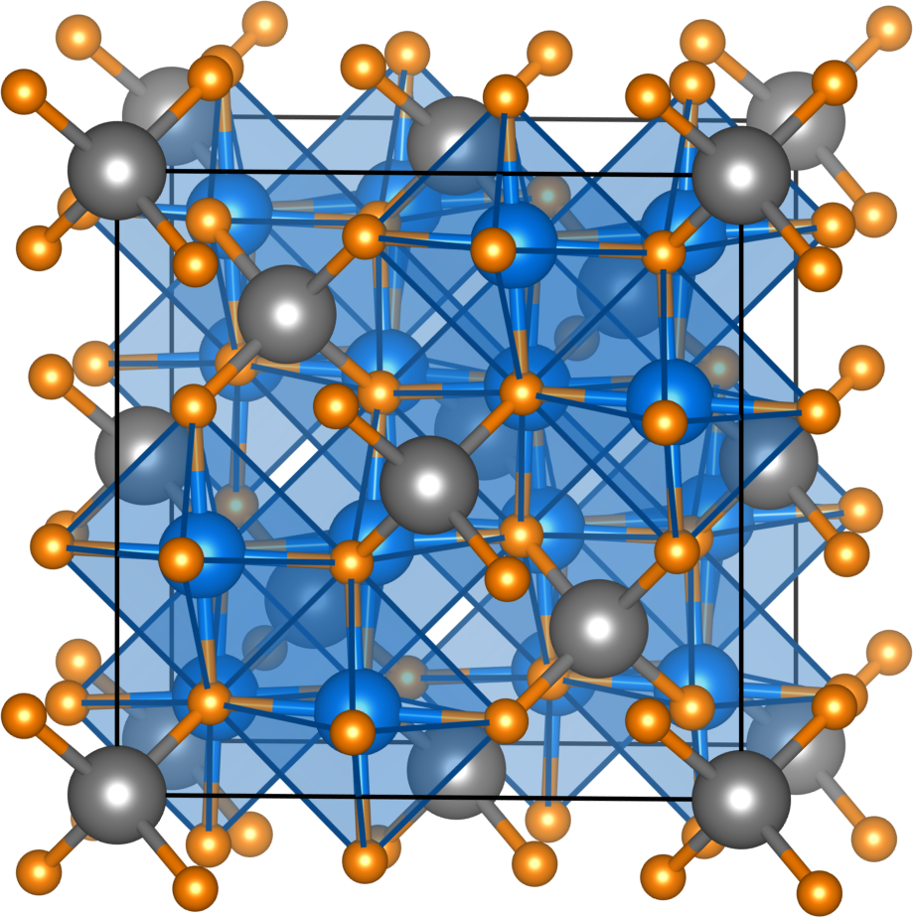
Spinel AB₂O₄
MgAl₂O₄
Ubiquitous structure when ions have similar sizes, around 0.6 Å.
A is tetrahedrally coordinated, and B octahedral (actually with a slight trigonal distortion).
In general, lower oxidation states and smaller bandwidths than in perovskites.

Slide 29
Spinel AB₂O₄
ions on the A site
Li
Mg
Al
Sc
Ti
V
Cr
Mn II
Fe III
Co
II
Ni
Cu
Zn
Ga
Ge
Rh
Ag
Cd
In
Sn
ions on the B site
Li
Mg
Al
Sc
Ti III
V
III
Cr III
Mn III
Fe II,III
Co II
Ni II
Cu
Zn
Ga
Ge
Co, Rh
III
Ag
Cd
In
Sn
A,B
Jahn-Teller active
A,B
Diamagnetic
Co II
High single-ion anisotropy

Slide 30
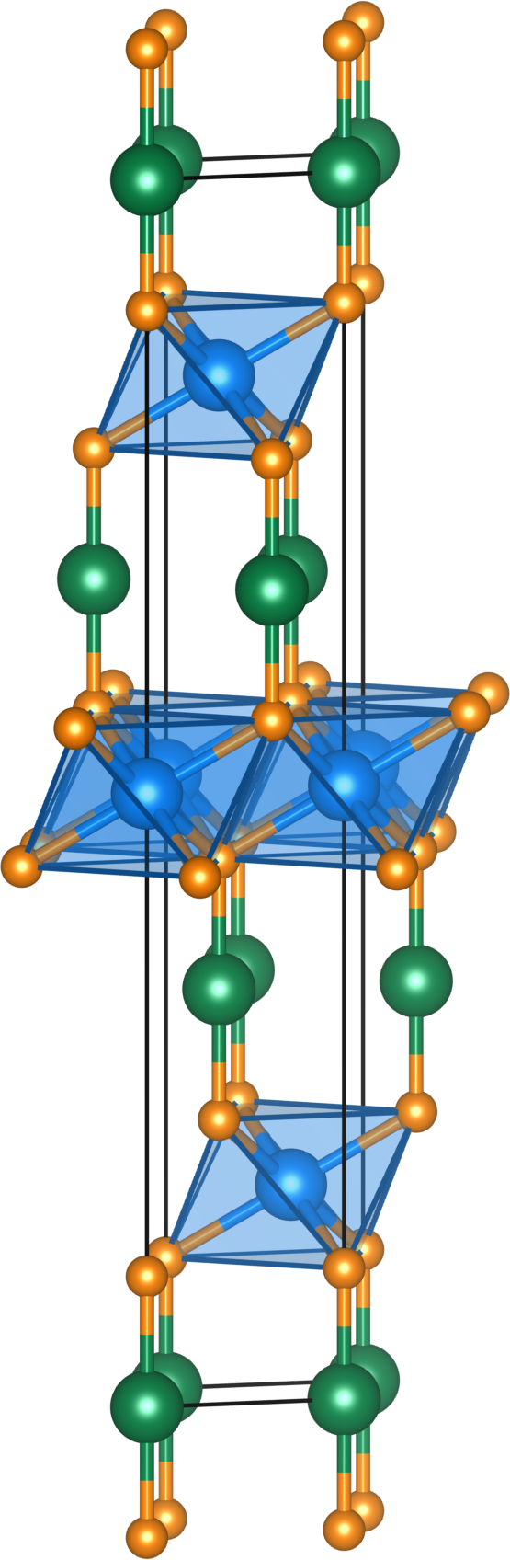
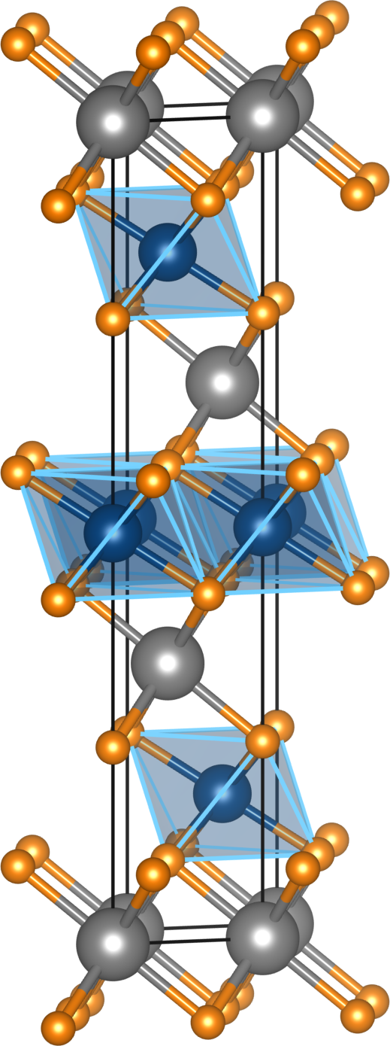
Some ABO₂ structures: Highly dense in-plane, and frequently metallic
LiCoO₂ (ordered rock-salt)
3R–CuFeO₂ (delafossite)
111-ordered with alternating octahedral LiO₆ and CoO₆ stacking
BO₂ (CdI₂) slabs separated by two-coordinate atoms, usually Cu⁺ and Ag⁺. Also unusually, Pd¹⁺ and Pt¹⁺.

Slide 31
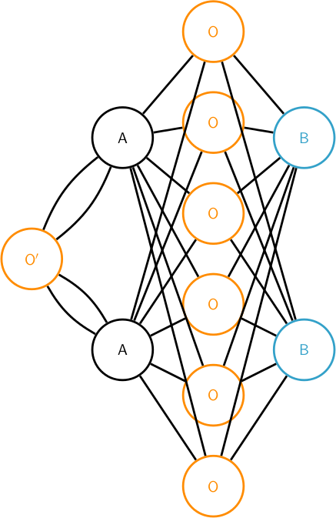
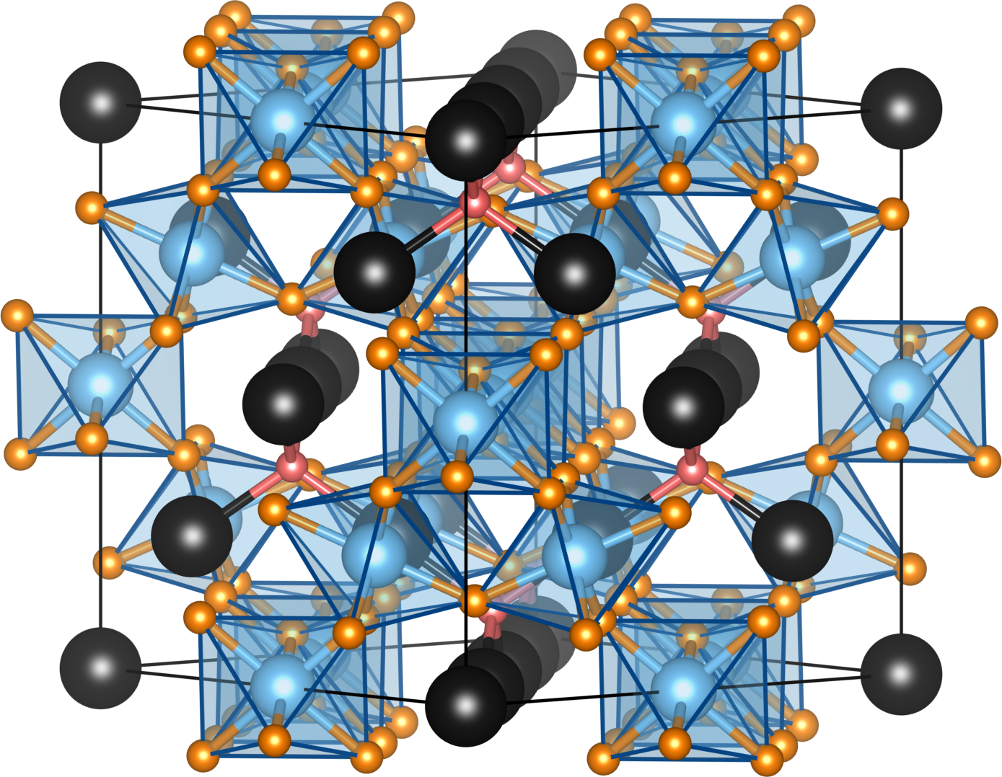
A₂B₂O₇ pyrochlore
Y₂Ti₂O₇ = Y₂Ti₂O₆O′
6+2-coordinate A atoms and 6-coordinate B atoms.
Separately, just connecting A or just connecting B yields two interpenetrating pyrochlore lattices of corner-connected tetrahedra.

Slide 32
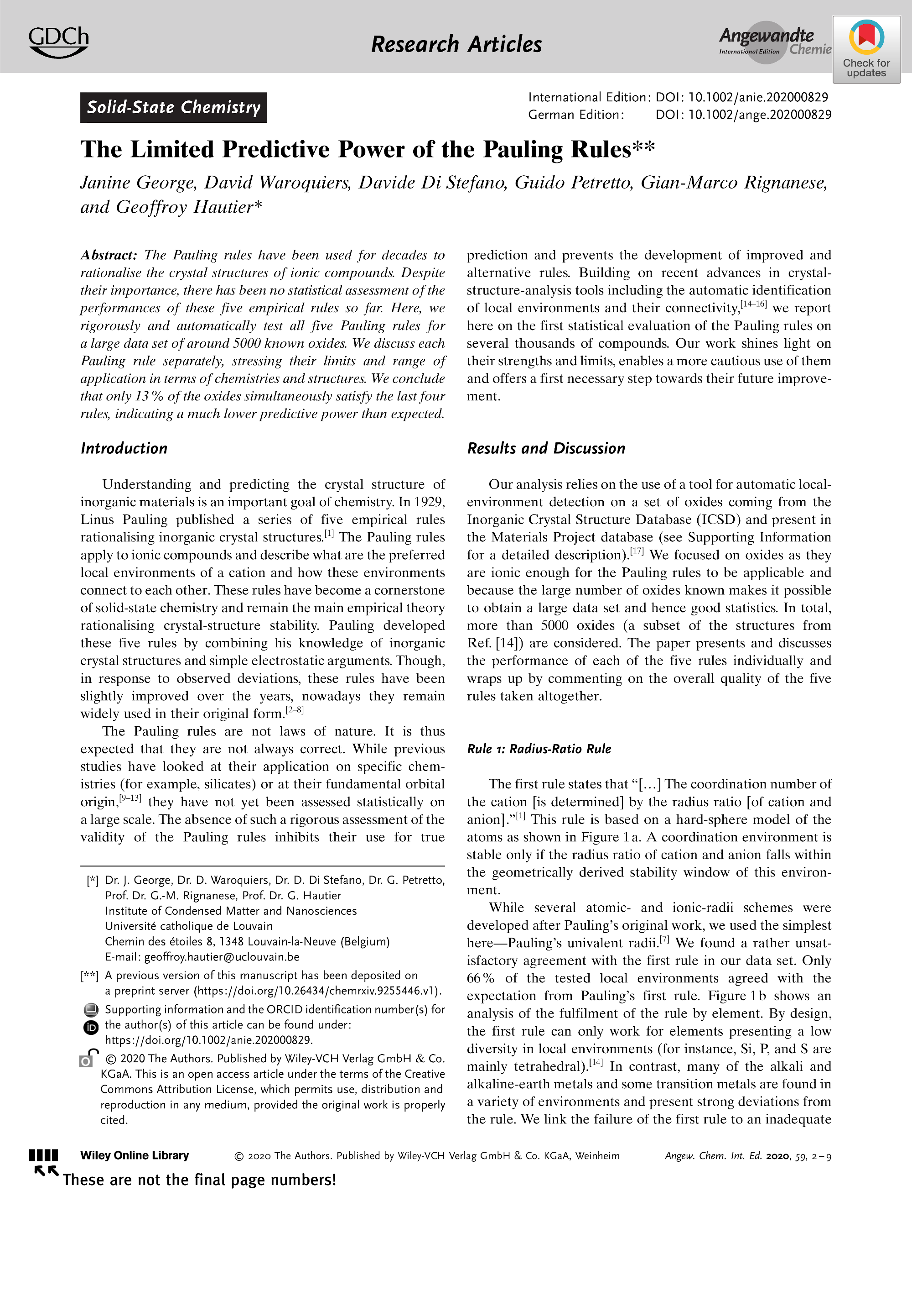
Some examples of the structural principles covered
“Here, we test rigorously and automatically all five Pauling rules for a large data set of around 5000 known oxides… We conclude that only 13% of the oxides simultaneously satisfy the last four rules, indicating their much lower predictive power than expected.”
https://doi.org/10.1002/anie.202000829

Slide 33
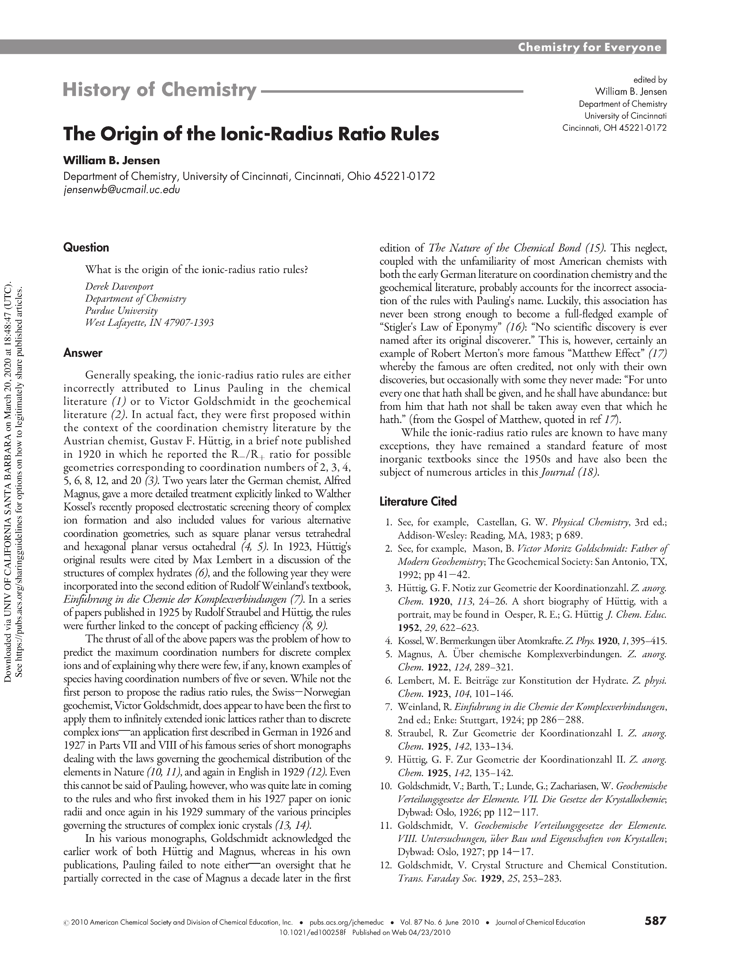
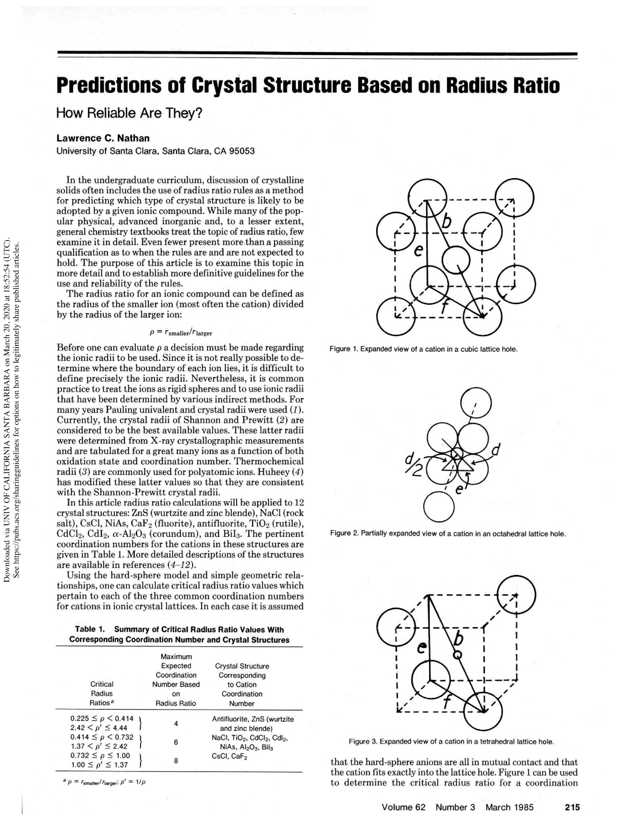
Not the first, and not the first …
https://doi.org/110.1021/ed100258f
https://doi.org/10.1021/ed062p215

Slide 34
Not the first, and not the first …
Letter from Pauling to W.L. Bragg. October 22, 1928:
“The last of August I sent two papers to the Editor of the Journal of the American Chemical Society. In one of them are rules governing the structures of complex crystals. I realize that nothing I have done is highly original - in particular was I gratified to read in your letter a statement of the rule governing the sharing of polyhedron elements.”

Slide 35
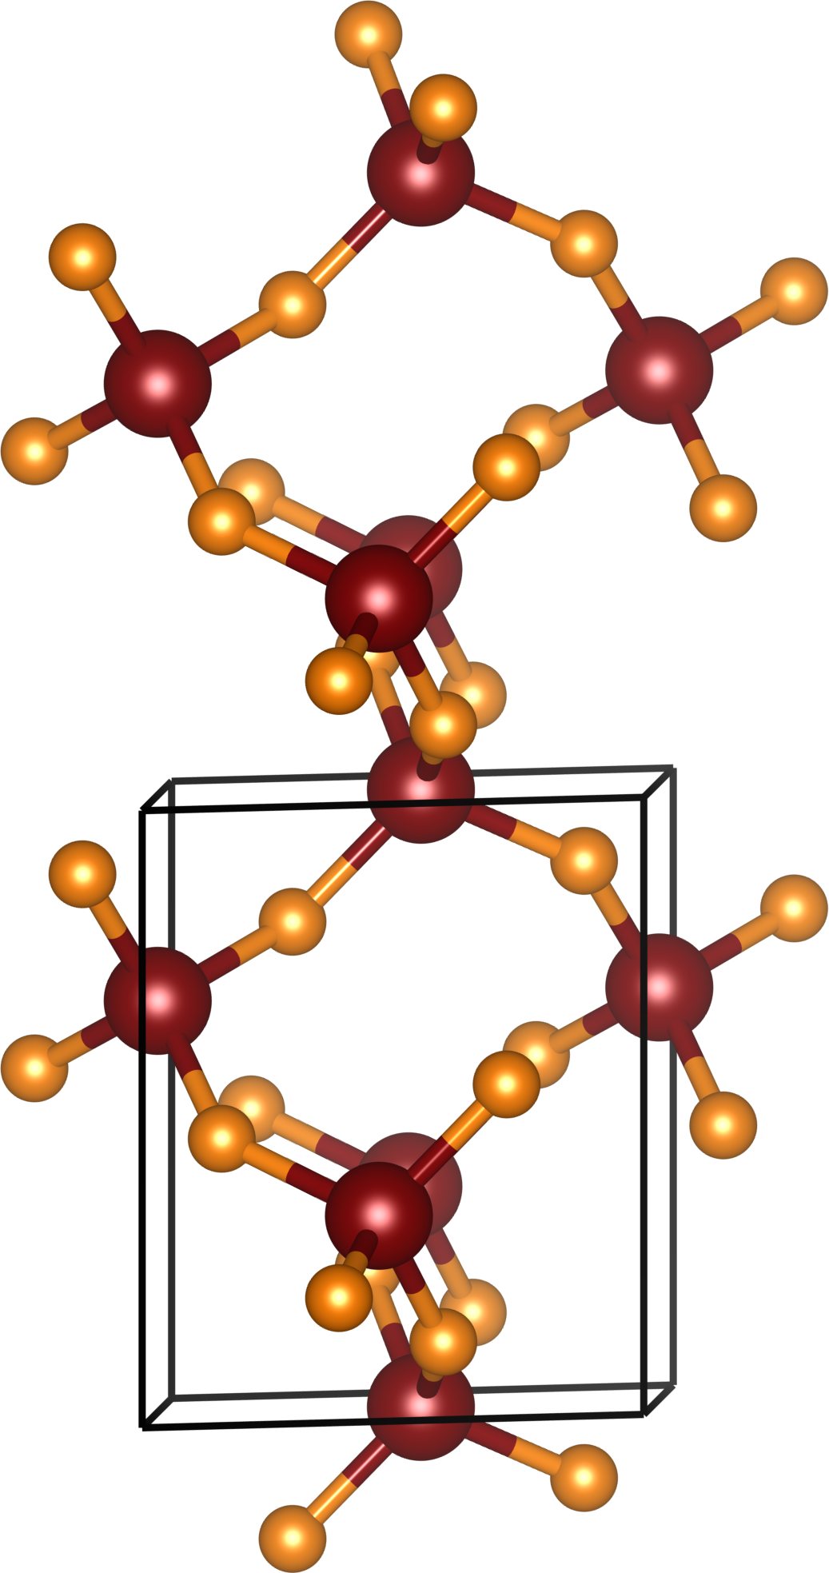

SiO₂ (low quartz, P3₂2₁)
O^{2–}
Si⁴⁺
O^{2–}

Slide 36
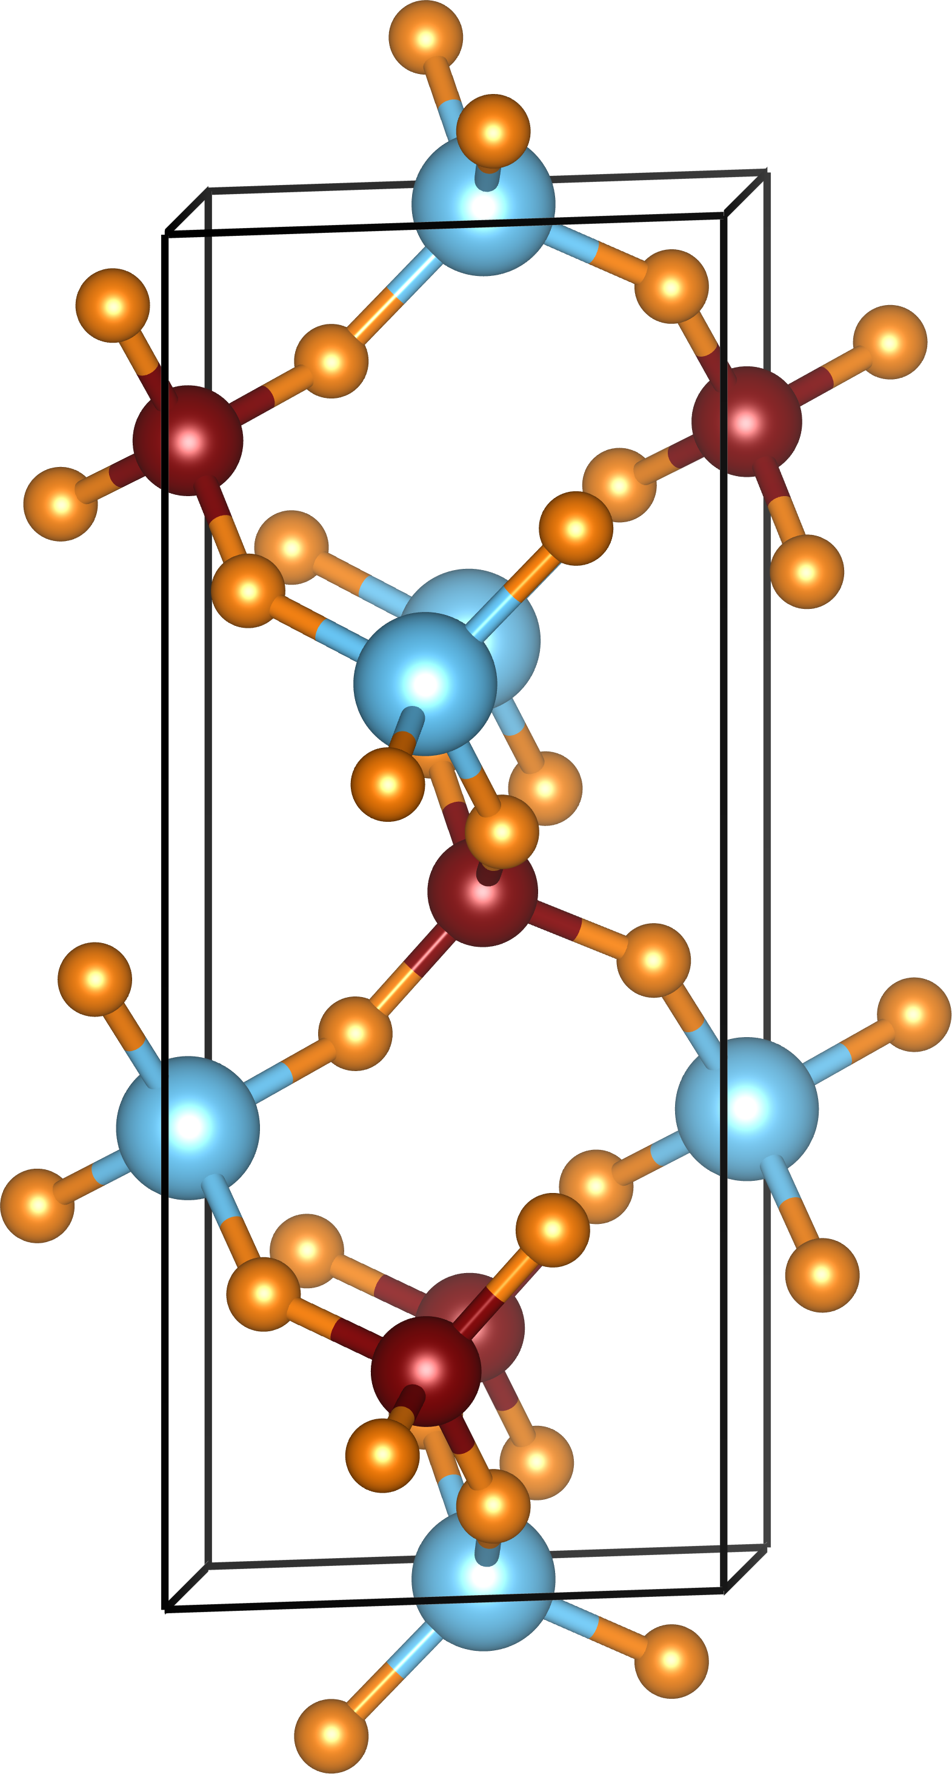
Berlinite, AlPO₄, obtained structurally by forking cation charges in SiO₂
O^{2–}
O^{2–}
P⁵⁺
Al³⁺
O^{2–}
O^{2–}

Slide 37
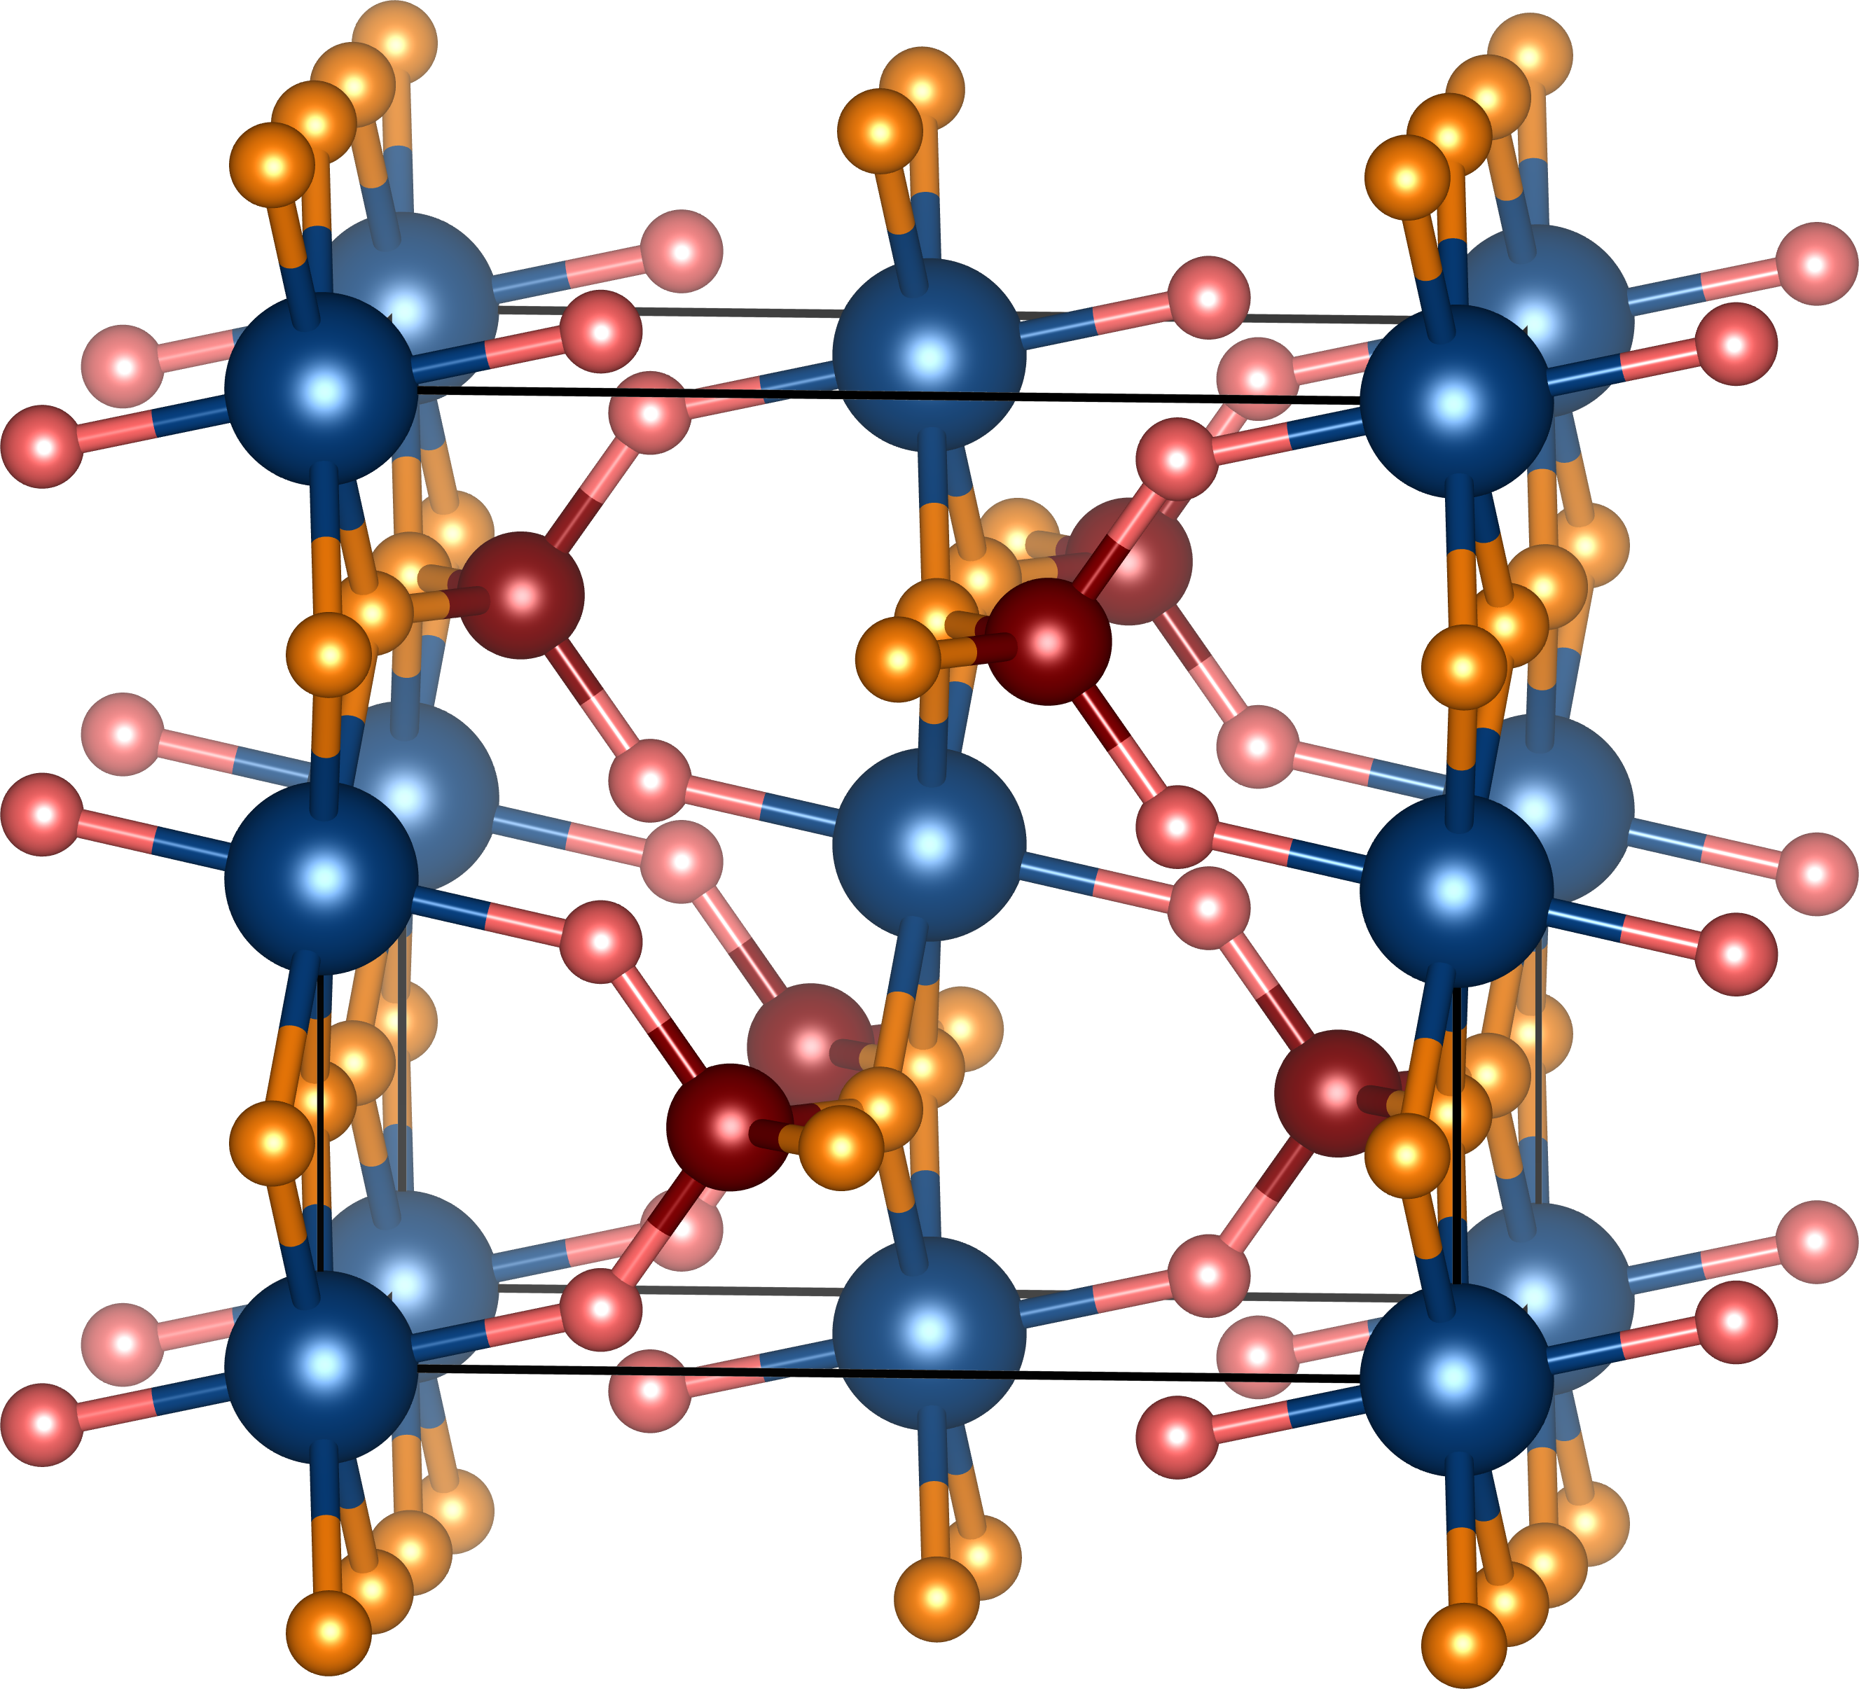
IPO₄: In³⁺ is too large for 4-coordination
O2^{2–}
O1^{2–}
P⁵⁺
In³⁺
O1^{2–}
O2^{2–}

Slide 38
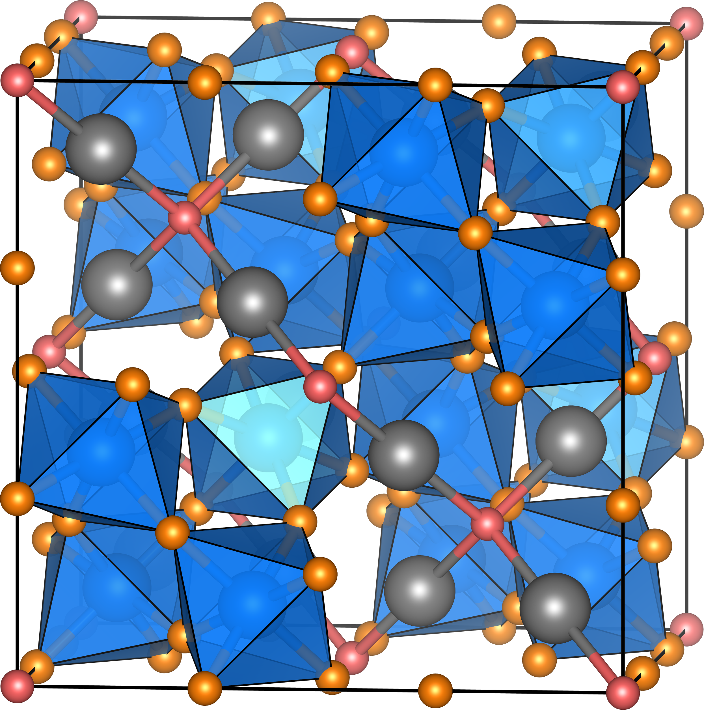
Pyrochlore Cd₂Ta₂O₇: The Bond Valence Map
O^{2–}
O^{2–}
Cd²⁺
Ta⁵⁺
O^{2–}
O′^{2–}
O^{2–}
Cd²⁺
Ta⁵⁺
O^{2–}
O^{2–}

