Slide 1
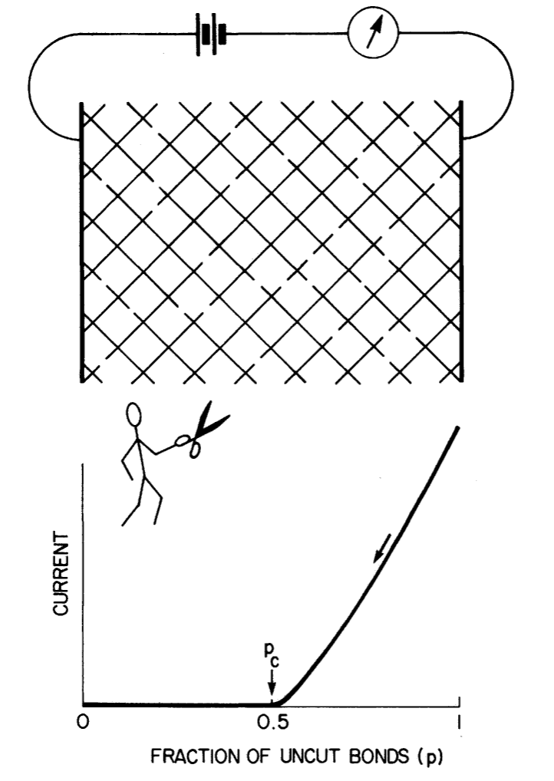
Percolation etc. [Closely following the text by R. Zallen]
This figure, from page 137 of Zallen, describes the problem in a 2D square mesh.
At some precise critical number of random snips, current flow stops.
This is an example of bond percolation as opposed to site percolation.
R. Zallen, The Physics of Amorphous Solids, Wiley-VCH, 2004.

Slide 2
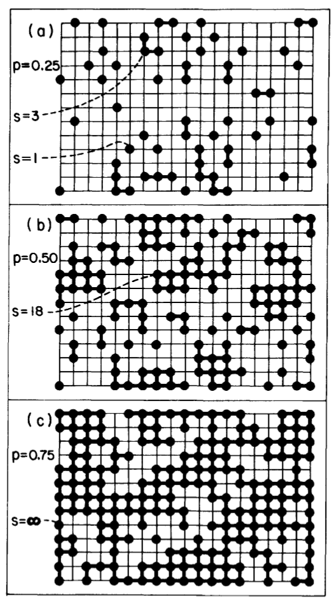
Percolation etc. [Closely following the text by R. Zallen]
This figure is from page 143 of Zallen.
This shows site percolation on a square lattice, with different site filling fractions p. For p = 0.75 in (c), the cluster formed by connecting neighboring atoms spans the whole lattice, and a percolation path is created.
R. Zallen, The Physics of Amorphous Solids, Wiley-VCH, 2004.

Slide 3
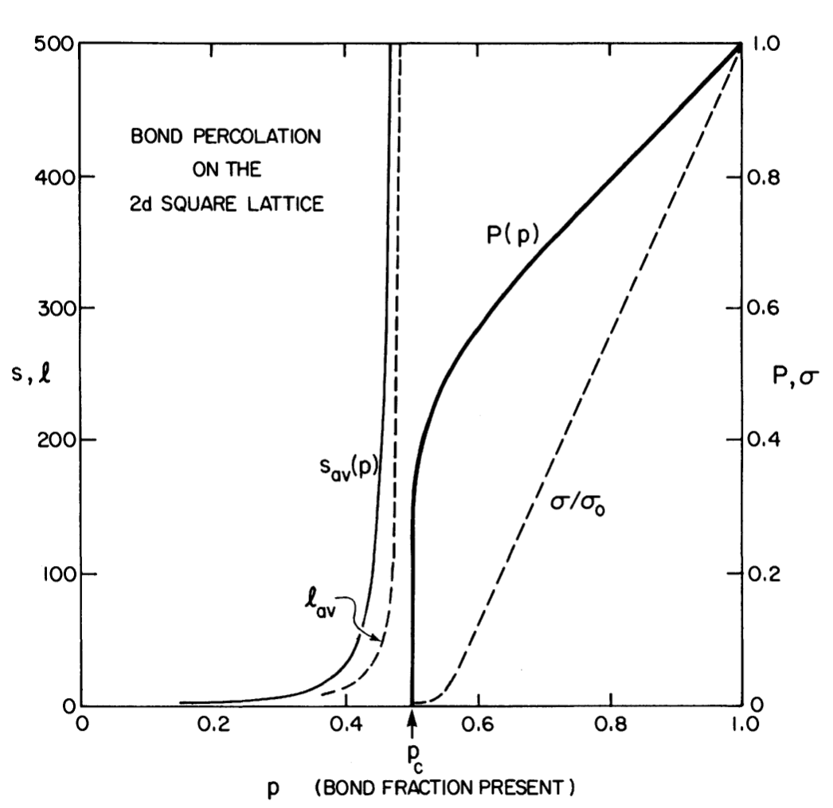
Percolation etc. [Closely following the text by R. Zallen]
This figure is from page 146 of Zallen.
Computer simulations on a large square lattice; s_{av}(p) is the average cluster size, and P(p) is the percolation probability.
R. Zallen, The Physics of Amorphous Solids, Wiley-VCH, 2004.

Slide 4
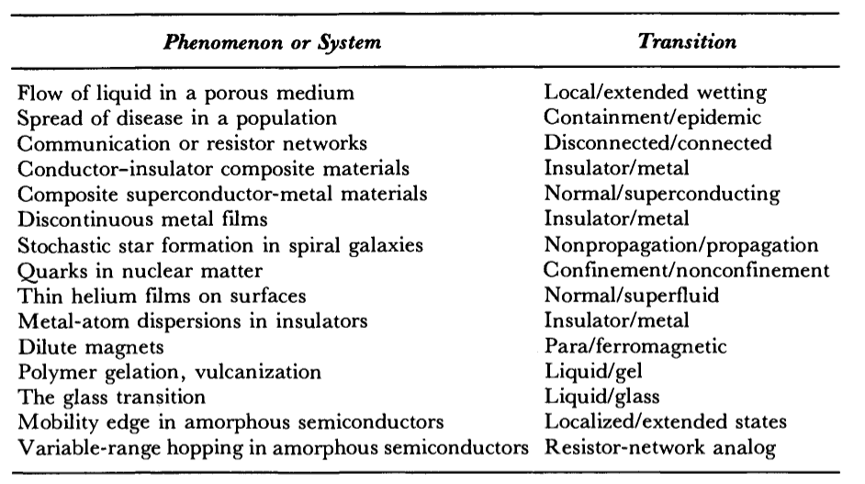
Percolation etc. [Closely following the text by R. Zallen]
Where is percolation applicable?
This table is from page 148 of Zallen.
R. Zallen, The Physics of Amorphous Solids, Wiley-VCH, 2004.

Slide 5
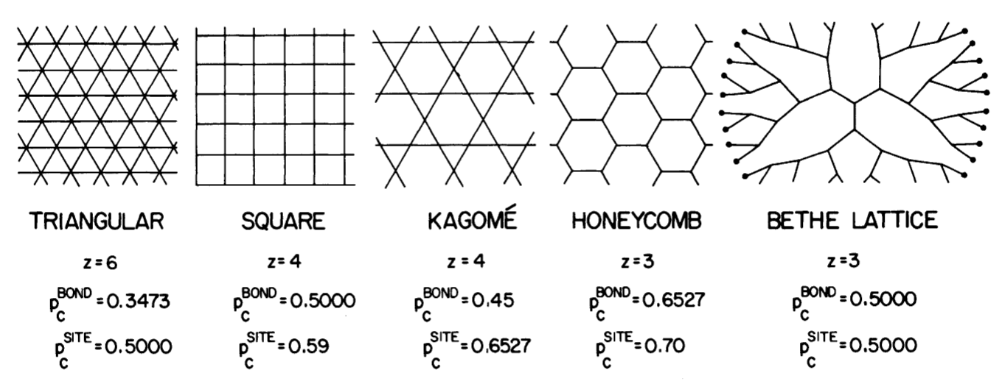
Percolation etc. [Closely following the text by R. Zallen]
Different lattices:
This table is from page 168 of Zallen.
R. Zallen, The Physics of Amorphous Solids, Wiley-VCH, 2004.

Slide 6
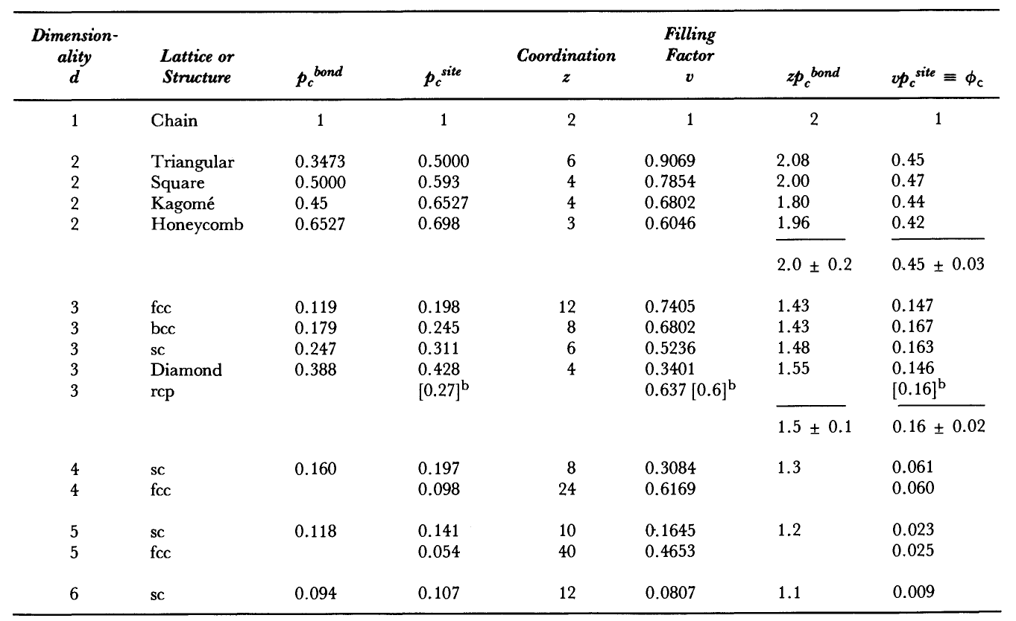
Percolation etc. [Closely following the text by R. Zallen]
This table is from page 168 of Zallen.
R. Zallen, The Physics of Amorphous Solids, Wiley-VCH, 2004.
Page 170 of Zallen.

Slide 7
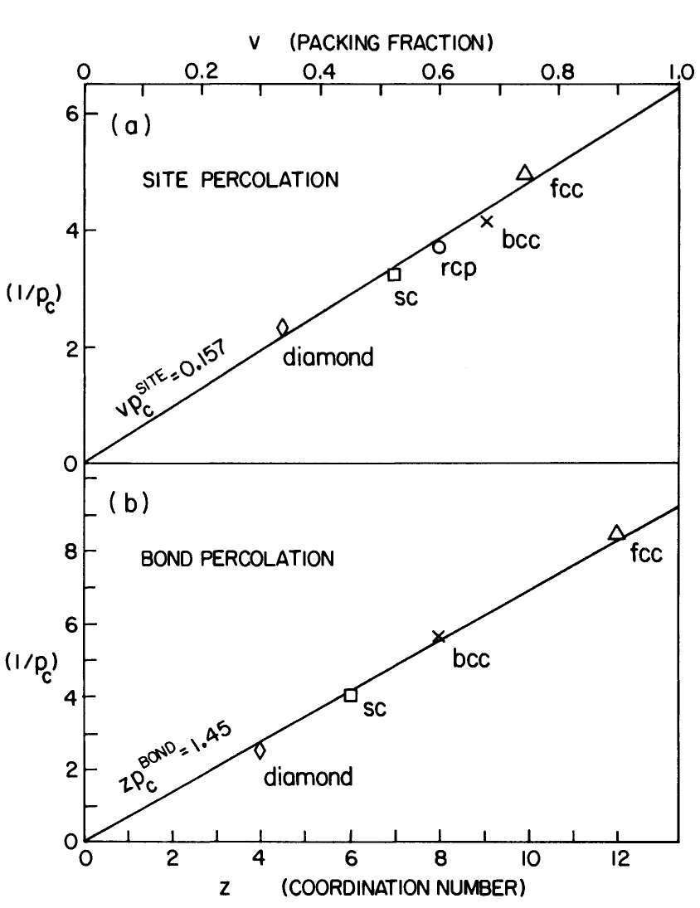
Percolation etc. [Closely following the text by R. Zallen]
This figure is from page 187 of Zallen.
There is a simple scaling in 3D, between both the site and bond percolation thresholds, with the packing fraction and coordination number, and the percolation thresholds.
R. Zallen, The Physics of Amorphous Solids, Wiley-VCH, 2004.

Slide 8
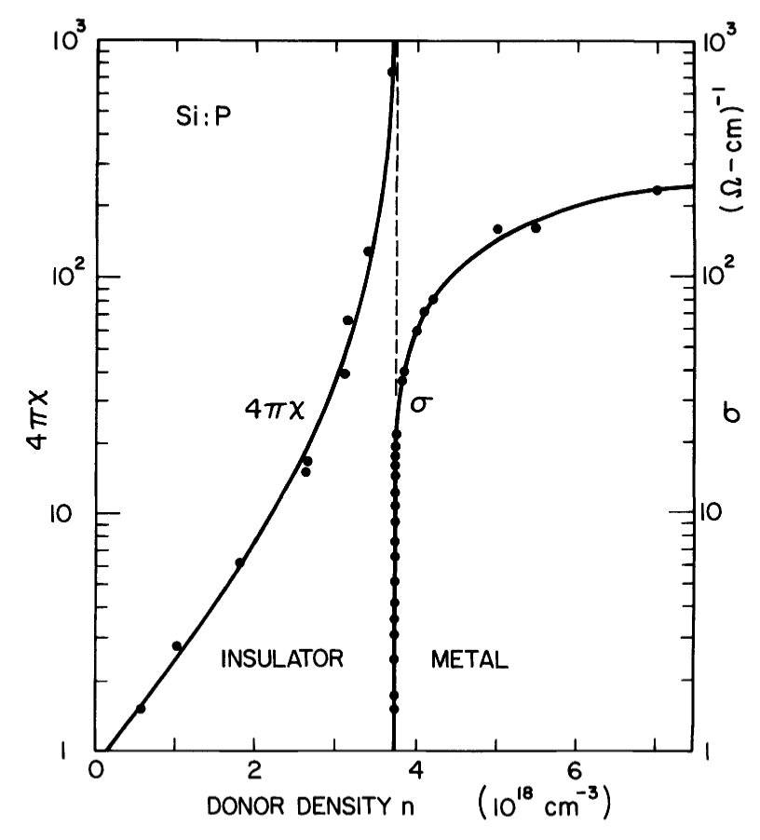
Percolation etc. [Closely following the text by R. Zallen]
This figure is from page 243 of Zallen.
The non-metal to metal transition on Si:P.
4πχ is the dielectric sucseptibility.
Note the similarity with percolation (the third slide in this set of slides).
Measurements by Rosenbaum and others at 10 mK.
R. Zallen, The Physics of Amorphous Solids, Wiley-VCH, 2004.

Slide 9
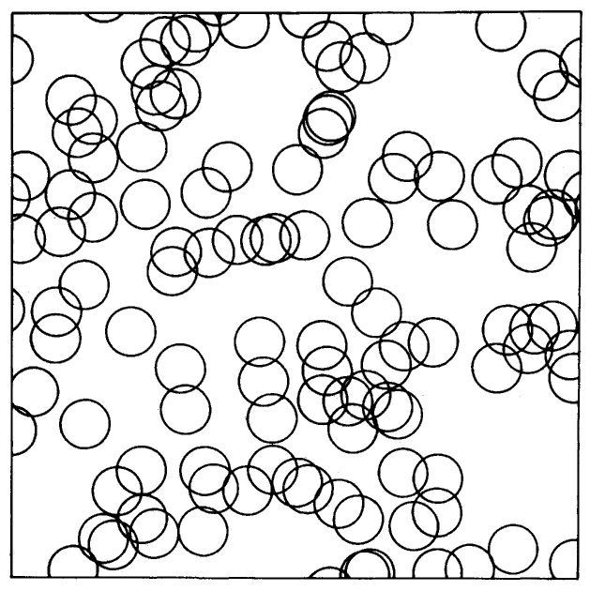
Percolation etc. [Closely following the text by R. Zallen]
This figure is from page 244 of Zallen.
Showing the percolation of hydrogenic wave-functions around the phosphorus donor atoms (much larger than the interatomic spacing).
Since P substitution is random, this is a problem of percolation in a random close packing.
R. Zallen, The Physics of Amorphous Solids, Wiley-VCH, 2004.

Slide 10
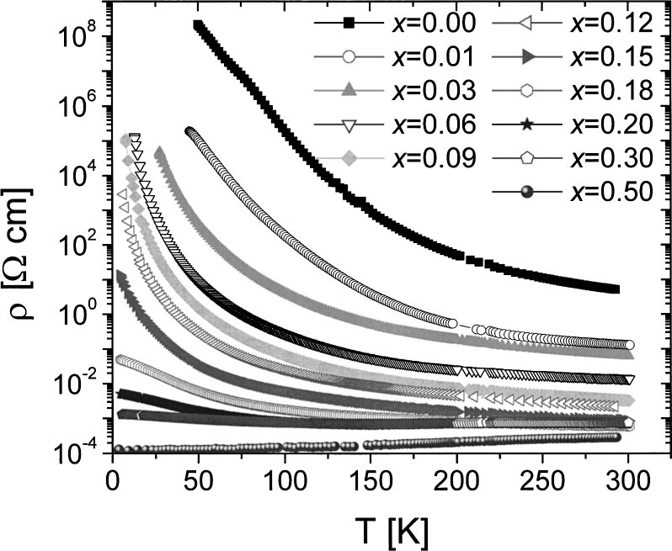
Percolation ?
La_{1–x}Sr_{x}CoO₃
Wu, Leighton, Phys. Rev. B 67 (2003) 174408.

Slide 11
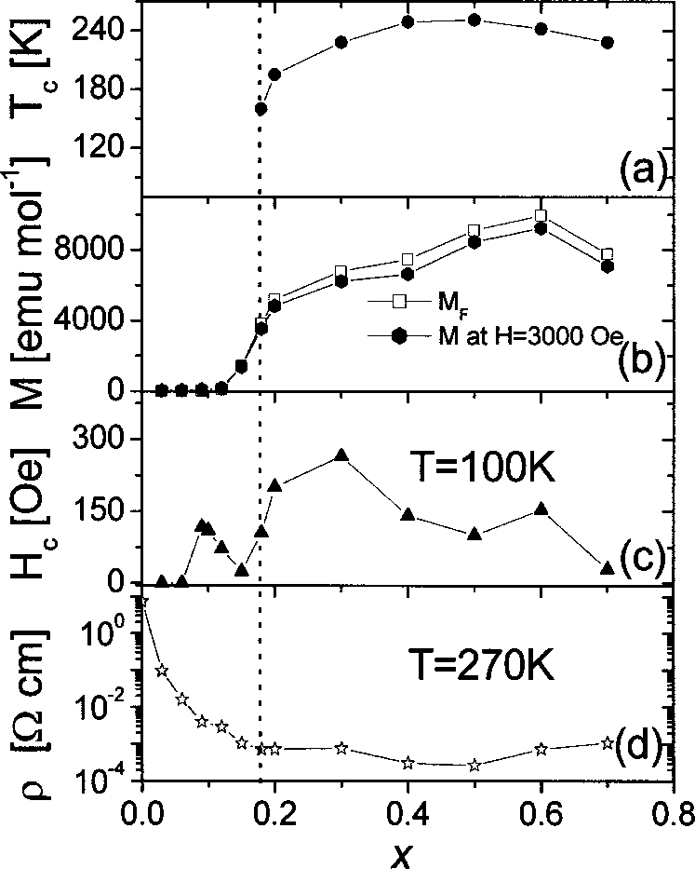
Percolation ?
La_{1–x}Sr_{x}CoO₃
Wu, Leighton, Phys. Rev. B 67 (2003) 174408.

Slide 12
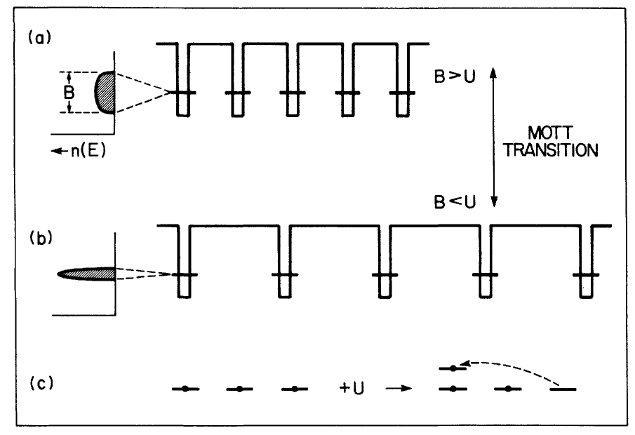
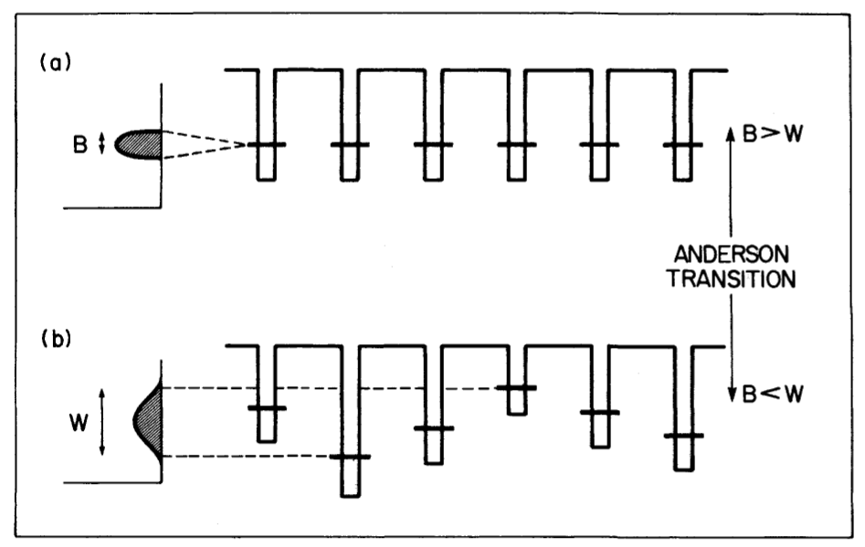
Anderson localization and the mobility edge
This figure is from pages 229 and 232 of Zallen.
The Mott and Anderson transitions represented graphically in 1D.
R. Zallen, The Physics of Amorphous Solids, Wiley-VCH, 2004.

Slide 13
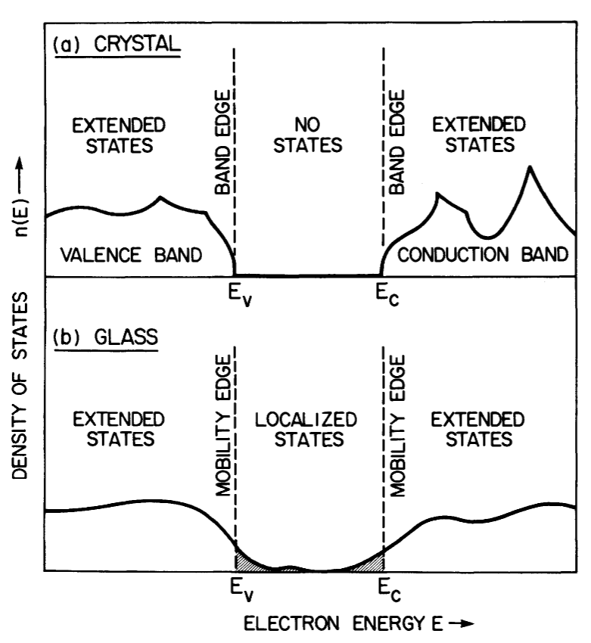
Anderson localization and the mobility edge
This figure is from page 235 of Zallen.
The notion of the mobility edge.
R. Zallen, The Physics of Amorphous Solids, Wiley-VCH, 2004.

Slide 14
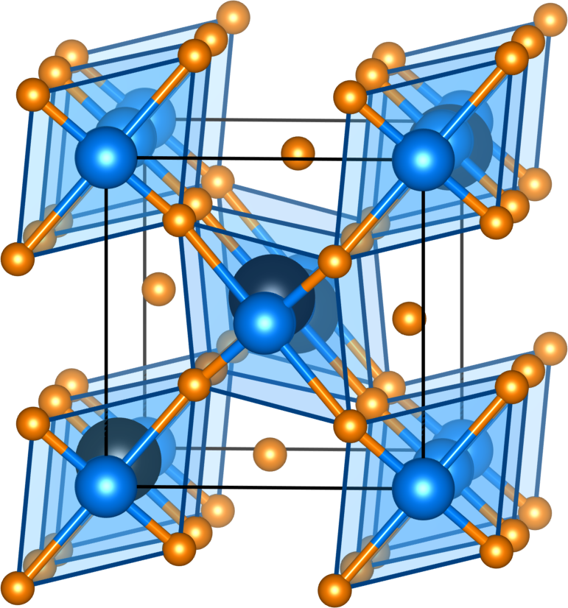
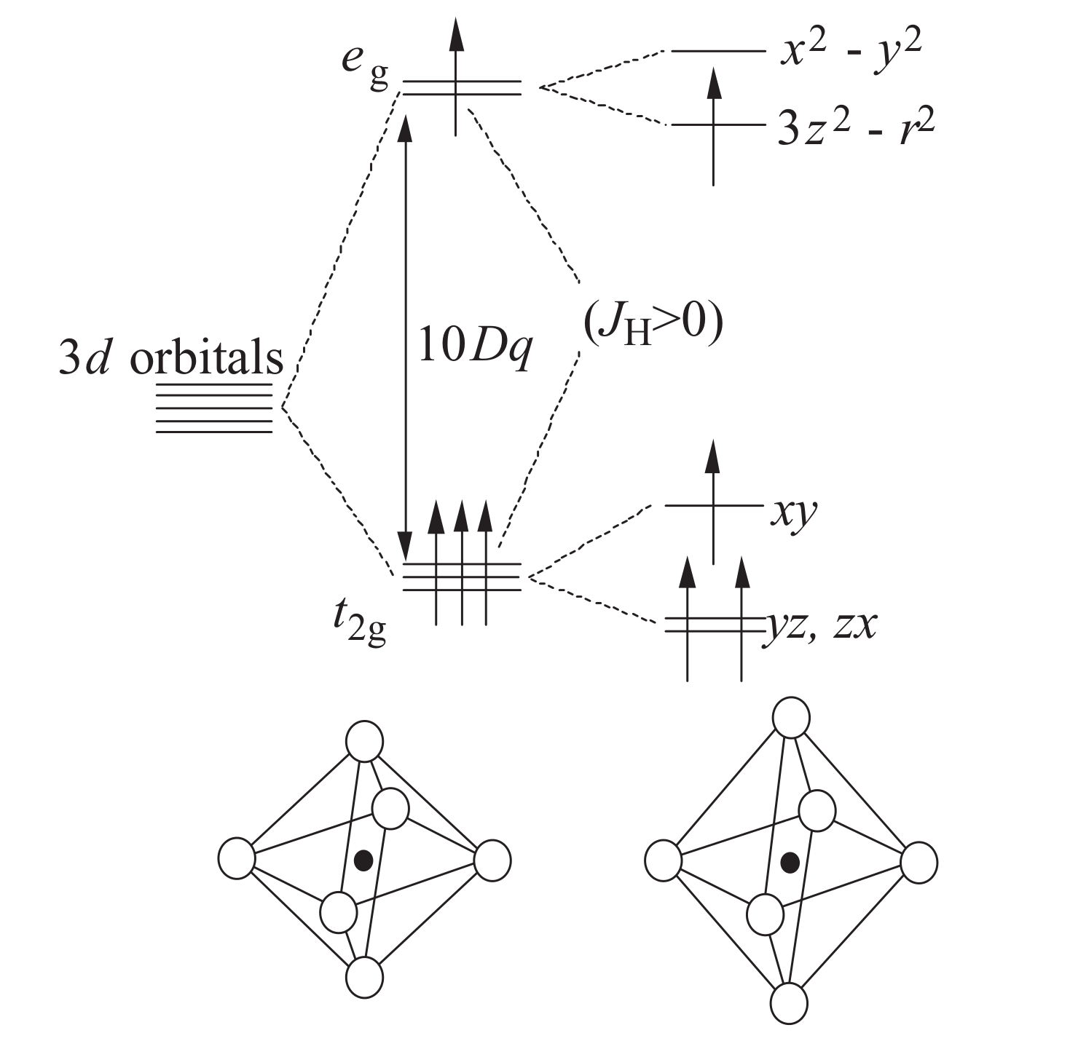
Correlations and the Hubbard model: LaMnO₃
Jahn-Teller distorted orthorhombic perovskite (space group Pnma)

Slide 15
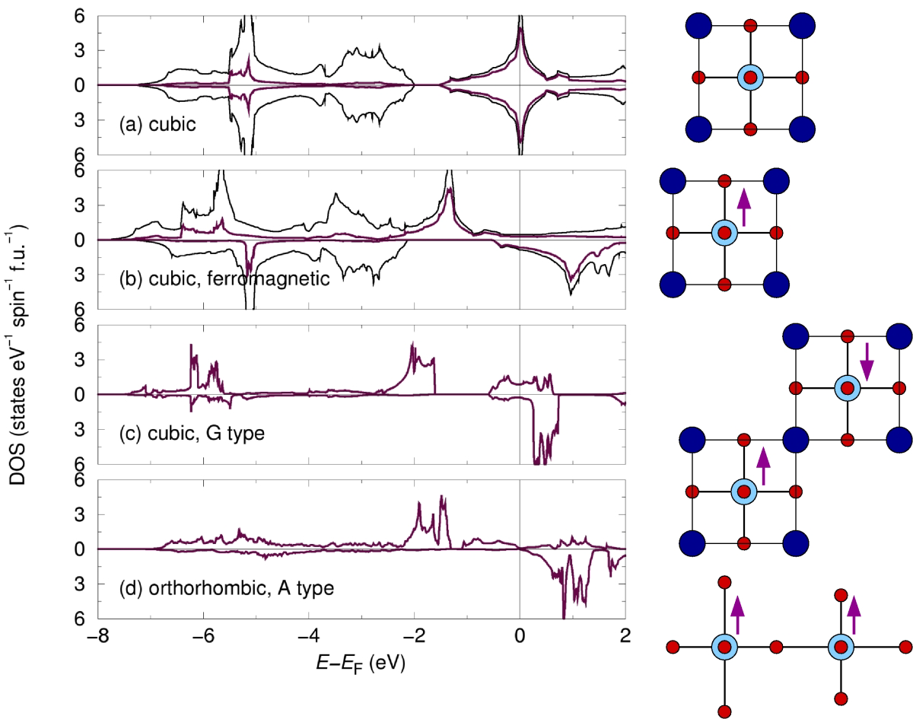
Correlations and the Hubbard model: LaMnO₃
Structure and magnetism do not explain the insulating behavior.

Slide 16
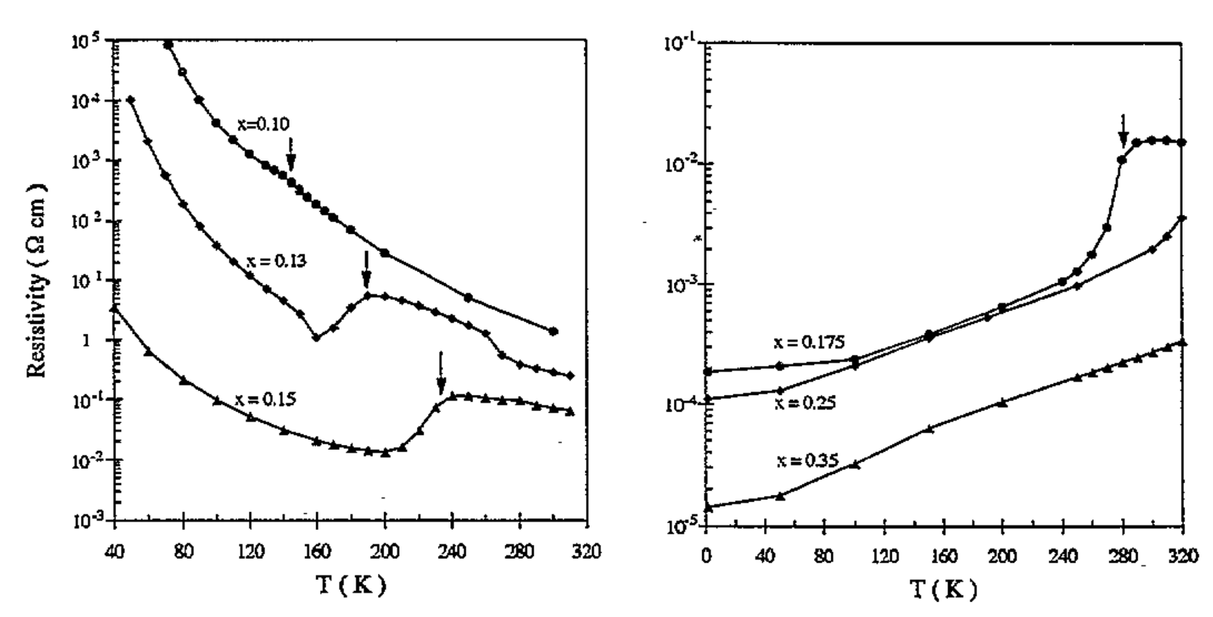
Correlations and the Hubbard model: LaMnO₃
Electrical resistivity behavior in La_{1–x}Sr_{x}MnO₃
Anane, Dupast, Dang, Renard, Veillet, de Leon Guevare, Millot, Pinsard, Revcolevschi, J. Phys.: Condens. Matter 7 (1995) 7015-7021.

Slide 17
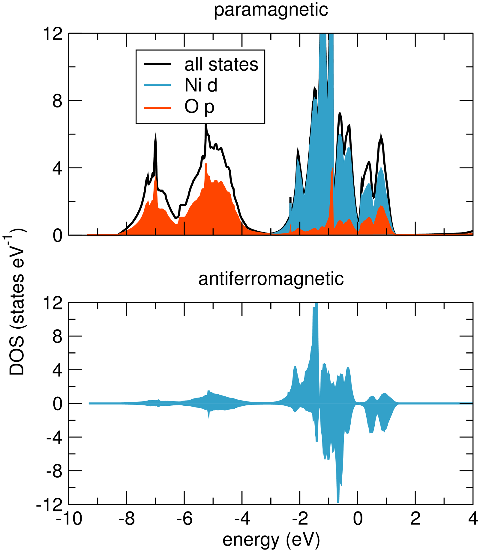
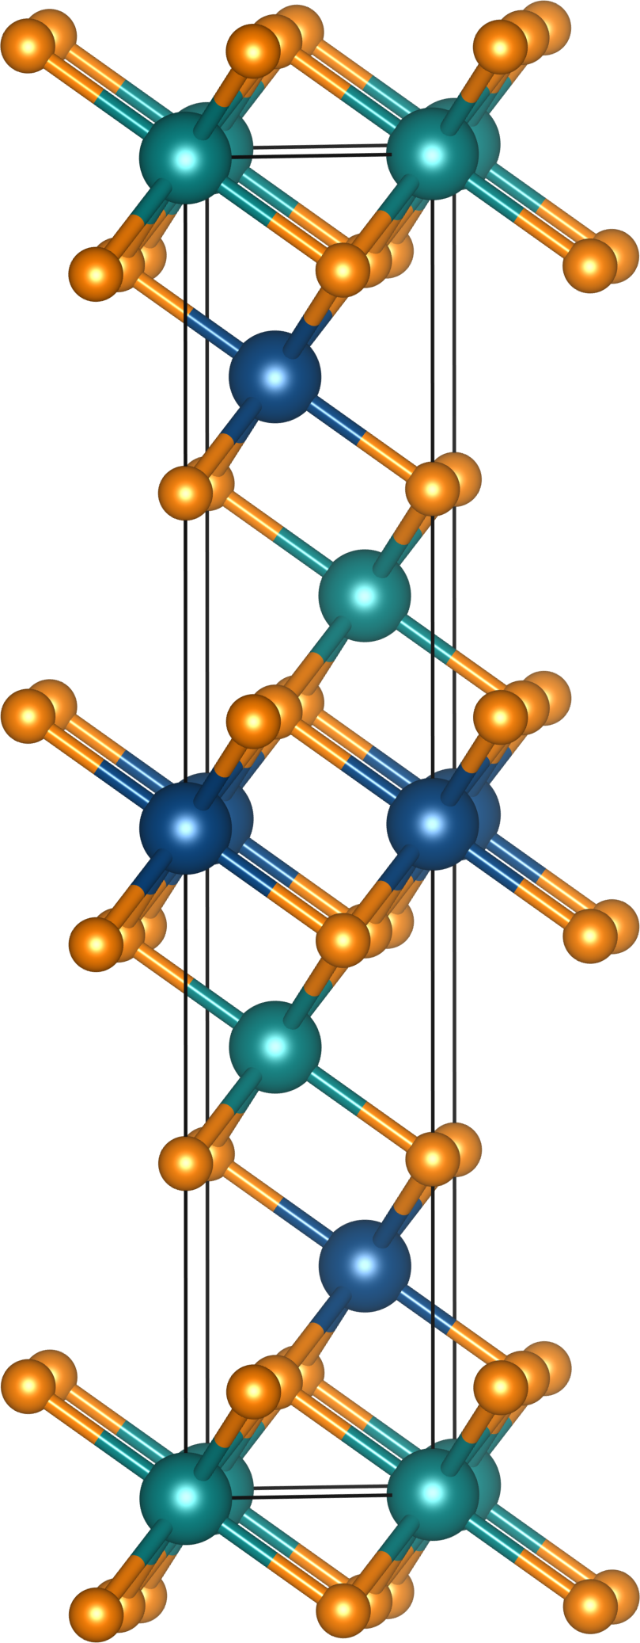
Correlations and the Hubbard model: NiO
NiO displays the color of isolated Ni²⁺ in solution, with similar spectra.

Slide 18
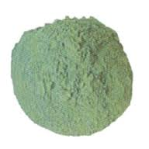
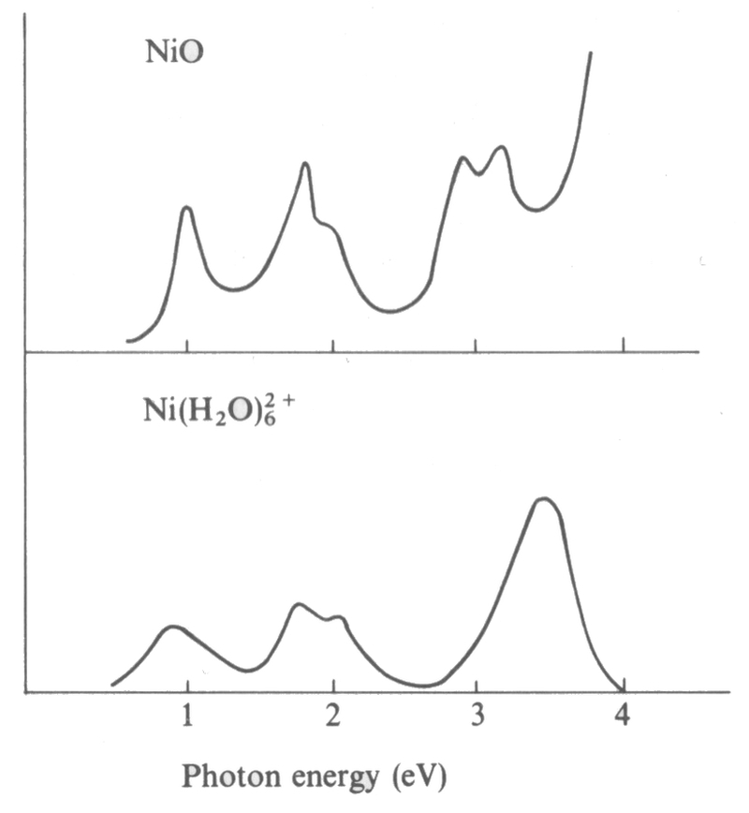
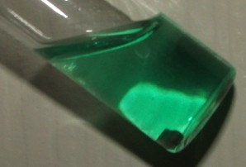
Correlations and the Hubbard model: NiO
From the Cox text, page 151
NiO displays the color of isolated Ni²⁺ in solution, with similar spectra.

Slide 19
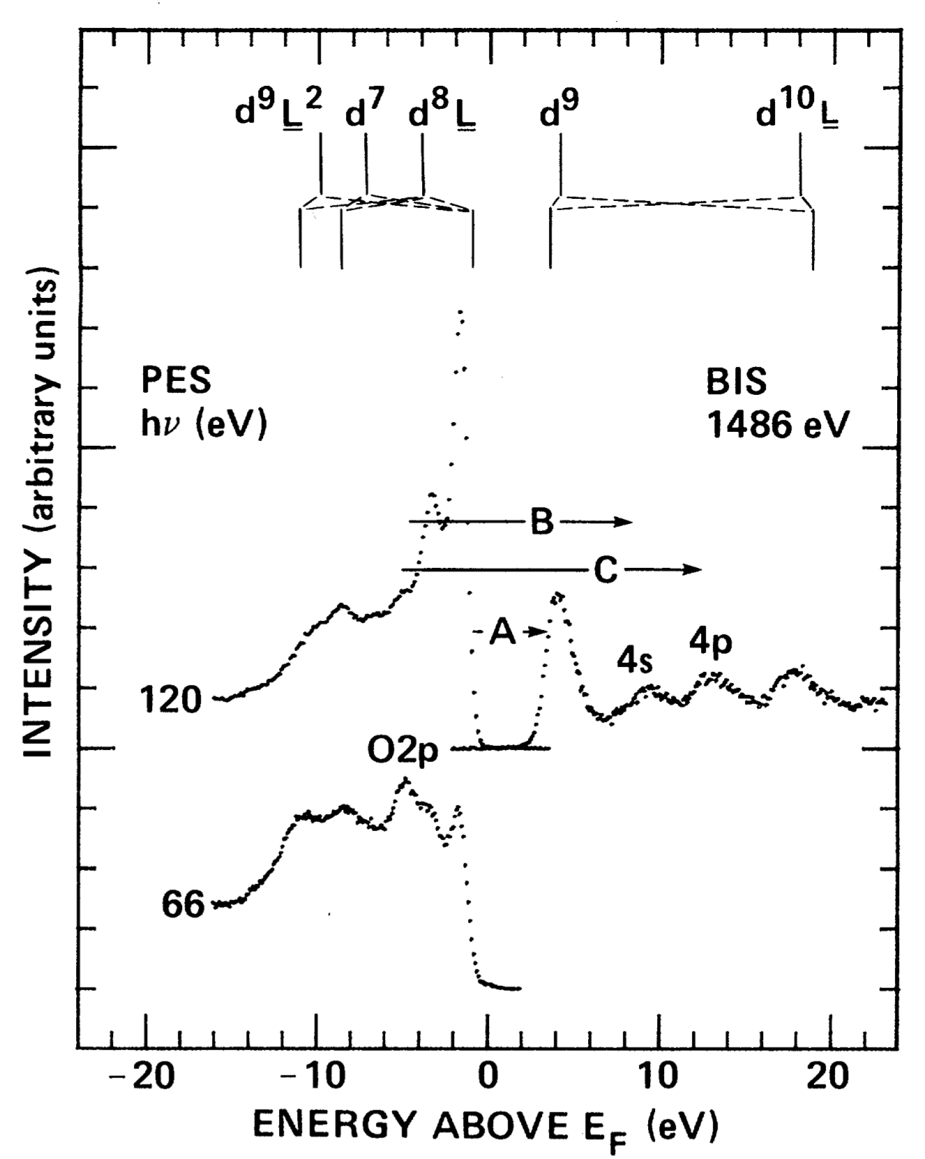
Correlations and the Hubbard model: NiO, spectroscopic studies

Slide 20
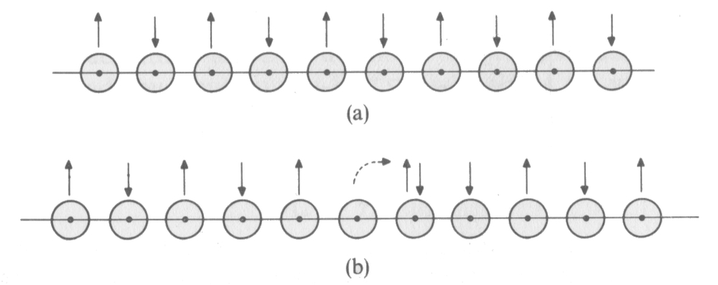
Correlations and the Hubbard model: The idea of Mott
From the Cox text, page 135
Consider a chain of orbitals, each with one electron. To hop an electron, an orbital has to be ionized at cost I, which is compensated a little by the electron affinity A.
U = I – A
For H atoms, I = 13.6 eV and A = 0.8 eV, meaning U = 12.8 eV. However, this does not account for some screening (due to the dielectric not being vacuum).

Slide 21
Correlations and the Hubbard model: The Hamiltonian
hopping or tight-binding (LCAO) part
double-occupancy cost or on-site repulsion

Slide 22
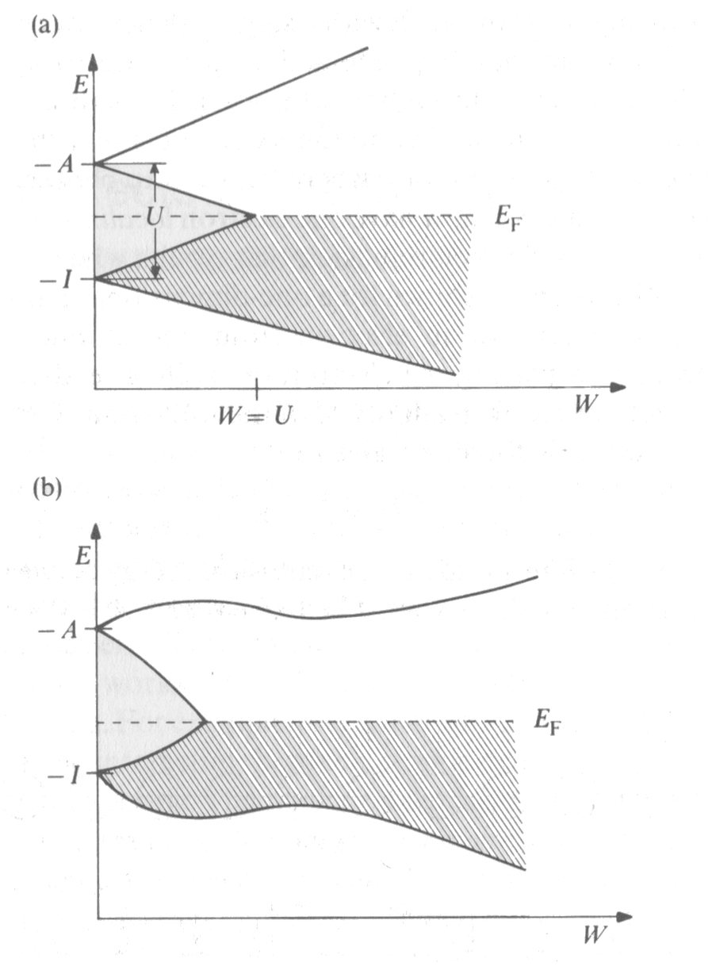
Correlations and the Hubbard model: The Hamiltonian
As the bandwidth is increased, (or as the atoms approach closer) the gap can close.
From the Cox text, page 137

Slide 23
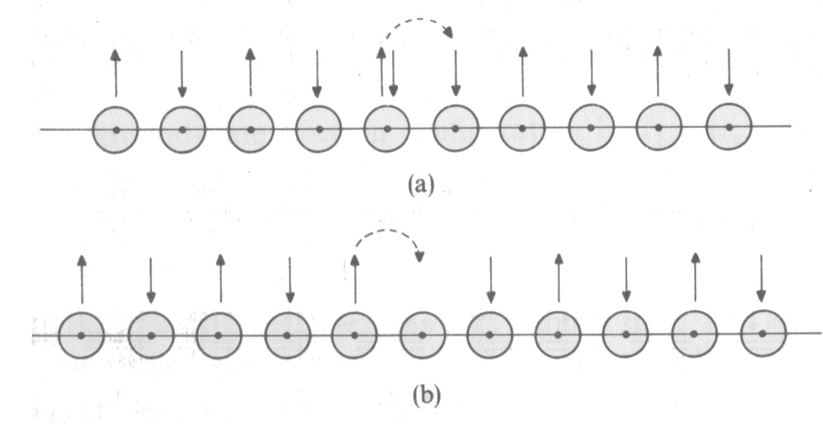
Correlations and the Hubbard model: The Hamiltonian
Doping of holes (removal of electrons) as in (b) makes hopping much easier, with the on-site repulsion having been removed.
From the Cox text, page 149

Slide 24
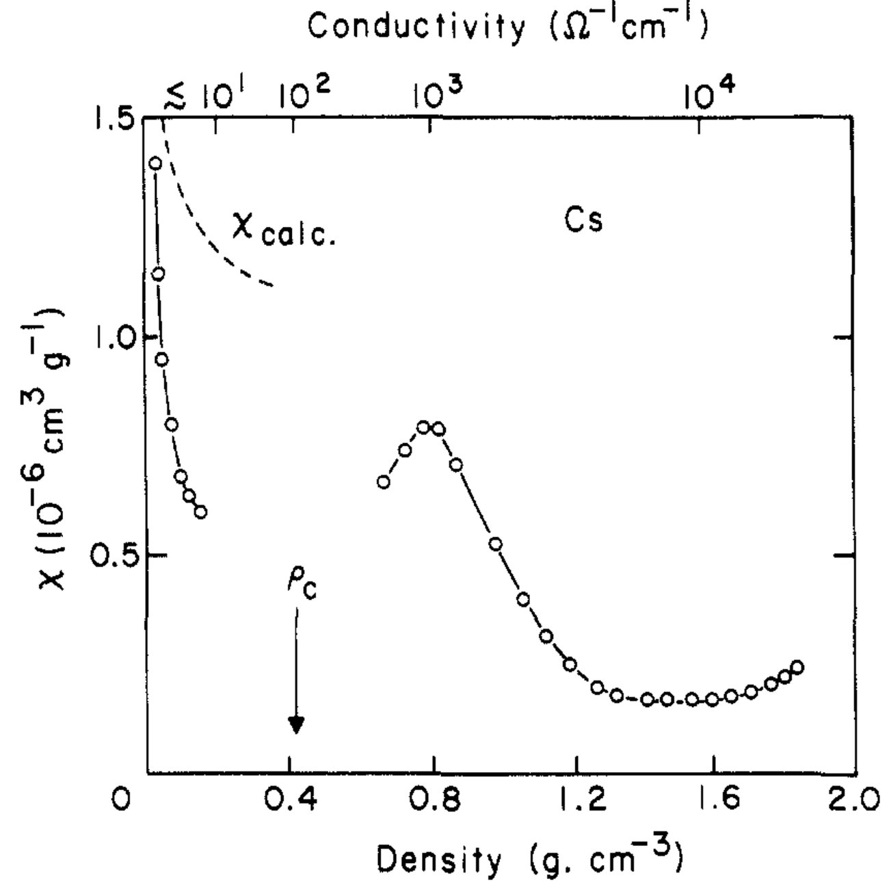
The Hubard model and magnetism
On the insulating side of the M–I transition, magnetism of some sort (usually antiferromagnetism) manifests.

Slide 25
The Hubard model and magnetism
In the limit that U >> t, the Hubbard model:
Can be reduced to the Heisenberg Hamiltonian:
where

Slide 26
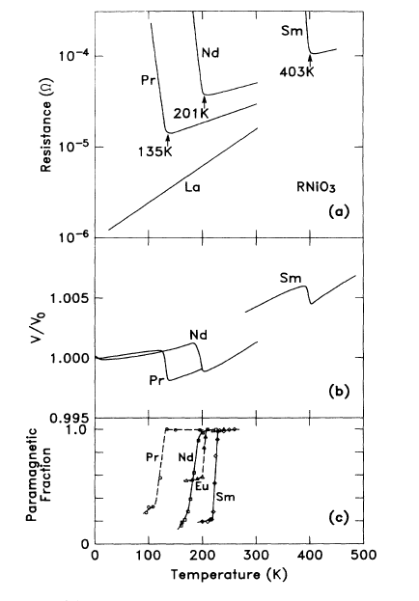
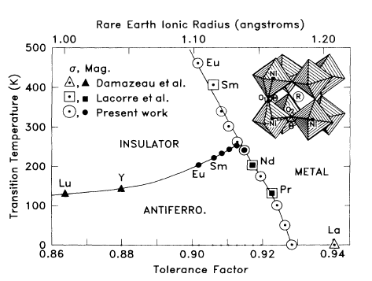
The Hubard model and magnetism [will return to these !]
The example of LnNiO₃, Ln = La, Pr, Nd, Sm:
Torrance, Lacorre, Nazzal, Ansaldo, Niedermayer, Phys. Rev. B. 45 (1992) 8209–8212.

Slide 27
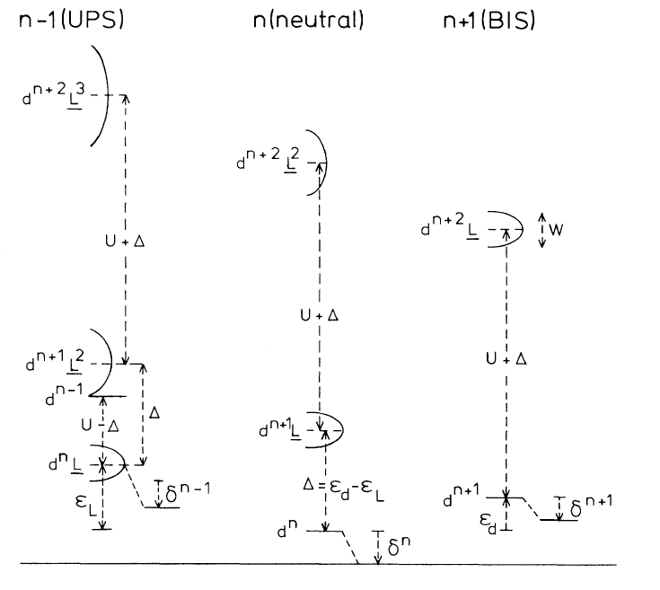
The Zaanen-Sawatzky-Allen phase diagram
The position of transition metal d-states vs. anion p states:
Zaanen, Sawatzky, Allen, Phys. Rev. Lett. 55 (1985) 418–421.

Slide 28
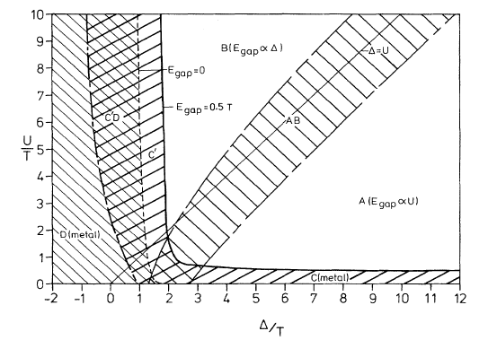
The Zaanen-Sawatzky-Allen phase diagram
The actual diagram. Note that T is what we have been calling W, and W is proportional to t in the Hubbard Model.
Zaanen, Sawatzky, Allen, Phys. Rev. Lett. 55 (1985) 418–421.

Slide 29
The Zaanen-Sawatzky-Allen phase diagram
A simplified view: In the language of ZSA:
Mott-Hubbard insulators:
Charge-transfer insulators:
upper Hubbard
upper Hubbard
U
Δ
lower Hubbard
anion p states
anion p states
lower Hubbard
Zaanen, Sawatzky, Allen, Phys. Rev. Lett. 55 (1985) 418–421.

Slide 30
The Zaanen-Sawatzky-Allen phase diagram
Examples of Mott-Hubbard: V₂O₃, Ti₂O₃, Cr₂O₃ and most halides. Early transition metals, and lower oxidation states. Interestingly, these do display T-dependent M–I transitions.
Examples of Charge-transfer: CuO, NiCl₂, NiS, etc. Later transition metals and higher oxidation states. CuO and NiCl₂ are always insulating.
Zaanen, Sawatzky, Allen, Phys. Rev. Lett. 55 (1985) 418–421.

Slide 31
The Zaanen-Sawatzky-Allen phase diagram. Periodic trends
Zaanen, Sawatzky, Allen, Phys. Rev. Lett. 55 (1985) 418–421.

Slide 32
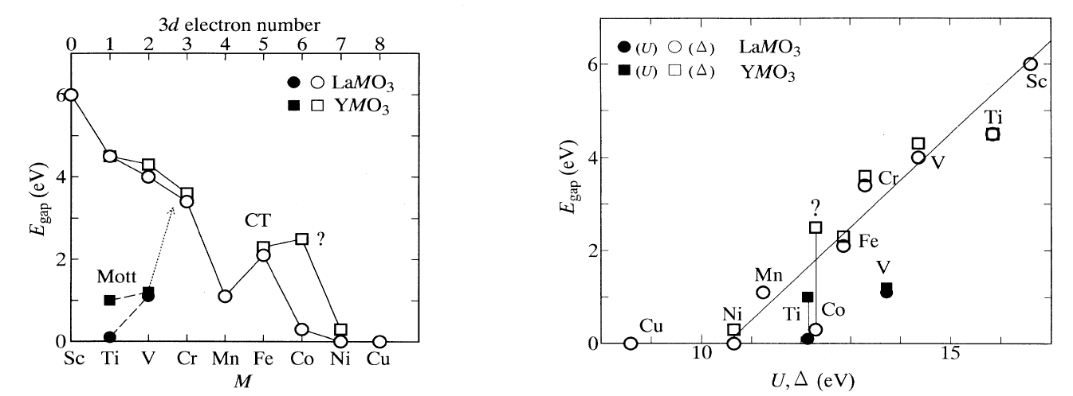
The Zaanen-Sawatzky-Allen phase diagram and perovskites
Optical studies of band gaps: Distinguishing d–d and p–d character:
Arima, Tokura, Torrance, Phys. Rev. B. 48 (1993) 17006–17009.

Slide 33
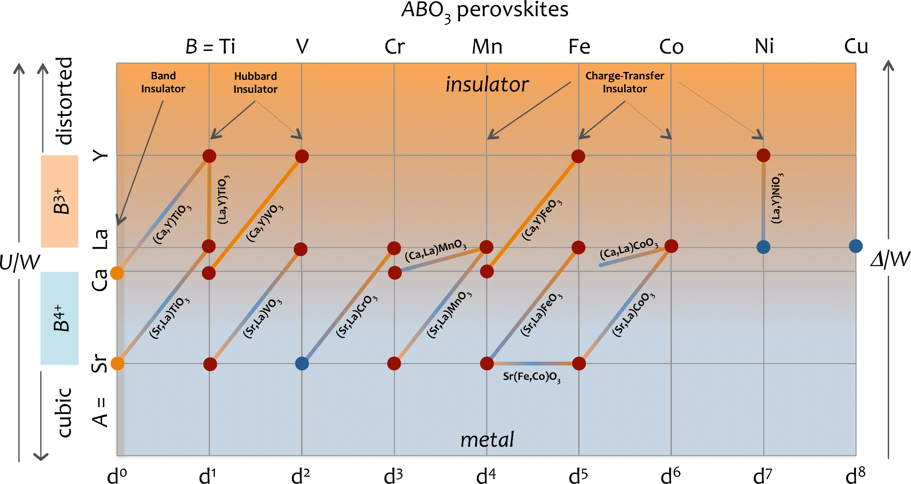
The Zaanen-Sawatzky-Allen phase diagram and perovskites

Slide 34
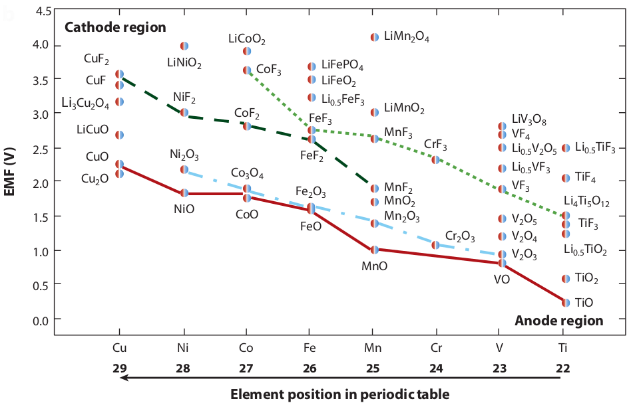
The Zaanen-Sawatzky-Allen phase diagram and batteries
The transition metal d and anion p levels manifest in Li-battery electrochemistry.
Hayner, Zhao, Kung, Annu. Rev. Chem. Biomolec. Eng. 3 (2012) 445–471.

Slide 35
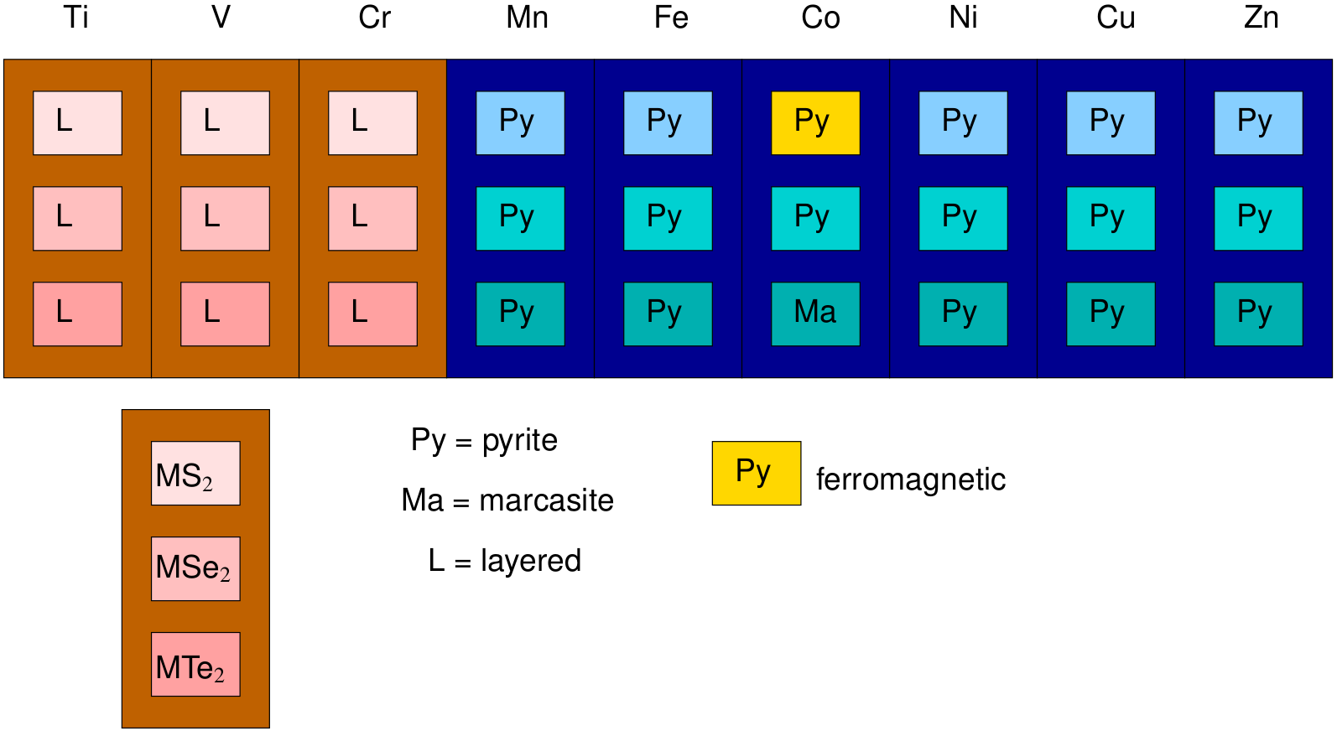
The Zaanen-Sawatzky-Allen phase diagram and redox competition
M⁴⁺
M²⁺
Ideas of Goodenough, Rouxel etc.

Slide 36
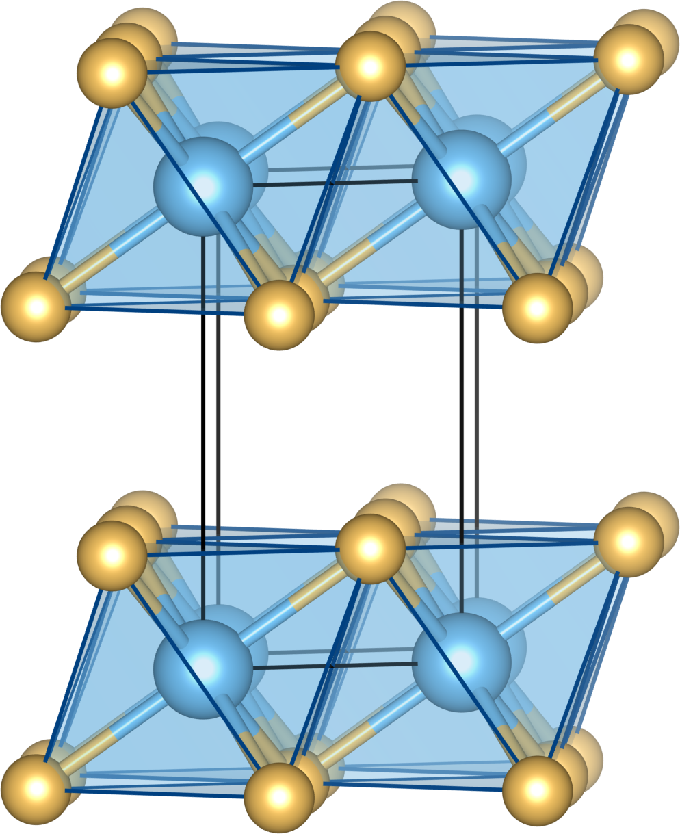
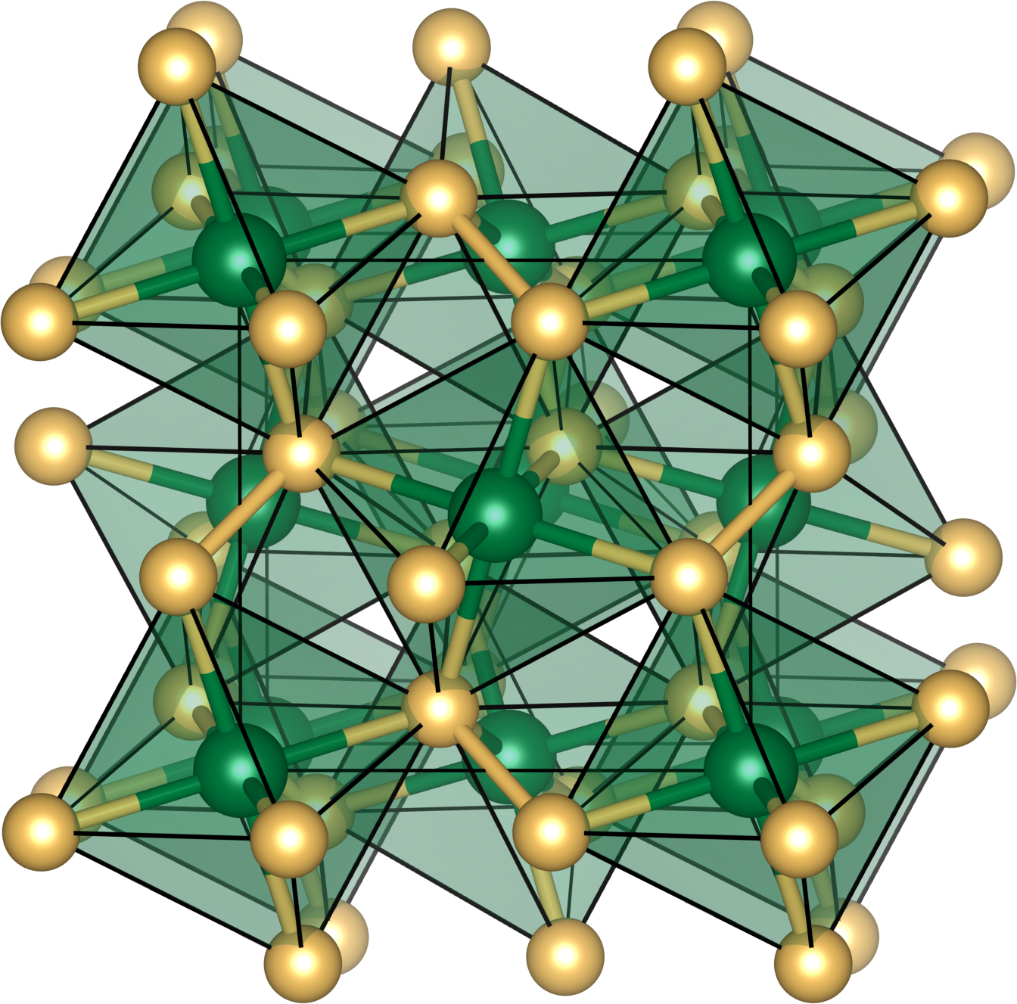
The Zaanen-Sawatzky-Allen phase diagram and redox competition

