Slide 1
NMR Studies of Metal-Insulator Transitions
Leo Lamontagne
MATRL286K
December 10th, 2014

Slide 2
Intro to Nuclear Magnetic Resonance
Element specific technique utilizing nuclear spins of atoms
Nuclear spins are aligned in a magnetic field and pulsed with a radio frequency causing spins to precess.
Local environments around the nucleus can change the effective magnetic field resulting in slight shifts of the precession frequency
ω₀= γ⋅B₀

Slide 3
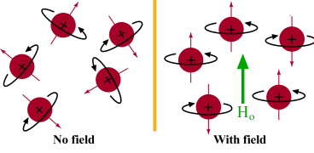
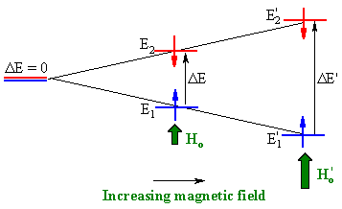
Nuclear spins separate in energy in a magnetic field
Energy separation between aligned and anti-aligned states is in the MHz range. The decay of excited nuclei is measured
http://www.chem.ucalgary.ca/courses/350/Carey5th/Ch13/ch13-nmr-1b.html

Slide 4
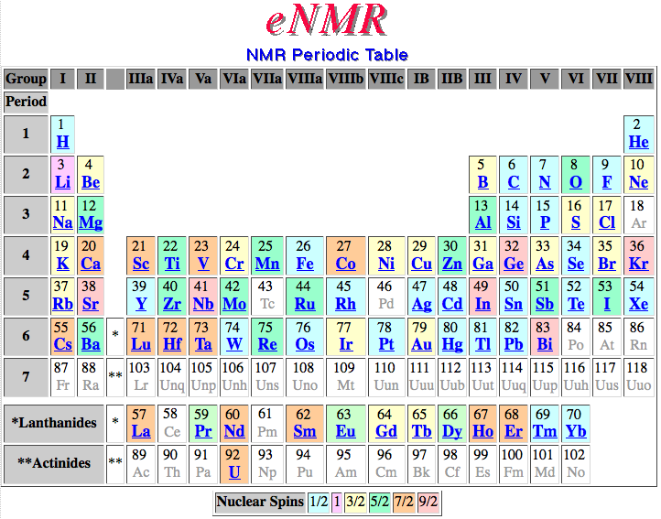
http://www.bruker-nmr.de/guide/eNMR/chem/NMRnuclei.html

Slide 5
The Knight Shift
Shift from Larmor frequency in metals due to the polarization of the conduction electrons
W. D. Knight, Phys. Rev. 76 (1949) 1259-1260

Slide 6
Shift of the Cu peak in Cu metal as compared to CuCl
“shift may be due to the paramagnetic effect of the conduction electrons in the vicinities of the metal nuclei”
W. D. Knight, Phys. Rev. 76 (1949) 1259-1260

Slide 7
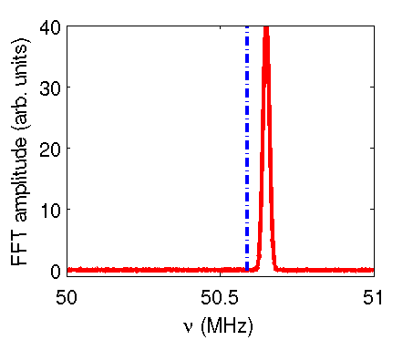
Simple Schematic Representation
Blue line is larmor frequency of nucleus
Red peak is Knight shifted to higher frequency
% difference frequently reported
http://www.fis.unipr.it/~derenzi/dispense/pmwiki.php?n=NMR.Knight

Slide 8
MIT in expanded mercury
At low densities, the knight shift drops sharply corresponding with onset of semiconducting behavior
W. W. Warren, F. Hensel, Phys. Rev. B. 26 (1982) 5980-5982

Slide 9
Density of MIT in liquid determined through NMR, corresponds with onset of “plasma transition” in gas phase
W. W. Warren, F. Hensel, Phys. Rev. B. 26 (1982) 5980-5982

Slide 10
Li_{x}CoO₂ gets more conductive upon Li deintercalation
Conductivity increases by about 6 orders of magnitude and for x<0.70
Metallic behavior is seen at high temperature
Phase separation proposed from shoulders in XRD pattern
M. Menetrier, I. Saadoune, S. Levasseur, C. Delmas, J. Mater. Chem. 9 (1999) 1135-1140

Slide 11
2 phase nature is confirmed by NMR
Below x=0.94 two phases arise,
Li_{0.94}CoO₂ and Li_{0.75}CoO₂
The peak of the second phase is knight shifted
Shift increases with increasing hole concentration
M. Menetrier, I. Saadoune, S. Levasseur, C. Delmas, J. Mater. Chem. 9 (1999) 1135-1140

Slide 12
NMR shows spin state transitions in RCoO₃
LaCoO₃ transitions from LS to IS around 100 K, and is a metal above 500 K
NMR shows similar MIT in other rare-earths without IS transition
M. Itoh, J. Hasimoto, S. Yamaguchi, Y. Tokura, Physica B 281 (2000) 510-511

Slide 13
NMR in V₂O₃ confirms no local moments in metallic state
V₂O₃ is AFI at low temperatures
Can be driven metallic with pressure
Presence of signal indicates MIT is “accompanied by transition from localized magnetic moment behavior to band magnetism”
A. C. Gossard, D. B. McWhan, J. P. Remeika, Phys. Rev. B. 2 (1970) 3762-3768

Slide 14
Sharp change in Knight Shift indicates MIT
Bi_{1.6}V₈O₁₆ is metallic at all temperatures
Bi_{1.77}V₈O₁₆ becomes insulating below ~80 K
T. Waki, H. Kato, M. Kato, K. Yoshimura, J. Phys. Soc. Jpn. 73 (2004) 275-279

Slide 15
Korringa relationship also demonstrates metallic behavior
T₁ spin-lattice relaxation time is proportional to temperature for metals
Deviations can inform electron correlation or spin frustration
T. Waki, H. Kato, M. Kato, K. Yoshimura, J. Phys. Soc. Jpn. 73 (2004) 275-279

Slide 16
²³Na NMR confirms formation of insulating phase with doping
(NH₃)_{x}NaK₂C₆₀ is superconducting for x<1
Increasing ammonia further results in formation of insulating phase
M. Ricco, G. Fumera, T. Shiroka, O. Ligabue, C. Bucci, F. Bolzoni, Phys. Rev. B. 68 (2003) 035102

Slide 17
Korringa relation illustrates transition
Thermally activated nuclear relaxations for the insulating sample
Potential charge disproportions from C₆₀ anions
M. Ricco, G. Fumera, T. Shiroka, O. Ligabue, C. Bucci, F. Bolzoni, Phys. Rev. B. 68 (2003) 035102

Slide 18
Conclusions
NMR is an element specific technique which probes the local environment
The Knight Shift results from the polarization of the conduction electrons in metals
Metal-insulator transitions can be observed through NMR via the Knight Shift and relaxation times in a variety of systems

