Slide 2
M—I Transition In Rare-Earth Nickelates And The Impact Of Structural Distortions
Outline:
LaNiO₃: The basics
Tuning the Metal-Insulator Transition
Structural distortions
Oxygen deficiency
Dimensionality

Slide 3
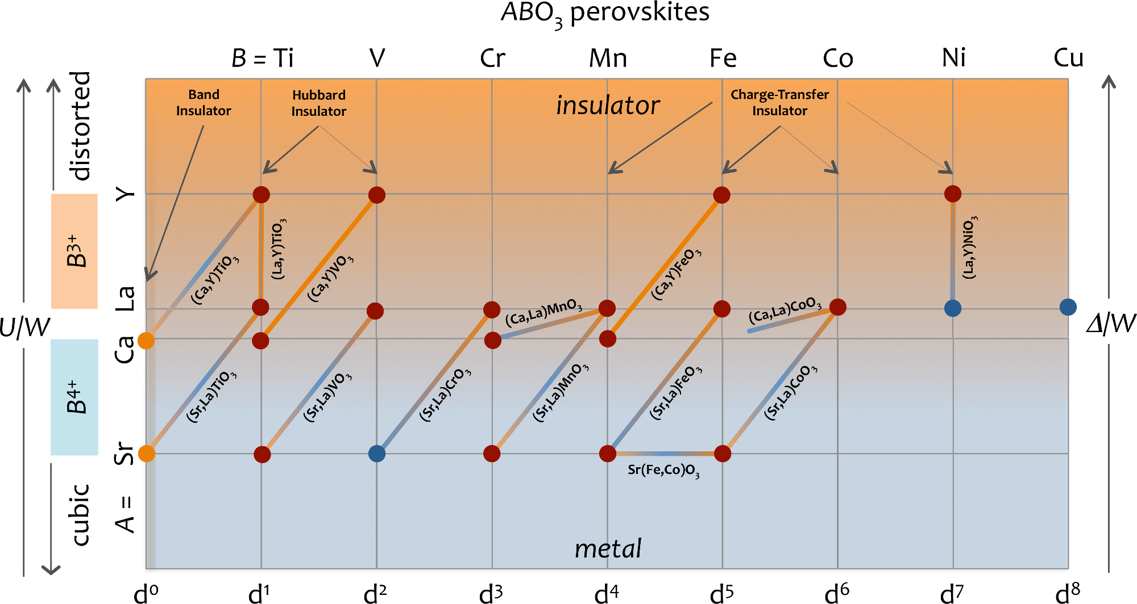
LaNiO₃
Remember me?

Slide 4
LaNiO₃
Remember me?

Slide 5
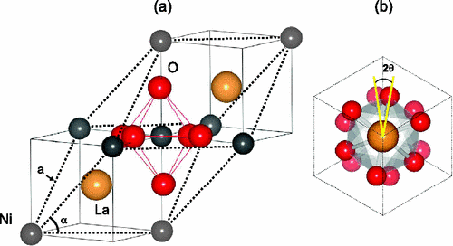
LaNiO₃: An Introduction
Paramagnetic
Correlated metal
Gou et al., Phys. Rev. B 84 (2011) 144101.

Slide 6
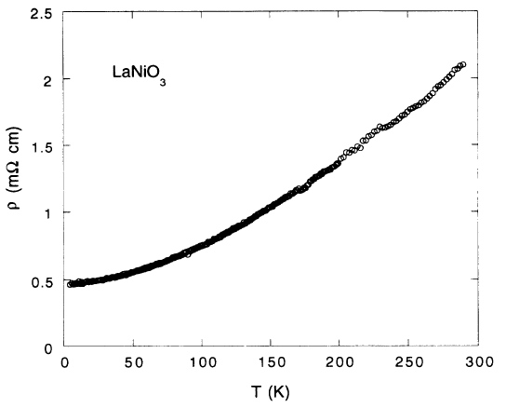
LaNiO₃: An Introduction
Paramagnetic
Correlated metal
Sanchez et al., Phys. Rev. B 54 (1996) 16574-16578.
Sreedhar et al., Phys. Rev. B 46 (1992) 6382-6386.

Slide 7
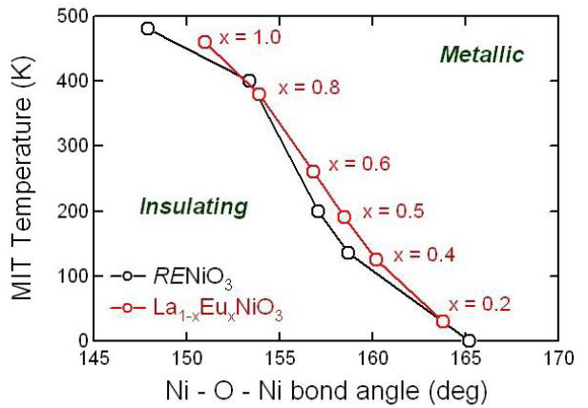
Varying A-site radius: LnNiO₃
Rare earth size allows tuning structural distortions
Problem: Hard to prepare…
Medarde et al., J. Phys. Condensed Matter 9 (1997) 1679.

Slide 8
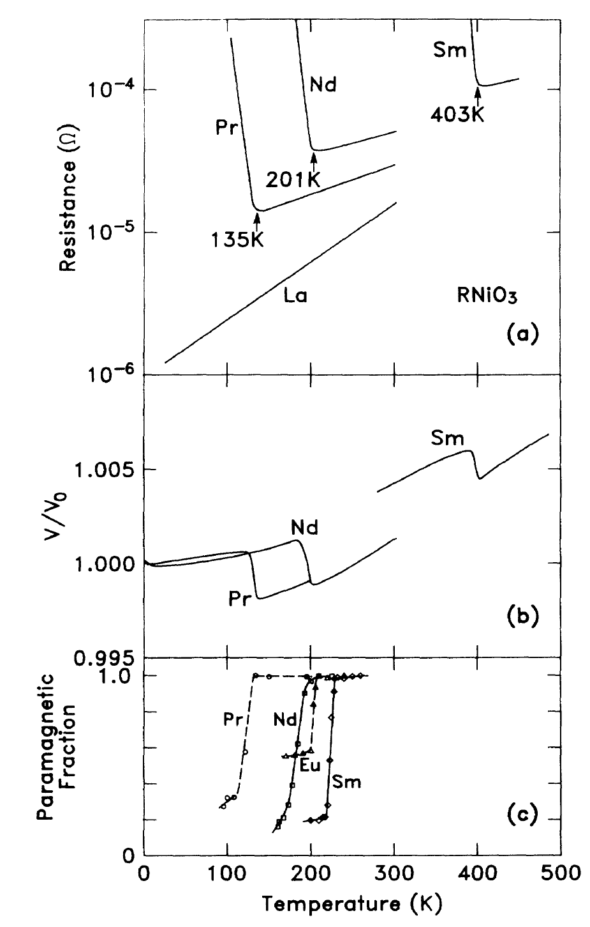
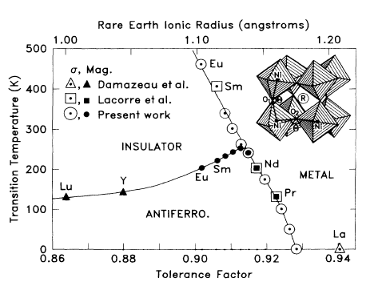
Varying A-site radius: LnNiO₃
Structural distortions dictate the M–I transition of LnNiO₃
Torrance et al. Phys. Rev. B. 45 (1992) 8209–8212.

Slide 9
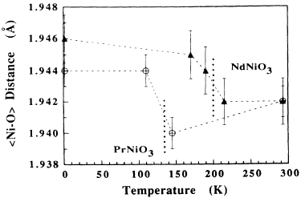
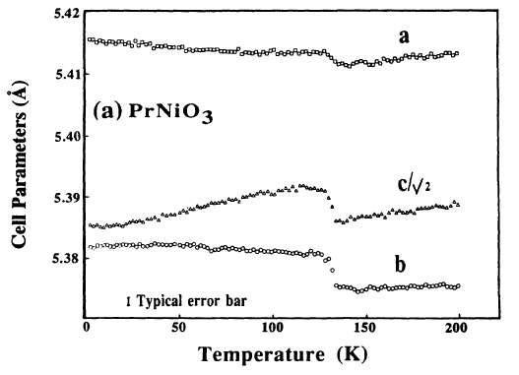
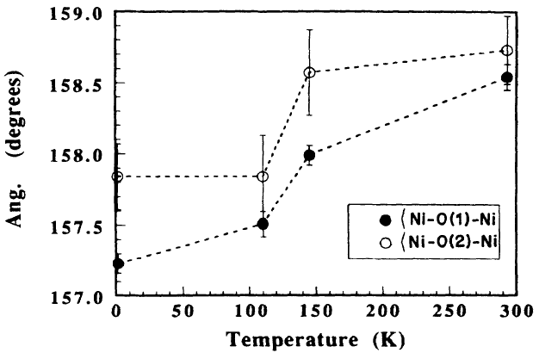
Varying A-site radius: LnNiO₃
Measuring structural distortions with neutron diffraction
Garcia-Munoz et al., Phys. Rev. B 46 (1992) 4414-4425.

Slide 10
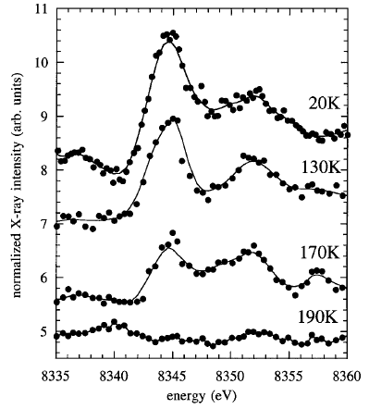
Varying A-site radius: LnNiO₃
Charge ordering: 2 Ni³⁺ -> Ni^{(3+δ)+} + Ni^{(3-δ’)+}
For NdNiO₃, δ+δ’ = 0.45
Smaller than bond-valence sum (0.6)
Staub et al., Phys. Rev. Lett. 88 (2002) 126402.

Slide 11
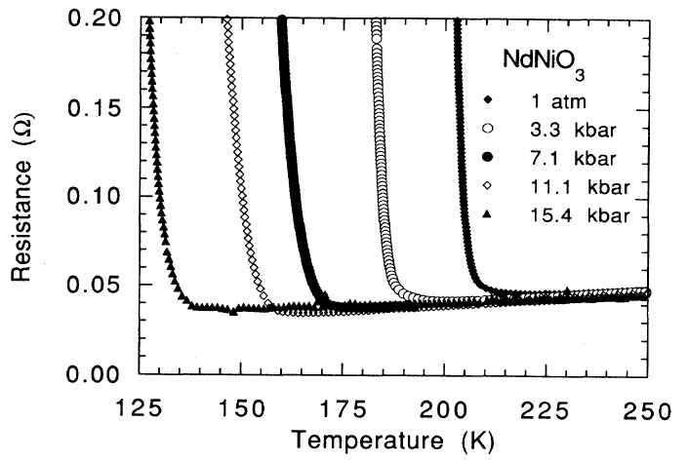
Varying A-site radius: LnNiO₃
Pressure effects – alters oxygen vibration frequency
LaNiO₃
PrNiO₃
NdNiO₃
Sm_{0.5}Nd_{0.5}NiO₃
Obradors et al. Phys. Rev. B 47 (1993) 12353.
Zhou et al., Phys. Rev. B 61 (2000) 4401-4404.

Slide 12
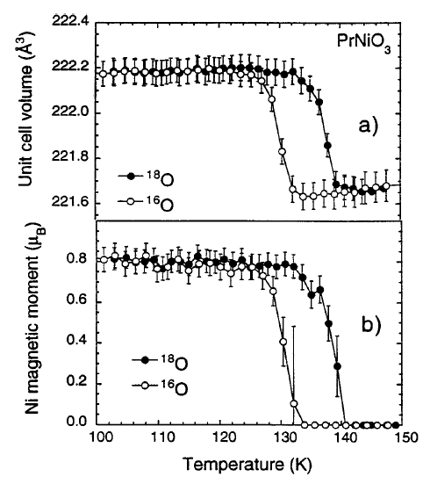
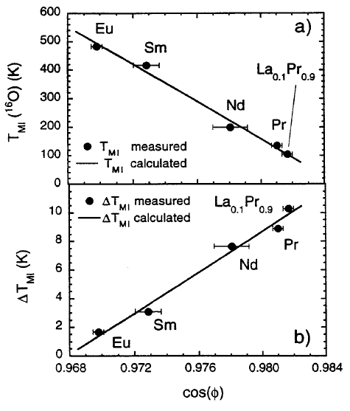
Varying A-site radius: LnNiO₃
Lattice dynamics (i.e. electron-lattice coupling) plays an important role
Medarde et al., Phys. Rev. Lett. 80 (1998) 2397–2400.

Slide 13
M—I Transition In Rare-Earth Nickelates And The Impact Of Structural Distortions
Outline:
LaNiO₃: The basics
Tuning the Metal-Insulator Transition
Structural distortions
Oxygen deficiency
Dimensionality

Slide 14
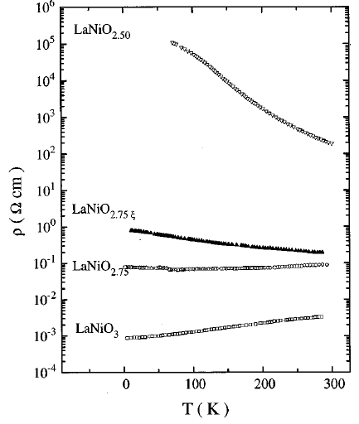
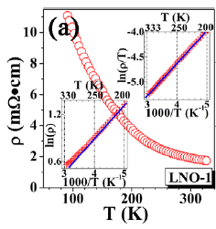
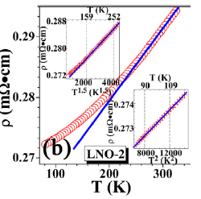
Oxygen Deficiency: LaNiO_{3-δ}
Metal-Insulator transition near δ = 0.25
LaNiO_{2.64}
LaNiO_{2.84}
Sanchez et al., Phys. Rev. B 54 (1996) 16574-16578.
Qiao and Bi, Europhysics Lett. 93 (2011) 57002.

Slide 15
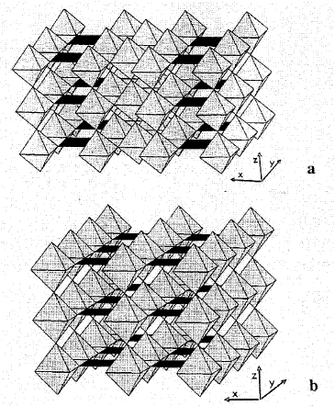
Oxygen Deficiency: LaNiO_{3-δ}
r_{Ni3+} = 0.60 nm
r_{Ni2+} = 0.69 nm
LaNiO_{2.75}
LaNiO_{2.5}
Sanchez et al., Phys. Rev. B 96 (1996) 16574-16578.
Qiao and Bi, Europhysics Lett. 93 (2011) 57002.

Slide 16
M—I Transition In Rare-Earth Nickelates And The Impact Of Structural Distortions
Outline:
LaNiO₃: The basics
Tuning the Metal-Insulator Transition
Structural distortions
Oxygen deficiency
Dimensionality

Slide 17
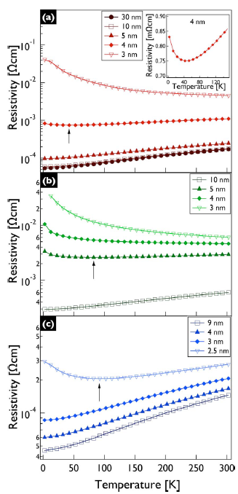
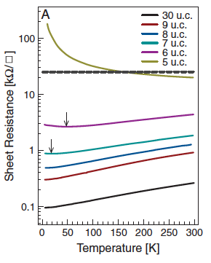
Tuning Dimensionality: Thin LaNiO₃
Ioffe-Regel limit:
k_{F} l = h/e² = 25kΩ/sq --> 1
R_{s} R_{s}
LSAT
SrTiO₃
DyScO₃
LaAlO₃
Scherwitzl et al., Phys. Rev. Lett. 106 (2011) 246403.
Son et al., Appl. Phys. Lett. 96 (2010) 062114.

Slide 18
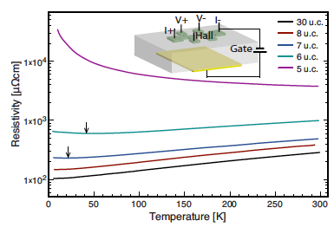
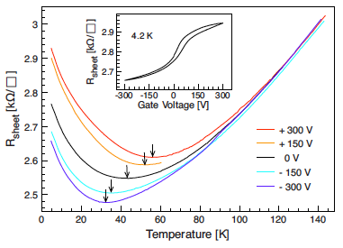
Tuning Dimensionality: Thin LaNiO₃
Tuning T_{MI} with gate bias
Scherwitzl et al., Appl. Phys. Lett. 95 (2009) 222114.

Slide 19
M—I Transition In Rare-Earth Nickelates And The Impact Of Structural Distortions
Summary:
Multiple methods to tune across metal-insulator transition in LnNiO₃
Distorting Ni – O – Ni bond angle
Rare earth cation radius
Pressure
Oxygen deficiency (Ni oxidation state)
Dimensionality

Slide 20
Title
Text
Citation

