Slide 1
Iridates
Bill Flaherty
Materials 286K, UCSB
Dec. 8th, 2014

Slide 2
5d transition metals: uninteresting?
“The properties of the 4d and 5d compounds tend to be less exotic” – Mattheiss, 1976
3d transition metal oxides: localized states
Strong correlations
Narrow bands, large U/W
4d, 5d: spatially extended states
Wide bandwidth
Low on-site repulsion, smaller U/W
Predicted to be metallic, ferromagnetic

Slide 3
Discovery of “MORE EXOTIC” 4d, 5d TMOs
Sr₂IrO₄ - M. K. Crawford et al., Phys. Rev. B 49, 9198 (1994).
Sr₂IrO₄, Sr₂RuO₄ - R. J. Cava et al., Phys. Rev. B 49, 11 890 (1994)
Ca_{2-x}Sr_{x}RuO₄ - S. Nakatsuji and Y. Maeno, Phys. Rev. Lett. 84, 2666 (2000)
Cd₂Os₂O₇ - D. Mandrus et al., Phys. Rev. B 63, 195104 (2001).
Y, Ca, Sr, Bi Ruthenates - J. S. Lee et al., Phys. Rev. B 64, 245107 (2001).

Slide 4
Sr-214 Band structure
Sr₂⁽²⁺⁾Ir⁽⁴⁺⁾O₄
Ir⁽⁴⁺⁾: 5d⁵ system

Slide 5
Sr-214: correct Band structure
Novel J_{eff} = 1/2 Mott State Induced by Relativistic Spin-Orbit Coupling in Sr₂IrO₄
B. J. Kim et al., Phys. Rev. Lett 101, 076402 (2008)
Spin-Orbit Coupling (SOC)
t_{2g} states → l = 1 states
Strong SOC:
t_{2g} splits into J_{eff} = 3/2 and 1/2
Narrow Jeff = ½ band due to hopping integrals

Slide 6
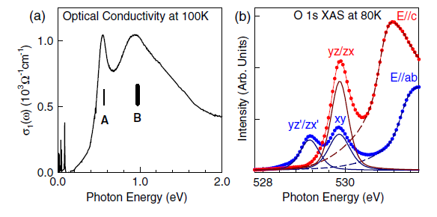
Observation of u + SOC
ARPES, Optical Conductivity, XAS experiments
DFT calculations (LDA, LDA + U)
Novel Jeff = 1/2 Mott State Induced by Relativistic Spin-Orbit Coupling in Sr₂IrO₄
B. J. Kim et al., Phys. Rev. Lett 101, 076402 (2008)

Slide 7
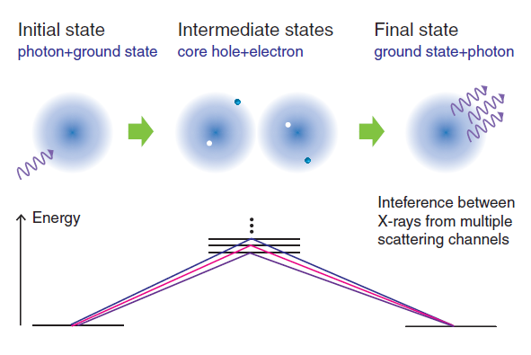
Resonant x-ray studies
Phase-Sensitive Observation of a Spin-Orbital Mott State in Sr₂IrO₄
B. J. Kim et al., Science 323, 1329 (2009)
Resonant X-ray Spectroscopy
Contains information from quantum interference
of different scattering paths

Slide 8
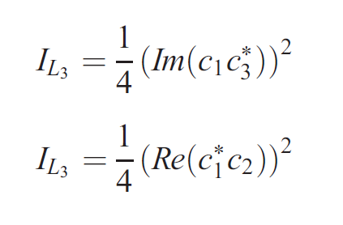
Phase-sensitive measurements
J_{eff} = ½ states – linear combinations of xy, yz, zx that differ in phase
No phase difference for simple t_{2g} states (real wave fns.)
Scattering amplitudes depend on phase differences between states
→ Test J_{eff} = ½ model vs. S = ½
Phase-Sensitive Observation of a Spin-Orbital Mott State in Sr₂IrO₄
B. J. Kim et al., Science 323, 1329 (2009)

Slide 9
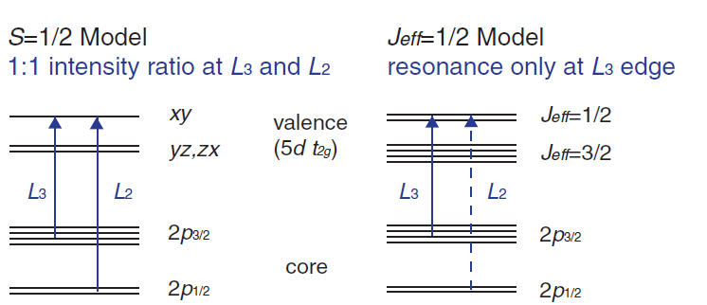
Results
Phase-Sensitive Observation of a Spin-Orbital Mott State in Sr₂IrO₄
B. J. Kim et al., Science 323, 1329 (2009)

Slide 10
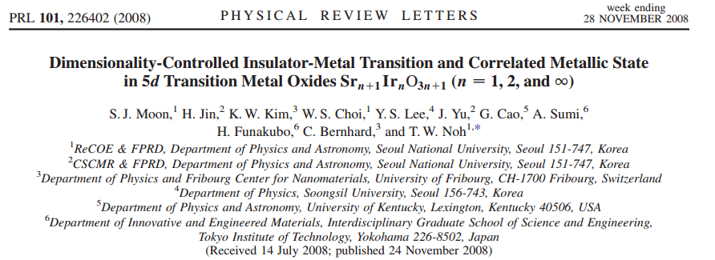
Tuning the I.-m.T. with Structure
How can we tune U/W?
Bandwidth depends on number of Ir nearest neighbors
Grow different Ruddelsden-Popper phases to change W and tune U/W

Slide 11
Ruddelsden-Popper phases
Figure from D. A. Zocco et al., J. Phys.: Condens. Matter 26, 255603 (2014)
Sr_{n+1}Ir_{n}O_{3n+1}
n = 1 Sr₂IrO₄
four nearest neighbors
n = 2 Sr₃Ir₂O₇
five nearest neighbors
n → infinity SrIrO₃
(Perovskite on MgO substrate)
six nearest neighbors

Slide 12
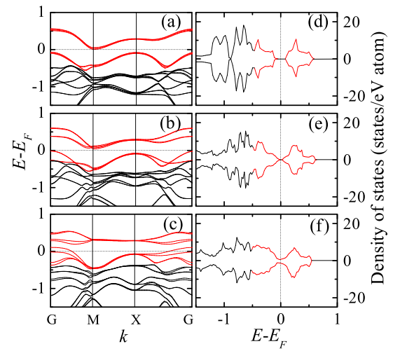
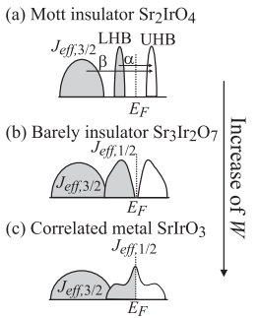
Results – Lda + U
U = 2 eV
U typically much larger for a Mott Ins, 4-7 eV
S. J. Moon et al., Phys. Rev. Lett. 101, 226402 (2008)
Insulating Sr₂IrO₄
Barely Insulating Sr₃Ir₂O₇
Correlated Metal SrIrO₃

Slide 13
results
S. J. Moon et al., Phys. Rev. Lett. 101, 226402 (2008)
Optical Conductivity

Slide 14
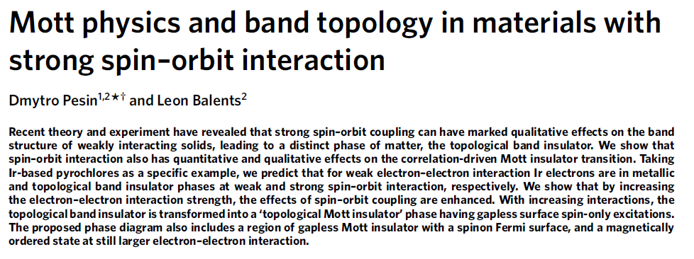
Topological Mott insulators
SOC scales by atomic number as Z⁴
Hg and Bi – strong SOC, weak correlation (s- and p-states)

Slide 15
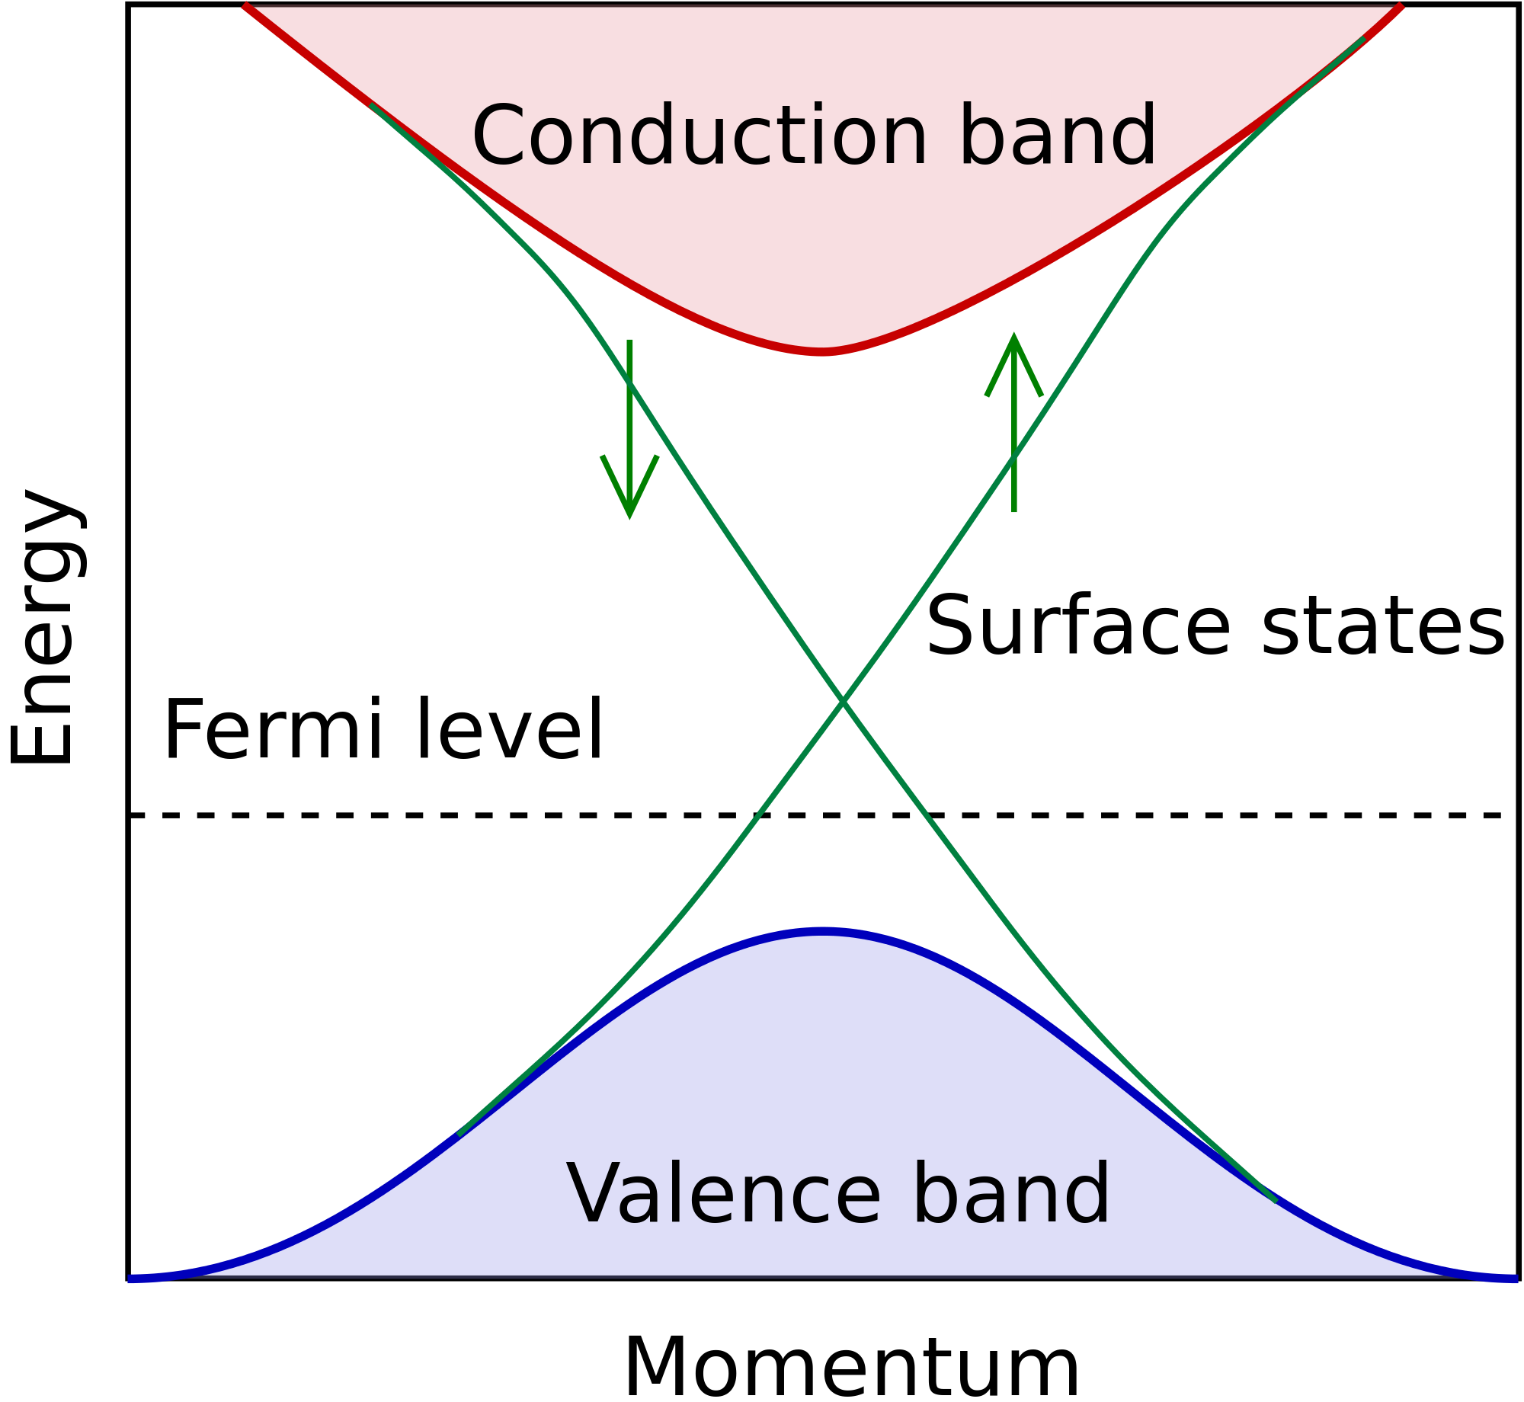
Topological insulators
Bulk is insulating
Conducting surface states
Robust against defects
topologically protected states
Potential uses for quantum computing
Unusual particle statistics – Dirac fermions (SmB₆ – 2014)
Delocalized states resistant against decoherence

Slide 16
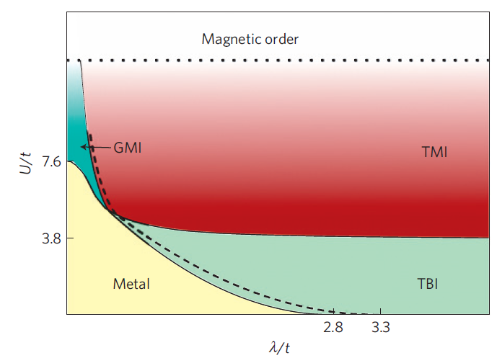
Pyrochlore Iridates
A₂⁽³⁺⁾Ir₂⁽⁴⁺⁾O₇
Spinons, quantum criticality
TBI – Topological Band Ins
GMI – Gapless Mott Ins
TMI – Topological Mott Ins
Charge-spin separation
Spinons – gapless spin excitations
Insulating surface states

