Slide 1
Phase Transitions in VO2 – Nikita Butakov
Mott vs. Mott-Hubbard Transitions
Role of Lattice vs. Electronic Subsystems
Presence of intermediary phases
Trigger-dependent excitation pathways
Electron/hole doping
Heating
Structural distortions

Slide 2
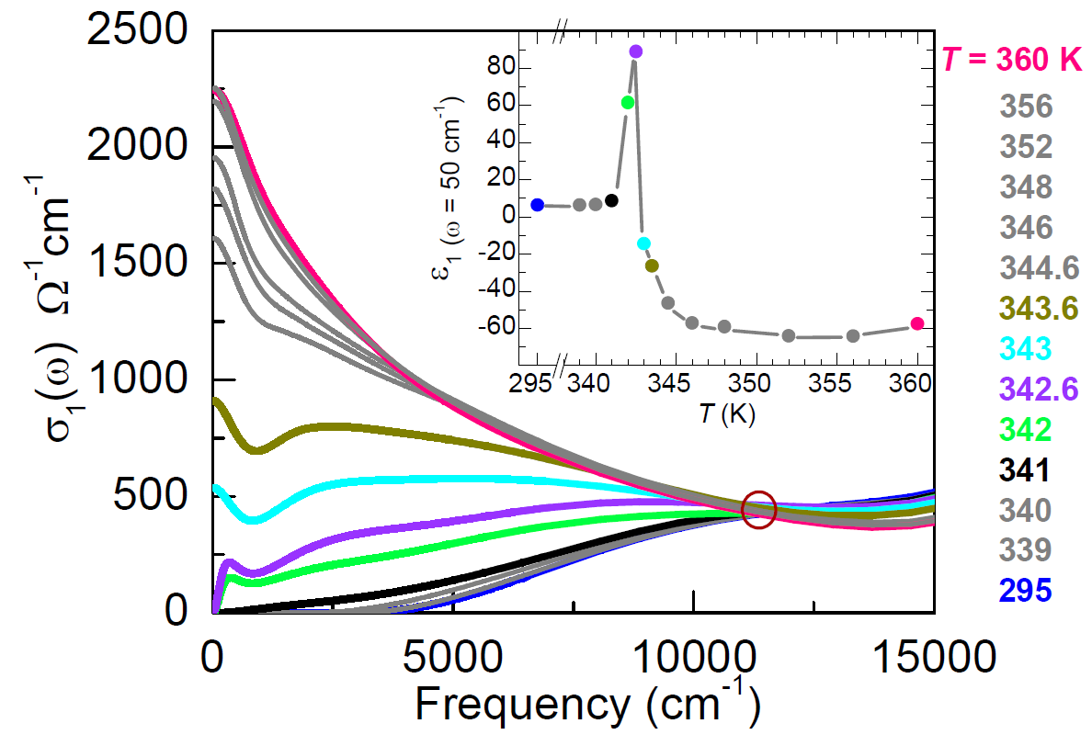
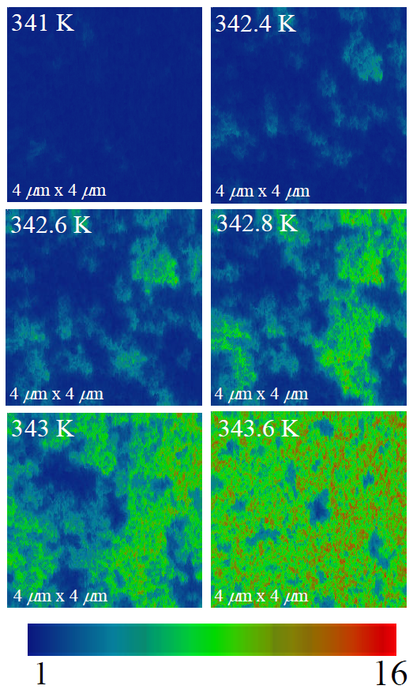
Thermally Induced Insulator-Metal Phase Transition in VO2
Thermally induced insulator-metal transition in VO2 probed with Infrared Spectroscopy and a Scanning Near-field Infrared Microscope (SNIM) technique
Percolative nature clearly apparent
“Dielectric catastrophe” in the low frequency dielectric constant at the IMT
Qazilbash, Brehm, Chae, Ho, Andreev, Kim, Yun, Balatsky, Maple, Keilmann, Kim, Basov. Mott Transition in VO2 Revealed by Infrared Spectroscopy and Nano-Imaging. Science 318, 1750 (2007).

Slide 3
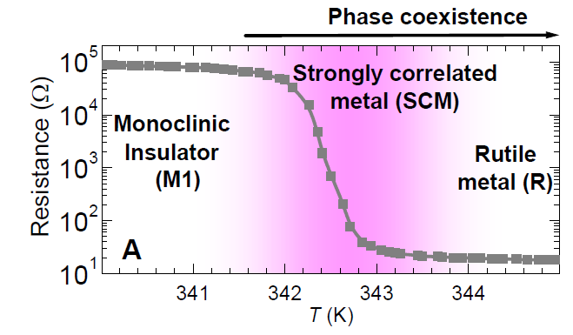
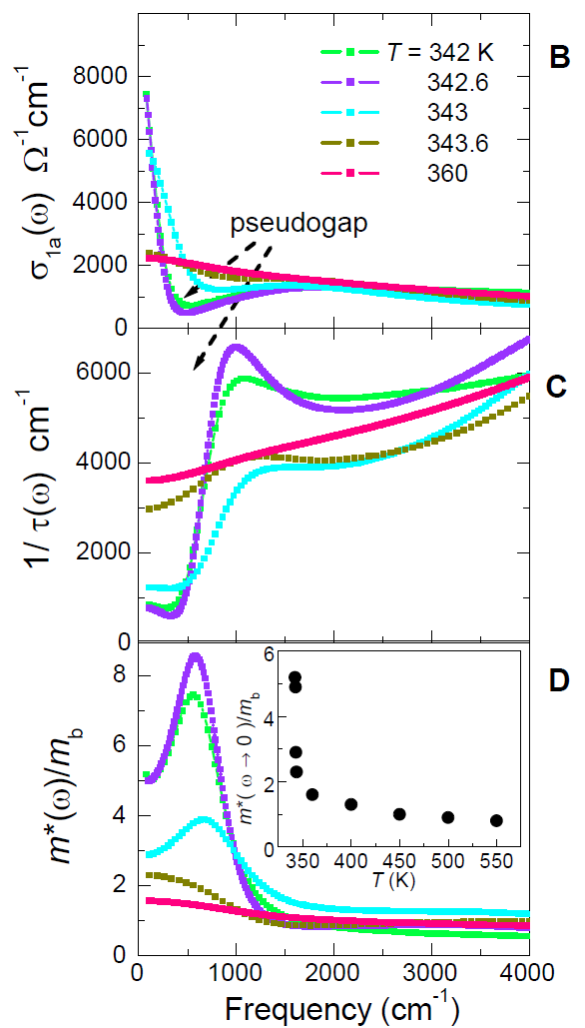
Thermally Induced Insulator-Metal Phase Transition in VO2
Optical conductivity measurements of the metallic inclusions indicate the presence of a correlated metallic phase
Divergent effective mass associated with Mott transitions
The increasing conductivity in the vicinity of the pseudogap region indicates localization, and therefore correlation
Rutile metal phase consistent with “bad metal” behavior (typically associated with high scattering rates and disordered structures)
Qazilbash, Brehm, Chae, Ho, Andreev, Kim, Yun, Balatsky, Maple, Keilmann, Kim, Basov. Mott Transition in VO2 Revealed by Infrared Spectroscopy and Nano-Imaging. Science 318, 1750 (2007).

Slide 4
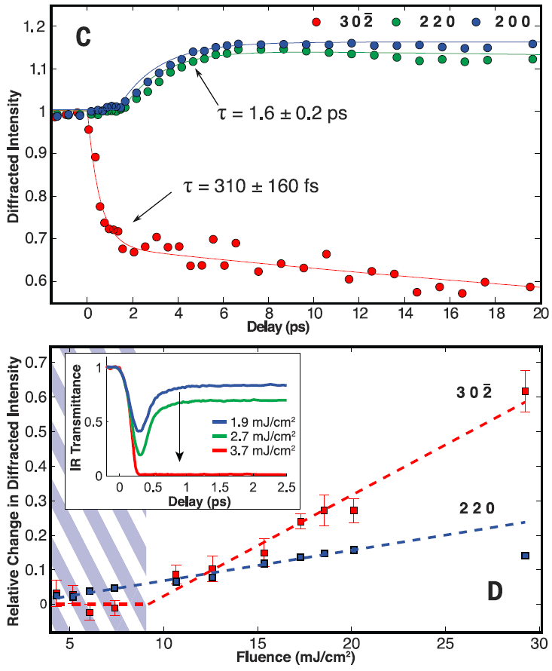
Photo-Induced Insulator-Metal Phase Transition in VO2
Structure probed on short time scales with a combination of pump/probe spectroscopy and ultrafast electron diffraction
Rapid time scale for the diffraction peak associated with the periodic lattice distortion
Slow increase in the diffraction peaks associated with valence charge distribution
For small fluence, the slow time scale diffraction peak increases, indicative of a partial transition into a conductive state
Morrison, Chatelain, Tiwari, Hendaoui, Bruhacs, Chaker, Siwick. A photoinduced metal-like phase of
monoclinic VO2 revealed by ultrafast electron diffraction. Science 346, 445 (2014).

Slide 5
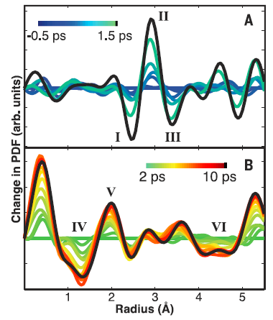
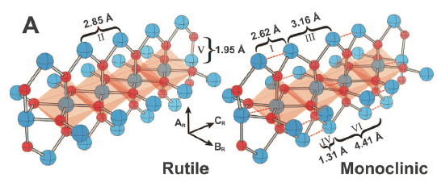
Photo-Induced Insulator-Metal Phase Transition in VO2
Difference pair distribution functions for fast dynamics (top) and slow dynamics (bottom)
Fast dynamics correspond to non-thermal melting of the PLD (increase in R-phase V-V bond length and a reduction in M-phase dimer separation)
Slow dynamics correspond to an increase of the valence charge density onto the V dimer bonds while decreasing the electrostatic potential on oxygen atoms
Morrison, Chatelain, Tiwari, Hendaoui, Bruhacs, Chaker, Siwick. A photoinduced metal-like phase of
monoclinic VO2 revealed by ultrafast electron diffraction. Science 346, 445 (2014).

Slide 6
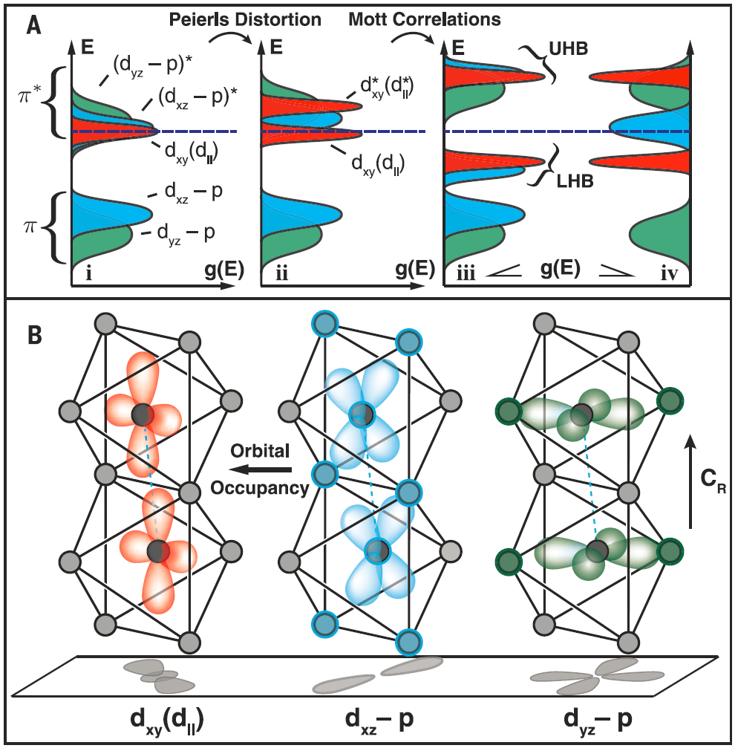
Photo-Induced Insulator-Metal Phase Transition in VO2
(i) t_{2g} bands overlap at the Fermi energy in the rutile metallic phase
(ii) Periodic lattice distortion splits d|| states into bonding and anti-bonding bands
(iii) Electronic correlations further split bands into an Upper Hubbard Band and a Lower Hubbard Band, corresponding to a Mott-Hubbard system
(iv) Optical excitation with sufficiently low fluence can drive a 1D redistribution of occupancy, without melting the periodic lattice distortion
Morrison, Chatelain, Tiwari, Hendaoui, Bruhacs, Chaker, Siwick. A photoinduced metal-like phase of
monoclinic VO2 revealed by ultrafast electron diffraction. Science 346, 445 (2014).

Slide 7
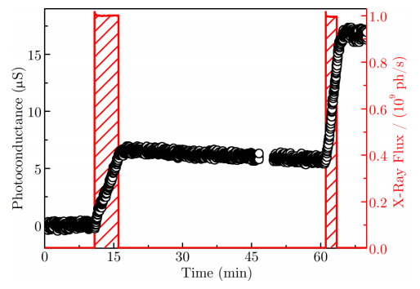
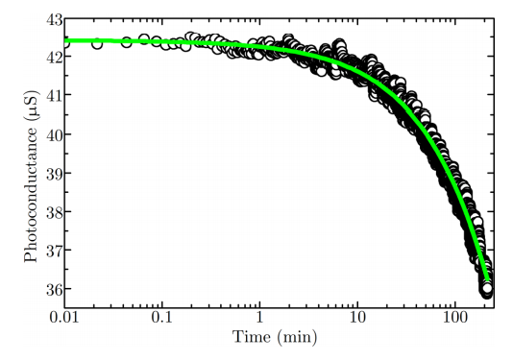
X-Ray Induced Insulator-Metal Phase Transition in VO2
VO2 illuminated under 10.3 keV x-rays at room temperature
Persistent photoconductivity decays over several days, suggesting that this transition is not thermally driven
May be attributed to the disassociation of V-V dimers, or the formation of narrow metallic filaments along VO_{x} grain boundaries
Long recombination times are attributed to phonon-assisted hopping and/or tunneling through potential barriers
IMT temperature not affected by illumination, in contrast to high-Tc cuprates, in which illumination modifies the superconducting transition temperature
Dietze, Marsh, Wang, Ramírez, Cai, Mohanty, I.K. Schuller, and Shpyrko. X-ray-induced persistent photoconductivity in vanadium dioxide. Phys. Rev. B 90, 165109, (2014).

Slide 8
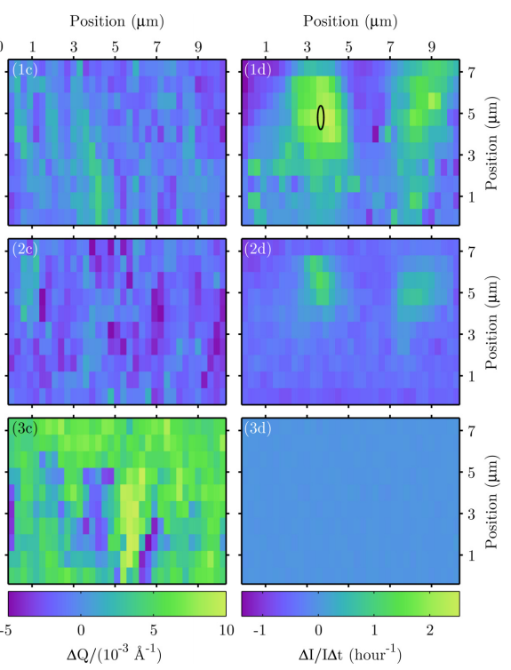
X-Ray Induced Insulator-Metal Phase Transition in VO2
Local structure was probed using focused x-rays with exposure times of 8 sec
On the left column, the change in the Bragg diffraction peak is shown, on the right, the change in photoconductivity
No apparent signatures of the metallic rutile phase post x-ray illumination
Insulating
Monoclinic
Post
Illumination
Metallic
Rutile
Dietze, Marsh, Wang, Ramírez, Cai, Mohanty, I.K. Schuller, and Shpyrko. X-ray-induced persistent photoconductivity in vanadium dioxide. Phys. Rev. B 90, 165109, (2014).

Slide 9
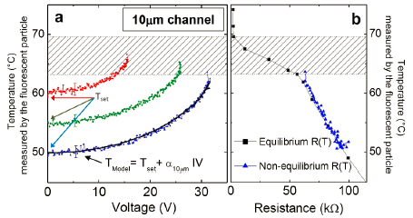
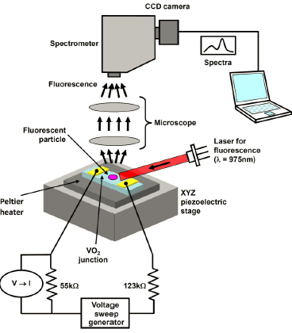
Current Driven Insulator-Metal Phase Transition in VO2
Is the IMT the result of a structural phase transition? Or is due to electron/hole doping?
In this study, the local temperature was probed with a calibrated fluorescent nanosensor
Joule heating results in a significant increase in local temperature, which can be large enough to drive a phase transition
Zimmers, Aigouy, Mortier, Sharoni, Wang, West, Ramirez, I. K. Schuller. Role of Thermal Heating on the Voltage Induced Insulator-Metal Transition in VO2. PRL 110, 056601 (2013).

Slide 10
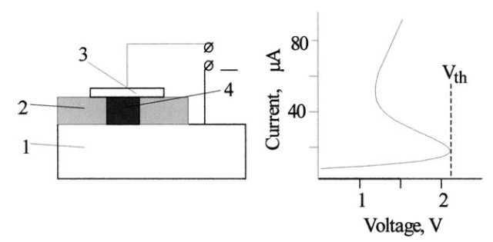
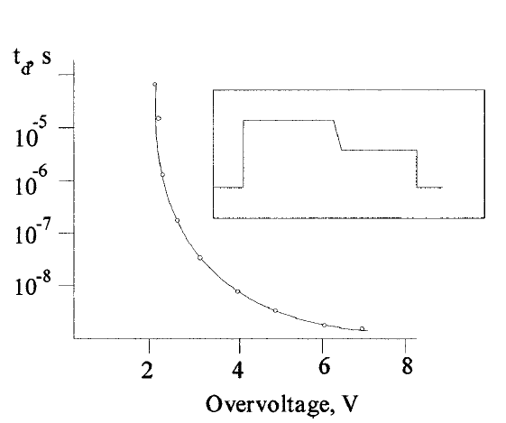
Charge Injection Driven Insulator-Metal Phase Transition in VO2
Holes injected from Si into VO2 with a metal-oxide-semiconductor structure
Found that time delays are too fast, and leakage currents are too small, to attribute changes in conductivity to thermally induced phase transitions
Effects attributed to an increase in charge carrier density, which screens Coulomb interactions, and effectively reduces the IMT temperature, and eliminates the Mott-Hubbard energy gap
Stefanovich, Pergament, Stefanovich. Electrical switching and Mott transition in VO2. Journal of Physics: Condensed Matter, 12, 8837–8845 (2000).

Slide 11
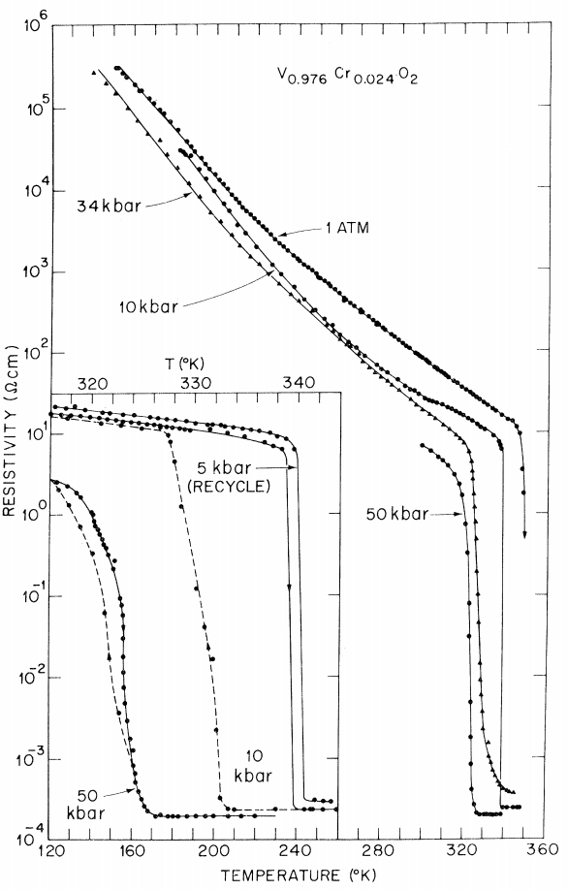
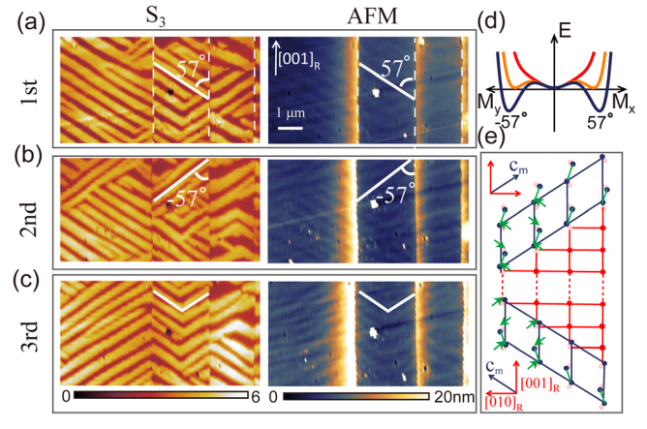
Other Ways of Driving Phase Transitions
Pressure
Resonant Excitation of Phonons
with THz and X-Ray Photons
Strain-Induced Ordering
Spontaneous symmetry breaking of the insulating monoclinic state
Liu, Wagner, Zhang, McLeod, Kittiwatanakul, Fei, Abreu, Goldflam, Sternbach, Dai, West, Lu, Wolf, Averitt, and Basov. Symmetry breaking and geometric confinement in VO2: Results from a three-dimensional infrared nano-imaging. Appl. Phys. Lett. 104, 121905 (2014).
Marezio, McWhan, Remeika, and Dernier. Structural Aspects of the Metal-Insulator Transitions in Cr-Doped VO2. Physical Review B, 5, 2541, (1972).

