Slide 1

MAT286K
12-08-2014
Lars Bjaalie
The rare-earth titanates (RTiO3)

Slide 2
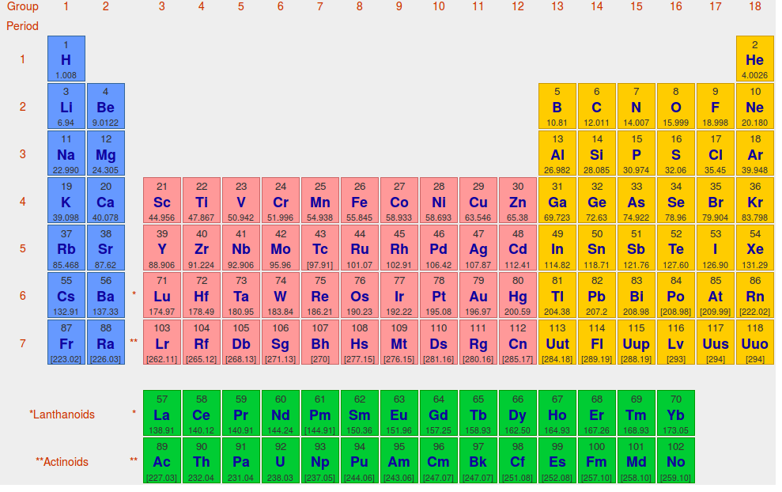

Slide 3
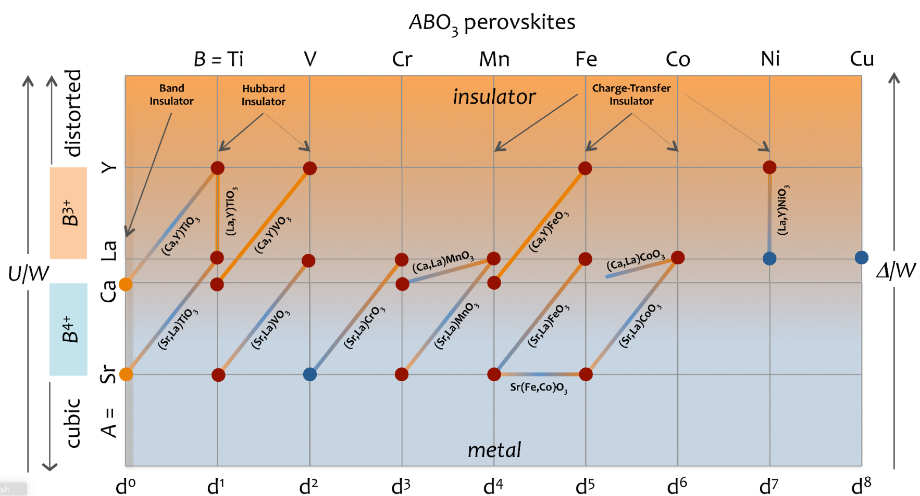
Fig. adapted by Ram Seshadri from A. Fujimori, J. Phys. Chem. Solids 53 (1992) 1595–1602.

Slide 4
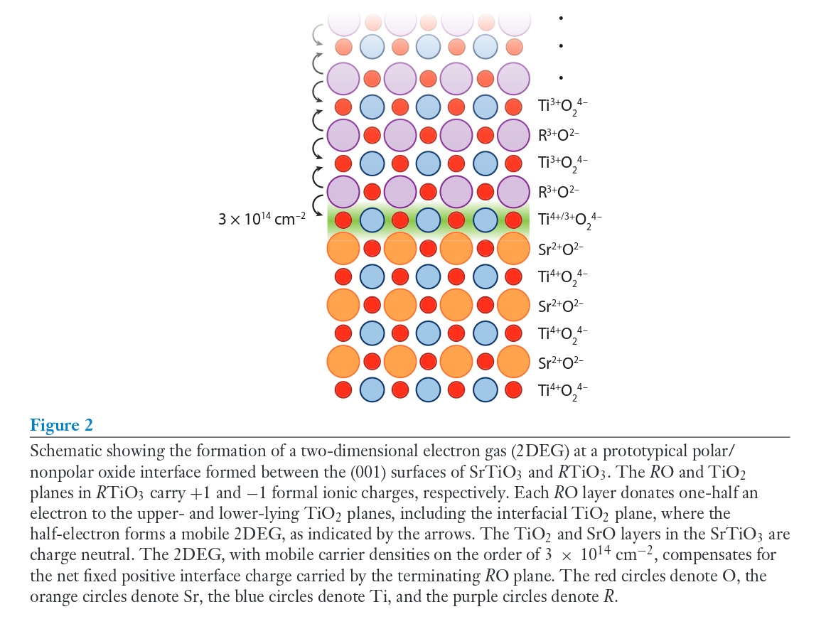
Background
Fig. from S. Stemmer and S. J. Allen, Annu. Rev. Materials Research 44, 151-171 (2014)

Slide 5
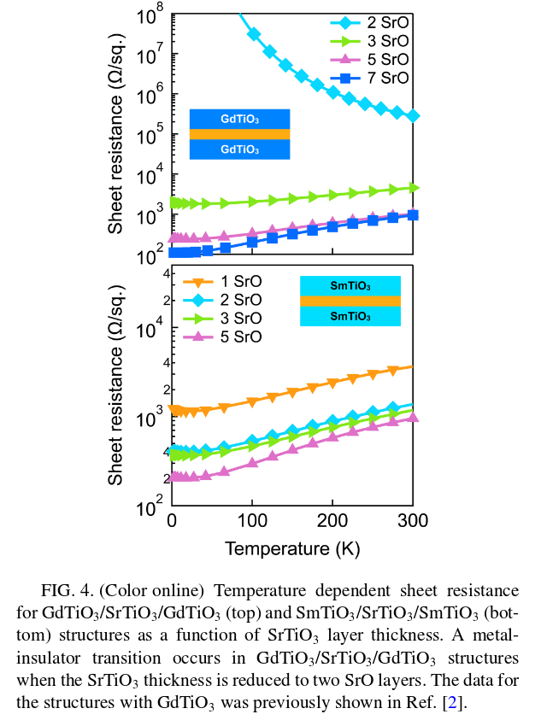
Background
Fig. from J. Y. Zhang et al., Phys. Rev. B 89, 075140 (2014)
SmTiO3/SrTiO3/SmTiO3 metallic regardless of SrTiO3 thickness
GdTiO3/SrTiO3/SmTiO3 insulating for 1 [a] and 2 SrTiO3 layers
Related to small polaron formation in the interface RTiO3 layer?
[a] D. G. Ouellette et al., Sci. Rep. 3, 3284 (2013)

Slide 6
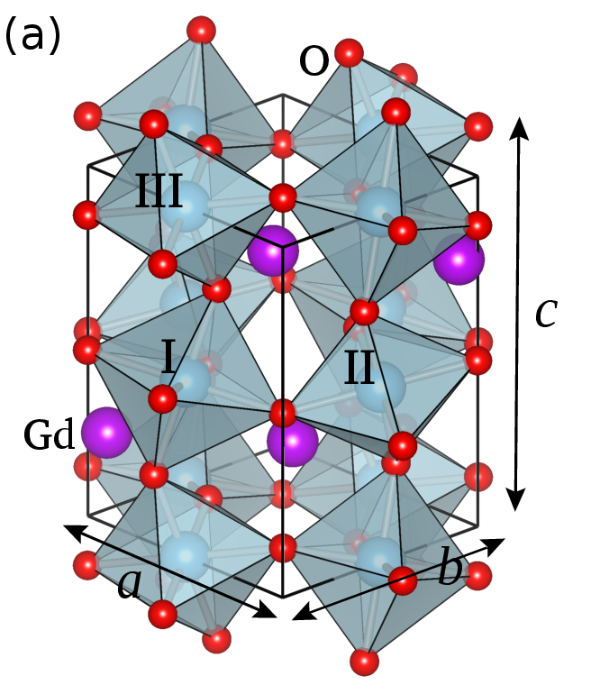
Structure
GdFeO₃ type rotations/tilts
Glaser notation: a⁻a⁻b⁺
Pbnm or Pnma space group
depending on c-axis orientation
Lattice constants and
Ti-O-Ti angles depend on
rare-earth radius
Where do the distortions
come from?

Slide 7
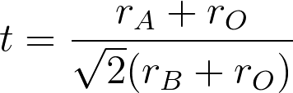
Distortions in perovskites (MAT218)
Rare-earth radius: size effect, Goldschmhidt tolerance factor [a]
Derived by simply considering the radii of the ionic spheres
t > 1: A ion too big or B ion too small, hexagonal (BaNiO₃)
0.9 < t < 1: Good match, cubic (SrTiO₃)
0.71 < t < 0.9: A ions too small to fit into B ion interstices,
Orthorhombic/rhombohedral (CaTiO₃)
[a] V. M. Goldschmidt, Die Naturwissenschaften 21, 477-485 (1926)

Slide 8
Distortions in perovskites (MAT218)
Beyond ionic hard-spheres:
Oxygen p-orbitals σ-bond to A-site cation d-orbitals
Distortions favor electron localization:
Decreasing W
Increasing crystal field splitting
All RTiO₃ (3d¹) compounds are Mott insulators
Not the case for all 3d¹ materials, for example CaVO₃

Slide 9
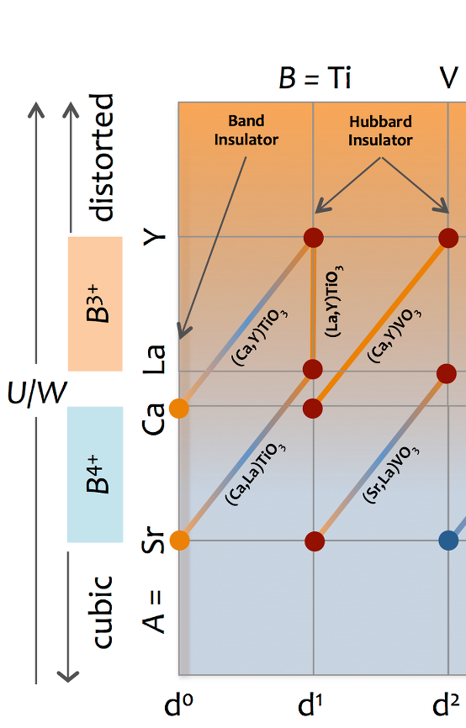
U/W ratio changing with structure
U: on-site repulsion energy
W: bandwidth – from orbital overlaps, determined by Ti-O-Ti angle
Largest overlap for 180° Ti-O-Ti angles
From YTiO3 to LaTiO3:
Straightening out bond angles, increasing W, transitioning from localized to itinerant d-electrons?

Slide 10
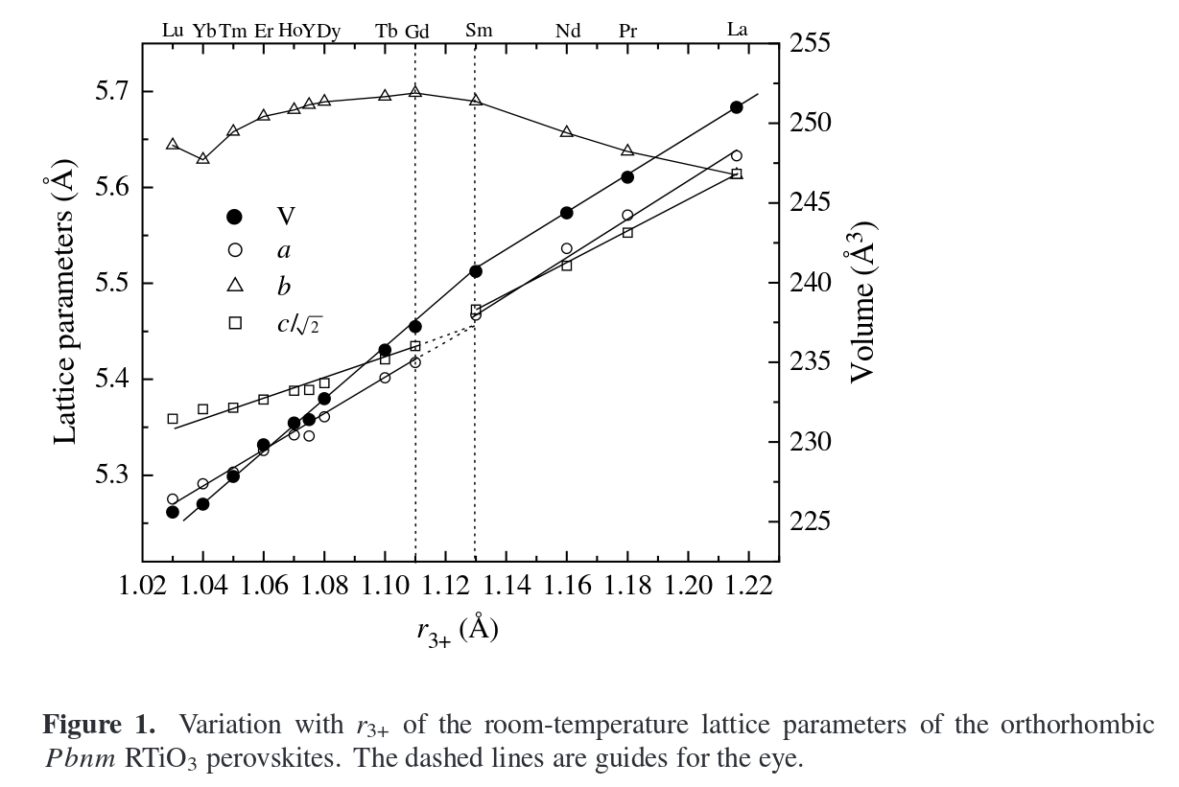
Lattice parameters
Fig. from H. D. Zhou and J. B. Goodenough, J. Phys.: Condens. Matter 17, 7395-7406 (2005)
Transition (b decreasing) at r₃₊ = 1.11 Å interpreted as a distortion
of the octahedra superimposed on the cooperative site rotations (GdFeO₃) as a result of R-O interactions

Slide 11
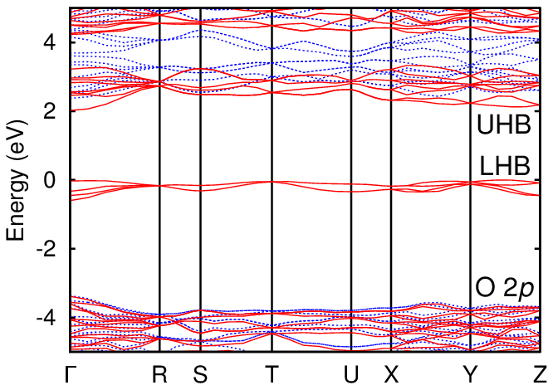
Electronic structure
e_{g}
t_{2g}
HSE electronic structure of GdTiO₃
Crystal field from off-cubic rare-earth ions split 3d levels
Gap from placing two electrons on the same Ti atom
Prototypical Mott insulators

Slide 12
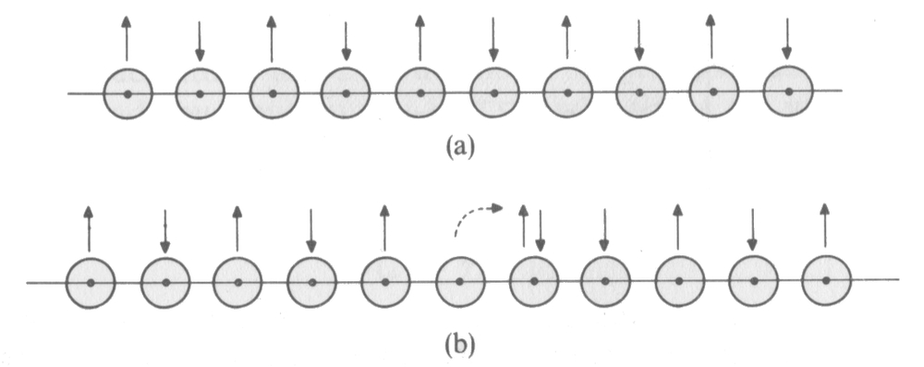
Class 04. Correlations and the Hubbard model: The idea of Mott
From the Cox text, page 135
Consider a chain of orbitals, each with one electron. To hop an electron, an orbital has to be ionized at cost I, which is compensated a little by the electron affinity A.
U = I – A
For H atoms, I = 13.6 eV and A = 0.8 eV, meaning U = 12.8 eV. However, this does not account for some screening (due to the dielectric not being vacuum).

Slide 13
Class 04. Correlations and the Hubbard model: The Hamiltonian
hopping or tight-binding (LCAO) part
double-occupancy cost or on-site repulsion

Slide 14
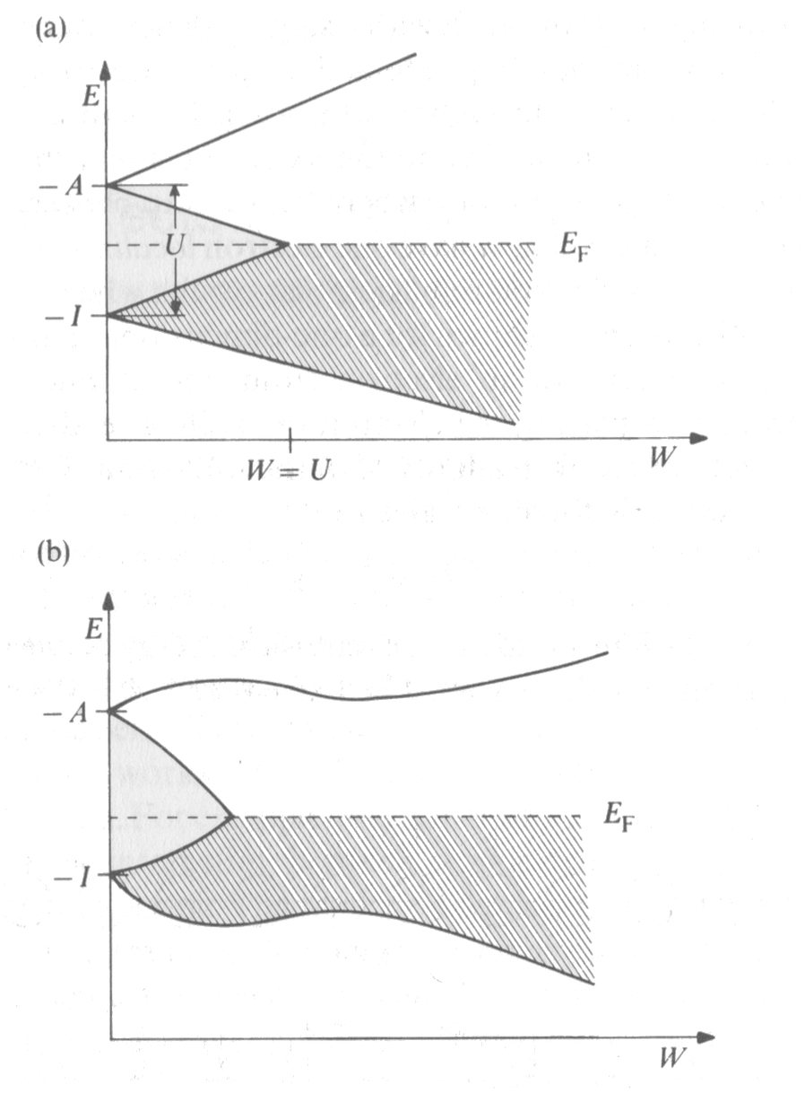
Class 04. Correlations and the Hubbard model: The Hamiltonian
As the bandwidth is increased, (or as the atoms approach closer) the gap can close.
From the Cox text, page 137

Slide 15
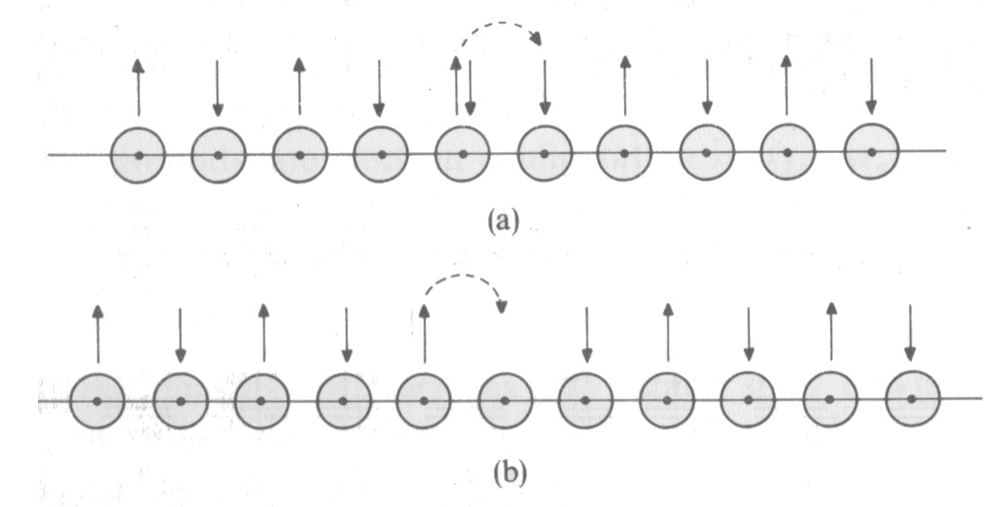
Class 04. Correlations and the Hubbard model: The Hamiltonian
Doping of holes (removal of electrons) as in (b) makes hopping much easier, with the on-site repulsion having been removed.
From the Cox text, page 149

Slide 16
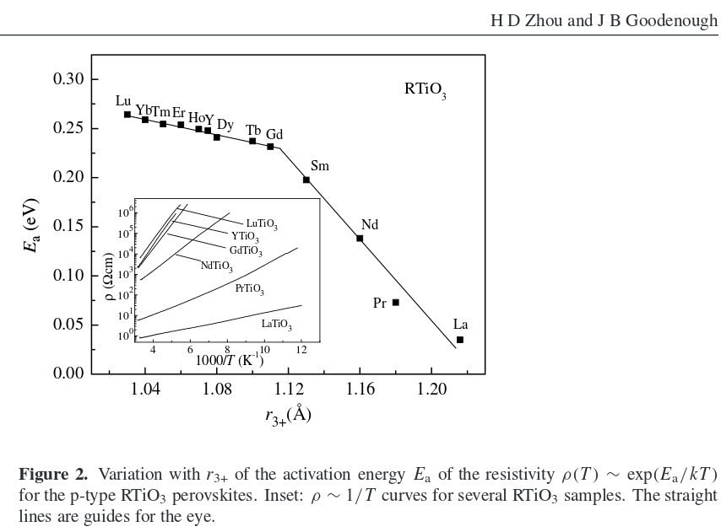
Electronic behavior - polarons
Fig. from H. D. Zhou and J. B. Goodenough, J. Phys.: Condens. Matter 17, 7395-7406 (2005)
[a] H. D. Zhou and J. B. Goodenough, Phys. Rev. B 71, 184431 (2005)
Intrinsic p-type conductivity (from Seebeck coefficient)
Two activation energy regimes: Small and large hole polarons?
10 sites in LaTiO₃ (thermoelectric power measurements) [a]

Slide 17
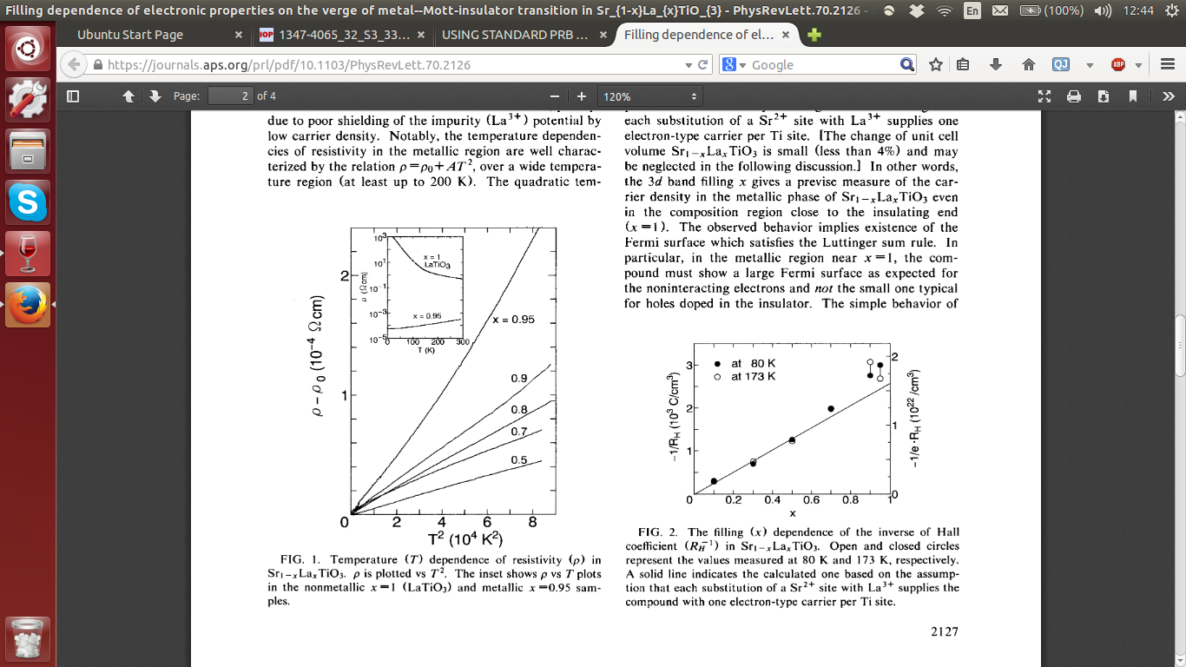
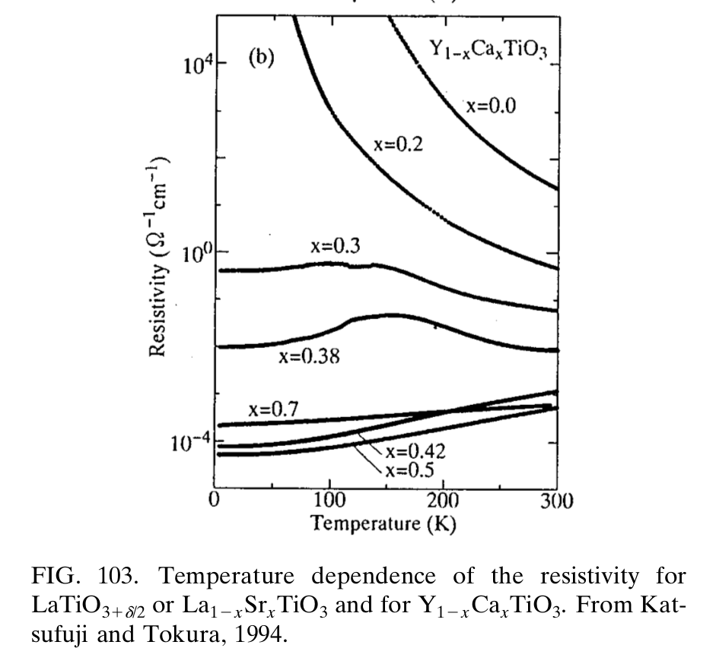
Electronic behavior – MIT from hole doping
Sr doping of LaTiO3
Y. Tokura et al., Phys. Rev. Lett. 70, 2126-2129 (1993)
Ca doping of YTiO3
T. Katsufuji and Y. Tokura, Phys. Rev. B 50, 2704-2707 (1994)
Higher doping threshold for YTiO3 indicative of smaller polaron size? Lecture 3: Percolation, Anderson Localization

Slide 18
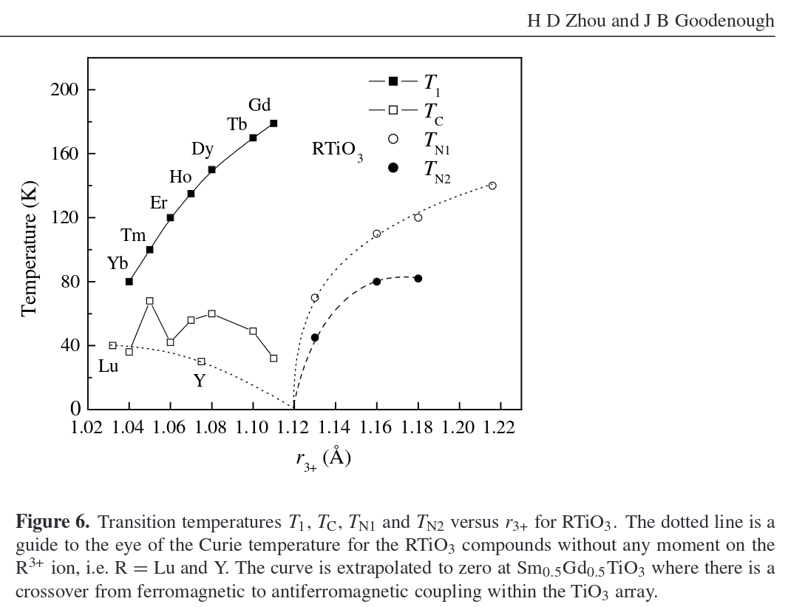
Magnetism in the rare-earth titanates
Fig. from H. D. Zhou and J. B. Goodenough, J. Phys.: Condens. Matter 17, 7395-7406 (2005)
La
T_{C}: Curie temperature
T₁: FM FM R order
T_{N1}: AFM Ti order
T_{N2}: AFM R order
Nd
Pr
Sm
Crossover from anti-ferromagnetic to ferromagnetic order of Ti 3d¹ spins, again at r₃₊ = 1.11 Å

Slide 19
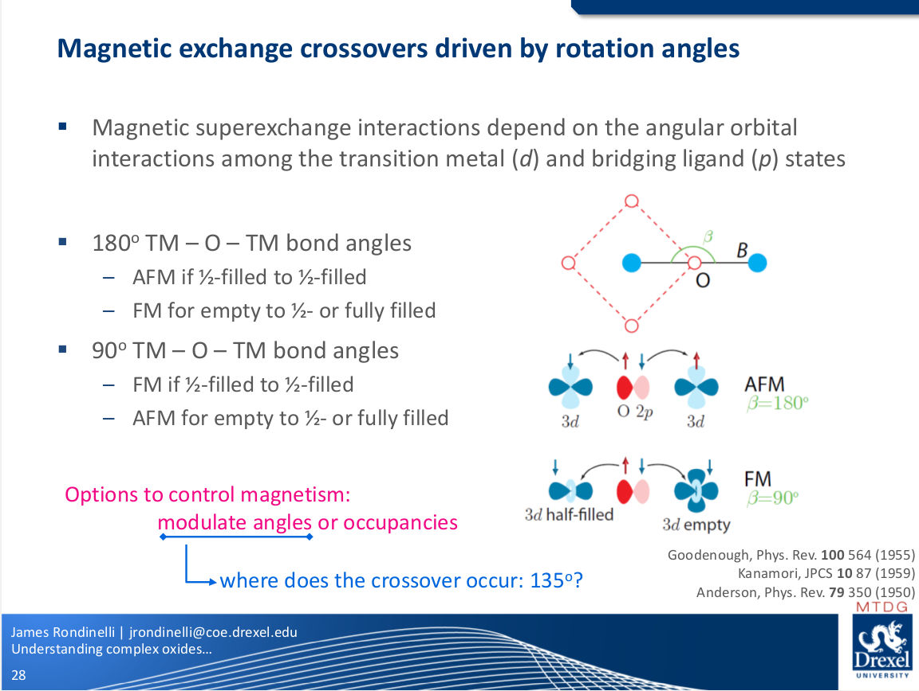

Slide 20
Transitions at r₃₊ = 1.11 Å – cooperative Jahn-Teller distortion
Structure – TiO₆ octahedra more distorted (uneven Ti-O lengths)
Hopping activation energy – large to small polarons
Ti 3d¹ magnetism – AFM to FM
G-type orbital ordering – alternating yz and xz orbitals
Cooperative Jahn-Teller distortion about b-axis minimizing elastic energy and maximizing the ferromagnetic interactions
Also helps in stabilizing small polarons?
Cooperative Jahn-Teller distortions characteristic of localized electrons; orbital ordering temperature increases with decreasing W
H. D. Zhou and J. B. Goodenough, J. Phys.: Condens. Matter 17, 7395-7406 (2005)
E. Pavarini, A. Yamasaki, J. Nuss, O. K. Andersen, New J. Phys. 7, 188 (2005)
M. Mochizuki, M. Imada, New J. Phys. 6, 154 (2004)

Slide 21
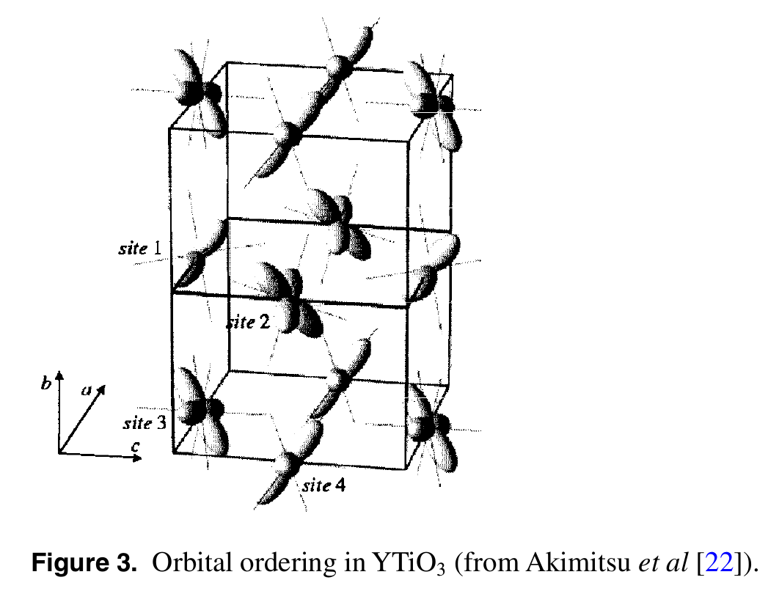
Transitions at r₃₊ = 1.11 Å – cooperative Jahn-Teller distortion
Akimitsu J, Ichikawa H, Eguchi N, Miyano T, Nishi M and Kakurai K 2001 J. Phys. Soc. Japan 70 3052

Slide 22
Measuring distortions of octahedra
 | YTiO3 |  | SmTiO3 |  | LaTiO3
 | Ti-O (Å) | Diff. | Ti-O (Å) | Diff. | Ti-O (Å) | Diff.
ab-in-plane | 2.016 | -1.13% | 2.044 | 0% | 2.030 | -0.44%
ab-in-plane | 2.077 | +1.86% | 2.058 | +0.73% | 2.057 | +0.88%
c | 2.023 | -0.78% | 2.028 | -0.73% | 2.030 | -0.44%
average | 2.039 |  | 2.043 |  | 2.039
r₃₊ < 1.11
r₃₊ > 1.11
Geometry of octahedra changes?
Structural data from [a]
Probably some experimental uncertainty…
[a] D. A. MacLean, H. N. Ng, J. E. Greedan, J. Solid State Chem 30, 35-44 (1979)

Slide 23
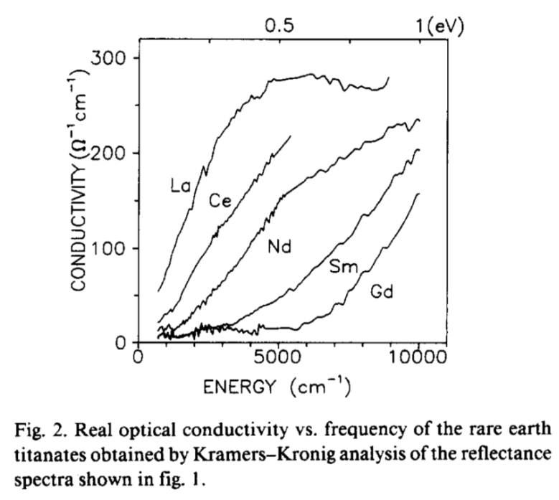
Value of the Mott-Hubbard gap?
Fig. from D. A. Crandels, T. Timusk, J. D. Garret, J. E. Greedan, Physica C 201, 407-412 (1992)
Onset of optical conductivity from reflectance measurements:
Gap from 0.2 eV (LaTiO₃) to 0.7 eV (GdTiO₃)
Could polarons play a role?

Slide 24
From reflectivity to optical absorption
R(ε(ω)): Refractive index
I(ε(ω)): Absorption
Reflectivity => refractive index => R(ε(ω))
Kramers-Kronig relations: Relating real and imaginary parts of a complex function analytic in the upper half plane => I(ε(ω))
Optical conductivity: Electrical conductivity in the presence of electric field – depends on absorbed light only, I(ε(ω))
Reference:
A. B. Kuzmenko, Rev. Sci. Instrum. 76, 083108 (2005)

Slide 25
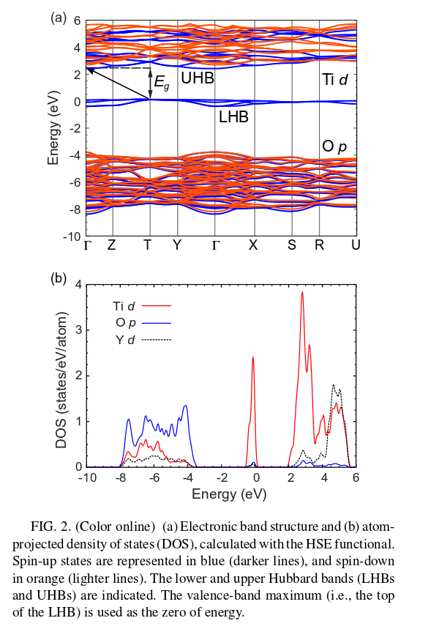
Polarons affecting reflectivity measurements? YTiO3
Fig. from B. Himmetoglu, A. Janotti, L. Bjaalie, C. G. Van de Walle, Phys. Rev. B 90, 161102(R) 2014
YTiO3: Onset of optical conductivity at 0.7 eV
HSE band gap 2.1 eV

Slide 26
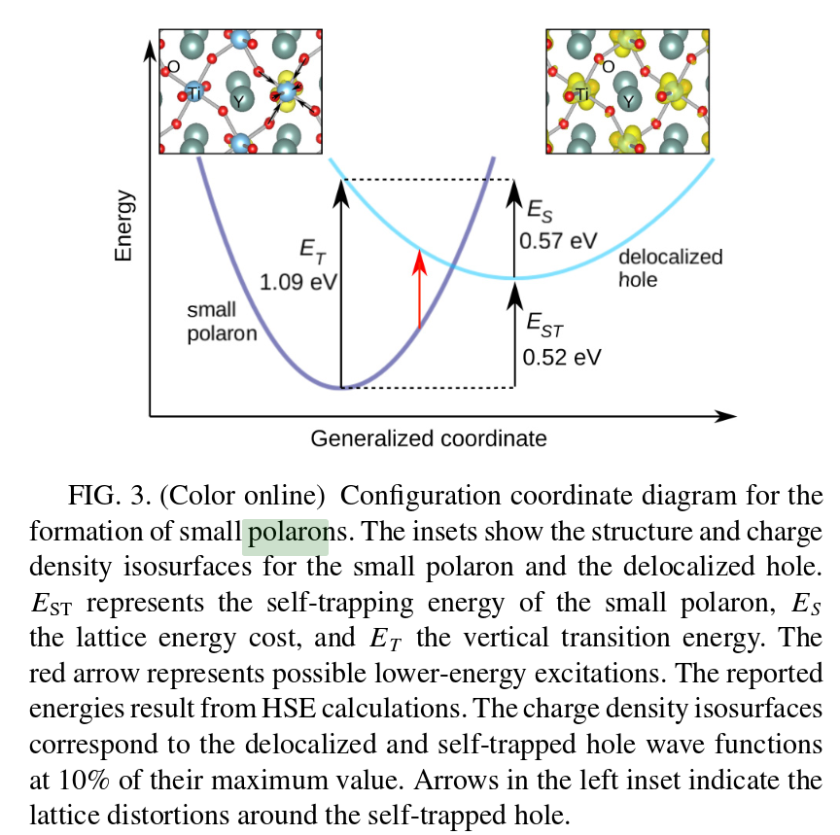
Polarons affecting reflectivity measurements? YTiO3
Fig. from B. Himmetoglu, A. Janotti, L. Bjaalie, C. G. Van de Walle, Phys. Rev. B 90, 161102(R) 2014
UHB (Ti 3d)
Small hole polaron
LHB (Ti 3d)

Slide 27
Bonus: Victor Moritz Goldschmidt (1888-1947)
“Founder of modern geochemistry”
1901: Moved to Oslo from Zurich
Thesis 1911: Die Kontaktmetaorphose im Kristianiagebiet
1929: Knight of the Order of St. Olav
November 1942: Arrested for deportation
February 1943: Fled to Sweden, later England
June 1946: Returned to Oslo, died shortly after
Mountain range Goldschmidtfjella in Svalbard

