Slide 1
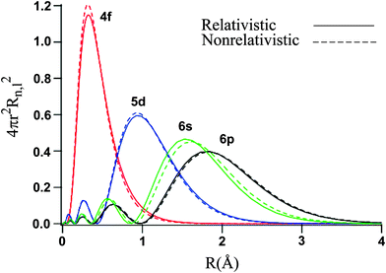
Class 14, 4d and 5d
Going from 3d to 4d, we expect broader bands, and for 5d, relativistic effects. The changes in the radial distribution function correspond to scalar relativistic effects.
In addition, for heavier elements (usually beyond La), spin-orbit coupling (also referred to as “fully relativistic” effects mix up quantum numbers.

Slide 2
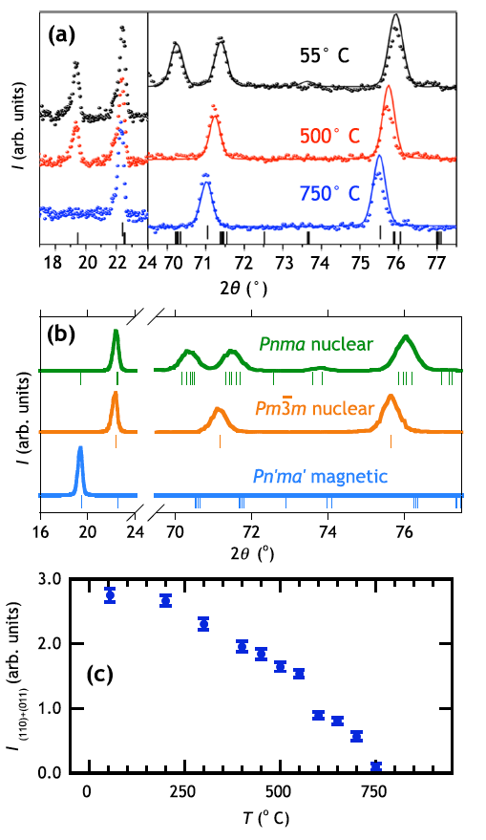
Class 14, 4d and 5d: SrTcO₃
SrTcO3 has the highest magnetic ordering temperature of any perovskite oxide, and the highest ordering temperature of any non 3d compound.
Rodriguez, Poineau, Llobet, Kennedy, Avdeev, Thorogood, Carter, Seshadri, Singh, Cheetham, Phys. Rev. Lett. 106 (2011) 067201(1–4).

Slide 3
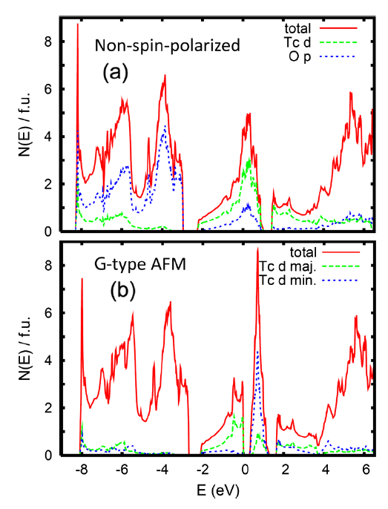
Class 14, 4d and 5d: SrTcO₃
High ordering temperatures arise because of very high covalency and hence strong superexchange.
Rodriguez, Poineau, Llobet, Kennedy, Avdeev, Thorogood, Carter, Seshadri, Singh, Cheetham, Phys. Rev. Lett. 106 (2011) 067201(1–4).

Slide 4
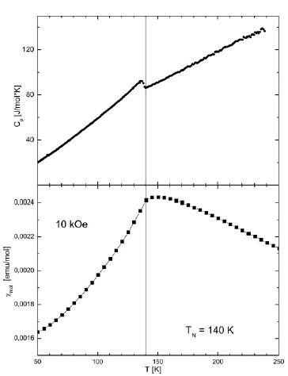
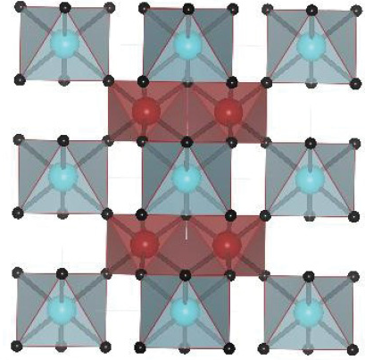
Class 14, 4d and 5d: PdAs₂O₆
PdAs₂O₆ has a significantly higher Neel temperature (140 K) than NiAs₂O₆ (30 K).
Reehuis, Saha-Dasgupta, Orosel, Nuss, Rahaman, Keimer, Andersen, Jansen, Phys. Rev. B. 85 (2012) 115118(1–4).

Slide 5
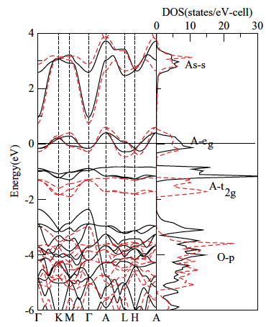
Class 14, 4d and 5d: PdAs₂O₆
PdAs₂O₆ has a significantly higher Neel temperature (140 K) than NiAs₂O₆ (30 K).
Dashed red is Pd and solid back in Ni.
Reehuis, Saha-Dasgupta, Orosel, Nuss, Rahaman, Keimer, Andersen, Jansen, Phys. Rev. B. 85 (2012) 115118(1–4).

Slide 6
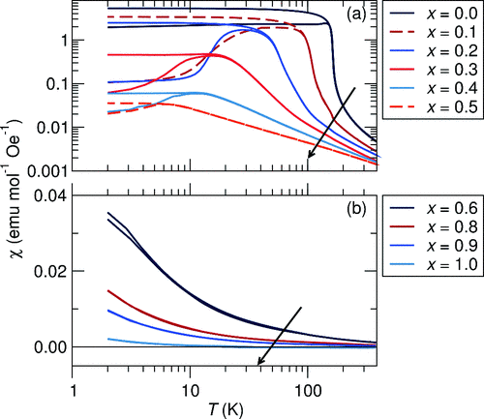
Class 14, 4d and 5d: Ruthenates: SrRuO₃
SrRuO₃ is a metallic ferromagnet. In this example, substitution of Sr by La and Ru by Rh results in the magnetism (and metallicity) being suppressed.
Barton, Seshadri, Rosseinsky, Phys. Rev. B. 83 (2011) 064417(1–8).

Slide 7
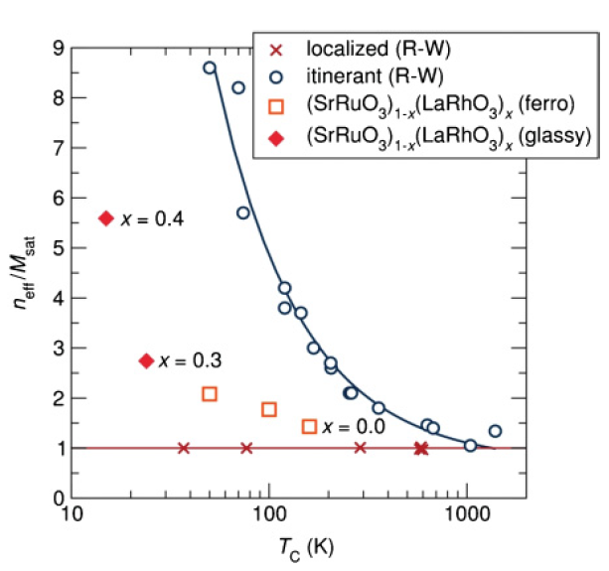
Class 14, 4d and 5d: Ruthenates: SrRuO₃
The nature of the magnetism from the Rhodes-Wolfarth ratio. SrRuO₃ is neither perfectly localized not perfectly itinerant.
Barton, Seshadri, Rosseinsky, Phys. Rev. B. 83 (2011) 064417(1–8).

Slide 8
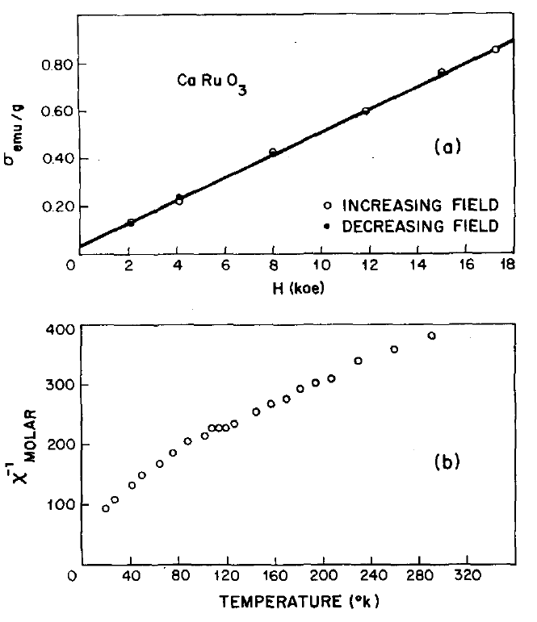
Class 14, 4d and 5d: Ruthenates: SrRuO₃
Metallic behavior and magnetism can be killed by tilting.
Longo, Raccah, Goodenough, J. Appl. Phys. 39 (1968) 1327–1328.

Slide 9
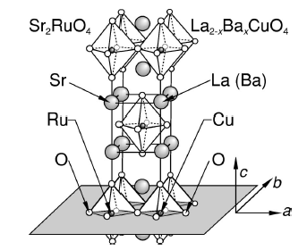
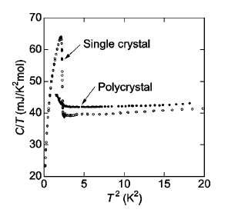
Class 14, 4d and 5d: Ruthenates: Sr₂RuO₄ is a superconductor
Sr₂RuO₄ is a superconductor below 2 K
Mackenzie, Maeno, Rev. Mod. Phys. 75 (2003) 657–712.

Slide 10
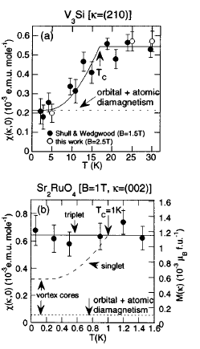
Class 14, 4d and 5d: Ruthenates: Sr₂RuO₄ is a superconductor
Unconventional superconductor with d-wave pairing.
Mackenzie, Maeno, Rev. Mod. Phys. 75 (2003) 657–712.

Slide 11
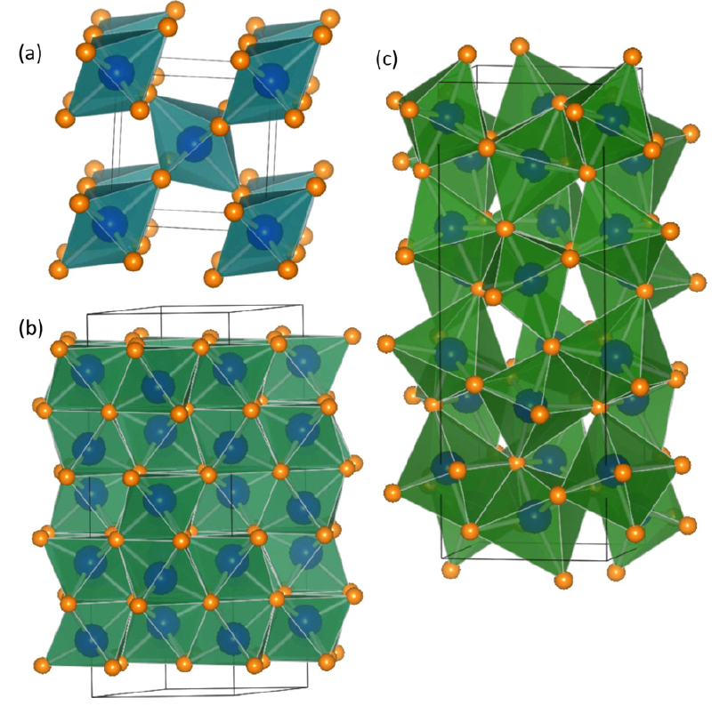
Class 14, 4d and 5d: Iridates. Rh³⁺ vs. Ir⁴⁺.
The structures of Ir and Rh oxides, including (a) rutile MO₂, (b) corundum M₂O₃ and (c) the orthorhombic Pbna M₂O₃.
Miao, Seshadri, J. Phys. Condens. Matter 24 (2012) 215503(1–8).

Slide 12
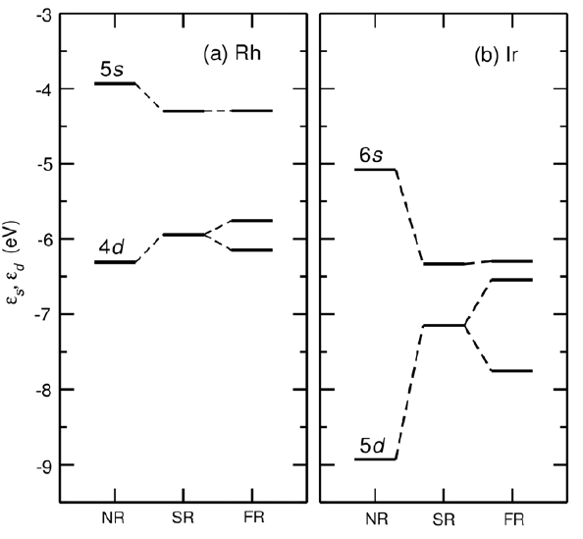
Class 14, 4d and 5d: Iridates. Rh³⁺ vs. Ir⁴⁺.
Energy levels with and without relativistic effects..
Miao, Seshadri, J. Phys. Condens. Matter 24 (2012) 215503(1–8).

Slide 13
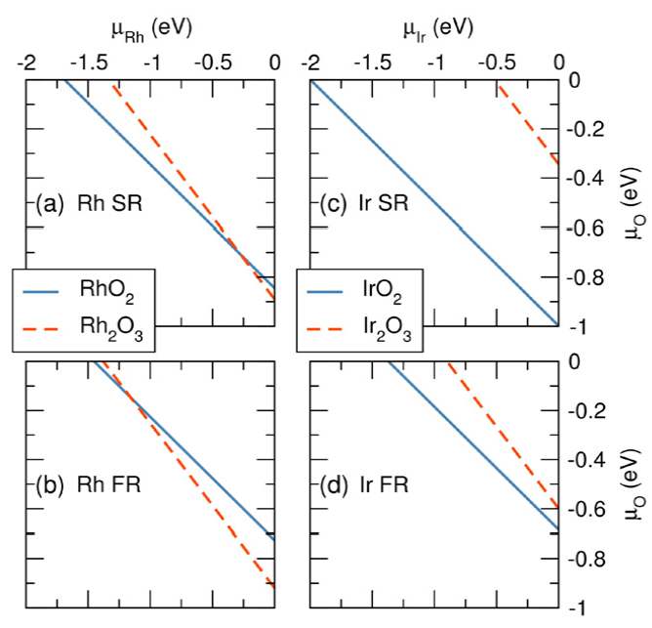
Class 14, 4d and 5d: Iridates. Rh³⁺ vs. Ir⁴⁺.
Relativistic effects give the preference for IrO₂ over Rh₂O₃.
Miao, Seshadri, J. Phys. Condens. Matter 24 (2012) 215503(1–8).

Slide 14
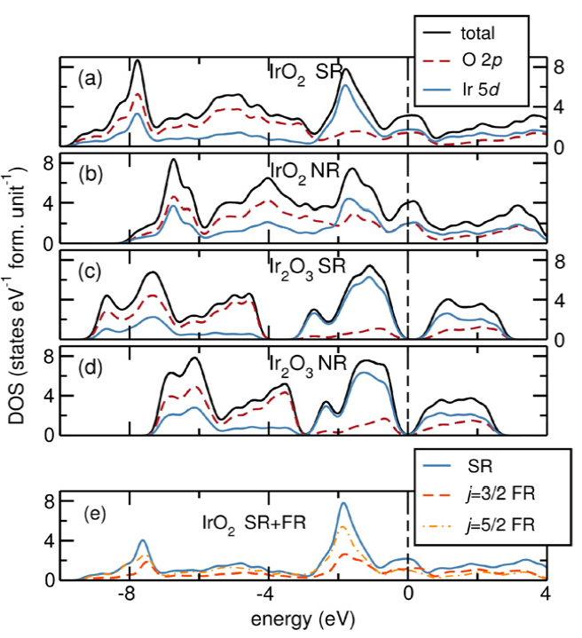
Class 14, 4d and 5d: Iridates. Rh³⁺ vs. Ir⁴⁺.
DOS:
Miao, Seshadri, J. Phys. Condens. Matter 24 (2012) 215503(1–8).

Slide 15
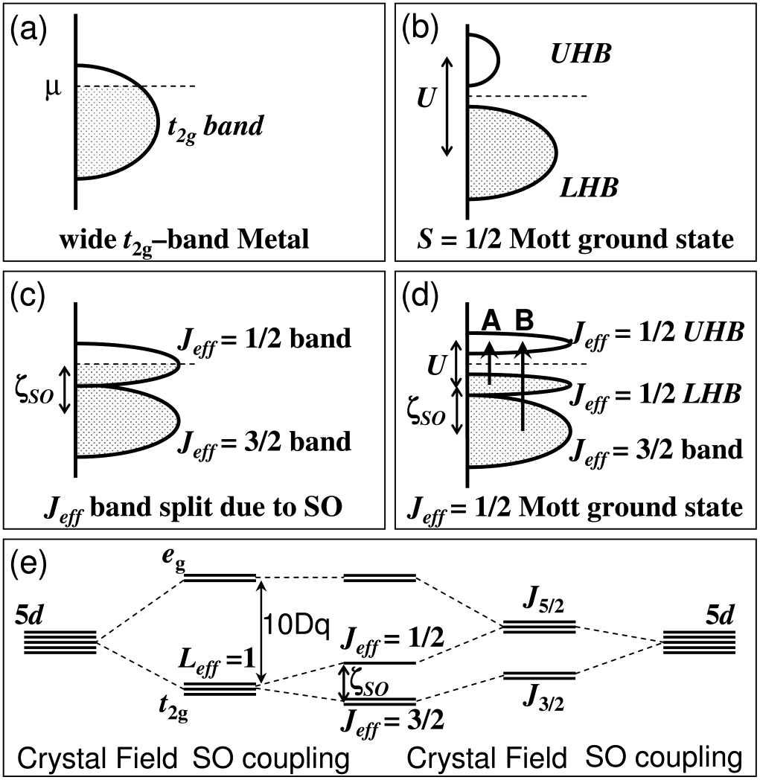
Class 14, 4d and 5d: Sr₂IrO₄
“Despite delocalized Ir 5d states, the J_{eff} states form such narrow bands that even a small correlation energy leads to the J_{eff} = 1/2 Mott ground state with unique electronic and magnetic behaviors, suggesting a new class of J_{eff} quantum spin driven correlated-electron phenomena.”
Kim, Jin, Moon, Kim, Park, Leem, Yu, Noh, Kim, Oh, Park, Durairaj, Cao, Rotenberg, Phys. Rev. Lett. 101 (2008) 076402 (1–4).

Slide 16
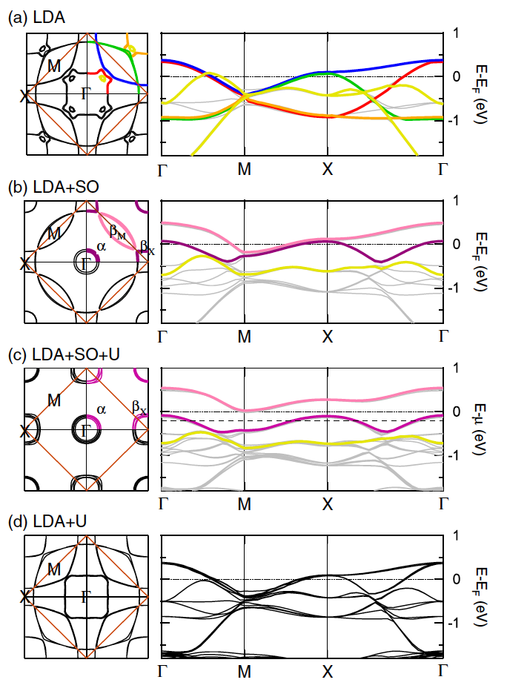
Class 14, 4d and 5d: Sr₂IrO₄
LDA + SO + U appears to provide the correct description of the electronic structure.
Kim, Jin, Moon, Kim, Park, Leem, Yu, Noh, Kim, Oh, Park, Durairaj, Cao, Rotenberg, Phys. Rev. Lett. 101 (2008) 076402 (1–4).

Slide 17
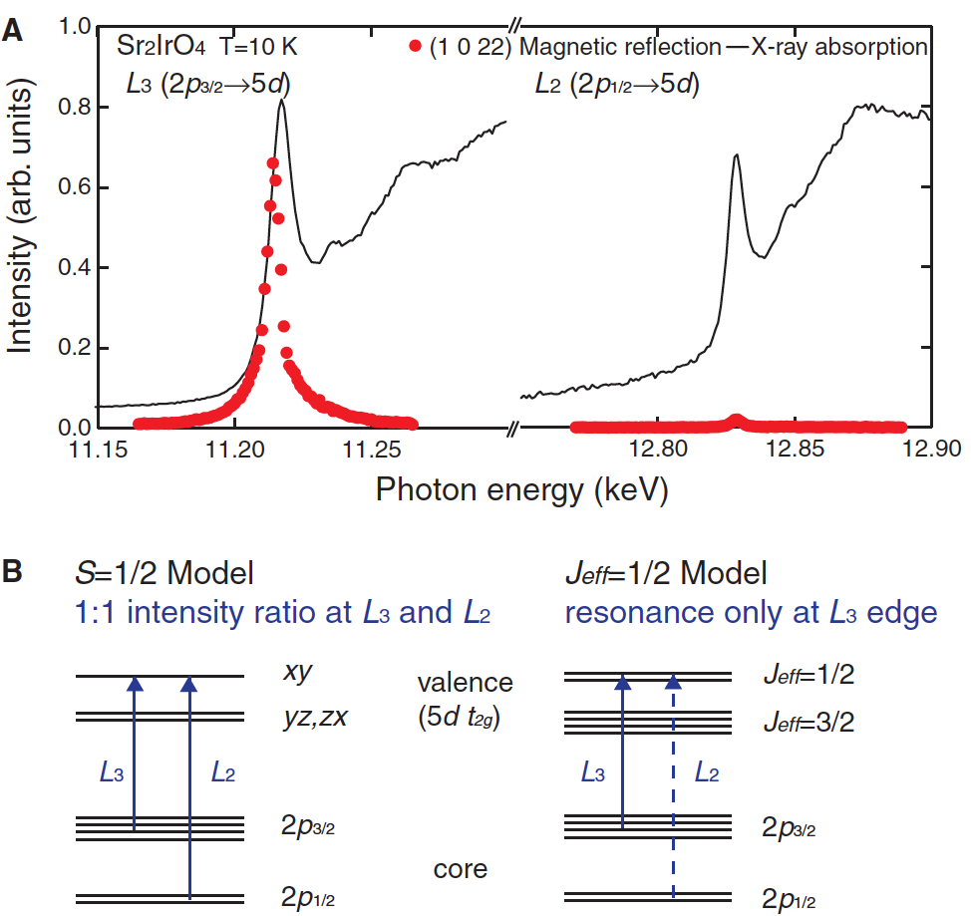
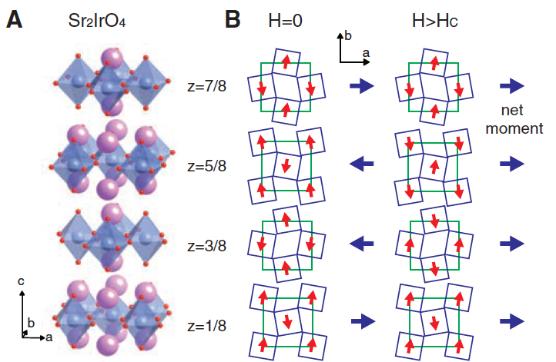
Class 14, 4d and 5d: Sr₂IrO₄
Resonant X-ray scattering appears to support the idea of the spin-orbit-Mott state.
Kim, Ohsumi, Komesu, Sakai, Morita, Takagi, Arima, Science 323 (2009) 1329–1332.

Slide 18
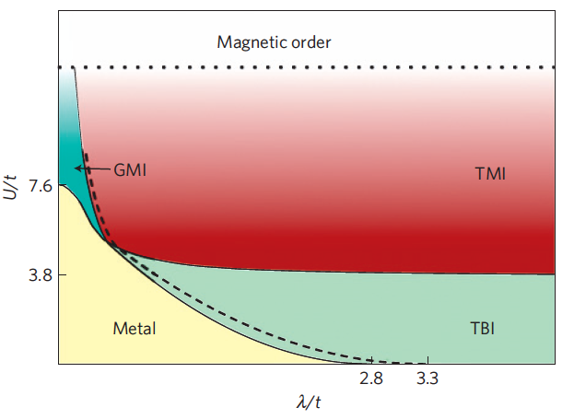
Class 14, 4d and 5d: Spin-Orbit-Mott phases
Resonant X-ray scattering apears to support the idea of the spin-orbit-Mott state.
Pesin, Balents, Nature Phys. 6 (2010) 376–381.

