Slide 1
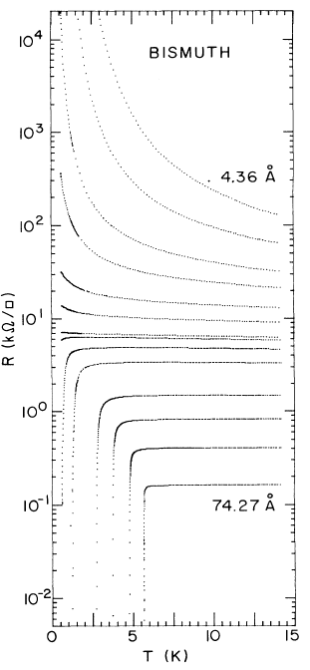
Class 12, Experimental techniques: Resistivity
Ultrathin Bi films. “The onset of superconductivity in homogeneous ultrathin films is found to occur when their normal state
sheet resistance falls below a value close to h/(4e²), the quantum resistance for pairs. The data further
suggest that in the T = 0 limit such films are either superconducting or insulating.”
Haviland, Liu, Goldman, Phys. Rev. Lett. 62 (1989) 2180–2183.

Slide 2
Class 12, Experimental techniques: Resistivity
Resistivity of a semiconductor:
Resistivity of a system with a mobility edge:
Variable range hopping or VRH (d is the dimensionality):
for a 3D system.

Slide 3
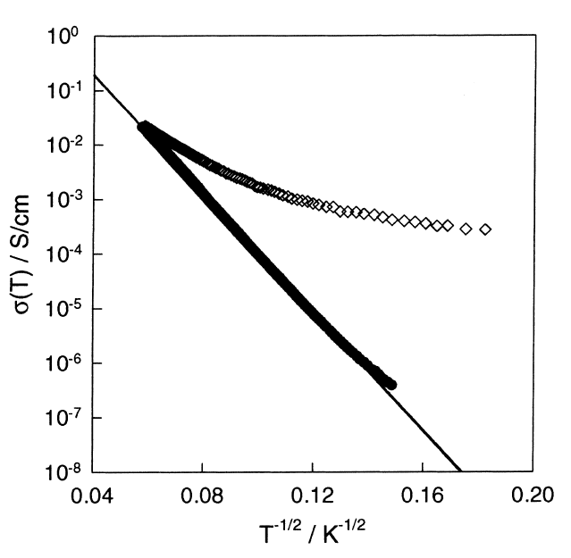
Class 12, Experimental techniques: Resistivity
Conducting polymers (quasi–1D): Polyaniline and polypyrrole.
Epstein, Lee, Progodin, Synth. Met. 117 (2001) 9–13.

Slide 4
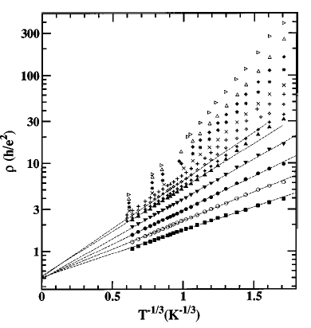
Class 12, Experimental techniques: Resistivity
A 2D system: δ-doped GaAs/AlGaAs heterostructures.
Khondaker, Shlimak, Nicholls, Pepper, Ritchie, Phys. Rev. B. 59 (1999) 4580–4583.

Slide 5
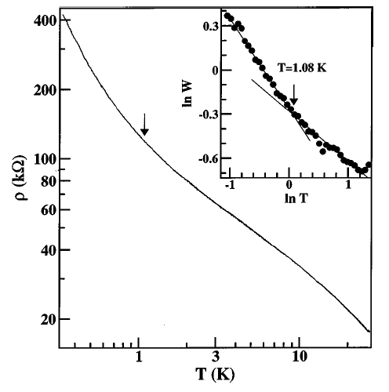
Class 12, Experimental techniques: Resistivity
A 2D system: δ-doped GaAs/AlGaAs heterostructures.
“The inset shows the same data plotted as ln W versus ln T; the slope gives the exponent p.
Around 1 K there is a change of slope of ln W as p changes from 0.55±0.05 to 0.34±0.03.”
This change to the slope close to 1 /2 signifies Efros-Shklovskii hopping due to Coulomb correlations:
Khondaker, Shlimak, Nicholls, Pepper, Ritchie, Phys. Rev. B. 59 (1999) 4580–4583.

Slide 6
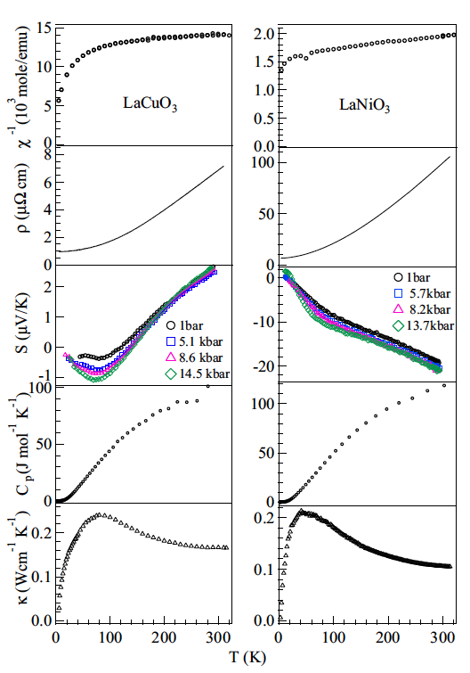
Class 12, Experimental techniques: Seebeck, heat capacity, etc.
LaNiO₃ and LaCuO₃ prepared under pressure.
Zhou, Marshall, Goodenough, Mass enhancement versus Stoner enhancement in strongly correlated metallic perovskites: LaNiO₃ and LaCuO₃, Phys. Rev. B. 89 (2014) 245138(1–8).

Slide 7
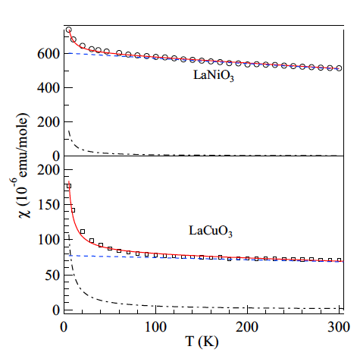
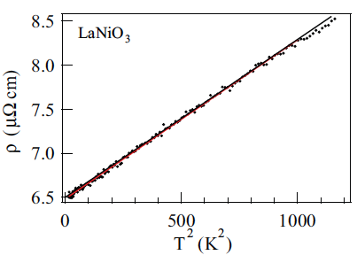
Class 12, Experimental techniques: Seebeck, heat capacity, etc.
LaNiO₃ and LaCuO₃ prepared under pressure.
Zhou, Marshall, Goodenough, Mass enhancement versus Stoner enhancement in strongly correlated metallic perovskites: LaNiO₃ and LaCuO₃, Phys. Rev. B. 89 (2014) 245138(1–8).

Slide 8
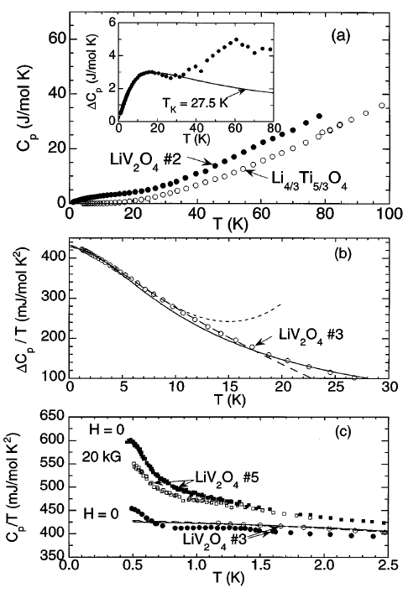
Class 12, Experimental techniques: Seebeck, heat capacity, etc.
LiV₂O₄: Heavy fermions !
γ = 0.42 J/mol-K² is exceptionally large for a transition metal compound.
The Wilson ratio is 1.7
Kondo et al., LiV₂O₄: A heavy fermion transition metal oxide, Phys. Rev. Lett. 79 (1997) 3729–3732.

Slide 9
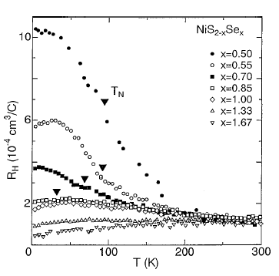
Class 12, Experimental techniques: Photoemission
The pyrite system: NiS_{2–x}Se_{x}
From Imada, Fujimori, Tokura, Rev. Mod. Phys.

Slide 10
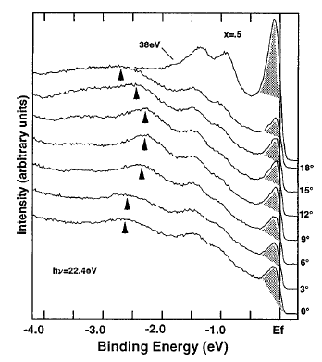
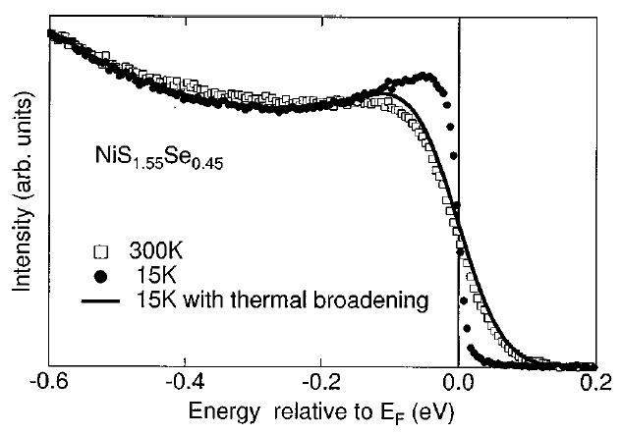
Class 12, Experimental techniques: Photoemission
Angle-resolved photoemission of NiS_{1.5}Se_{0.5}
From Imada, Fujimori, Tokura, Rev. Mod. Phys.

Slide 11
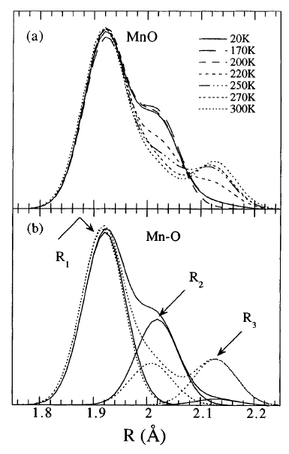
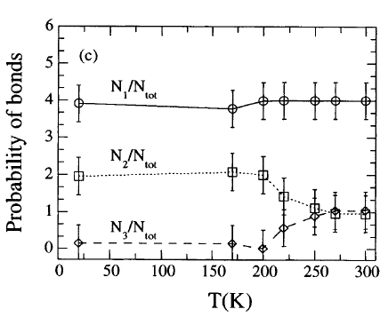
Class 12, Experimental techniques: Probing polarons with XAS
La_{0.75}Ca_{0.25}MnO₃ studied by x-ray absorption (EXAFS) across the transition.
Lanzara, Saini, Brunelli, Natali, Bianconi, Radaelli, Cheong, Crossover from Large to Small Polarons across the Metal-Insulator Transition in Manganites, Phys. Rev. Lett. 81 (1998) 878–881.

Slide 12
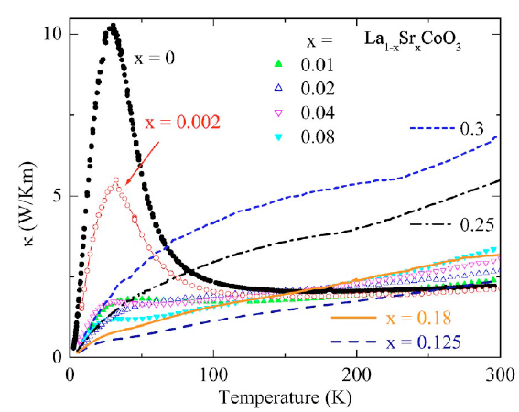
Class 12, Experimental techniques: Probing polarons with thermal transport
La_{1–x}Sr_{x}CoO₃:
Berggold, Kriener, Zobel, Reichl, Reuther, Müller, Freimuth, Lorenz, Phys. Rev. B 72 (2005) 155116(1–7).

