Slide 1
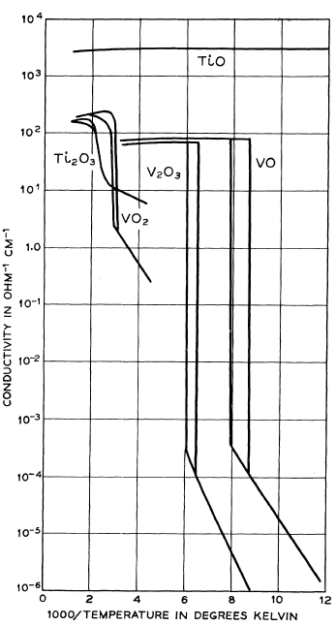
Class 09. VO₂, V₂O₃
Morin reported on TiO, VO, Ti₂O₃, V₂O₃, and VO₂
Morin, Phys. Rev. Lett. 3 (1959) 34–36.

Slide 2
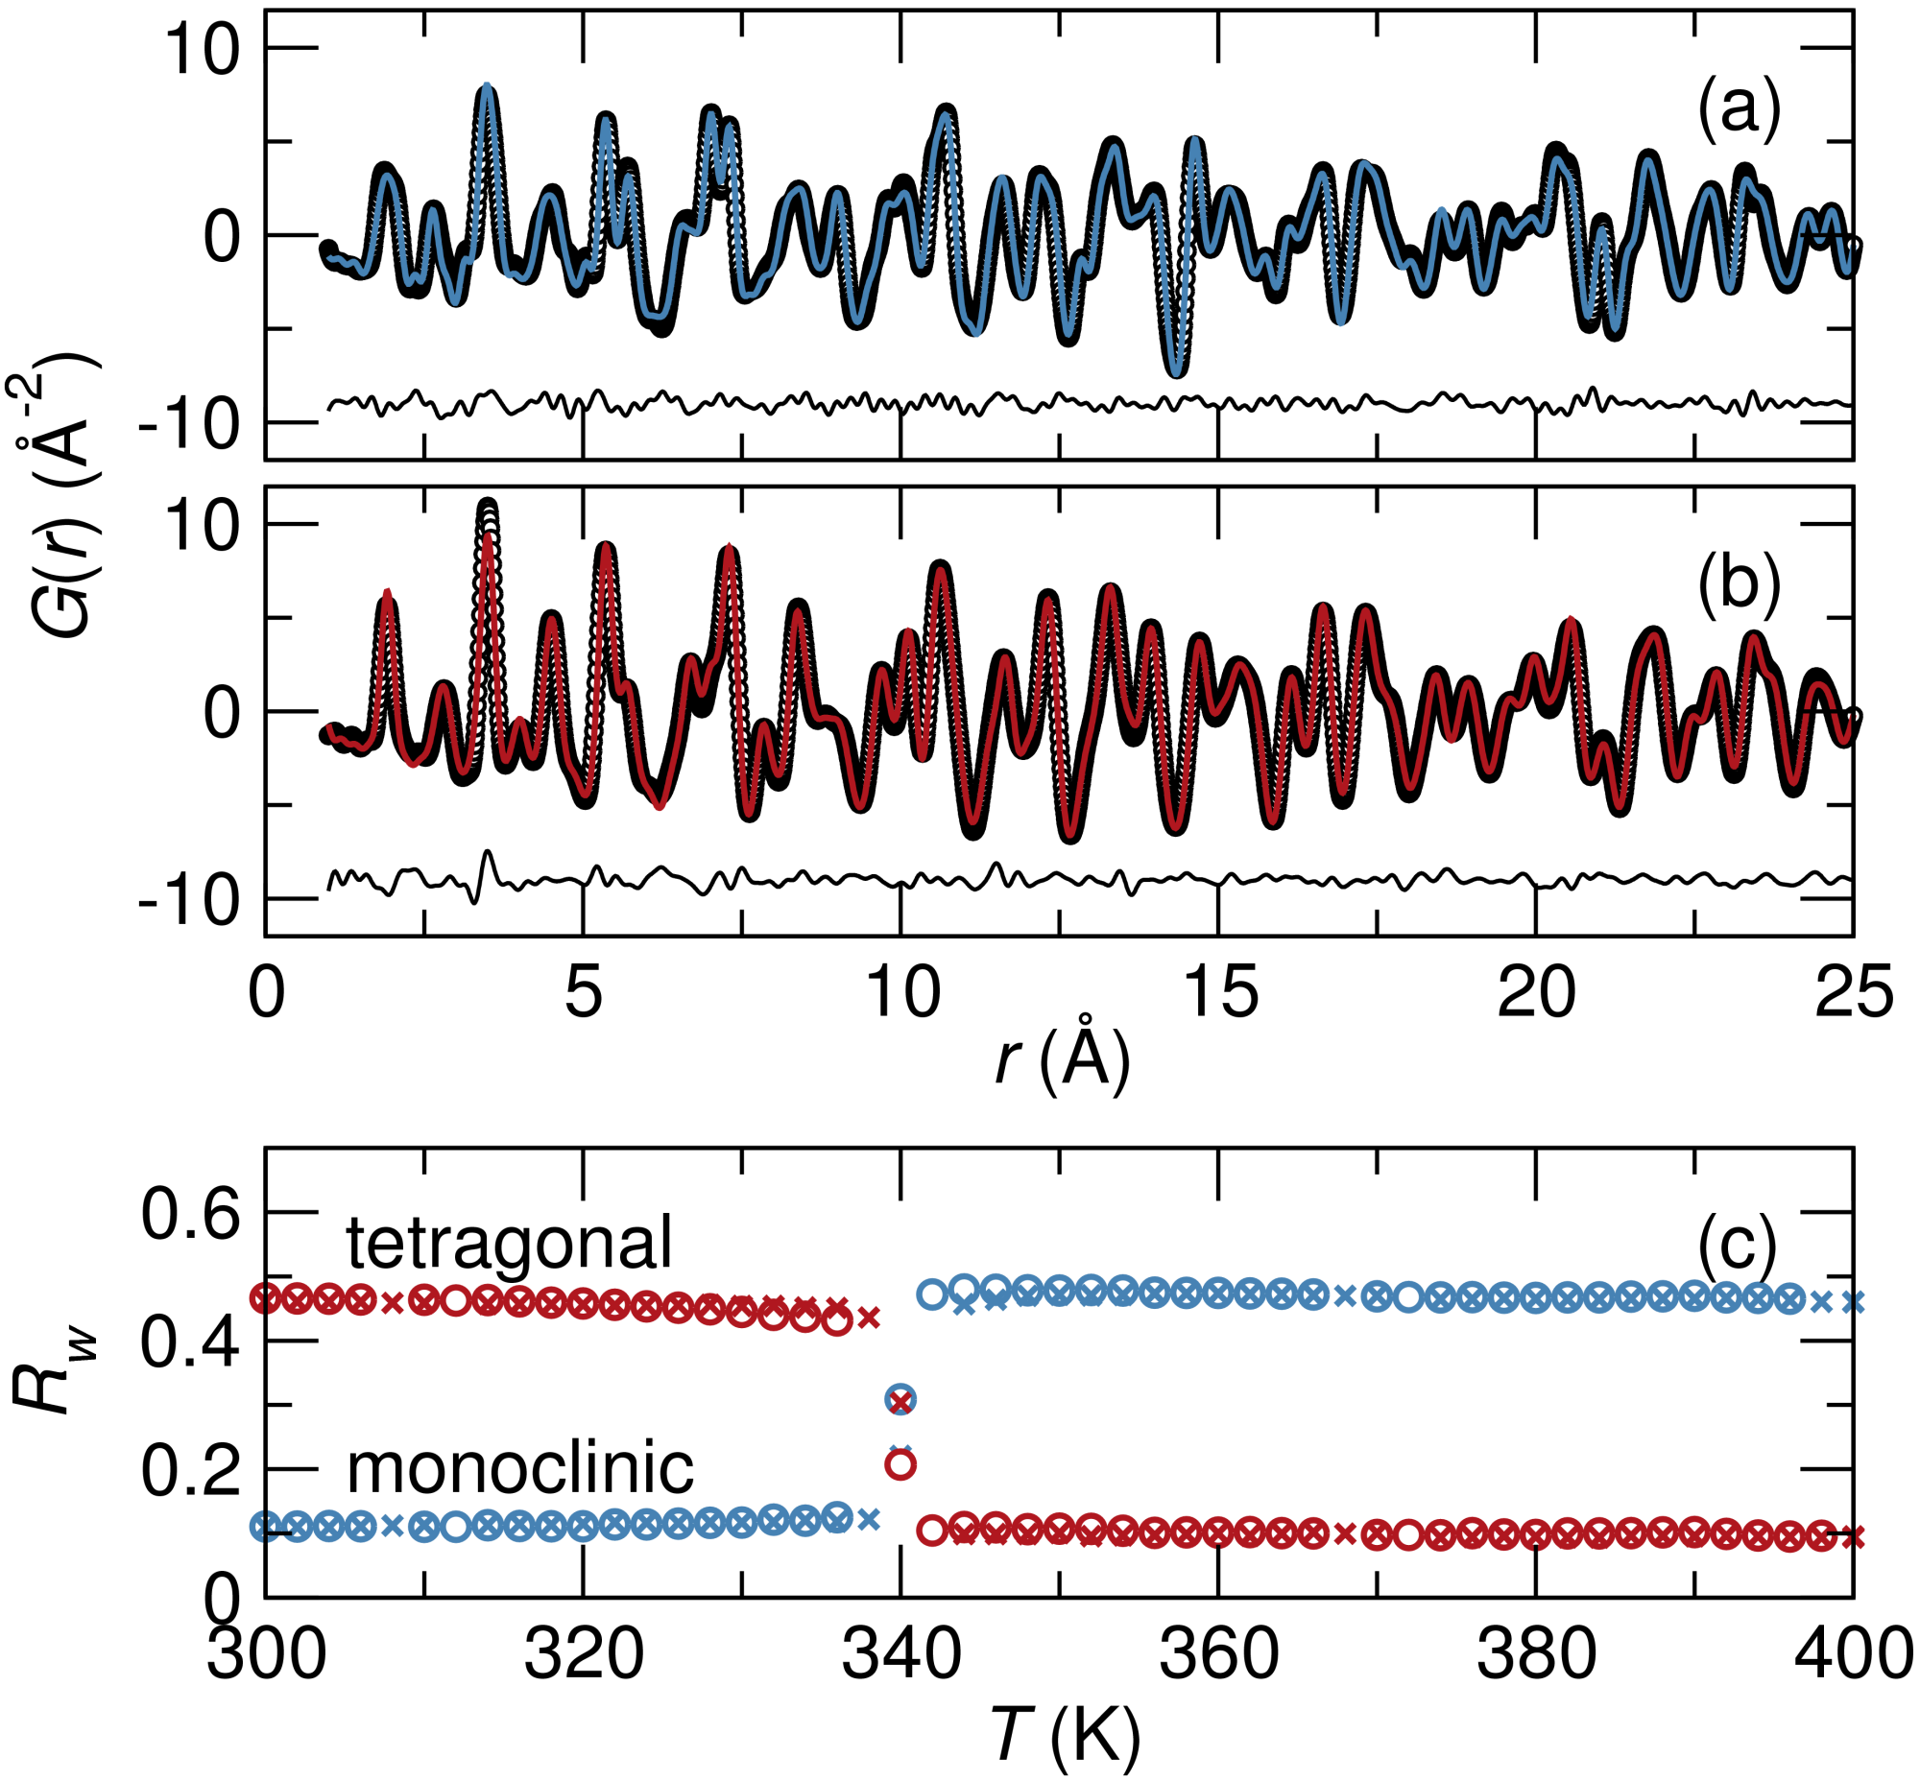
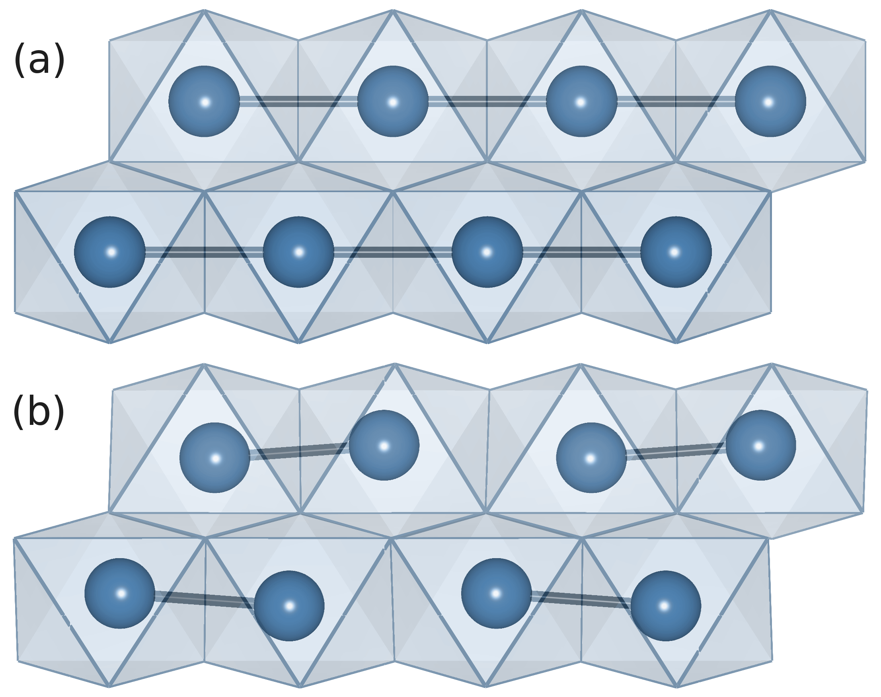
Class 09. VO₂
X-ray PDF (Argonne 11-ID-B) study of the temperature-dependent (a) tetragonal metal to (b) monoclinic insulator transition upon cooling.
Corr, Shoemaker, Melot, Seshadri, Real space investigation of structural changes at the metal-insulator transition in VO₂, Phys. Rev. Lett. 105 (2010) 056404(1–4).

Slide 3
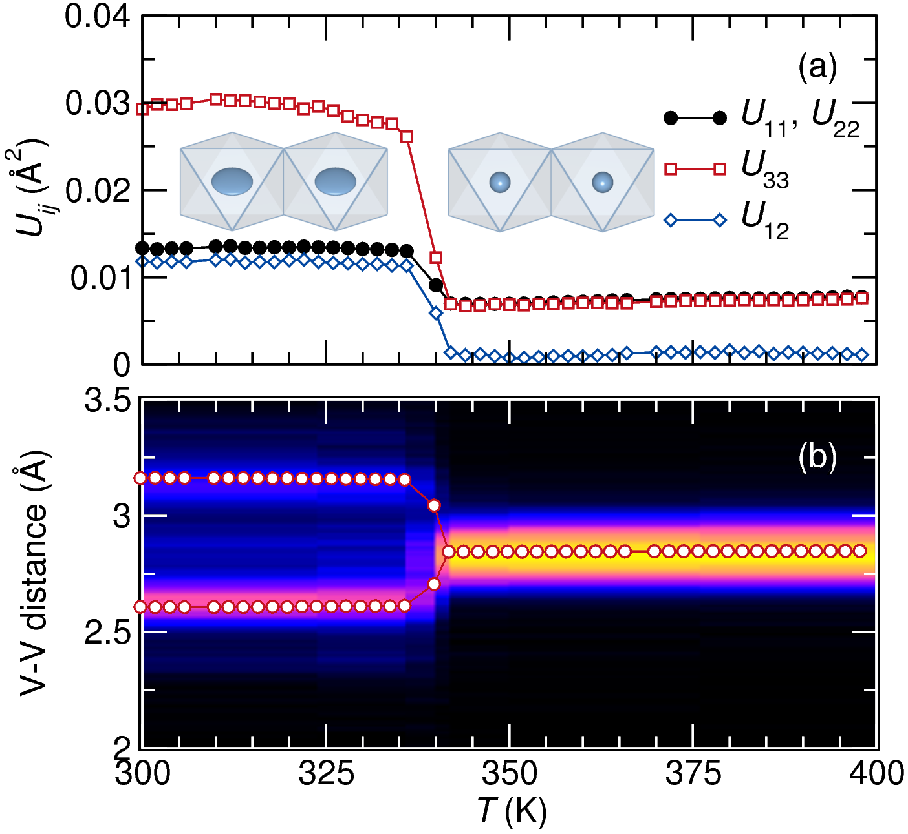
Class 09. VO₂
The question: Is there an intermediate phase, and are there signature of dimers in the high-temperature tetragonal phase?
Fitting the tetragonal rule at all temperatures dhows evidence for the phase transition in the U's.
The V-V bond distance along the chain is directly monitored by the PDF. Points are from fitting the PDF and contours from reverse Monte Carlo.

Slide 4
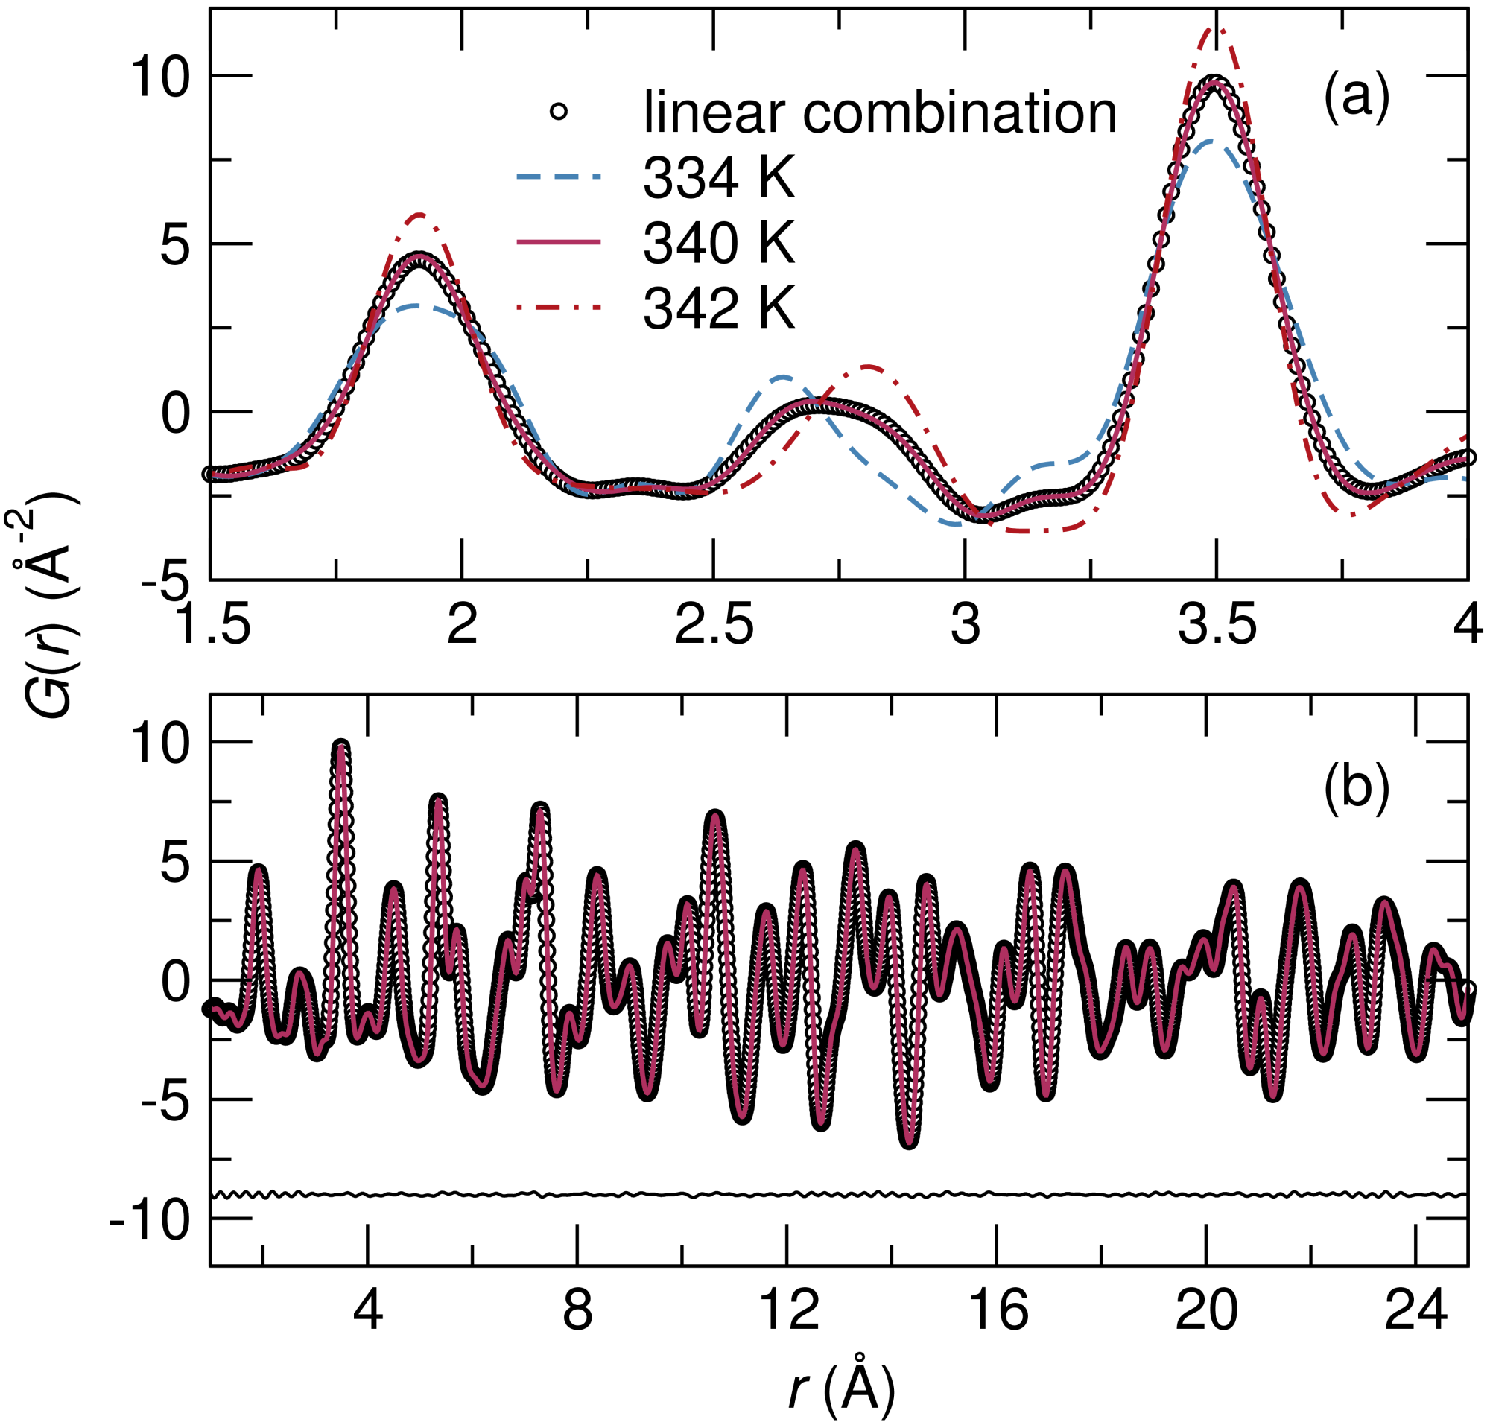
Class 09. VO₂
A closer look at the PDF near the phase transition:
The PDF at 340 K (at the transition) is simply a linear combination of the 334 K and 342 K PDF.

Slide 5
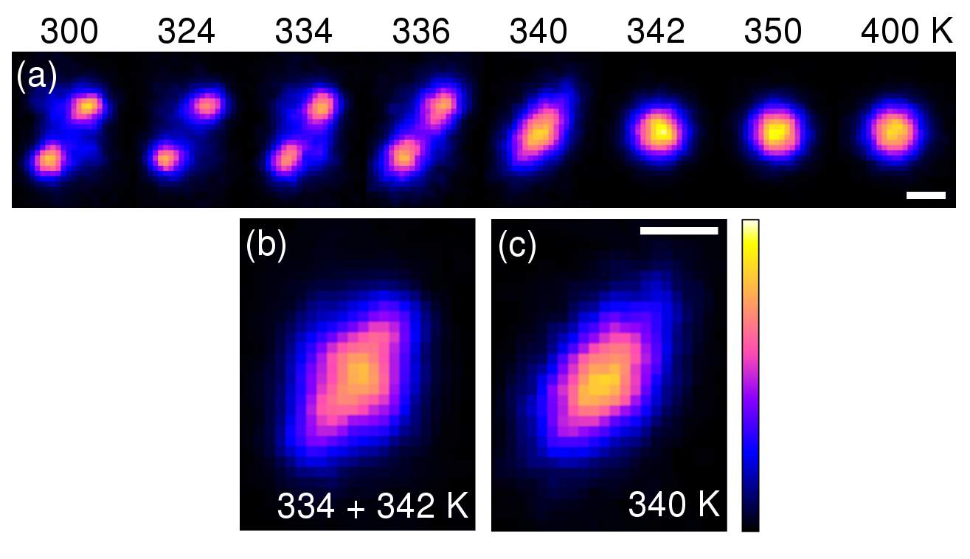
Class 09. VO₂
Reverse Monte Carlo (RMC) allows the PDF to be modeled using a large box (thousands of atoms) unbiased by symmetry constraints. Projections of V positions shown below (bars 0.2 Å):
Again, the picture at the transition temperature is simply of two phases, tetragonal and monoclinic.

Slide 6
Class 09. VO₂
Findings:
The phase transition is "clean" first order with coexisting phases, and no signature of an intermediate phase.
RMC shows unambiguously that there are no "fleeting" dimers in the high-temperature phase: Cf. Jahn-Teller phase transitions where the distortion is already there !
Rexamine the statement: The Peierls transition is a solid state analogue of a Jahn-Teller distortion.

Slide 7
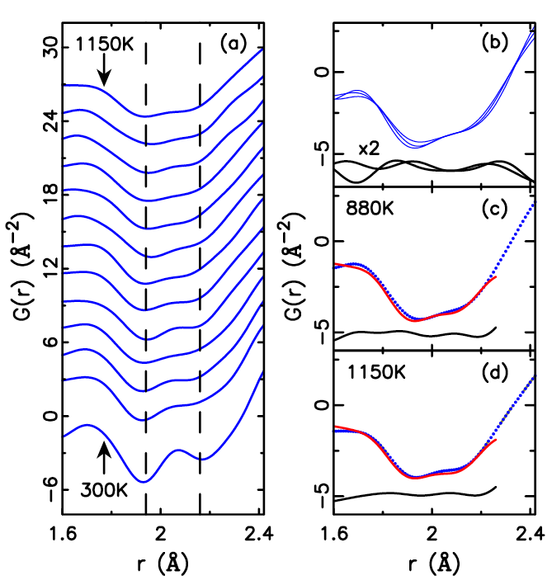
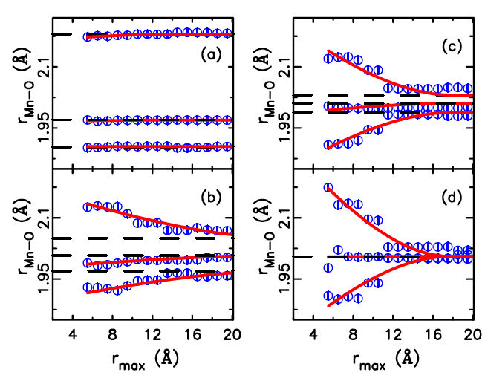
Class 09. Local structure in LaMnO₃ (contrast with VO₂)
T_{J–T} = 735 K, T_{O–R} = 1010 K
(a) 300 K, (b) 740 K, (c) 800 K, (d) 1100 K.
Qui, Proffen, Mitchell, Billinge, Phys. Rev. Lett. 94 (2005) 177203(1–4).

Slide 8
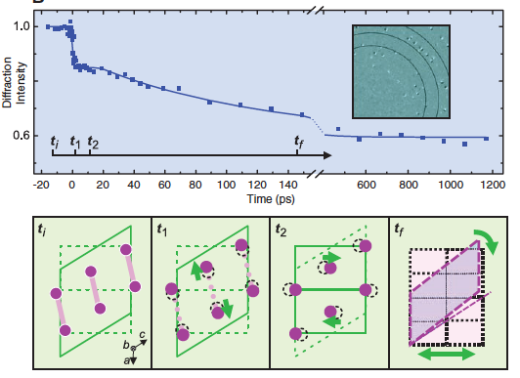
Class 09. Time-resolved studies of VO₂
“4D Microscopy”: Very short times for local rearrangement, longer for the entire crystal to change.
Baum, Yang, Zewail, Science 318 (2007) 788–792.

Slide 9
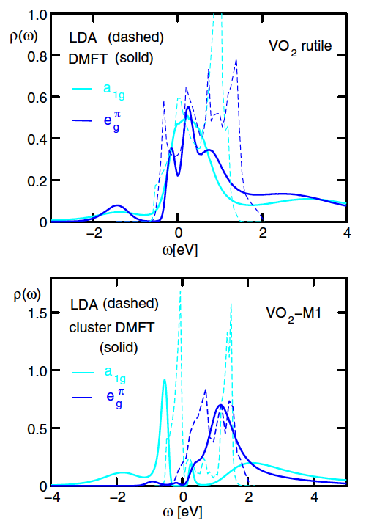
Class 09. Dynamical mean-field theory
“…The interplay of strong electronic Coulomb interactions and structural distortions, in particular, the dimerization of vanadium atoms in the low-temperature phase, plays a crucial role. We find that VO₂ is not a conventional Mott insulator, but that the formation of dynamical V-V singlet pairs due to strong Coulomb correlations is necessary to trigger the opening of a Peierls gap.”
Biermann. Poteryaev, Lichtenstein, Georges, Phys. Rev. Lett. 94 (2005) 026404(-–4).

Slide 10
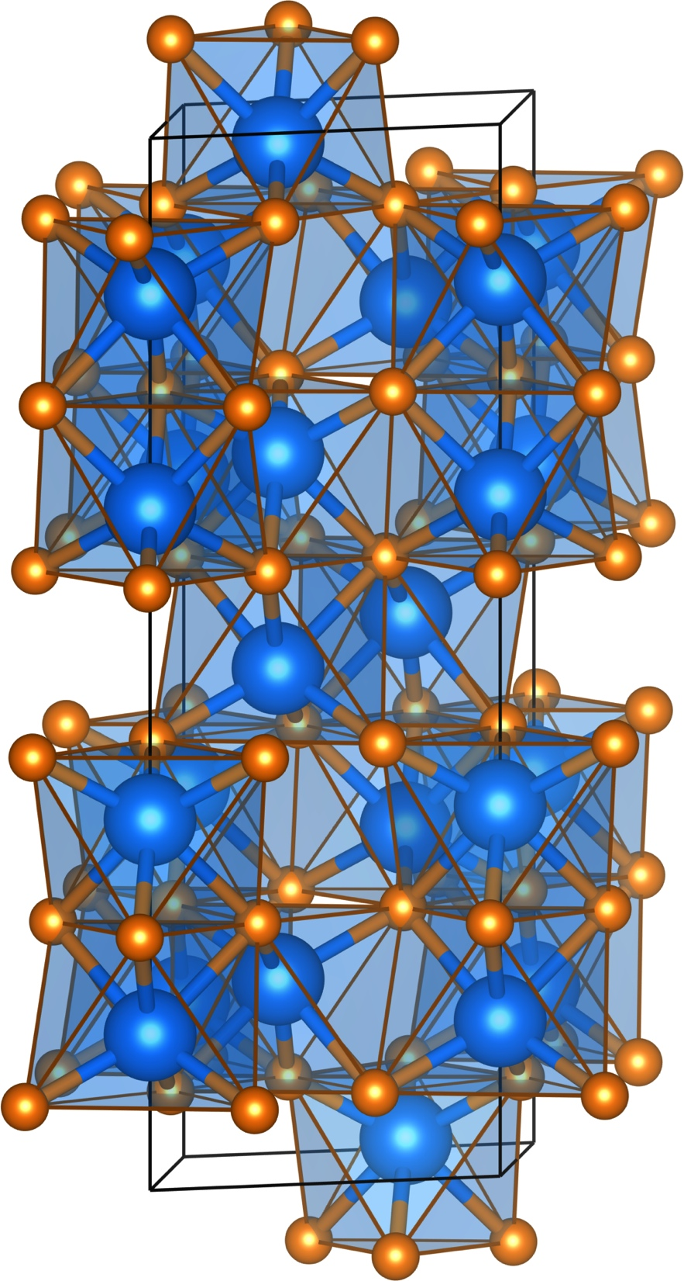
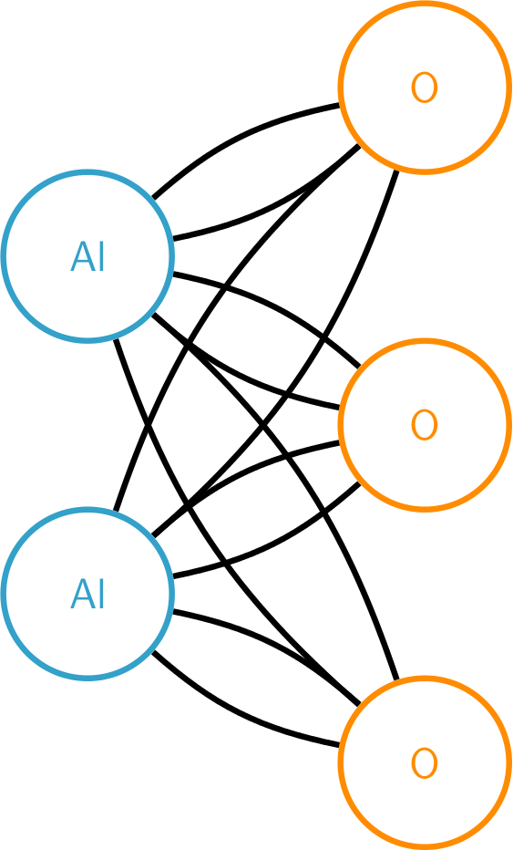
Class 09. V₂O₃
Corundum crystal structure:
α-Al₂O₃ (corundum)

Slide 11
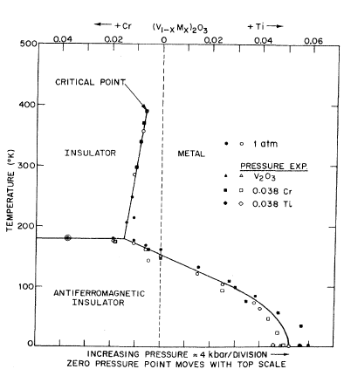
Class 09. V₂O₃
Corundum crystal structure:
α-Al₂O₃ (corundum)
McWhan, Menth, Remeika, Brinkman, Rice, Phys. Rev. B 7 (1973) 1920–1932.

