Slide 1
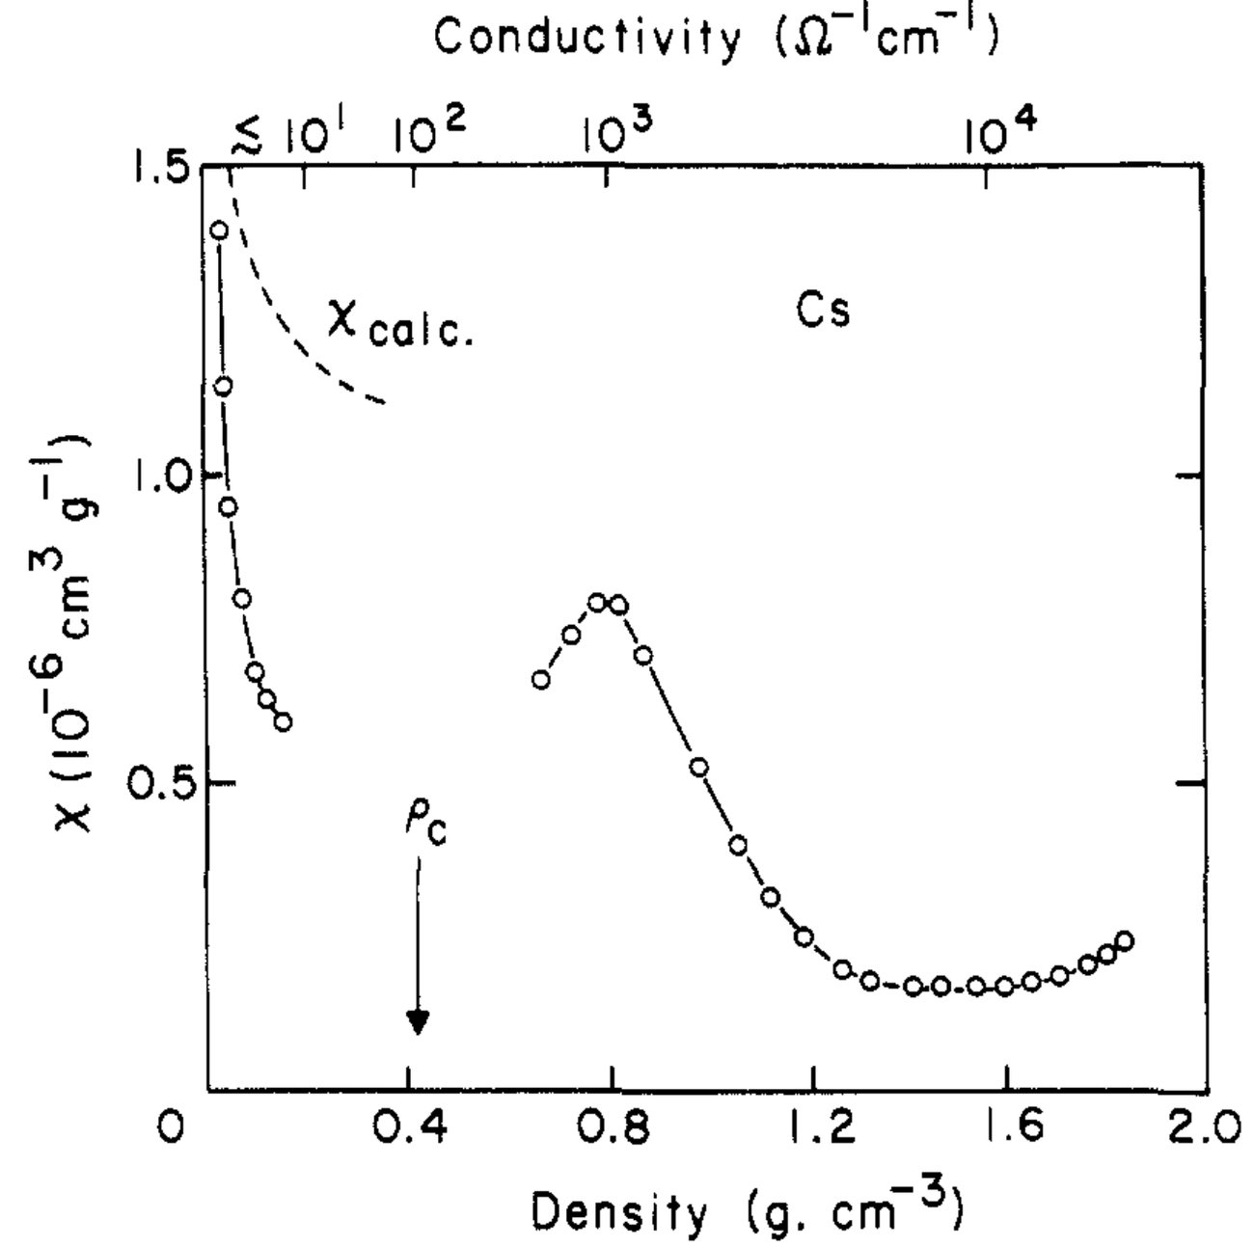
Class 05. The Hubard model and magnetism
On the insulating side of the M–I transition, magnetism of some sort (usually antiferromagnetism) manifests.

Slide 2
Class 05. The Hubard model and magnetism
In the limit that U >> t, the Hubbard model:
Can be reduced to the Heisenberg Hamiltonian:
where

Slide 3
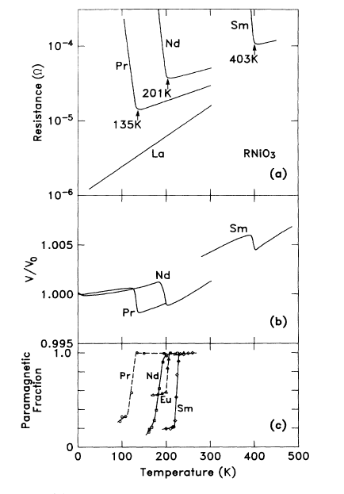
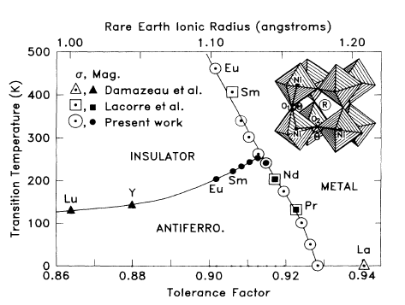
Class 05. The Hubard model and magnetism [will return to these !]
The example of LnNiO₃, Ln = La, Pr, Nd, Sm:
Torrance, Lacorre, Nazzal, Ansaldo, Niedermayer, Phys. Rev. B. 45 (1992) 8209–8212.

Slide 4
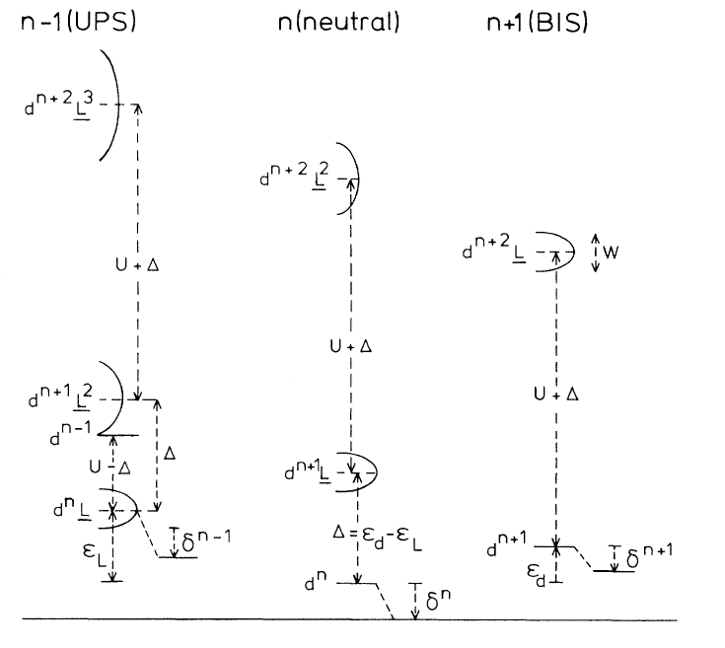
Class 05. The Zaanen-Sawatzky-Allen phase diagram
The position of transition metal d-states vs. anion p states:
Zaanen, Sawatzky, Allen, Phys. Rev. Lett. 55 (1985) 418–421.

Slide 5
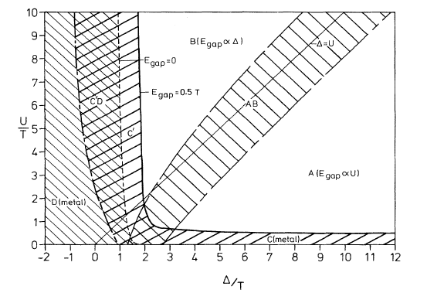
Class 05. The Zaanen-Sawatzky-Allen phase diagram
The actual diagram. Note that T is what we have been calling W, and W is proportional to t in the Hubbard Model.
Zaanen, Sawatzky, Allen, Phys. Rev. Lett. 55 (1985) 418–421.

Slide 6
Class 05. The Zaanen-Sawatzky-Allen phase diagram
A simplified view: In the language of ZSA:
Mott-Hubbard insulators:
Charge-transfer insulators:
upper Hubbard
upper Hubbard
U
Δ
lower Hubbard
anion p states
anion p states
lower Hubbard
Zaanen, Sawatzky, Allen, Phys. Rev. Lett. 55 (1985) 418–421.

Slide 7
Class 05. The Zaanen-Sawatzky-Allen phase diagram
Examples of Mott-Hubbard: V₂O₃, Ti₂O₃, Cr₂O₃ and most halides. Early transition metals, and lower oxidation states. Interestingly, these do display T-dependent M–I transitions.
Examples of Charge-transfer: CuO, NiCl₂, NiS, etc. Later transition metals and higher oxidation states. CuO and NiCl₂ are always insulating.
Zaanen, Sawatzky, Allen, Phys. Rev. Lett. 55 (1985) 418–421.

Slide 8
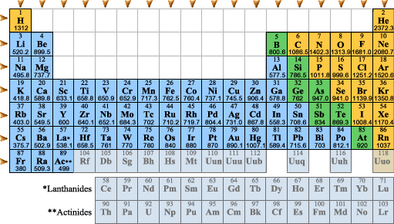
Class 05. The Zaanen-Sawatzky-Allen phase diagram. Periodic trends
Zaanen, Sawatzky, Allen, Phys. Rev. Lett. 55 (1985) 418–421.

Slide 9
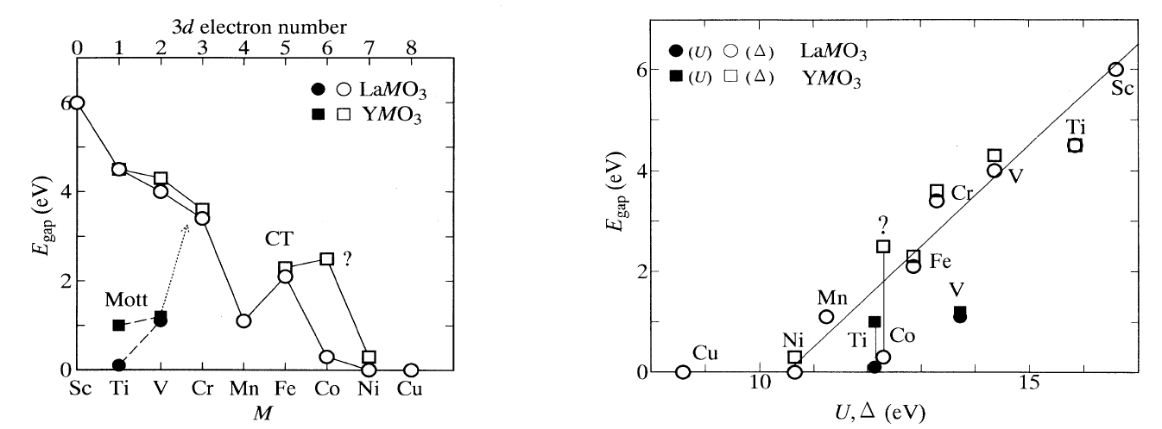
Class 05. The Zaanen-Sawatzky-Allen phase diagram and perovskites
Optical studies of band gaps: Distinguishing d–d and p–d character:
Arima, Tokura, Torrance, Phys. Rev. B. 48 (1993) 17006–17009.

Slide 10
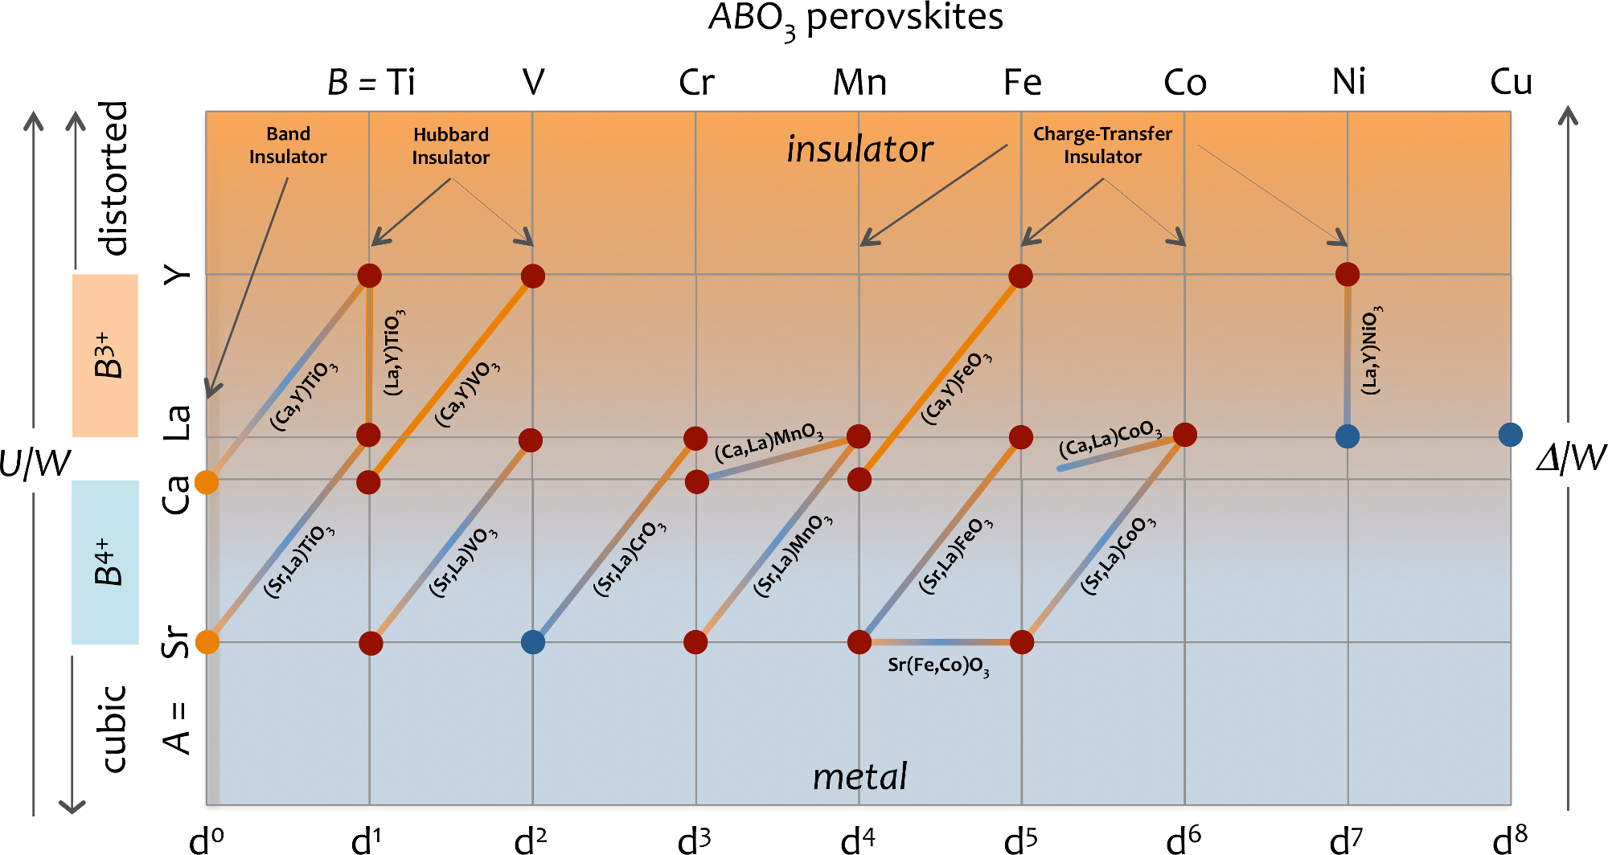
Class 05. The Zaanen-Sawatzky-Allen phase diagram and perovskites

Slide 11
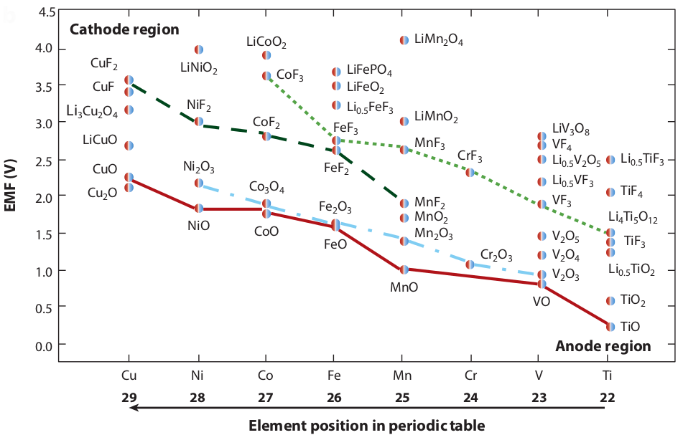
Class 05. The Zaanen-Sawatzky-Allen phase diagram and batteries
The transition metal d and anion p levels manifest in Li-battery electrochemistry.
Hayner, Zhao, Kung, Annu. Rev. Chem. Biomolec. Eng. 3 (2012) 445–471.

Slide 12
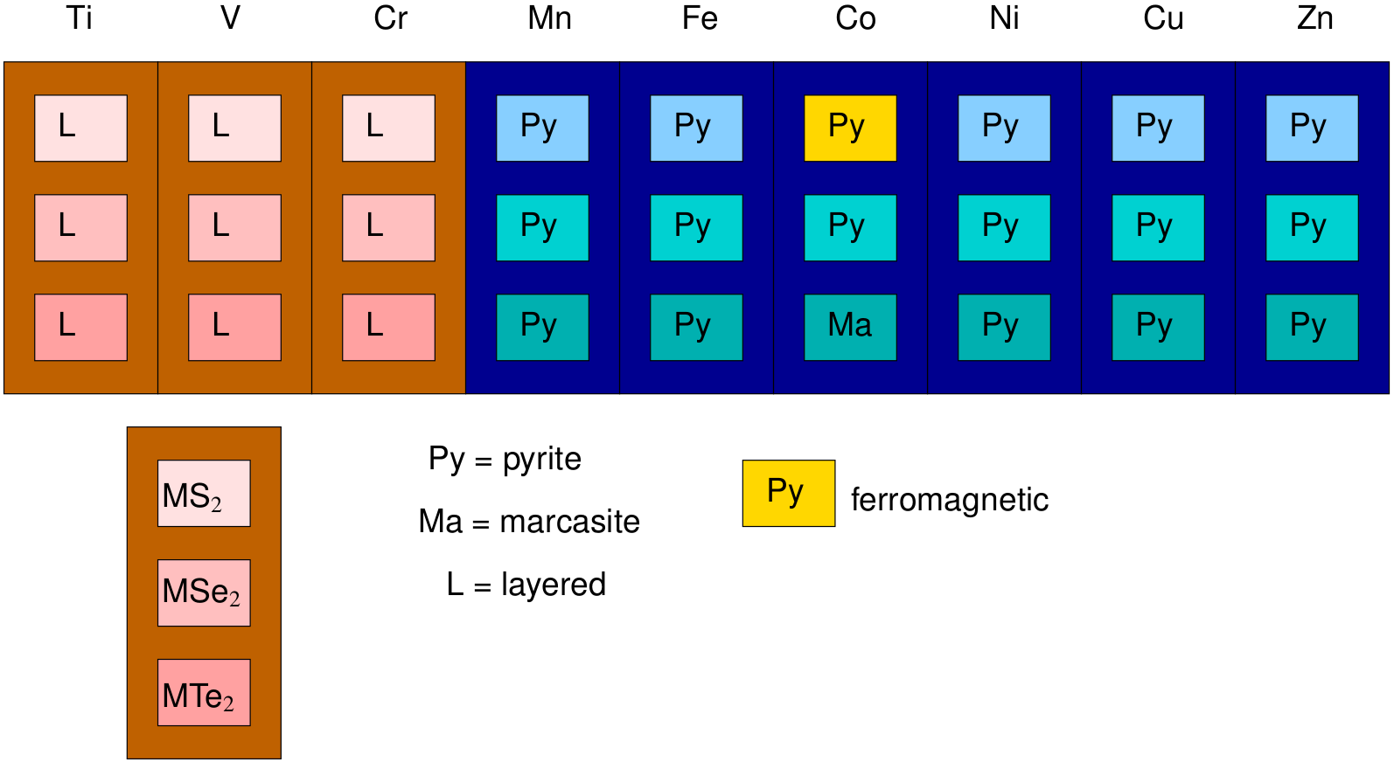
Class 05. The Zaanen-Sawatzky-Allen phase diagram and redox competition
M⁴⁺
M²⁺
Ideas of Goodenough, Rouxel etc.

Slide 13
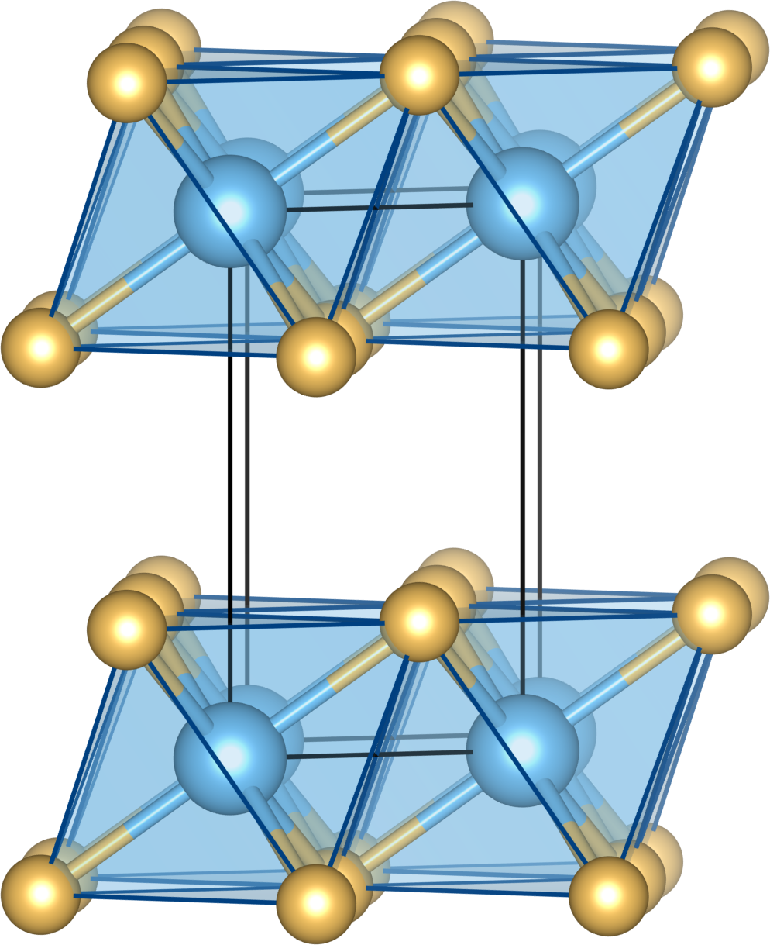
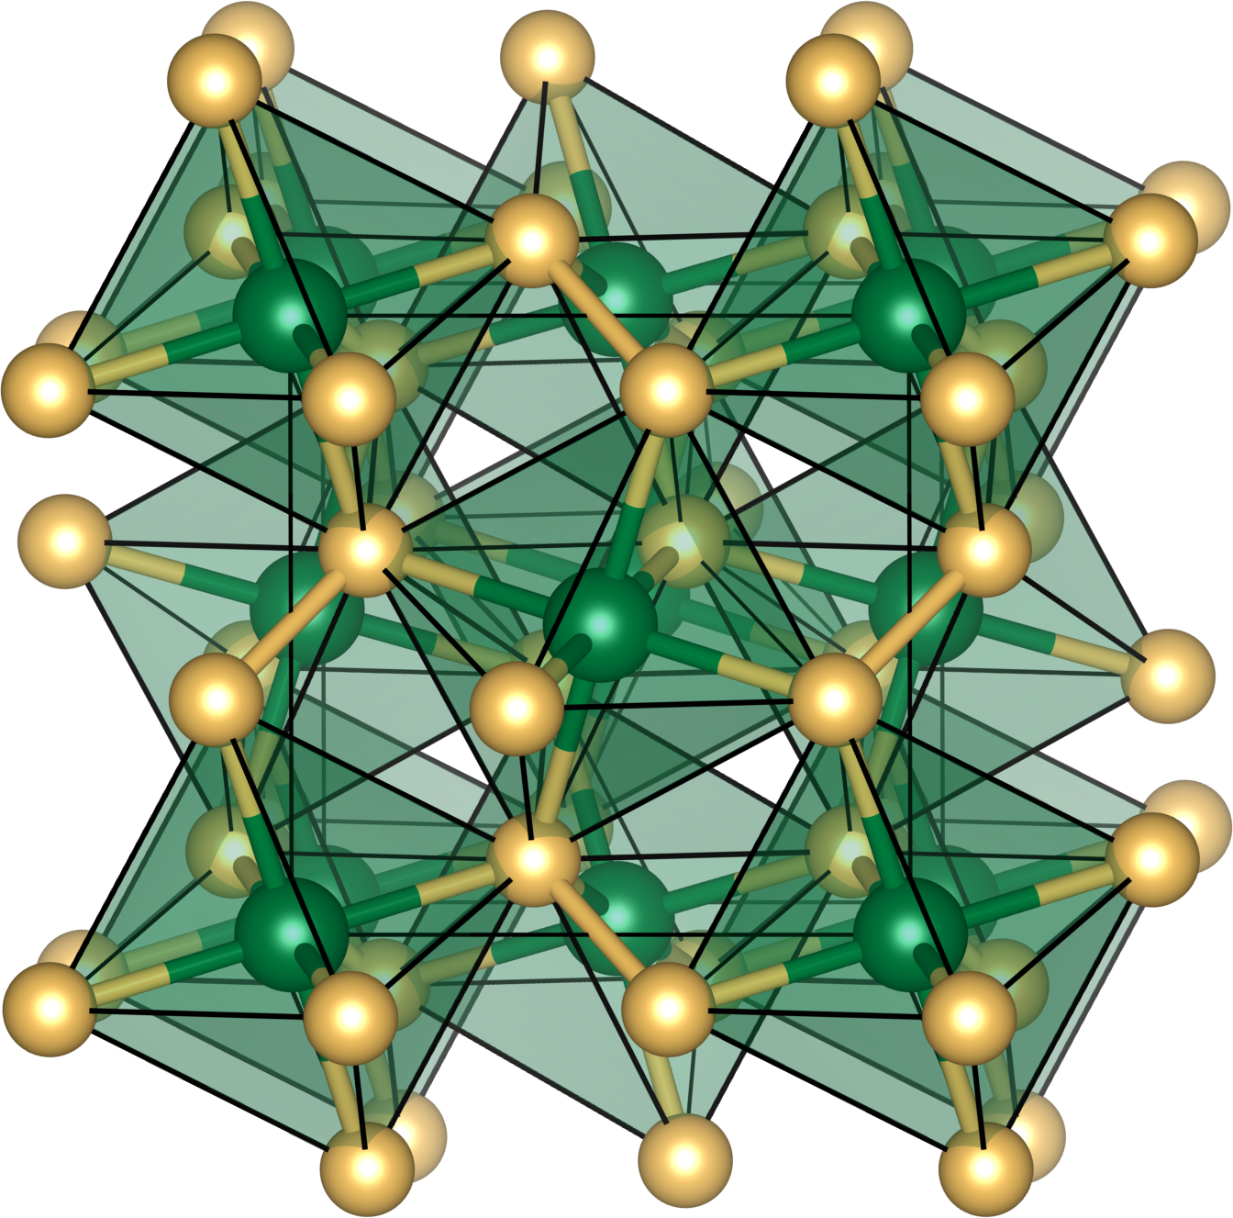
Class 05. The Zaanen-Sawatzky-Allen phase diagram and redox competition

