Slide 1
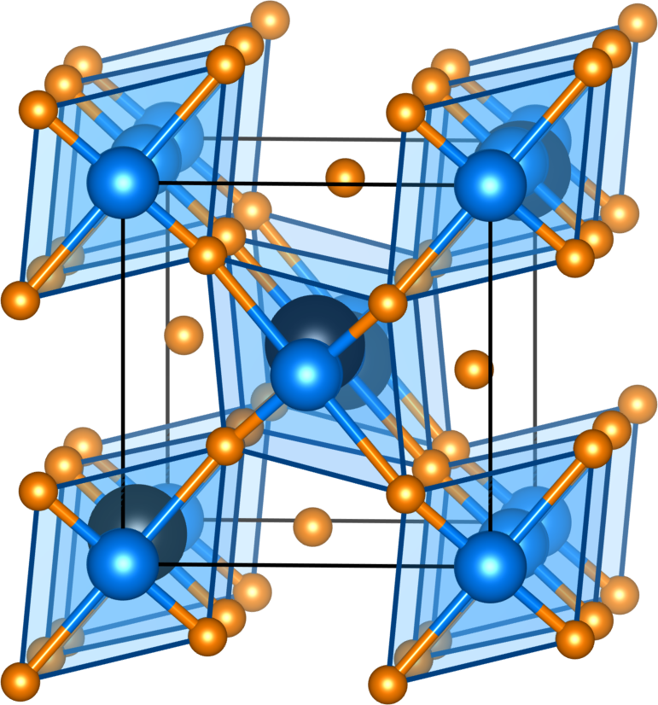
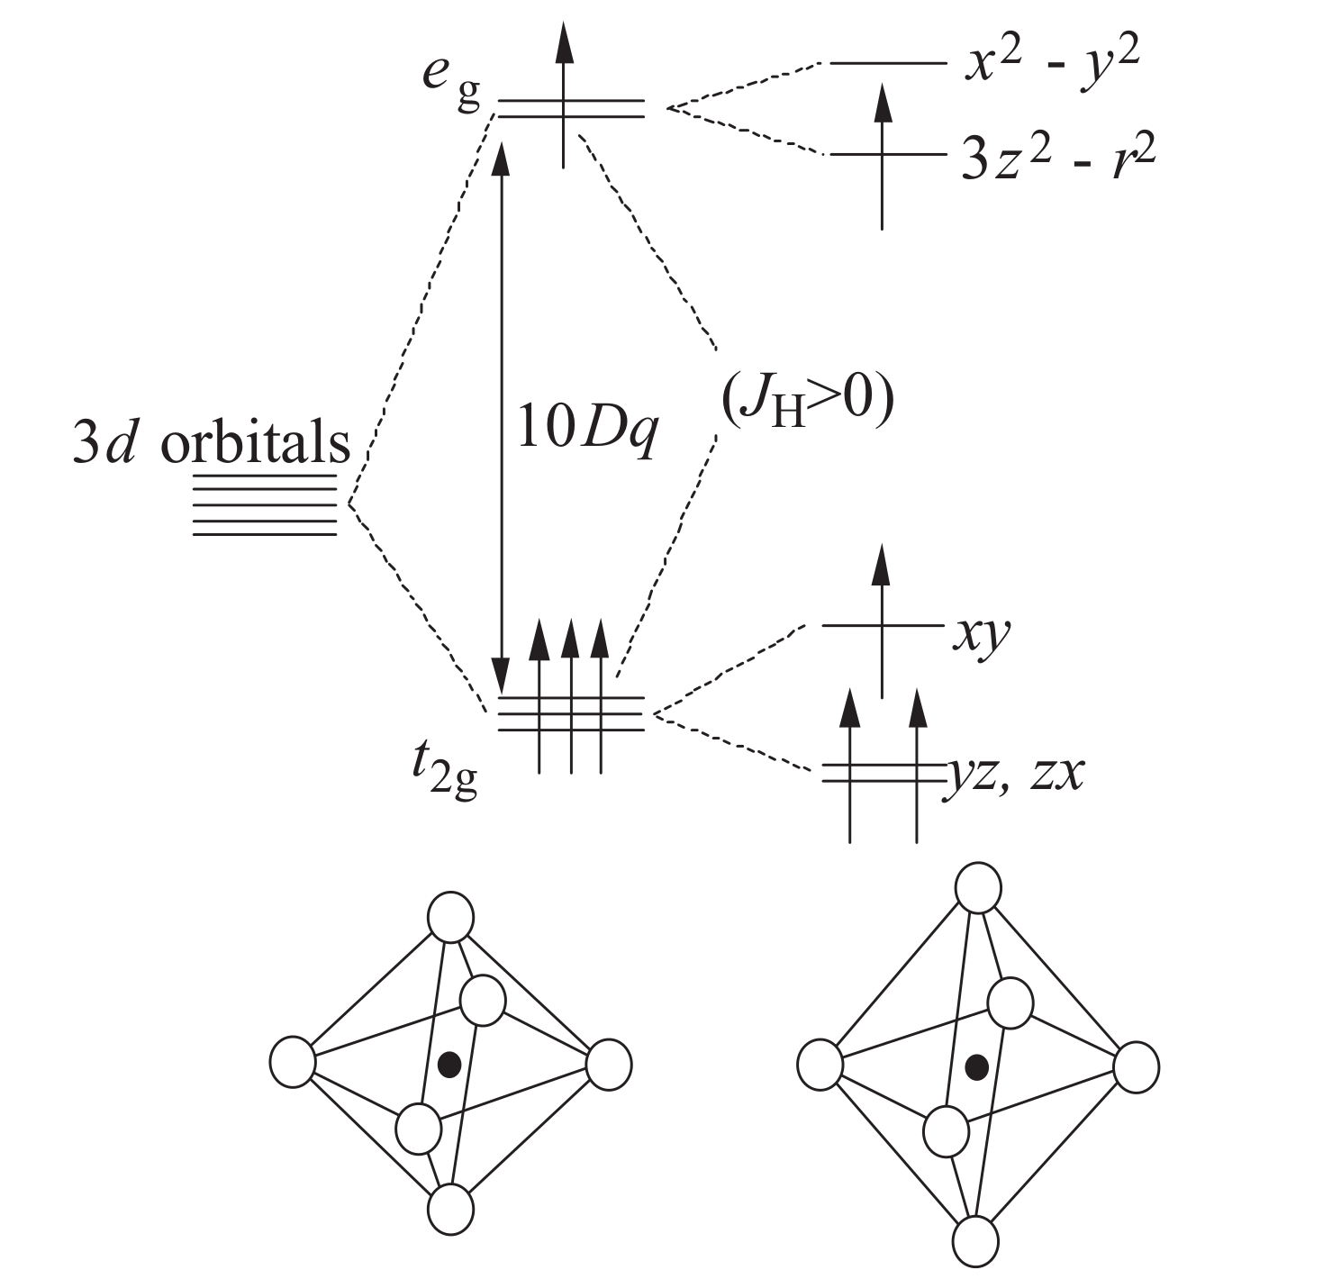
Class 04. Correlations and the Hubbard model: LaMnO₃
Jahn-Teller distorted orthorhombic perovskite (space group Pnma)

Slide 2
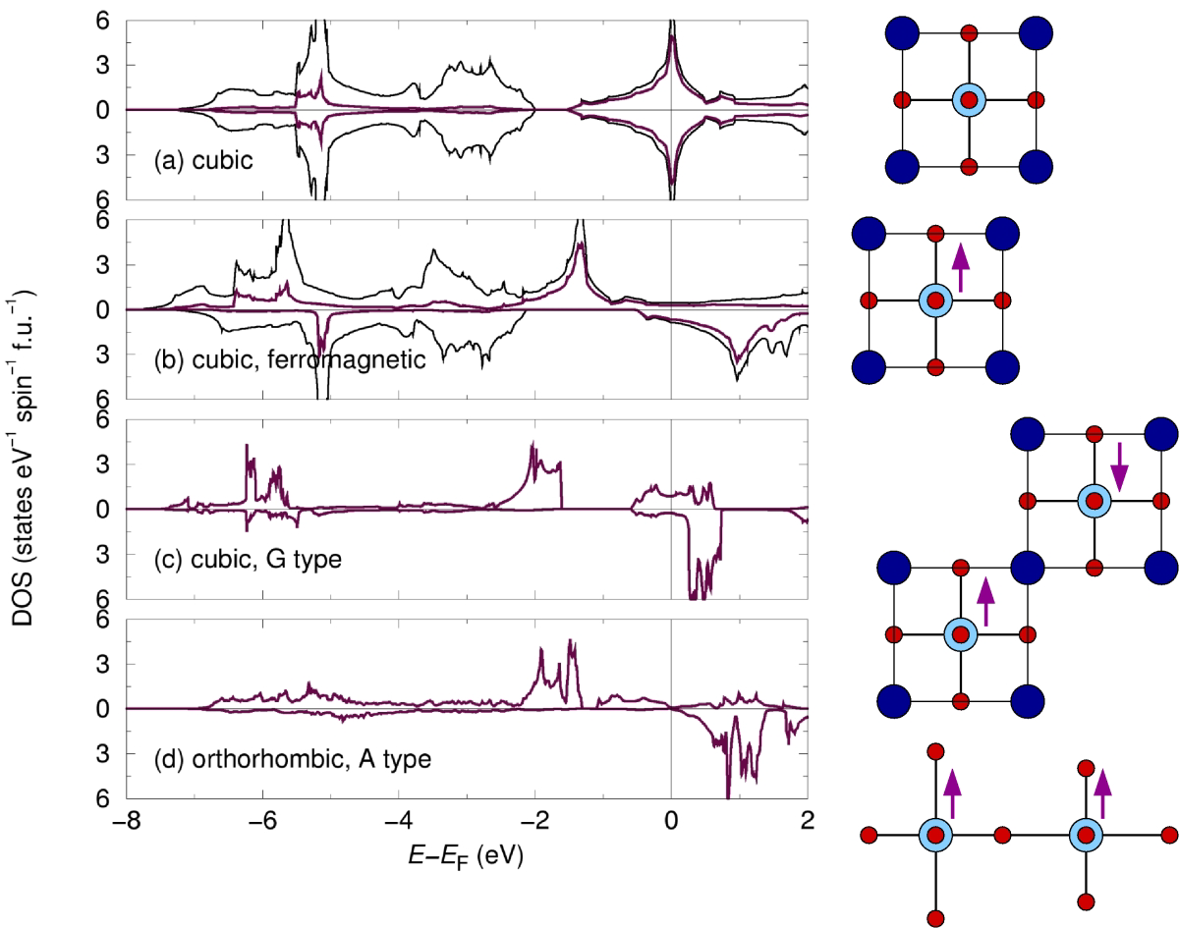
Class 04. Correlations and the Hubbard model: LaMnO₃
Structure and magnetism do not explain the insulating behavior.

Slide 3
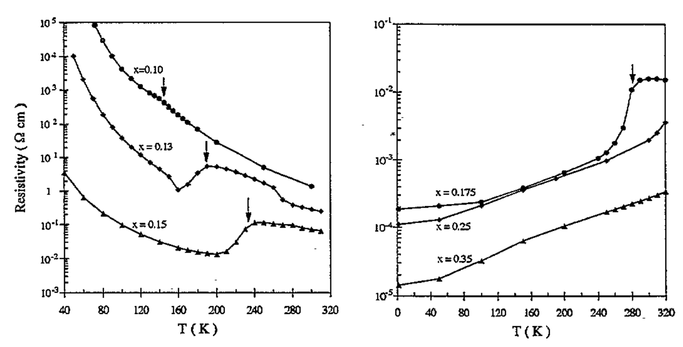
Class 04. Correlations and the Hubbard model: LaMnO₃
Electrical resistivity behavior in La_{1–x}Sr_{x}MnO₃
Anane, Dupast, Dang, Renard, Veillet, de Leon Guevare, Millot, Pinsard, Revcolevschi, J. Phys.: Condens. Matter 7 (1995) 7015-7021.

Slide 4
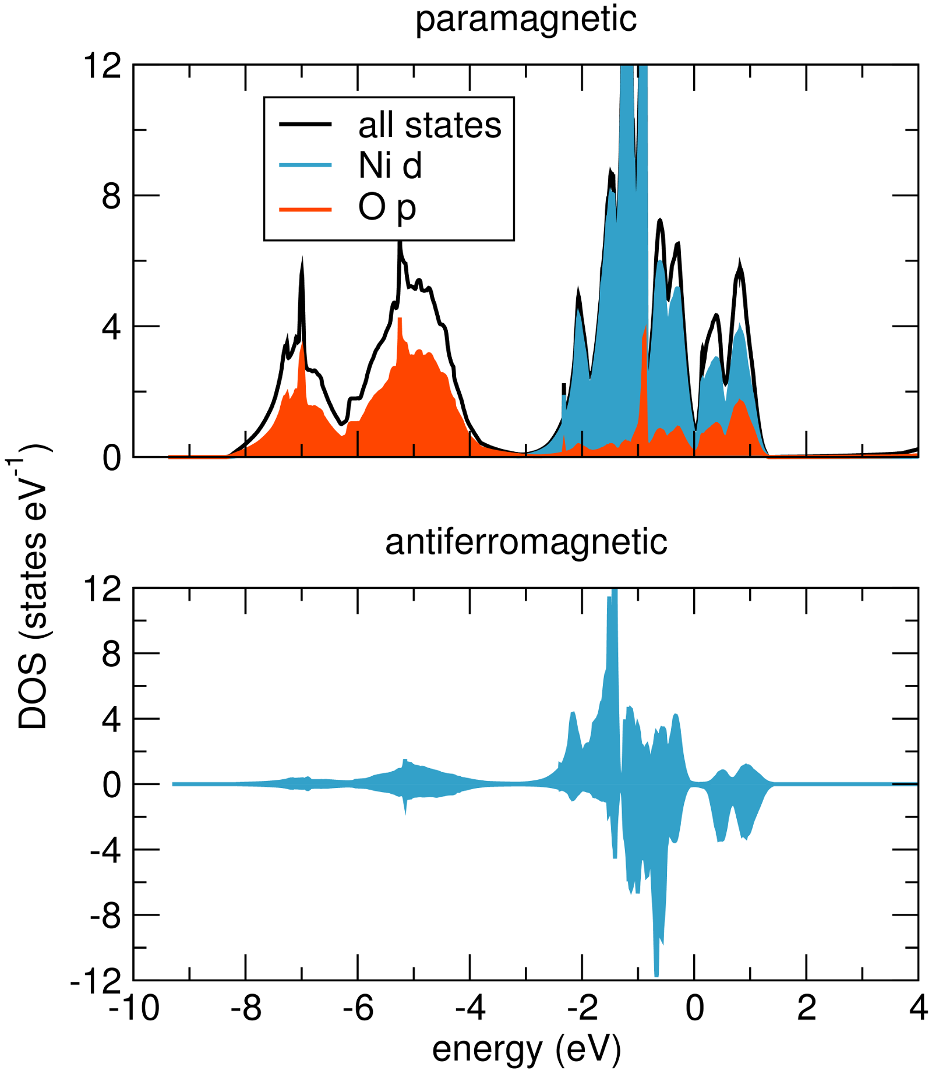
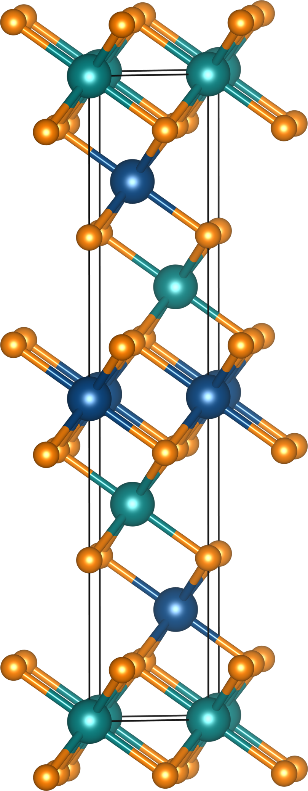
Class 04. Correlations and the Hubbard model: NiO
NiO displays the color of isolated Ni²⁺ in solution, with similar spectra.

Slide 5
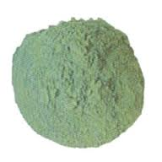
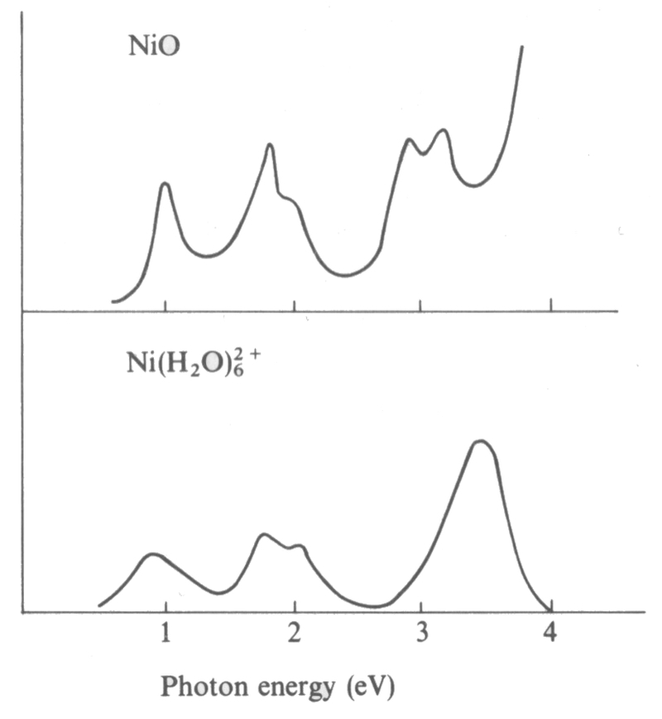
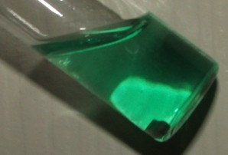
Class 04. Correlations and the Hubbard model: NiO
From the Cox text, page 151
NiO displays the color of isolated Ni²⁺ in solution, with similar spectra.

Slide 6
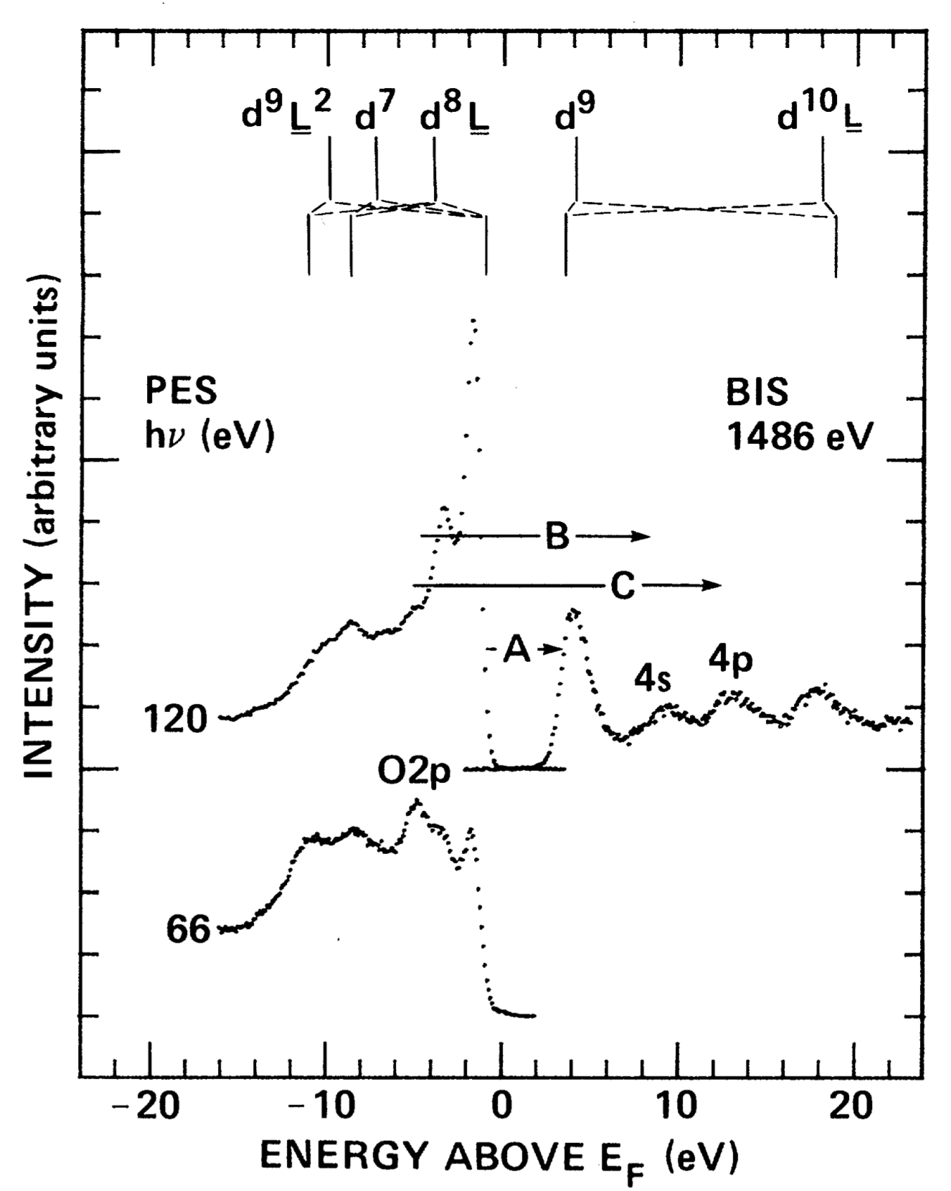
Class 04. Correlations and the Hubbard model: NiO, spectroscopic studies

Slide 7
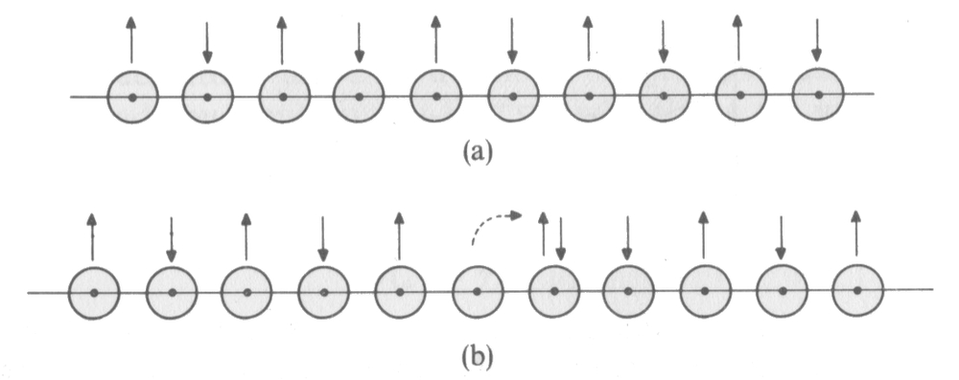
Class 04. Correlations and the Hubbard model: The idea of Mott
From the Cox text, page 135
Consider a chain of orbitals, each with one electron. To hop an electron, an orbital has to be ionized at cost I, which is compensated a little by the electron affinity A.
U = I – A
For H atoms, I = 13.6 eV and A = 0.8 eV, meaning U = 12.8 eV. However, this does not account for some screening (due to the dielectric not being vacuum).

Slide 8
Class 04. Correlations and the Hubbard model: The Hamiltonian
hopping or tight-binding (LCAO) part
double-occupancy cost or on-site repulsion

Slide 9
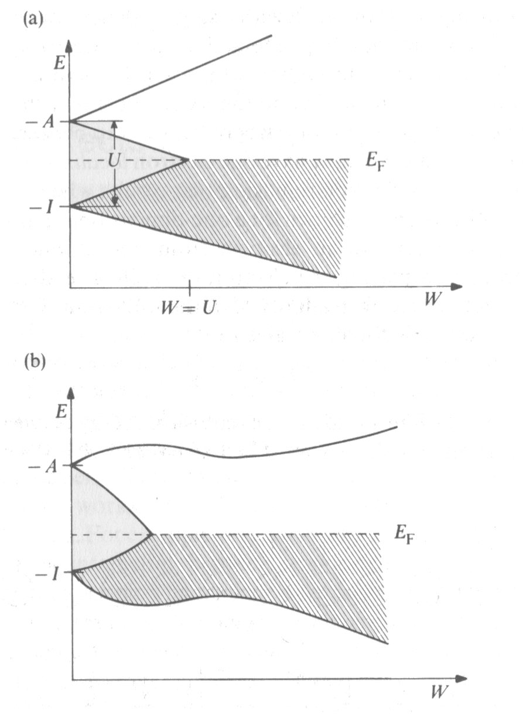
Class 04. Correlations and the Hubbard model: The Hamiltonian
As the bandwidth is increased, (or as the atoms approach closer) the gap can close.
From the Cox text, page 137

Slide 10
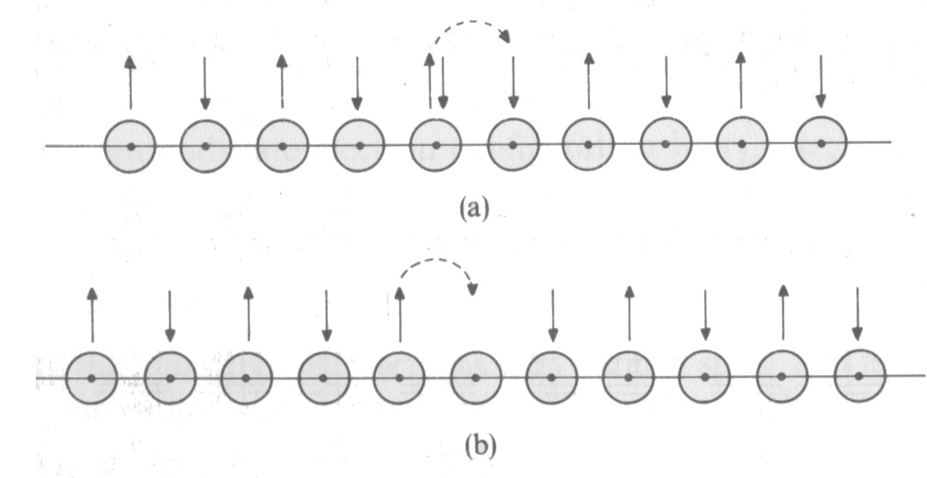
Class 04. Correlations and the Hubbard model: The Hamiltonian
Doping of holes (removal of electrons) as in (b) makes hopping much easier, with the on-site repulsion having been removed.
From the Cox text, page 149

