Slide 1
Class 02. The Peierls distortion seen in 1D chains: The simplest model for a gap.
E
k
Note that we go from being valence-imprecise to being valence precise: Now two electrons per unit cell.

Slide 2
Class 02. Charge carrier concentration and the filling-driven Mott transition
A real-world example of Peierls: MnB₄
Knappschneider et al., Peierls-distorted monoclinic MnB4 with a Mn-Mn bond, Angew. Chem. Int. Ed. 53 (2014) 1684–1688.

Slide 3
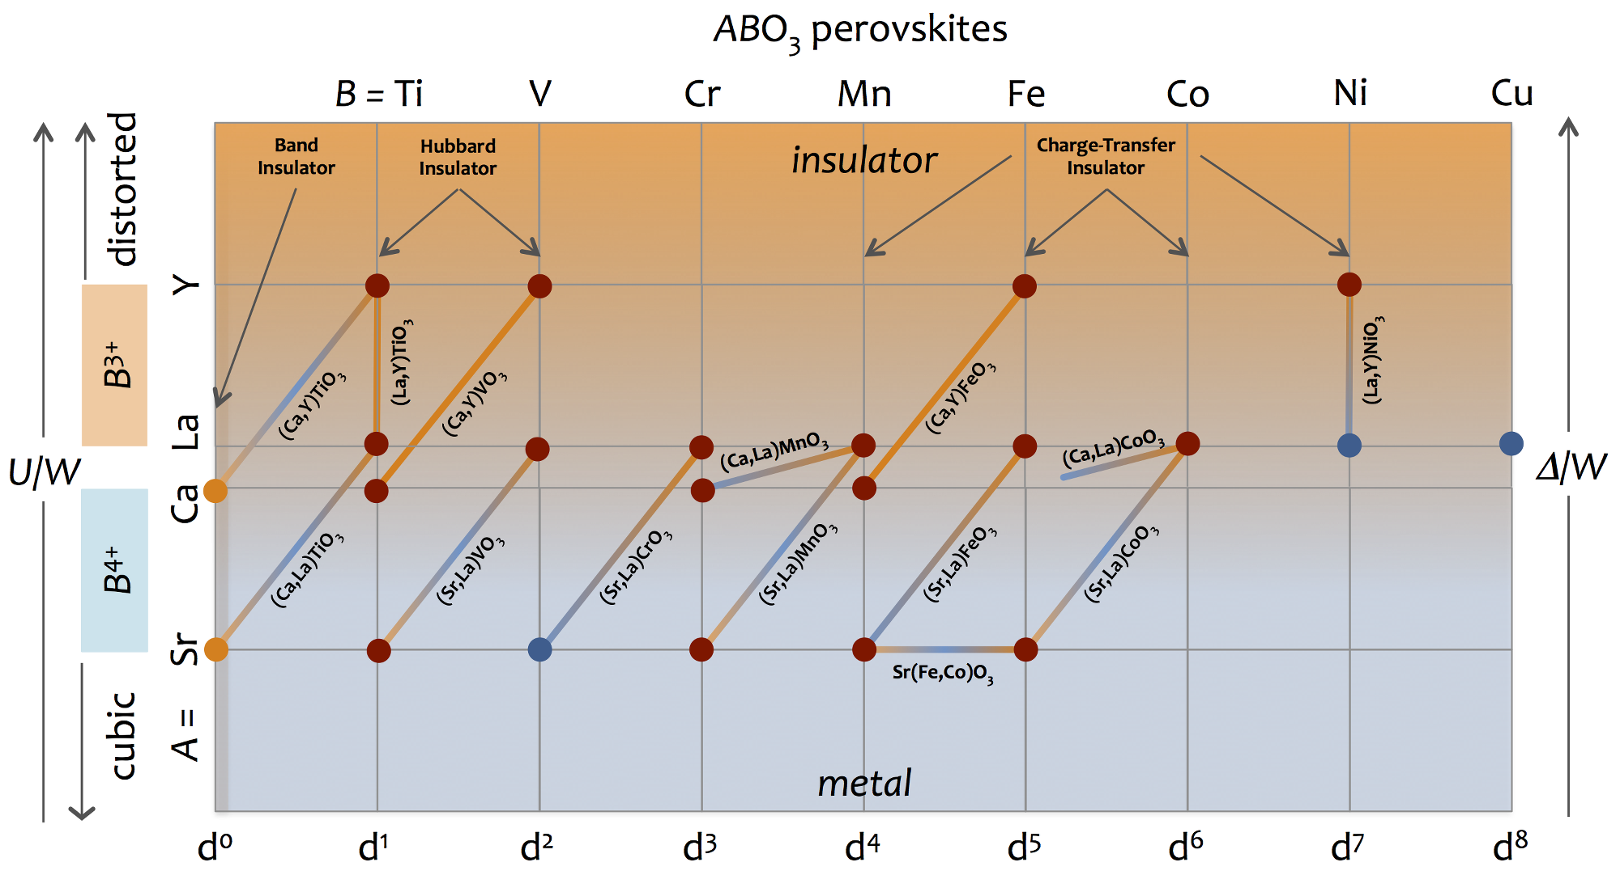
Class 02. Charge carrier concentration and the filling-driven Mott transition
Band theory (Wilson theory) and DFT would suggest that any departure from a band insulator should give rise to metallic behavior. This is wrong. Look close to SrTiO₃ and CaTiO₃.

Slide 4
Class 02. Charge carrier concentration and the filling-driven Mott transition
Consider the 1D chain again, at half-filling. Assume Peierls does not take place.
The system remains metallic no matter how far apart the atoms, which cannot be right. Mott: “... this is against common experience, and, one might say,
common sense”
E
k
k

Slide 5
Class 02. Charge carrier concentration and the filling-driven Mott transition
This familiar picture of atomic orbital levels interacting and spreading out as they approach, is not a band-structure picture. This picture captures the Herzfeld criterion discussed previously.
most antibonding
E
most antibonding
A
B
most bonding
most bonding
inverse distance
related picture with atoms and potentials

Slide 6
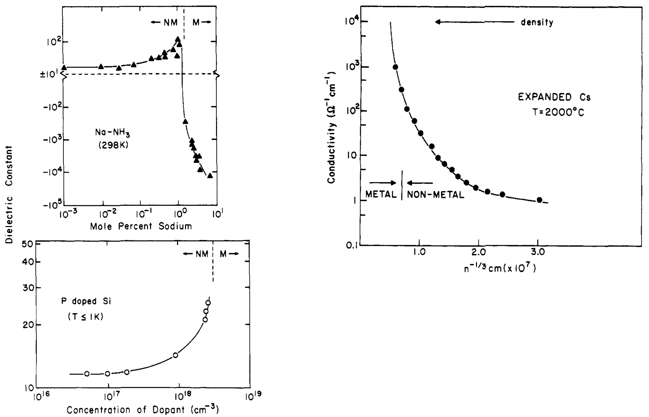
Class 02. Charge carrier concentration and the filling-driven Mott transition
Examples of composition (band-filling) dependent non-metal to metal transitions:
Edwards and Sienko, Acc. Chem. Res.

Slide 7
Class 02. Charge carrier concentration and the filling-driven Mott transition
Consider the case of expanded Cs, which for convenience, can be treated as a chain. When the atoms are infinitely separated, the energy required to remove an electron is the ionization energy IE = 3.89.
The energy required to place an electron on neutron Cs is the electron affinity EA = 0.47 eV.
The energy cost to transfer an electron is the difference, referred to as the Hubbard U.
U = IE – EA = 3.42 eV
This is the potential energy barrier required to be overcome, in order for electrons to hop.
Hopping is favored by the kinetic energy or bandwidth.

Slide 8
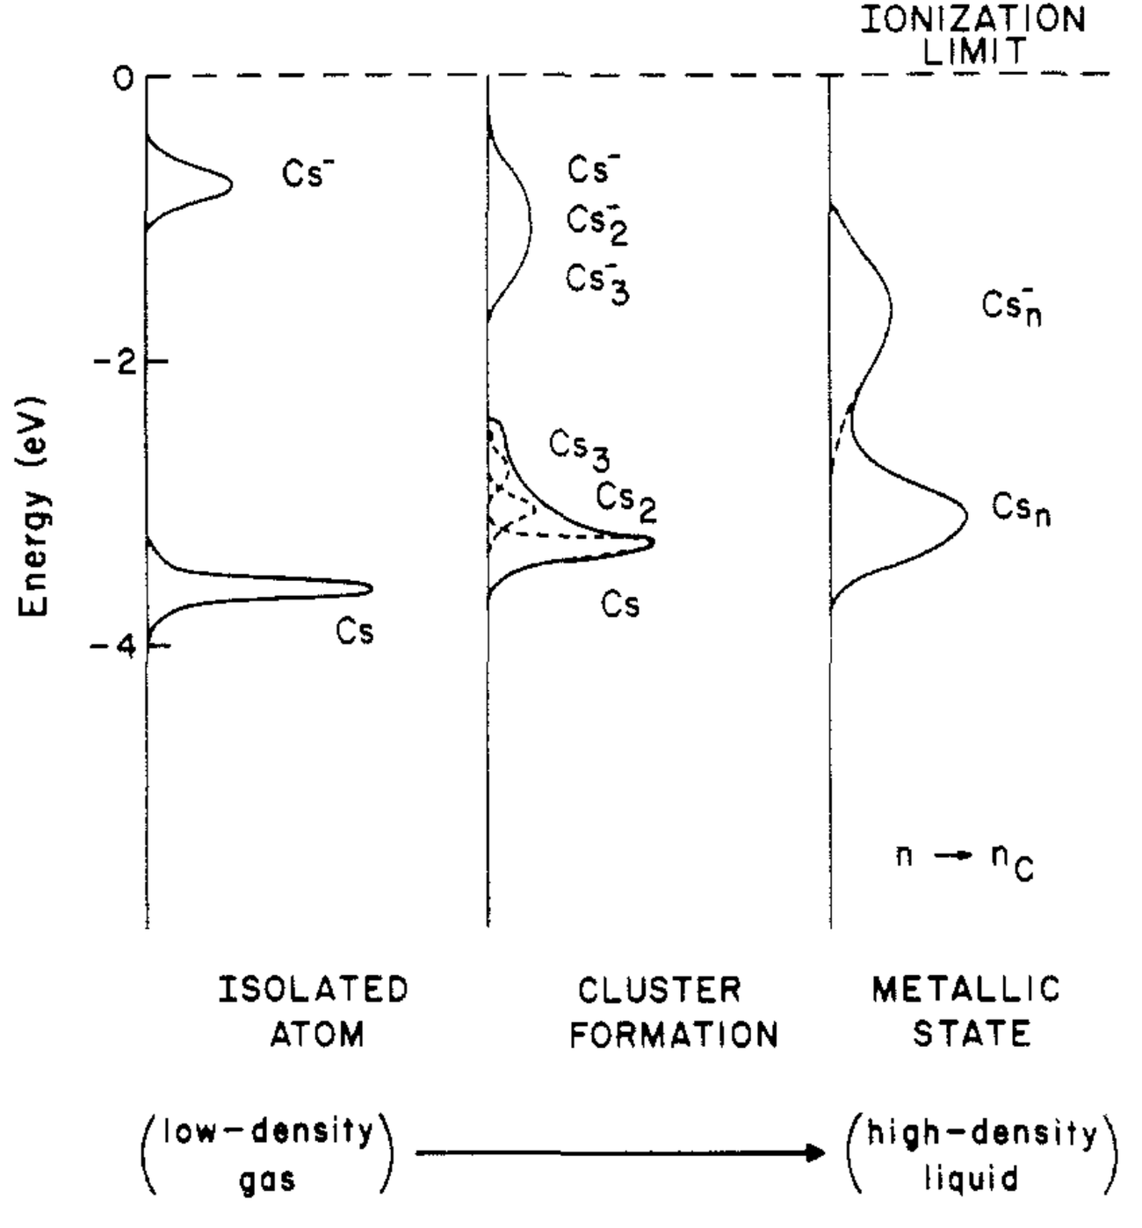
Class 02. Charge carrier concentration and the filling-driven Mott transition
Approximate energetics for the metallization of Cs.
Edwards and Sienko, Acc. Chem. Res.

Slide 9
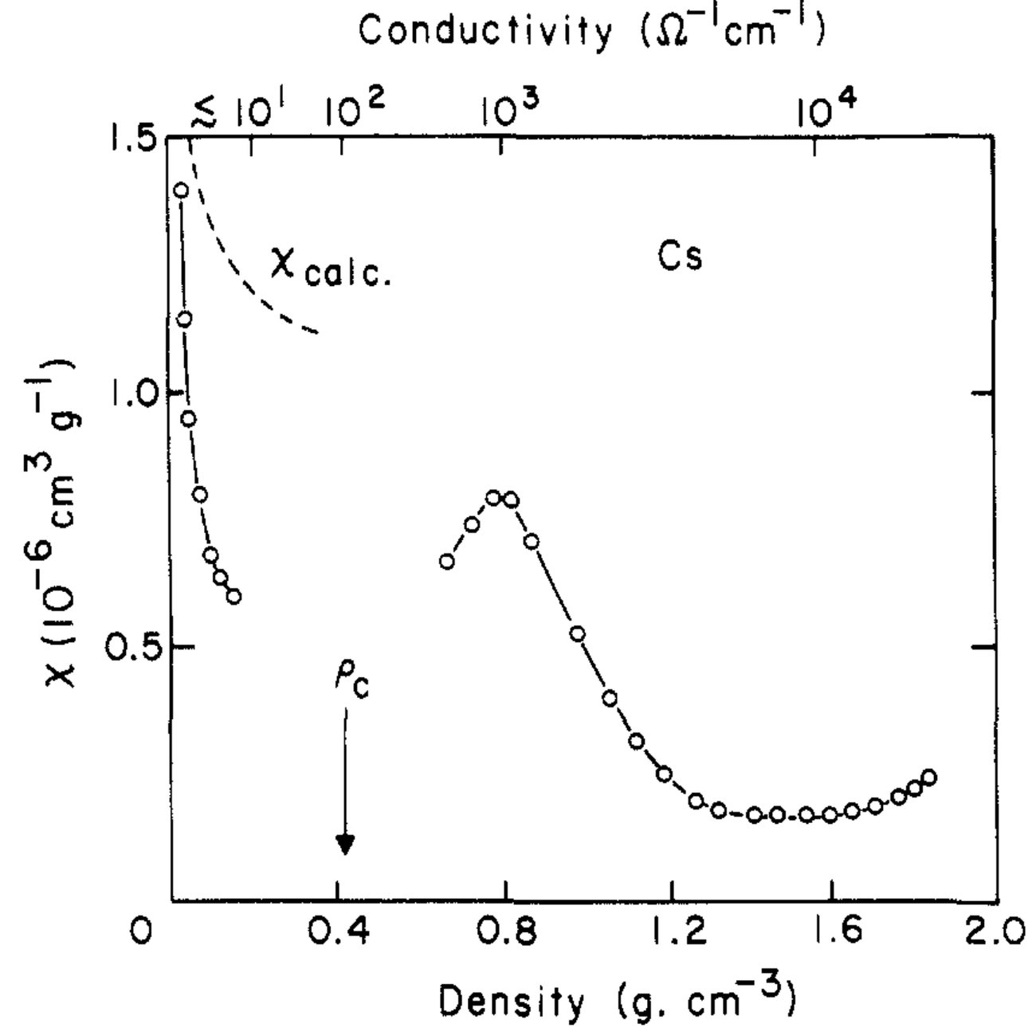
Class 02. Charge carrier concentration and the filling-driven Mott transition
Consequences for magnetism: When the charge carriers are localized, they can carry spin.
Magnetism is therefore frequently associated with non-metal to metal transitions.
Edwards and Sienko, Acc. Chem. Res.

Slide 10
Class 02. Charge carrier concentration and the filling-driven Mott transition
The Mott treatment of when the threshold concentration is crossed, is based on Thomas-Fermi screening:
When the strength of the screening overcomes the Coulombic repulsion U, at a critical number density of carriers n_{c} and the Mott criterion is fulfilled:
where a₀ is the hydrogenic Bohr radius.
This should be a first-order phase transition, although that has not been easy to verify.
with

Slide 11
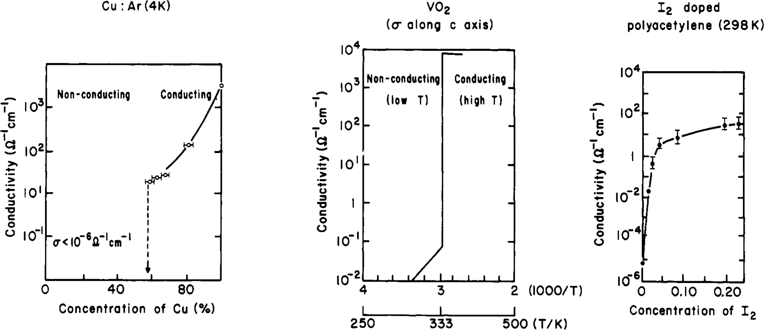
Class 02. Charge carrier concentration and the filling-driven Mott transition
Some more examples:
Edwards and Sienko, Acc. Chem. Res.

Slide 12
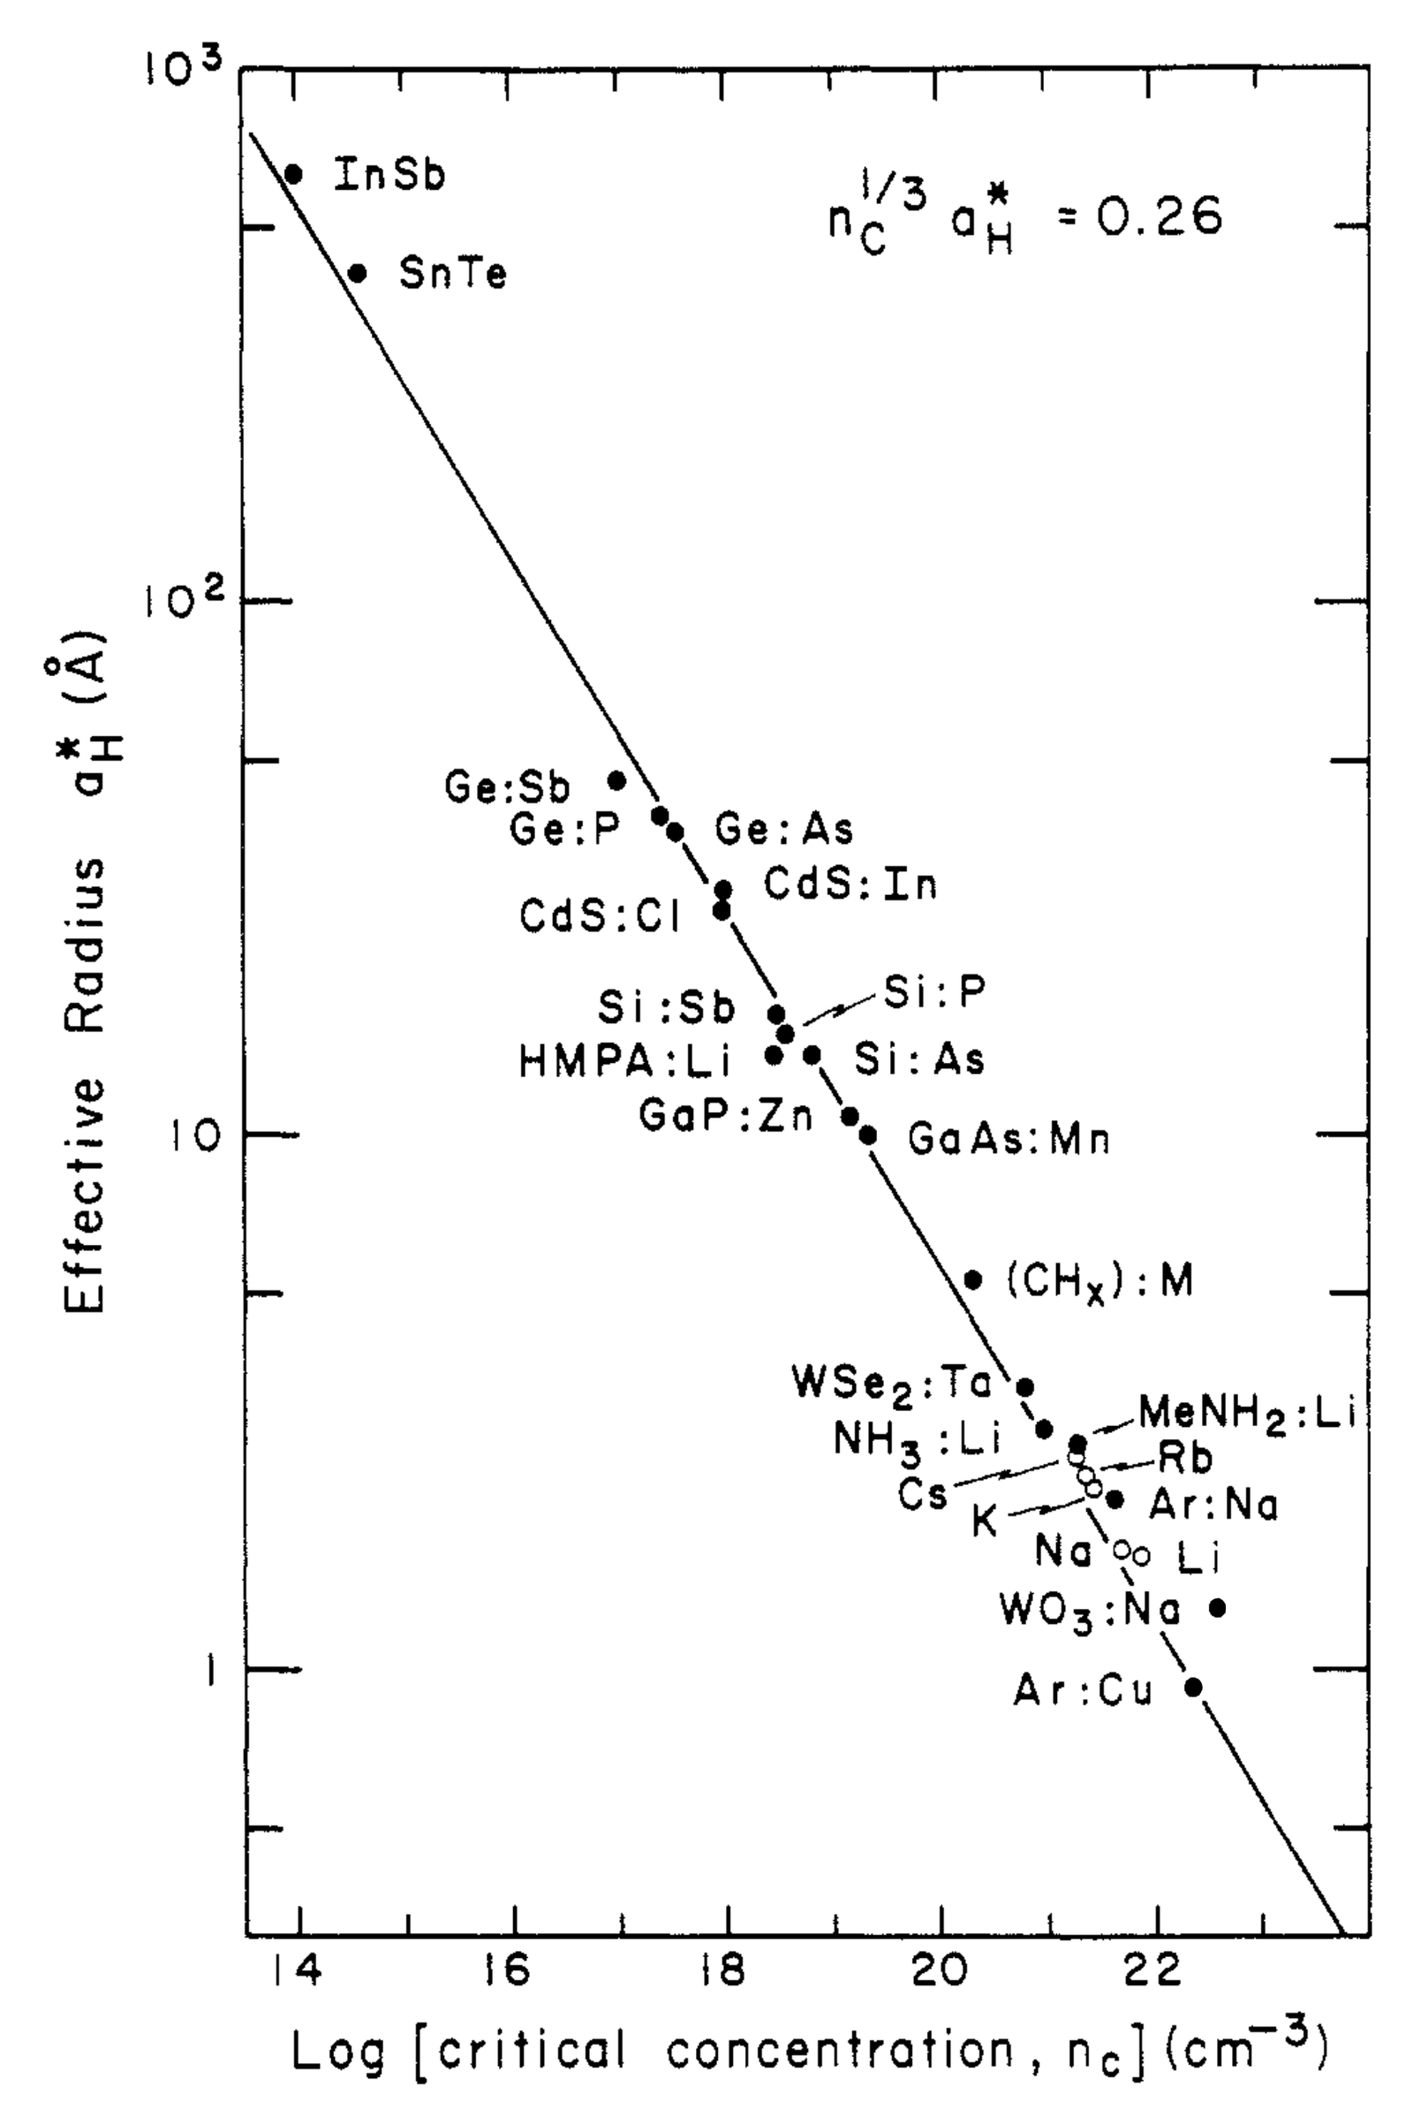
Class 02. Charge carrier concentration and the filling-driven Mott transition
Manifestations of the Mott criterion.
Note that a large Bohr radius should correspond to a high mobility.
Remember:
Edwards and Sienko, Acc. Chem. Res.

Slide 13
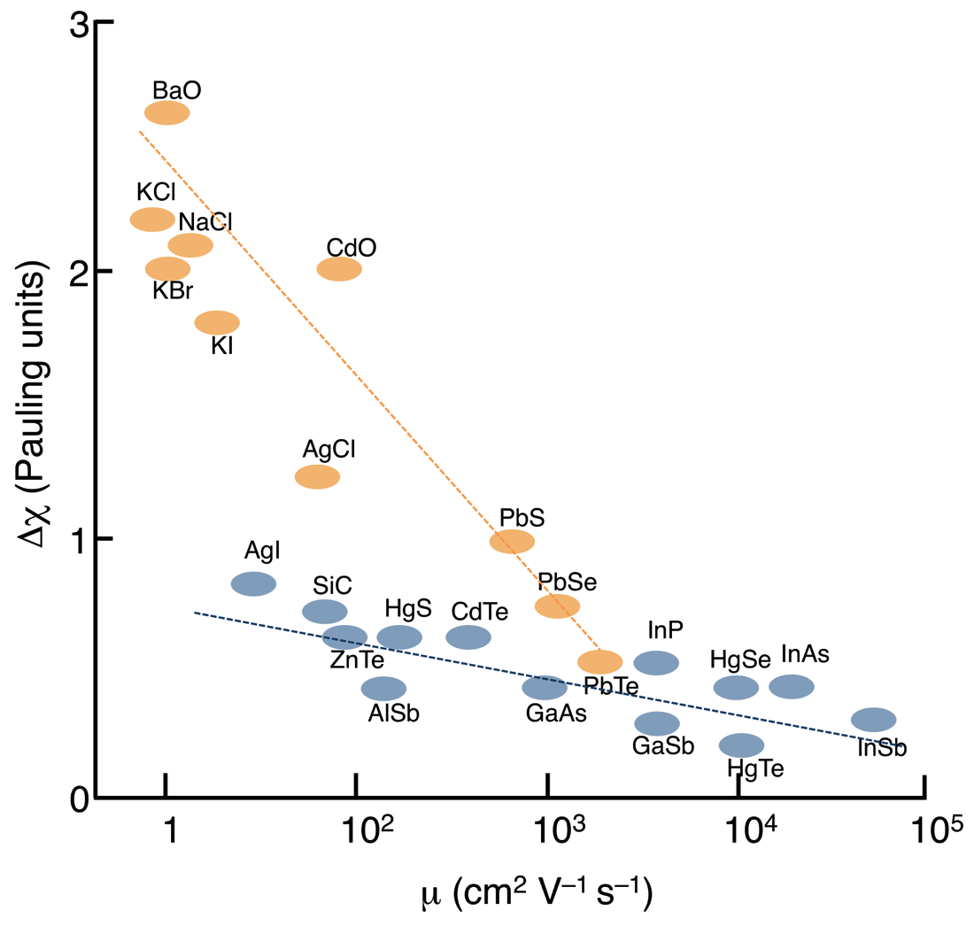
Class 02. Charge carrier concentration and the filling-driven Mott transition
But large intrinsic μ is associated with small electronegativity differences.
Adapted from R. E. Newnham, Properties of Materials
Edwards and Sienko, Acc. Chem. Res.

Slide 14
Class 02. Charge carrier concentration and the filling-driven Mott transition
The Mott minimum metallic conductivity (originally argued for disordered systems):
implies that at the transition:
This is a fixed value of the conductivity, usually close to 100 S cm^{–1}, or correspondingly, there is a maximum metallic resistivity, close to 0.01 Ω cm.
Möbius, The metal-semiconductor transition in three-dimensional disordered systems-reanalysis of recent experiments for and against minimum metallic conductivity, J. Phys. C: Solid State Phys. 18 (1985) 4639–4670.

Slide 15
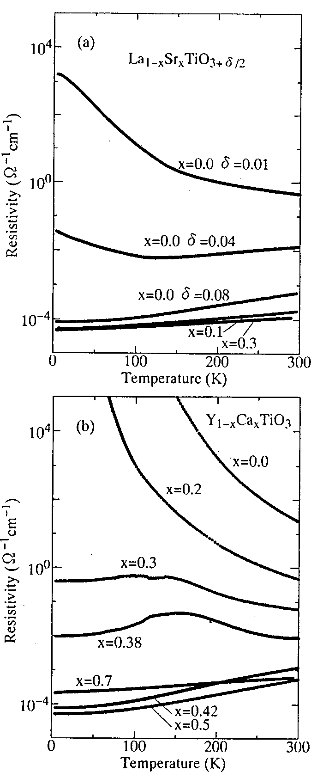
Class 02. Charge carrier concentration and the filling-driven Mott transition
Examples:

