Slide 1
Simulated annealing for crystal structure determination
Ryan Latture
Materials Department
University of California, Santa Barbara
June 4th, 2014

Slide 2
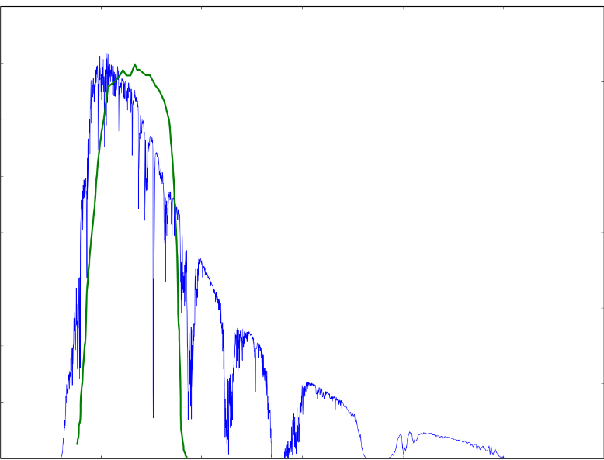
Given a composition what is the crystal structure?
Ga
As
.16
30
.12
20
Spectral Irradiance
Quantum Efficiency (%)
0.8
10
0.4
500
1500
3000
Wavelength (nm)
Hubbard, Seth, and Ryne Raffaelle. "Boosting solar-cell efficiency with quantum-dot-based nanotechnology." SPIE Newsroom (2010).
Notes:
Arbitrary composition -> get crystal structure -> predict properties
Spectral Irradiance W m-2 nm-1

Slide 3
Outline
Introduction to simulated annealing
SA algorithm
Benchmarking key aspects
Application to crystal structure:
Global minimum of Lennard-Jones clusters
Simulated annealing aided with x-ray diffraction
Automated assembly of secondary building units

Slide 4
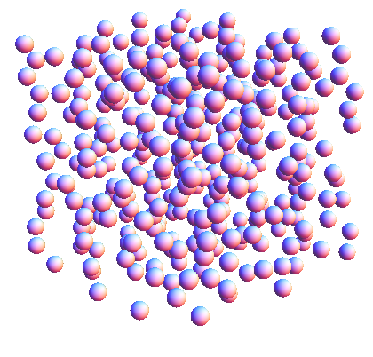
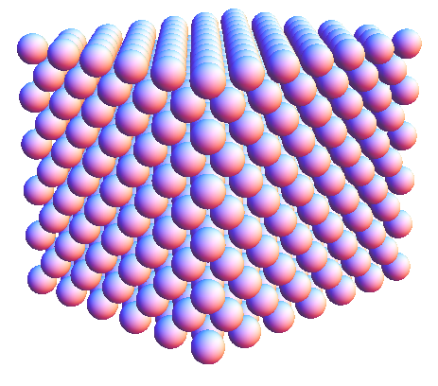
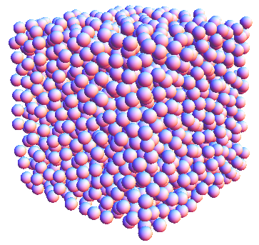
Overview of simulated annealing
Global minimization technique:
Suitable for objective functions with many local minima.
Named for the annealing process in metals.
Begin at high “temperature”
Cooling schedule determines end state

Slide 5
Steps in simulated annealing algorithm
Start: define cost function & initial guess
Stop
Yes
Generate randomized candidate solution
Decrease temperature
No
Reached maximum number of iterations?
Is candidate better than current solution?
No
Yes
Replace current solution with given probability:
$$p<e^{−ΔE/T}$$
Replace current solution with candidate solution

Slide 6
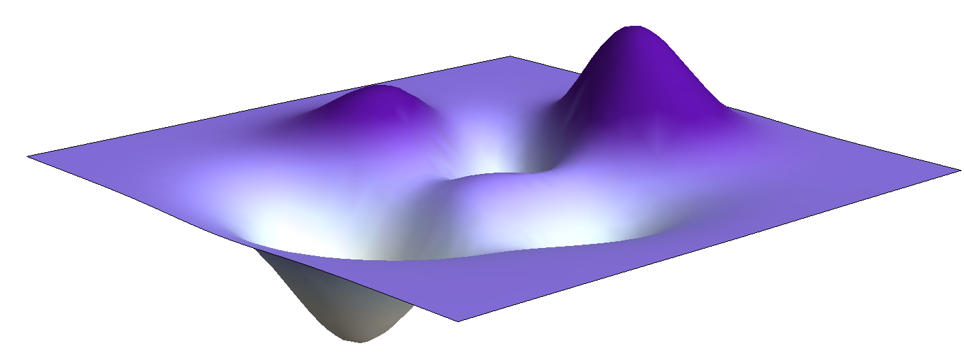
Visualizing simulated annealing
Randomized
Jump
Optimum Solution
Start

Slide 7
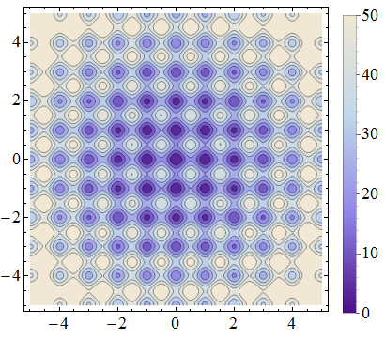
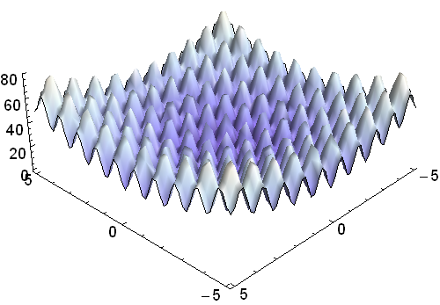
Benchmarking key aspects of simulated annealing
Step Size
Dictates the amount of the landscape that is probed
Temperature
Cooling too quickly possible convergence on local optimum

Slide 8
Choose step size based on specific landscape
Temperature:
$$p<e^{\frac{−ΔE}{E}}$$
T is constant
Step size:
0.01
Start: (2.5,2.5)
Iterations: 100,000

Slide 9
Appropriate step size speeds up convergence
Temperature:
$$p<e^{\frac{−ΔE}{E}}$$
T is constant
Step size:
1.0
Start: (2.5,2.5)
Iterations: 8,000

Slide 10
Logarithmic temperature quickly converges to a solution
Temperature:
$$p<e^{\frac{−ΔE}{kT}}$$
T decreases logarithmically
Step size:
1.0
Start: (2.5,2.5)
Iterations: 2,000
Notes:
Initial temperature:
generate N random points around initial guess
Evaluate cost for each candidate
Store max and min cost values
Compute $χ\left(T_{n}\right)=\frac{sum\exp{Emax }}{sum\exp{Emin}}$
If $χ\left(T_{n}\right)−χ_{o}<tolerance$, return T
Else, $T_{n+1}=T_{n} (lnχ\left(T_{n}\right)$/$χ\left(T_{n}\right))^(1/p)$
N=n+1
p=2
$$T_{1}=−\sum{\frac{({E_{mx}−E}_{mn})}{\left\|S\right\|ln⁡(χ_{o})}}$$
$$T_{1}$$

Slide 11
Linear temperature is slower but more successful
Temperature:
$$p<e^{\frac{−ΔE}{kT}}$$
T decreases linearly
Step size:
1.0
Start: (2.5,2.5)
Iterations: 8,000

Slide 12
Summary of simulated annealing
Step size $≈$distance between local minima
Initial temperature $≈ΔE$ between local minima
Cannot know the optimum choice a priori
Adaptive SA algorithm

Slide 13
Outline
Introduction to simulated annealing
SA algorithm
Benchmarking key aspects
Application to crystal structure:
Global minimum of Lennard-Jones clusters
Simulated annealing aided with x-ray diffraction
Automated assembly of secondary building units

Slide 14
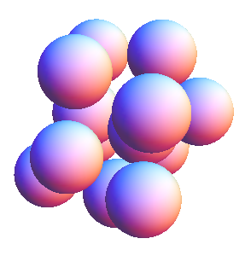
SA applied to 13 atom Lennard-Jones cluster
Lennard-Jones Potential:
Initial guess
$$E=4ε\sum_{i<j}{\left[{\left(\frac{σ}{r_{ij}}\right)}^{12}−{\left(\frac{σ}{r_{ij}}\right)}^{6}\right]}$$
Global minimum

Slide 15
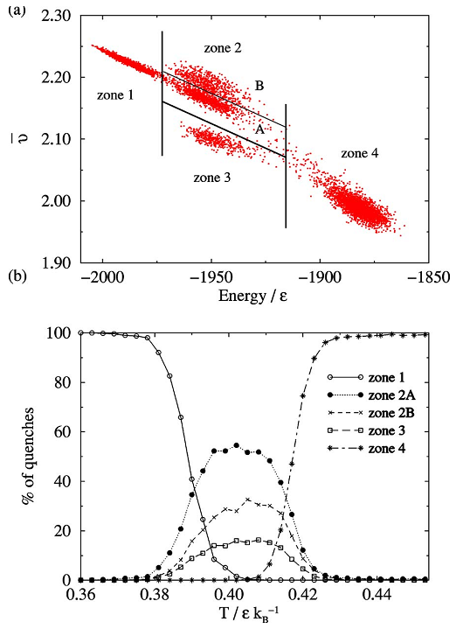
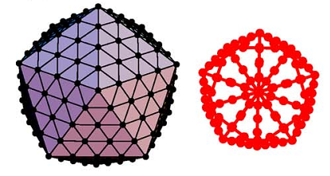
SA used to study structural transitions
309-atom L-J cluster
Noya, Eva G., and Jonathan PK Doye. "Structural transitions in the 309-atom magic number Lennard-Jones cluster." The Journal of chemical physics 124.10 (2006): 104503.
Notes:
Desc LJ -> desc cluster -> SA technique ->
It is well established that, for N<1000, LJ clusters follow an icosahedral pattern growth, showing magic numbers corresponding to complete Mackay icosahedra at N=13, 55, 147, 309, 561, and 923. In between these magic numbers, the vast majority of the global minima correspond to a Mackay icosahedron core covered with an incomplete outer layer.
A Mackay icosahedron can be considered to be made up of 20 slightly distorted fcc tetrahedra sharing a common vertex
~10⁷-10⁸ MC cycles with 32 systems at different temperatures
All the temperatures were initialized with the Mackay icosahedron ground-state structure.
Evaporation and fragmentation of the cluster were avoided by adding a hard wall of radius r+sigma
v is the mean vibrational freq. For LJ potential reflects number of nearest neighbors and average neighbor distance. The latter because the second derivative of the LJ potential decreases with distance. Strained structures, which inevitably have a variety of nearest-neighbor distances, have a larger average nearest-neighbor distance, because of the anharmonic nature of the LJ well, and hence have smaller values of v
2^1/6*sigma = eq. separation distance
Epsilon = pair well depth
all the atoms in the interior of these clusters have 12 nearest neighbors, whose local coordination shell can be characterized as icosahedral, decahedral, fcc, or hcp.
The isomers found in zone 2A are Mackay icosahedra in which a pit is formed on one side of the cluster, while an adatom island is formed on the opposite side
Zone 2B: aggregates of fcc tetrahedra with six atoms per edge (instead of 5)
Zone 3, is occupied by isomers with a 147-atom Mackay icosahedral core, but where the outer layer has undergone a surface reconstruction from a Mackay to an antiMackay overlayer. Results in 279 atom structure with 30 atoms left over.
Zone 4, is associated with completely melted structures, in which both the core and surface atoms are disordered.

Slide 16
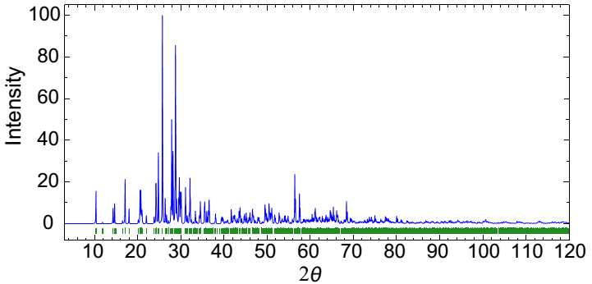
Solving for crystal structure using diffraction data
Objective function:
$$E=E_{chem}+wE_{exp}$$
AlVO₄
Coelho, A. A. "Whole-profile structure solution from powder diffraction data using simulated annealing." Journal of applied crystallography 33.3 (2000): 899-908.
Notes:
E_{chem} comprises empirical information about equilibrium covalent bonding geometry, vibrations, and hydrogen-bonded and non-bonded
interactions in accordance with prior knowledge of these quantities obtained from small molecule crystallography and spectroscopy.
E_{exp} describes the difference between observed and computed diffraction data.
Aluminum Orthovanadate

Slide 17
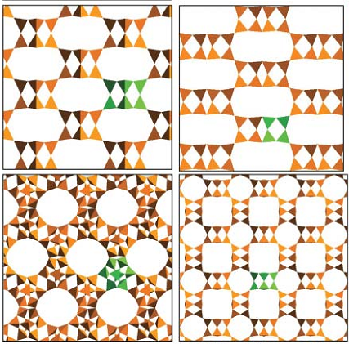
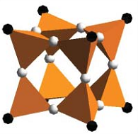
SBUs reduce degrees of freedom
D4R building unit
Theoretical structures
Mellot-Draznieks, Caroline, Stéphanie Girard, and Gérard Férey. "Novel inorganic frameworks constructed from double-four-ring (D4R) units." Journal of the American Chemical Society 124.51 (2002): 15326-15335.
Notes:
E_{chem} comprises empirical information about equilibrium covalent bonding geometry, vibrations, and hydrogen-bonded and non-bonded
interactions in accordance with prior knowledge of these quantities obtained from small molecule crystallography and spectroscopy.
E_{exp} describes the difference between observed and computed diffraction data.

Slide 18
Conclusions
Simulations using Lennard-Jones potentials can model systems with large number of atoms.
Any information to about the crystal structure will speed up convergence.
Diffraction data
AASBU

Slide 19
Questions?

