Slide 1
Comparing magnetic SrMO₃ perovskites M= 3d vs. 4d
Leo Lamontagne
MTRL 286G
6/2/2014

Slide 2
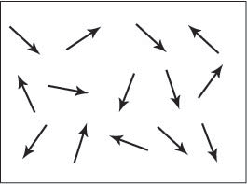
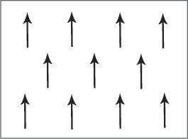
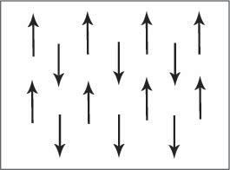
3d vs. 4d magnetism
3d:
Smaller bandwidth leads to stoner instabilities
Stronger correlation between electrons
4d:
Greater orbital overlap gives more disperse bands
Spin orbit coupling can play a role
http://www.doitpoms.ac.uk/tlplib/ferromagnetic/types.php

Slide 3
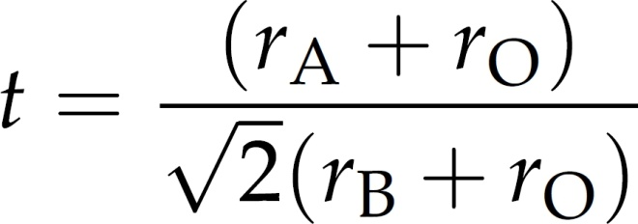
The perovskite structure distorts based on cation size
e_{g}
t_{2g}

Slide 4
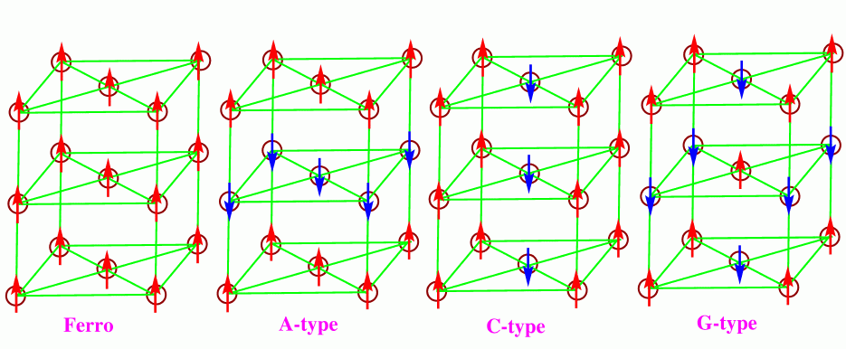
Spin ordering in magnetic perovskites
http://folk.uio.no/ravi/activity/ordering/spinfig.html

Slide 5
Magnetism varies widely even among neighbors in PT
$$SrMO_{3}$$
Magnetism present
Relations to DOS and structure

Slide 6
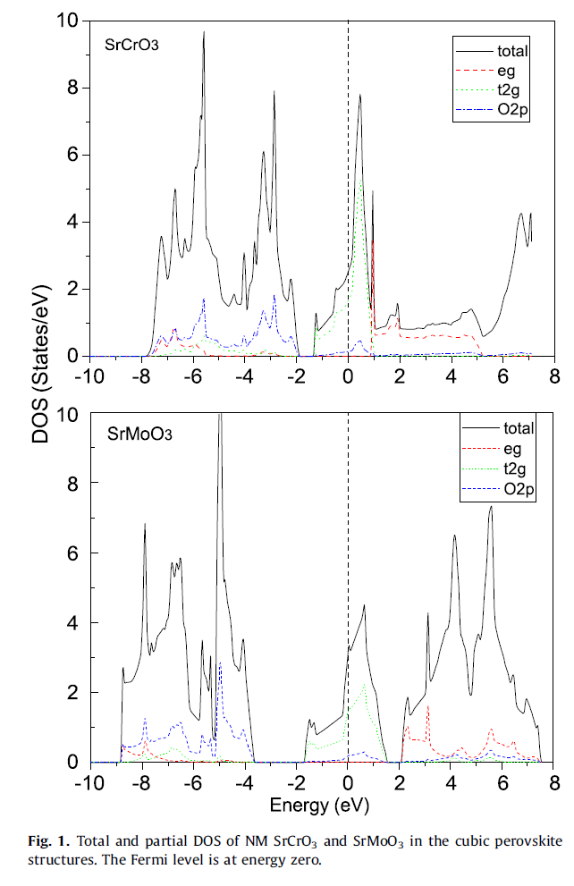
SrCrO₃ and SrMoO₃
Both cubic, Pm-3m
SrMoO₃ undergoes transition to tetragonal (I4/mcm) to orthorhombic (Imma).
SrCrO_{3,} is cubic until 40-50K then tetragonal, P4/mmm
Zhu, Z.L, Gu, J.H., Jia, Y., Hu, X., Physica B, 407 (2012) p1990-1994

Slide 7
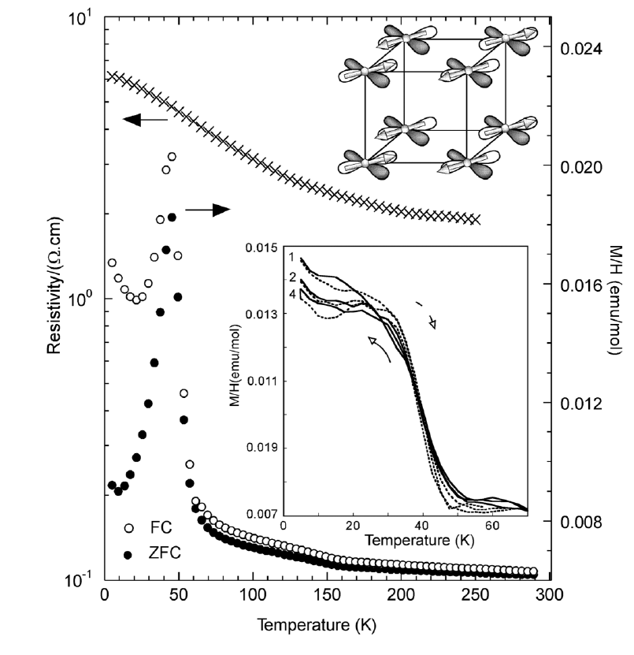
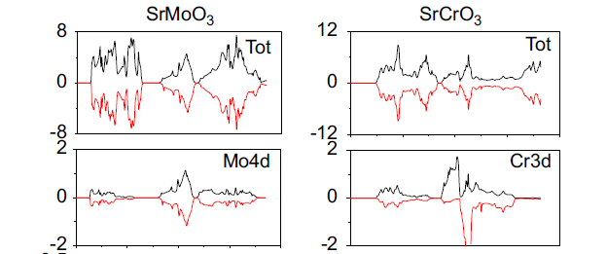
SrCrO₃ is AFM in the tetragonal phase
Tetragonal phase made under high pressure shows AFM transition in SrCrO₃
Cubic phases of both SrMoO₃ and SrCrO₃ are paramagnetic
San-Martin, L.O., Williams, A.J., Rodgers, J., Attfield, J.P.,
Heymann, G., Huppertz, H., PRL, 99 (2007) 255701
Notes:
C-type Antiferromagnet

Slide 8
SrMnO₃ crystallizes in a hexagonal structure
G-type antiferromagnet with T_{N}=280K in
At 750K, cubic with T_{N}=250K
Oxygen stoichiometry can vary T_{N}
Sodena, R., Ravindran, P., Stolen, S., Grande, T., Hanfland, M. Phys Rev B, 74 (2006) 144102

Slide 9
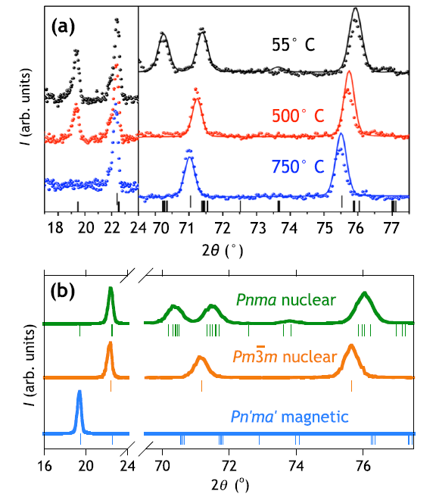
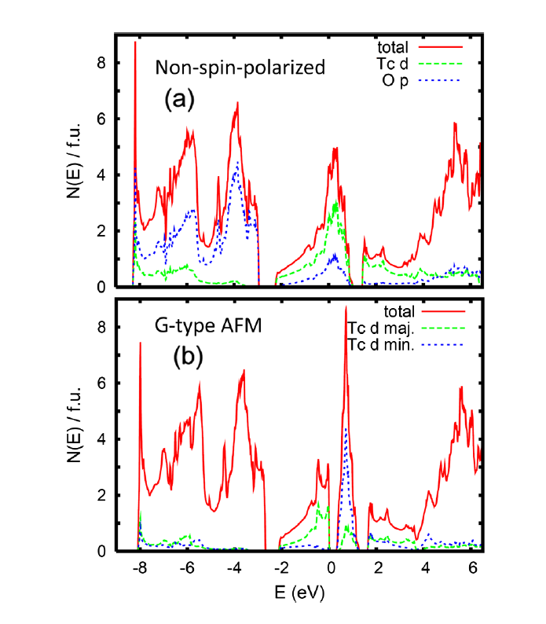
4d analog SrTcO₃ has extremely high T_{N}
Orthorhombic, Pnma
T_{N}=750ºC
Rodriguez, E., Poineau, F., Llobet, A., Kennedy, B.J., Avdeev, M., Thorogood, G.J.,
Carter, M.L., Seshadri, R., Singh, D.J., Cheetham, A.K., PRL 106 (2011) 067201

Slide 10
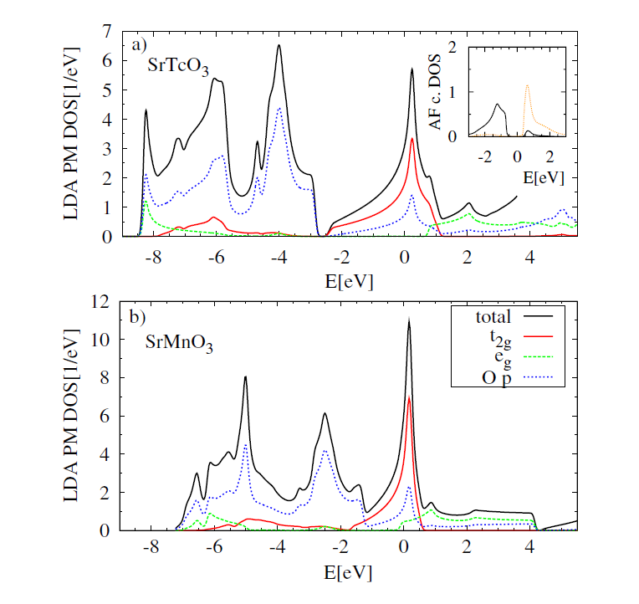
High T_{N} is due to several factors
High Tc-O bond covalency
Large band width
Half filled t_{2g} and close to locaI-itinerant electrons
Mravlje, J. Aichhorn, M., Georges, A. PRL 108 (2012) 197202

Slide 11
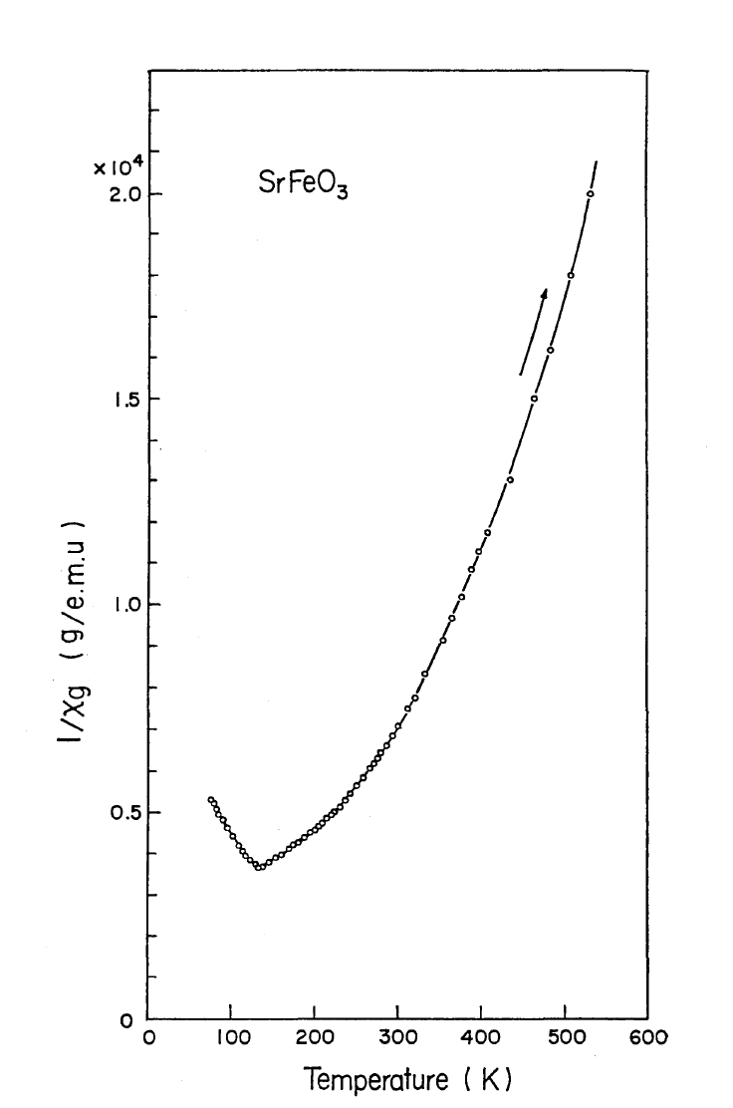
SrFeO₃ is a cubic AFM down to 4K
Fe⁴⁺ is high spin with localized t_{2g} electrons and itinerant e_{g} so no Jahn Teller distortion is observed
Antiferromagnetic with helical spin structure
e_{g}
t_{2g}
Takeda, T., Yamaguchi, Y., Watanabe, H. J. Phys. Soc. Jpn., 33 (1972) 967

Slide 12
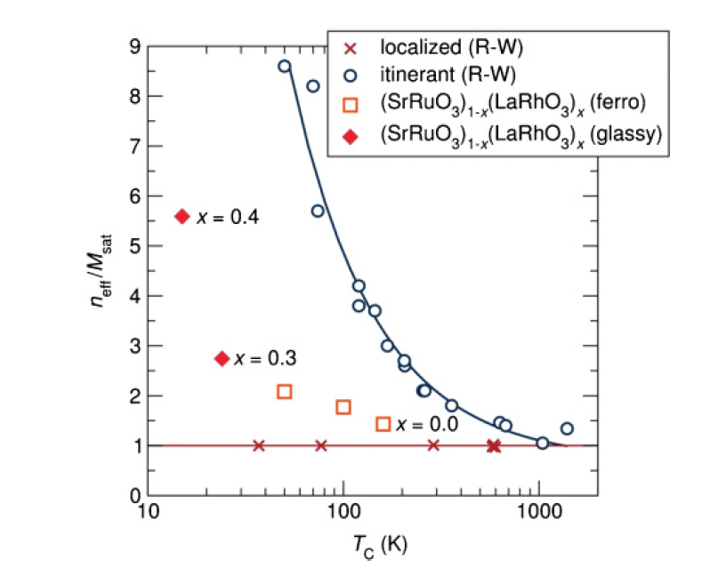
SrRuO₃ is ferromagnetic
Orthorhombic, Pnma, at room temperature
Mixed itinerant/local electron behavior
e_{g}
t_{2g}
Rhodes-Wohlfarth ratio probes degree of itinerant behavior
Barton, P.T., Seshadri, R., Rosseinsky, M. Phys. Rev. B., 83 (2011) 064417

Slide 13
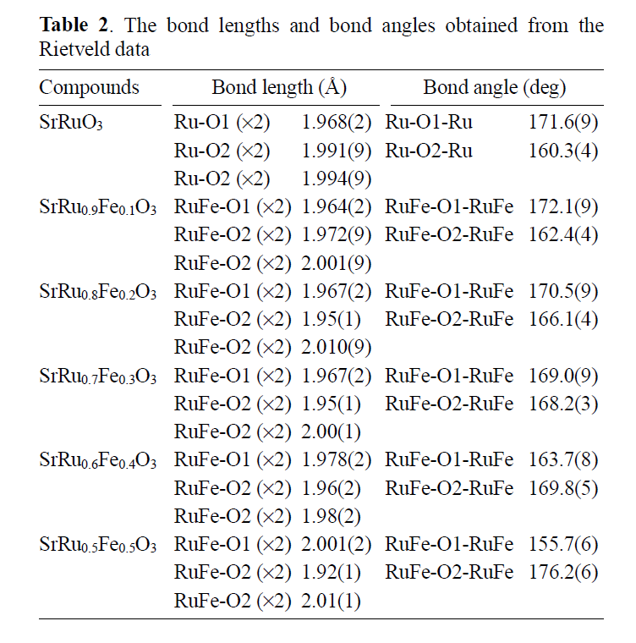
Structural distortions can weaken FM
Park, J.C., Kim, D., Lee, C.S., Byeon, S.H., Bull Korean Chem Soc, 24 (2003) 650

Slide 14
Conclusions
Type of magnetism and transition temperature can vary widely from 3d to 4d
Broad bands in 4d metals can significantly effect type of magnetism
M-O covalency can change transition temperature
Structural distortions can weaken magnetism

