Slide 1
Heusler Half-Metals
Sean Harrington
Mat 286G
5/28/14
Notes:
Hi, I’m Sean Harrington, a 2nd year student in the Palmstrom group. Earlier this quarter, professor Seshadri introduced half metals and more specifically the Half-Heusler crystal structured half metals. Today I will be extending that discussion of half metals to the full Heusler structured

Slide 2
Outline
Motivation and introduction
  Spintronics
  What is a half metal?
  Heuslers
Origin of half-metallic behavior in Heuslers
Current and future investigations

Slide 3
Motivation - Spintronics
Spintronic devices
utilize the spin of the electron
  Increased processing speeds
  Nonvolatile memory
  Higher integration densities
  Reduced power consumption
Spin valve
Non magnetic
Low resistance
Notes:
Spintronics is a relatively new field that utilize the spin-degree of freedom within the electron to store and manipulate information which offers a number of advantages over current electronic technology. One such device, which Ram touched on briefly earlier in the quarter. is the Spin valve which uses to ferromagnetic electrodes sandwiching a non magnetic layer as depicted here. If the magnetic moments are aligned as shown, current flows easily- transition

Slide 4
Motivation - Spintronics
Spintronic devices
utilize the spin of the electron
  Increased processing speeds
  Nonvolatile memory
  Higher integration densities
  Reduced power consumption
Spin valve
Non magnetic
High resistance
Notes:
Or in an anti-aligned state, the device is higher in resistance. This on off feature is what gives it its name. This device is already integrated into magnetic sensors as well as hard disk read heads.

Slide 5
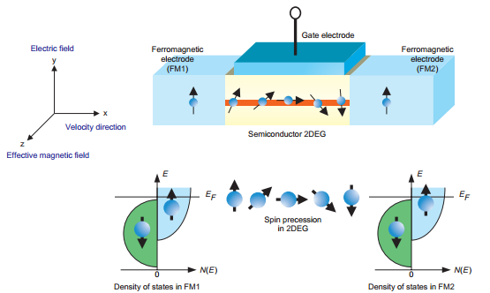
Motivation - Spintronics
Datta-Das spin field-effect transistor
J. Nitta, “Semiconductor Spintronics,” NTT Review. vol. 2 no. 6, 2004.
Concept from: S. Datta and B. Das, “Electronic analog of the electro-optic modulator,” Appl. Phys. Lett., vol. 56, pp. 665–667, 1990.
Notes:
Another device that was proposed by Datta-Das, is the Spin-Field-Effect transistor. Similar in construction to the classical field-effect transistor seen in many current electronic devices, it relies on the manipulation of the spin current between the source and drain electrodes to turn the FET on and off. Critical to its operation is good spin injection and detection. Using ferromagnetic electrodes is one such way to achieve this. Theoretically, the higher the spin polarization of the injected current and the detection electrode, the better the performance of the device. Thus a 100% spin polarized injector and detector, a half-metal, would be ideal for optimal performance.

Slide 6
What is a Half Metal?
E
↑
E
↓
↑
E
↓
↑
↓
E_{f}
E_{f}
E_{f}
Metal
Ferromagnet
Half-metallic ferromagnet

Slide 7
Some Predicted Half Metals
CrO₂ (Rutile)
Fe₃O₄ (Inverse Spinel)
La_{0.7}Sr_{0.3}MnO₃(Perovskite)
NiMnSb (Half Heusler)
Co₂MnSi (Full Heusler)
Notes:
Half metals predicted in a variety of compounds with different crystal structures many of which were discussed in Materials 218 and earlier this quarter.

Slide 8
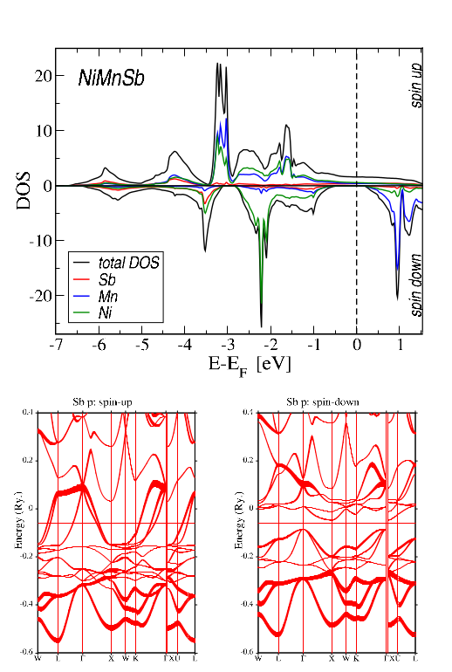
Heusler Half Metals
Heusler advantages
  Relatively high Curie temperatures
  Have already been incorporated in spin filters, tunnel junctions, and GMR devices
  Structure and lattice parameter match well to III/V semiconductors

Slide 9
Half Heusler Crystal Structure
X
Y
Z
+
=
Zinc blende
FCC
+
=
Half-Heusler
½ of tetrahedral sites
Rock salt
Notes:
Let’s take a quick review of the half Heusler crystal structure and how it leads to half metallicity. When ordered, it has the F-43m space group (216)

Slide 10
Heusler Crystal Structure
X
Y
+
=
Z
Rock Salt
Tetrahedral Sites
Full Heusler
Chemical formula: X₂YZ or YX₂Z

Slide 11
Origin of Gap in Co₂MnSi
Energy
e_{u}
d_{3z2-r2}, d_{x2-y2}
t_{1u}
d_{3z2-r2}, d_{x2-y2}
Co
Co
d_{xy}, d_{yz}, d_{zx}
t_{2g}
d_{xy}, d_{yz}, d_{zx}
e_{g}
Notes:
Let’s first consider the origin of the minority spin gap in the full-Heusler Co2MnSi which is relatively well studied half metal both experimentally and theoretically. It can give some insight into

Slide 12
Origin of Gap in Co₂MnSi
Energy
e_{u}
d_{3z2-r2}, d_{x2-y2}
t_{1u}
d_{3z2-r2}, d_{x2-y2}
Co
Co
d_{xy}, d_{yz}, d_{zx}
t_{2g}
d_{xy}, d_{yz}, d_{zx}
e_{g}

Slide 13
Origin of Gap in Co₂MnSi
Energy
d_{3z2-r2}, d_{x2-y2}
Mn
e_{u}
t_{1u}
d_{xy}, d_{yz}, d_{zx}
Co-Co
t_{2g}
e_{g}

Slide 14
Origin of Gap in Co₂MnSi
Energy
d_{xy}, d_{yz}, d_{zx}
e_{u}
E_{ex}
Mn
t_{1u}
e_{u}
t_{1u}
d_{3z2-r2}, d_{x2-y2}
Co-Co
t_{2g}
e_{g}
t_{2g}
Minority
e_{g}
Majority

Slide 15
Origin of Gap in Co₂MnSi
Energy
d_{3z2-r2}, d_{x2-y2}
Mn
e_{u}
t_{1u}
d_{xy}, d_{yz}, d_{zx}
Co-Co
t_{2g}
e_{g}
N_{v} = 29 Valence Electrons
N_{d} = 21 d Electrons
m = 5 μ_{B} per formula unit

Slide 16
Origin of Gap in Co₂MnSi
Energy
d_{3z2-r2}, d_{x2-y2}
Mn
e_{u}
ΔE_{g}↓
t_{1u}
d_{xy}, d_{yz}, d_{zx}
Co-Co
t_{2g}
e_{g}
N_{v} = 29 Valence Electrons
N_{d} = 21 d Electrons
m = 5 μ_{B} per formula unit

Slide 17
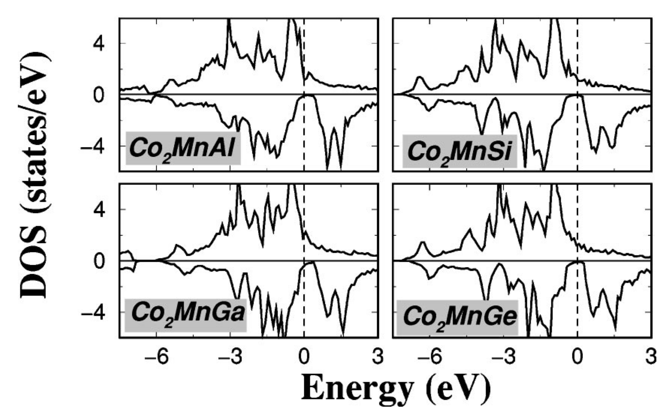
Co₂MnSi Density of States
I. Galanakis, P. Dederichs, and N. Papanikolaou, “Slater-Pauling behavior and origin of the half-metallicity of the full-Heusler alloys,” Physical Review B, vol. 66. 2002.

Slide 18
Origin of Gap in Co₂MnAl
Energy
d_{3z2-r2}, d_{x2-y2}
Mn
e_{u}
ΔE_{g}↓
t_{1u}
d_{xy}, d_{yz}, d_{zx}
Co-Co
t_{2g}
e_{g}
N_{v} = 28 Valence Electrons
N_{d} = 20 d Electrons
m = 4 μ_{B} per formula unit

Slide 19
Origin of Gap in Co₂FeSi
Energy
d_{3z2-r2}, d_{x2-y2}
Fe
e_{u}
ΔE_{g}↓
t_{1u}
d_{xy}, d_{yz}, d_{zx}
Co-Co
t_{2g}
e_{g}
N_{v} = 30 Valence Electrons
N_{d} = 22 d Electrons
m = 6 μ_{B} per formula unit

Slide 20
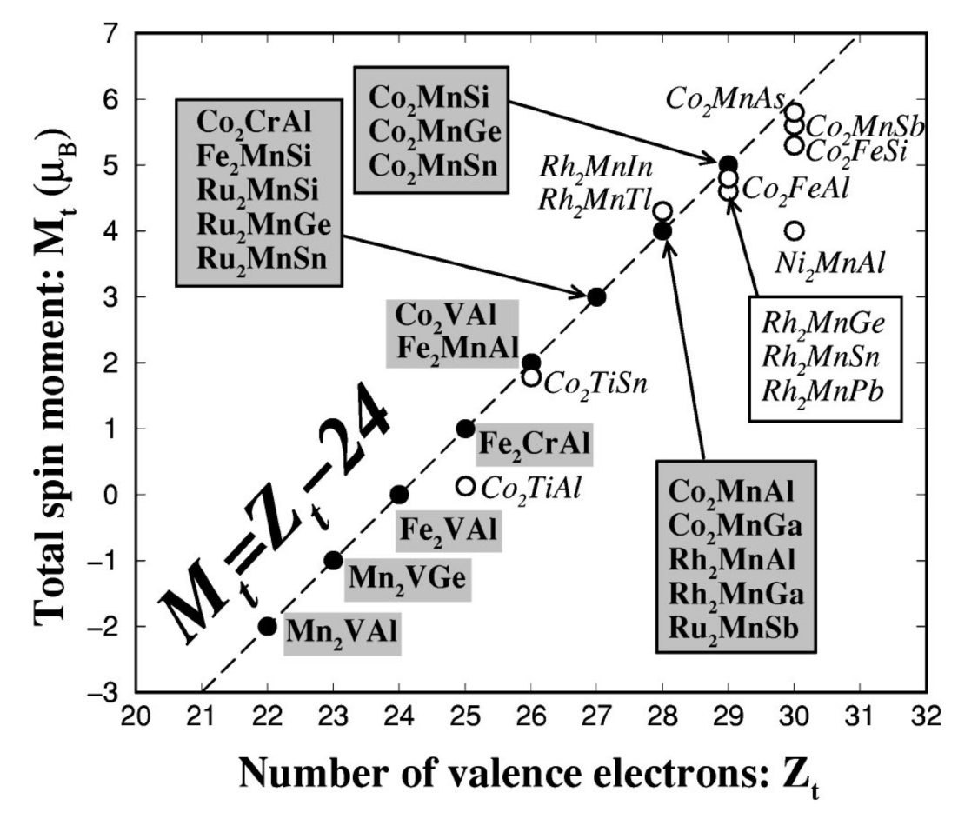
Slater-Pauling Behavior
Magnetic moment m can be estimated based on the average valence electron number (Z_{t}) per atom.
  m_{x2yz} = Z_{t}-24
I. Galanakis, P. Dederichs, and N. Papanikolaou, “Slater-Pauling behavior and origin of the half-metallicity of the full-Heusler alloys,” Physical Review B, vol. 66. 2002.

Slide 21
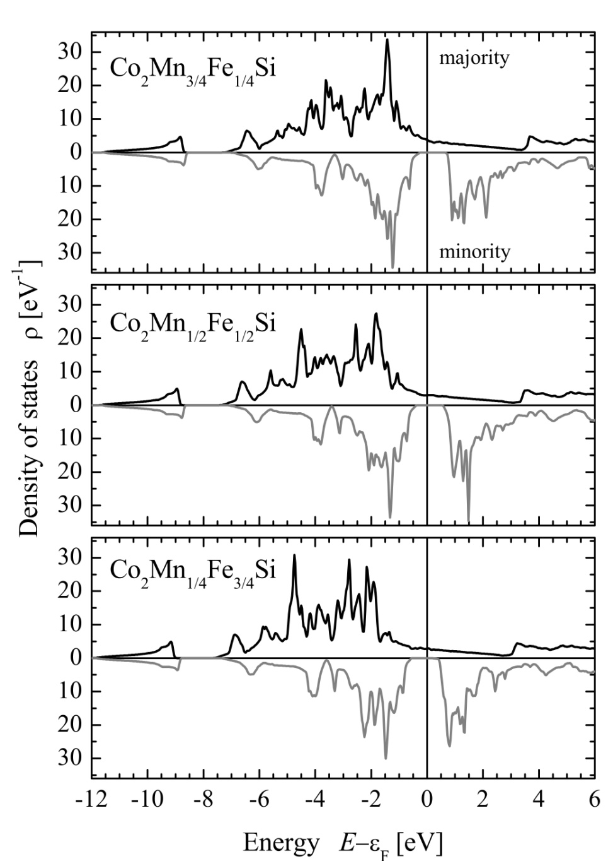
Quaternary Heusler
Can use a fourth element to manipulate the location of the Fermi energy and shape of DOS
B. Balke, G. H. Fecher, H. C. Kandpal, C. Felser, K. Kobayashi, E. Ikenaga, J. J. Kim, and S. Ueda, “Properties of the quaternary half-metal-type Heusler alloy Co2 Mn1-x Fex Si,” Phys. Rev. B - Condens. Matter Mater. Phys., vol. 74, 2006.

Slide 22
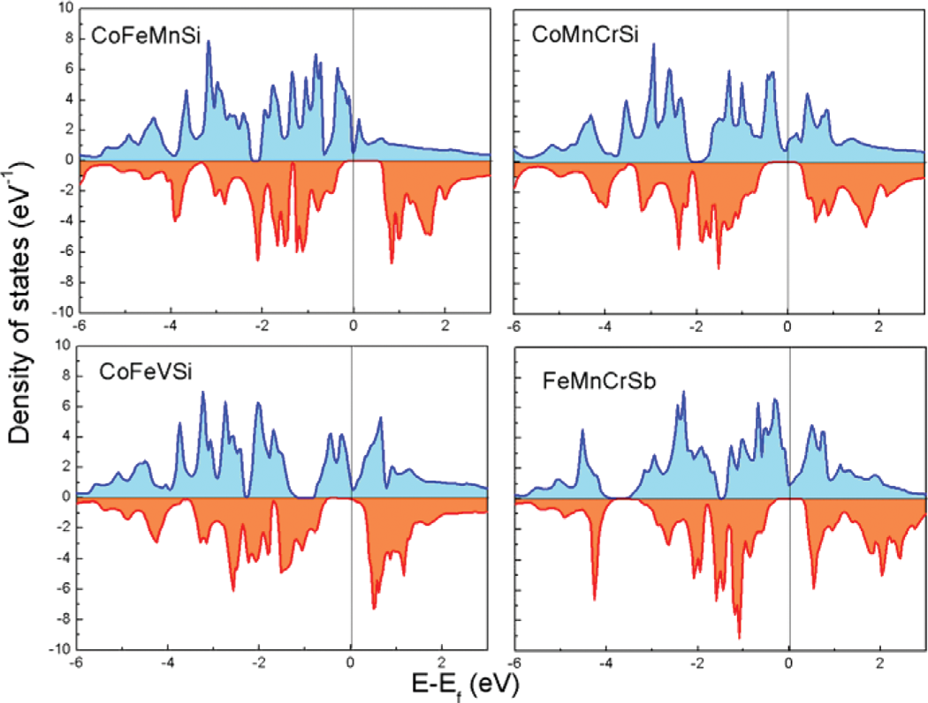
Quaternary Heuslers (Cont.)
G. Z. Xu, E. K. Liu, Y. Du, G. J. Li, G. D. Liu, W. H. Wang, and G. H. Wu, “A new spin gapless semiconductors family: Quaternary Heusler compounds,” EPL, vol. 102, p. 17007, 2013.

Slide 23


Summary
Half metallic behavior comes about from strong exchange splitting and ferromagnetic coupling between X and Y atoms
Number of valence electrons determines magnetic moment
Can tune the Fermi level and DOS by alloying with a fourth element

Slide 24
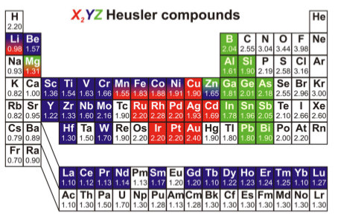
Heusler Periodic Table
T. Graf, C. Felser, and S. S. P. Parkin, “Simple rules for the understanding of Heusler compounds,” Prog. Solid State Chem., vol. 39, no. 1, pp. 1–50, May 2011.

Slide 25
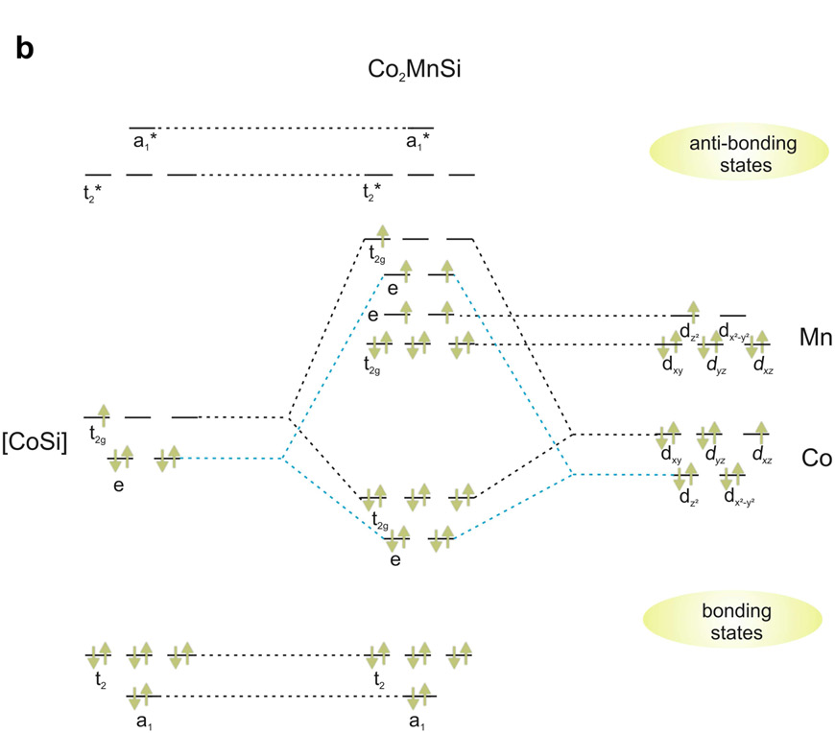
Origin of Gap in Co₂MnSi
T. Graf, C. Felser, and S. S. P. Parkin, “Simple rules for the understanding of Heusler compounds,” Prog. Solid State Chem., vol. 39, no. 1, pp. 1–50, May 2011.

Slide 26
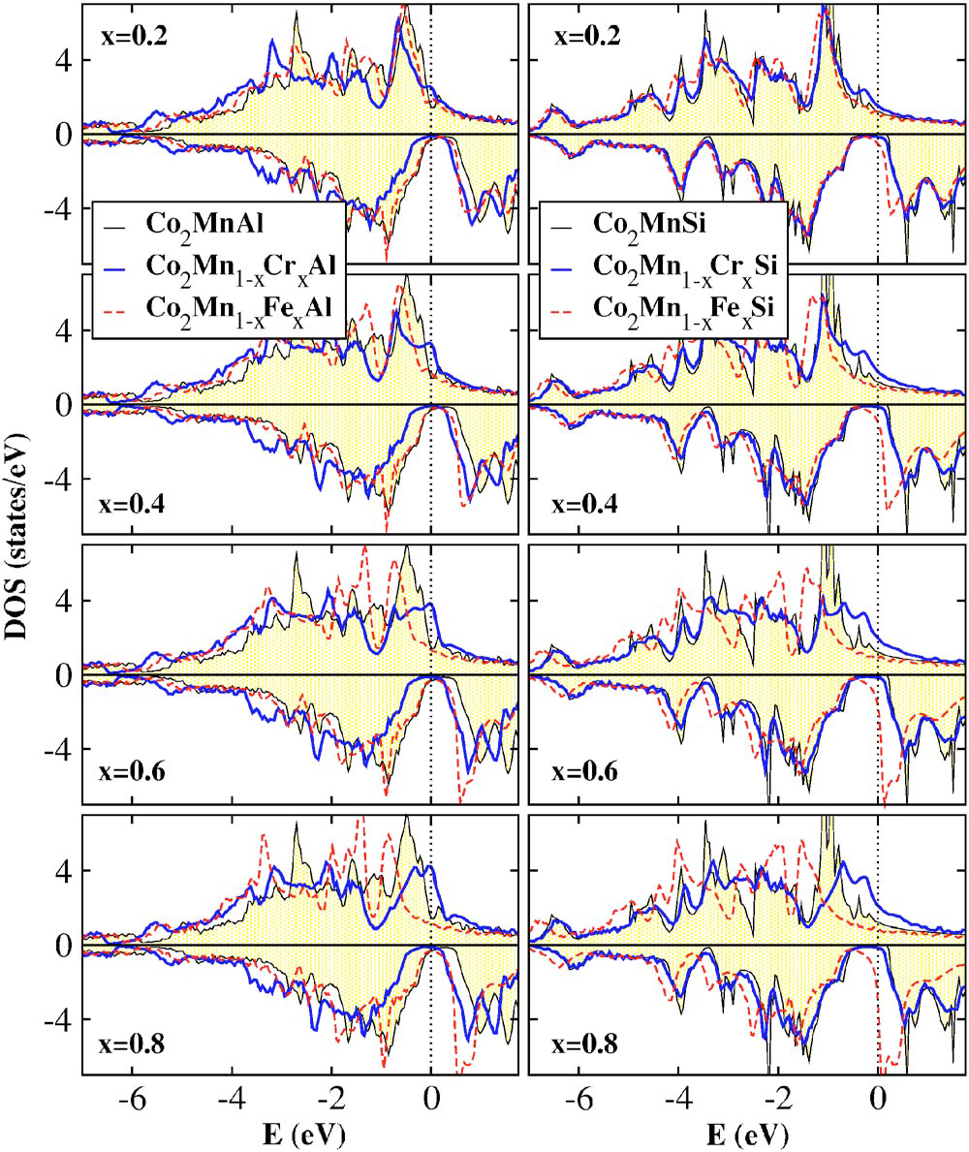
Quaternary Heuslers
K. Özdoğan, B. Aktaş, I. Galanakis, and E. Şaşıoğlu, “Influence of mixing the low-valent transition metal atoms (Y, Y*=Cr,Mn,Fe) on the properties of quaternary Co2[Y1xYx*]Z(Z=Al, Ga, Si, Ge, or Sn) Heusler Compounds,” J. Appl. Phys., vol. 101, no. 7, p. 073910, 2007.

Slide 27
Mulliken Symbols
Mulliken Symbol | Interpretation
a | Non-degenerate orbital; symmetric to principal C_{n}
b | Non-degenerate orbital; unsymmetric to principal C_{n}
e | Doubly degenerate orbital
t | Triply degenerate orbital
(subscript) g | Symmetric with respect to center of inversion
(subscript) u | Antisymmetric with respect to center of inversion
(subscript) 1 | Symmetric with respect to C₂ perp. to principal C_{n}
(subscript) 2 | Antisymmetric with respect to C₂ perp. to principal C_{n}
(superscript) ' | Symmetric with respect to σ_{h}
(superscript) " | Antisymmetric with respect to σ_{h}

