Slide 1
Polytypism of Silicon Carbide
Steven Griffiths
MATRL 286G
6-4-14

Slide 2
Outline
Applications
Generalized Properties
SiC Structure and Polytypism
Polytype Notation
Theories on Polytype Formation
Screw Dislocation Theory
Faulted Matrix Model
Axial Next Nearest Neighbor Ising Model (ANNNI)
Bulk SiC Growth – Modified Lely
Polytype Stabilization in Epitaxy

Slide 3
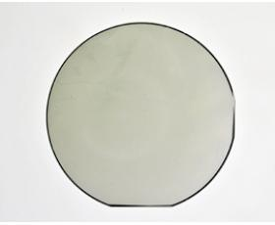
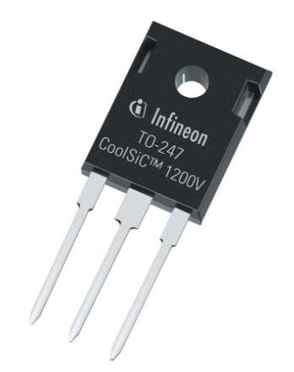
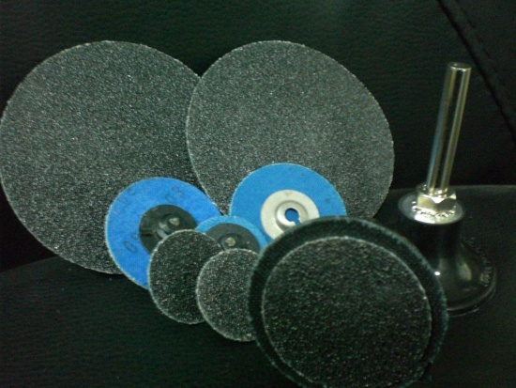
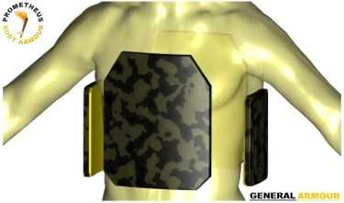
Applications for SiC
[2]
[1]
[3]
[5]
[4]
Non-publication links on last slide
Notes:
- H. J. Round noted yellow luminescence from SiC in 1907, and later blue, spawning first LED
-The plate was successfully tested using .30-06 Springfield 166 grain armor piercing ammunition at a velocity in excess of 2,900 fps
-Substrates now as large as 3-4”
-1200 V JFET

Slide 4
Generalized Properties
Material | E_{g} (eV) | μ_{n} (cm2/Vs) | μ_{p} (cm2/Vs) | E_{c} (MV/cm) | κ (W/cm-K) | a, c (Å)
3C-SiC | 2.2 (I) | 900 | 40 | 1.2 | 3.6 | 4.36
6H-SiC | 3.0 (I) | 370ª 50^{c} | 70 | 2.4 | 4.9 | 3.08ª 15.12^{c}
4H-SiC | 3.3 (I) | 720ª 650^{c} | 90 | 2.0 | 3.7 | 3.08ª 10.08^{c}
2H-SiC | 3.3 (I) | NA | NA | NA | NA | 3.08ª 5.05^{c}
Si | 1.1 (I) | 1500 | 450 | 0.3 | 1.5 | 5.43
GaAs | 1.4 (D) | 8500 | 400 | 0.4 | 0.5 | 5.65
GaN | 3.4 (D) | 1400 | 350 | 2.0 | 1.3 | 3.19ª 5.19^{c}
Chow, T.P., Ramungul, N., Fedison, J., & Tang, Y. (2004). SiC power bipolar transistors and thyristors. Silicon Carbide: Recent Major Adcances.
Mishra, U. K., & Singh, J. (2008). Semiconductor device physics and design. Dordrecht, the Netherlands: Springer.

Slide 5
SiC Structure and Polytypism
“Polytypie”
-Baumhauer, 1912
“Polymorphism in one dimension”
-Schneer, 1955
3C
4H
6H
[0001]
[1100]
[1120]
Starke, U., Bernhardt, J., Schardt, J., & Heinz, K. (1999). SiC surface reconstruction: relevancy of atomic structure for growth technology. Surface Review and Letters.
Notes:
Si- [Ne]3s2-3p2
C- [He]2s2-2p2

Slide 6
Polytype Notation
Ramsdell | Zhdanov | Hägg | Jagodzinski | Stacking Order
3C | NA | NA | NA | ABC or ACB
2H | NA | NA | NA | ABABAB
4H | 22 | ++-- | khkh | ABCB
6H | 33 | +++--- | hkkhkk | ABCACB
15R | (23)₃ | (++---)₃ | (kkhkh)₃ | ABCBACABACBCACB
Notes:
A,B,C are unique positions along horizontal direction
BCB stacking is designated h for HCP stacking
ABC stacking is designated c or k for FCC

Slide 7
Screw Dislocation Theory
Dislocations with a screw component (b || t) provide continuous nucleation sites along the [0001] axis
The “pitch” of the screw is equivalent to the magnitude of the Burgers vector
Dislocations with Burgers vector magnitudes differing from integer-multiples of the original unit cell height produce different [0001] periodicities, i.e. different polytypes
Burton, W. K., Cabrera, N., & Frank, F. C. (1951). The Growth of Crystals and the Equilibrium Structure of their Surfaces. Philosophical Transactions of the Royal Society A: Mathematical, Physical and Engineering Sciences

Slide 8
Faulted Matrix Model
Some SiC polytypes have been grown with integer-multiples of 6H, 15R, or 4H unit cells
Stacking faults present near the surface of the screw dislocation ledge make anomalous polytypes possible
Stacking fault energies determine the likelihood that specific polytypes might be grown
Pandey, D., & Krishna, P. (1975). A model for the growth of anomalous polytype structures in vapour grown SiC. Journal of Crystal Growth.
Notes:
Intrinsic (vacancy-agglomerated) fault
SFE in SiC ~ 0.19 uJ/cm^2 compared to 7.5 uJ/cm^2 for Cu

Slide 9
Axial Next-Nearest Neighbor Ising Model (ANNNI)
Band notation is analogous to that of Zhdanov and Ramsdell:
<1> = 2H
<∞> = 3C
<2> = 4H = 22
<3> = 6H = 33
Interaction parameters are dependent on T,p,μ
Independent experiments show three types of reversible SiC reactions:
2H ⇄ 3C, i.e. <1> ⇄ <∞>
3C ⇄ 6H, i.e. <∞> ⇄ <3>
6H ⇄ 4H, i.e. <3> ⇄ <2>
Price, G. D. and Yeomans, J. (1984), The application of the ANNNI model to polytypic behaviour. Acta Cryst. B, 40: 448–454.
Notes:
ANNNI was developed as an equilibrium method to describe magnetic phase transitions using mean field theory
Si, sj= Ising spin variables
J0= In plane interaction parameter
J1=First neighbor interaction energy
J2=Second neighbor interaction energy

Slide 10
Bulk SiC Growth - Modified Lely
Growth Metrics (4H and 6H):
T_{seed} = 2000 – 2300 °C
T_{source} = 2300 – 2600 °C
P = 6 mbar (Ar)
Diameter > 3 in.
Growth Rate:
4H = 100 – 200 μm/h
6H = 300 – 1000 μm/h
Ziegler, G., Lanig, P., Theis, D., Weyrich, C. (1983), Single crystal growth of SiC substrate material for blue light emitting diodes. Electron Devices, IEEE Transactions on , vol.30, no.4, pp.277-281.
Pons, M. (1999), State of the art in the modelling of SiC sublimation growth, Materials Science and Engineering: B, Volumes 61–62, 30, pp.18-28.

Slide 11
Polytype Stabilization in Epitaxy
Two-Dimensional Nucleation Growth
Surface-reaction limited
Large area terraces
Polytype determined by T
Step-Flow Growth
Diffusion limited
Small area terraces (vicinal substrates)
Stabilizes substrate polytype to lower T
Matsunami, H., & Kimoto, T. (1997). Step-controlled epitaxial growth of SiC: High quality homoepitaxy. Materials Science and Engineering: R: Reports.
Notes:
Surface reaction limited with

Slide 12
Conclusions
SiC is a useful material for electronic applications
Wide bandgap
High temperature, field stability
Easy to dope
Many polytypes exist
Various (sometimes conflicting) kinetic and thermodynamic justifications
Certain polytypes can be stabilized by tailoring the growth mode with seed orientation and environmental factors
Park, C. H., Cheong, B. H., Lee, K. H., & Chang, K. J. (1994). Structural and electronic properties of cubic, 2H, 4H, and 6H SiC. Physical Review B, 49(7), 4485-4493.
Notes:
2H highest b/c stacking of off axis bonds
Planar averaged charge densities between neighboring h (slightly positive) and c (slightly negative) layers act to lower the crystal energy
-Calculated with self-consistent pseudopotential method, within local-density-functional approx.

Slide 13
Non-Publication References
http://www.autointell.com/news-2000/September-2000/September-05-00-p5.htm
http://www.powerwaywafer.com/SiC-Substrate.html
http://www.infineon.com/cms/en/corporate/press/news/releases/2012/INFPMM201205-038.html
http://www.generalarmour.com/pagePBA/Traumaplatesstart.htm
http://www.signicn.com/productinfo.asp?id=2120

