Slide 1
Copper Chalcogenide Semiconductors for Photovoltaic Applications
Brian Evanko
Materials 286G
2 June 2014

Slide 2
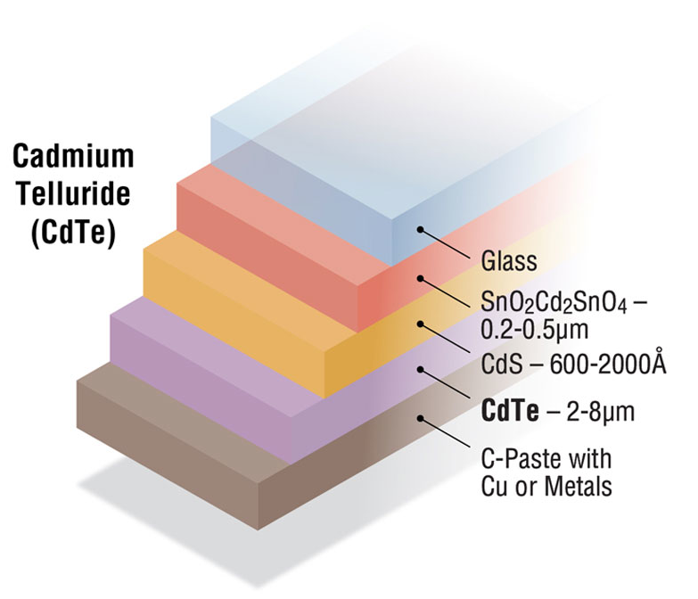
Thin Film Solar cells
Thin film solar cell semiconductors have very high absorption coefficients and are manufactured with much less material.
Efficiency is lower than crystalline Si, but so is $/W.
P-type absorber layer:
E_{g} from 1 to 1.5 eV
Absorption coefficient > 10⁴ cm⁻¹
Al Hicks. Driving Solar Innovations from Laboratory to Marketplace. NREL Continuum. 2014. www.nrel.gov/continuum/spectrum/photovoltaics.cfm
Notes:
TFPV also benefits from flexibility
CdTe is industry standard, but cadmium toxicity and tellurium shortage with exponential growth are problematic
Towards $.50/W

Slide 3
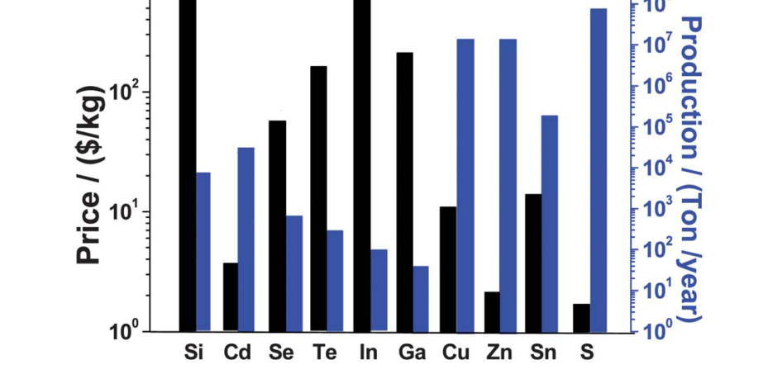
Copper Chalcogenides
Y. Zhao and C. Burda, “Development of plasmonic semiconductor nanomaterials with copper chalcogenides for a future with sustainable energy materials,” Energy Environ. Sci., vol. 5, no. 2, p. 5564, 2012.
CZTS
CIGS
Cu₂S
Notes:
Material cost and abundance
CU2S - First successful thin film technology
CIGS - Declining cost of crystalline Si versus In and Ga => Solyndra
CZTS - Earth abundance is desirable

Slide 4
Outline
Binary Cu₂S
Early Cu₂S/CdS cells
Material instability
Ternary (I-III-VI₂) materials
Copper indium selenide (CIS)
Copper gallium selenide (CGS) and CIGS
Derivation of chalcopyrite from zinc blende
Quaternary (I₂-II-IV-VI₄) materials
Copper zinc tin sulfide (CZTS) and selenide (CZTSe)
Derivation of kesterite from chalcopyrite

Slide 5
Cuprous Sulfide (Cu₂S)
P-type with 1.2 eV band gap
CdS/Cu₂S heterojunction cells have efficiencies of 10%
Most common synthesis method is cation exchange by dipping CdS film into CuCl
Cu₂S
Cu¹⁺ Cu¹⁺ | S²⁻
4s⁰3d¹⁰ | 3s²3p⁶
J. Tang, Z. Huo, Sarah Brittman, Hanwei Gao and Peidong Yang . “Solution-processed core–shell nanowires for efficient photovoltaic cells.” Nature Nanotechnology 6, 568–572 (2011).
Notes:
Cu Diffusion/stability. Problem. Toxicity Chemical simplicity means easier processing
Sulfur valence has a full octet/complete shell configuration

Slide 6
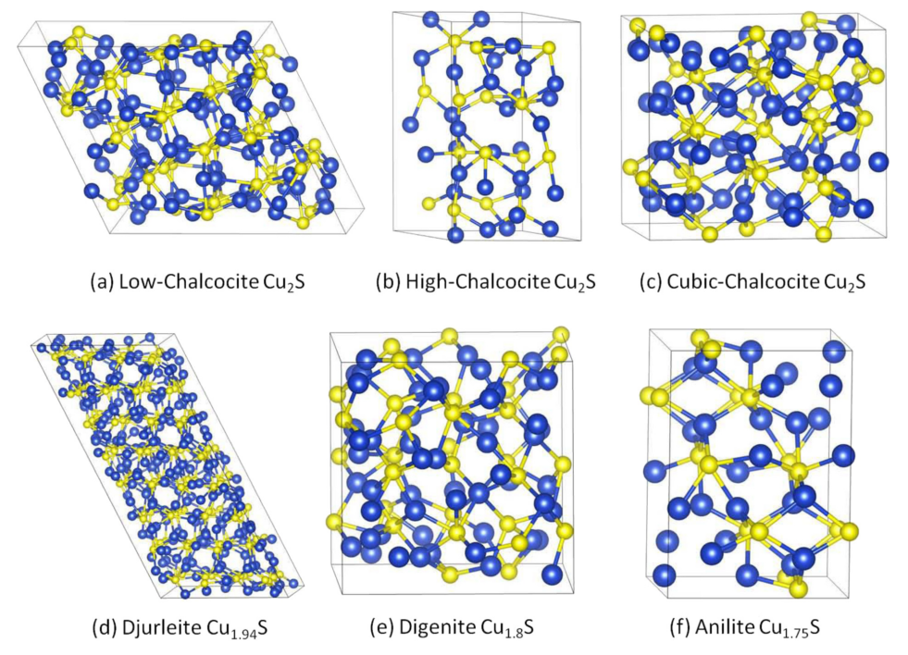
Structure of Cu_{x}S Phases
Q. Xu, B. Huang, Y. Zhao, Y. Yan, R. Noufi, and S.-H. Wei, “Crystal and electronic structures of CuxS solar cell absorbers,” Appl. Phys. Lett., vol. 100, no. 6, p. 061906, 2012.
Notes:
HCP backbone of sulfur anions with interstitial “fluid” of copper atoms
Low chalcocite: 96 copper atoms, 48 Sulfur atoms. Monoclinic
Phase purity problems. Vacancy stability plus “disproportionation” of Cu+ to Cu0 and Cu2+ gives static Cu2+ (bound to sulfur lattice) and highly mobile Cu0

Slide 7
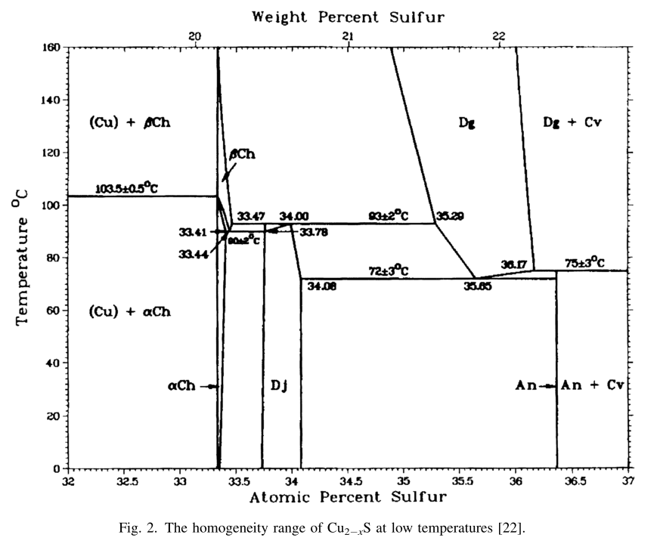
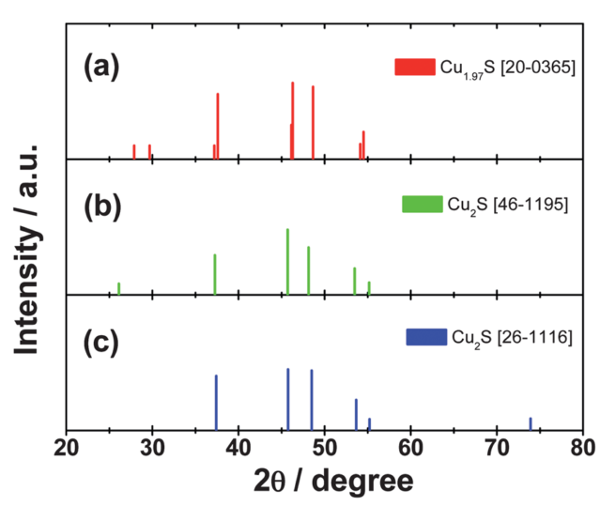
Analysis of Cu_{x}S
Synthesizing and identifying phase-pure materials is difficult
Digenite
Y. Zhao and C. Burda, “Development of plasmonic semiconductor nanomaterials with copper chalcogenides for a future with sustainable energy materials,” Energy Environ. Sci., vol. 5, no. 2, p. 5564, 2012.
R. Blachnik and A. Muller, “The formation of Cu2S from the elements I. Copper used in form of powders,” Thermochim. Acta, vol. 361, pp. 31–52, 2000
Notes:
Hard to get phase purity.
Djurlite is difficult to distinguish from chalcocite by XRD, and surface is unstable in ambient conditions
Anilite is most stable, with 1.4 eV bandgap. NREL thinks it may be promising, especially if Sn-doped

Slide 8
Copper Indium Selenide
CuInSe₂ (CIS) has E_{g} = 1 eV
I-III-VI₂ copper chalcogenide semiconductor with chalcopyrite structure
Band gap is tunable from 1 eV – 1.7 eV by forming solid solution with CuGaSe₂ (CGS)
CuIn_{x}Ga_{1-x}Se₂ (CIGS) now rivals CdTe with 20% solar energy conversion efficiency

Slide 9
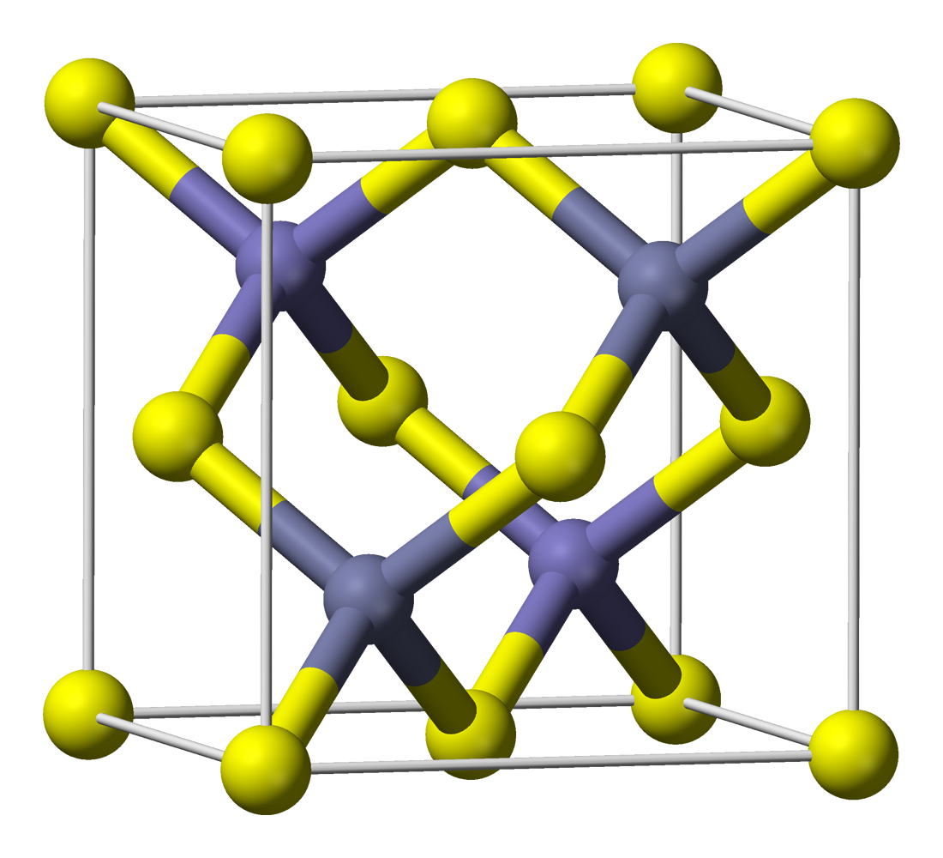
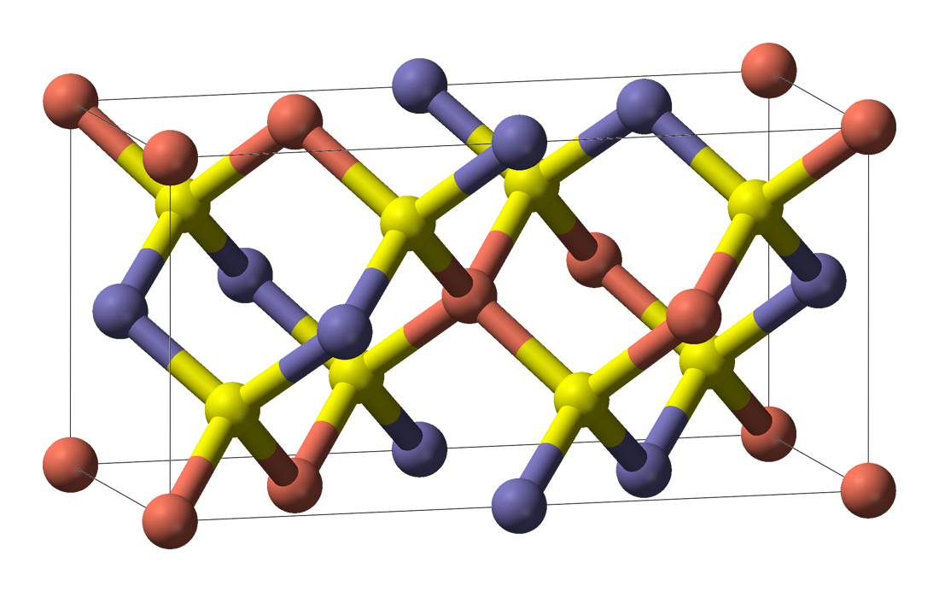
Chalcopyrite Crystal Structure
ZnS
Zn²⁺ | S²⁻
Cu⁺ In³⁺ | Se²⁻ Se²⁻
CuInSe₂
Zinc Blende
Chalcopyrite
en.wikipedia.org/wiki/File:Sphalerite-unit-cell-3D-balls.png and
en.wikipedia.org/wiki/File:Chalcopyrite-unit-cell-3D-balls.png
Notes:
Zinc Blende interpenetrating fcc, but not rock salt. It is diamond cubic with alternating S and Zn
Can see why CIS is a good semiconductor and understand its structure simultaneously by starting with ZnS
ZnS II-VI semiconductor wide band gap
Fork Zn2+
All atoms are 4-coordinated

Slide 10
Density of States
Top of the valence band is a hybridization of Cu d-states and Se p-states.
VB has antibonding character. Energy is increased by repulsive p-d interactions, lowering the band gap.
This behavior is different than many semiconductors, and attributed to the high-energy Cu d-electrons
S. Siebentritt, M. Igalson, C. Persson, and S. Lany, “The electronic structure of chalcopyrites-bands, point defects and grain boundaries,” Prog. Photovoltaics Res. Appl., vol. 18, no. 6, pp. 390–410, Sep. 2010.
Notes:
Note Ga band gap is higher than that of In

Slide 11
Copper Zinc Tin Sulfide
Cu₂ZnSnS₄ (CZTS) has E_{g}=1.5 eV
I₂-II-IV-VI₄ copper chalcogenide semiconductor with kesterite structure
Band gap is tunable from 1 eV – 1.5 eV by forming solid solution with Cu₂ZnSnSe₄ to get Cu₂ZnSn(S_{x}Se_{1-x})₄ (CZTSSe)
CZTSSe has surpassed 10% solar energy conversion efficiency
Earth abundant materials

Slide 12
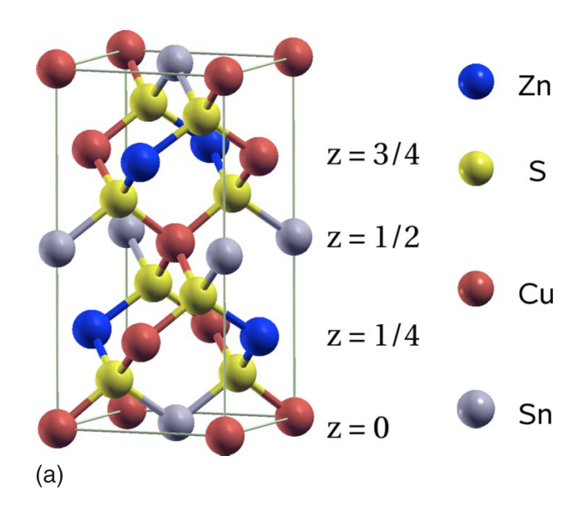
Kesterite Crystal Structure
CuInSe₂
Cu⁺ In³⁺ | Se²⁻ Se²⁻
Cu⁺ Cu⁺ Zn²⁺ Sn⁴⁺ | S²⁻ S²⁻ S²⁻ S²⁻
Cu₂ZnSnS₄
J. Paier, R. Asahi, A. Nagoya, and G. Kresse, “Cu2ZnSnS4 as a potential photovoltaic material: A hybrid Hartree-Fock density functional theory study,” Phys. Rev. B, vol. 79, no. 11, pp. 115–126, Mar. 2009.
Chalcopyrite
Kesterite
Notes:
Alternating layers
Compare to Zinc Blende
Valence octet

Slide 13
Density of States
For CZTS and CZTSe, the top of the valence band is a hybridization of Cu d-states and chalcogen p-states, similar to CIGS.
C. Persson, “Electronic and optical properties of Cu2ZnSnS4 and Cu2ZnSnSe4,” J. Appl. Phys., vol. 107, no. 5, p. 053710, 2010.
Kesterite Cu₂ZnSnS₄
Kesterite Cu₂ZnSnSe₄

Slide 14
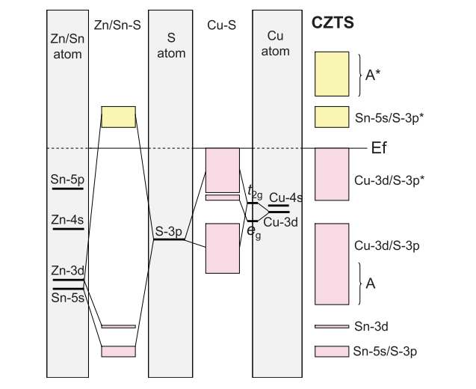
CZTS Electronic Structure
Molecular interaction and band diagrams for CZTS
J. Paier, R. Asahi, A. Nagoya, and G. Kresse, “Cu2ZnSnS4 as a potential photovoltaic material: A hybrid Hartree-Fock density functional theory study,” Phys. Rev. B, vol. 79, no. 11, pp. 115–126, Mar. 2009.
Notes:
“A” LCAO is hybridization of Cu-4s, Zn-4s, and Sn-5p
Top of VB is again anti-bonding, decreasing gap
Sub-band splitting can be see in the molecular interaction diagram and in the band diagram

Slide 15
Performance
Copper chalcogenides are well represented in the categories of thin-film and emerging photovoltaics.
Research Cell Efficiency Records. National Renewable Energy Laboratory. 2014. www.nrel.gov/ncpv/

Slide 16
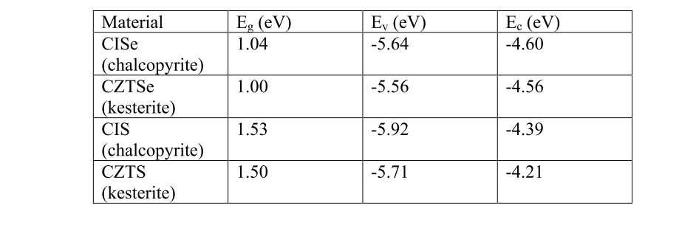
Summary
Cu₂S showed early promise but is limited by low stability.
CISe has a chalcopyrite structure and a low band gap
E_{g} can be increased by incorporating gallium.
CZTS has a kesterite structure and a high band gap
E_{g} can be decreased by incorporating selenium
Chalcopyrite and kesterite are derived from zinc blende
I. Repins, N. Vora, C. Beall, S. Wei, Y. Yan, M. Romero, G. Teeter, H. Du, B. To, and M. Young, “Kesterites and Chalcopyrites : A Comparison of Close Cousins,” in Materials Research Society Spring Meeting, 2011, no. May.

Slide 17
Questions

