Slide 1
Spin-Orbit Coupling in Heavy Semiconductors
Will Elliott MATRL 286G
Notes:
Hello, I’m Will Elliott, and I’m going to talk to you about Spin-Orbit coupling in heavy semiconductors

Slide 2
Review: S.O. Coupling in Atomic Physics
Electron orbits nucleus in potential energy well V₀
Notes:
In a Bohr atom, electrons zip around nuclei like the Earth around the sun, and spin (which isn’t part of the model) can be treated as the literal spinning of the electron about it’s

Slide 3
Review: S.O. Coupling in Atomic Physics
Electron orbits nucleus in potential energy well V₀
From POV of the electron, nucleus revolves around the electron, with speed dependent on p
Notes:
Just as the sun appears to (or does in fact, if Urban VIII is to be believe) revolve around the Earth from Earth’s surface, from the point of view of the electron, the nucleus appears to revolve around it. How fast it appears to revolving is dependent only upon how fast the electron is revolving, decoupled from the spin. The Earth rotates about an axis, but if it didn’t (and weren’t tidally locked) days would simply be a year long.

Slide 4
Review: S.O. Coupling in Atomic Physics
Mobile positive charge induces B field perpendicular to p and V₀
Induced field interacts with electron’s spin
Notes:
Just as we would normally think of the electrons moving inducing a magnetic field as dicted by Biot-Savart, the electron moving through a static electric field will experience a magnetic field. This is true generally, and gives us the ability to control spin

Slide 5
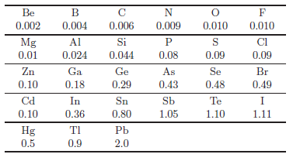
Spin-Orbit Gap
The “oribtal” angular momentum of electrons is changed by interaction of spin to split bands
Winkler, R. Spin--Orbit Coupling Effects in Two-Dimensional Electron and Hole Systems, 3rd ed.; Springer: New York, 2003; pp 1-30, 61-115.

Slide 6
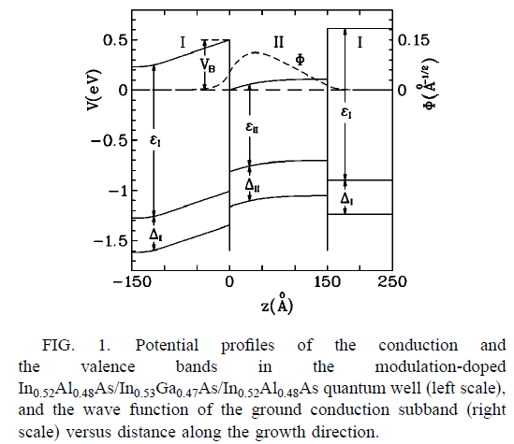
Inversion Asymmetry
Bulk Inversion Asymmetry (BIA)
Structural Inversion Asymmetry (SIA)
Winkler, R. Spin--Orbit Coupling Effects in Two-Dimensional Electron and Hole Systems, 3rd ed.; Springer: New York, 2003; pp 1-30, 61-115.

Slide 7
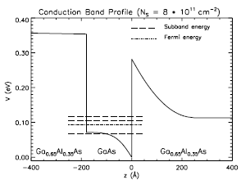
Rashba Effect
Structural Inversion Asymmetry (SIA)
Asymmetry in quantum confinement
Occurs at heterostructures and surfaces
Applied E field can increase effect
Winkler, R. Spin--Orbit Coupling Effects in Two-Dimensional Electron and Hole Systems, 3rd ed.; Springer: New York, 2003; pp 168
B. Andrei Bernevig,1,2 J. Orenstein,3,4 and Shou-Cheng Zhang1 PRL 97, 236601 (2006)
Notes:
Gradient in band is an electric field.
Symmetric bending -> no net field
Asymmetric bending -> net field causes SO interaction

Slide 8
Rashba Effect
Structural Inversion Asymmetry (SIA)
Winkler, R. Spin--Orbit Coupling Effects in Two-Dimensional Electron and Hole Systems, 3rd ed.; Springer: New York, 2003; pp 168 Winkler, R. “Spin-Orbit Coupling in 2 Dimensions”
B. Andrei Bernevig,1,2 J. Orenstein,3,4 and Shou-Cheng Zhang1 PRL 97, 236601 (2006)
Notes:
Gradient in band is an electric field.
Symmetric bending -> no net field
Asymmetric bending -> net field causes SO interaction

Slide 9
Rashba Effect
Structural Inversion Asymmetry (SIA)
Winkler, R. Spin--Orbit Coupling Effects in Two-Dimensional Electron and Hole Systems, 3rd ed.; Springer: New York, 2003; pp 168 Lorenz Meier, Gian Salis, Ivan Shorubalko, Emilio Gini, Silke Schön, and Klaus Ensslin. (2007). Measurement of Rashba and Dresselhaus spin–orbit magnetic fields. Nature Physics. doi:10.1038/nphys675
B. Andrei Bernevig,1,2 J. Orenstein,3,4 and Shou-Cheng Zhang1 PRL 97, 236601 (2006)
Notes:
Gradient in band is an electric field.
Symmetric bending -> no net field
Asymmetric bending -> net field causes SO interaction

Slide 10
Dresselhaus Effect
Bulk Inversion Asymmetry (BIA)
Inversion asymmetry in crystal structure
Occurs in bulk
Magnitude often similar to Rashba effect
http://en.wikipedia.org/wiki/File:Sphalerite-unit-cell-depth-fade-3D-balls.png

Slide 11
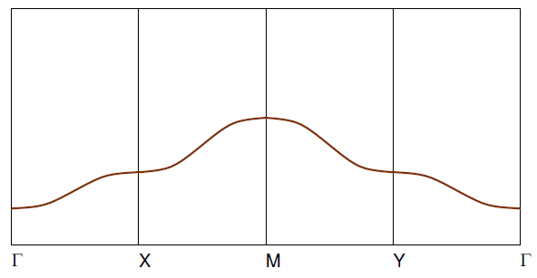
Dresselhaus Effect
Bulk Inversion Asymmetry (BIA)
Seshadri, R. “Cohesion II” Lecture in MATRL 218 course, Winter 2014, UCSB http://upload.wikimedia.org/wikipedia/commons/f/f1/Silicon-unit-cell-3D-balls.png

Slide 12
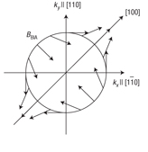
Dresselhaus Effect
Bulk Inversion Asymmetry (BIA)
Lorenz Meier, Gian Salis, Ivan Shorubalko, Emilio Gini, Silke Schön, and Klaus Ensslin. (2007). Measurement of Rashba and Dresselhaus spin–orbit magnetic fields. Nature Physics. doi:10.1038/nphys675
http://en.wikipedia.org/wiki/File:Sphalerite-unit-cell-depth-fade-3D-balls.png

Slide 13
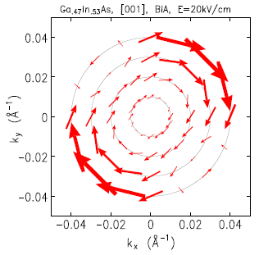
Dresselhaus and Rashba Interaction
Desselhaus
Rashba
Net S.O. Field
Winkler, R. “Spin-Orbit Coupling in 2 Dimensions” Lecture at University of Hannover, http://www.niu.edu/rwinkler/teaching/spin-04/wh3.pdf

Slide 14
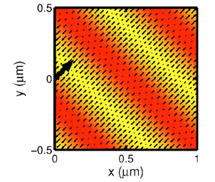
Special Case
When Rashba and Dresselhaus coupling are of equal magnitude
Invariance with respect to rotation of electron spin gives conservation of spin polarization
Normally broken by spin-orbit coupling
Can recover this symmetry with amplitude and phase of helical density wave if Rashba and Dresselhaus effects are equal
Liu, M.-H.; Chen, K.-W.; Chen, S.-H.; Chang, C.-R. Persistent spin helix in Rashba-Dresselhaus two-dimensional electron systems. Phys. Rev. B 2006, 74, 235322.

