Slide 1
How transition metal, anion, and structure
affect the operating potential of an electrode
Megan Butala
June 2, 2014

Slide 2
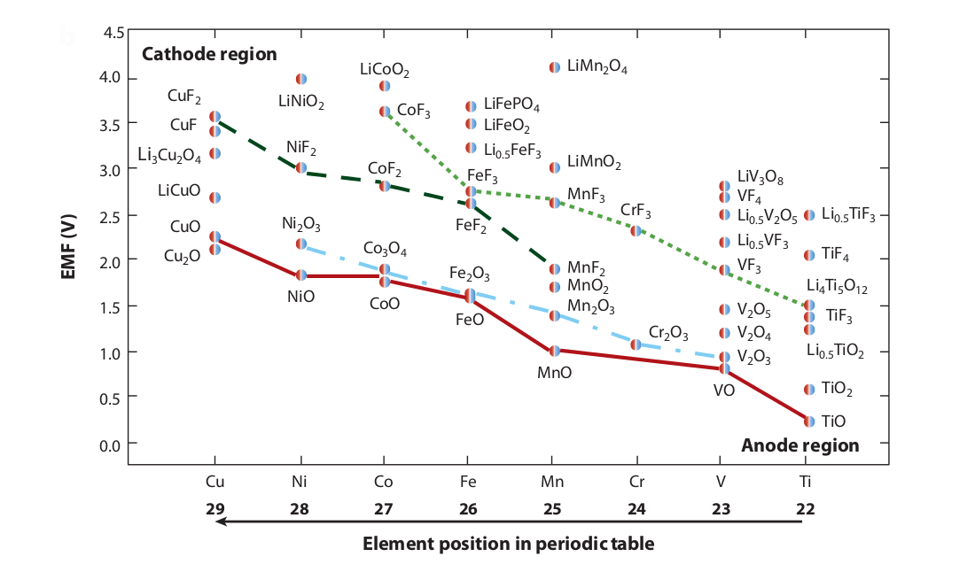
A wide range of electrode potentials
can be achieved
Hayner, Zhao & Kung. Annu .Rev. Chem. Biomolec. Eng. 3, 445–71 (2012).
Notes:
Can see variation with TM, anion, oxidation state

Slide 3
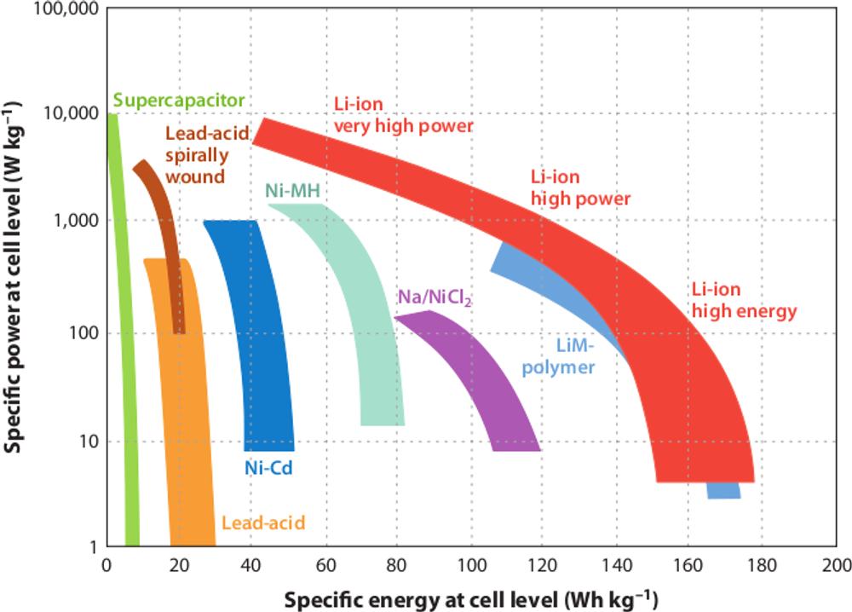
Power and energy are common metrics
for comparing energy storage technologies
Hayner, Zhao & Kung. Annu .Rev. Chem. Biomolec. Eng. 3, 445–71 (2012).
Notes:
Going beyond the Eg of the electrolyte can result in decomposition of the electrolyte, which will add complexity to the analysis and understanding.
So – what kinds of things influence the energy/potential of each electrode?

Slide 4
What physical phenomena
are described by these metrics?
Specific power = Specific energy × time to charge
Specific energy = capacity × V_{oc}
Notes:
Going beyond the Eg of the electrolyte can result in decomposition of the electrolyte, which will add complexity to the analysis and understanding.
So – what kinds of things influence the energy/potential of each electrode?

Slide 5
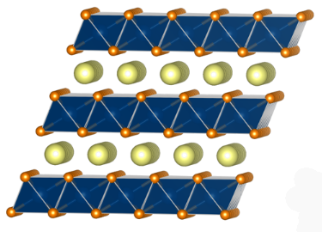
What physical phenomena
are described by these metrics?
Specific power = Specific energy × time to charge
Specific energy = capacity × V_{oc}
charge stored per mass active material
LiCoO₂
xLi⁺ +xe⁻+ Li_{1-x}CoO₂
Ex:
Notes:
Going beyond the Eg of the electrolyte can result in decomposition of the electrolyte, which will add complexity to the analysis and understanding.
So – what kinds of things influence the energy/potential of each electrode?

Slide 6
What physical phenomena
are described by these metrics?
Specific power = Specific energy × time to charge
Specific energy = capacity × V_{oc}
V_{oc} = (μ_{A} – μ_{C})/e
charge stored per mass active material
V_{oc} = EMF_{C} - EMF_{A}
LiCoO₂
xLi⁺ +xe⁻+ Li_{1-x}CoO₂
Ex:
Notes:
Going beyond the Eg of the electrolyte can result in decomposition of the electrolyte, which will add complexity to the analysis and understanding.
So – what kinds of things influence the energy/potential of each electrode?

Slide 7

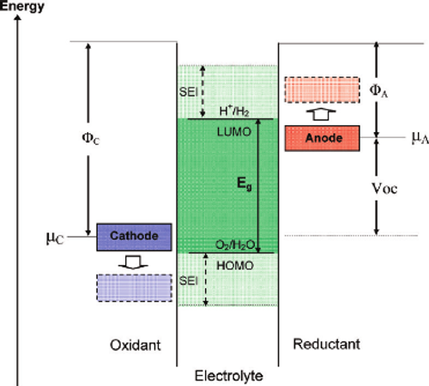
How a battery works
V and chemical potential
Batteries by DOS
Notes:
Turn this schematic image over, think about

Slide 8
How a battery works
V and chemical potential
Batteries by DOS
Notes:
Turn this schematic image over, think about

Slide 9
Li⁺ ions and electrons are shuttled between electrodes to store and deliver energy
Anode
Cathode
Notes:
On discharge – reducing cathode (Li to cathode)
Improve title

Slide 10
Applying a load to the cell drives Li⁺ and electrons to the cathode during discharge
e⁻
Li⁺
Li⁺
Anode
Cathode
Notes:
On discharge – reducing cathode (Li to cathode)

Slide 11
Applying a voltage to the cell drives Li⁺ ions and electrons to the anode during charge
e⁻
V
Li⁺
Li⁺
Anode
Cathode
Notes:
On discharge – reducing cathode (Li to cathode)

Slide 12
How a battery works
V and chemical potential
Batteries by DOS
Notes:
Turn this schematic image over, think about

Slide 13
We can consider the energies of
the 3 major battery components
eV_{oc} = μ_{A} - μ_{C}
V_{oc} = EMF_{C} - EMF_{A}
Goodenough & Kim. Chem. Mater. 22, 587-603 (2010).
Notes:
Going beyond the Eg of the electrolyte can result in decomposition of the electrolyte, which will add complexity to the analysis and understanding.
So – what kinds of things influence the energy/potential of each electrode?

Slide 14
We can consider the energies of
the 3 major battery components
eV_{oc} = μ_{A} - μ_{C}
V_{oc} = EMF_{C} - EMF_{A}
Goodenough & Kim. Chem. Mater. 22, 587-603 (2010).
Notes:
Going beyond the Eg of the electrolyte can result in decomposition of the electrolyte, which will add complexity to the analysis and understanding.
So – what kinds of things influence the energy/potential of each electrode?

Slide 15
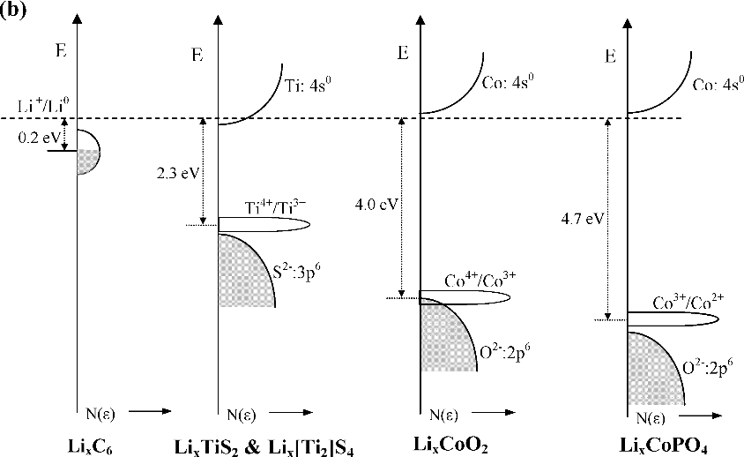
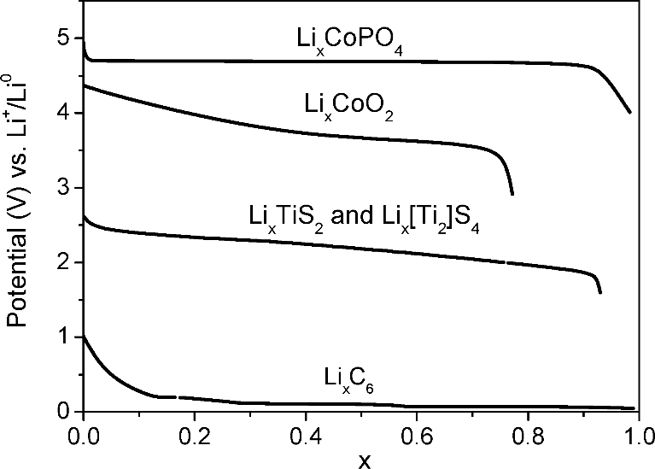
An electrode’s EMF can be understood
by the nature of its DOS
Goodenough & Kim. Chem. Mater. 22, 587-603 (2010).
Notes:
The energy can correspond to the fermi energy in an itinerant-electron band, or based on the energy of a redox couple of a transition metal cation

Slide 16
An electrode’s EMF can be understood
by the nature of its DOS
Lower orbital energy = higher potential
Goodenough & Kim. Chem. Mater. 22, 587-603 (2010).
Notes:
The energy can correspond to the fermi energy in an itinerant-electron band, or based on the energy of a redox couple of a transition metal cation

Slide 17
How a battery works
V and chemical potential
Batteries by DOS
Notes:
Turn this schematic image over, think about

Slide 18
The potential of an electrode depends on chemistry and structure
M_{a}X_{b}
M = transition metal
X = anion (O, S, F, N)
E
M d^{n}/d^{n-1}
M d^{n+1}/d^{n}
X p-band
Notes:
The energy can correspond to the fermi energy in an itinerant-electron band, or based on the energy of a redox couple of a transition metal cation

Slide 19
Transition metal energy stabilization shows trends from L to R based on ionization energy
Goodenough & Kim. Chem. Mater. 22, 587-603 (2010).
Notes:
The energy can correspond to the fermi energy in an itinerant-electron band, or based on the energy of a redox couple of a transition metal cation

Slide 20
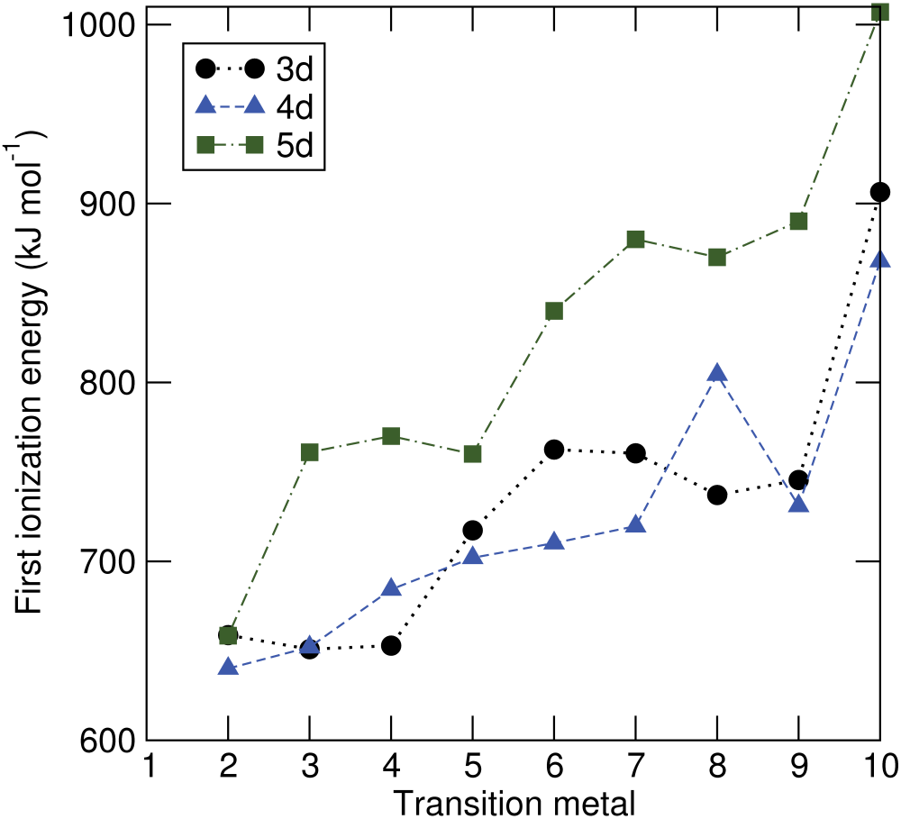
Transition metal energy stabilization shows trends from L to R based on ionization energy
Co
Ti
Goodenough & Kim. Chem. Mater. 22, 587-603 (2010).
Notes:
The energy can correspond to the fermi energy in an itinerant-electron band, or based on the energy of a redox couple of a transition metal cation

Slide 21
Transition metal energy stabilization shows trends from L to R based on ionization energy
Co
Ti
Goodenough & Kim. Chem. Mater. 22, 587-603 (2010).
Notes:
The energy can correspond to the fermi energy in an itinerant-electron band, or based on the energy of a redox couple of a transition metal cation

Slide 22
The relative stabilization and bandwidth of the anion (X) p-band vary with electronegativity
E
S p-band
O p-band
F p-band
EN ↑
Adapted from Goodenough & Kim. Chem. Mater. 22, 587-603 (2010).
Notes:
The energy can correspond to the fermi energy in an itinerant-electron band, or based on the energy of a redox couple of a transition metal cation

Slide 23
The relative stabilization and bandwidth of the anion (X) p-band vary with electronegativity
E
S p-band
BW
O p-band
F p-band
EN ↑
Adapted from Goodenough & Kim. Chem. Mater. 22, 587-603 (2010).
Notes:
Bandwidth of d bands also decrease with increasing EN of anion

Slide 24
Mott-Hubbard vs. charge transfer dominated character will alter potential
M_{a}X_{b}
E
M d^{n}/d^{n-1}
U
Δ
M d^{n+1}/d^{n}
X p-band
Zaanen, Sawatzky & Allen. Phys. Rev. Lett. 55, 418-421 (1985)
Cox. “The Electronic Structure and Chemistry of Solids”. Oxford Science Publications (2005)
Notes:
The energy can correspond to the fermi energy in an itinerant-electron band, or based on the energy of a redox couple of a transition metal cation

Slide 25
Mott-Hubbard vs. charge transfer dominated character will alter potential
M_{a}X_{b}
E
M d^{n}/d^{n-1}
Increases across the row of TMs from L to R
Directly related to Madelung potential and EN of anion X
U
Δ
M d^{n+1}/d^{n}
X p-band
Zaanen, Sawatzky & Allen. Phys. Rev. Lett. 55, 418-421 (1985)
Cox. “The Electronic Structure and Chemistry of Solids”. Oxford Science Publications (2005)
Notes:
Hubbard assumes that the only important repulsion effects occur between two electrons on the same atom.

Slide 26
Mott-Hubbard vs. charge transfer character
will alter electrode potential
M_{a}X_{b}
E
E
M d^{n}/d^{n-1}
M d^{n}/d^{n-1}
Δ
U
Δ
M d^{n+1}/d^{n}
U
X p-band
X p-band
M d^{n+1}/d^{n}
early TM compounds
M = Ti, V, . . .
late TM compounds
M = Co, Ni, Cu, . . .
Notes:
The energy can correspond to the fermi energy in an itinerant-electron band, or based on the energy of a redox couple of a transition metal cation

Slide 27
Mott-Hubbard vs. charge transfer character
will alter electrode potential
Li⁺/Li⁰
M_{a}X_{b}
Li⁺/Li⁰
M d^{n}/d^{n-1}
M d^{n}/d^{n-1}
EMF
EMF
U
Δ
M d^{n+1}/d^{n}
X p-band
X p-band
M d^{n+1}/d^{n}
early TM compounds
M = Ti, V, . . .
late TM compounds
M = Co, Ni, Cu, . . .
Notes:
The energy can correspond to the fermi energy in an itinerant-electron band, or based on the energy of a redox couple of a transition metal cation

Slide 28
For early TMs, we can consider the potential to be defined by the d-band redox couples
Li₀TiS₂
Li⁺/Li⁰
Ti d³⁺/d²⁺
EMF
Ti d⁴⁺/d³⁺
S p-band
Adapted from Goodenough & Kim. Chem. Mater. 22, 587-603 (2010).
Notes:
The energy can correspond to the fermi energy in an itinerant-electron band, or based on the energy of a redox couple of a transition metal cation

Slide 29
For early TMs, we can consider the potential to be defined by the d-band redox couples
Li₀TiS₂
Li_{0.5}TiS₂
Li⁺/Li⁰
Ti d³⁺/d²⁺
EMF
EMF
Ti d⁴⁺/d³⁺
We approximate the
d-band to be sufficiently narrow that a redox couple will have a singular energy
S p-band
Adapted from Goodenough & Kim. Chem. Mater. 22, 587-603 (2010).
Notes:
The energy can correspond to the fermi energy in an itinerant-electron band, or based on the energy of a redox couple of a transition metal cation

Slide 30
For early TMs, we can consider the potential to be defined by the d-band redox couples
Li₀TiS₂
LiTiS₂
LiTiS₂
Li⁺/Li⁰
Ti d³⁺/d²⁺
EMF
EMF
EMF
Ti d⁴⁺/d³⁺
S p-band
Adapted from Goodenough & Kim. Chem. Mater. 22, 587-603 (2010).
Notes:
The energy can correspond to the fermi energy in an itinerant-electron band, or based on the energy of a redox couple of a transition metal cation

Slide 31
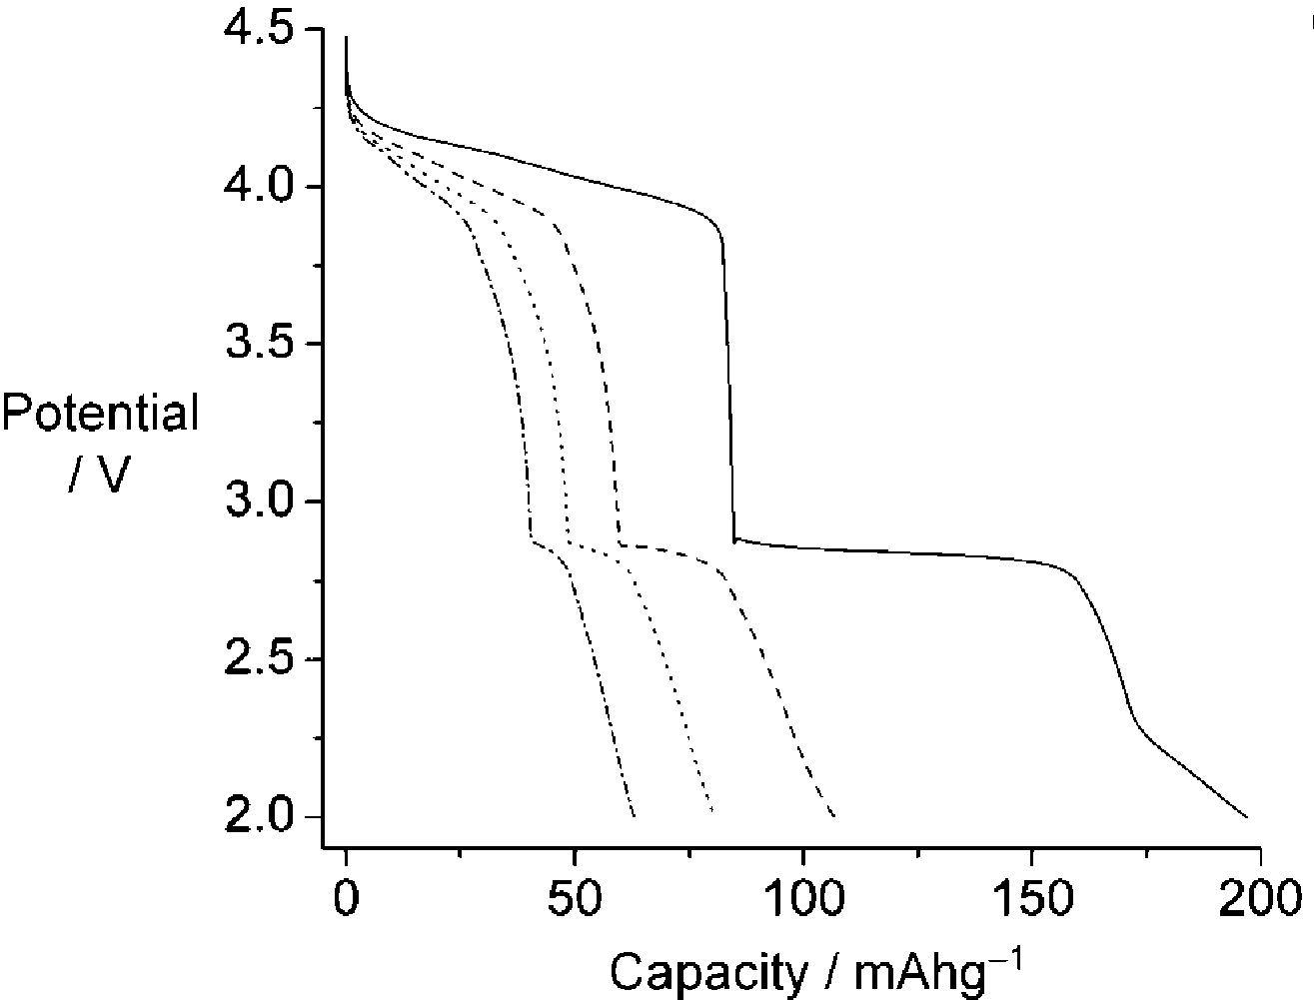
Structure also affects potential: LiMn₂O₄ has octahedral and tetrahedral Li sites
Li_{x}Mn₂O₄
Li⁺/Li⁰
tetrahedral
Mn (oct-Li) d⁴⁺/d³⁺
Mn (tet-Li) d⁴⁺/d³⁺
octahedral
O p-band
Thackeray, Jahnson, De Picciotto, Bruce & Goodenough. Mater. Res. Bull. 19, 435 (1984).
Notes:
The energy can correspond to the fermi energy in an itinerant-electron band, or based on the energy of a redox couple of a transition metal cation

Slide 32
Structure also affects potential: LiMn₂O₄ has octahedral and tetrahedral Li sites
Li_{x}Mn₂O₄
Li⁺/Li⁰
tetrahedral
Mn (oct-Li) d⁴⁺/d³⁺
EMF
Mn (tet-Li) d⁴⁺/d³⁺
octahedral
O p-band
Thackeray, Jahnson, De Picciotto, Bruce & Goodenough. Mater. Res. Bull. 19, 435 (1984).
Notes:
The energy can correspond to the fermi energy in an itinerant-electron band, or based on the energy of a redox couple of a transition metal cation

Slide 33
Structure also affects potential: LiMn₂O₄ has octahedral and tetrahedral Li sites
Li_{x}Mn₂O₄
Li⁺/Li⁰
tetrahedral
EMF
Mn (oct-Li) d⁴⁺/d³⁺
Mn (tet-Li) d⁴⁺/d³⁺
octahedral
O p-band
Thackeray, Jahnson, De Picciotto, Bruce & Goodenough. Mater. Res. Bull. 19, 435 (1984).
Notes:
The energy can correspond to the fermi energy in an itinerant-electron band, or based on the energy of a redox couple of a transition metal cation

Slide 34
We can think about electrode EMF by DOS
M_{a}X_{b}
M = transition metal
X = anion (O, S, F, N)
E
M d^{n}/d^{n-1}
Position and BW of M d-bands
ionization energy
EN of anion
coordination of M
Position and BW of anion p-band
EN of anion
Madelung potential
Charge transfer vs. Mott-Hubbard
Nature of M and X
M d^{n+1}/d^{n}
X p-band
Notes:
The energy can correspond to the fermi energy in an itinerant-electron band, or based on the energy of a redox couple of a transition metal cation

Slide 35
We can tailor electrode potential
to suit a specific application
. . . but that is one small piece of battery performance
Specific power = Specific energy × time to charge
Specific energy = capacity × V_{oc}
Notes:
Going beyond the Eg of the electrolyte can result in decomposition of the electrolyte, which will add complexity to the analysis and understanding.
So – what kinds of things influence the energy/potential of each electrode?

Slide 36
We can tailor electrode potential
to suit a specific application
. . . but that is one small piece of battery performance
Specific power = Specific energy × time to charge
Specific energy = capacity × V_{oc}
And these other factors depend heavily on kinetics and structure.
Notes:
Going beyond the Eg of the electrolyte can result in decomposition of the electrolyte, which will add complexity to the analysis and understanding.
So – what kinds of things influence the energy/potential of each electrode?

Slide 37
We can think about electrode EMF by DOS
M_{a}X_{b}
M = transition metal
X = anion (O, S, F, N)
E
M d^{n}/d^{n-1}
Position and BW of M d-bands
ionization energy
EN of anion
coordination of M
Position and BW of anion p-band
EN of anion
Madelung potential
Charge transfer vs. Mott-Hubbard
Nature of M and X
M d^{n+1}/d^{n}
X p-band
Notes:
The energy can correspond to the fermi energy in an itinerant-electron band, or based on the energy of a redox couple of a transition metal cation

Slide 38
A wide range of potentials can be achieved
Hayner, Zhao & Kung. Annu .Rev. Chem. Biomolec. Eng. 3, 445–71 (2012).
Notes:
Can see variation with TM, anion, oxidation state

Slide 39
Power and energy are common metrics
for comparing energy storage technologies
Hayner, Zhao & Kung. Annu .Rev. Chem. Biomolec. Eng. 3, 445–71 (2012).
Notes:
Going beyond the Eg of the electrolyte can result in decomposition of the electrolyte, which will add complexity to the analysis and understanding.
So – what kinds of things influence the energy/potential of each electrode?

Slide 40
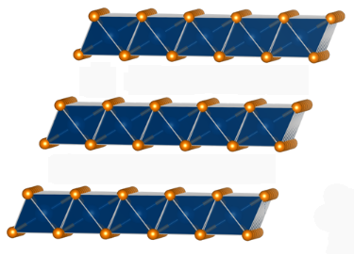
Commercial electrodes typically function through Li intercalation
cycling
Ex:
LiCoO₂
xLi⁺ +xe⁻+ Li_{1-x}CoO₂

Slide 41
Madelung potential
Correction factor to account for ionic interactions – electrostatic potential of oppositely charged ions
Vm = Am(z*e)/(4*pi*Epsilon0*r)

