Slide 1
Off-centering Distortions in Thermoelectrics
Jonathon Bechtel
May 28, 2014

Slide 4
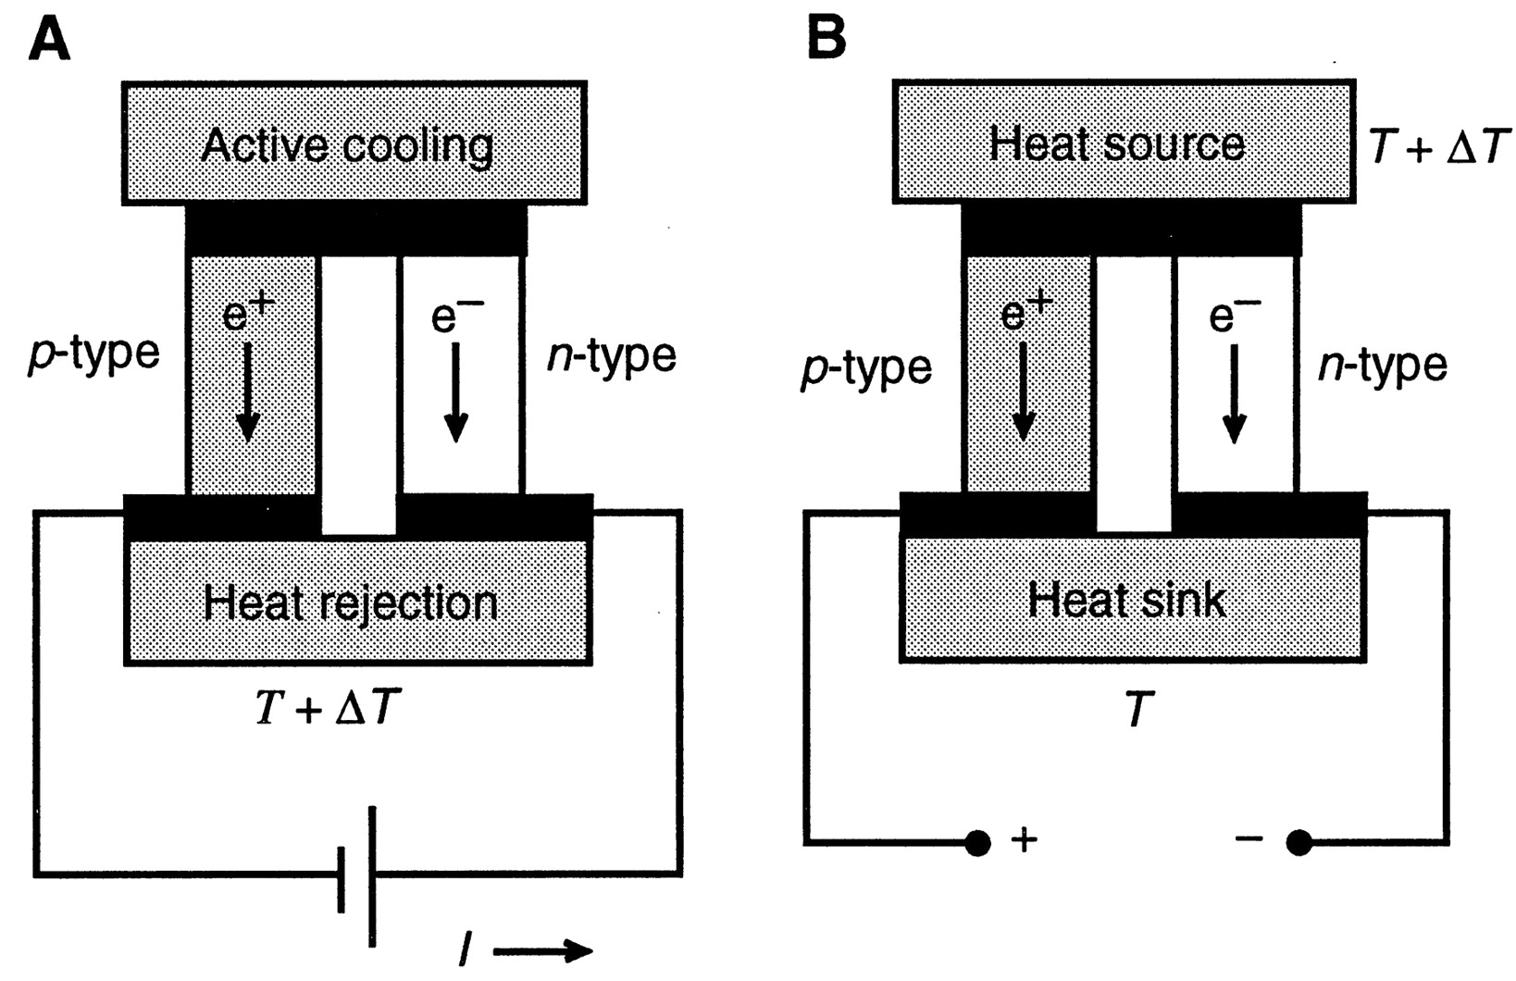
Basic Working Principles
Seebeck Effect.
Figure of Merit:
Conflicting material requirements.
DiSalvo, Francis J. "Thermoelectric cooling and power generation." Science 285, no. 5428 (1999): 703-706.

Slide 5
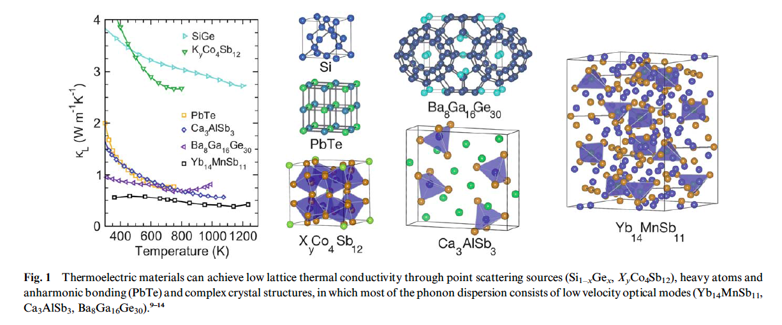
Approaches to low lattice thermal conductivity, κ_{L}
Umklapp Scattering
Introduce disorder through Point Defects/Nanostructuring
Complex/Large Unit Cells
Rattling Atoms
ˆ
Toberer, Eric S., Alex Zevalkink, and G. Jeffrey Snyder. "Phonon engineering through crystal chemistry." Journal of Materials Chemistry 21, no. 40 (2011): 15843-15852.

Slide 6
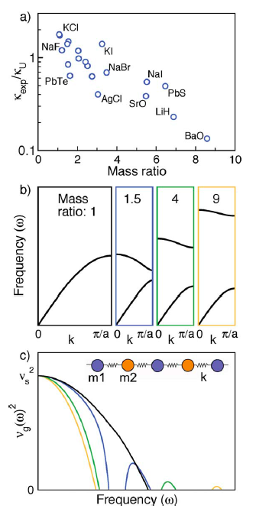
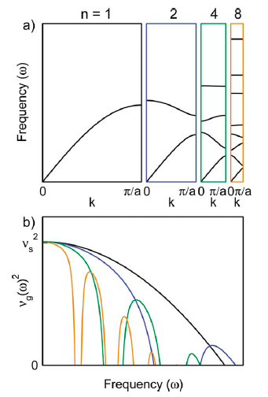
Phonon Conduction
Mass Contrast
Complex Unit Cell
Toberer, Eric S., Lauryn L. Baranowski, and Chris Dames. "Advances in thermal conductivity." Annual Review of Materials Research 42 (2012): 179-209.
Toberer, Eric S., Alex Zevalkink, and G. Jeffrey Snyder. "Phonon engineering through crystal chemistry." Journal of Materials Chemistry 21, no. 40 (2011): 15843-15852.

Slide 7
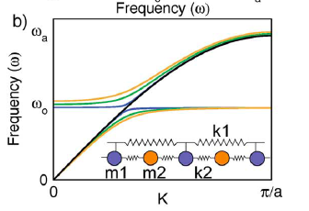
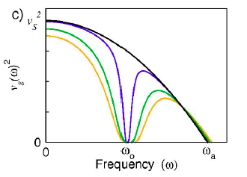
Guest atom inclusion to promote rattling modes.
Rattling
Avoided Crossing
Reduced group velocity
Toberer, Eric S., Lauryn L. Baranowski, and Chris Dames. "Advances in thermal conductivity." Annual Review of Materials Research 42 (2012): 179-209.
Toberer, Eric S., Alex Zevalkink, and G. Jeffrey Snyder. "Phonon engineering through crystal chemistry." Journal of Materials Chemistry 21, no. 40 (2011): 15843-15852.

Slide 8
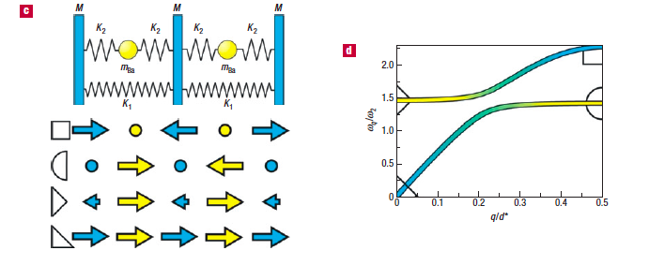
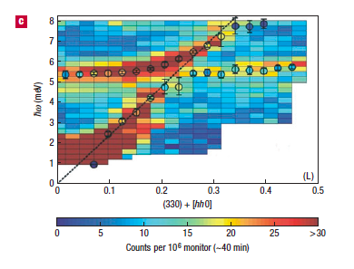
Clathrate host-guest structure promotes rattling modes
Ba₈Ga₁₆Ge₃₀
Christensen, Mogens, et. al. "Avoided crossing of rattler modes in thermoelectric materials." Nature materials 7, no. 10 (2008): 811-815.

Slide 9
Reconsider simple rock-salt thermoelectric materials
Moderate mass contrast
Cubic rock-salt unit cell
How to explain low κ_{L}?
Toberer, Eric S., Alex Zevalkink, and G. Jeffrey Snyder. "Phonon engineering through crystal chemistry." Journal of Materials Chemistry 21, no. 40 (2011): 15843-15852.

Slide 10
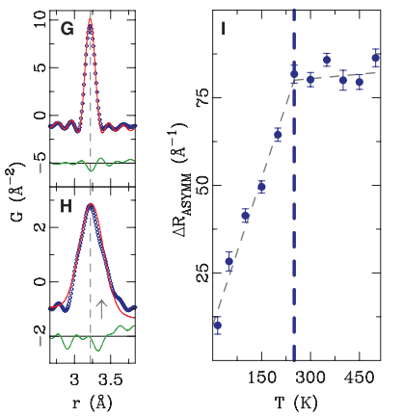
Reconsider simple rock-salt thermoelectric materials
Early evidence of off-centering upon heating
Asymmetric nearest neighbor peak.
Disordered, off-center cations
Božin, Emil S., Christos D. Malliakas, Petros Souvatzis, Thomas Proffen, Nicola A. Spaldin, Mercouri G. Kanatzidis, and Simon JL Billinge. "Entropically stabilized local dipole formation in lead chalcogenides." Science 330, no. 6011 (2010): 1660-1663.

Slide 11
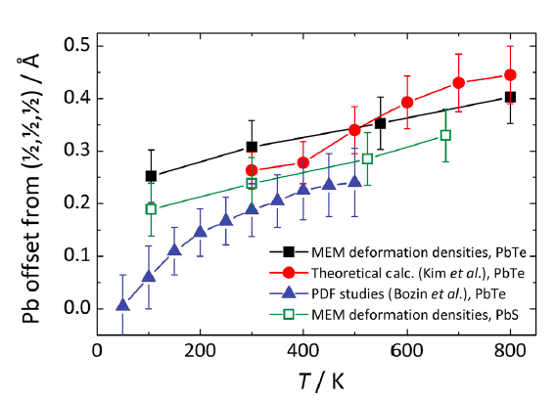
Further evidence of off-centering
SPXRD to quantify cation disorder
Maximum entropy method for electron densities
Confirm off-centering
Kastbjerg, Sofie, Niels Bindzus, Martin Søndergaard, Simon Johnsen, Nina Lock, Mogens Christensen, Masaki Takata, Mark A. Spackman, and Bo Brummerstedt Iversen. "Direct Evidence of Cation Disorder in Thermoelectric Lead Chalcogenides PbTe and PbS." Advanced Functional Materials 23, no. 44 (2013): 5477-5483.

Slide 12
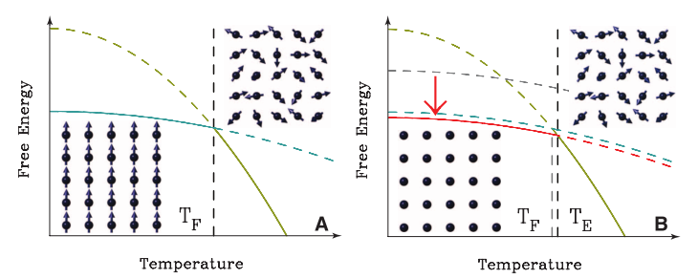
Rationalize unusual behavior with simple thermodynamic argument
F = U – T*S
Metastable state entropically stabilized at high temperature
Božin, Emil S., Christos D. Malliakas, Petros Souvatzis, Thomas Proffen, Nicola A. Spaldin, Mercouri G. Kanatzidis, and Simon JL Billinge. "Entropically stabilized local dipole formation in lead chalcogenides." Science 330, no. 6011 (2010): 1660-1663.

Slide 13
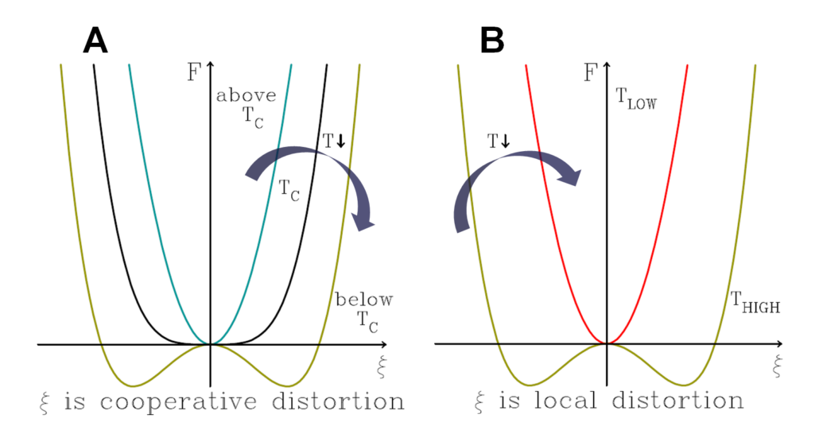
Departure from Landau Theory
Opposite of traditional phase transition
Fluctuating dipoles may affect:
Thermal conductivity, carrier mobility (T^{-2.5})
Božin, Emil S., Christos D. Malliakas, Petros Souvatzis, Thomas Proffen, Nicola A. Spaldin, Mercouri G. Kanatzidis, and Simon JL Billinge. "Entropically stabilized local dipole formation in lead chalcogenides." Science 330, no. 6011 (2010): 1660-1663.

Slide 14
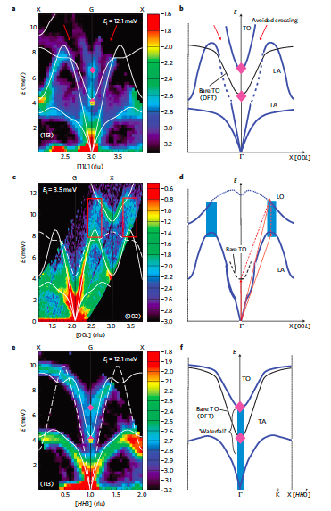
PbTe phonon dispersion reveals avoided crossing
Highly anharmonic phonon coupling
LA vs. TO
Scattering
LA+TO <-> LO
Incipient Ferroelectric
Waterfall effect
Delaire, Olivier, Jie Ma, Karol Marty, Andrew F. May, Michael A. McGuire, Mao-Hua Du, David J. Singh et al. "Giant anharmonic phonon scattering in PbTe." Nature materials 10, no. 8 (2011): 614-619.

Slide 15
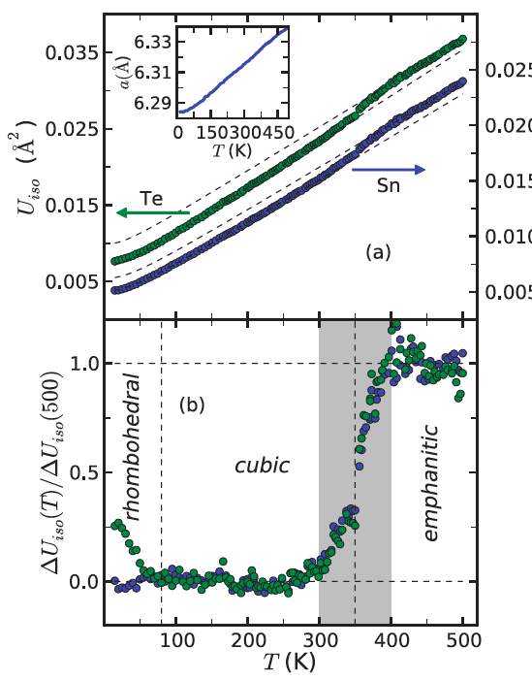
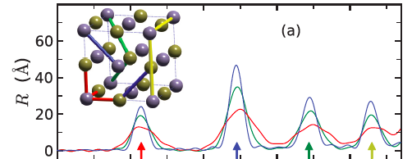
Emphanisis in SnTe
SnTe: Rhombohedral to Cubic to Emphanitic
Knox, K. R., E. S. Bozin, C. D. Malliakas, M. G. Kanatzidis, and S. J. L. Billinge. "Local off-centering symmetry breaking in the high-temperature regime of SnTe." Physical Review B 89, no. 1 (2014): 014102.

Slide 16
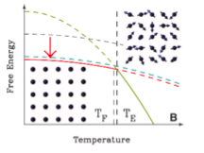
Conclusions and Outlooks
Avenues to low κ_{L}
Phonon Engineering
Off-centering
Emphanisis and Lone Pairs
Božin, Emil S., Christos D. Malliakas, Petros Souvatzis, Thomas Proffen, Nicola A. Spaldin, Mercouri G. Kanatzidis, and Simon JL Billinge. "Entropically stabilized local dipole formation in lead chalcogenides." Science 330, no. 6011 (2010): 1660-1663.

