Slide 1
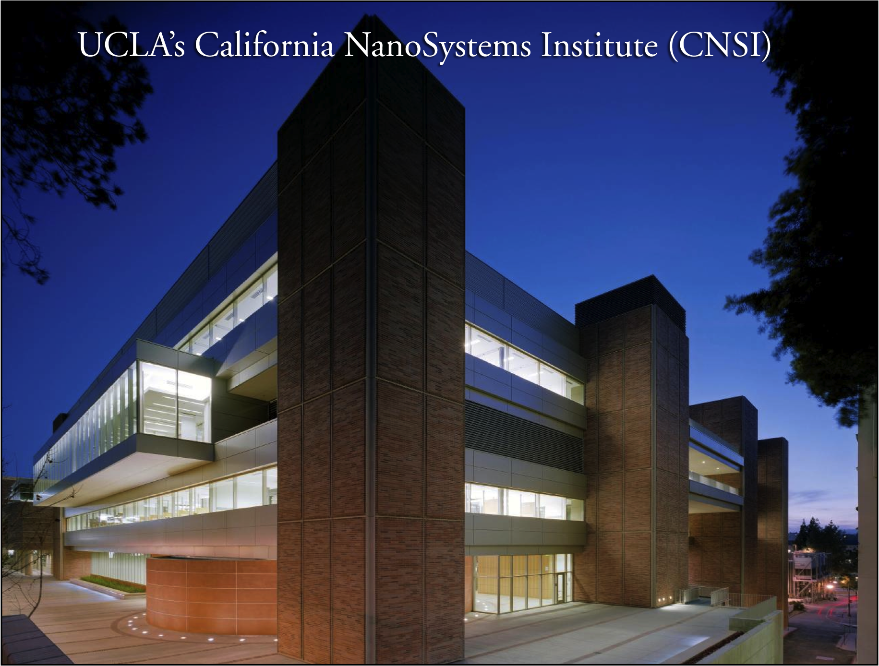

Slide 2

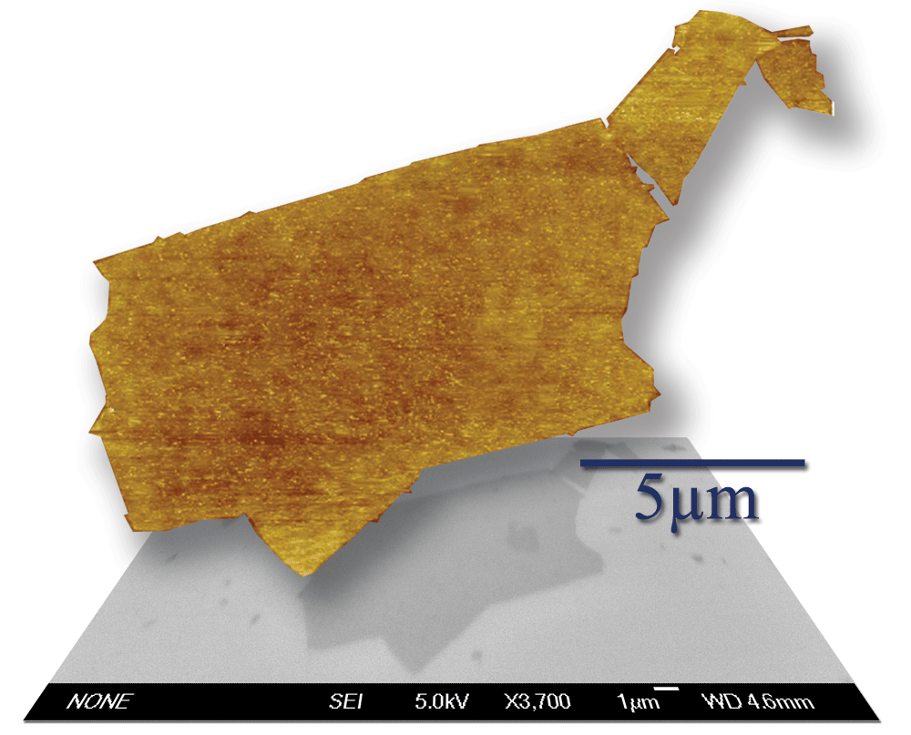

Synthesis and Applications of Graphene
Richard B. Kaner
Professor, Department of Chemistry & Biochemistry
Professor, Department of Materials Science & Engineering
Member, California NanoSystems Institute
University of California, Los Angeles (UCLA)

Slide 3
Outline
Carbon allotropes
Routes to graphene: exfoliation, CVD, graphite oxide
3. Solution processing
4. Sensors and transparent electrodes
5. Laser scribed graphene (LSG) and supercapacitors

Slide 4
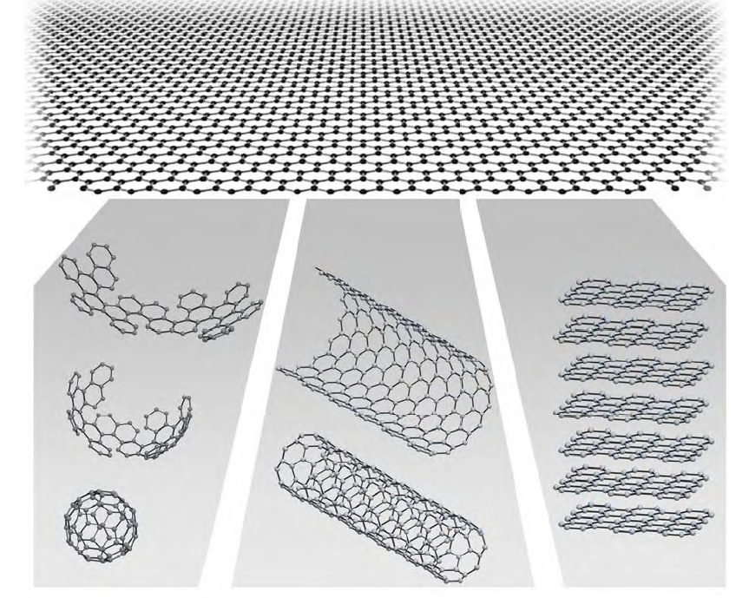
Graphene : The building block of all graphitic forms
Graphene is the 2-dimentional building block for carbon allotropes of
every other dimensionality.
Novoselov, K.S. et al. Nature, 6, 183 (2006).
Notes:
Graphene is the name given to individual sheets of sp2-hybridized carbon bound in two dimensions of which
crystalline graphite, a great deal of attention has been generated by graphene, due to its unique electronic property stemming from its semimetalic nature.
Novoselov et al This provided a method to search the myriad of multilayered graphitic fragments left behind after drawing in order to find a single
layer of graphene

Slide 5
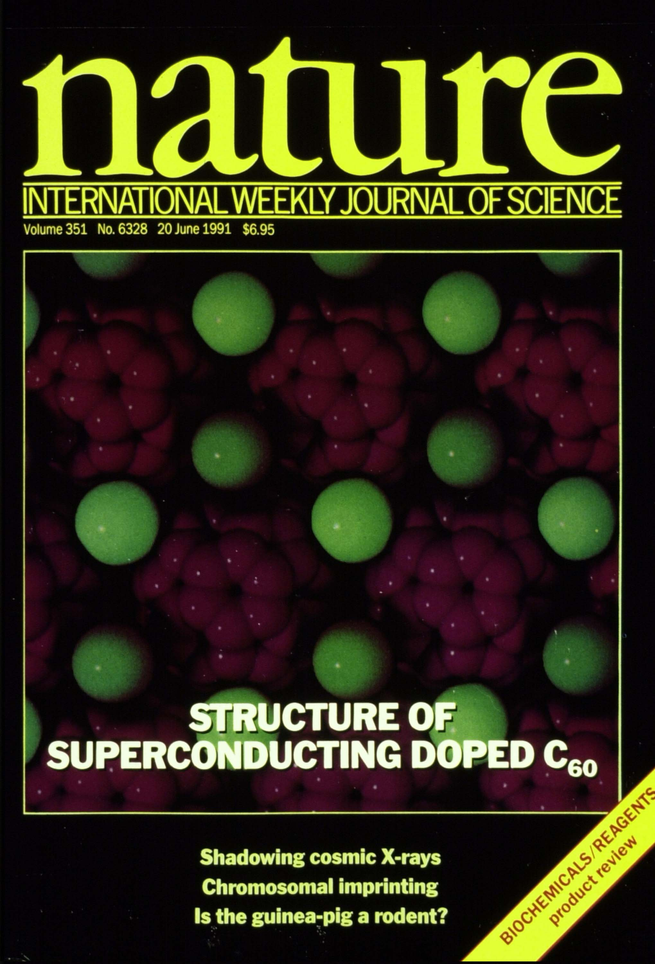

Slide 6
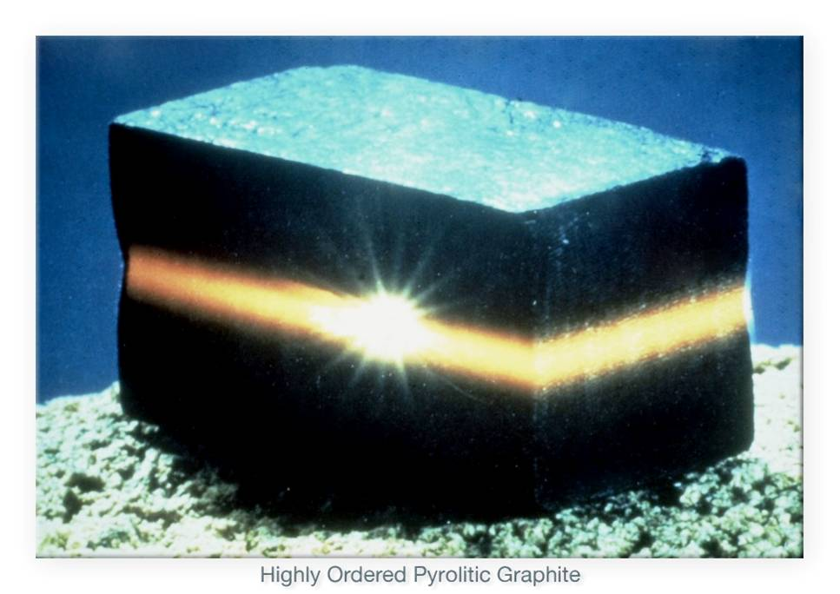

Slide 7
Noteworthy Synthetic Routes to Graphene
1. Intercalation and Exfoliation
Difficulty is the strong van der Waals forces between sheets
Viculis, L.M, Mack, J.J., Kaner, R.B., Science, 2003;
Ruoff, R. et al., Carbon 2007
2. Mechanical Exfoliation
Tape used to peel single and/or few layers from HOPG
(exceedingly low yield).
Novoselov, K.S. et al., Science, 2004
3. Reduction of Silicon Carbide
In some cases, silicon is not most suitable target substrate
de Heer, et al., 2006
4. Chemical Vapor Deposition of Graphene
Ruoff, R. et al., Science, 2009
Notes:
More recently, some researchers have attempted to create large scale graphene using the reduction of SiC to form a single carbon layer through the loss of Si.

Slide 8
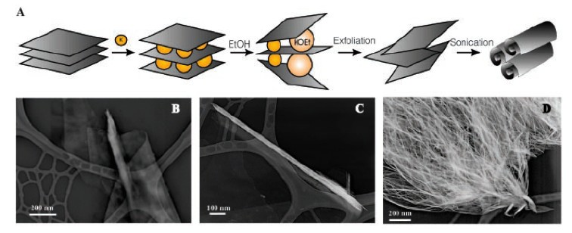
Intercalation and Exfoliation of HOPG
• Produces carbon nanoscrolls comprised ~30 graphene layers
Viculis, L.M., Mack, J.J., Kaner, R.B. Science, 299, 1361 (2003).
Notes:
One realize that few layers of graphene must be pulled out from a monolith of HOPG.
Intercalation/exfoliation method have failed to produce material less than 100 nm

Slide 9
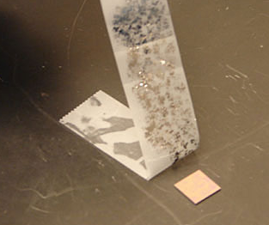
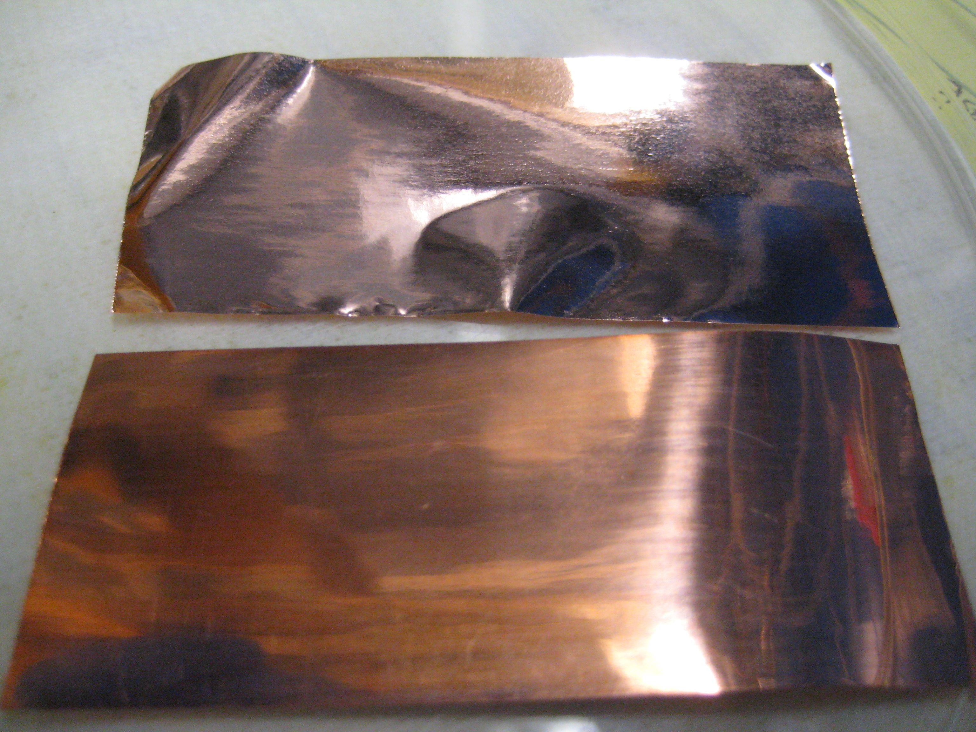
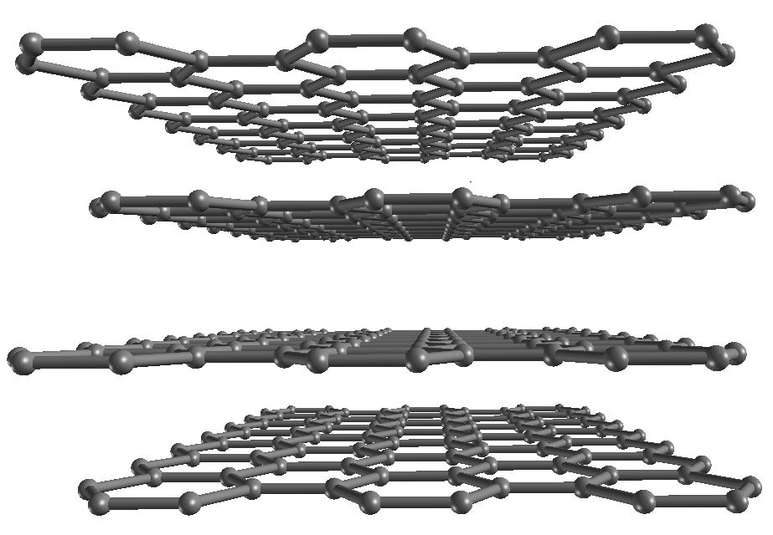
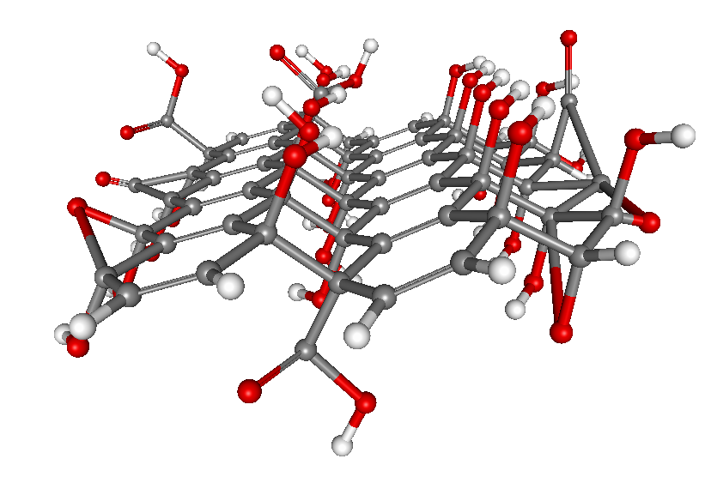
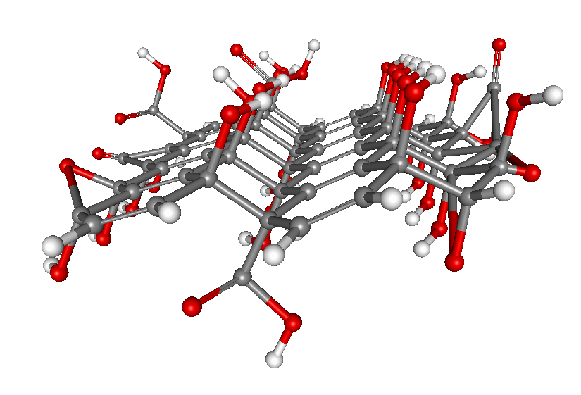
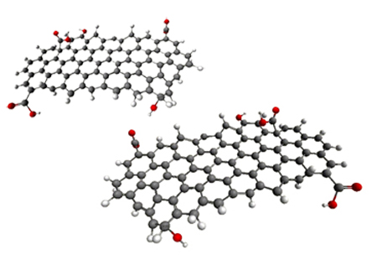

How we prepare graphene
Mechanical exfoliation
Chemical vapor deposition
Chemical exfoliation and reduction
carbon source
copper
heat
cool
graphene coated
copper
Notes:
The reduction of graphene oxide to a graphene-like material can be achieved through a variety of routes such as: Hydrazine, Thermal deoxygenation, thermal treatment in NMP, Laser scribing.

Slide 10
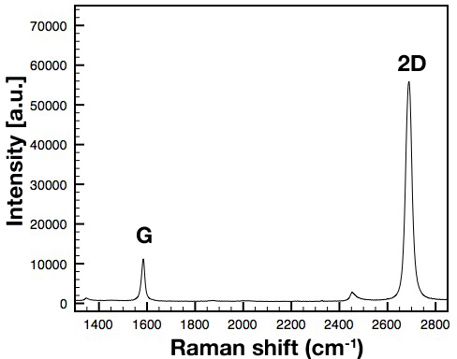
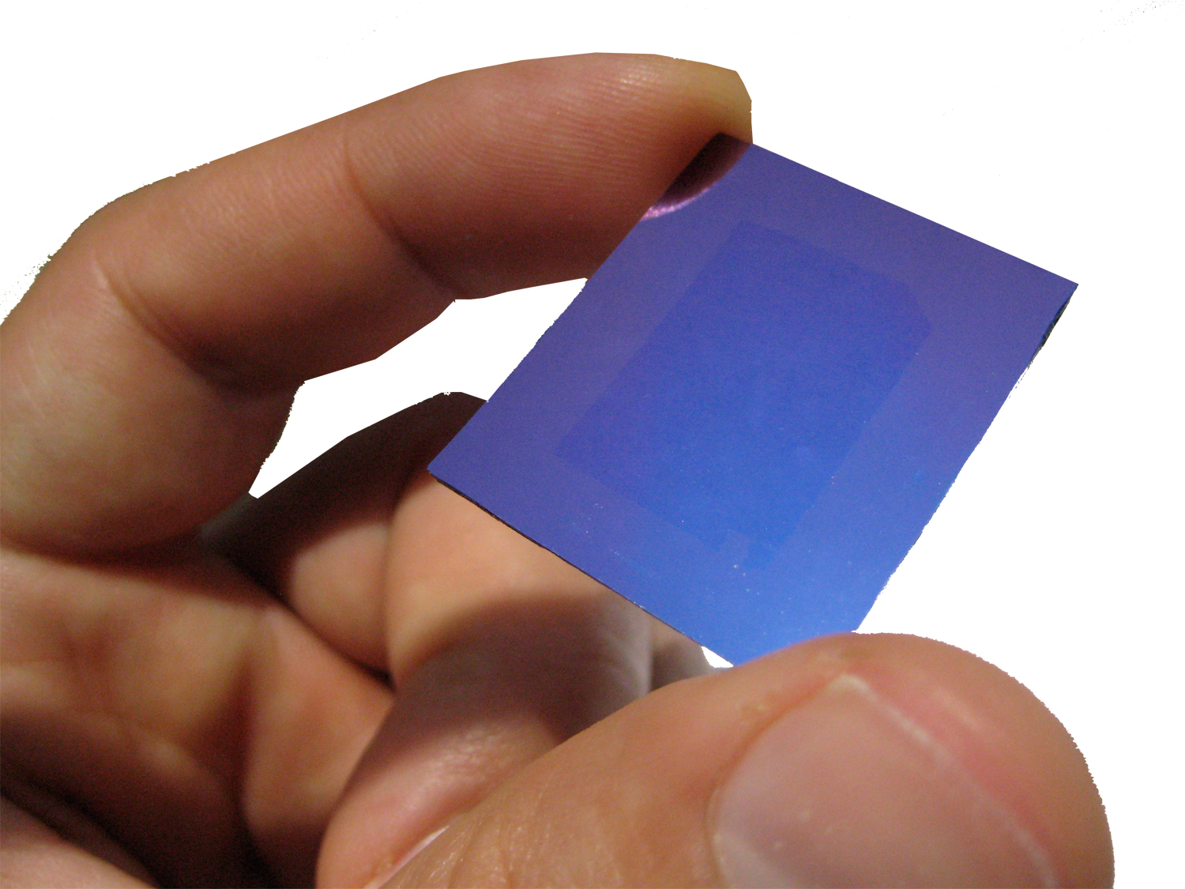
Large-area and highly crystalline graphene made by chemical vapor deposition

Slide 11
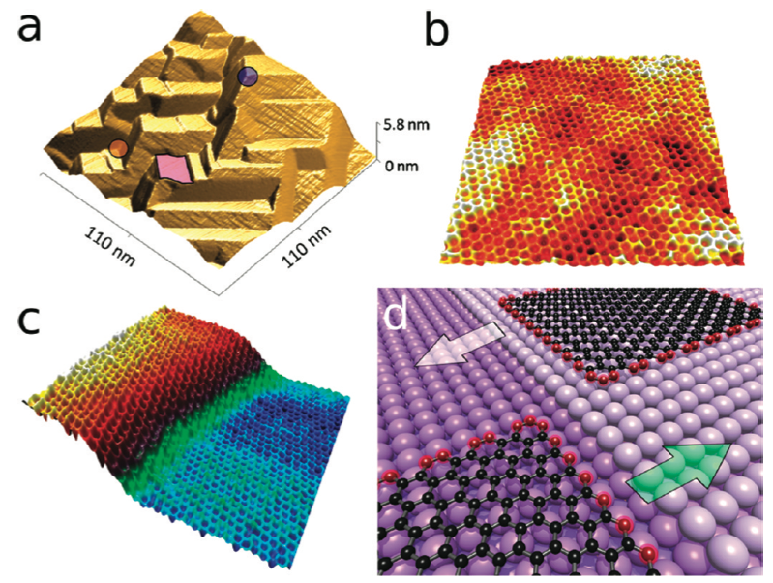
STM Reveals Continuous Graphene Growth
Rasool, H., Song, E., Allen, M., Wassei, J.K., Kaner, R.B., Wang, K.L., Weiller B, Gimzewski, J.K. Nano Lett. 2011, 11, 251.

Slide 12
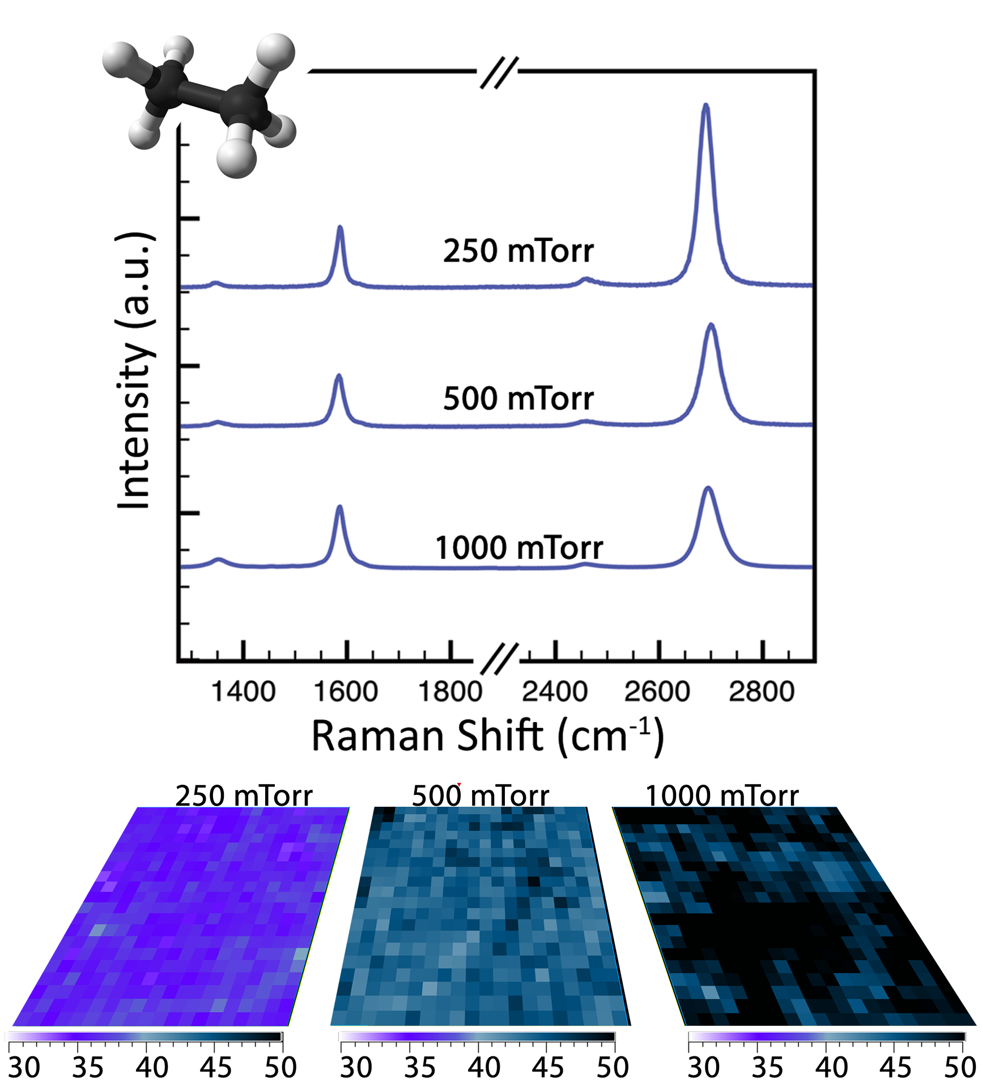
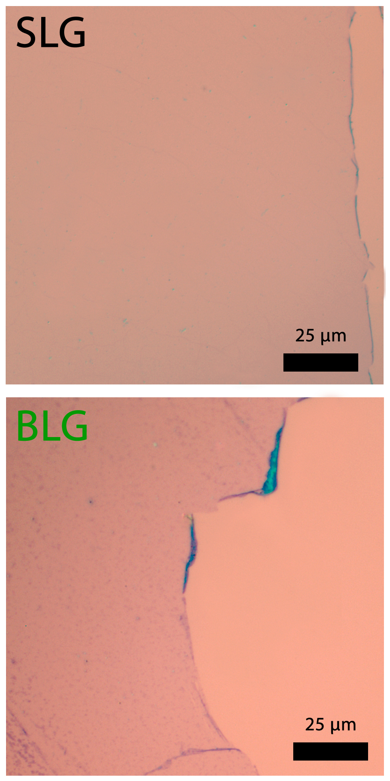
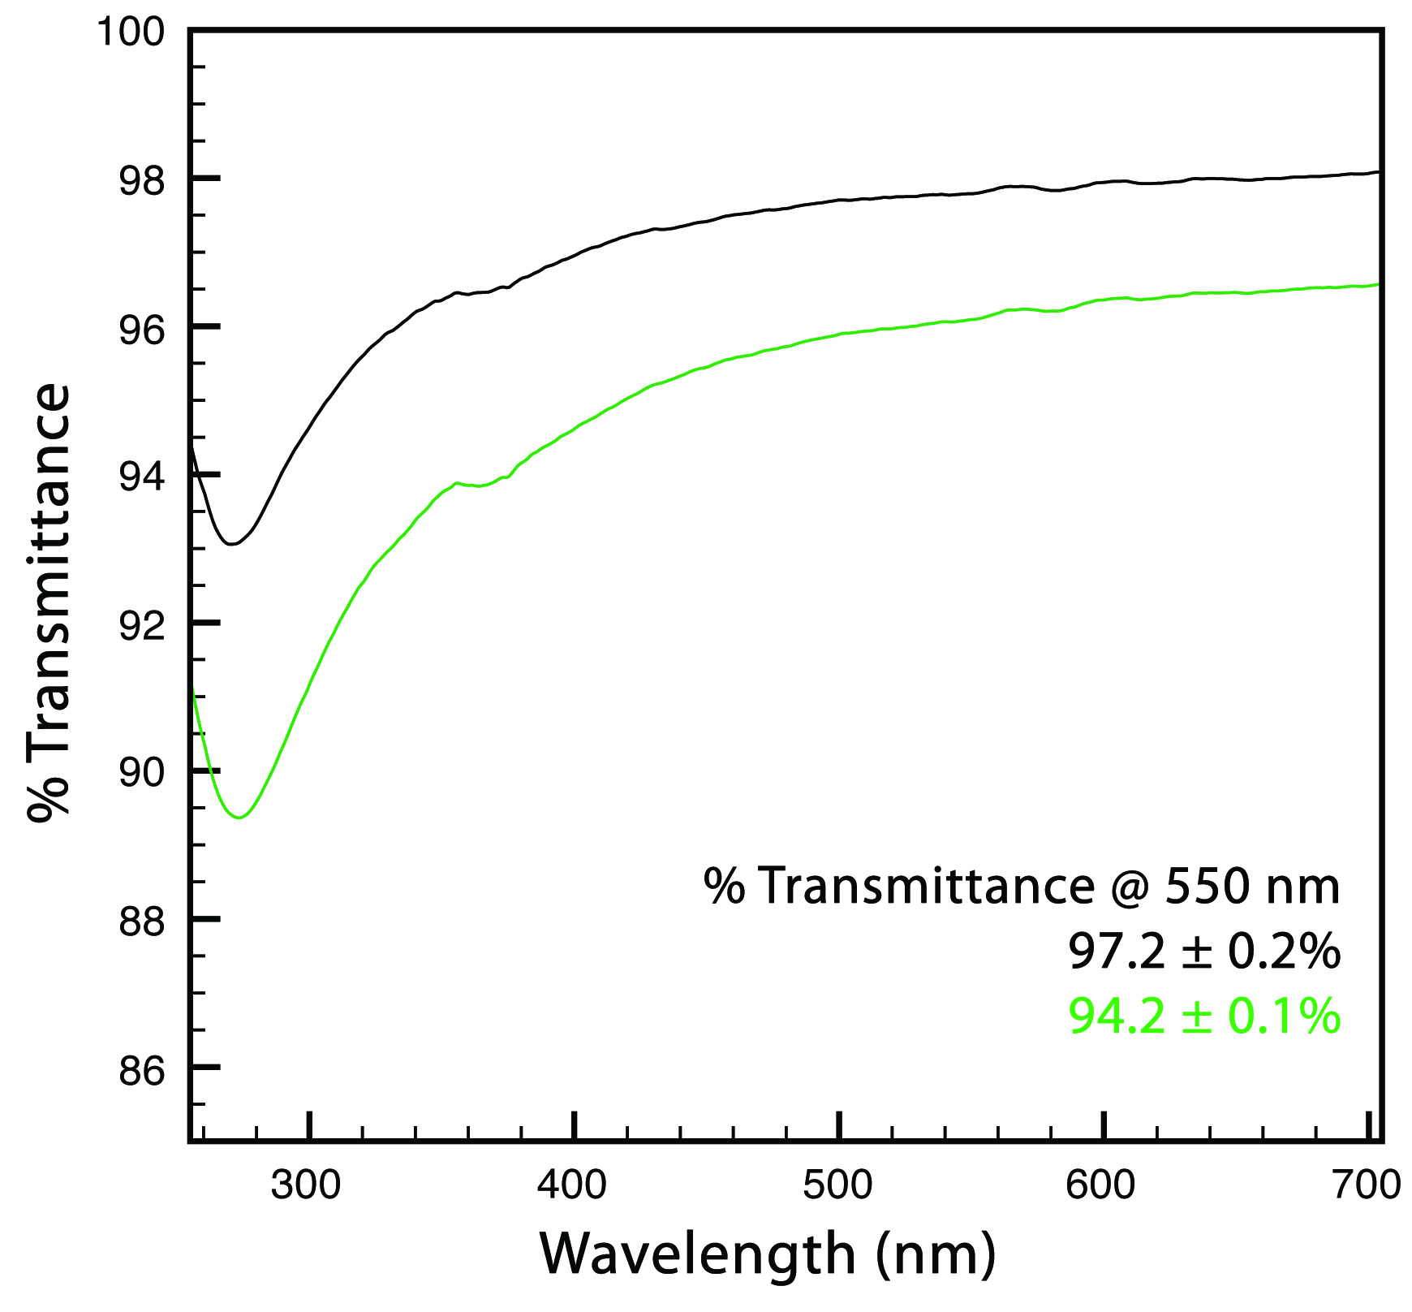
Growing graphene with ethane at different pressures yields single or bilayers
Optical micrographs Raman spectrum UV-Vis spectrum
& mapping
Wassei, J.K., Torres, J., Kaner, R.B., et al., Small, 8, 1415 (2012).
Notes:
*** Under the conditions studied, propane controllably grows bilayer and multilayer graphene, while no single layer is observed.

Slide 13
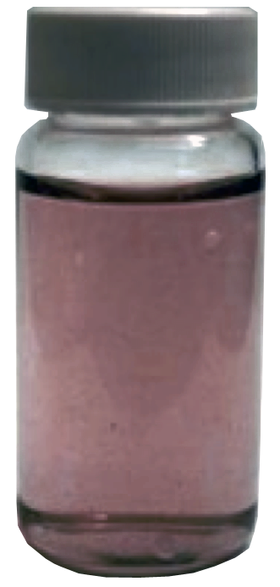
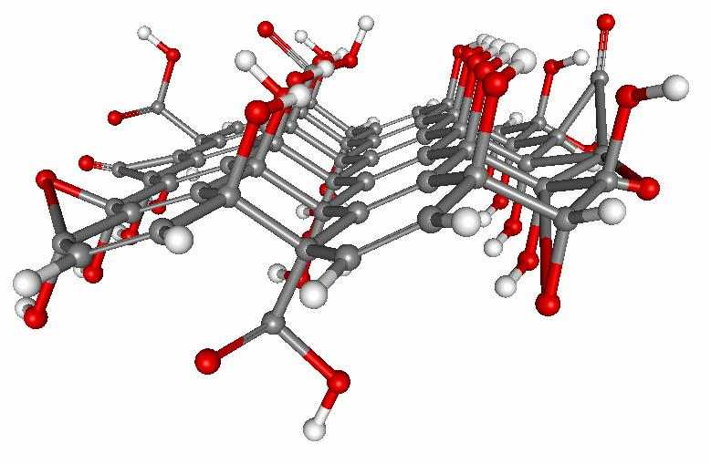
Solutions of graphene oxide
Highly oxidized graphite can be prepared with -OH, O , C=O and -COOH functionalities*
The sheets interact strongly with water and exfoliate
Graphene Oxide
Brodie, et al. Liebigs Ann. Chem. 6, 114 (1860).
*Kovtyukhova, et al. Chem. Mater. 11, 3 (1999).

Slide 14
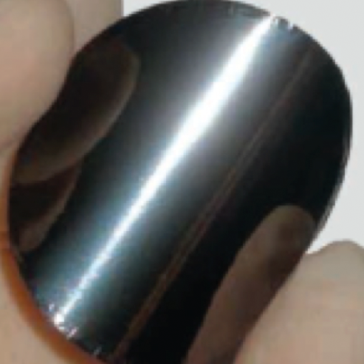
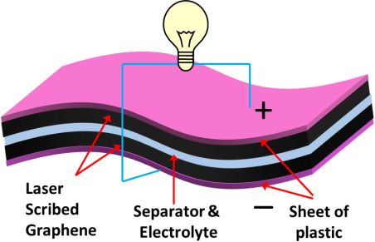
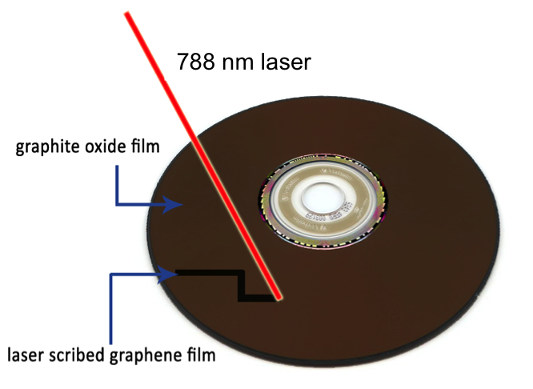
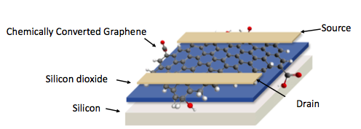
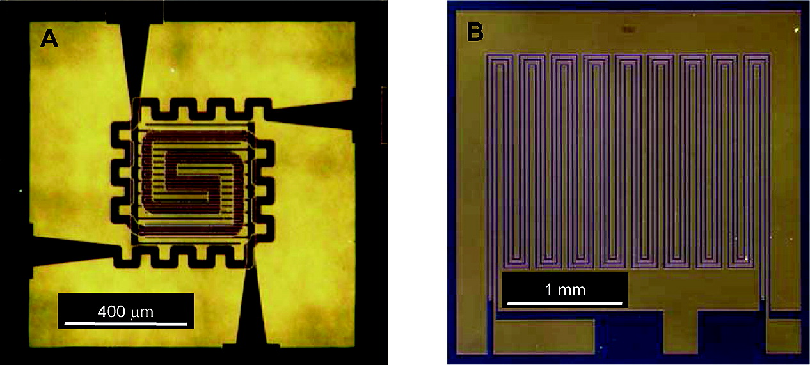
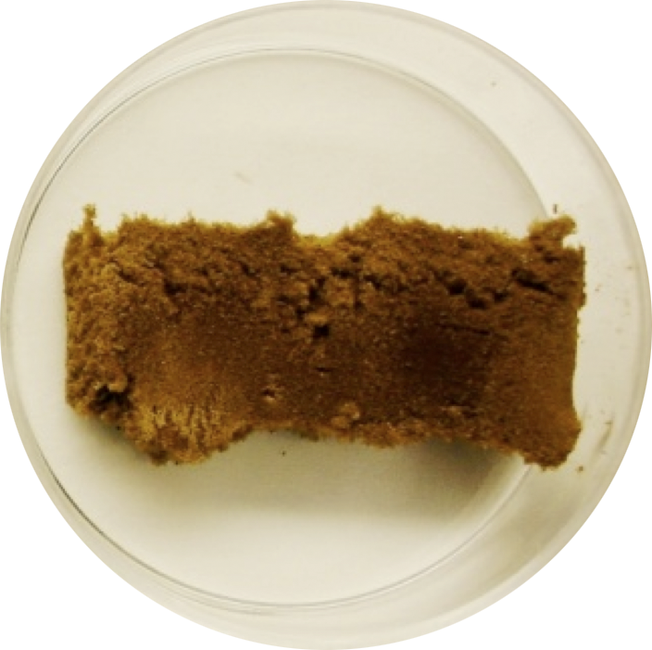
A range of applications stemming from graphene oxide
supercapacitors
graphene paper
light scribe lithography
electronics
robust chemical sensors
graphene oxide foam

Slide 15
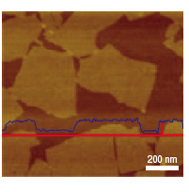
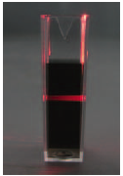
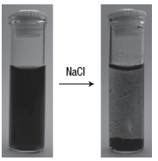
Morphological and Colloidal Characterization of CCG Dispersions
1. The Tyndall effect and salt effect confirm the colloidal nature of the CCG dispersion.
2. Tapping mode AFM image of CCG sheets with a high profile (blue) curve taken along the red curve.
1 nm
Tyndall effect
Salt effect
AFM
Li, D., Gilje, S., Wallace, G.G., Kaner, R.B. Nature Nanotech. 3, 101 (2008).
Notes:
Attempts have been made to complete the reduction stage in solution, but sheets tend to aggregate due to the attractive force between layers and an overall decrease in hydrophilicity.

Slide 16
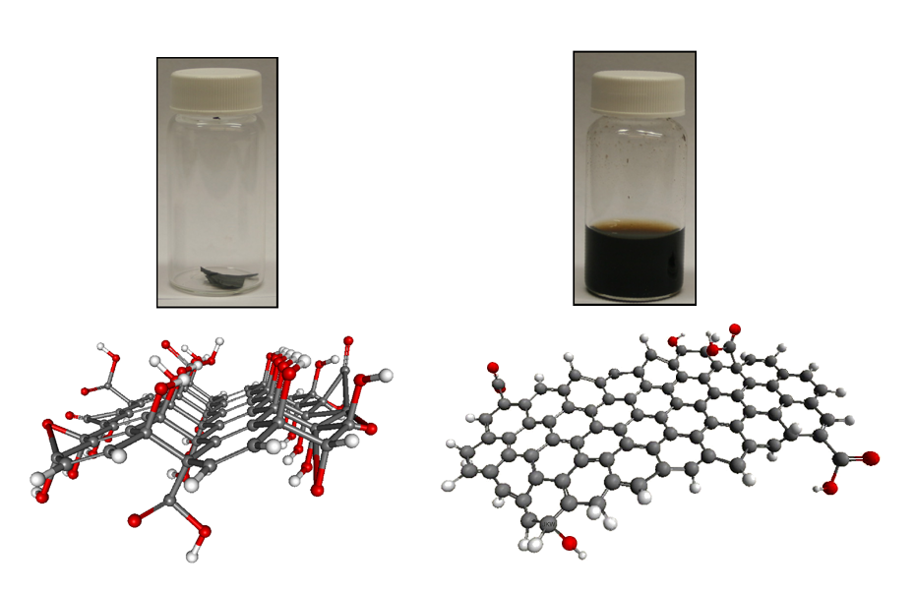
Reduction and Dispersion in Pure Hydrazine
N₂H₄
Tung, V.C., Allen, M.J., Yang, Y., Kaner, R.B. Nature Nanotech. 4, 25 (2009).
Notes:
The prevention of agglomerates is of great interest, because most of their unique properties only exhibit in individual
The graphene sheets produced have the largest area (up to 40 μm x 25 μm) of any yet reported, making them far easier to process

Slide 17
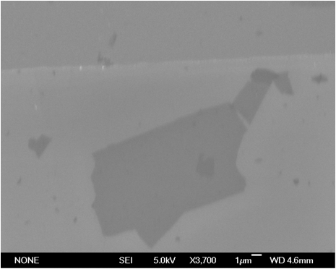
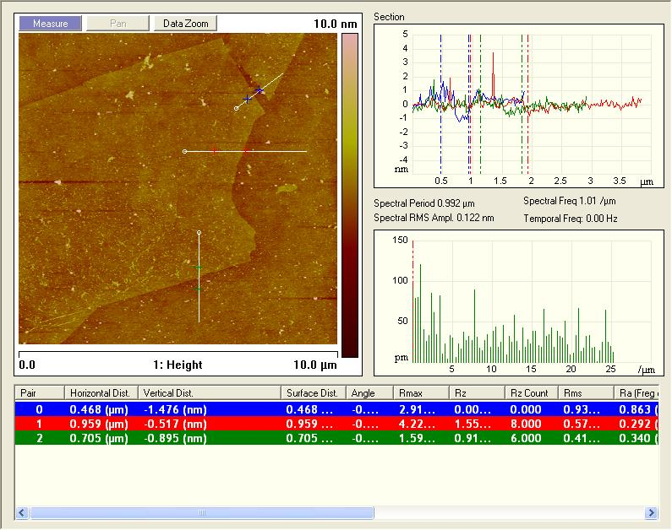
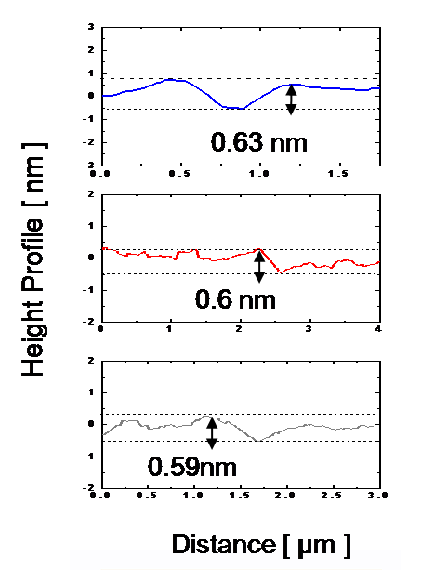
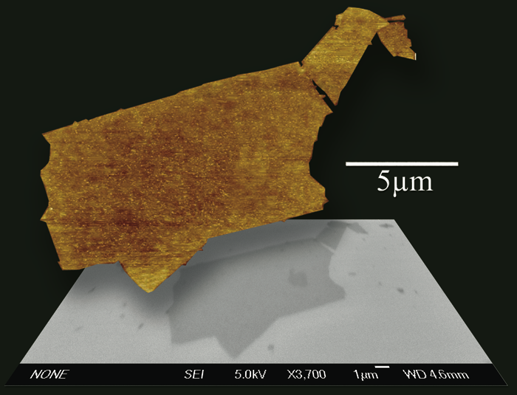
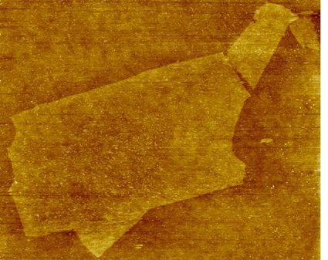

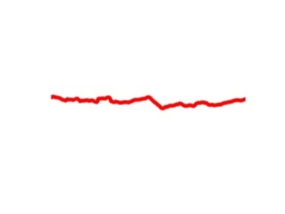

SEM & AFM on the same specimen
5 µm
5 µm
Height profiles show step height from SiO₂ to chemically converted graphene of 0.6 nm for a given cross-section. The result suggests that most of the oxygen moieties have been removed.
Nature Nanotech. 4, 25 (2009)

Slide 18
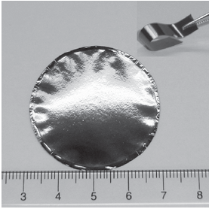
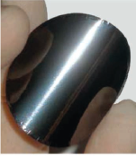
Flexible Chemically Converted Graphene Films
Li, D., Kaner, R.B. Science, 315, 1379 (2008).

Slide 19

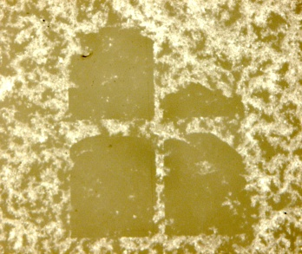
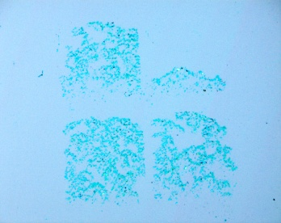
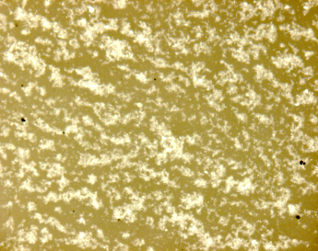
Selective Registration of CCG
oligomers
500 µm
500 µm
500 µm
85ºC
Adv. Mater., 21, 2098 (2009).

Slide 20
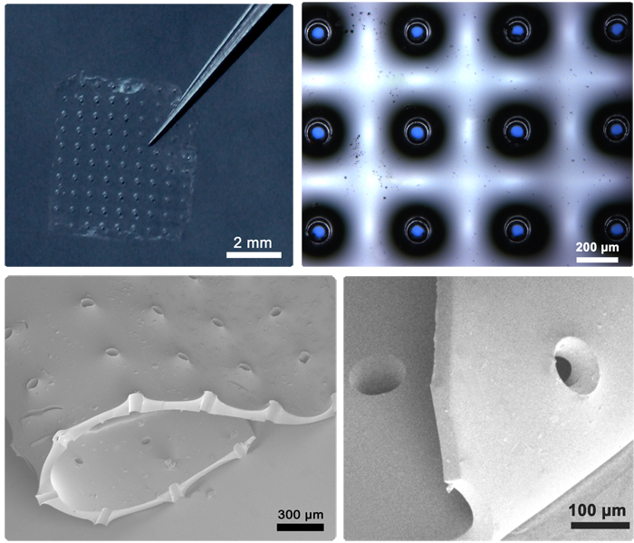
Stenciling with Elastomeric Membranes
Wassei, J.K., Tung, V.C., Jonas, S.J., Yang, Y., Kaner, R.B. Adv. Mater. 22, 897 (2010).
Notes:
Using photolithography, we pattern photoresist pillars onto a master wafer
b. PDMS is spin-coated over master wafer
c. Regions of PDMS are cut out and lifted off
d. The membrane (mask) is placed down onto a new substrate
e. Hydrazinium nano carbon is spin-coated over mask and substrate
f. An array of patterned features are revealed after peeling away membrane.

Slide 21
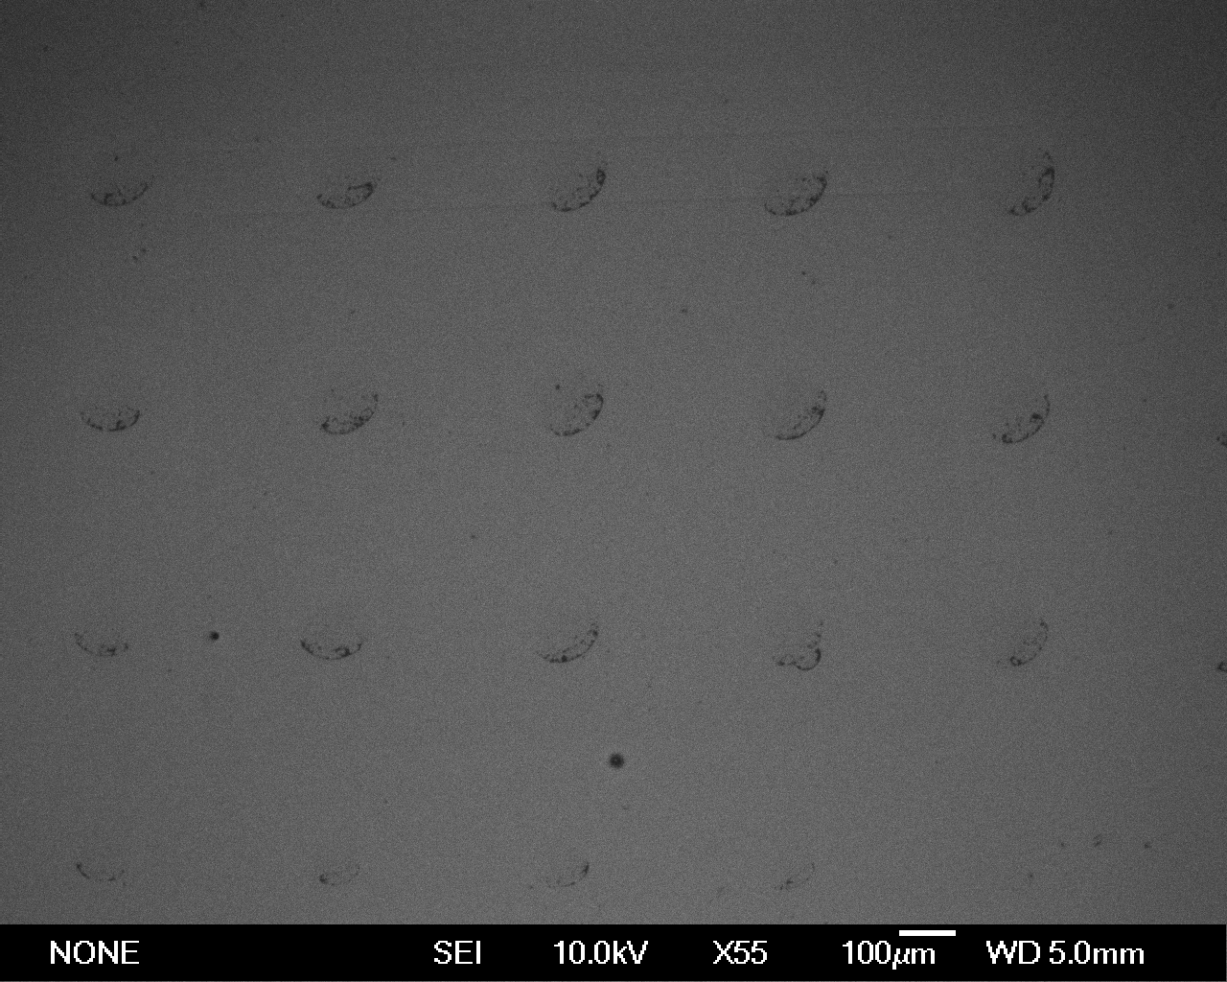
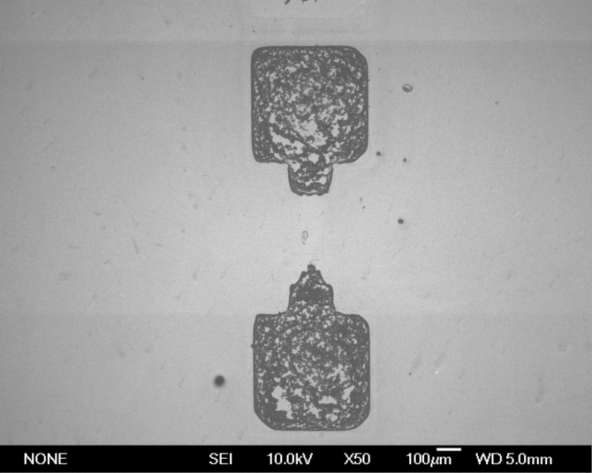
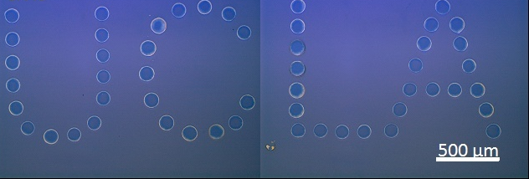
Selective Registration of Graphene sheets
Adv. Mater. 22, 897 (2010).
Notes:
Through manipulation of the surfaces hydrophillic and hydrophobic properties we have shown that it is also possible to register more specific regions with single graphene sheets.
Above are circular regions from PDMS patterning and inside those rings we find individual graphene sheets.
Below is an image of concentrated graphene to produce the UCLA pattern.

Slide 22
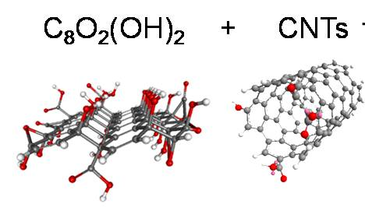
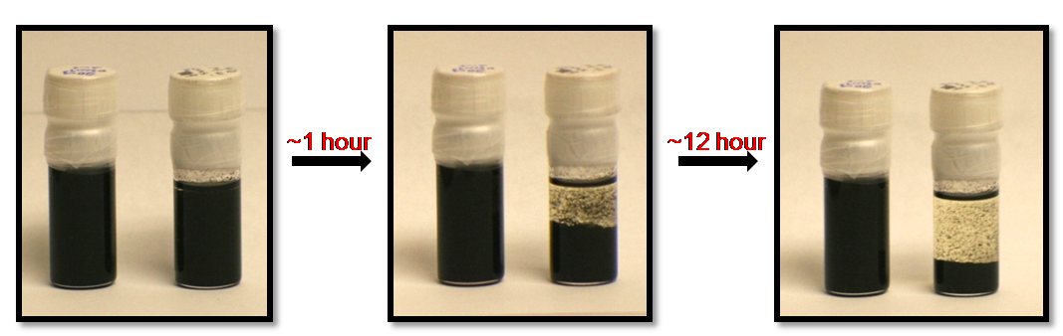
Graphene-Carbon Nanotube dispersions
N₂H₄
C₆H₅Cl
N₂H₄
C₆H₅Cl
N₂H₄
C₆H₅Cl
Tung, V.C., Allen, M.J., Wassei, J.K., Yang, Y., Kaner, R.B. Nano Lett. 9, 1949 (2009).

Slide 23
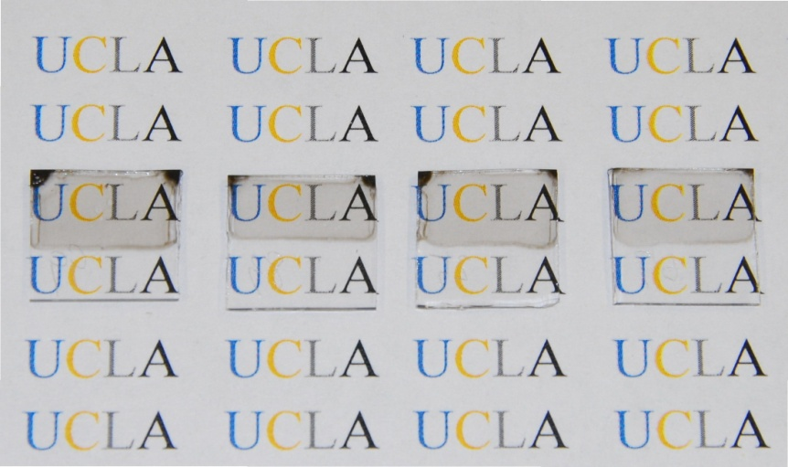
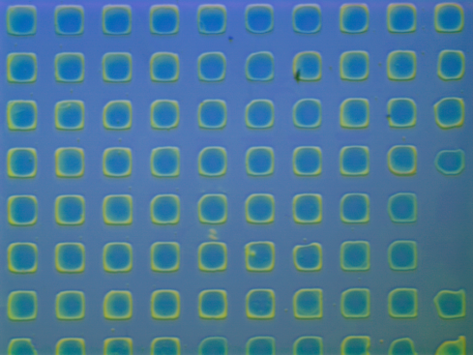
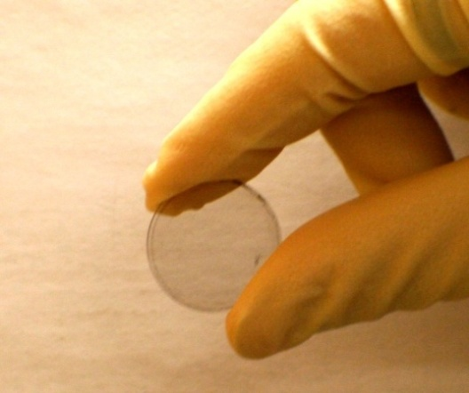


Graphene/CNTs Transparent Conductor Deposited on a Variety of Substrates
Glass
Si/SiO₂
1050 r.p.m. 1250 r.pm. 1500 r.p.m. 1750 r.p,m.
500 µm
Sapphire
PET
500 µm
Nano Lett. 9, 1949 (2009).
Notes:
G-CNT hybrid materials are readily deposited onto a variety of substrates and subsequently heated to 150 to remove excess solvent.

Slide 24


Mechanically robust G-CNT films as transparent electrodes
Nano Lett. 9, 1949 (2009).

Slide 25

Practical chemical sensors from graphene
Micro Hotplate (MHP)
Fowler, J., Allen, M.J., Tung, V.C., Kaner, R.B., Yang, Y., Weiller B. ACS Nano, 3, 301 (2009).
Notes:
The electrode array is a 400µm square with individual electrodes 10µm wide with 10µm gaps. The sensor is suspended on a thin silicon nitride membrane. The four-point interdigitated electrode (IDE) sensor has two serpentine electrodes between the IDE which are used for the four-point resistance measurements.
The NO₂ sensing took place at varying temperatures of 21º-149ºC

Slide 26



Practical chemical sensors from graphene
N-type
Ground state
P-type

Slide 27


Practical chemical sensors from graphene
NH₃ detection at 5 ppm
Band diagram of CCG
ACS Nano, 3, 301 (2009).
Notes:
Four-point electrode sensors (Figure 1B) were produced at The Aerospace Corporation and consisted of gold interdigitated electrodes (where source current is applied) with a serpentine electrode pair wound between them (where sense voltage is read).30 The four-point electrodes were deposited on top of thermally grown silicon dioxide to isolate them from the bulk silicon, while the MHP electrodes were deposited on top of
low-stress silicon nitride. Both types of sensors were mounted in 24-pin dual in-line packages (DIPs) and cleaned with acetone, isopropanol, and an oxygen plasma prior to being spin-coated with HG. In the case of dinitrotoluene, current was applied and voltage was read using the interdigitated electrodes in a two point configuration.

Slide 28


Practical chemical sensors from graphene
NO₂ detection at 5 ppm
Band diagram of CCG
ACS Nano, 3, 301 (2009).
Notes:
Four-point electrode sensors (Figure 1B) were produced at The Aerospace Corporation and consisted of gold interdigitated electrodes (where source current is applied) with a serpentine electrode pair wound between them (where sense voltage is read). The four-point electrodes were deposited on top of thermally grown silicon dioxide to isolate them from the bulk silicon, while the MHP electrodes were deposited on top of
low-stress silicon nitride. Both types of sensors were mounted in 24-pin dual in-line packages (DIPs) and cleaned with acetone, isopropanol, and an oxygen plasma prior to being spin-coated with HG. In the case of dinitrotoluene, current was applied and voltage was read using the interdigitated electrodes in a two point configuration.

Slide 29

Practical chemical sensors from graphene
NO₂ detection at 5 ppm on the MHP
ACS Nano, 3, 301 (2009).
Notes:
Four-point electrode sensors (Figure 1B) were produced at The Aerospace Corporation and consisted of gold interdigitated electrodes (where source current is applied) with a serpentine electrode pair wound between them (where sense voltage is read).30 The four-point electrodes were deposited on top of thermally grown silicon dioxide to isolate them from the bulk silicon, while the MHP electrodes were deposited on top of
low-stress silicon nitride. Both types of sensors were mounted in 24-pin dual in-line packages (DIPs) and cleaned with acetone, isopropanol, and an oxygen plasma prior to being spin-coated with HG. In the case of dinitrotoluene, current was applied and voltage was read using the interdigitated electrodes in a two point configuration.

Slide 30



Practical chemical sensors from graphene
2,4-Dinitrotoluene detection at 52 ppb
ACS Nano, 3, 301 (2009).
Notes:
Four-point electrode sensors (Figure 1B) were produced at The Aerospace Corporation and consisted of gold interdigitated electrodes (where source current is applied) with a serpentine electrode pair wound between them (where sense voltage is read).30 The four-point electrodes were deposited on top of thermally grown silicon dioxide to isolate them from the bulk silicon, while the MHP electrodes were deposited on top of
low-stress silicon nitride. Both types of sensors were mounted in 24-pin dual in-line packages (DIPs) and cleaned with acetone, isopropanol, and an oxygen plasma prior to being spin-coated with HG. In the case of dinitrotoluene, current was applied and voltage was read using the interdigitated electrodes in a two point configuration.

Slide 31






Photothermal deoxygenation of graphene oxide foam
Freeze dried graphene oxide (foam)
Flashed graphene oxide
1000x
1000x
100,000x
Gilje, S., Kaner, R.B., et al., Adv. Mater. 22, 419 (2010).
Cote, Cruz-Silva, Huang, J. Am. Chem. Soc. 131, 11027 (2009).
Notes:
By freeze-drying a graphene oxide dispersion, light energy from a camera flash or enough energy to raise temperature of graphite oxide to 200°C can be used as a method of reduction

Slide 32


Photothermal deoxygenation of graphene oxide
Adv. Mater. 22, 419 (2010).

Slide 33





Fine laser patterning through controlled reduction
www.lightscribe.com
780 nm laser
Strong, Dubin, El-Kady, Lech, Wang, Weiller, Kaner, ACS Nano 6, 1395 (2012).
Notes:
PET- Polyethylene terephthalate
I-V curves show that there is 6 orders of magnitude change in the film resistance between GO and LSG.

Slide 34


All organic, flexible NO₂ gas sensor
Standard Image
Laser scribed graphene
Levels of reduction are directly related to the laser intensity
ACS Nano 6, 1395 (2012).
Notes:
R₀ = 7775 ohms
Interdigitated pattern with partially reduced material-
Partial recovery after 10min intervals.
Sheet resistance with response to the NO2 gas—where R_{o} is initial resistance before NO2 gas
NO2 is a P-type dopant, which causes lots of holes.

Slide 35


All organic, flexible NO₂ gas sensor
ACS Nano 6, 1395 (2012).
Notes:
R₀ = 7775 ohms
Interdigitated pattern with partially reduced material-
Partial recovery after 10min intervals.
Sheet resistance with response to the NO2 gas—where R_{o} is initial resistance before NO2 gas
NO2 is a P-type dopant, which causes lots of holes.

Slide 36




Electrochemical applications of laser scribed graphene (LSG)
ΔE = 0.0595 V at 10 mV/s
potentiostat
Ferro/ferri-cyanide couple as a redox probe
Fe(CN)₆³⁻
e⁻
Fe(CN)₆⁴⁻
LSG
[Fe(CN)₆]³⁻/
[Fe(CN)₆]⁴⁻
Ag/AgCl
Pt
 | Graphite | CNT | LSG
$k_{obs}^{o}$ (cm s⁻¹) | $$1.26 ×{10}^{−4}$$ | $$8.34 ×{10}^{−5}$$ $3.67 ×{10}^{−3}$* | $$1.33 ×{10}^{−2}$$
 |  | * Chem. Asian J. 2008, 3, 2046–2055. | All-carbon electrode (no current collector)
ACS Nano 6, 1395 (2012).
Notes:
It was demonstrated that the electrochemical nature of graphene resides in electron transfer from the edge of graphene which structurally resembles the behaviour of an edge plane of highly ordered pyrolytic graphite.
Note that these electrodes were fabricated on PET substrates
1.0 mM K₂PtCl₆ in 0.5 M H₂SO₄ at a constant potential of -0.25 V. To control the amount and size of Pt nanoparticles, the deposition lasted for different periods of time.

Slide 37





Functionalization of Laser Scribed Graphene with metals
Pt
Au
Pd
potentiostat
2.5 min
10 nm
7.5 min
12 nm
20 min
17 nm
M^{n+}
LSG
Ag/AgCl
Pt
Notes:
It was demonstrated that the electrochemical nature of graphene resides in electron transfer from the edge of graphene which structurally resembles the behaviour of an edge plane of highly ordered pyrolytic graphite.
Note that these electrodes were fabricated on PET substrates
1.0 mM K₂PtCl₆ in 0.5 M H₂SO₄ at a constant potential of -0.25 V. To control the amount and size of Pt nanoparticles, the deposition lasted for different periods of time.

Slide 38







Why Energy Storage?
Portable electronics
Electric Vehicles
Tesla Roadster
Large scale energy storage
Solar
Wind
M.El-Kady, V.Strong, S.Dubin, R.B. Kaner, Science 335,1326(2012).
Notes:
Energy storage systems have more or less a direct impact on the daily life of each one of us – for example, batteries made it possible to have portable electronics such as cell phones, laptops and so on.
Looking at the future, what’s really important is how to electrify vehicles such as hybrid, plug-in and all EV. Since transportation accounts for 25-30% of the CO2 emissions, making cost-effective EV has a significant impact to the environmental problems and not just energy.
Looking at the bigger scale such as solar, wind – those are renewable energy sources that are not available all the time. So we need to come up with energy storage systems to store this energy so we can use at different time when we really need it.
These areas represent different excitement but share the energy storage

Slide 39




Current technology
capacitors
Ragone Plot
HEV goal*
Power density (W/kg)
supercapacitors
batteries
Energy density (Wh/kg)
HEV = hybrid electric vehicles
*D. Howell, U.S. Department of Energy, 2008
Supercapacitors fill in the gap between batteries and conventional capacitors
Target is increase the energy density of supercapacitors without sacrificing their high power density
Require electrodes with high surface area and high conductivity.
Notes:
Current energy storage systems include high power capacitors, high energy density batteries and supercapacitors fill in the gap between them.
Compared with batteries, supercapacitors have very high cycling life however they are still limited by low energy density. so the target is to increase the energy density of supercapacitors without sacrificing their high power density. Basically to fill in this area of the Ragone plot (point to the area), it turns out that this is very important since the target for the hybrid electric vehicles is here. but this requires electrodes of higher and more accessible surface area than activated carbon which is currently used in commercial supercapacitors and also high electrical conductivity.

Slide 40


Graphene: High energy and power densities
Theoretical specific capacitance 550 F/g *
(50 Wh/kg, 3V when packaged, compare at 5 Wh/kg for commercial
Achieved so far ~ 100-150 F/g
Problem: Restacking of graphene sheets in real devices
* Nat. Nanotech. 4, 505 (2009).
graphene
Theoretical surface area = 2630 m²/g
Power density (W/kg)
Energy density (Wh/kg)
Science 335, 1326 (2012).
Notes:
Graphene shows promise in this respect with its very high theoretical surface area of over 2600 m2/g, graphene supercapacitors can achieve a theoretical capacitance of 550 F/g which is promising for achieving high energy density. However, up until this work most graphene supercapacitors shows only Cs of 100-150 F/g. this can be explained by the strong pi-pi interactions between graphene sheets which results into the restacking of the sheets in real devices and this lower its effective surface area and the result is a material that shows little performance advantage over conventional activated carbon supercapacitors. Besides, in these approaches toxic chemicals are often used and is also time consuming.
To solve this problem we used a very simple and innovative technique.

Slide 41


Making graphene supercapacitors in a DVD burner
Making graphene supercapacitors
is as easy as burning a DVD
Notes:
So, making graphene supercapacitors can be as easy as burning a DVD. We start with a DVD disc, we coat it with a sheet of plastic followed by a film of graphite oxide. Do LightScribe in the drive that changes GO into graphene. the process takes about 20 minutes total. simply peel off the plastic which is now coated with graphene, cut it with scissors into desired shapes. A symmetric supercapacitor can be made by from two pieces put together with a little electrolyte and ion-porous separator.
And here is a picture showing the assembled device.

Slide 42







High-performance laser scribed graphene electrodes
Activated carbon
LSG
GO
Side View
Side View
LSG electrode
1 µm
1 µm
 | Activated Carbon | LSG | Impact
Electrical conductivity (S/m) | 10-100 | 1740 | High power density
Surface area (m²/g) | 1000-2000 (micropores) | 1520 (accessible) | High energy density
Mechanical properties | Powder | Flexible electrodes | Flexible devices
Binders and current collector | Yes | No | Simple fabrication
Science 335, 1326 (2012).
Notes:
Simultaneous reduction and exfoliation of GO in a single step

Slide 43



Electro-mechanical properties of LSG electrodes
Release
Bending radius of 5 mm
Bending
Potential candidate for Flexible Electronics
Science 335, 1326 (2012).
Notes:
What’s really nice about the LSG electrode is its excellent mechanical flexibility. So here the resistance of the film is shown as a function of the radius of curvature. Upon bending the film show small resistance decrease of ~2.5% and this change is completely reversible by straightening the electrode back to its original flat state. And if you repeat this process back and forth for 1000 cycles, nothing happens. This holds promise not only for improved supercapacitors but also for flexible gadgets. So for example
Making this electrode potentially useful for flexible electronics.

Slide 44



High-Performance LSG supercapacitors
LSG
Activated carbon
Scan rate 1000 mV/s
Stack capacitance
Current collector
Active material
Fast ion transport
Separator + electrolyte
Active material
Current collector
Science 335, 1326 (2012).
Notes:
Here is the performance data…
__compared with graphite oxide, the LSG-EC shows an enhanced electrochemical performance with a nearly rectangular CV shape at high scan rate of 1000 mV/s, which is indicative of nearly ideal capacitive behavior even though no metal current collector, binders, or electroactive additives were used, as is the case in commercial ECs.
In order to get a real picture of the performance of this LSG supercapacitor, let’s see how it compares with commercial supercapacitors, I got this supercapacitors from Panasonic and did the characterization under the same dynamic conditions.
Here the volumetric capacitance was calculated for the whole stack including the current collector (or the plastic support in case of LSG), the active material, the electrolyte and separator. Here are the results shown as the stack capacitance as a function of the current density.
At low current density both supercapacitors show similar values, if you drive the activated carbon supercapacitor faster the capacitance fall off very quickly, whereas the LSG supercapacitors continue to provide high capacitance which is quite interesting. This also indicates high ion transport rates within the LSG electrodes

Slide 45


Rapid Frequency Response
Al electrolytic cap
LSG-EC
10,000 ms
30ms
1ms
Activated Carbon EC
At -45°, capacitance = resistance
LSG supercap is 2-3 orders of magnitudes times faster than AC supercap
Science 335, 1326 (2012).
Notes:
This was also confirmed from electrochemical impedance spectroscopy shown as the phase angle as a function of frequency for a commercial Al electrolytic capacitor shown in blue, activated carbon supercapacitor shown in red and the LSG supercapacitor shown in green. The frequency at -45degree corresponds to a time constant of 10,000 ms for AC and 30 ms for the LSG which means that LSG supercapacitor is more than 2-3 orders of magnitude times faster than the activated carbon supercapacitor.

Slide 46




Flexible, Solid State Supercapacitors
1.0 M H₃PO₄
PVA-H₃PO₄
Notes:
In order to make the flexible supercapacitors, we further replaced the liquid electrolytes used in this design that I’ve shown in the previous slides with a gel polymer electrolyte. Here the gel electrolyte acts as both the electrolyte and the separator which further reduces the device thickness and results in simple fabrication process. This helps improve the mechanical integrity of the device making it potentially useful for flexible electronics (point to the figure).
In order to test under real conditions the potential of this all solid-state LSG-EC for flexible storage, we placed a device under constant mechanical stress to analyze its performance. so here shown in different color are the CV performance of the supercapacitor tested under different bending angles. You can see that the bending had almost no effect on the device performance. We attribute the high performance to the high mechanical flexibility of the electrodes and the gel electrolyte which solidifies during the device assembly and acts like glue that holds the device components together.”

Slide 47








Tandem Supercapacitors
3.6 V
2,200mA
3.6 V
2,200mA
3.6 V
2,200mA
3.6 V
2,200mA
̶
+
Standard Li-ion battery
3.6V - 2,200mAh
3.6 V
2,200mA
3.6 V
2,200mA
3.6 V
2,200mA
3.6 V
2,200mA
Tandem supercapacitors?
Notes:
in order to meet energy and power requirements, Portable equipment often requires cells packaged either in series, in parallel, or in combinations of the two. For example, laptop batteries commonly have four 3.6-V lithium ion cells connected in series to achieve a voltage of 14.4 V, and two in parallel to increase the capacity from by a factor of 2.
____How about supercapacitors.
-----here by combining 4 supercapacitors in series, we were able to extend the potential window from 1 V for the single device to 4 volts for the serial assembly. The serial assembly was used to light up an LED that operates at a minimum voltage of ~2V. When 4 supercapacitor are connected 2 in series and 2 in parallel you can see that the potential window increased by a factor of 2 and the runtime is increased by a factor of 2 as we would expect. Which means that the LSG supercapacitor can be used in serial and parallel combinations without suffering from energy losses.

Slide 48


Cycling and Shelf-Life
Cycling life
Shelf life
Notes:
Also, the solid state supercapacitor shows excellent cycling life with only 3% fade afer 10,000 cycles and the shelf life was tested for 4 months and showed very stable response.

Slide 49




Energy Density and Potential Window
Energy Density = 1/2 CV²
Electrolyte | Potential window | C (F/g)
Aq. H₃PO₄ | 1 V | 202
PVA-H₃PO₄ | 1 V | 185
TEA-BF₄/CH₃CN | 3 V | 265
EMIMBF₄ (ionic liquid) | 4 V | 276
Organic Electrolyte
Ionic Liquid
Et₄NBF₄
High operating voltage
High thermal stability
(up to 350°C)
Nonvolatility
High ion density
Dissolved in Acetonitrile
Notes:
Looking the energy density equation, E = 0.5 CV^2, there are 2 ways of increasing the energy density of a supercapacitor.(1) by increasing the specific capacitance of the material. (2) by increasing the operating voltage of the device. Hopefully, I convinced you that the LSG electrodes not only that they show high specific capacitance but also they show high rate capabilities. Now, by using organic electrolytes and ionic liquids which allow higher operating voltage, it’s possible to increase further the energy density of our supercapacitors. For example, we used tetraethylammonium tetrafluoroborate in acetonitrile which is the common electrolyte in commercial devices. you can see that we can get up to 265 F/g at 3V window. Ionic liquid allows for even higher voltage window with a specific capacitance of upto 276 F/g.
Et4NBF4 = tetraethylammonium tetrafluoroborate
Ionic Liquid = 1-ethyl-3-methylimidazolium tetrafluoroborate

Slide 50

LSG vs commercial supercapacitors
Notes:
The LSG-EC can exhibit energy densities of up to 1.36 mWh/cm3, a value that is approximately two times higher than that of the AC-EC. Additionally,
LSG-ECs can deliver a power density of ~20 W/cm3, which is 20 times higher than that of the AC-EC and three-orders of magnitude higher
than that of the 500-mAh thin-film lithium battery
Although the electrolytic capacitor delivers ultrahigh power, it has an energy density that is three orders of magnitude lower than the LSGEC.

Slide 51

Lighting up an LED
Notes:
Here is a simple demo for lighting up an LED. LSG supercapacitor is assembled in IL and charged up for 2 seconds at 4V. It can be used to light up the LED for 5 minutes or so.

Slide 52


Applications
Power dressing. Design and concept for self-powering smart garments that
harvest energy from body movement and stores them in supercapacitors.
Samsung Flexible AMOLED display
John R. Miller, Science 335, 1312 (2012).
Notes:
a power dress that can be self powered by using piezoelectric patches that harvest energy from body movement and then using our flexible supercapacitors to store this energy which can be used when we really need them.
--AMOLED (active-matrix organic light-emitting diode) is a display technology for use in mobile devices and televisions

Slide 53
Conclusions
CVD graphene may be useful for electronic devices.
Chemically converted graphene makes robust sensors and with carbon naotubes transparent conducting electrodes.
Laser scribed graphene enables fine-tuned patterning.
Laser scribed graphene makes high-performance, flexible supercapacitors.
For additional details please see Allen, M.J., Tung, V.C., Kaner, R.B. Chemical Reviews, 110, 132 (2010).

Slide 54















Dr. Scott Gilje
Northrop-Grumman
Dr. Matthew Allen
McKenzie & Co.
Dr. Vincent Tung
UC Merced
Dr. Veronica Strong
Intel
Jonathan Wassei
Sergey Dubin
Maher El-Kady
Jaime Torres

