Slide 1
Cu(I) based delafossites as candidate materials for p-type transparent conducting oxides
05/28/10
Roy Rotstein

Slide 2
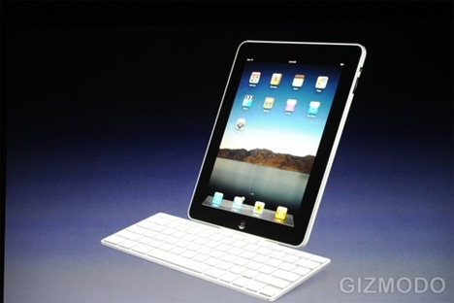
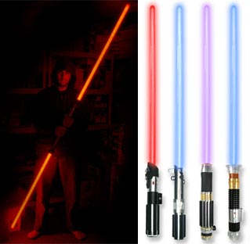
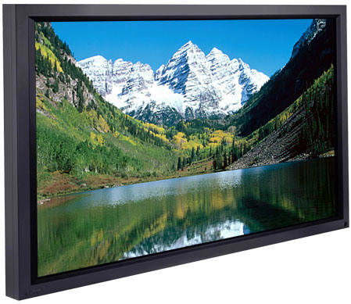
ITO widely used in electronic devices

Slide 3
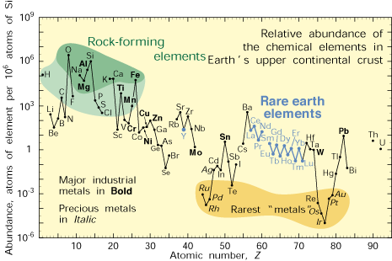

Slide 4
Considerations for p-type TCO
Positive charges (holes) act as charge carriers
Bandgap must be greater than 3eV to avoid absorption in the visible spectrum
Localization of upper edge of valence band to oxides results in low hole mobility

Slide 5
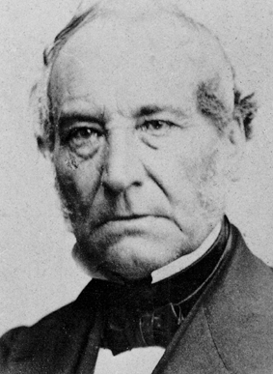
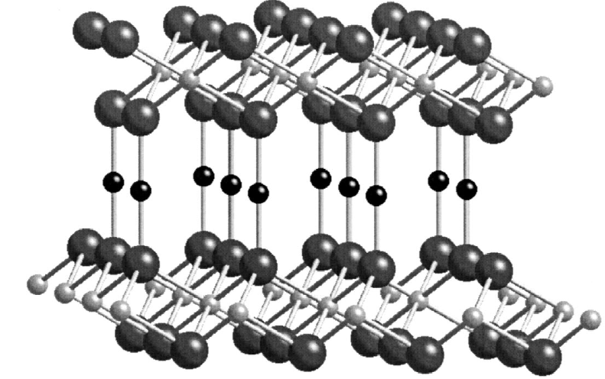
Structural characteristics of CuMO₂ delafossites
M³⁺
Cu(I)
oxygen
Gabriel Delafosse
Space Group: R3m

Slide 6
Rational design of a p-type delafossite TCO
Covalent bonding behavior between cation and oxide helps reduce localization of 2p electrons from oxide
Cation must have a closed electronic shell
Avoid coloration from intra-atomic excitation
Energy level must be comparable to 2p electrons from oxides

Slide 7
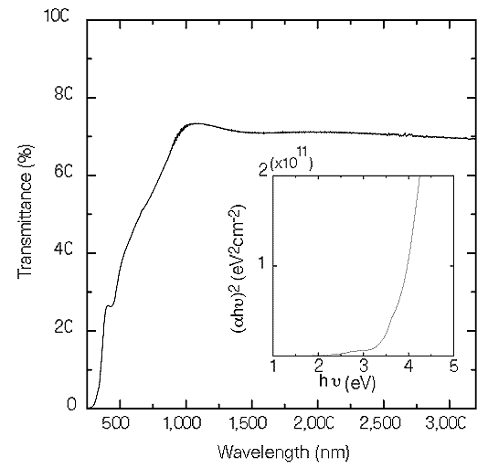
CuAlO₂ optically transparent
Estimated E_{g} = 3.5 eV
Film thickness: 500nm
Kawazoe, Hiroshi; et al. "P-type Electrical Conduction in Transparent Thin Films of CuAlO2." Nature 389 (1997): 939-42.

Slide 8
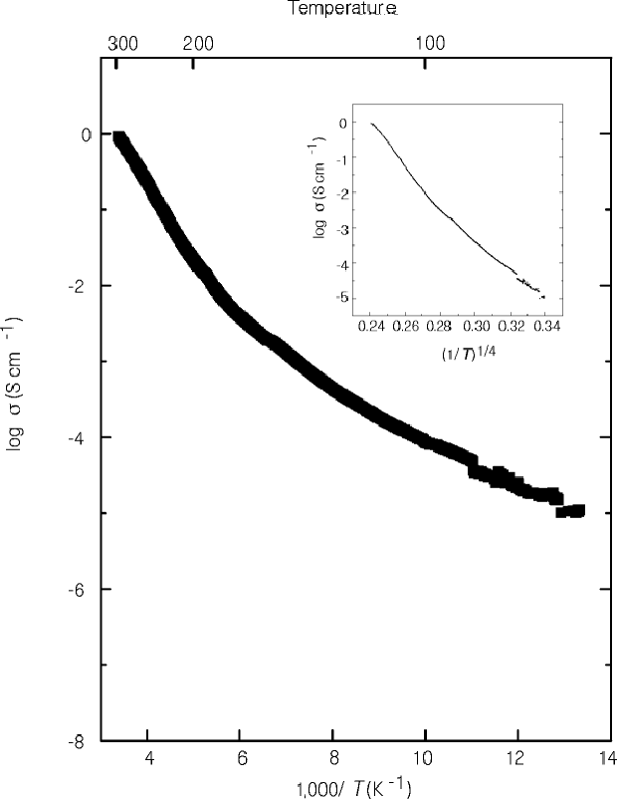
CuAlO₂ exhibits semiconductive temperature dependence
Conductivity at room temperature: 0.095 S/cm
Carrier density: 1.3 * 10¹⁷ cm⁻³
Hole mobility: 10.4 cm²⁻V¹s⁻¹
Seebeck coefficient: 183μVK⁻¹

Slide 9
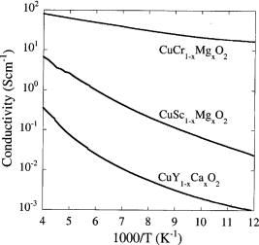
Doping with divalent cations increases conductivity
Film Thickness: 250nm
Conductivity at
room temperature: 200 S cm⁻¹
Nagarajan, R., A. D. Draeseke, A. W. Sleight, and J. Tate. "P-type Conductivity in CuCr1-xMgxO2 Films and Powders." Journal of Applied Physics 89.12 (2001): 8022-025.

Slide 10
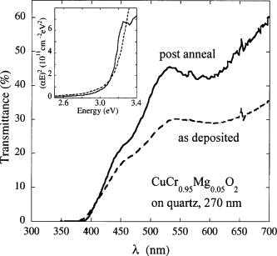
Annealing at 900°C increases transparency but reduces conductivity
Pre-annealing: 200 S cm⁻¹
Post-annealing: 1 S cm⁻¹

Slide 11
Conclusions
Cu(I) based delafossites are the leading candidate materials for p-type TCO
Origin of p-type behavior unkown for undoped compounds
Tradeoff between transparency and conductivity in doped compounds

