Slide 1
Zintl-Based Materials For Thermoelectrics
Ca₁₁GaSb₉
286G Final Presentation, 5-26-2010
Brett Compton

Slide 2
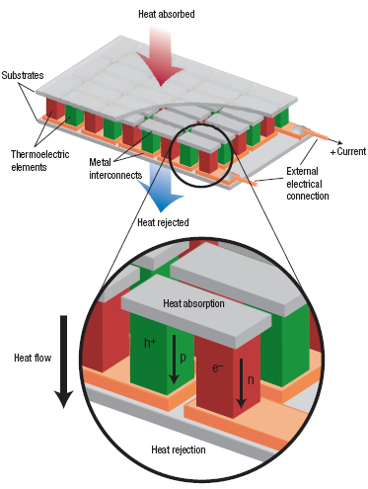
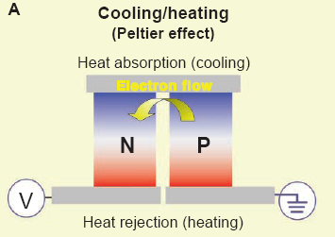
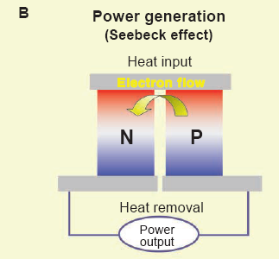
Thermoelectric Concept
Snyder and Toberer, 2008
Bell, 2008

Slide 3
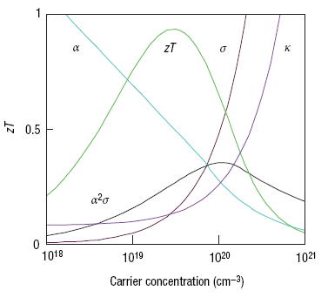
Material Property Requirements
Dimensionless Figure of Merit:
Seebeck Coefficient:
Electrical Conductivity:
Thermal Conductivity:
Electronic Contribution
to Thermal Conductivity:
Effective TE materials need tunable carrier concentrations
and low lattice thermal conductivity: “Electron crystal – phonon glass”
Snyder and Toberer, 2008

Slide 4
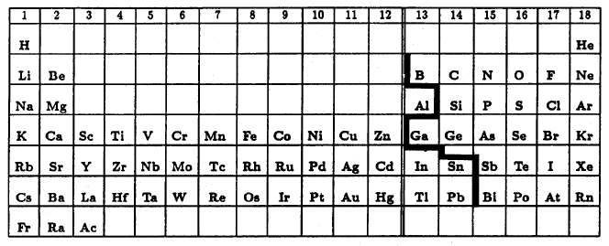
What Are Zintl Materials?
Valence balanced intermetallic compounds
with ionic and covalent bonding character.
Zintl-Klemm Concept:
There is complete charge transfer from
A to the X_{s} “Zintl anion.”
The Zintl anions then form bonds to
satisfy valence.
1. Typically: AX_{s} A: Group 1 or 2 metal
X: Semi-metal
2. Semiconducting
3. Diamagnetic
4. X – X bonding
Nesper, 1990

Slide 5
Simple Zintl Phase: NaTl
Ionic bonding results in
Na⁺ Tl⁻
[Tl⁻] has 4 valence electrons and
forms a covalent diamond structure
with the Na⁺ cations stuffing the
lattice.
The covalent network in Zintl materials provides the “electron crystal”
properties while the cation sites allow for carrier concentration tuning
and phonon scattering.

Slide 6
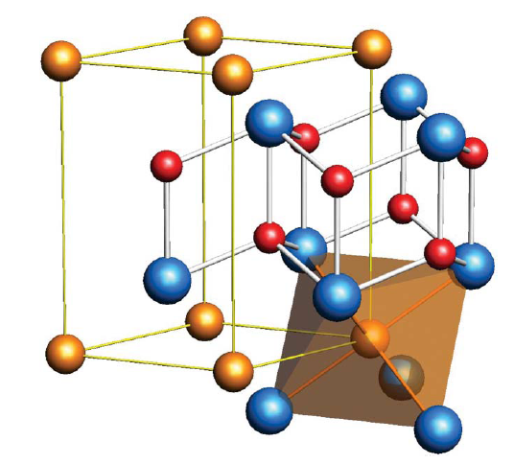
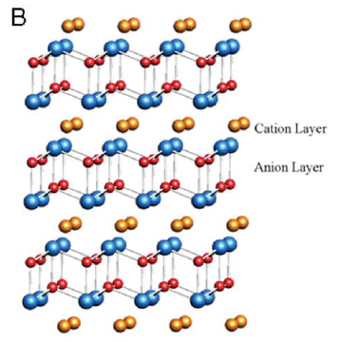
A More Complicated Example: CaZn₂Sb₂
Ca
Sb
Zn
Ca²⁺ [Zn₂Sb₂]²⁻
Ca is rather electropositive and donates two electrons to the
[Zn₂Sb₂] unit. [Zn₂Sb₂]²⁻ is isoelectronic with ZnS and forms a
wurtzite-like structure with intercalated Ca²⁺ sheets.
This is a semiconductor with a band gap of 0.25 eV.
Wurtzite
Kauzlarich et al., 2007
Notes:
Similar to Wurtzite structure with Ca2+ layers intercalated in.

Slide 7
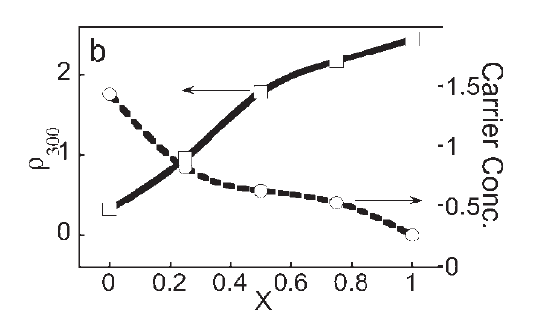
Tuning CaZn₂Sb₂ For Thermoelectric Properties
Ca_{x}Yb_{1-x}
Alloy Isoelectronic Species: Yb for Ca
(Ca_{x}Yb_{1-x})²⁻ [Zn₂Sb₂]²⁺
Sb
Zn
Yb is less electropositive than Ca which results in an incomplete
charge transfer to [Zn₂Sb₂]²⁻ and therefore high p-type carrier
concentration in the anionic lattice.
Gascoin et al., 2005

Slide 8
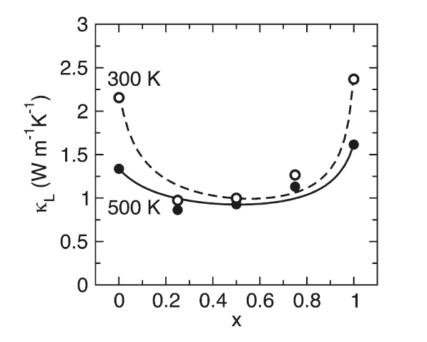
Tuning CaZn₂Sb₂ For Thermoelectric Properties
Ca_{x}Yb_{1-x}
Alloy Isoelectronic Species: Yb for Ca
(Ca_{x}Yb_{1-x})²⁻ [Zn₂Sb₂]²⁺
Sb
Zn
Additionally, Yb is much heavier than Ca (~4:1) which results in effective
phonon scattering and significantly reduced thermal conductivity.
Toberer et al., 2009

Slide 9
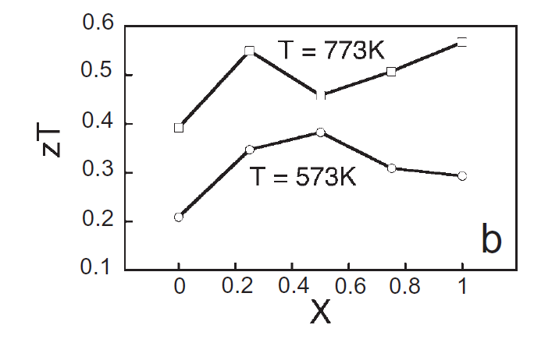
Tuning CaZn₂Sb₂ For Thermoelectric Properties
Ca_{x}Yb_{1-x}
Alloy Isoelectronic Species: Yb for Ca
(Ca_{x}Yb_{1-x})²⁻ [Zn₂Sb₂]²⁺
Sb
Zn
The combination of carrier concentration tuning and phonon scattering
can result in a significant improvement in zT for this material.
Gascoin et al., 2005

Slide 10
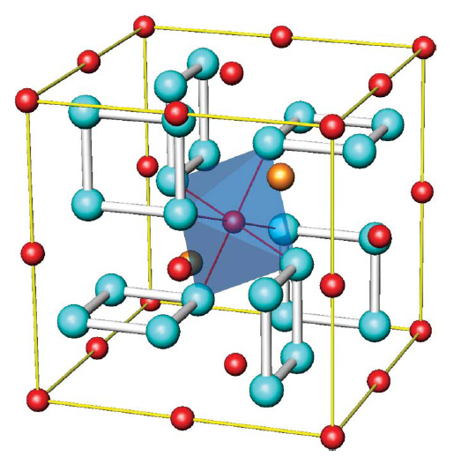
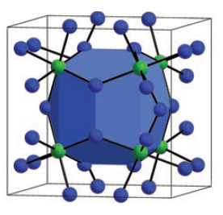
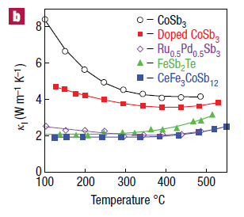
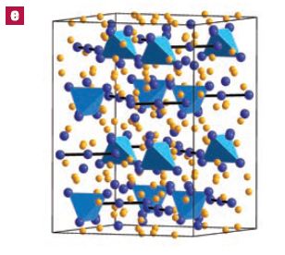
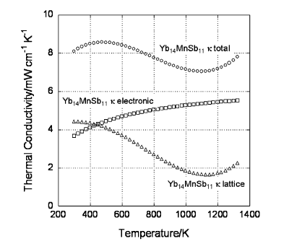
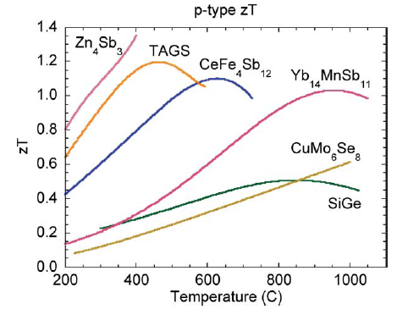
Other Zintl-based Thermoelectrics
Filled
Skutterudite: CoSb₃
14-1-11: Yb₁₄MnSb₁₁
Snyder and Toberer, 2008
Kauzlarich et al., 2007

Slide 11
References
Bell, L. E. (2008). Cooling, heating, generating power, and recovering waste heat with thermoelectric systems. Science (New York, N.Y.), 321(5895), 1457-61. doi: 10.1126/science.1158899.
Gascoin, F., Ottensmann, S., Stark, D., Haïle, S. M., & Snyder, G. J. (2005). Zintl Phases as Thermoelectric Materials: Tuned Transport Properties of the Compounds CaxYb1-xZn2Sb2. Advanced Functional Materials, 15(11), 1860-1864. doi: 10.1002/adfm.200500043.
Kauzlarich, S. M., Brown, S. R., & Snyder, G. J. (2007). Zintl phases for thermoelectric devices. Dalton transactions (Cambridge, England : 2003), (21), 2099-107. doi: 10.1039/b702266b.
Nesper, R. (1990). Structure and chemical bonding in zintl-phases containing lithium. Progress in Solid State Chemistry, 20(1), 1-45. doi: 10.1016/0079-6786(90)90006-2.
Sales, B. C., Jin, R., & Mandrus, D. (2008). Zintl Compounds : From Power Generation To The Anomalous Hall Effect. Quantum, (Skutterudite 2007), 48-53.
Snyder, G. J., & Toberer, E. S. (2008). Complex thermoelectric materials. Nature materials, 7(2), 105-14. doi: 10.1038/nmat2090.
Toberer, E. S., May, A. F., & Snyder, G. J. (2010). Zintl Chemistry for Designing High Efficiency Thermoelectric Materials † ‡. Chemistry of Materials, 22(3), 624-634. doi: 10.1021/cm901956r.

