Slide 1
Going green with chemicals and fuels Sustainable at a premium or not?
Martin Skov Skjøth-Rasmussen, Vice President, Chemicals R&D, Haldor Topsøe A/S
Workshop on Challenges and Opportunities for Sustainable Production of Chemicals and Fuels beyond the Shale Gale, February 2015

Slide 2
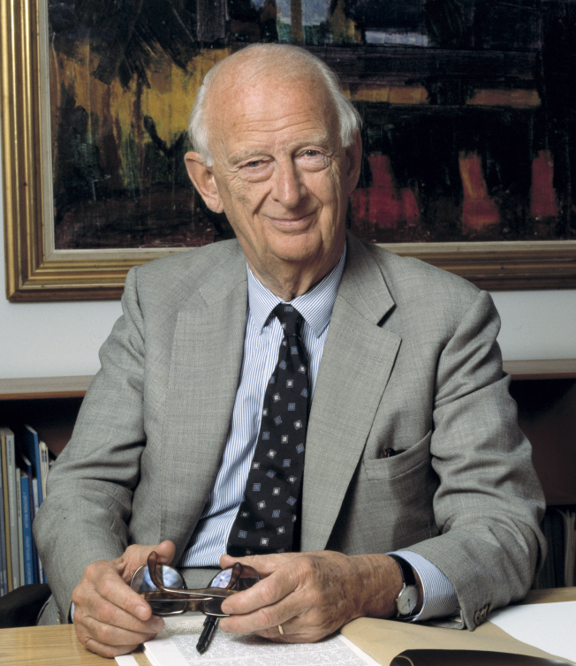
Haldor Topsoe
In brief
Established in 1940 by Dr. Haldor Topsøe.
Private 100% family owned company.
Market leader in heterogeneous catalysis and surface science for over 70 years.
2,800 employees in 11 countries across five continents.
Headquarters in Lyngby, Denmark.
Production in Frederikssund, Denmark, and Houston, USA.
New plants to open in Tianjin, China, and Joinville, Brazil in 2015.
Spend more than 10% of revenue on R&D.
2013 revenue DKK 5,348m (~ USD 1b)
2013 operating profit DKK 701m (~ USD 130m)
Notes:
Established in 1940 by Dr. Haldor Topsøe
Private 100% family owned company
Global market leader in heterogeneous catalysis and surface science
2,800+ employees in 11 countries across five continents
Headquarters in Denmark
Production in Denmark and USA.
New plant to open in China in 2015
Revenue ~ USD 1 billion in 2013
R&D spend more than 10% of revenue
We remain a very R&D centric company. 15% of our employees are engaged in R&D and in 2013 we spent 11.4% of our total revenue on R&D.
We are structured around three key operating business units: Chemicals, Environmental, and Refinery. A fourth unit, New Business Unit, focused on developing new technologies.
Our revenue was 5,3 billion DKK in 2013 and we achieved a healthy operating profit of 701 million in 2013.

Slide 3
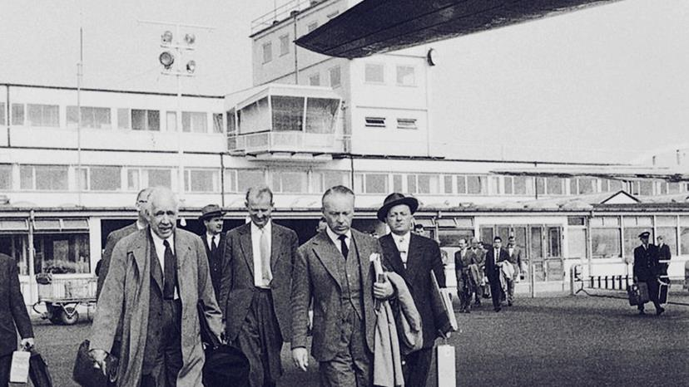
Our founder, Dr. Haldor Topsøe, had an infectious passion
for science and determination to prove it could make a difference
Our Mission:
Driven by our passion for science, we contribute to a profitable and sustainable future for our customers, their businesses, and their communities.
Notes:
Haldor Topsøe with Niels Bohr on their way to Geneva to participate in the 1958 UN International Conference on the Peaceful Use of Atomic Energy.

Slide 4
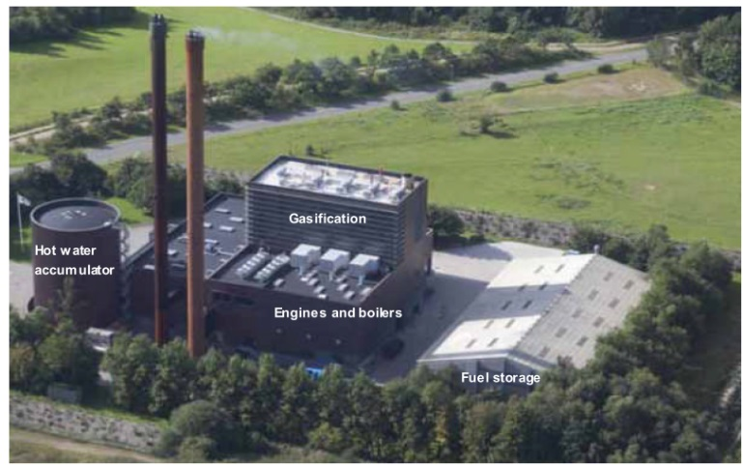
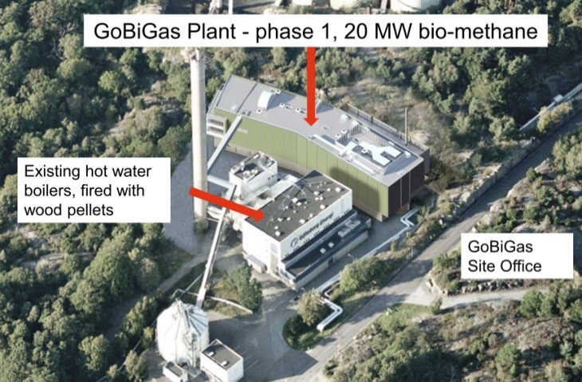


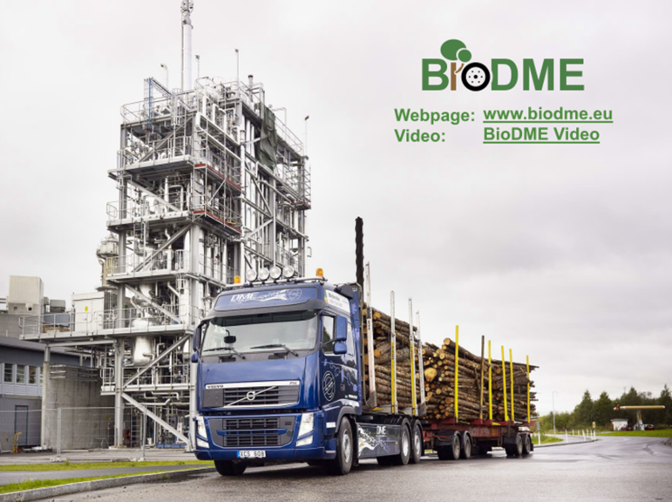


Outline of presentation
Green
Haldor Topsøe’s involvement in production of new clean fuels and chemicals
Motivation for presentation
Highlights from ongoing activities involving:
  BioElectricity and heat
  BioSNG
  BioDME
  BioGasoline
Mainly small-scale biomass based activities
  Will large scale facilities be economical ?
  Will they in fact sustainable …?

Slide 5
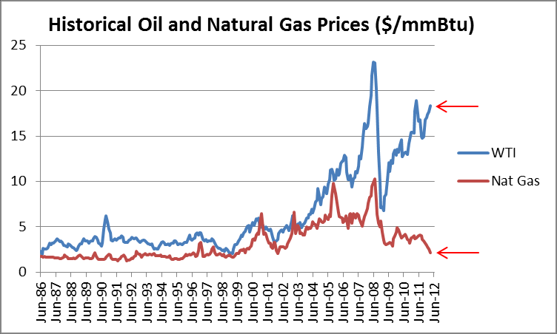
Motivation September / October 2014
Can biomass based processes compete with natural gas and oil based processes?

Slide 6
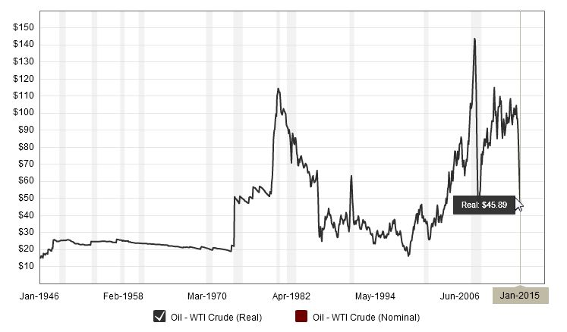
Motivation four months later…

Slide 7
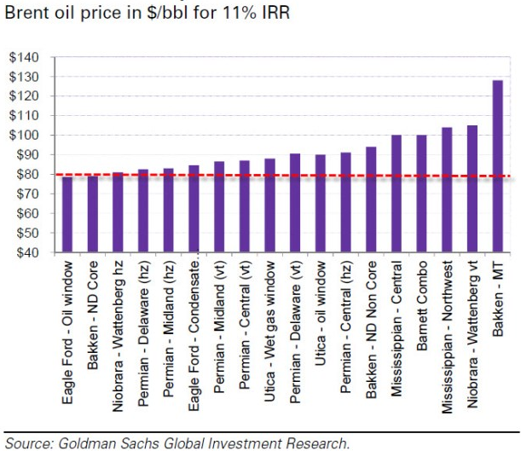
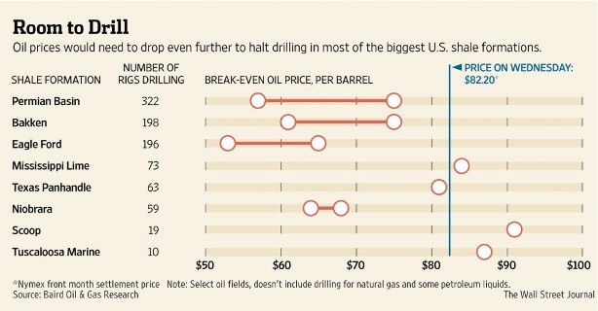
Shale gas drive…
Even the ”Shale Gale” is under pressure
While production of energy, fuels and bulk chemicals from alternative feedstocks, may have made sense a couple of months ago, - nothing competes with current oil prices!

Slide 8
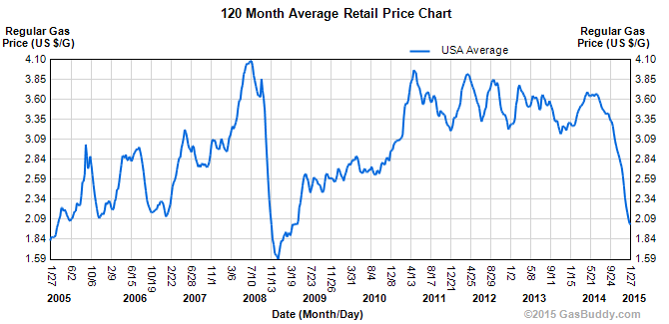
Shale gas drive, and gasoline prices on a ten year horizon…
Our work was done
at these conditions!

Slide 9
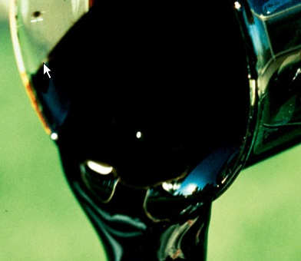
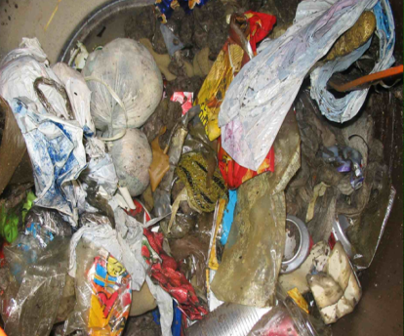
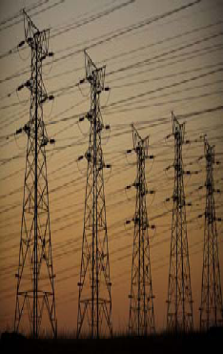


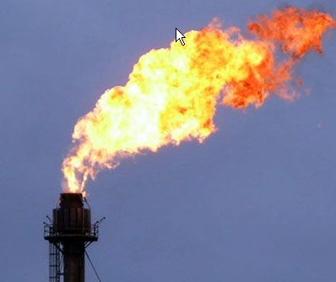
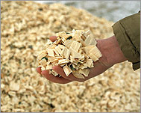
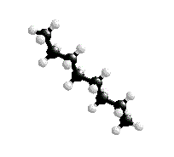
Sustainable feedstock are already available
Syngas based routes are flexible and available!
Power
Black liquor
Waste
H₂
Bulk chemicals
CO
Associated
Gas Flare
Synthesis Gas
Platform
Biomass
Liquid fuel

Slide 10

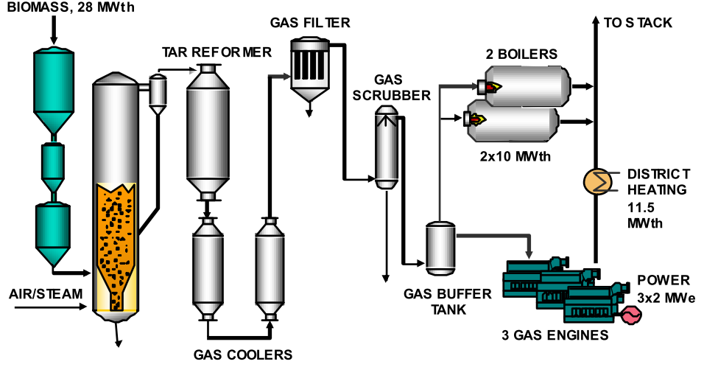


Case 1: Skive CHP plant in Denmark
28 MWth CHP plant operating since 2010 on wood pellets
Gasification Plant Process:
  Air blown, low pressure bubbling fluidized bed gasifier
  Catalytic tar reforming, gas cooling, filtration, and scrubber
Power Plant Process:
  3 Gas Engines with heat recovery and 2 Gas Boilers
Haldor Topsøe primarily involved in Tar reforming
  Increases gas production
  Convert polyaromatic components to an extent that allows the syngas to cool for further processing without fouling or precipitation
  Utilize the high temperature levels from gasification for increased efficiency
Plant requires a week ship load of wood pellets to Skive Harbor to operate

Slide 11
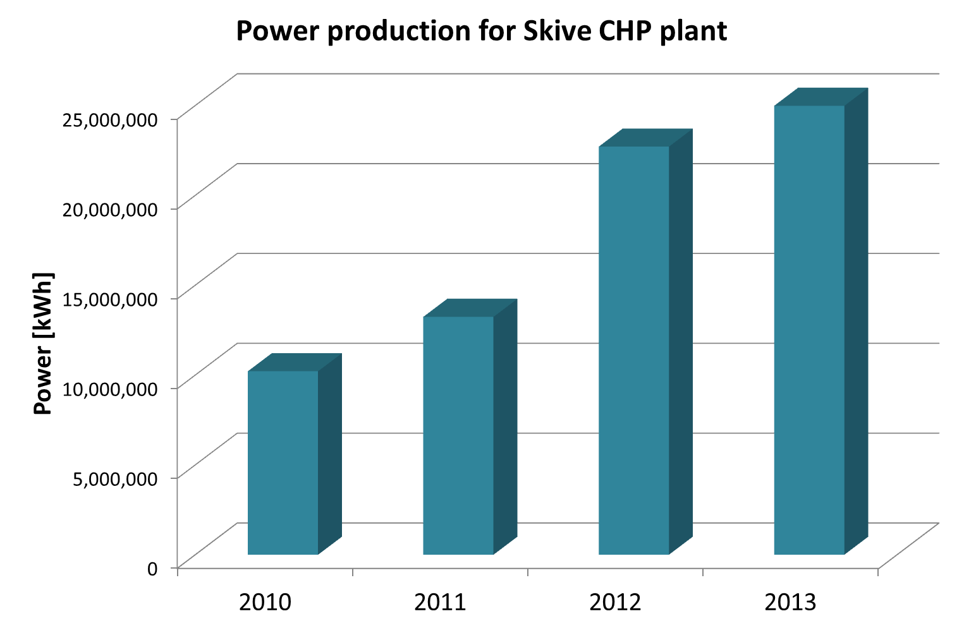
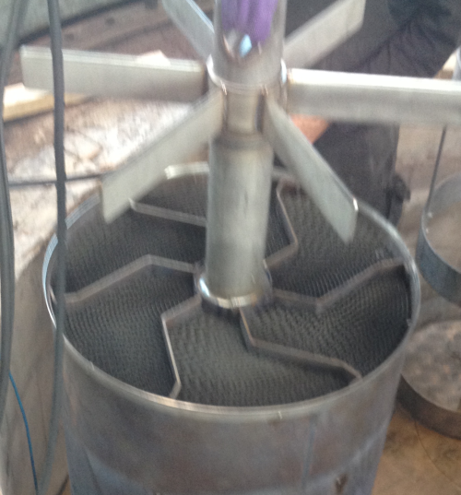
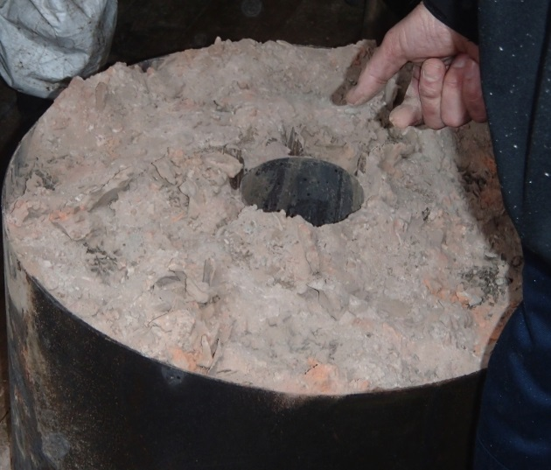
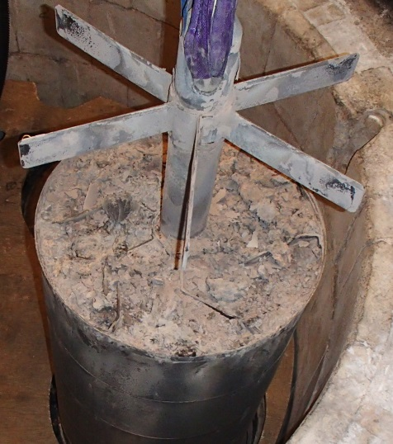
Case 1: Skive CHP plant in Denmark
Challenges, improvements and performance
Achievements today:
  Total efficiency 84%
  Electric efficiency: 28%
  Heat efficiency: 56%
Now on-stream ~7000 hr per year
After original start-up two joint follow projects required to improve performance
Dust handling is difficult and causes fouling of tar reforming catalyst
Frequent planned regenerations to increase on-stream factor
Still issues with ash handing, since bottom ash is pyrophoric
Gas cleaning and conditioning is a challenge – many volatiles
Fresh
After 4- 5 months of operation
Skimminig is required

Slide 12
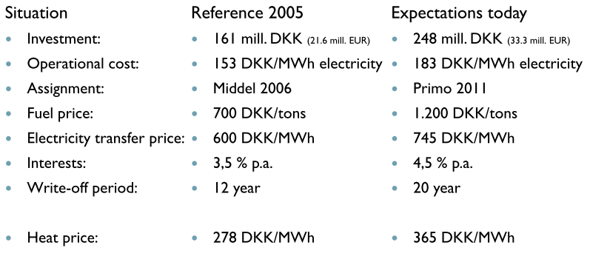
Case 1: Skive CHP plant in Denmark
Economics
at start-up
Total invesment: ~40 Milllion US$
  EU, DOE, & DK grants: ~ 5Million US$
Operational cost: ~27US$/MWh electricity
Fuel price: ~180US$/ton
Electricity transfer price: ~113US$/MWh (US ~8 US$/100kWh)
Heat price: ~10US$/MWh (NG Equivalent ~35 US$/MMBTU)
Interest: 4.5% p.a.
Write-off period: +20 years
A significant premium is required on energy sales prices

Slide 13
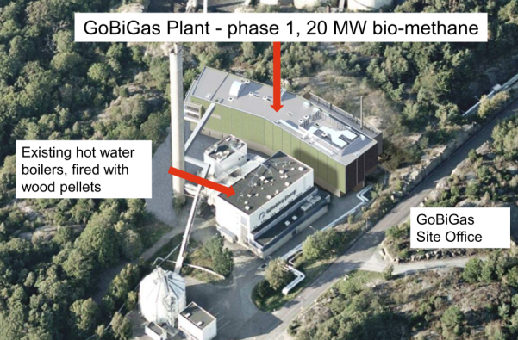
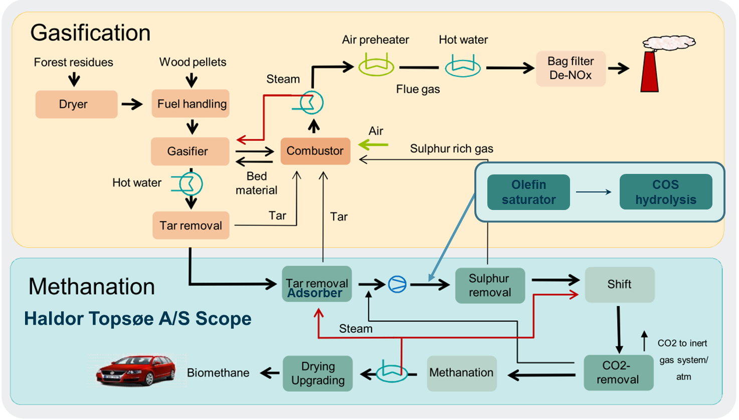

Case 2: GoBiGas BioSNG production in Sweden
20 MW BioSNG plant operating since 2013/15 on wood pellets
and forrest residue
Evaluation during 7 years – until 2020
  Start-up 2013 – Grid supply Jan. 2015
Cooperation between:
  Göteborg Energi AB/ GoBiGas and suppliers
Purpose to learn from the demonstration plant to enable scaling up to 100 MW in phase 2
Evaluation of the following parameters:
  Product quality
  Plant performance – efficiency etc.
  Plant availability
  Environmental footprint
  Maintenance needs
  Operating costs

Slide 14
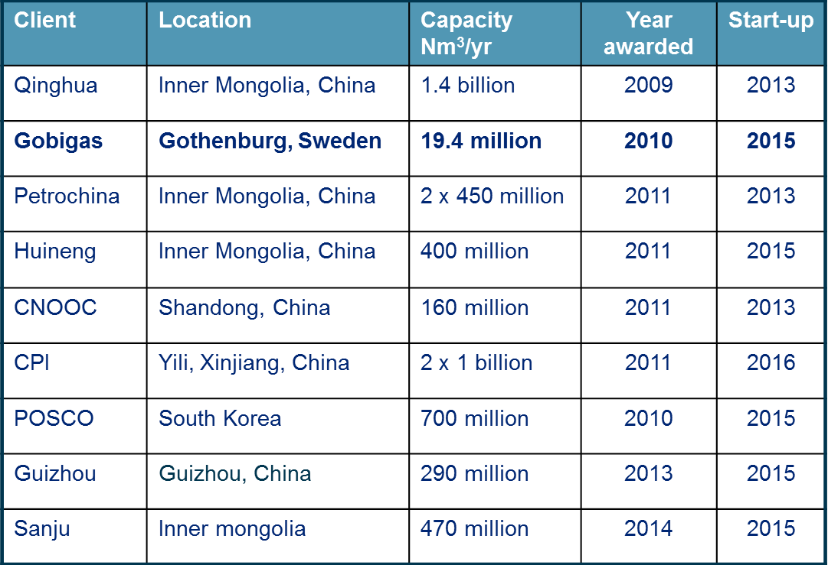
Case 2: GoBiGas BioSNG production in Sweden
Early perspectives…
Plant size order of magnitude smaller than coal and coke oven gas (COG) based plants
Complexity higher than coal based plants, and significantly more complex than COG plants
Some technology solution less proven than those applied in coal and COG based plants
Phase 2 - 100MW plant:
  Will also be small when compared to coal and COG based plants
  Will require around 4 -5 ship loads of wood per week
Plant lacks the economy of scale achieved with coal based plants
E.On granted +200 Million € by EU to build 100MW, but are hesitant to initiated project…

Slide 15
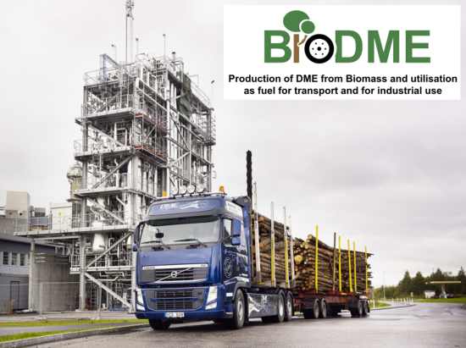







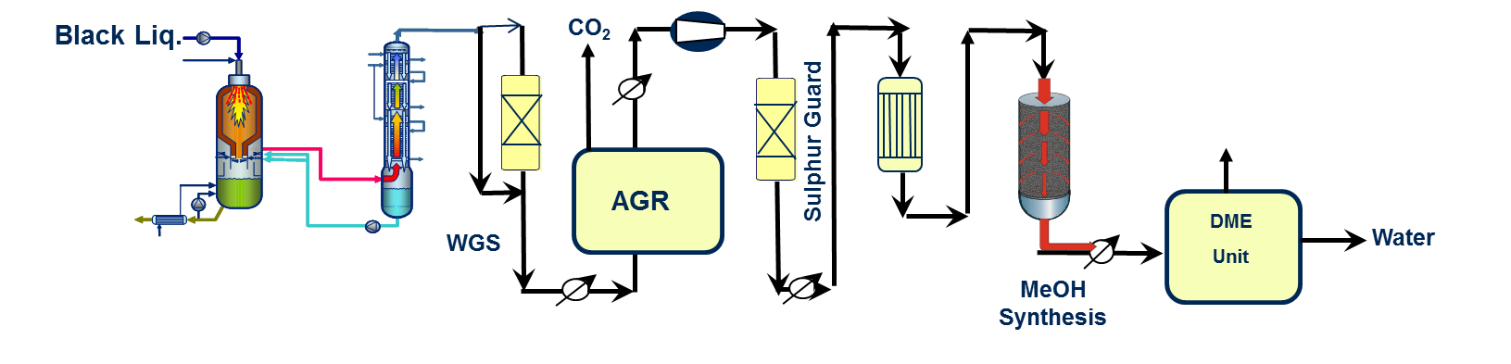
Case 3: Piteå BioDME pilot plant
4 tons BioDME pilot operating since 2010 on black liquor
Demonstration of new once-through methanol technology
Demonstration of integrated fuel production from black liquor at paper mill
BioDME to be demonstrated as diesel substitute
Project partners:

Slide 16
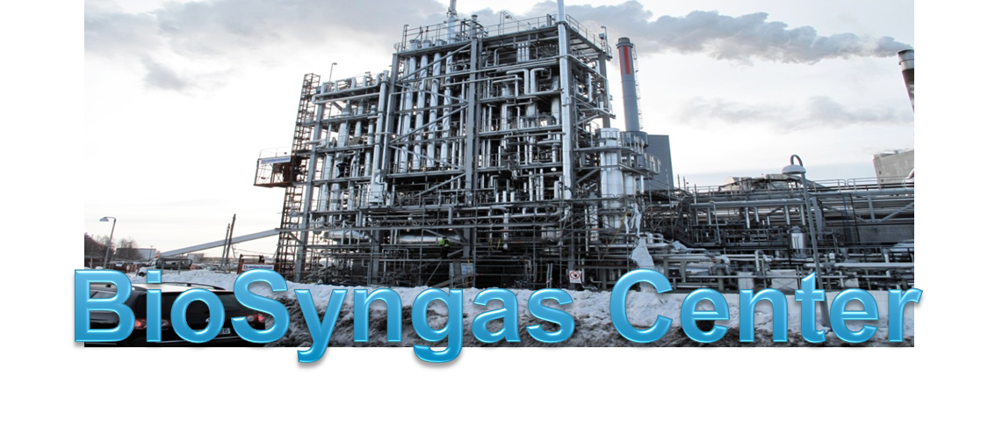
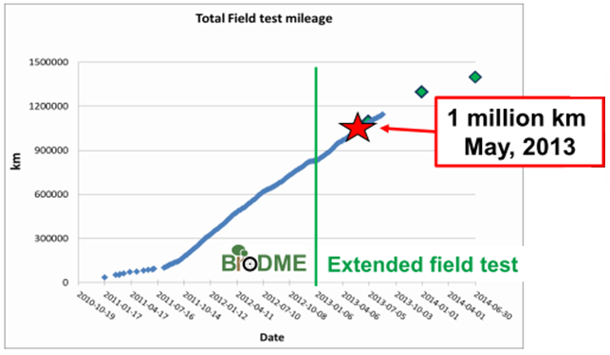
Case 3: Piteå BioDME pilot plant
Project achievements
Production of >4 tons of DME per day demonstrated September 2013
Production of >4.5 tons of methanol per day demonstrated November 2014
More than 1.250.000 km cover by trucks in fleet test
One truck has covered more than 250.000 km
Funding for 3 more years demonstration obtained from Swedish Energy Agency Jan 2014
BioSyngas Consortium established by Luleå Technical University
  Focus on alternative feedstocks
  Focus on alternative downstream products

Slide 17
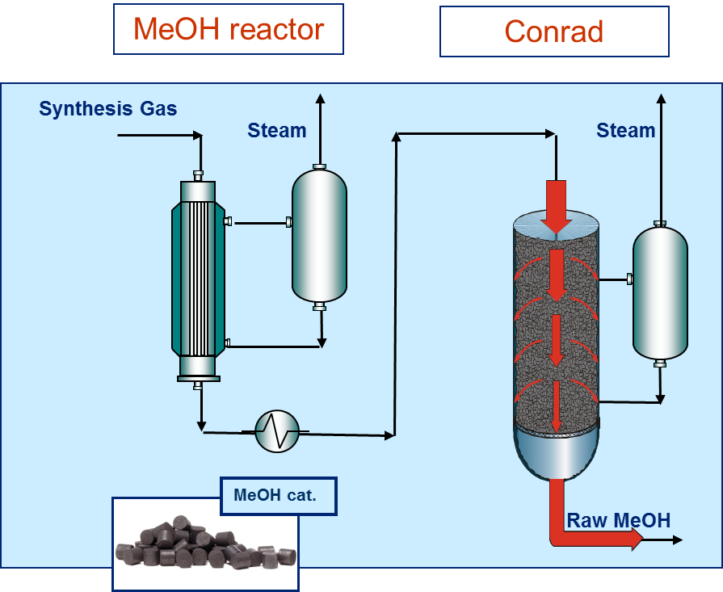
Case 3: Piteå BioDME pilot plant
Project outlook and economics
On the bright side
Paper mills are suffering in Scandinavia and North America!
Availability of black liquor is not nearly as good as originally anticipated!
All commercial projects have been abandon
Sweden could cover the nations entire need for transpotation fuels from three plants operating on waste wood!
The commercial tax-free breakeven price for BioDME from black liquor is approximately 7US$/Gallon
Scenario with no tax on transportation fuels:
  Government has to accept a considerable income loss, and find alternative revenue streams
  Tax payers have to accept new taxes and less money to spend
Succesful demonstration of new once-through methanol converter

Slide 18






Case 4: Wood 2 Gasoline pilot at GTI in Chicago
waste
25 bbl/d gasoline production tested 2013 - 2014
Gasifier
Scrubber
Morphysorb
Tigas
Off-gas
Gasoline
Wood
chips
Oxygen
steam
Water

Slide 19
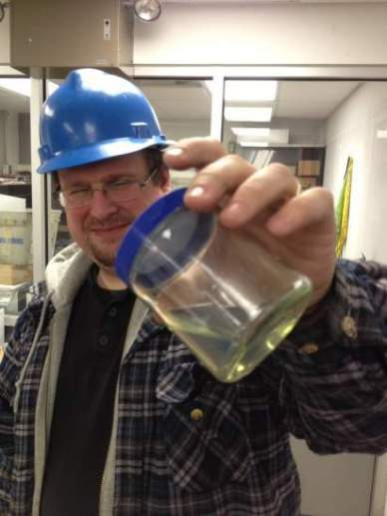
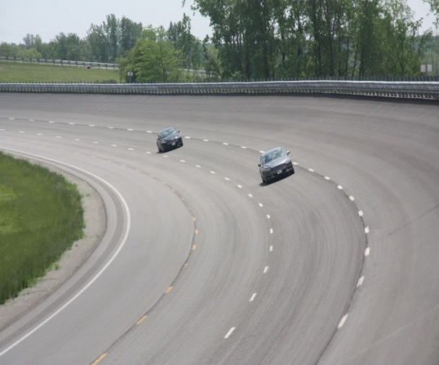
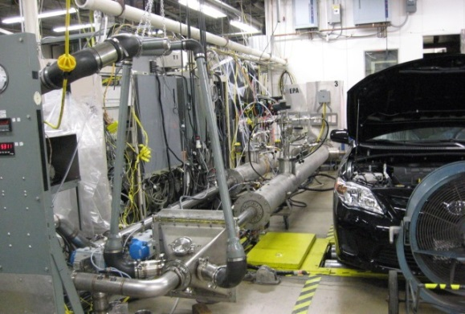

Case 4: Wood 2 Gasoline pilot at GTI in Chicago
Wood2Gasoline achievements
Status:
  +1000 hours of operation
  > 2000 gallons gasoline product
  RON = 97, MON =86
Independent engineer approval: October 2013
Engine Emissions Testing
  Toxicology review of gasoline components approved by Phillips66
Gasoline testing af SwRI:
  80/20 blend found to be ” substantially similar” to conventional gasoline
NACE TM01-72 corrosion test by Innospec Fuel Specialties
Fleet Testing
  75,000 mi using EPA SRC
  2 Camry’s (2.5 L PFI),
  2 Corollas (1.8 L PFI)
  2 F-150’s (3.5 L V6 EcoBoost®),
  2 Fusion’s (1.5 L EcoBoost®)

Slide 20
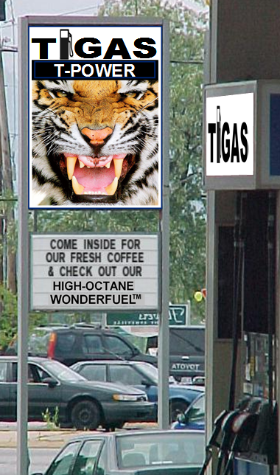
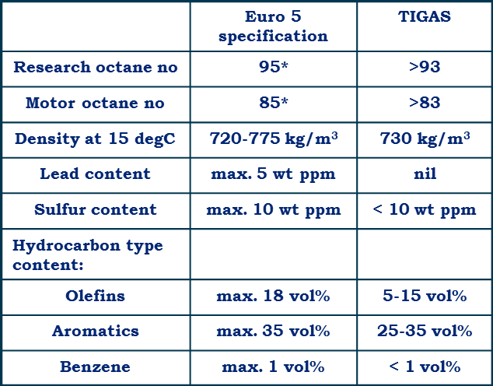
Case 4: Wood 2 Gasoline pilot at GTI in Chicago
Comparison to conventional gasoline and plant efficiency
Process efficiency in commercial biomass based plant
Energy efficiency:
  45% input energy (biomass) converted to final products(gasoline + LPG)
  State of the art GTL plant >90%
Carbon efficiency
  32% input carbon (biomass) converted into final product (gasoline + LPG)
  State of the art GTL plant >80%
*) Including ethanol (octane booster), and country dependent
Industrial plants awarded:
15.500 bbl. NG based (Turkmenistan)
XX.X00 bbl. coal based (China)

Slide 21
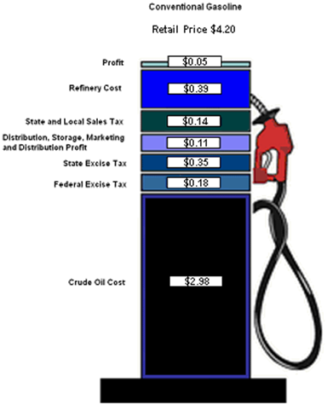
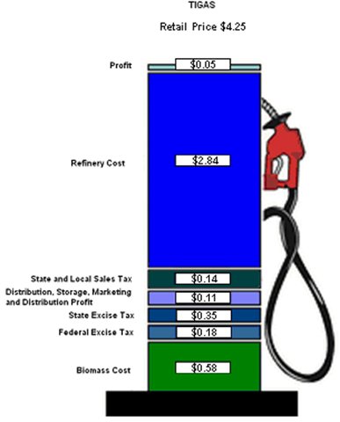
Case 4: Wood 2 Gasoline pilot at GTI in Chicago
Project economics
Crude prices year 2020
You have to pay a premium if you want green gasoline
Crude at $155/barrel
Source: AEO2013 - Report Number DOE/EIA-0383(2013) http://www.eia.gov/forecasts/aeo/
Gasoline retail price – example California Year 2020

Slide 22
Summary of leanings
Pro’s and Cons for bioderived fuels and chemicals
Feedstock supply may require additional logistics
Feedstock may be limited in quantity locally
Transport of feedstock may not be economic over wide ranges
Energy efficiencies are low
Carbon efficiencies are low
Small to medium size plants miss the economy of scale
Capex are equally high or higher when compared to conventional gas and oil based plants
OPEX are likely to become higher
People will have to pay a premium
Syngas based technologies are available
Feedstock will be available for centuries
Partial solution to green house gas emissions
Plenty of room for improvement (Work for us all…)
  Technologies far from optimized
  No work on process intensification
Independency of geopolitic instabilities
  Opportunity to become self supplying
Biomass already contain high chemical complexity if recovered properly
  The syngas route works, but may not be optimal
We are not going to see a bio to fuels and bulk chemicals revolution, but some evolution

Slide 23
So what are the future alternatives to biomass?
Waste is more opportune than biomass,
    Waste will often have similar or higher chemical complexity than biomass
    Everyone see the problems!
Wind and solar energy to chemistry
  Solar energy to chemistry – like nature?
  Electricity to chemistry:
    Electrolysis, Induction, Plasma, …
Coal
  Resources are available
  Traditional mining may not be attractive
  Could UGC be the future solution?
Often with emphasis on small scale decentralized productions,, which will require low CAPEX solutions
Low CAPAEX may result in:
Low efficiency
Shorts equipment lifetimes
Increased consumption and more waste

Slide 24
Beyond the low oil prices the ”Shale Gale” will reemerge
Beyond and during the ”Shale Gale” UCG (Underground Coal Gasification) will take of and become an important source to fuels and bulk chemicals
Biomass will only make sense if the more complex chemical structures can be isolated and recovered

Slide 25

Thank you

