Slide 1
Issues in Renewable Energy and Feedstocks from a Big Chemical Company Perspective
Jim Stevens
Dow Distinguished Fellow (retired)
Global Research & Development
The Dow Chemical Company

Slide 2
Key Points of My Talk
Today’s chemical feedstocks are byproducts of fuel production
  Unlikely to change because of relative scales.
  The scale of chemistry / feedstocks is enormous, fuel is ~20-25 times larger
Biofeedstocks are likely to provide only a fraction of our current needs for fuels or feedstocks because of low solar conversion efficiency.
Only high efficiency (≥30%) solar-based processes have a chance to provide a sustainable source of all needed fuels and feedstocks.
There are significant sources of fossil carbon that will provide headwinds for sustainable fuels / feedstocks until global warming becomes too obvious to ignore and precipitates a crisis.
  Quadrillions of dollars of carbon must be left in the ground.
Slide 2

Slide 3





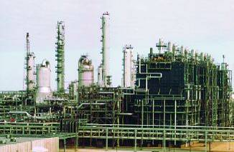
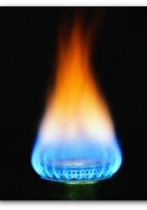



The Chemical Industry
Global Chemical Industry
>95% of the world’s goods use
chemistry as a building block
NaCl + e⁻
190 Bn lbs
1.1 kWh per lb Cl₂
C₂
219 Bn lbs
(2.4% by wt of
global oil scale)
C₃
138 Bn lbs
(1.5% by wt of oil)
C₄
20 Bn lbs
C₆
[Global Oil Consumption ~ 9 x 10¹² lbs/yr – US EIA 2011]
77 Bn lbs
The chemical industry uses 38 EJ (8% of world energy consumption)
The chemical industry uses 40 Quads (8% of world consumption)

Slide 4
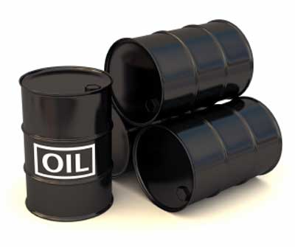
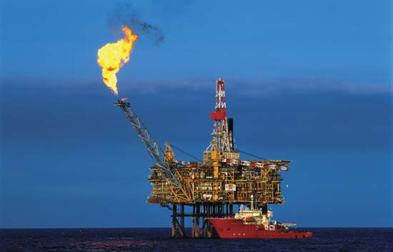
Where Do Most Chemicals & Plastics Come From?
By-products of the energy business are the major chemical feedstocks
Naptha
5-6 C atoms: poor choice for gasoline
Ethane
C₂H₆: 1-6% of natural gas

Slide 5
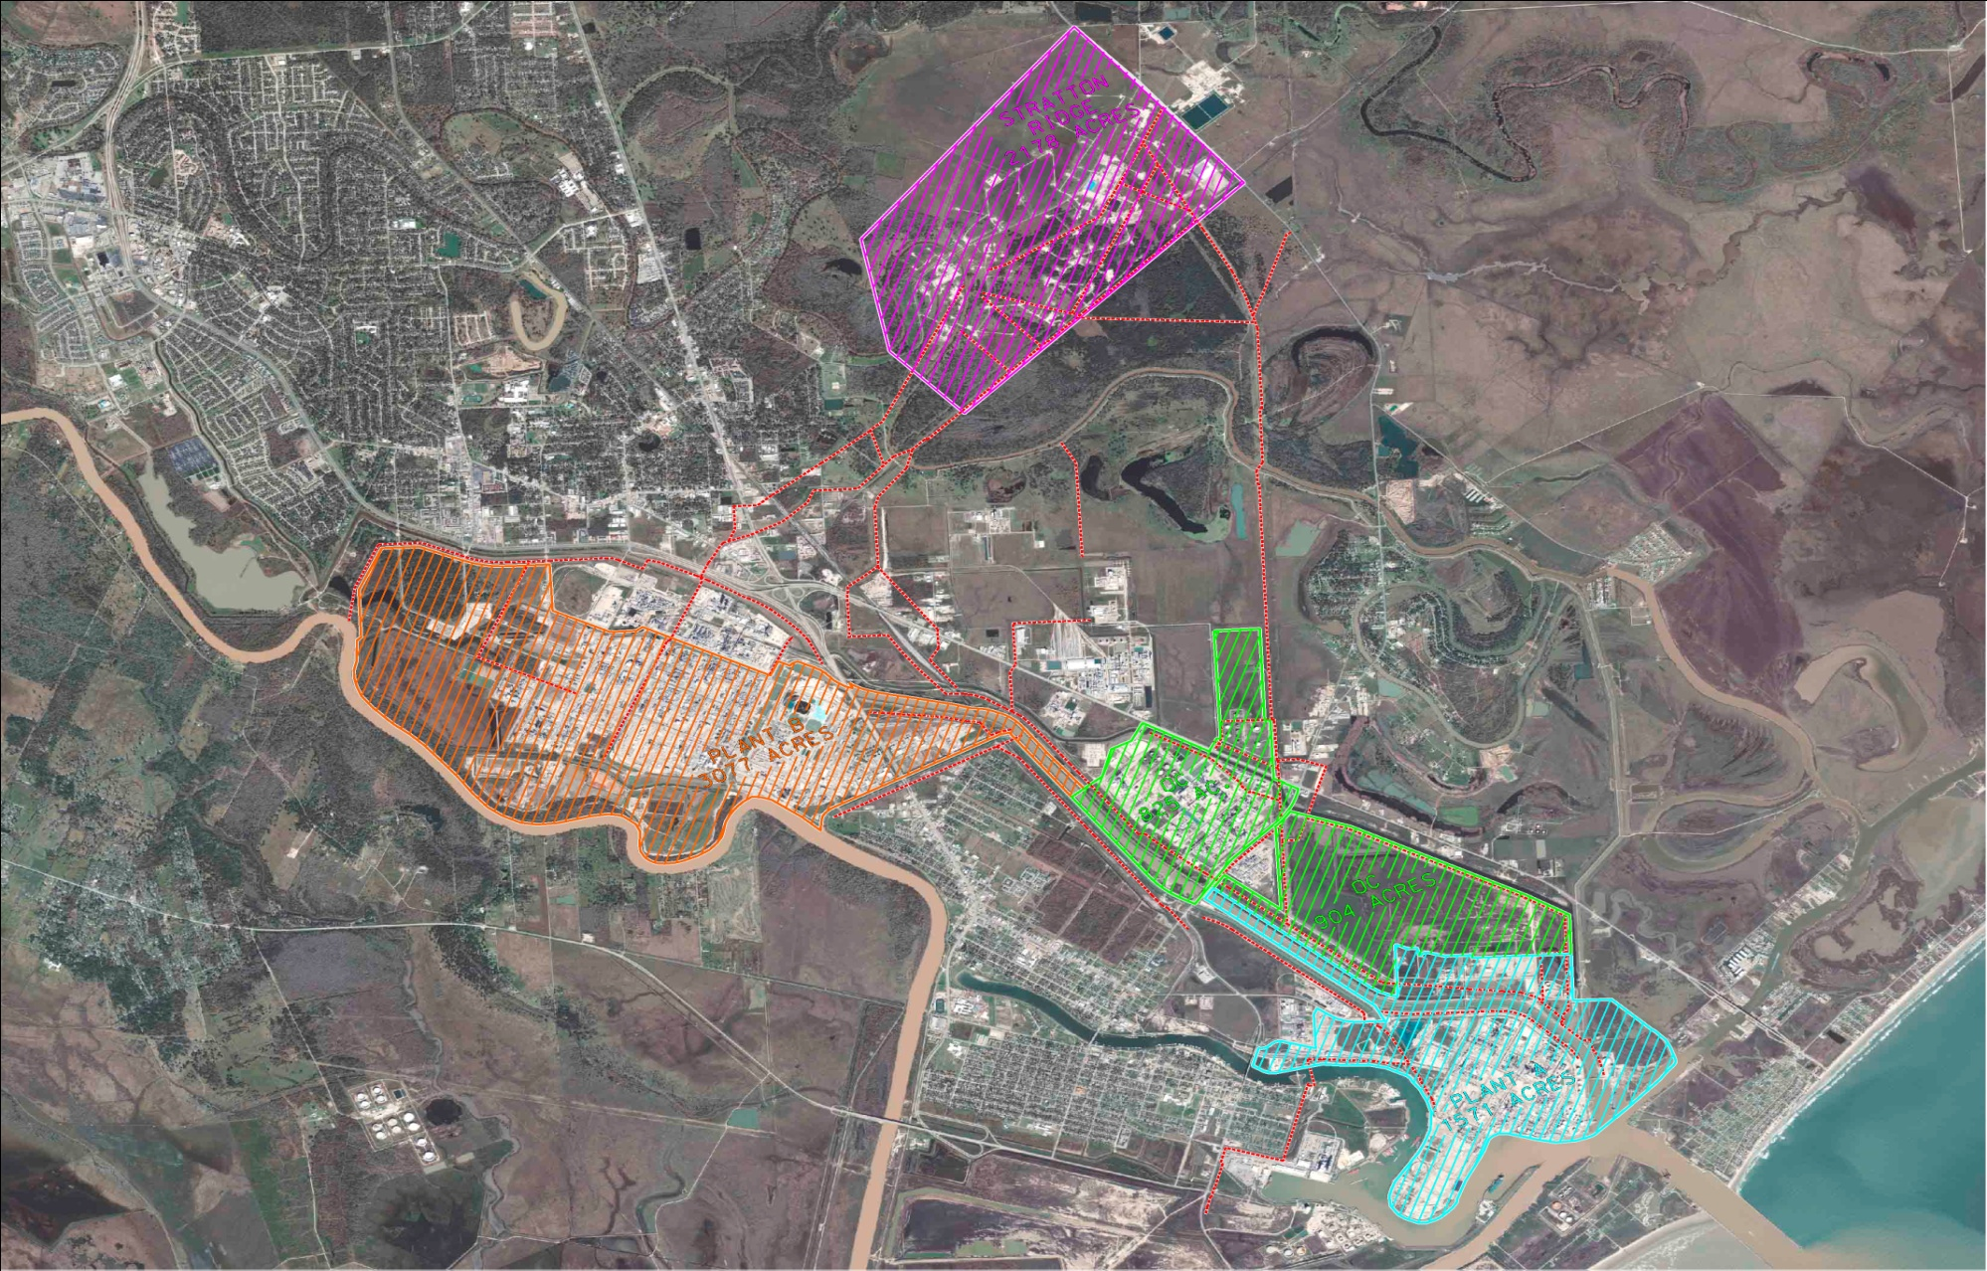
Texas Operations - Freeport

Slide 6
Texas Operations - The Basics …
Worlds Largest chemical complex
Comprised of 4 major facilities around Freeport, Texas covering 20 sq miles
  Waterways & pipe corridors covering 3,200 acres (1300 hectares)
  4,700 acres used for reservoir operations (1900 hectares)
  9,500 acres used for grazing, non-production (3800 hectares)
67 production plants serving all Dow business portfolios
8,500 Dow and contract/service employees
Dow globally has 6,500 employees in R&D (mostly Ph.D’s)

Slide 7
Texas Operations - The Basics …
Produce 25 billion pounds of product (11,500 metric tons)
Underground storage for hydrocarbons of 90+ million barrels
  Dow uses ~1M barrels of oil equivalent/day as feedstock
Generate 1300MW of power
  The amount used by 1.5 million homes – about the size of Houston daily
  Dow consumes as much electricity as Australia
65 Miles of Rail track with a capacity for 2000 rail cars
  Equivalent to a Short Line Railroad – Dow US Rail Fleet is 16,000 railcars
Industrial water system (off Brazos River) supplies local municipalities and 6 additional industrial users
  1 million gallons/day of Potable Water production
  100,000 gallons/min of industrial water production

Slide 8
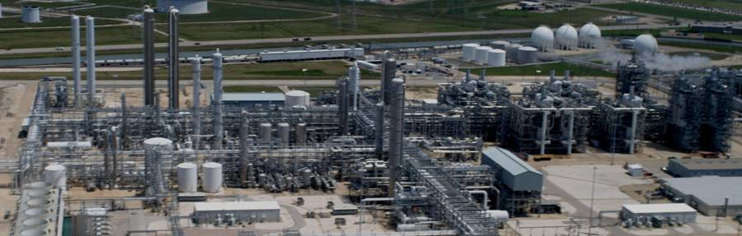
Current Olefins Technology
LHC-8 Freeport, TX
14 Dow crackers worldwide
Plant asset base is worth over $15 billion
Dow crackers convert over 5 million pounds of mostly ethane feedstock every hour!
Recently announced $4 billion Freeport TX ethane cracker, propane-to-propylene – both startup 2016-17.
Key products include ethylene, propylene, butadiene, benzene, toluene

Slide 9
Efficiency of Chemical Industry
1
1
0
1
0
0
9
0
8
0
7
0
6
0
5
0
4
0
1
9
9
0
1
9
9
1
1
9
9
2
1
9
9
3
1
9
9
4
1
9
9
5
1
9
9
6
1
9
9
7
1
9
9
8
1
9
9
9
2
0
0
0
2
0
0
1
2
0
0
2
2
0
0
3
2
0
0
4
2
0
0
5
I
n
d
e
x
e
d
I
n
t
e
n
s
i
t
y
1
9
9
0
=
1
0
0
%
D
o
w
G
l
o
b
a
l
E
n
e
r
g
y
C
o
n
s
u
m
p
t
i
o
n
A
m
e
r
i
c
a
n
C
h
e
m
i
c
a
l
I
n
d
u
s
t
r
y
E
n
e
r
g
y
C
o
n
s
u
m
p
t
i
o
n
U
S
A
T
o
t
a
l
E
n
e
r
g
y
C
o
n
s
u
m
p
t
i
o
n
Dow uses about 1 Million barrels of oil equivalent per day (feedstock + energy)

Slide 10

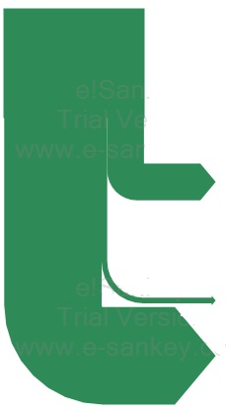
Energy & Feedstocks for Chemical Industry
Carbon Stewardship
Chemical Industry*
Ethane to Polyethylene**
Ethane
Nat. Gas, Naphtha, Fuel Oil, Coal, &
Biomass
10560 TWh
Fuel Uses = 49%
Energy to produce
ethylene = 26%
Energy to produce
polyethylene = 4%
Contained in Products = 51%
Energy conserved
in polyethylene = 70%
*EIA 2004 Refining Data and IEA Energy Technology Transitions for Industry 2009,
**Energy and Environmental Profile of the U.S. Chemical Industry, May 2000, Energetics Inc.

Slide 11

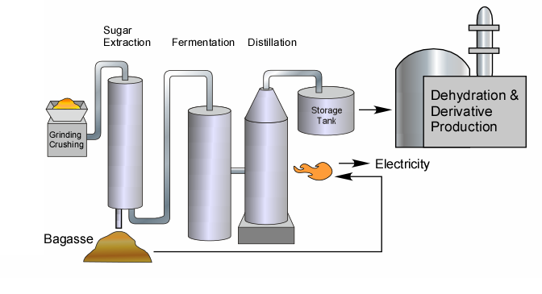
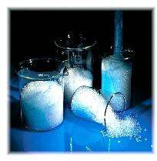
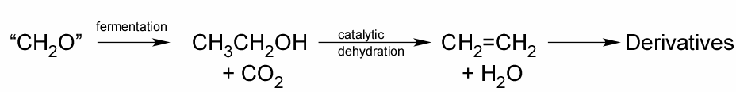
Brazilian Biomass as Chemical Feedstock
CO₂
700 Million lbs / yr ethylene and derivatives (currently ethanol)
2.2 B pounds CO₂ sequestered, 2.4 B pounds O₂ released
Recyclable polyethylene plastic (CO₂ fixation)
Existing infrastructure for ethanol in Brazil
High polyethylene price in Brazil.
High hydrocarbons cost in Brazil.
463 square miles of cane! (~0.2% Efficiency sunlight to ethanol)

Slide 12
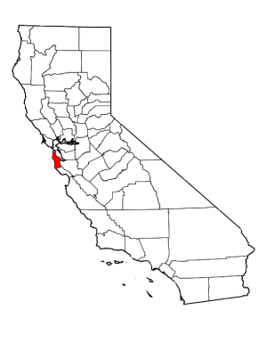
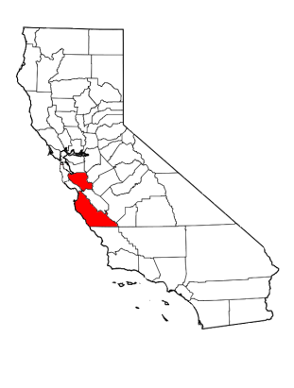

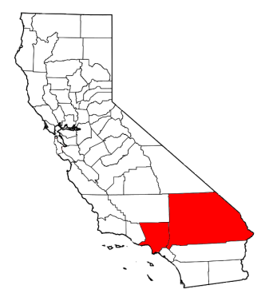
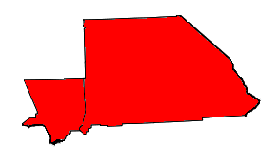

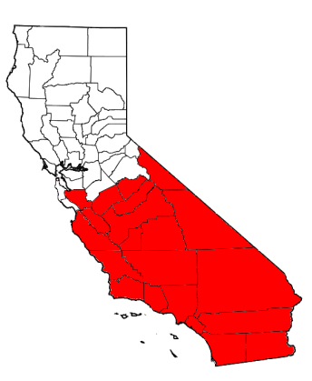
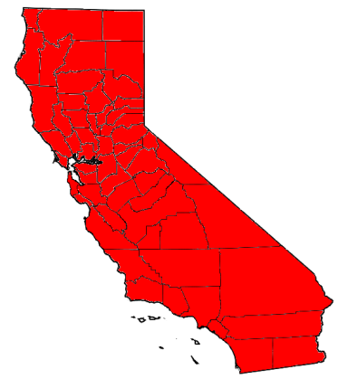
Benchmarking Land Use
Dow Brazil Plant
Dow LLDPE Capacity
Global LLDPE Capacity
San Mateo
Monterey & Santa Clara
San Bernardino & Los Angeles
Assumes Brazil Cane Yields – Corn Requires ~5-10X the Land
Global Polyethylene
Global Ethylene
Notes:
Numbers are based on Dow’s cane ethanol-to-ethylene yield in Brazil of 350 kTA for 120,000 hectares. Since 120,000 hectares = 463 miles squared, then 1 square mile gives 350/463 = 0.756 kTA.

Slide 13
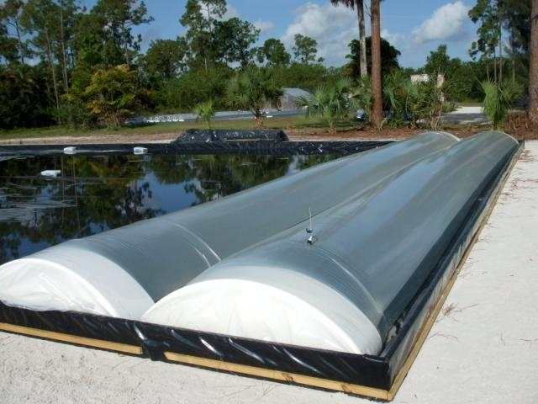
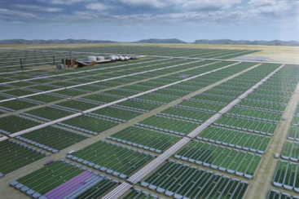
Algae-based CO₂ to Ethanol to Ethylene to Polyethylene for Carbon Capture and Sequestration
Dow has evaluated technology to build and operate pilot-scale algae-based integrated biorefineries that will convert CO₂ into ethanol.
Sustainability Profile
Sugar Cane
Algae
Tropics
Large fresh water input
Prime arable land
Potential loss of forest land
Near ocean and power plant (CO₂ source)
Salt water
Desert / waste land
High cost of bioreactors, systems

Slide 14
Cost and Time to Implement Fuel from Biomass
9% of US Liquid Fuel Consumption in 2020
3% of US total Energy Consumption in 2020
1 New Plant every 8 days
∼$200B in capital
National Academy of Engineering Projected Biomass (550MM ton) with Thermochemical Process
Actual Growth from
Corn Ethanol
Data shown in 2020 includes only the energy generated by the 550 MM ton of biomass with performance of 2012 DOE target
Notes:
KEY POINT: If the projected biomass availability for 2020 (550MM ton) is indeed available in that time frame, the capital required to convert that biomass into ethanol exceeds $200billion dollars and 1 new plant has to built every 8 days. This shows how massive the investment is to produce ethanol from biomass due to the small economy of scale. What is even more concerning is that this significant investment would only generate 9% of the US liquid fuel consumption (on an energy basis) and 3% of the US total energy consumption.
The national academy of sciences states that the following points are potential rate-limiting steps for biomass availability:
Efficient delivery of geographically distributed biomass
2) Environmental concerns from farmers of removing crop residues from fields. Farmers will insist on being adequately compensated for the time, labor, and other expenses incurred in harvesting, storing, and delivering crop residues as well as for the nutrients, carbon content, and erosion control that will have to be replaced with increases fertilization and other strategies if the materials are harvested and sold as biofuel feedtsock
3) Another important concern, especially for midwestern farmers, is the amount of time available to handle stover when grain harvesting, trucking, storage, and fall tillage already accupy almost all their available time and labor between crop maturity and the onset winter weather. Any threat to slow down grain harvesting will be viewed with skepticism.
4) Another concern is that additional wheel traffic will increase soil compaction and that on-farm storage will require space or even facilities that are not available on many parcels of land
Additional data:
The National Academy of Science projects that 550MMton of biomass could be available by 2020. For that to happen, these are key assumptions:
Corn Stover – for continuous corn, 2.3 ton/acre has to be left on fields to sustain soil carbon and control erosion. Anything above that can be harvested
Corn rotated with soybean requires 3.5 ton/acre to be left to meet those needs.
The panel assumes that future increases will mirror those achieved in the past 30 years
Wheat straw and grass straw – future increases are based on historical rates of increase in crop fields
Hay – assumes that price increase in biomass will encourage higher yields in hay
Dediciated biofuel-biomass crops – assumed that 24MM acres would be planted in perennial plants
DOE Targets for 2012 Thermochemical Process:
Conversion Efficiency 83.7 gal EtOH/ ton dry biomass
Capital for the plant is $432MM from DOE target.
Source of Biomass:
2020 Liquid Trasnportation Fuels from Coal and Biomass forecasts 550million ton of Biomass potentially available by 2020

Slide 15
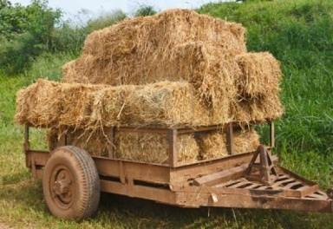
The Scale Challenge
12 Refineries = 796 Cellulosic Ethanol Plants (100million gal/year each)
$83.2B $344B
ENERGY DENSITY
Crude oil 37 MJ/L
Corn Stover (dry) 2.6 MJ/L
Refineries capacities and cost from World Wide Construction update report, O&G Journal, Dec. 6 2010
Distribution in US for cellulosic Ethanol Plants is illustrative and does not represent real locations
Notes:
Calculations
Energy efficiency of refineries 90%
Cellulosic Ethanol Plants assumed at 100 million gal/year
1bbl/day = 49.8 ton/year (BP statistical report)
1ton of oil = 40 million BTU
1 gal Ethanol = 76000 BTU
Cellulosic Ethanol Plant Cost = $432MM
Illustrative purpose: Necessary Plants 796 / Shown Plants 745

Slide 16

The Scale of Industry
Largest Social Community on Internet
Original Investment
0.05% of Global Electricity Generation
Revenue $1051MM/y
0.02% of Global Electricity Generation
Revenue $441MM/y
Capital for Single Plant
2% of Global MEG Consumption
0.3% of Global Ethylene Consumption
Sources: facebook original investment showing combined amounts from Peter Thiel (PayPal cofounder), Accel Partners and Greylock Partners as described in the History of facebook on wikipedia; Power Plants: RL34746 report - Stan Kaplan - Congressional Research Service; MTO: PEP Report 261 – SRI and EG: PEP Repor 2I – SRI; Revenues for Power Plants calculated using 2010 electricity average retail prices (all sectors) 9.88 cents/kWh (data from DOE)
Notes:
KEY POINT: The Energy and Chemical Industry operate on, at least, one order of magnitude more expensive environments than small start up companies in IT space that are claimed to be “ aggressive, creative and Innovative”. The chemical industry is creative and it is Innovative but the bill to be paid is very high…making a simple pilot experiment costs millions of dollars .
Sources:
facebook original investment showing combined amounts from Peter Thiel (PayPal cofounder), Accel Partners and Greylock Partners as described in the History of facebook on wikipedia;
Power Plants: RL34746 report - Stan Kaplan - Congressional Research Service; MTO: PEP Report 261 – SRI and EG: PEP Repor 2I – SRI;
Revenues : calculated using 2010 electricity average retail prices (all sectors) 9.88 cents/kWh
Electric Power Monthly with data for December 2010
Report Released: March 11, 2011
http://www.eia.doe.gov/cneaf/electricity/epm/epm_sum.html
Capacity Factors for Power Plants used from RL34746 report - Stan Kaplan - Congressional Research Service (90% Nuclear and 85% Pulverized Coal)

Slide 17
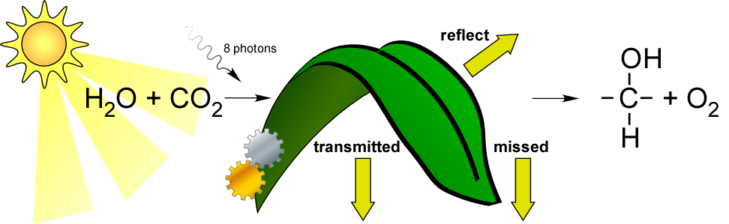
Limits to Photosynthesis
5%
17 MJ/kg
5%
Any low efficiency solar process will consume unreasonable land area to provide current energy needs
  Biomass
  PV
  Solar H₂
  Biofuels
Efficiency (Ideal conditions)
Cane to ethylene (tropics) ~ 0.2 %
Corn, dry (whole plant): 0.3%
Microalgae ethanol: ~2-4% (potential)
~0.6% (current lab)
US Farm Crops (edible portion) 0.05%
EtOH - Corn(net, best technology) 0.02%
Switchgrass, US, dry 0.3%
~2/3

Slide 18
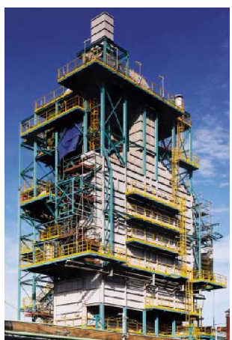
Feedstocks and Energy Issues
Naphtha
Ethane
Higher Energy Content
Propane
Benzene
PP
Styrene
HDPE
LDPE
PS
Propylene
EG
EO
Biomass
CO₂
Dow’s Top 15 Products (by mass)
LLDPE
PO
VCM
Ethylene
Ethyl
Benzene
EDC
Acrylic
Acid
-4
-3
-2
-1
0
1
2
3
4
Average Carbon Oxidation State

Slide 19
Issues With ANY Solar Process
Especially bio-based processes (US area – 3.7 MM mi² all 50 states, land only)
US

Slide 20
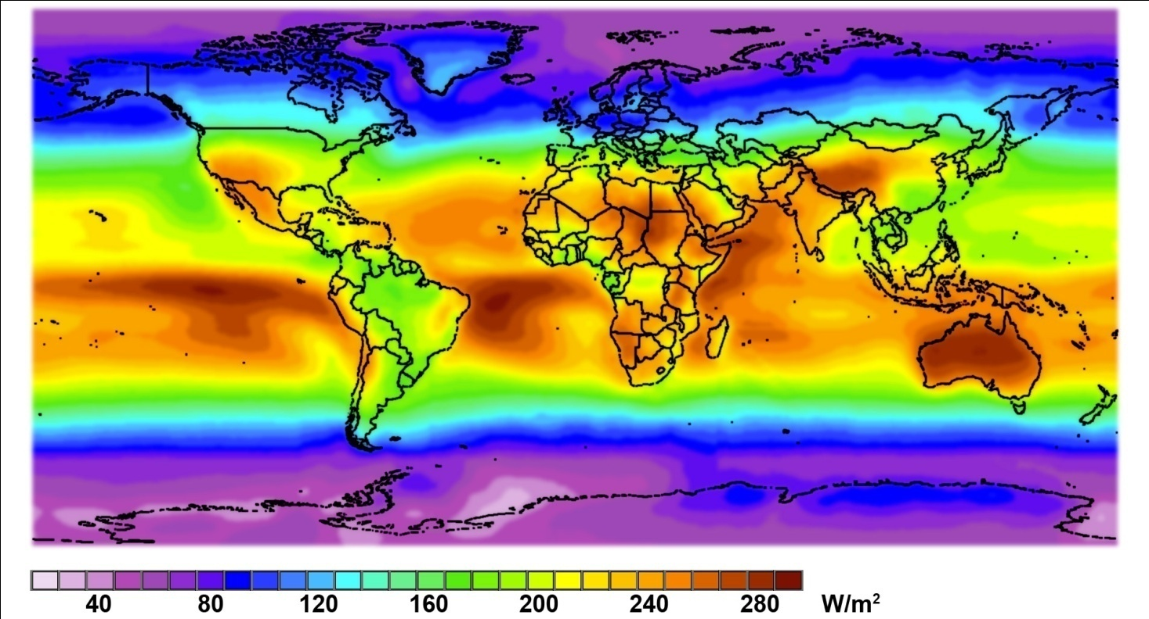
Potential for Biomass Solar Energy
Current use of ~475 EJ projected to grow to 1,900 EJ by 2050
At 0.1 % efficiency, requires 70% of all land on Earth for current needs
For 2050, need 2.7 Earths
Total solar energy on land
= 697,000 EJ/year
1300 times world needs!
Average Solar Radiation 1990-2004
Adapted from Mines ParisTech / Armines ©2006
Notes:
With an energy need that is increasing at this rate, it is necessary to find additions to our use of fossil fuels. Note that I do say ‘additions to” and not “alternatives to”. Because the truth is we will have to use other energy sources IN ADDITION TO fossil fuels in order to meet this increasing need in a cost effective fashion. The fact is that fossil fuels are inexpensive and convenient. And plentiful. But unfortunately not limitless. And not entirely benign.
Our only other option is….the sun.
Obviously any alternative energy we adopt will have to be solar based. Solar energy represents 99.9% of the energy available on the earth – geothermal and tidal total to less than 0.1%. There is no end in sight to this energy source. In fact, the amount of solar energy that makes it to the ground is 1000 times what we need to meet our current energy needs! And it can serve as a primary source of energy (as heat), or a secondary source…for example it can serve as the energy source to grow plants, which can be used as energy. And this source, biomass, is one that has had renewed interest. Truth is, biomass was the first non solar energy source and it is still used by more than a third of the population as their only energy source (2.4 billion people in the world still use wood and only wood for energy).

Slide 21

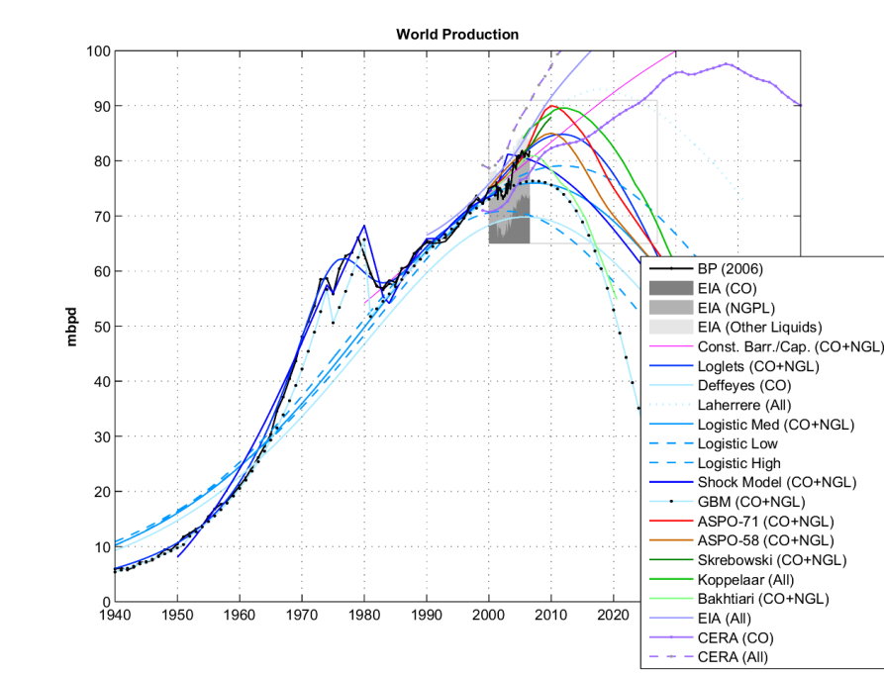
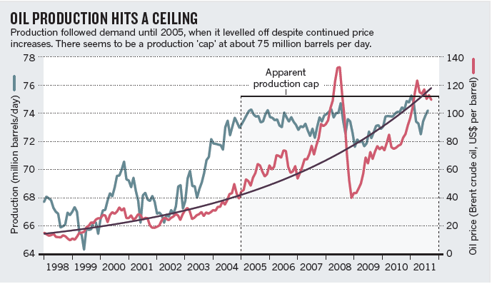
Is There a Looming Hydrocarbon Shortage?
“All the easy oil and gas in the world has pretty much been found. Now comes the harder work in finding and producing oil from more challenging environments and work areas” William Cummings, Exxon-Mobil ,2005
J. Murray, D. King, Nature 2012, 481, 433.

Slide 22

Or Not?
“The Earth’s supply of hydrocarbons is almost infinite.” Clive Mather, CEO Shell Canada, referring to oil sands and shales.

Slide 23
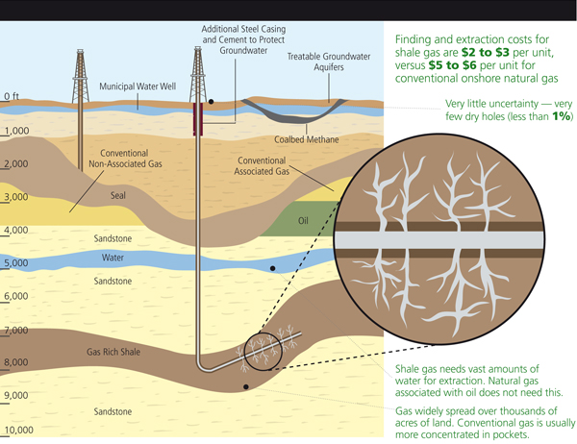
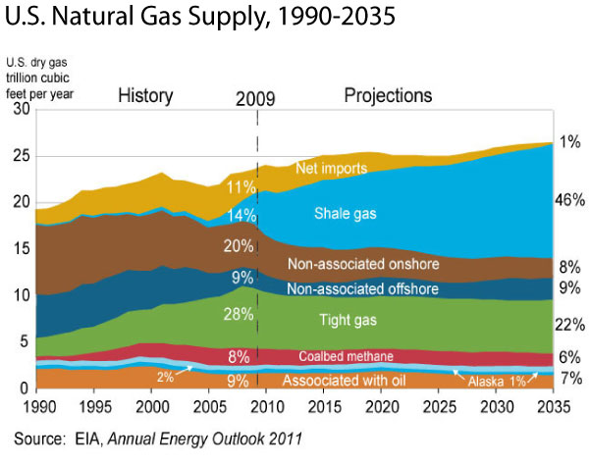
Dynamic Headwinds - Shale Gas
Explosive growth of shale gas will have implications for US energy policy, renewables.
Current glut of natural gas (CH₄) has led to lowest prices in decades. $15.38/MBTU (2005) - <$2.30 today
Downward pressure on transportation fuels, especially for trucks.
Glut of by-product ethane – 4 major new crackers announced (3 US Gulf coast), 4 major plant expansions.
There is an abundance of fossil carbon in sinks
  Every O₂ molecule in atmosphere balanced by a stored carbon atom.
  We have used ~0.095% of atmospheric O₂ since preindustrial times (potential for 1000X more fossil carbon available.

Slide 24
Value of Solar Energy*
Efficiency | 100% | 20% | 10% | 5%
Electricity value, per day.m² | $0.59 | $0.12 | $0.06 | $0.03
H₂, g/day.m² | 127 g | 25.4 g | 12.7 g | 6.3 g
H₂ value, $ | $0.14 | $.028 | $0.014 | $0.007
H₂ volume, STP, gallons/day.m² | 376 | 76 | 38 | 19
Maximum System Price Required to Achieve 10-year Payback, incl. BOS
PV Electricity, per m² | $2153 | $430 | $215 | $107
Solar H₂, per m² | $511 | $102 | $51 | $25
*Assumptions:
Electricity at US residential national average (11.81 ₵/kWh)
Hydrogen at $1.10/kg, Gulf Coast 2011 contract, delivered in 500 kg tube trailer.
5 kWh/m² average US insolation.
Electricity is currently more valuable than fuels or feedstocks.

Slide 25
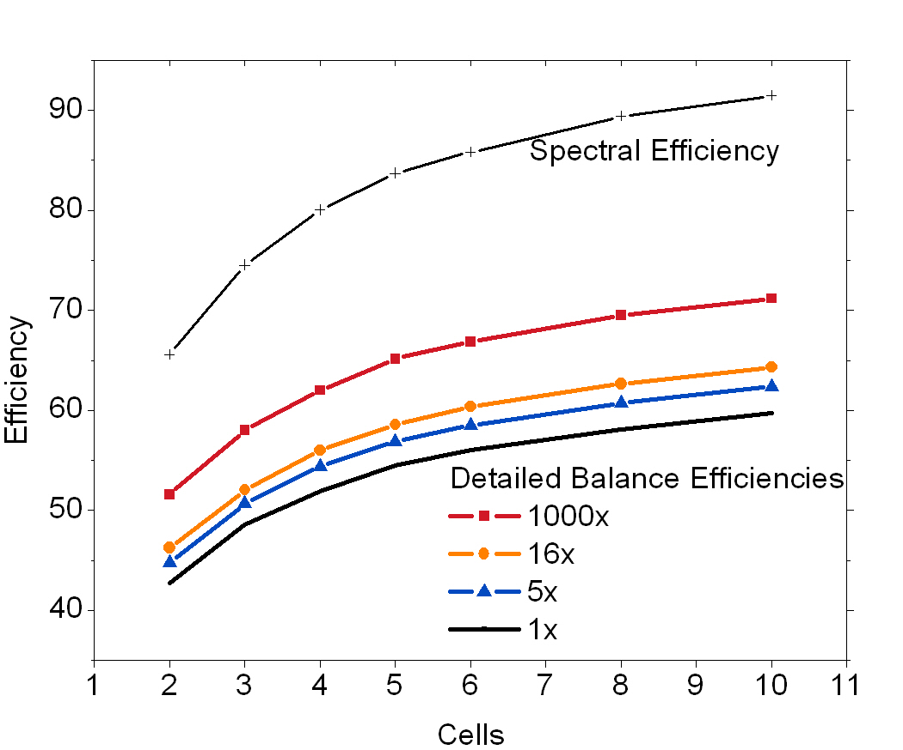
High Efficiency is Possible for New Solar Cell Architectures
Optical spectral splitting with independently electrically connected sub-cells matched to spectral slices.
8 cells is a good match to existing PV materials with very high efficiency potential.
More cells – higher complexity. Fewer cells – lower cost.

Slide 26
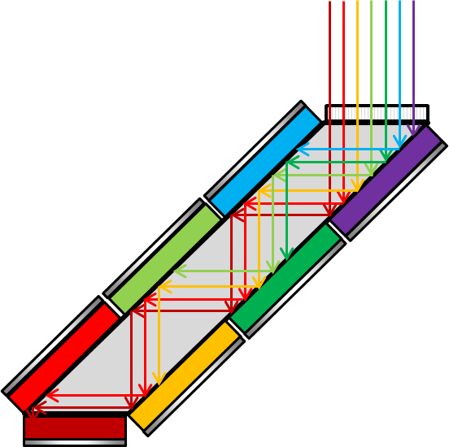
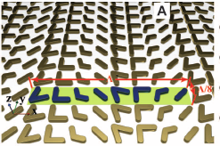

Potential High Efficiency Full Spectrum Structures
Light Trapping Filtered Concentrator
Polyhedral and Stacked Cells
Holographic Splitter
Phase Antenna Array Splitter
d
d
Antenna array: X. Ni, et al., Science (2012).
“The newly discovered generalized version of Snell’s law ushers in a new era of light manipulation”
Holographic optics: Torrey, et al., J. Appl. Phys. (2011).

Slide 27
Significant Society-Changing Challenges
Higher efficiency, lower cost photovoltaics.
  Land area required is a steep function of efficiency. Can we get >50% efficiency at low cost?
Lower cost electricity storage.
  Li-ion batteries currently ~$650/kWh, 0.5 MJ/kg.
  Gasoline – $0.10/kWh (@$3.76/gal), 47 MJ/kg
  Flow batteries? Recent claims of $125/kWh
Practical way to store electricity in chemical bonds
  Not H₂. 120 MJ/kg, 0.003 kWh/l
  Octane is ideal, 48.4 MJ/kg, 9.45 kWh/l
Biological system with efficiency (sunlight to fuel) >10%
  Fuel = cellulose, sugar, ethanol, oil, biodiesel, whatever.

Slide 28
Conclusions
Biofeedstocks are unlikely to provide our current needs for feedstocks or fuels.
Only high efficiency (≥30%) solar-based processes have a chance to provide a sustainable source of fuels and feedstocks.
There are significant sources of fossil carbon that will provide headwinds for sustainable fuels/feedstocks until global warming becomes too obvious to ignore and precipitates a crisis.
  Quadrillions of dollars of carbon must be left in the ground.
Electrification of transportation, low-cost storage of electricity, and storage of electrical energy in chemical bonds of transportation fuels is of primary importance.
Slide 28

