Slide 1
Clean Coal Applications…NICE Perspectives Chang Wei National Institute of Clean-and-Low-Carbon Energy (NICE) Shenhua Group, China February 2, 2015

Slide 2
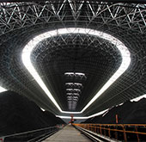
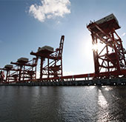
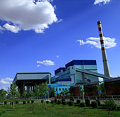
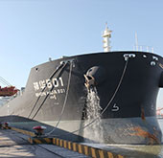
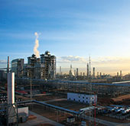
Shenhua Group
Core Businesses
The world largest coal supplier
One of the largest power producers in China
Expanding rapidly to other energy areas (shale gas, wind, solar)
2014 revenue ~ $50B with the net profit of $10B
Ranked 165th among the Fortune Global 500 companies (2014)
Coal
Port
Power
Marine
Railway
Coal to chemicals
2
Notes:
2

Slide 3
National Institute of Clean-and-Low-Carbon Energy (NICE)
The Corporate Research Arm for Shenhua Group
Clean Coal conversion & Utilization
Coal Upgrading
Coal Gasification
Near Zero Emission Combustion
Catalysis
Coal to olefins
Coal to liquids
Coal to SNG
Coal-based Performance Materials
Functional Materials
Waste-to-value Applications
Specialty Materials
Distributed Energy
Thin Film Solar
Energy Storage
Advanced Systems
Hydrogen & Applications
H2 Production
H2 Distribution
System Design & Control
Water Processes
TTT Applications*
Component Technologies
Process Design
*TTT: Tough-to-treat
3
Notes:
3

Slide 4
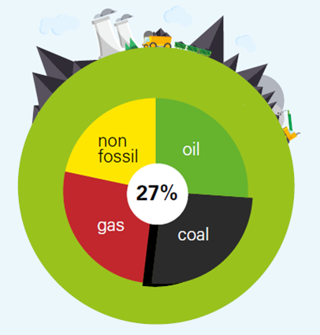
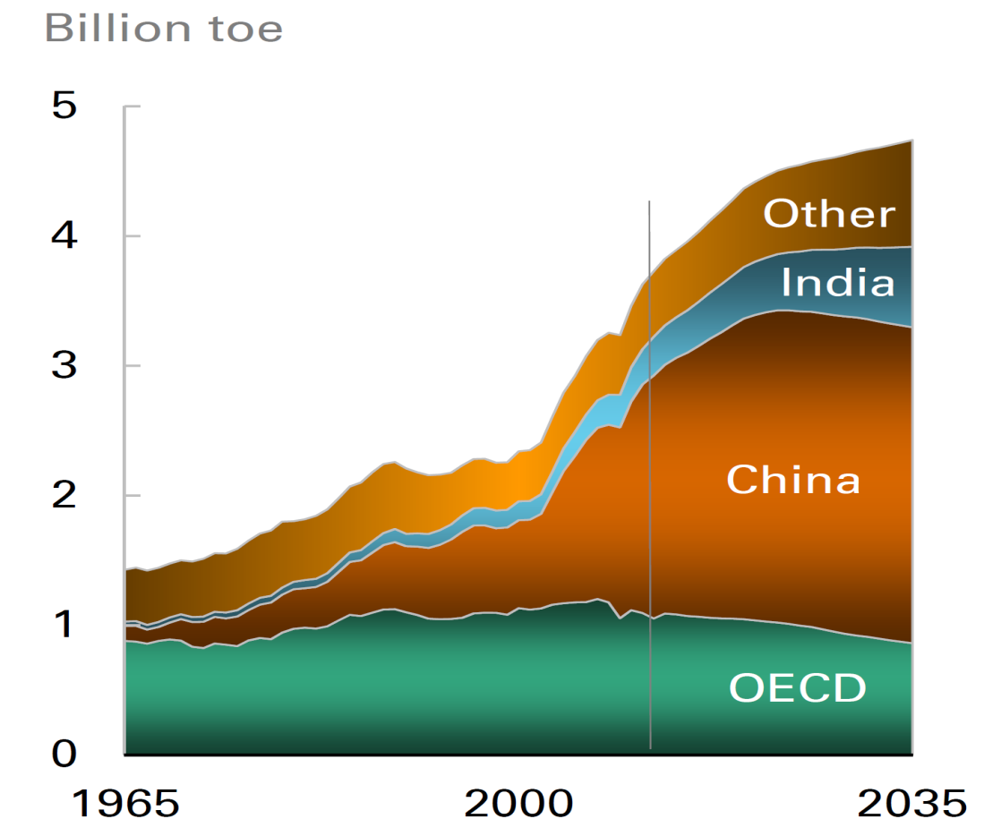
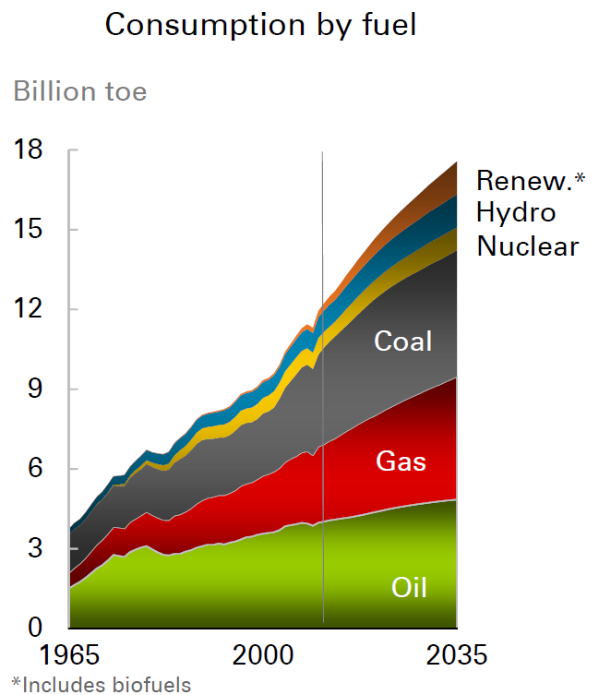
World Energy Outlook
Coal continues a key energy component
China accounts for ~50% of the world’s coal consumption
Source: BP Energy Outlook 2035
Global Consumption by fuel
Coal Consumption by region
4
Notes:
4

Slide 5
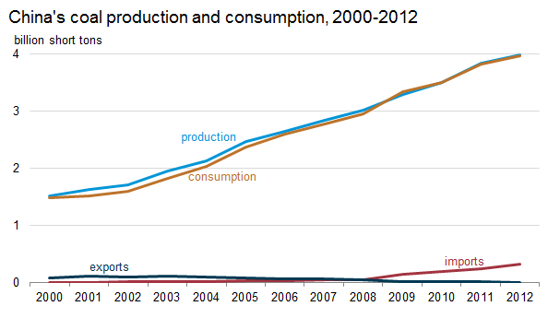
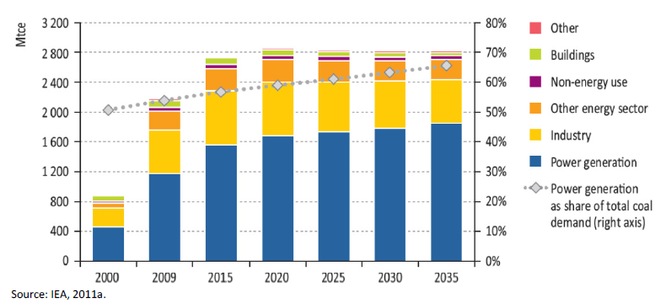
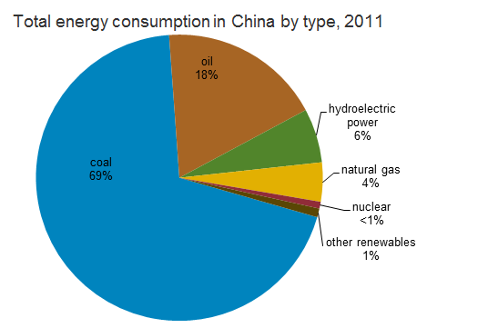
Coal in China Today
Coal demand in China by sector, 2000‐35
In China
Coal is a dominant energy source
Clean coal technologies critical
5
Notes:
5

Slide 6
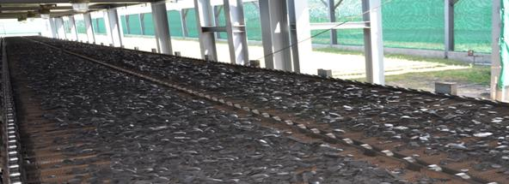
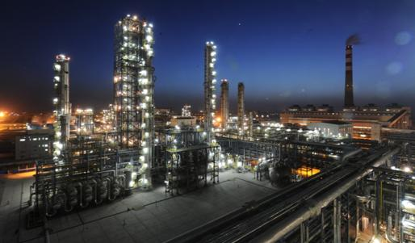
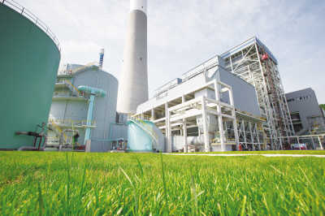
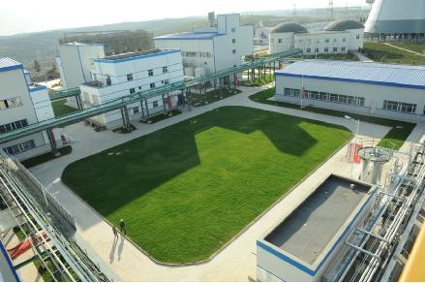
Clean Coal Technology
Clean Coal Technology（CCT）
Emission Control & Waste Recycling
Coal Processing Technologies
Coal Conversion Technologies
Combustion & Power Generation
6

Slide 7
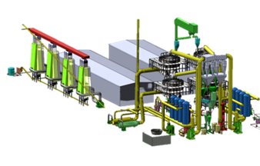
Coal Processing – Coal Upgrading
Lignite
13% China reserve
Moisture content: 25%+
Volatile content ~10%
Heat Generation
Upgrading
/ Refining
Power Generation
Sub-bituminous Coal
31% China reserve
Volatile content: 30%+
Oil yield: >10%
Chemical Production
Improved pollution control –significant
amount of mercury/sulfur removed
Reduced FGD and SCR cost
Reduced transportation cost
7

Slide 8
Shenhua Activities - Coal Upgrading
750 ºC
Drying and Pyrolysis for SUB-BIT COAL
CoalRefTM (solid heating-carrier)
Research
Pilot Test
Reactor Improvement
Demo., Scale-up & Further Applications
500 ºC
Drying & Pyrolysis for LIGNITE
CoalRefTM (gas heating-carrier)
R&D
1MMTA PDP Dev.
Applications, Improvements & Integration Study
200 ºC
Drying & Briquetting for LIGNITE
HPUTM (Hot Press Upgrading)
R&D
1MMTA Demo.
Application of Integration with gasification
2006
2008
2010
2012
2014
2016
8

Slide 9
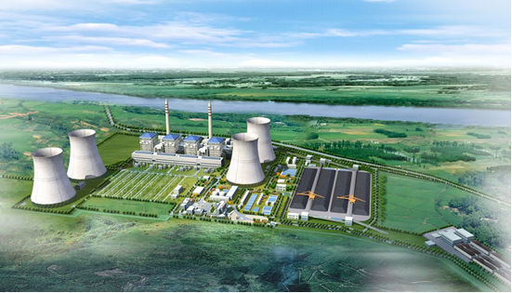
Combustion/Power Generation
Current Emission Standard
(Nature Gas)
EP indicator | Soot (mg/Nm³) | SO2 (mg/Nm³) | NOx (mg/Nm³)
National Standard (Gas firing) | ≤5 | ≤35 | ≤50
Shenhua…66GW Capacity of
Coal–fired Power Plants
Can coal-fired emission meet the nature gas standard??
9
Notes:
9

Slide 10
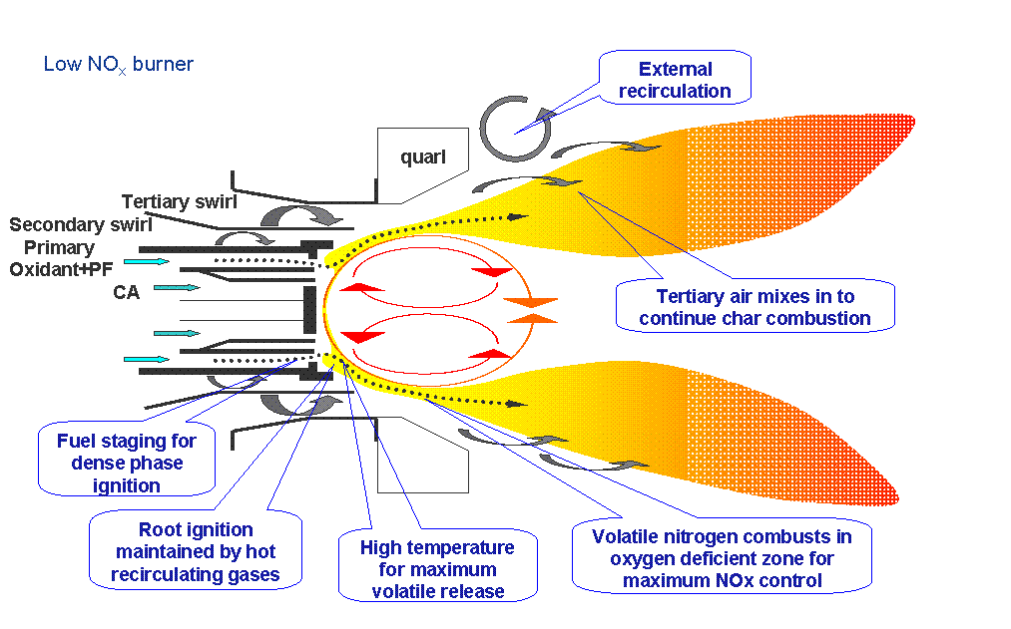
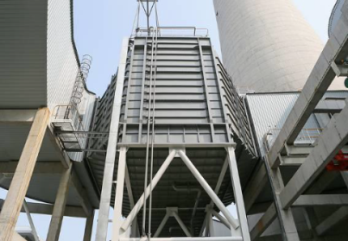
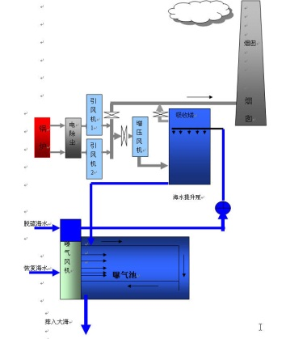
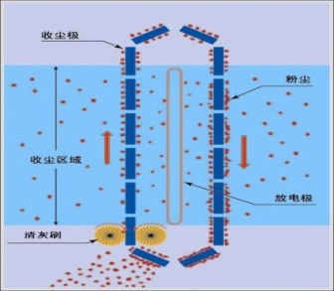
Shenhua Activities – Near Zero Emission
EP indicator | Soot (mg/Nm³) | SO2 (mg/Nm³) | NOx (mg/Nm³)
National Standard (Natural Gas) | ≤5 | ≤35 | ≤50
Shenhua demo plant | 2.46 | 2.76 | 19.8
Near Zero Emissions
DeNOx Burner
Electric precipitator
(ESP)
Flue Gas desulfurization
(FGD)
Wet Electric Precipitator
(Wet ESP)
SCR deNOx
Selective catalytic reduction
Flue gas
desulfuration
10

Slide 11
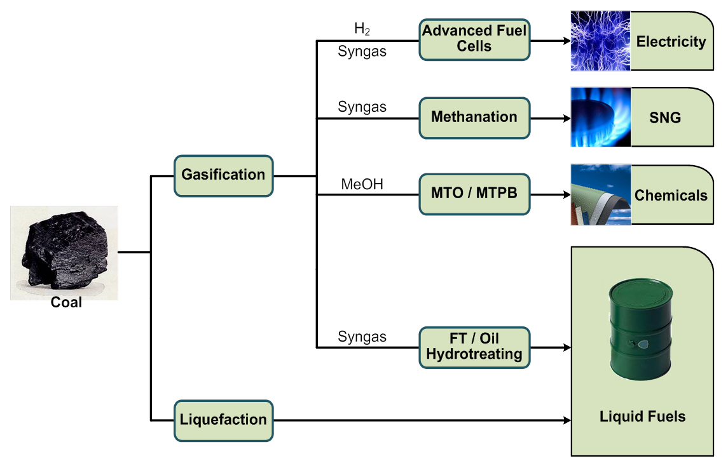
Coal Conversion
CRITICAL TECHNOLOGIES
Gasification
Liquefaction
Catalysts
Process Technologies
Reactor Development
11

Slide 12
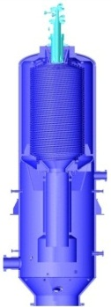
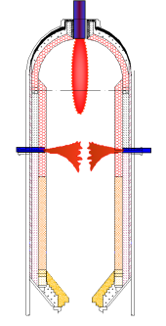
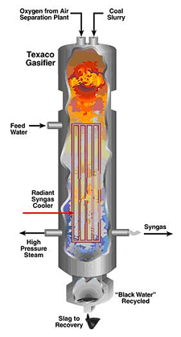
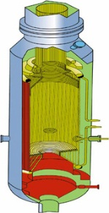
Shenhua Activities - Gasification
Commercial Activities
Technology Development
Deployment of dozens of state-of-art gasifiers in its plants
Flat–flame gasification
Feedstock flexibility
Gasification for fuel cells
Shenhua & GE Gasification JV
Shenhua Ningmei & Siemens JV
Cost
Efficiency Environment
12

Slide 13
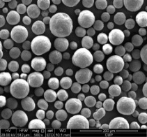
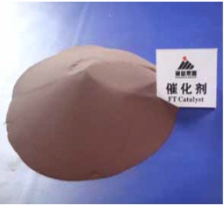
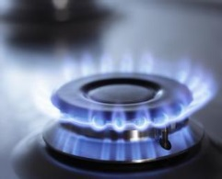
Shenhua Activities – Coal to “X”
MTO Catalysts
C2/C3
Olefins
Polymers
MeOH Syn.
Catalysts
Gasification
Sour
Syngas
Syngas
WGS Catalysts
FT Synthesis
Catalysts
Liquid Fuels
Coal
Methanation
Catalysts
SNG
WGS Catalysts
Sour Methanation Catalysts
Integrated Product Platform for Coal to Chemicals
13

Slide 14
Shenhua Activities – Coal to Chemicals
Shenhua DCL Project
(1.08 Mt/a)
Shenhua CTL Demonstration Project
(180 kt/a)
Shenhua MTO Plant
(600kt/a)
14

Slide 15
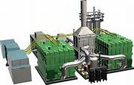
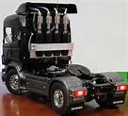
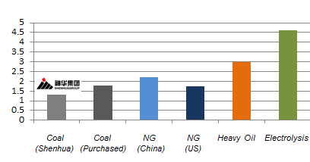
Shenhua Activities – Hydrogen Applications

CO₂
CO₂ Capture/Storage
Power
Generation
Coal
Coal to Hydrogen
Vehicle
US$/kg H2
Hydrogen Production
Hydrogen Infrastructure
Cost Advantage
15

Slide 16
Waste Recycling
Shenhua generates 60+MT fly ash each year
2+MM annual liquefaction residue expected for Shehua Plants
C2C: ~10 Gallon water used for 1 Gallon of product
16

Slide 17
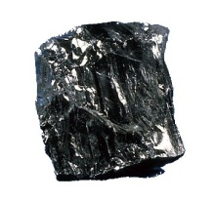
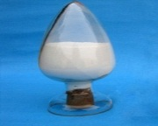
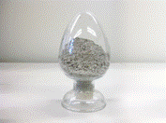
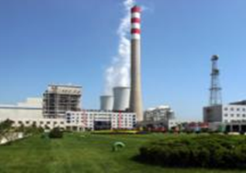
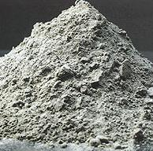
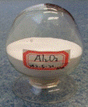
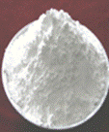
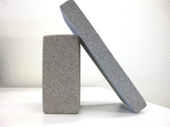
Shenhua Activities – Fly Ash Utilization
Coal
Material and Process Technologies
Value-added Product Portfolio
Functional fillers market
White
CB
Polymer Fillers
Industrial products market
Coal fired power plants
Products and Markets
Fly ash
Molecular Sieve
Alumina
60 million tons / year
Building materials market
Shenhua Coal fired plants
UC Glass
Foam panels
17

Slide 18
Shenhua Activities – Wastewater Recycle
Applications
Challenges
Shenhua Solutions
Coal to Chemical Wastewater
Power Generation Wastewater
High Salt Content
High Organic Content
Cost
Process Development
Component Technology
Integrated Package
Cost effective Zero Liquid Discharge
18

Slide 19
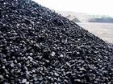
Shenhua Activities – Direct Coal Liquefaction Residuals Utilization
Liquefaction
Large Volume
Green Asphalt
Liquid Fuels
Formulation
Blending
Emulsion
Hign Value
Carbon Fiber
Mesophase
Pitch
Pitch
Articles
Carbon Articles
0.7 MT in 2013
2t MT by 2019
19

Slide 20
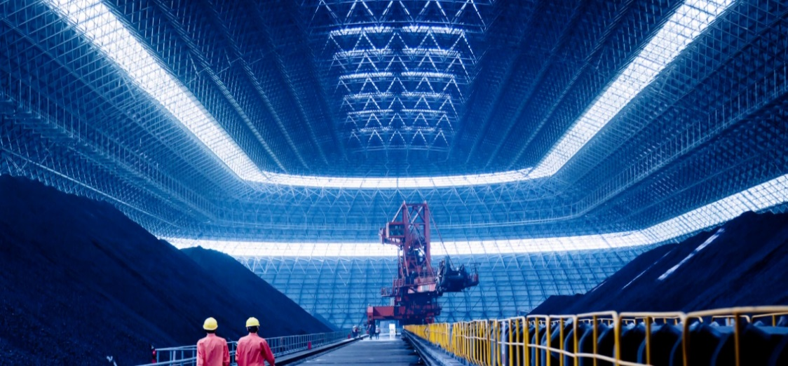
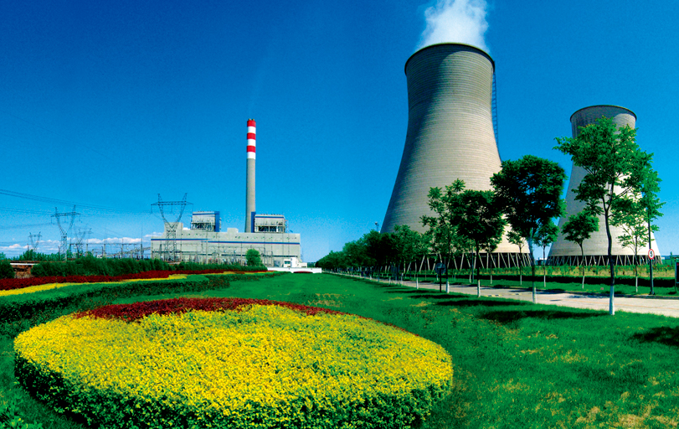
SUMMARY
Coal is a major energy source today
Coal will continue to be an important energy component in the foreseeable future
Coal applications need to be clean and can be clean
Technology innovation will drive economics
20

Slide 21
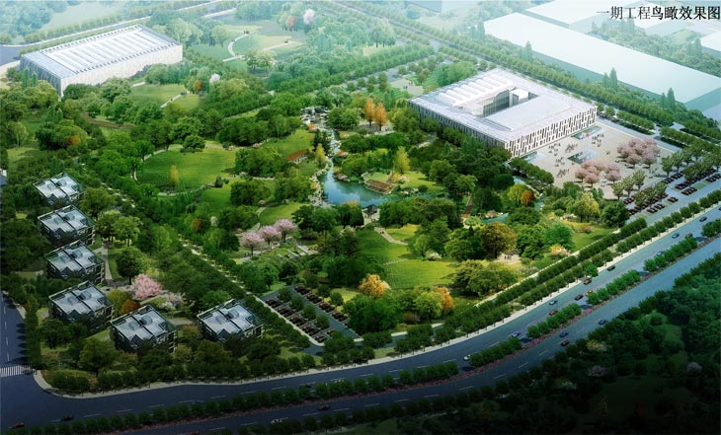
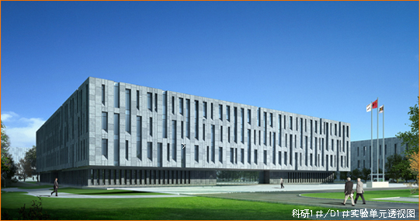
Questions ?
Thanks for your time, and any questions?
Shenhua NICE, Future Science & Technology City, Changping District, Beijing, P. R. China, 102209
T: +86-10-57595508 F : +86-10-57339834

