Slide 1
The public: Problem or solution for sustainability
Peta Ashworth – Adjunct Assoc. Professor
TeraWatts TeraGrams, TeraLiters 2016 1st February

Slide 2
fb/TheIDEAlist

Slide 3
Food, water, energy
The problem for us is how to get enough clean water. Without that the bugs will evolve to solve the problem by starting a massive plague. The bugs will solve the problem unless we get there first as there will be no one left anyway. That requires energy ,either nuclear or new technologies (not solar or wind ).

Slide 4
The elephant in the room

Slide 5
Recognize these numbers?
7,302,457,374
7,302,457,600
http://www.census.gov/popclock/

Slide 6
Chinese GDP versus Total Energy Production (1980 to 2011)
Source: The World Bank (2014)

Slide 7
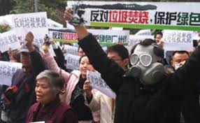
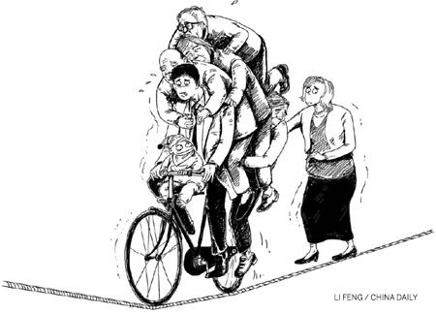
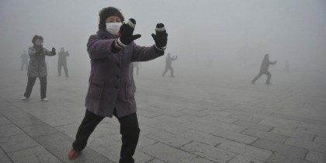
Economy and Social Transition

Slide 9
Do these numbers mean anything?
250,000
1,000,000
6,500,000
4,600,000
13,500,000

Slide 10
SYRIA – since 2011
250,000 People killed
1,000,000 Injured
6,500,000 Displaced within
4,600,000 Refugees
13,500,000 In dire need

Slide 12
Seventeen (17)
http://www.un.org/sustainabledevelopment/poverty/

Slide 14
Decision making
Notes:
2 + 2
Capital of France
Drive a car
24 x 17
Purchase insurance cover
System 2 – requires effort

Slide 15
North Carolina, Woodlands Council

Slide 16
US town bans solar, fearing it steals energy
… Woodland Town Council voted against a solar farm, and later voted for a complete moratorium on the energy panels after hearing from concerned locals.
Jane Mann, a retired science teacher who has lived in the town for 50 years, told the council that solar panels were stealing sunlight from plants, stopping their ability to photosynthesize. She also raised her concerns that the panels may cause cancer.
Another local resident, Bobby Mann, told the council meeting the farm would suck up all the energy from the sun and stop new businesses from coming to Woodland. 'You're killing your town,' he said. 'All the young people are going to move out.’
http://www.skynews.com.au/culture/offbeat/2015/12/14/us-town-bans-solar--fearing-it-steals-energy.html?cid=BP_RSS_sn-offbeat_0_us-town-bans-solar--fearing-it-steals-energy_141215

Slide 17
The BANANA Concept

Slide 18
Attitudes to new development
Build
Absolutely
Nothing
Anywhere
Near
Anybody
NIMBY, NUMBY, PIMBY

Slide 19
What technology is the answer?
http://www.un.org/sustainabledevelopment/energy/

Slide 20
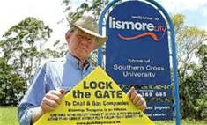
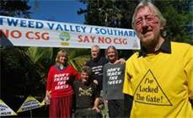
Trust & context are critical
A lack of confidence in government, industry and science to manage associated health, environment and social risks is likely to compound negative perceptions
Can we trust the project owners and government to take care of our problems?
What have our previous relationships been like?
Ashworth,P; Bradbury, J; Feenstra, Y; Greenberg, S; Hund, G; Mikunda, T; Wade, S (2012)

Slide 21
Procedural fairness
Will the process be fair?
Is it transparent?
Will anyone listen to us?
Can we have a say in what happens?
Who can I call?
Bradbury, J., Ray, I., Peterson, T., Wade, S., Wong-Parodi, G. and Feldpausch, A. (2009)

Slide 22
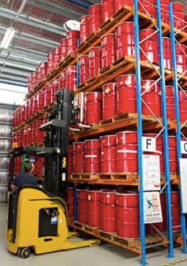
Why bother with engagement?
Most people are unsure about how they feel about proposed alternatives
Minimal understanding of broader context in which decisions must be made;
Unclear about how their values will be affected;
Prone to judgmental biases;
Ill-equipped (or unwilling) to address the required trade-offs.
Arvai, J. L.; et al. (2012)

Slide 23
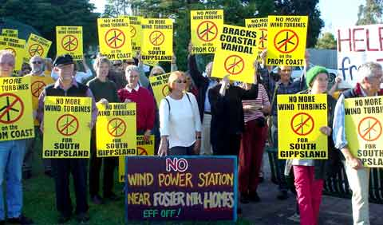
Be aware most of us are cognitive misers…
Limited cognitive ability to fully investigate every issue we face.
We employ ideological filters that reflect our identity, worldview, and belief systems.
These filters are strongly influenced by group values.
We generally endorse the position that most directly reinforces the connection we have with others in our referent group.
Fiske, S. T., & Taylor, S. E. (1991)

Slide 24
Improving decision making
Consultation involving decision makers, key stakeholders and content area experts
Access to high quality information (science, local knowledge) on which to base choices (science based decision making)
Processes that facilitate negotiation
The importance of fostering transparency and building trust with respect to the participants and the process Fairness and Competence
Joe Arvai, University of Michigan

Slide 25
Distribution % preferences MyPower (n=813)
Jeanneret, T., Muriuki, G., and Ashworth, P.

Slide 26
Extent of Social Approval (n=2549)
Jeanneret, T., Muriuki, G., and Ashworth, P.

Slide 28
Thank you
Email: p.ashworth@uq.edu.au

Slide 29
References
Arvai, J. L.; et al. Decision support for developing energy strategies. Issues Sci. Technol. 2012, 28 (4), 43−52.
Ashworth,P; Bradbury, J; Feenstra, Y; Greenberg, S; Hund, G; Mikunda, T; Wade, S (2012)What’s in Store:Lessons learnt from CCS. International Journal of Greenhouse Gas Control. Issue 9. Pages 402-408.
Ashworth, P.A., Liang, X., Lin, Y., Cao, S., (2015). Public participation for developing a CCUS project in the Guangdong region of China. Presentation for PACITA Conference, Berlin, 25-27 February.
Bradbury, J., Ray, I., Peterson, T., Wade, S., Wong-Parodi, G. and Feldpausch, A. (2009). The Role of Social Factors in Shaping Public Perceptions of CCS: Results of Multi-State Focus Group Interviews in the U.S. Energy Procedia, 1(1), 4665-4672
Fiske, S. T., & Taylor, S. E. (1991). Social cognition (2nd ed.). New York: McGraw-Hill.
Jeanneret, T., Muriuki, G., and Ashworth, P., (2014). Energy technology preferences of the Australian public: Results of a 2013 national survey, CSIRO, Australia
Terwel, B., Harink, F, Ellemers, N & D.Daamen (2011) Going beyond the properties of CO2 capture and storage (CCS) technology: How trust in stakeholders affects public acceptance of CCS. International Journal of Greenhouse Gas Control Issue 5. Pages 181-188.
Websites accessed:
United Nations Sustainabie Development Platform Accessed 30th January, 2016 https://sustainabledevelopment.un.org/sdgs
https://www.facebook.com/TheIDEAlistRevolution

