Slide 1
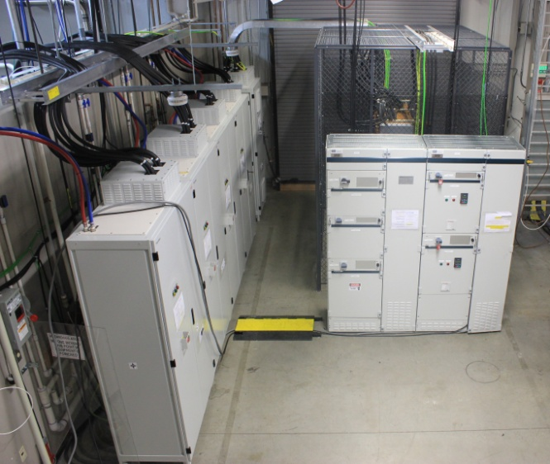
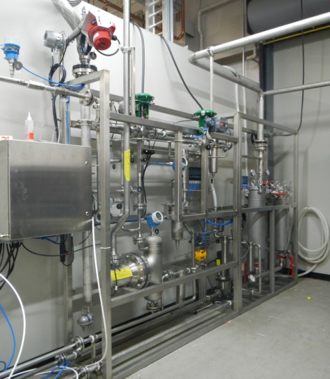
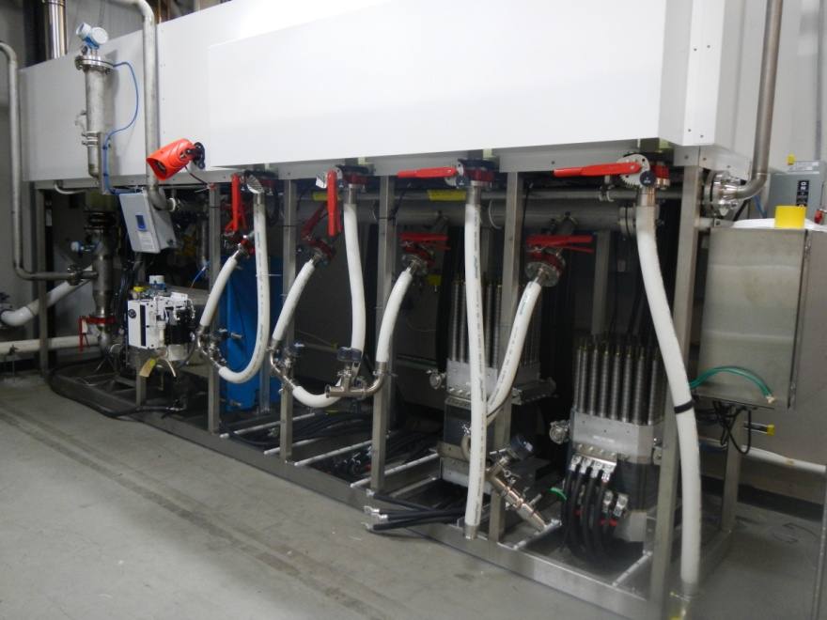
Megawatts and Gigawatts on the way to Terawatts
Kathy Ayers, Proton OnSite

Slide 2
Problem Definition
Need ~10 TW of carbon free energy by 2050
  Most renewables are intermittent
  Energy storage at this scale is required
To address the terawatt problem, we have to install megawatts and gigawatts first
  Leverage technologies at this scale now even if they “can’t” get to terawatts in the long term
  Innovation often happens in well understood technology

Slide 3
Why we shouldn’t (just) wait for new/better/more ideal technology
Storage needed now
Growing global
energy needs
Increasing
renewables
New Technologies:
Lab validation to market penetration is >20 years
All technologies have challenges, we just haven’t found them all yet
% Renewable electricity in mix
by geographic region, 2010 to 2050

Slide 4
Technology Development Timeline: Getting to 2050
(CO₂ emissions)
Stolten, October 2014: “The Potential Role of Hydrogen Technology for Future Mobility. How Can this Improve Our Life?”

Slide 5
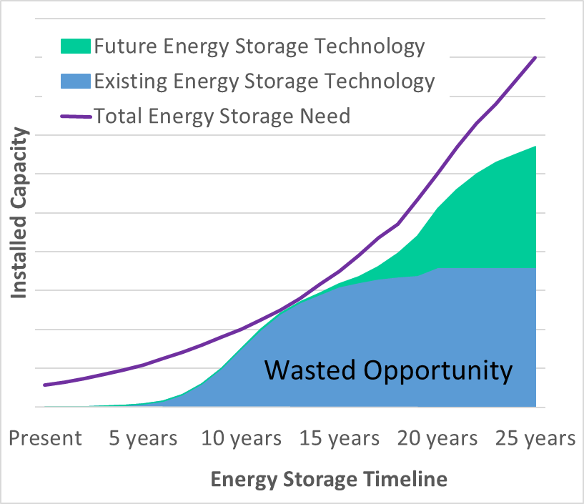
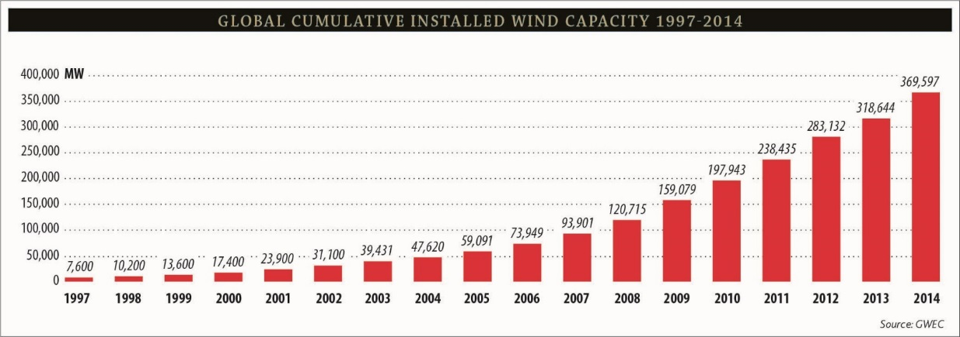
How can we make an earlier impact?
Implement higher TRL tech
  New technology is 10-12
  years from any impact
Problem is here today: wind
  160 GW in Germany and
  China alone, stranding 20-40%
  270 GW expected by 2020
Even installing MW systems today takes time to get to GW
Shift at least 10 years for new technology
Global installed wind ~400 GW

Slide 6
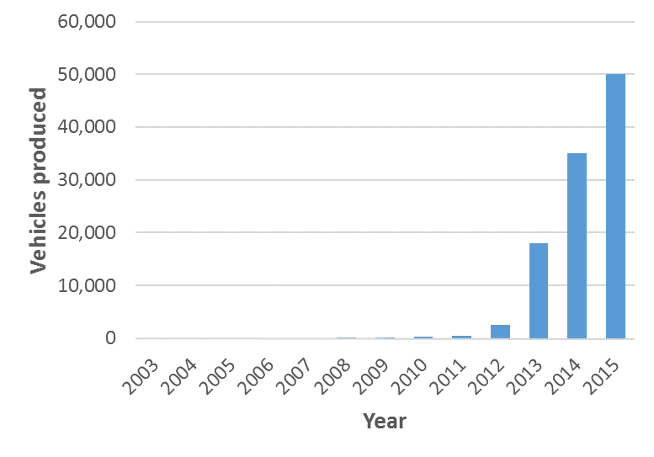
How Real is the 20 year Product Cycle?
Tesla: an “agile and innovative” example
Founded in 2003
  Existing, well established
  battery chemistry
  Cars are not a totally
  new invention
  Minimal sales till 2013
Even good ideas struggle
  Almost went bankrupt in 2008
Gigafactory expected to be running in 2017
  18650 Li-ion battery has been sold since 1991
Tesla Production History
Toyota produces >10,000,000 vehicles/year

Slide 7
Why does development take so long?
Not just about materials/performance
Manufacturing is its own science
  Cost and uniformity at scale
Durability testing takes time
Interactions can derail a system
  Impact of tolerance extremes
Design for safety and code compliance adds complexity
Efficiency
Electrode Structure
Processability
Durability
Catalyst system example

Slide 8
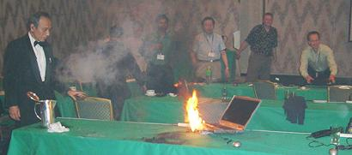
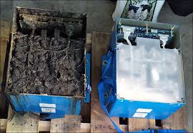
The Risks of Shortcutting Development
Laptop at Japan conference
Navy stress test for submarine energy system
Boeing 787 Dreamliner battery packs

Slide 9
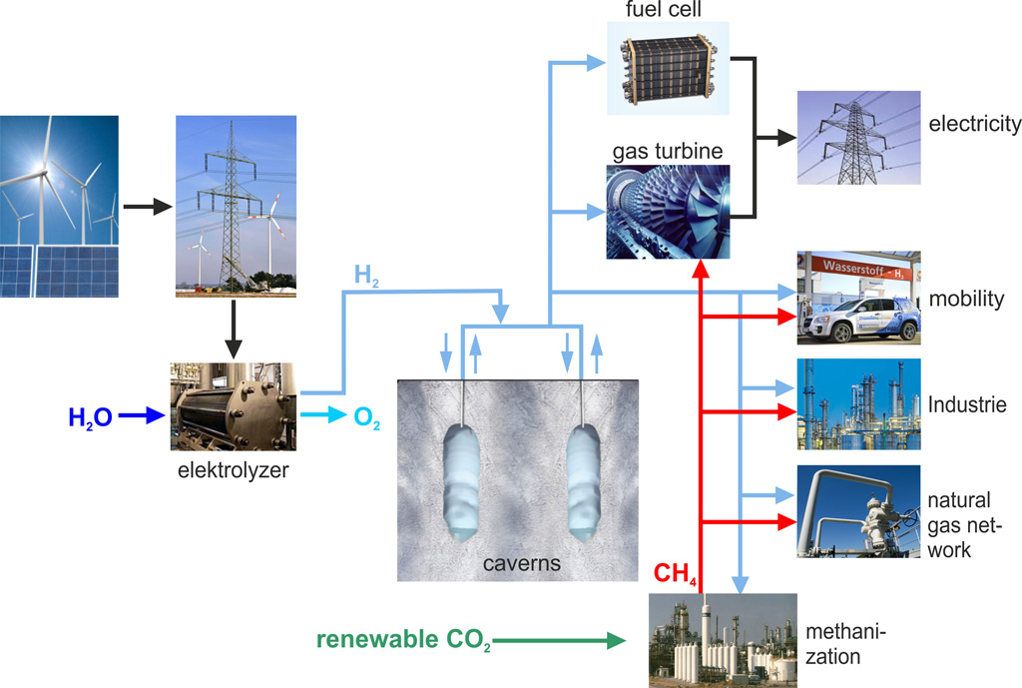
Case Study: Importance of
Renewable Hydrogen
Global demand >600 billion Nm³/yr – Largely driven by NH₃
Flexibility as an energy storage medium
Page 9

Slide 10
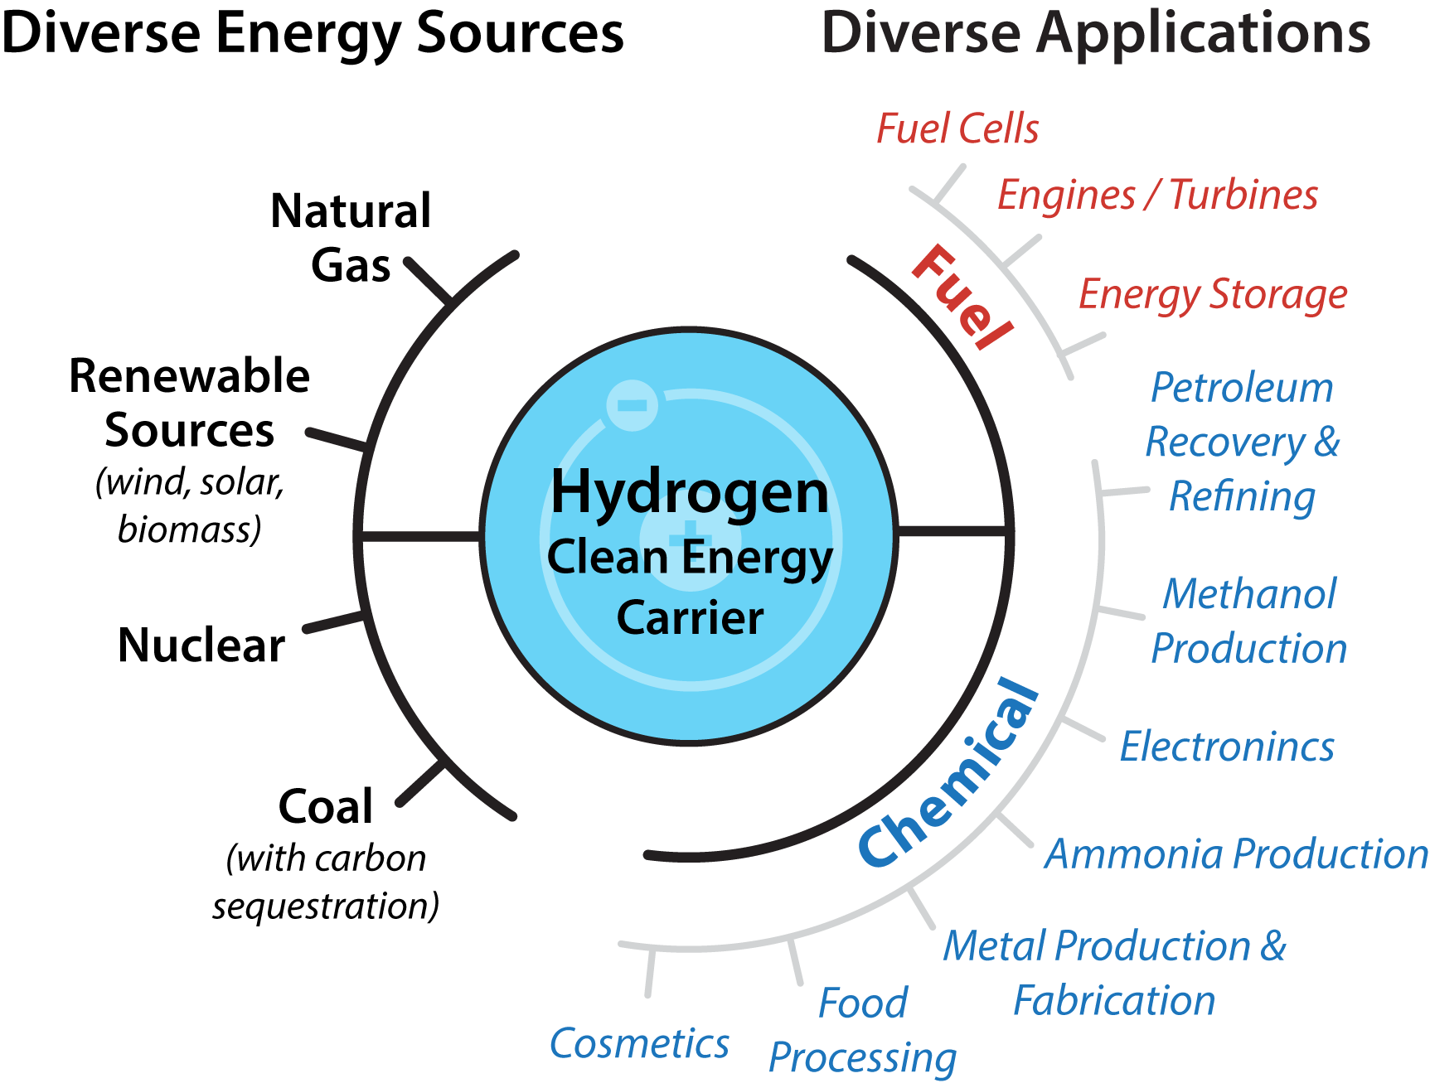
Impact
2% of US energy currently goes through H₂ more than 95% by natural gas reforming
If 2050 US H₂ projections can be produced from renewables, it could cut
45% of all US carbon emissions
2500 M metric tons of CO₂
$118 billion in market revenues projected
Slide courtesy of Bryan Pivovar, NREL 2016

Slide 11


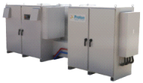
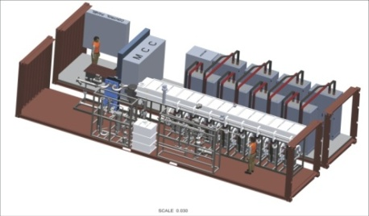
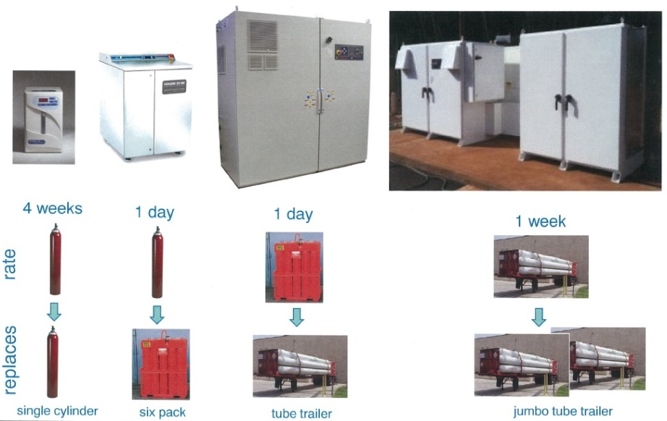
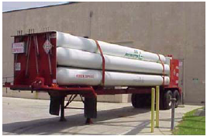
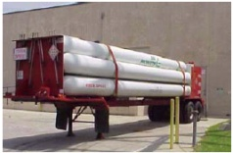
Proton’s Experience:
Timeline and Product Cost Evolution
Starting from a well-established technology in 1996
$/kW vs. S-Series
100%
43%
28%
13%
Product Type | S-Series | H-Series | C-Series | Megawatt
Year Introduced | 2000 | 2004 | 2012 | 2015
Units Sold | 450+ | 200+ | 22+ | NA
H2 output (Nm³/hr) | 1 | 6 | 30 | 200–400
Generates | 1 Day | 1 Day | 1 Week | 1 Day
Replaces | Six Pack | Tube Trailer | Jumbo Tube Trailer | Jumbo Tube Trailers
Input Power
6 kW
36 kW
180 kW
1 - 2 MW

Slide 12
Figures of Merit for MW scale electrolysis
Water usage: 1000 gal/day/MW
Total electrode area: 27 m²/MW (~50 m² of membrane)
Cell current: ~1260 A
Catalyst cost: $50K/MW ($50/kW)
Hydrogen produced: 400 kg/day/MW
Cars fueled: ~70/day (depending on storage)
Comparison to Solar Fuels TRL:
Typical goal metric: 100 cm² electrode at 10 mA/cm²
Equivalent to less than 1 gram of H₂/day

Slide 13
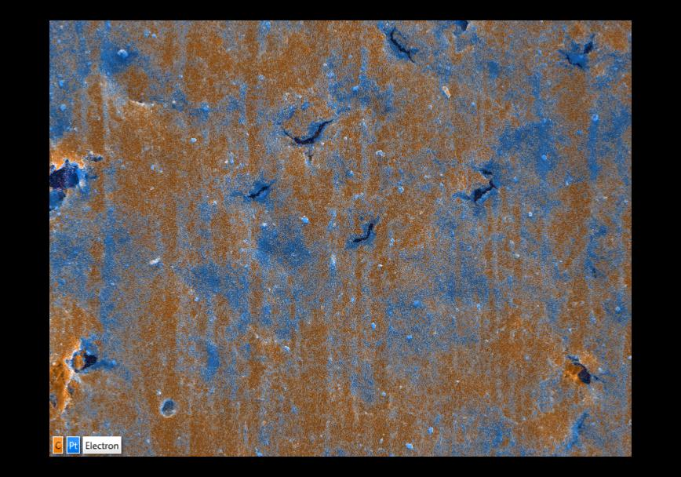
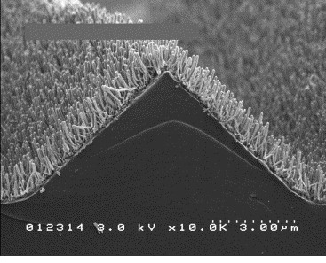
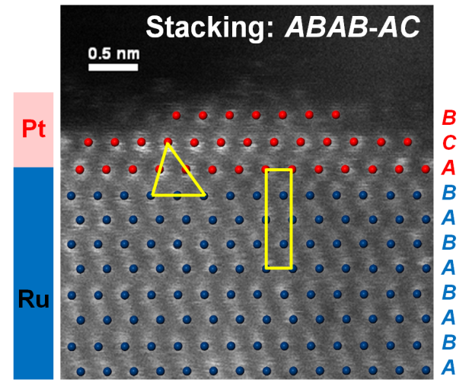
Is there enough platinum (and iridium)?
Power per annual production (Rossmeisl, 2014):
Pt Fuel cells: ~0.3 TW
Ir Electrolysis: ~0.1 TW
Need ~ 1-2 order of magnitude increase in activity to be relevant for global energy storage needs
Pathways:
Core shell catalysts
3M NSTF
Spray deposition

Slide 14
Necessity can force innovation
Emissions control well beyond what was known to be possible
*Courtesy of Ellen Stechel, ASU

Slide 15
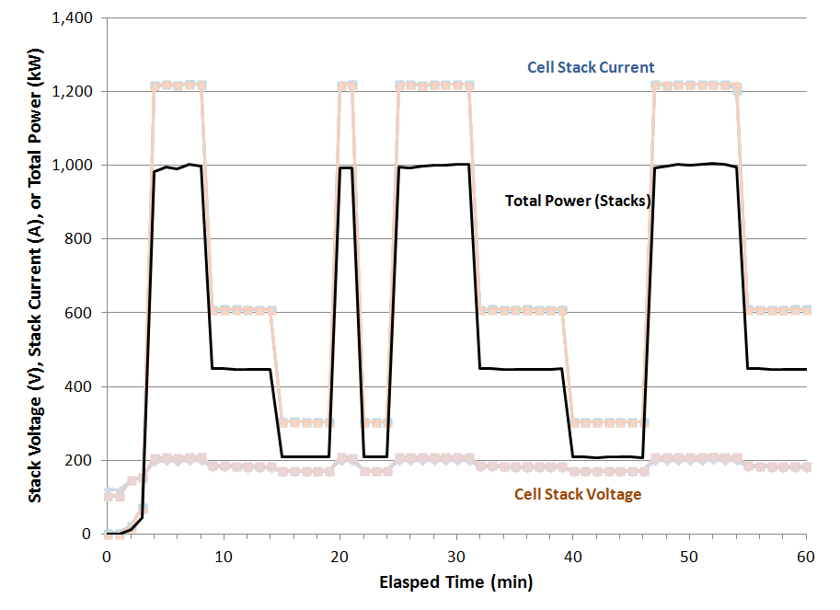
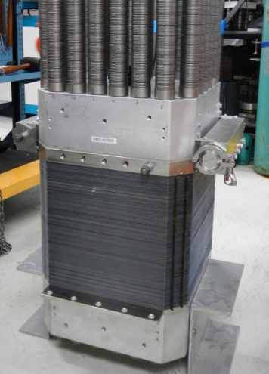
MW Status
+500,000 cell hours accumulated to date on stack design
Idle to Full Load
in less than 10 sec

Slide 16
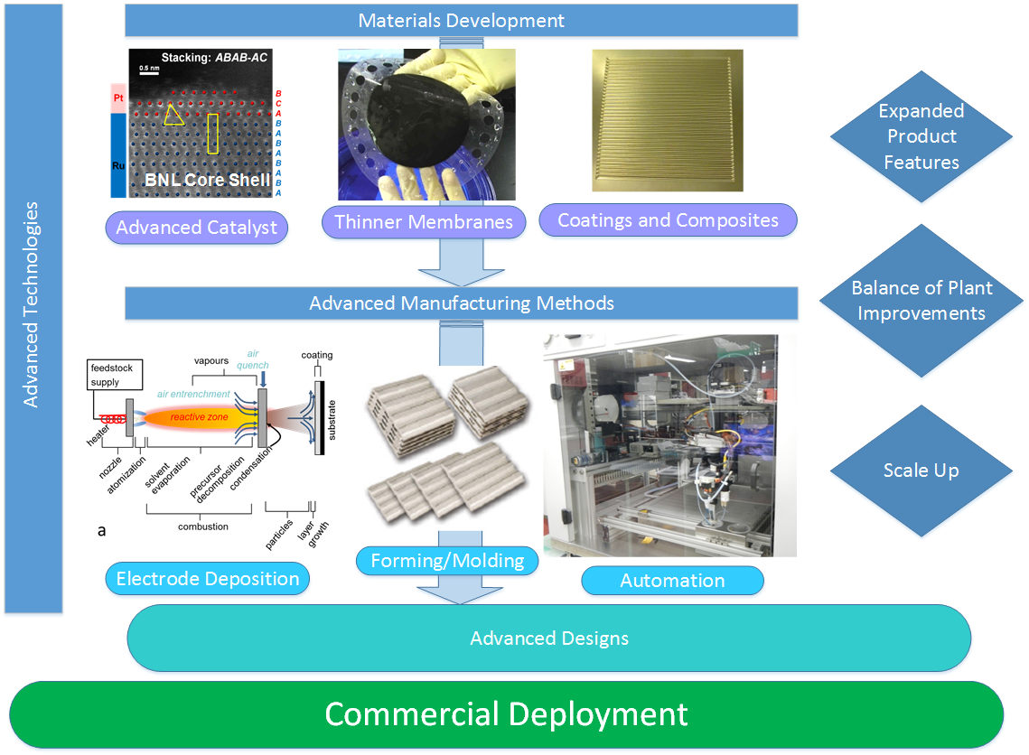
Opportunities and Challenges

Slide 17
The US Agency H₂ Gap
High pressure, separations
Electrolysis Needs
NASA
AMO
ARPA-E
DoD
OE
EERE
ManTech
Energy storage, non-H2
H2 applications limited
$/kg focus; overall portfolio
Cross-industry manufacturing
High risk, high reward

Slide 18
Need to Leverage Synergies
What PEC can do for electrolysis
What electrolysis can do for PEC
Materials development
  Ion exchange membranes
  (low H₂ permeation)
  OER catalysts
  Non-PGM catalyst supports
Manufacturing
  Large scale catalyst synthesis
  Electrode fabrication methods
Balance of plant for water-gas management
Controls and safety circuit development
Validation of large scale H₂ production
Integration experience

Slide 19
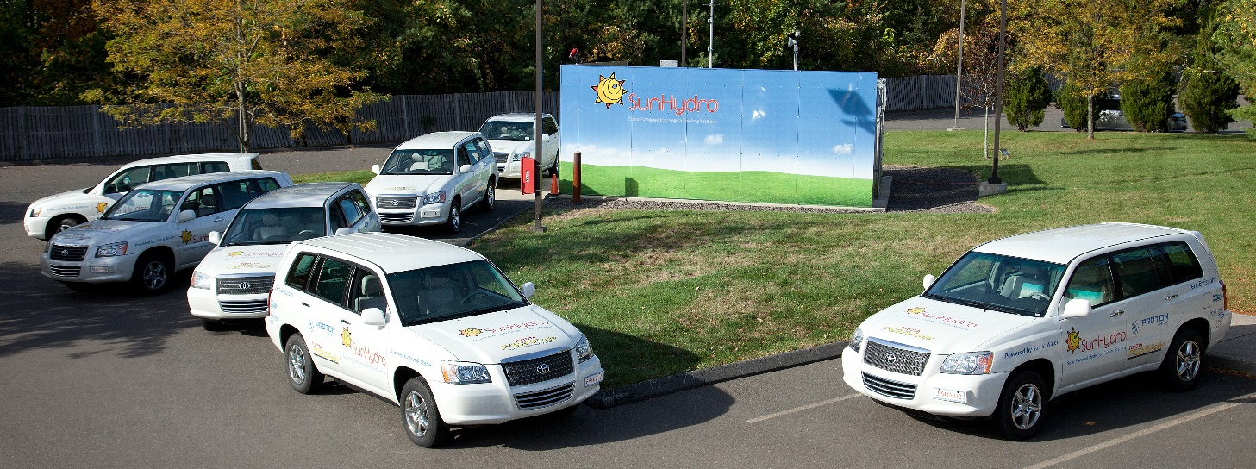
Conclusions
Need to be realistic about the timeframes for technology development
Government funding challenges to be addressed
Address near term needs as well as new science and discovery
Find synergies between both and drive progress

