Slide 1

Solar Energy Promises
a) Are likely to come true
b) Are empty
c) Are complex
…
Shane Ardo
Department of Chemistry
Department of Chemical Engineering & Materials Science
University of California, Irvine, USA
Monday, February 1, 2016 Tera³ Workshop, UCSB, Santa Barbara, CA

Slide 2
Quantifying the competition
  What does solar have to beat?
TeraWatts of Electricity
Fossil fuel power plants: $0.06/kWh
TeraGrams of H₂ Transportation Fuel
Steam methane reforming: $4/kg
TeraLiters of Potable Water
Reverse osmosis: $1/m³
Solar photovoltaics
Concentrated solar thermal
Solar photoelectrochemical H₂
Concentrated solar thermochemical H₂
Solar photoelectrodialysis
Concentrated solar thermal distillation
U.S. Energy Information Administration, 2016, http://www.eia.gov
U.S. Department of Energy, Office of Energy Efficiency & Renewable Energy, 2016, http://energy.gov/eere
Elimelech & Phillip, Science, 2011, 333, 712

Slide 3
Quantifying the competition
  What does solar have to beat?
TeraWatts of Electricity
Fossil fuel power plants: $0.06/kWh
TeraGrams of H₂ Transportation Fuel
Steam methane reforming: $4/kg
TeraLiters of Potable Water
Reverse osmosis: $1/m³
Electric
Electrochemical
Electrodialysis
  … and by how much?
U.S. Energy Information Administration, 2016, http://www.eia.gov
U.S. Department of Energy, Office of Energy Efficiency & Renewable Energy, 2016, http://energy.gov/eere
Elimelech & Phillip, Science, 2011, 333, 712

Slide 4
Quantifying the competition
  What does solar have to beat?
TeraWatts of Electricity
Fossil fuel power plants: $0.06/kWh
TeraGrams of H₂ Transportation Fuel
Steam methane reforming: $4/kg
TeraLiters of Potable Water
Reverse osmosis: $1/m³
Electric
Electrochemical
Electrodialysis
  “Move the decimal point over by one place.”
U.S. Energy Information Administration, 2016, http://www.eia.gov
U.S. Department of Energy, Office of Energy Efficiency & Renewable Energy, 2016, http://energy.gov/eere
Elimelech & Phillip, Science, 2011, 333, 712

Slide 5
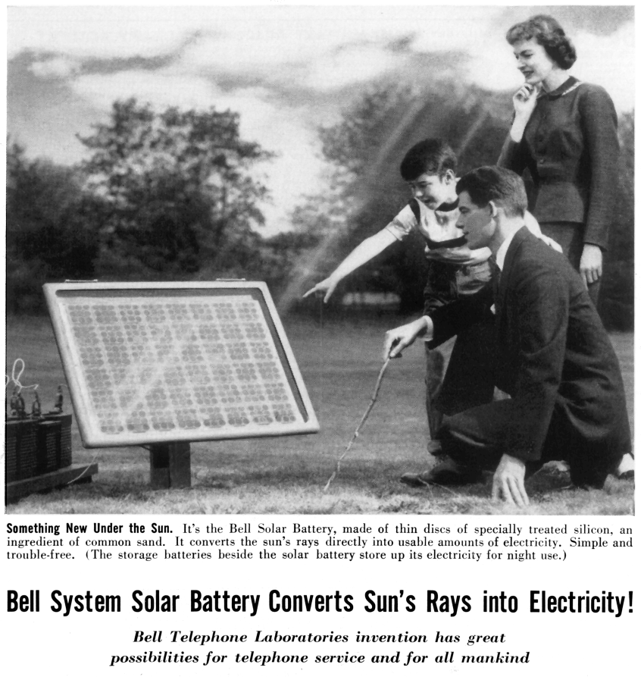
History of silicon for PV
Pearson, Chapin & Fuller
Bell Laboratories (1952 – 1953)
http://www.corp.att.com/attlabs/reputation/timeline/54solar.html
6% efficient!
Bell Solar Battery, Look Magazine (1956)
Bell Telephone Laboratories (April, 1954)
http://www.beatriceco.com/bti/porticus/bell/images/solar_battery2.gif

Slide 6
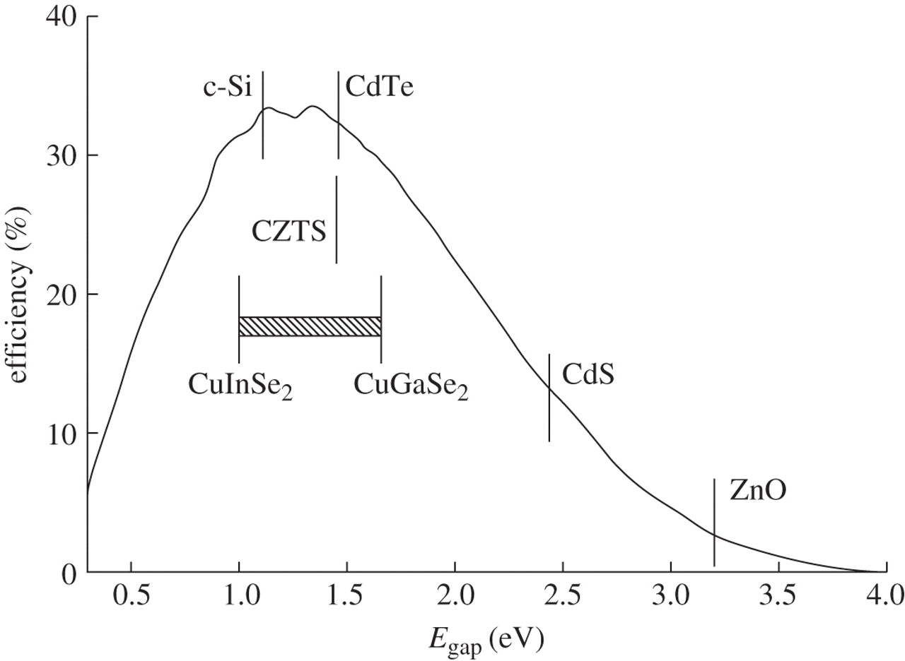
History of silicon for PV
GaAs
  Environmentally sustainable
United States Geological Survey, Rare Earth Elements – Critical Resources for High Technology Fact Sheet, 2002
Peter, Phil. Trans. Royal Soc. A, 2011, DOI: 10.1098/rsta.2010.0348

Slide 7
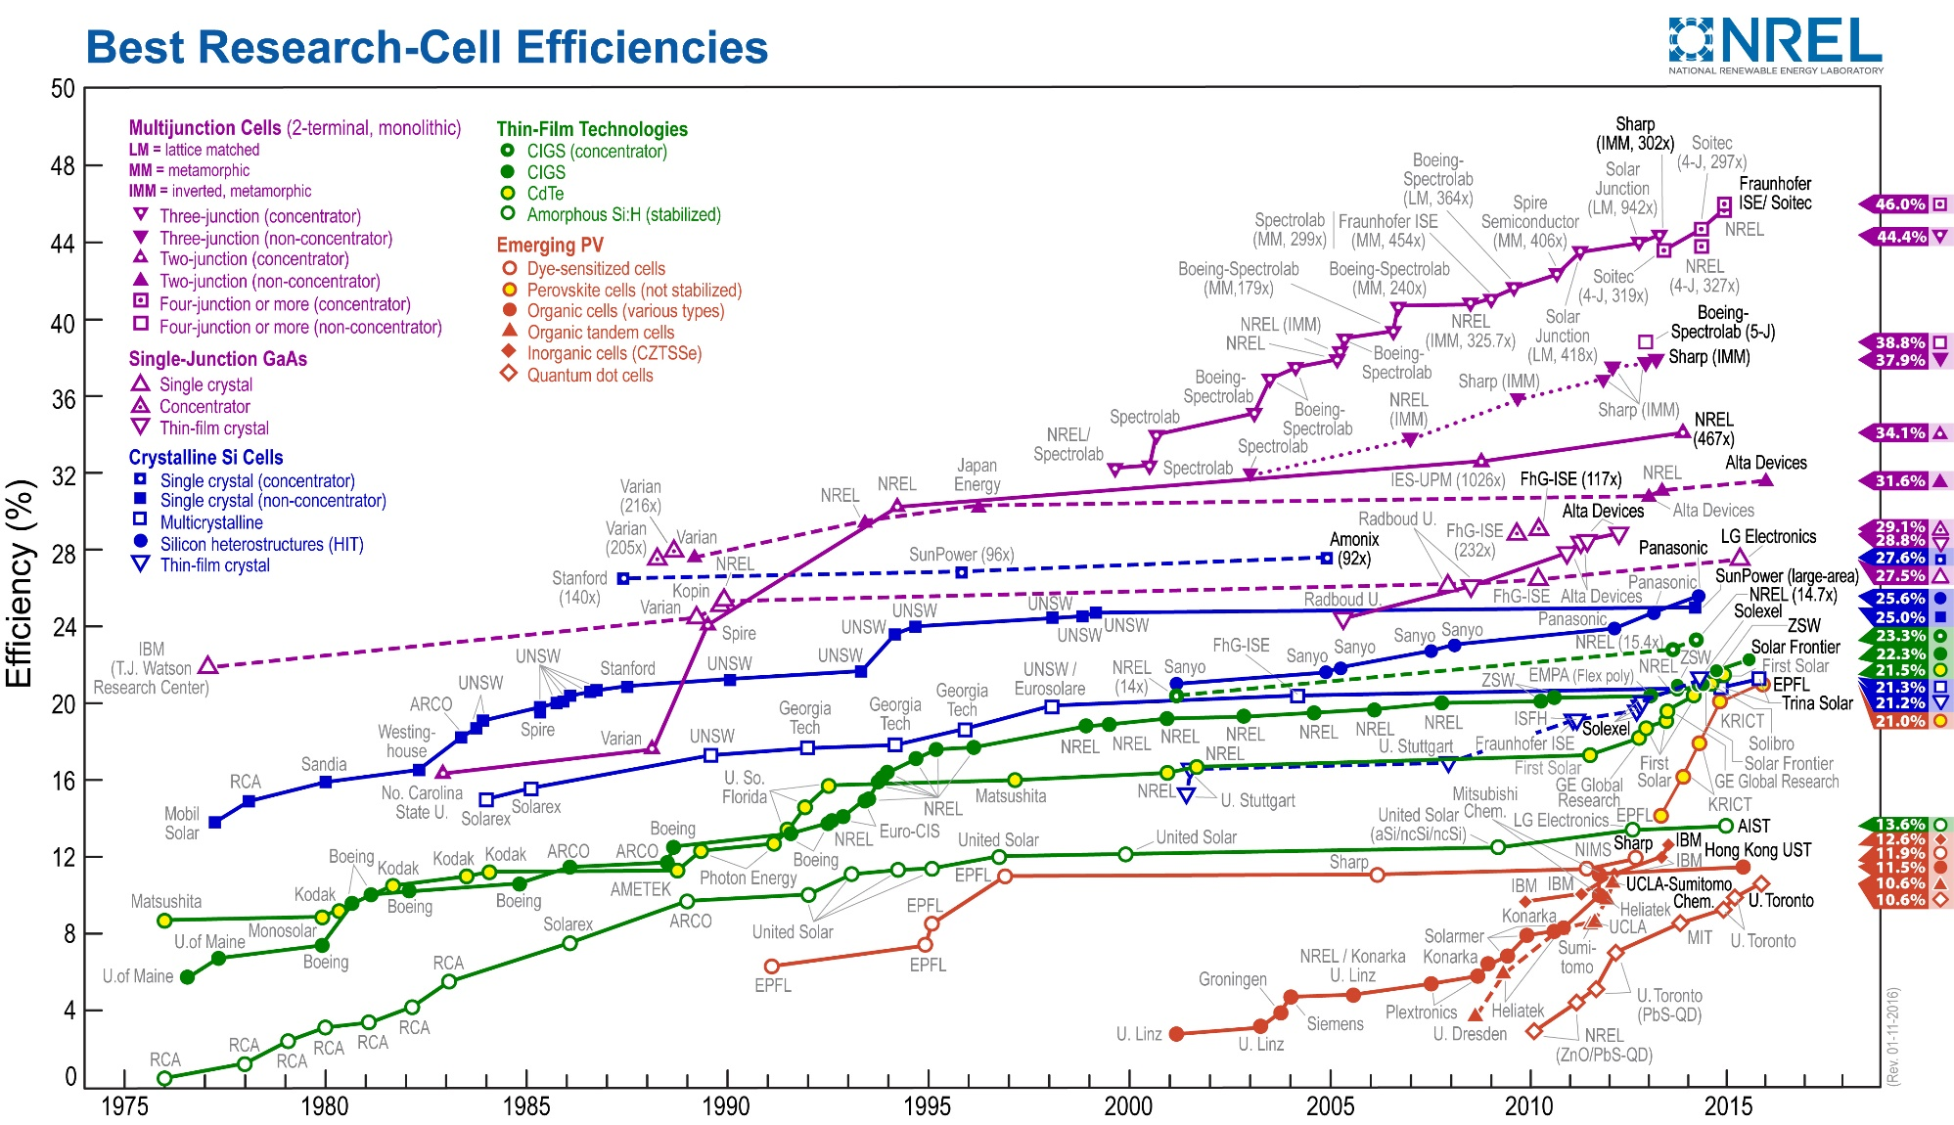
Lab-record PV efficiencies
Thermodynamic Limit
GaAs
Si
CdTe/CIGS/Pero
(Kazmerski), NREL, National Center for Photovoltaics, Research Cell Efficiency Records, 2016, http://www.nrel.gov/ncpv/

Slide 8
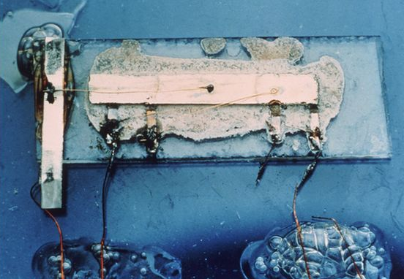
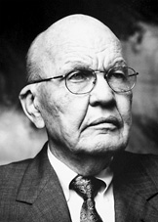
History of silicon for PV
Si beats GaAs
Jack Kilby
Texas Instruments Corporation (1958 – 1959)
Nobel Prize (2000)
SiO₂ allows gate for transistor and lithography to produce integrated circuit → Silicon Valley → Moore’s Law → microelectronics industry!
http://www.computerhistory.org/semiconductor/timeline.html

Slide 9
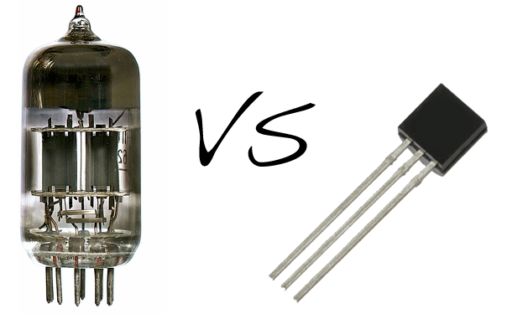
History of silicon for PV
Si beats GaAs
  Did this allow for a new function or was it a drop-in replacement?
Jack Kilby
Texas Instruments Corporation (1958 – 1959)
Nobel Prize (2000)
SiO₂ allows gate for transistor and lithography to produce integrated circuit → Silicon Valley → Moore’s Law → microelectronics industry!
  This moved the decimal point over by one place!
http://www.computerhistory.org/semiconductor/timeline.html

Slide 10
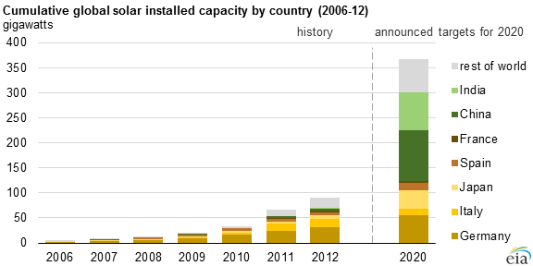
Global PV energy supply
  Problem solved, right?
< 0.4 TW
U.S. Energy Information Administration, 2016, http://www.eia.gov/todayinenergy/detail.cfm?id=22912

Slide 11
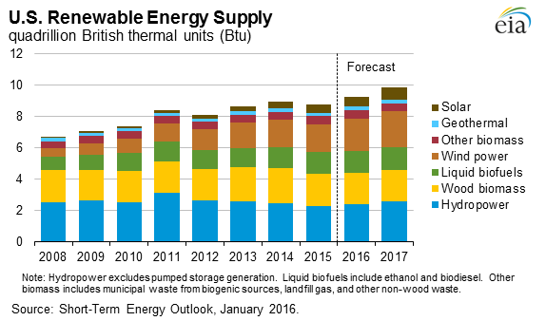
U.S. renewable energy supply
4% solar
U.S. Energy Information Administration, 2016, https://www.eia.gov/forecasts/steo/report/renew_co2.cfm

Slide 12
U.S. renewable energy supply
4% solar
  Economically unsustainable
U.S. Energy Information Administration, 2016, https://www.eia.gov/forecasts/steo/report/renew_co2.cfm
Infrastructure to support small-scale Si PVs exists from microelectronics industry, but not TW!

Slide 13
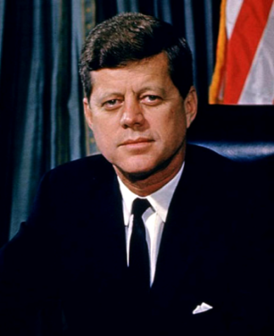
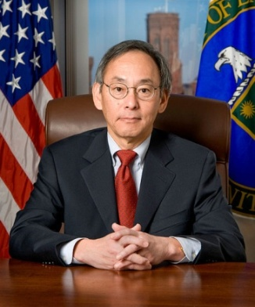
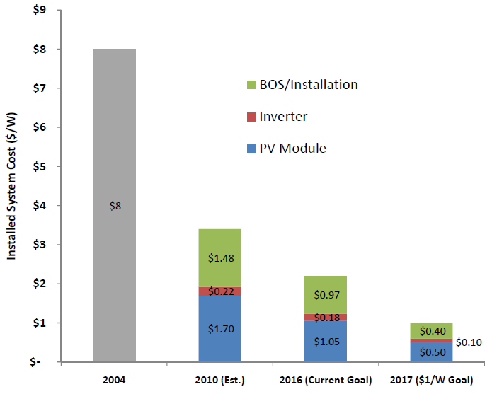
Moon Shot
SunShot Initiative
$8.00
“[Kennedy’s] advisers said, with adequate funding, this could be done, that there were no major technological obstacles.”
Price tag: ~$25 billion
$3.40
Price tag: ~$2 billion
$2.20
$1.00
2020
$0.06/kWh
DOE, EERE and ARPA-E, White Paper to Explore A Grand Challenge for Electricity from Solar, 2010
http://www5.eere.energy.gov/office_eere/program_budget_formulation.php
Mike Wall, SPACE.com, JFK's Moon Shot: Q & A With Space Policy Expert John Logsdon, http://www.space.com/11762-nasa-kennedy-moon-speech-logsdon-interview.html

Slide 14
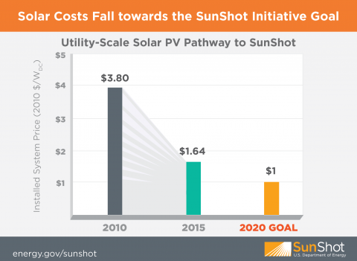
SunShot Initiative
U.S. DOE-EERE SunShot, 2016, http://energy.gov/eere/sunshot/about-sunshot-initiative

Slide 15
Annual global PV production
©Fraunhofer ISE: Photovoltaics Report, updated: 17 November 2015

Slide 16
Global price learning curve
Did we have a major SunShot breakthrough in ~2010?
Or did an ARPA-E discovery become commercial?
©Fraunhofer ISE: Photovoltaics Report, updated: 17 November 2015

Slide 17
Annual global PV production
  Nope, a huge Si PV supply and PV dumping
0.2% of China’s electricity
©Fraunhofer ISE: Photovoltaics Report, updated: 17 November 2015

Slide 18
Global thin-film PV market
  … and that market volatility hurt our innovation!
©Fraunhofer ISE: Photovoltaics Report, updated: 17 November 2015

Slide 19
Capex spikes are unsustainable
  … and that market volatility hurt our innovation!
Powell, Fu, Horowitz, Basore, Woodhouse & Buonassisi, Energy Environ Sci., 2015, 8, 3395

Slide 20
Capex spikes are unsustainable
  Economically unsustainable
  … and that market volatility hurt our innovation!
Powell, Fu, Horowitz, Basore, Woodhouse & Buonassisi, Energy Environ Sci., 2015, 8, 3395

Slide 21
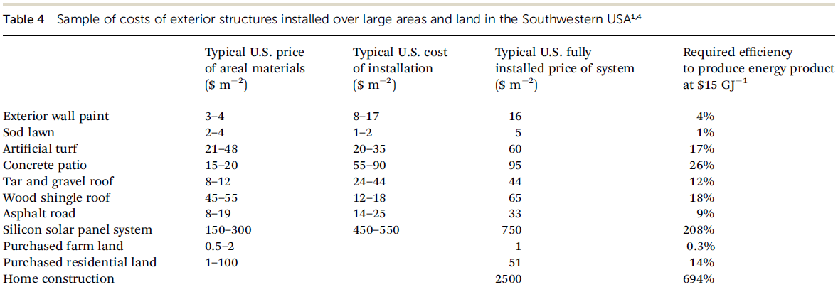
Metric for economic sustainability
McFarland, Energy Environ. Sci., 2014, 7, 846
  “Move the decimal point over by one place.”

Slide 22
Solar Energy Promises
a) Are likely to come true
b) Are empty
c) Are complex
…
Shane Ardo
Department of Chemistry
Department of Chemical Engineering & Materials Science
University of California, Irvine, USA
Monday, February 1, 2016 Tera³ Workshop, UCSB, Santa Barbara, CA

Slide 23
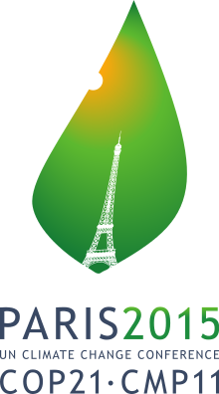
a) Are likely to come true SOON
Population will grow from 7 to 9–11 billion by 2050 with most growth in non-OCED countries where two-thirds of new energy will be required, and they don’t have a legacy infrastructure to deal with!
carbon tax
subsidies for solar PV
other government policies
enormous environmental catastrophes
wars, if poor domestic supply

Slide 24
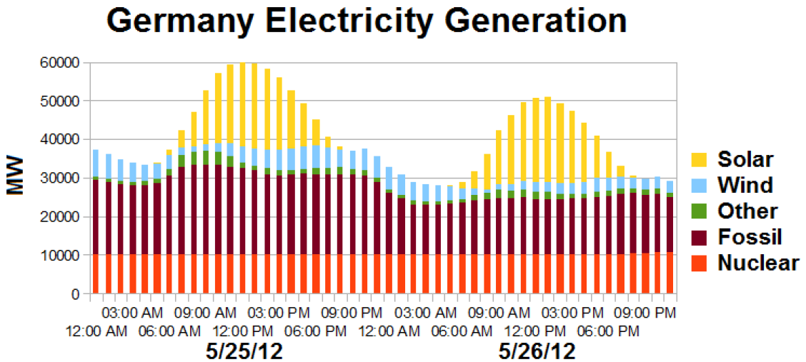
Sunny days devalue PV
Branz, ARPA-E, Solar Beyond Grid Parity for Dispatchable Electricity or Fuels Workshop, Beyond Grid Parity, 2013
At ~10 % solar PV electricity, solar installations in Germany were devalued

Slide 25
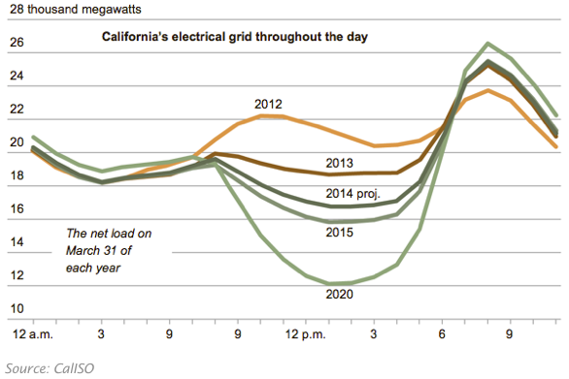
Infamous duck curves
http://ilsr.org/wp-content/uploads/2014/03/Screenshot-2014-03-25-14.36.08.png

Slide 26
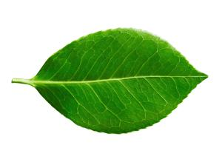
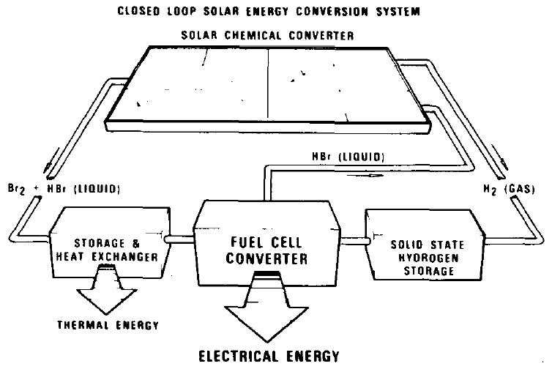
Solar photoelectrochemical H₂
Jack Kilby
Texas Instruments Corporation
(1979 – 1985)
H₂O → H₂ + O₂ → H₂O has a 40% round-trip energy-conversion efficiency
Johnson, IEEE IEDM (1981) 81-2–6; McKee, IEEE Trans. (1982) CHMT-5, 336–341;
Luttmer & Trachtenberg, J. Electrochem. Soc. (1985) 132, 1312–1315

Slide 27
Closing points
Economic sustainability on the TW scale requires more than leveraging an existing infrastructure
Si PV prices dropped recently due to economic unsustainability
In order to move the decimal point over one place we need:
  New materials discovery and new engineering designs
  Academia to take more risks ($$$), because industry will likely focus on incremental advances
Business-as-usual, or nearly business-as-usual, R&D efforts are not that helpful to economic sustainability
Change occurs from Subsidies, Taxes, Policies, Catastrophes, Wars
  There is no silver bullet energy technology
  … this sounds like a challenge to me

