Slide 1
History of Undersea Exploration
The 700s: Viking Sailors used sounding weights to determine ocean depth over distance. They also took samples from the seabed.
The depth would be measured by the length of a Viking’s outstretched arms (6ft) this nautical unit of distance is still used today and is called the fathom
Notes:
This can be easily demonstrated if you have a pond or pool near by. Use a string marked every meter with a weight attached to the end of it. Let the weight sink to the bottom in different areas of the pond to show changes in bottom topography.

Slide 2
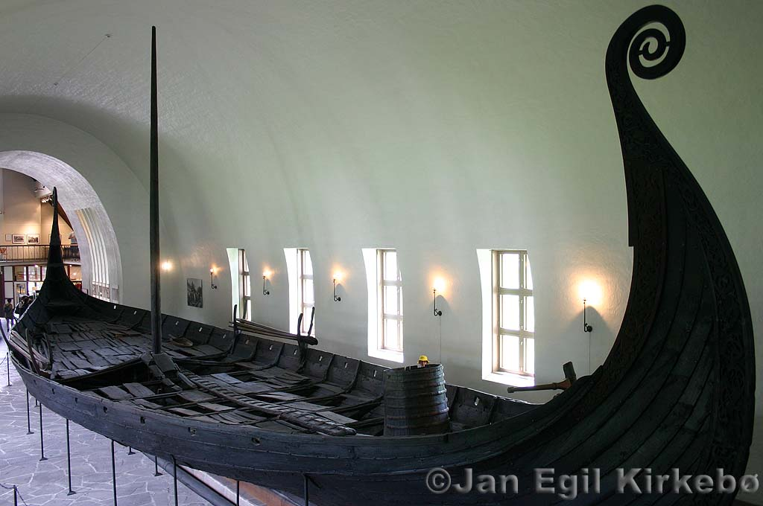
Notes:
Interesting fact about Viking ships: They were constructed to be flexible so that they could bend and conform to the rough seas of the North.

Slide 3
History of Undersea Exploration
1620: Cornelius Drebbel (Holland) is credited with the first submersible.
It was made of wood and bound in animal skin for water proofing.
He propelled it with oars on either side through sealed holes.
It reached a depth of 15ft.

Slide 4
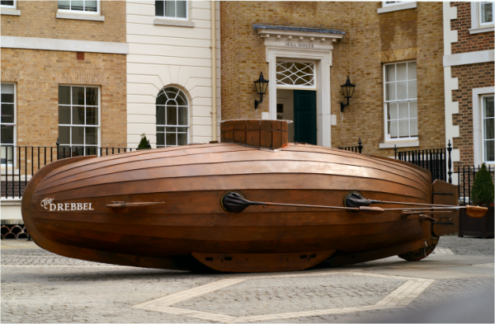
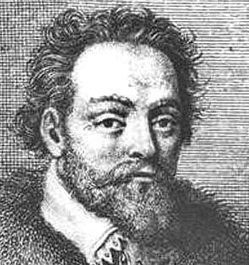
forum.spore.com
Notes:
Cornelius Drebbel and his sub

Slide 5
History of Undersea Exploration
1872-1876: The British sent the HMS Challenger on a 4 year expedition to explore the deep ocean.
They discovered over 4,000 new species of animals
Confirmed the general bathymetry of the sea floor to include features such as deep ocean basins.
They did this using sounding weights similar to the Vikings.
Today, SONAR is used to map bathymetry.
Notes:
Make the point that while new species were discovered, they were usually not alive by the time the crew got to look at them because they hauled the organisms up on to the ship. It was not until the Beebe bathysphere which had a window, that deep sea organisms were observed in their natural state.

Slide 6
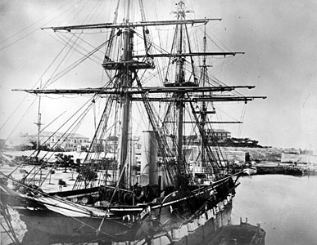
HMS Challenger
www.extremescience.com

Slide 7
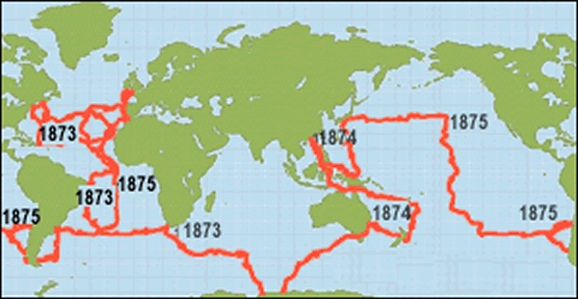
Route of HMS Challenger
oceanexplorer.noaa.gov -

Slide 8
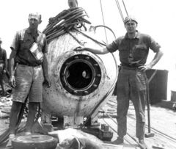
History of Undersea Exploration
1930s: William Beebe launches the Bathysphere.
Traveled to 3,000ft
The addition of a window made this the first time a marine biologist was able to observe marine life in its natural environment.
Wikipedia.org

Slide 9
History of Undersea Exploration
1960: Jaques Piccard and Don Walsh are the first to travel to the deepest part of the ocean.
Located in the Mariana trench, the deepest point is called Challenger Deep over 6 miles down.
The submersible was called the Trieste and is of the original submersible designs.
It took them 5 hours to reach the bottom and they only spent 20 minutes there.
No footage of the bottom was recorded.
Notes:
The reason no footage was recorded is because the when the Trieste landed she strirred up the bottom sediment. By the time it settled, they had to start the ascent. A great narrative about the Trieste descent experience as told by Jaques Piccard can be found here http://deepseachallenge.com/the-expedition/1960-dive/ .

Slide 10
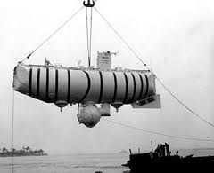
Gasoline filled
Lights
Personnel Sphere
Hnsa.org

Slide 11
Trieste
The majority of the vessel was a series of floats filled with 85,000 liters (22,000 US gal) of gasoline.
Water ballast tanks were included at either end of the vessel, as well as releasable iron ballast fore and aft of the crew sphere.
What function do you think the gasoline served?
Why would they need a releasable iron ballast?
Notes:
According to an account written by Jaques Piccard, the descent: “Ten minutes after leaving the surface, we were at a depth of only 300 feet. There the bathyscaph stopped of its own volition. We had reached a much colder layer of water, and the relative weight of the craft with respect to the water had suddenly diminished, bringing the descent to a halt.
Here already we faced a dilemma: We could wait until the gasoline of the float cooled enough to enable the bathyscaph to resume the descent; but then we would lose precious time, and it was absolutely necessary to surface before nightfall. The other course was to release some gasoline; but that would mean sacrificing at the very beginning of the dive some of the precious liquid needed to lift us back to the surface.”
From http://deepseachallenge.com/the-expedition/1960-dive/
You can read the quote to your students and then ask them to answer the questions.

Slide 12
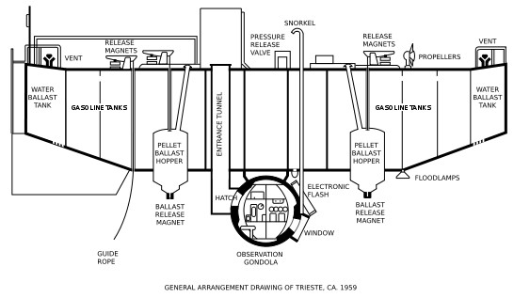

Slide 13
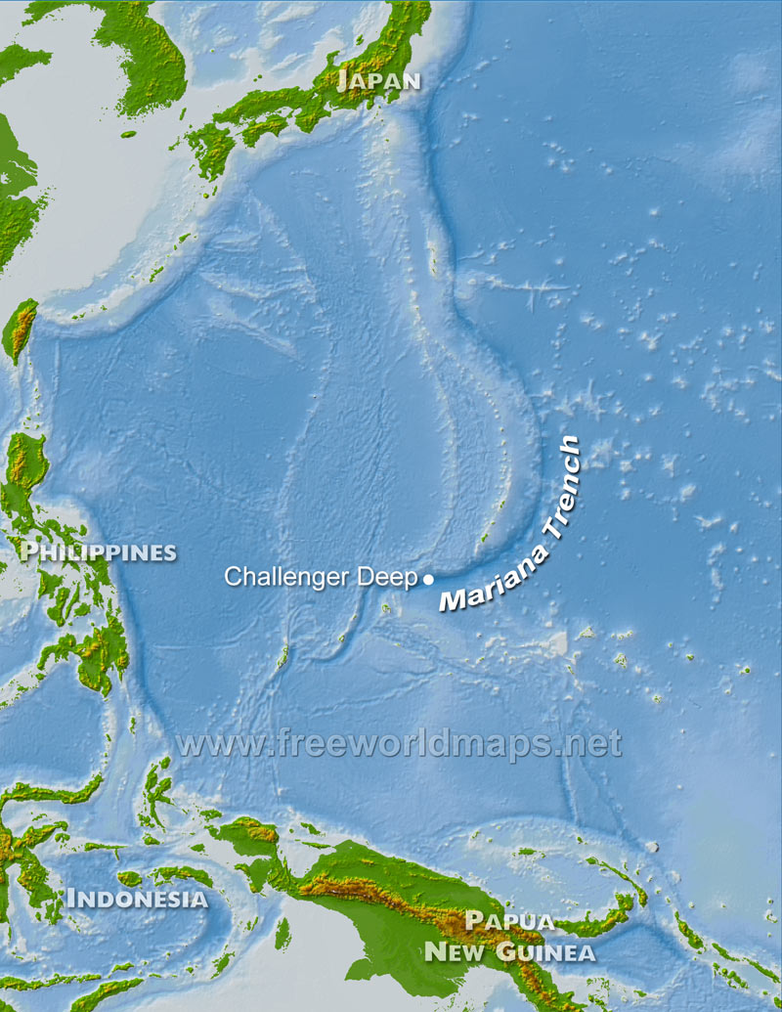
Notes:
In case your students do not know where the Mariana Trench is located.

Slide 14
Modern Undersea exploration
1964: ALVIN is built and has since made over 4400 dives.
Since the Trieste, ALVIN and similar HOVs have returned to the Mariana Trench and made amazing discoveries.
Other submersibles used include: ROVs,
AUVs, Towed vehicles and HROVs.
Each has its limitations and benefits over another.
Notes:
Alvin was the vessel used in the Deep Ocean movie they watched in unit 1.

Slide 15
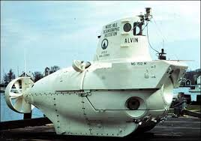
Whoi.edu
Notes:
Alvin in the water and out of the water.

Slide 16
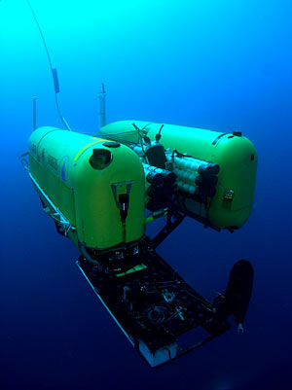
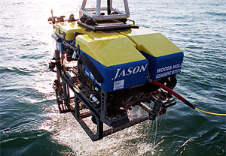
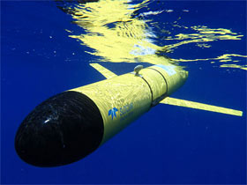
Notes:
Left to right: Nereus an AUV/ ROV hybrid ; ROV Jason is equipped with sonars, video and still imaging systems, lighting, and numerous sampling systems. Jason’s manipulator arms collect samples of rock, sediment, or marine life and place them in the vehicle’s basket or on “elevator” platforms that float heavier loads to the surface.; Slocum Glider The long-range and duration capabilities of Slocum gliders make them ideally suited for subsurface sampling at the regional scale. Carrying a wide variety of sensors, they can be programmed to patrol for weeks at a time.
From: whoi.edu

Slide 17
A race to the bottom
http://www.youtube.com/watch?v=0mBG0LbAoqk&feature=player_embedded
http://www.virginoceanic.com/vehicles/submersible/
Notes:
The first link is to a video interview with James Cameron. It compares his sub to the Trieste which students must do at the end of this lesson. You can have them make a T chart or Venn Diagram to compare and contrast the older and newer vessel with respect to materials, orientation and speed, etc.
The second link is to information about Richard Branson’s submersible. For a time, he and James Cameron were both trying to be the first to reach Challenger Deep in a new sub.

Slide 18
Building the technology
What variables must engineers consider when designing and building the underwater craft?
Pressure
Buoyancy
Data collection equipment: Filming, lighting, instrumentation, windows.
Fitting inside
Notes:
The next two slides allude to materials used to with stand the physical conditions and collect data.

Slide 19
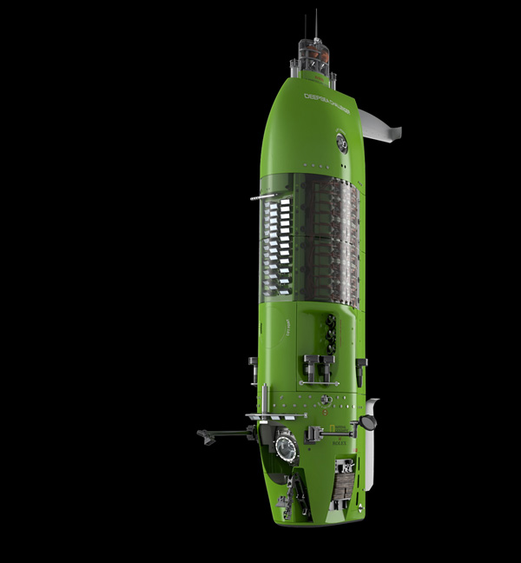
James Cameron’s Deepsea Challenger
Designers James Cameron and Ron Allum envisioned DEEPSEA CHALLENGER as a sleek underwater rocket ship to dive fast and ascend faster, allowing for more time to explore the deep seafloor.
Nationalgeographic.com

Slide 20
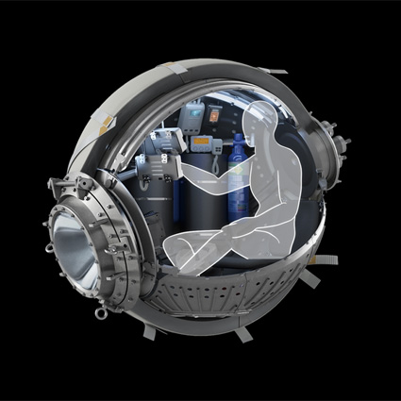
CAMERON’S CHAMBER
The 43-inch-wide pilot’s sphere, made of 2.5-inch-thick steel, was built to fit Cameron’s lanky six-foot-two-inch frame.
Inside: oxygen tanks, thruster joysticks, a touch screen, an optical acrylic viewport (window), and three video monitors
Nationalgeographic.com
Notes:
Make sure students take note of the fact that steel is used and that the window is acrylic, not glass.

Slide 21
Pressure
Pressure in the deep sea can be as high as 16,000 psi.
This is like having 3 cars crushing each finger!
Many materials can withstand this pressure.
But the requirements of a submersible makes it difficult to use many of them.
It must have a small window and house a chamber that can fit a human and lots of equipment.
Notes:
Refer back to the talking point of how empty spaces react to higher pressure.

Slide 22
Pressure
What about the hull (pressure chamber)?
Materials: Steel, Titanium, Pyrex, Ceramic?
Research has been done on the effectiveness of a ceramic vessel with a glass dome at one end and of a vessel made of one continuous piece of glass.
Steel is what has been used most recently by James Cameron.
The Nereus ROV is a titanium/ ceramic hybrid.

Slide 23
Buoyancy
What’s The problem with steel?
When the weight of the hull, equipment, pilots, batteries, instruments all adds up, the sub weighs in the tons.
With out buoyancy assistance, the sub would sink rapidly and be difficult to control.
What design considerations must there be to ensure buoyancy assistance ?
http://www.hnsa.org/ships/trieste.htm

Slide 24
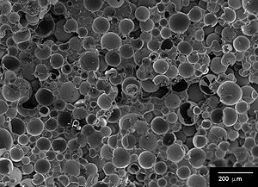
Buoyancy
SYNTACTIC FOAM The sub’s beam is made of a specialized foam developed by Australian engineer Ron Allum.
Formed by suspending hollow glass microspheres in an epoxy resin, the flotation material is designed to survive the intense pressure of the Mariana Trench, which compressed the 24-foot beam about two inches during the descent.

Slide 25
Buoyancy
So once the sub can float, how do the pilots control its location in the water column?
The Trieste used steel shot to weigh down the sub.
Held on by an electromagnet for quick release, to make it float up higher.
There were also gas filled compartments to control buoyancy by releasing a little gas as the sub descends.

